Slide 1

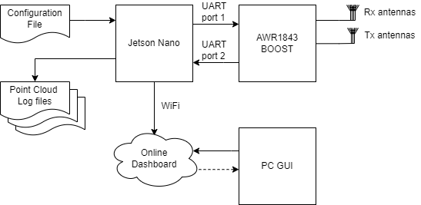




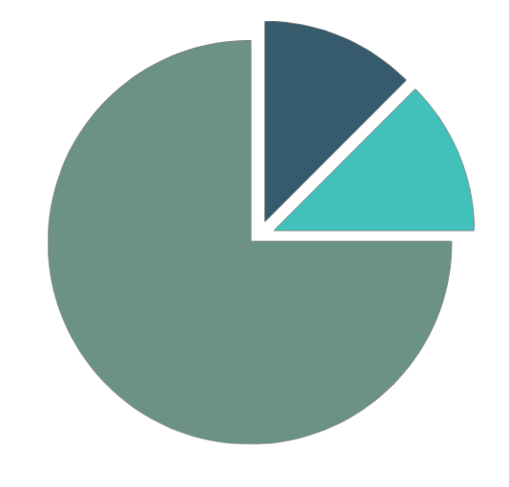
Tracking Indoor Room Occupancy with mmW Radar
Poseidon Blue Boston O’Neill | Blake Rowden | Liana van Teijlingen
Aims
Uptime
Stable for at least 8 hours without experiencing a critical fault
mmW Radar Sensor
Data points accurate to a resolution of 20cm in a 5mx5m area
Communication System
Latency should be less than or equal to 5 seconds between sensing and online dashboard update.
Machine Learning
Successfully identify 3 objects separate from noise
Data Visualization
View both current room occupancy and the history of room occupancy.
The history should be viewable for the same length as the embedded system uptime.
System Overview
Results
Below is an example of the results. Discuss…
Conclusions
Uptime
The system was tested running on the Jetson Nano for >12hrs with no failures
mmW Radar Sensor
Individual cloud data points were accurate to 3-5cm up to 8 m in the given cone and declined after that
Communication System
Latency between the radar and Python GUI was <0.2s running at 60Hz. The upload delay to the dashboard was capped at ~1s.
Machine Learning
From the clustering algorithm we are able to…..
Data Visualization
Current room occupancy

