Slide 1
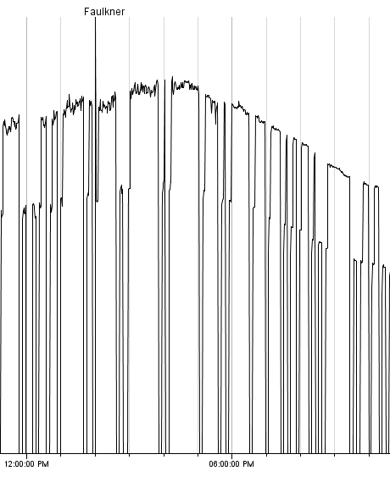
Houses do hold heat.
On extremely hot days, the A/C would supply much more cooling than expected given the outdoor temperature, although rarely more cooling than the cooling load of the building.

Slide 2
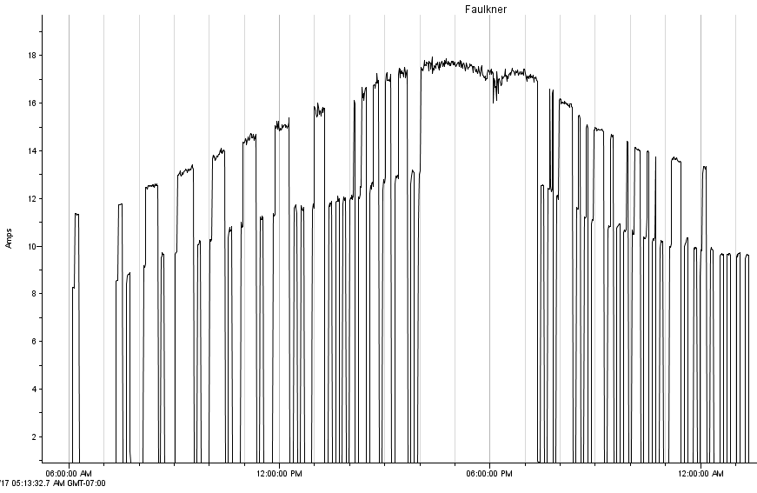
Hottest day of the year, note the cycling with the zoning system. Downstairs called for 73 and upstairs for 75.

Slide 3
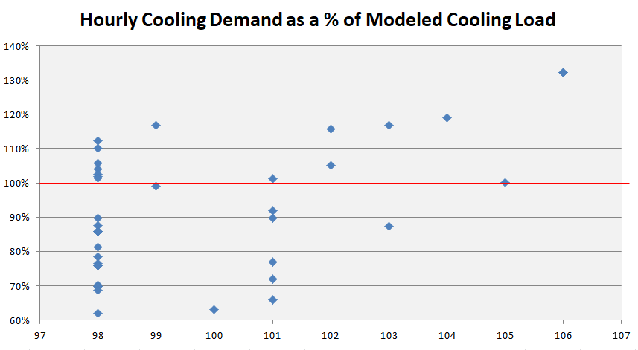
8 obs above 100% at 98. Our largest demand was 34 kBTU, 2nd largest was 30 kBTU, so we could’ve achieved the same results above with a 3 ton system.

