Slide 1
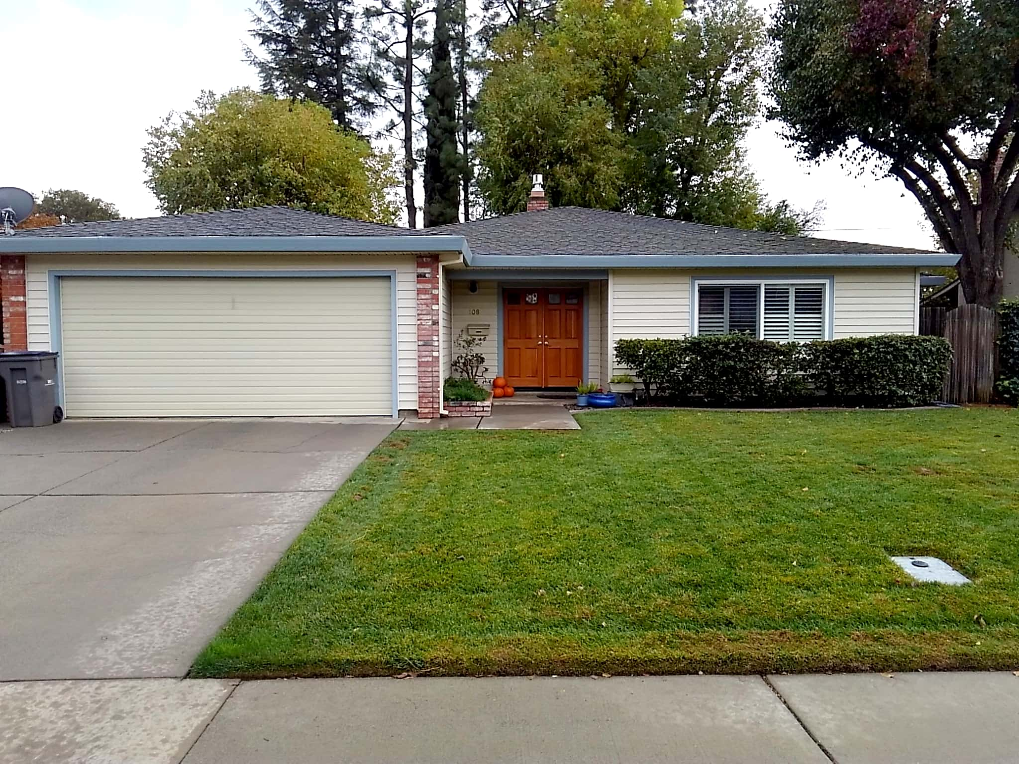

Slide 2
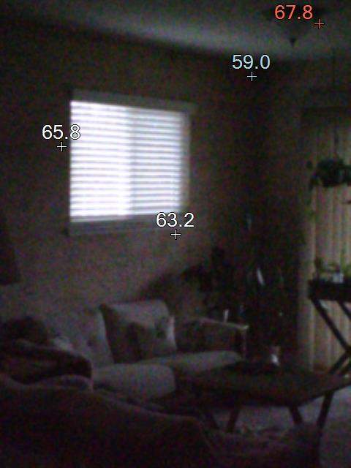
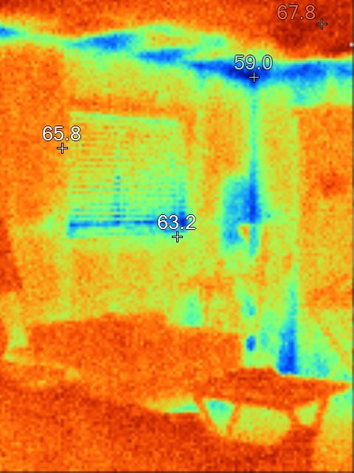

Slide 3
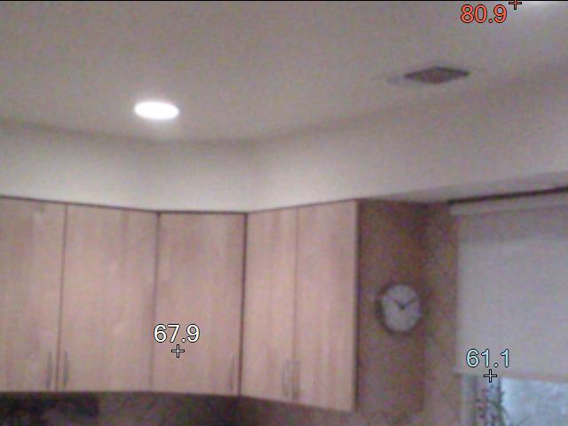
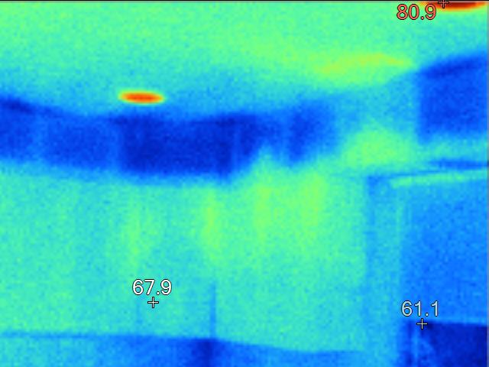
Blower Door- in: 1683, out: 1485 an 11% reduction.
Duct Leakage (outside): in: 183, out: 112
Looking at run-times, we estimate that the home has a heating load that is around 15-20 kBTUh. So let’s keep the furnace capacities small, please.

Slide 4
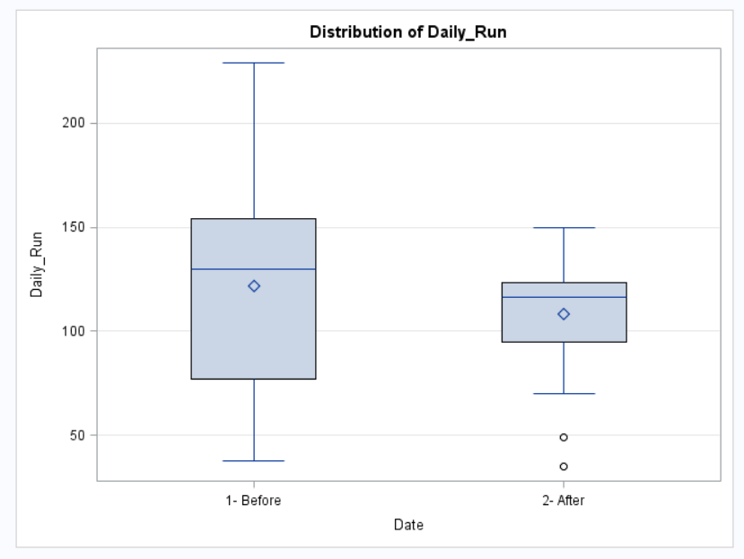
26% reduction in daily heating load.

Slide 5
Looking at run-times, we estimate that the home has a heating load that is around 15-20 kBTUh. So let’s keep the furnace capacities small, please.
(15% of INCOMs in December had furnaces that could have had a lower capacity while maintaining blower (ie. AC size)).

