Slide 1
Taxis in the mist: Weather impact on NYC taxi use
W205 Group Project Update
John Blakkan, Rohit Nair, Andrea Pope

Slide 2

Weather Impacts on NYC Taxi Use
The New York City Taxi & Limousine Commission (TLC) released a staggeringly detailed historical dataset covering over 1.1 billion individual taxi trips in the city from January 2009 through June 2016
Our project is complementing this data set with historical weather data during this same time period to look at how weather impacts traveling trends, such as:
How is taxi usage related to weather (temperature, precipitation, wind, …)?
During inclement weather, are short trips or longer trips more prevalent?
What behaviors are most common for beautiful days?
Does seasonality make a difference (e.g. taxis are used more on 50º days in fall, than 50º degree days in the Spring?)
How does passenger count change in different weather?
Social - are people more willing to share a cab?
Financial - should cab companies be using their vans?
Finally, leveraging the historical fact base, we will build a prediction model, that helps identify the number and location for cabs required given the forecast.

Slide 3
By The Numbers
2009-2015 TIMEFRAME
$14.6B REVENUE
1.15B RECORDS
40M RECORDS/MTH
1.9B PEOPLE
5.7B mi TRAVELLED

Slide 4
Architectural Overview
Speed/Reliability layer
Batch layer
Current Multiday
Weather forecast
Weather History
Ride History
Cached Forecast
Model
Ride Prediction
Results Presentation
Analytic/Presentation layer

Slide 5
Architectural Overview
Speed/Reliability layer
Batch layer
Data ingestion
Pull from NOAA “REST” service (XML)
Speed/Reliability issues
Forecasts change several times/hr
Response time of NOAA service is variable, and sometimes unreliable
> 15 seconds during weekends/late evening
Not acceptable for end-user service
Main toolchain: Postgres (for cached data), Python/REST/XML.
Update cache on 10 min cycle
Data Ingestion
Ride data (from 3 taxi/ride-hailing databases, csv) cleaned/translated into consolidated Schema
Joined with Weather Data (US government)
Main toolchain: HDFS/Hive
Driven by monthly release cycle of TLC data
Model Building
Predict demand
Model in Python (parameters in Postgres)
Updated monthly, following Data Ingestion
Analytic/Presentation layer
Predictions pre-computed from cached weather forecast and model
Stored in Hive/SQL
Results (6 day anticipated ride utilization and avg. passenger count)
Tableau User interface (prediction and historical data analysis)

Slide 6
Project Progress
Speed/Reliability layer
Batch layer
Current Multiday
Weather forecast
Weather History
Ride History
C
IP
C
IP*
Cached Forecast
Model
IP
IP
Ride Prediction
Notes:
Sample ride data set fully loaded
(100 M records; 6 months, fully loaded)
Working through mapping latitude/longitude for transformation
Results Presentation
Analytic/Presentation layer

Slide 7
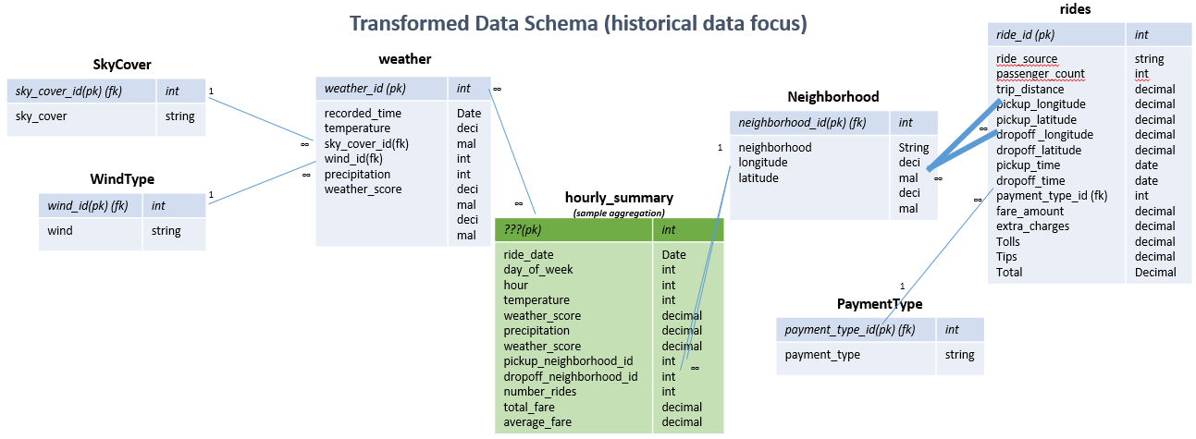
ERD (WIP)
Notes:
PK = primary key; FK = foreign key
Blue tables represent raw data, transformed from original sources (csv, etc.)
Green tables represent aggregations created for analysis
Weather: recorded time at hourly level
Weather: air temperature recorded in degrees Fahrenheit
Weather: weather score is an overall score, based on low/high temps, wind, and current precipitation (see documentation)
Payment Types: (1= Credit card, 2= Cash, 3= No charge, 4= Dispute, 5= Unknown, 6= Voided trip)
…

Slide 8
Challenges / Questions
Over 100 GB of historical data, with only 6 months of taxi data loaded (it’s a large historical data set)
Converting longitude/latitude to (simplified) neighborhoods (underway)
Validating technology at each step
FHV (For Hire Vehicles)
# of trips and pickup location only
Allows for analysis of trip volume
Prediction dependent on historical data providing statistically significant evidence relationship between taxi/weather usage
If not, we’ll need to investigate another streaming data sources for incorporation into analysis.

Slide 9
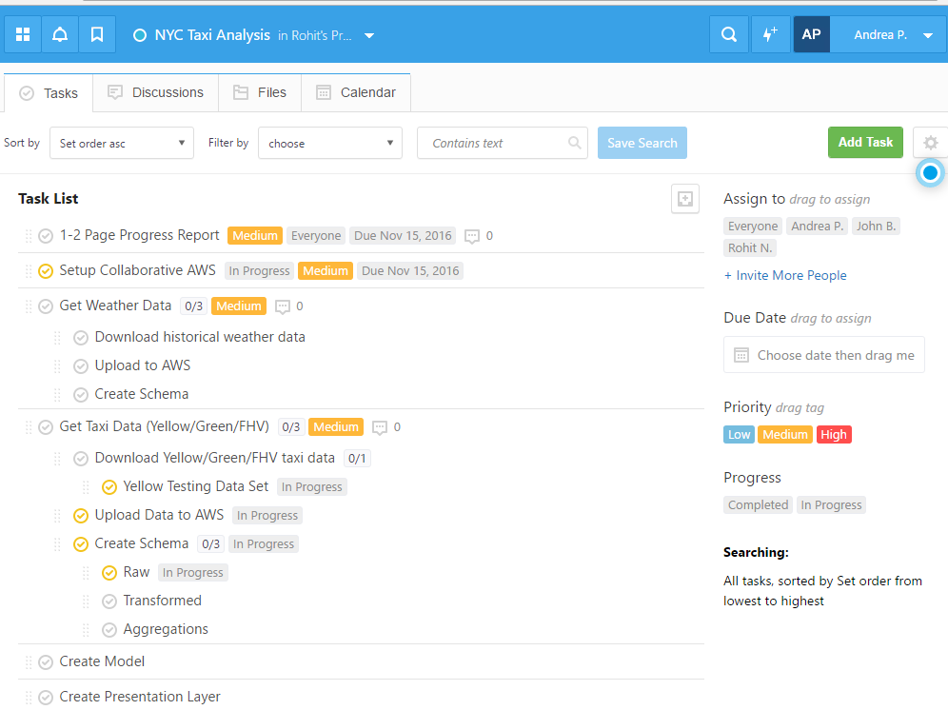
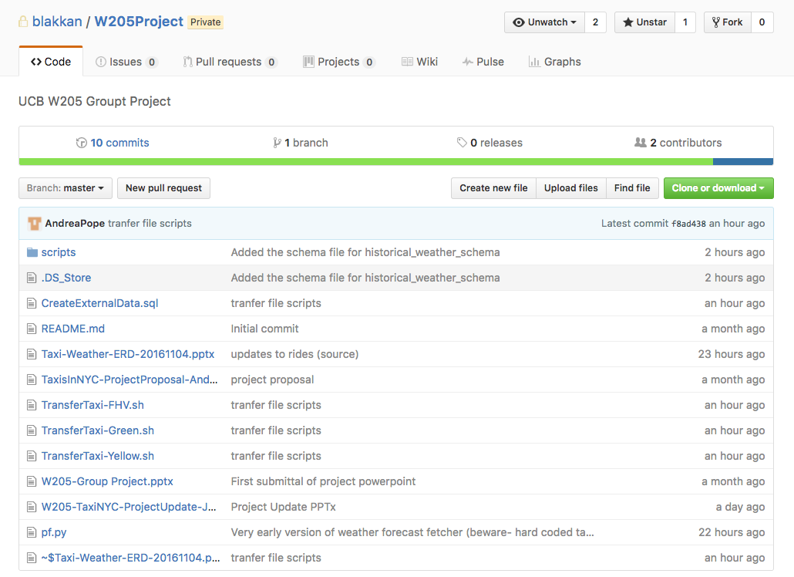
Team Administration
Team is leveraging FreedCamp and Github to organize tasks and show progress
https://github.com/blakkan/W205Project

Slide 10
Tech stack
SQL/BigQuery
Tableau
Spark SQL
Storm
PostgreSQL
Apache/NginX
HDFS
S3
EBS

Slide 11
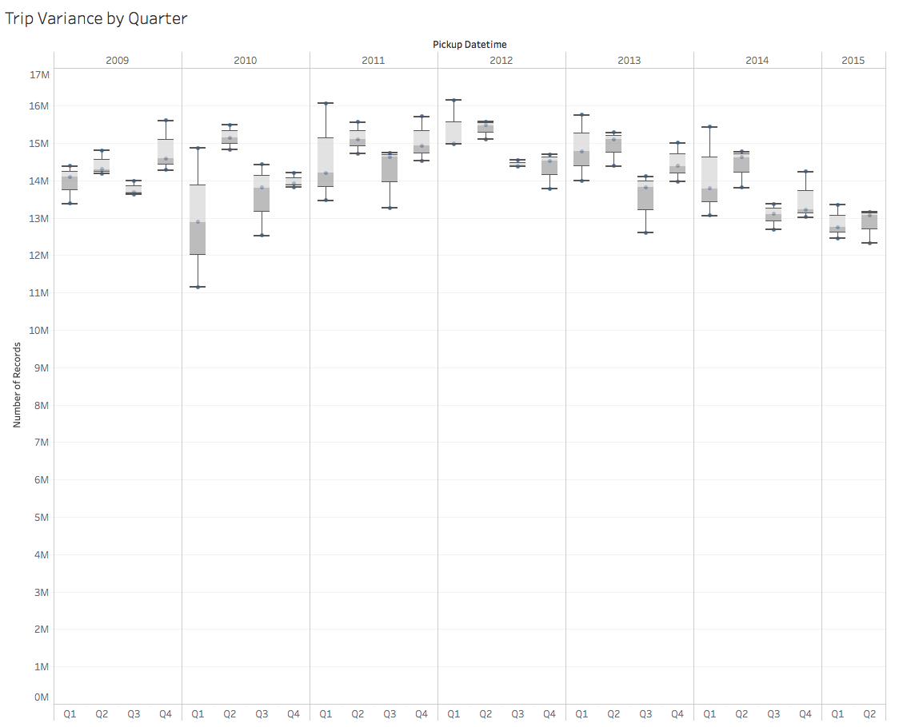
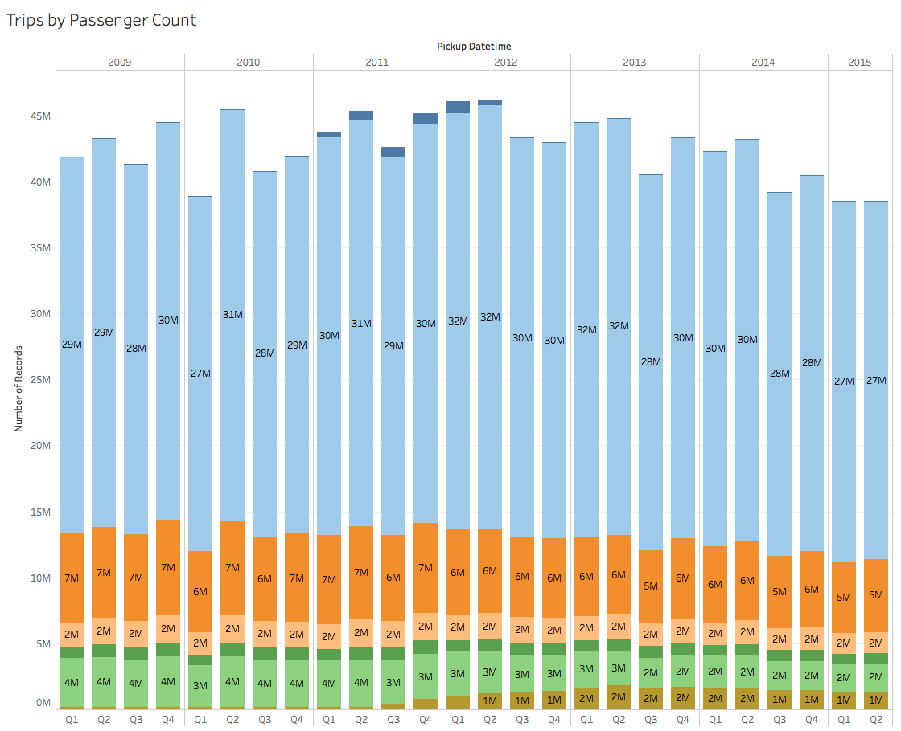
Exploratory Analysis

