Slide 1
Taxis in the mist: Weather and ride demand in New York City
W205 Group Project
John Blakkan, Rohit Nair, Andrea Pope

Slide 2
Predicting Demand
Addresses…
Stakeholders…
Economic Concerns
Each idle minute is profit lost, never recovered
Service Level (potential long-term customer loss)
Gov’t: Integration with municipal transit services
Deploy large vs. small busses on a line, or longer/shorter trains
Taxi companies
Guidance on pre-positioning at taxi stands
Allocating vehicles (big or small), staff, other resources
Ride Hailing Services
Setting incentives for drivers (e.g. “Surge” rates)
Independent Drivers
Schedule planning; when/where to work
Replace intuition with data-driven methods
Event Planners/Individual Passengers
E.g.: If cab use will be high, maybe charter a coach

Slide 3

Impact of Weather
Local demand could be predicted based solely on time (Month/Day, Day of Week, Hour of Day)
We propose weather as an additional factor in demand planning
Willingness to walk to subway
Willingness to wait for a bus

Slide 4
So, what did we find?
As expected, weather does impact ridership, e.g.
Less rides overall during precipitation
Cooler temperatures appears to raise ridership more than heat
Temperature seems to be tied to seasonality, more riders in moderate fall weather than in moderate spring weather (this warrants further analysis)
See Tableau Public
https://public.tableau.com/profile/publish/NYCTaxi-Analysis/NYCTaxiLimoDash#!/publish-confirm
https://public.tableau.com/profile/publish/NYCTaxi-Analysis/Predicting#!/publish-confirm
https://public.tableau.com/profile/publish/NYCTaxi-Analysis/PredictionDetailswFilters#!/publish-confirm

Slide 5
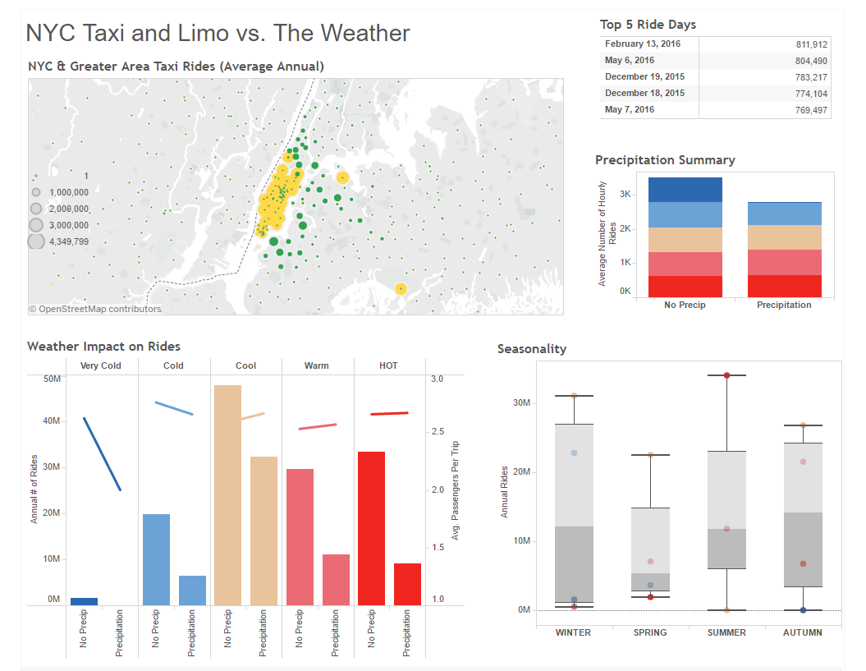

Slide 6
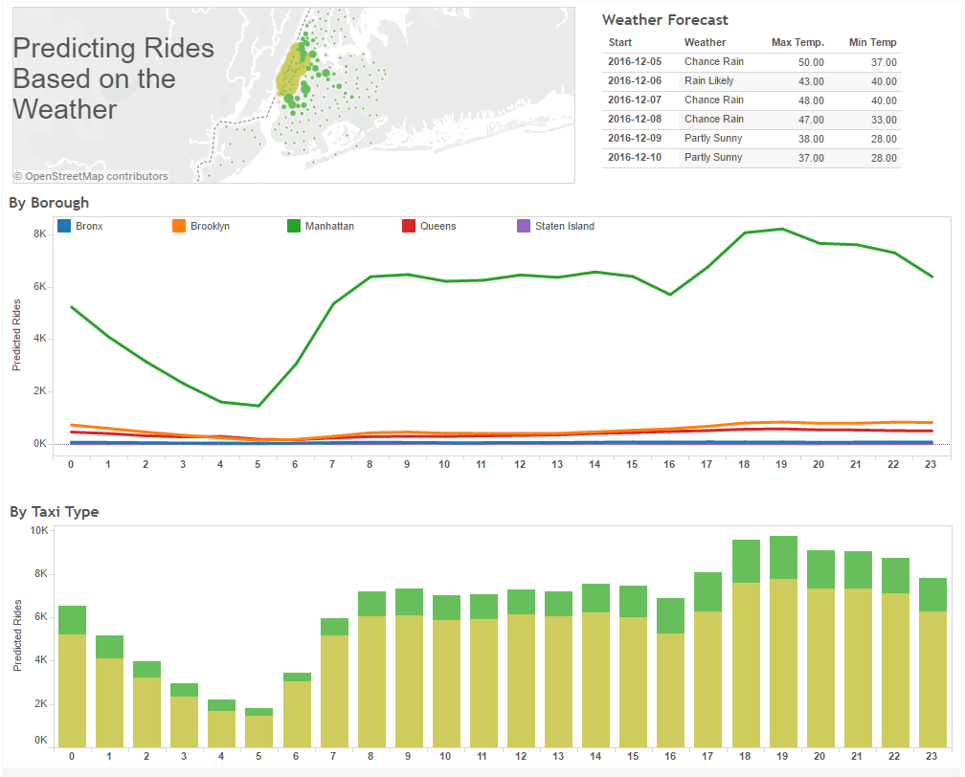

Slide 7
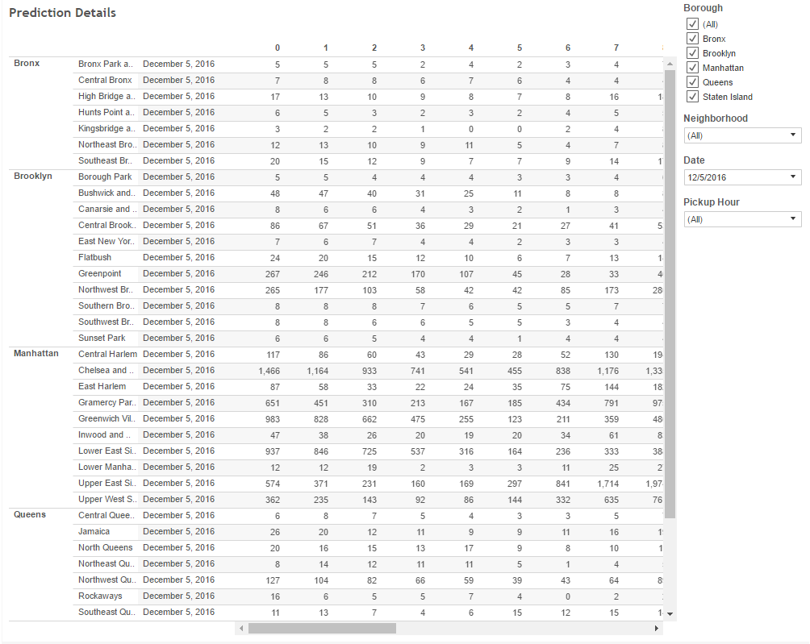

Slide 8
Scaling & Enhancement
Ride data is very large
But we mostly JOIN our very large data set with a small data-set
E.g. Weather is by day; only 365 days in a year
Geographic references are combined into zip-codes/boroughs
What could be an Order (MxN) operation turns into an Order(M) operation (or order M*Log(N) where N is small
Current solution not architected for more than one weather region
US has 374 total Metropolitan Statistical Census areas
Smaller than NYC, but still large in population
Each region might have multiple weather patterns
Each region could have different taxi rules, laws, public transport, …

Slide 9
Some Lessons Learned
Results: Weather impact is real; worth including in ridership models
Project Development:
Pre-calculation of results (like Lambda architecture) is almost unavoidable with big data sets
Tableau is a good choice for rapid development of a user interface (write to sql table, Tableau does the rest)
Don’t assume you need to do an SQL JOIN. With highly disparate sized tables, roll your own hash-join with pyspark shared routines/broadcast variables

Slide 10
How we got here…

Slide 11
Data Set
New York City Taxi and Limousine Commission
Regulates yellow/green cabs, limousines (“For Hire Vehicles- FHV”)
Released large data set of ride from 2009 onward
40 million records per month
Over 1.15 Billion rides total
Publicly available on Amazon AWS s3 service
NOAA Weather resources
Historical available from NOAA website
Six-date real-time forecast separately available from NOAA REST service

Slide 12
Architectural Overview
Speed/Reliability layer
Batch layer
Current Multiday
Weather forecast
Weather History
Ride History
Cached Forecast
Model
Ride Prediction
Results Presentation
Analytic/Presentation layer

Slide 13
Architectural Overview
Speed/Reliability layer
Batch layer
Data ingestion
Pull from NOAA “REST” service (XML)
Speed/Reliability issues
Forecasts change several times/hr
Response time of NOAA service is variable, and sometimes unreliable
> 15 seconds during weekends/late evening
Not acceptable for end-user service
Main toolchain: Postgres (for cached data), Python/REST/XML.
Update cache on 10 min cycle
Data Ingestion
Ride data (from 3 taxi/ride-hailing databases, csv) cleaned/translated into consolidated Schema
Joined with Weather Data (US government)
Main toolchain: HDFS/Hive
Driven by monthly release cycle of TLC data
Model Building
Predict demand
Model in Python (parameters in Postgres)
Updated monthly, following Data Ingestion
Analytic/Presentation layer
Predictions pre-computed from cached weather forecast and model
Stored in Hive/SQL
Results (6 day anticipated ride utilization and avg. passenger count)
Tableau User interface (prediction and historical data analysis)

Slide 14
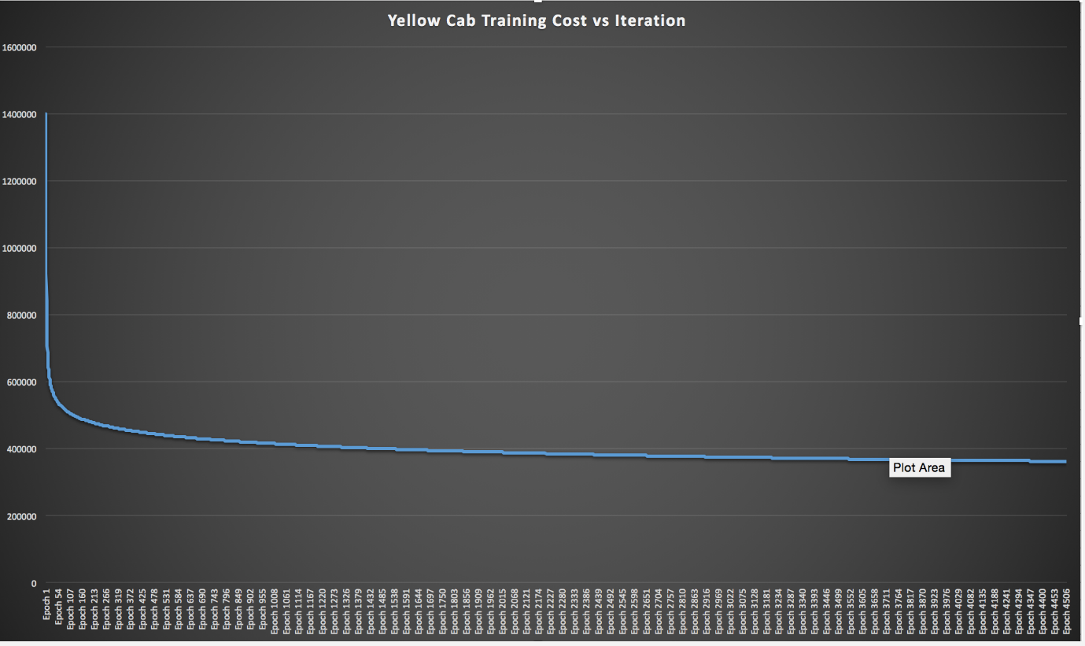
Training the Prediction Model

Slide 15
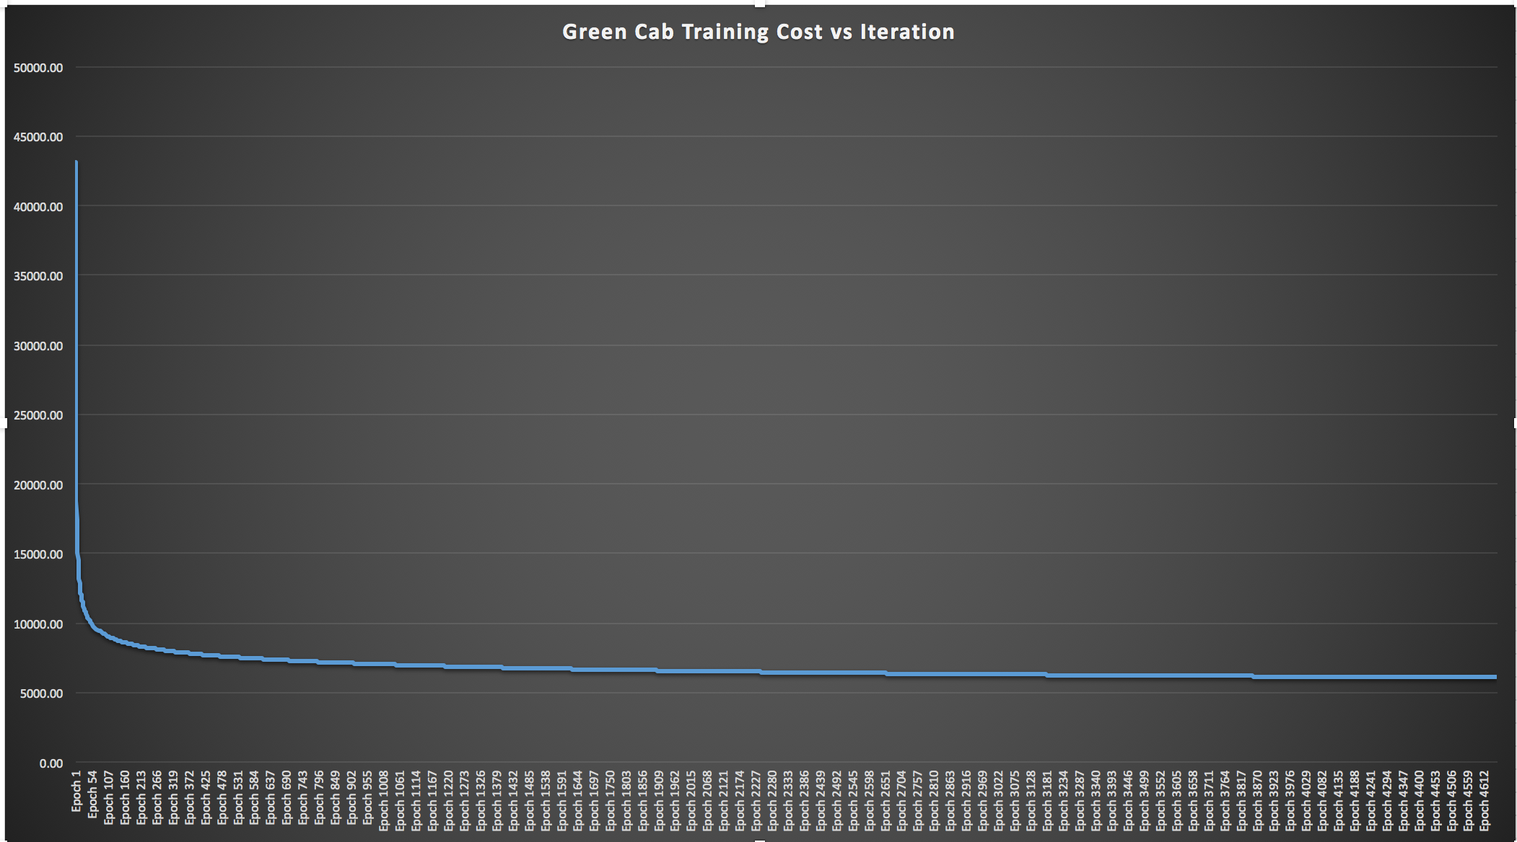
Training the Prediction Model

Slide 16
Technology stack
Python/Shell Scripting
Tableau
Amazon S3
Spark SQL
Hive
PostgreSQL
HDFS
EXT4

