Slide 1
Taxis in the mist:
Weather and ride demand in New York City
W205 Group Project
John Blakkan, Rohit Nair, Andrea Pope

Slide 2
Predicting Demand
Economic Concerns
  Each idle minute is profit lost, never recovered
  Service Level
    Potential long-term customer loss
Gov’t: Integration with municipal transit services
  Deploy large vs. small busses on a line, or longer/shorter trains

Slide 3
Demand Forecast: Stakeholders
Taxi companies
  Guidence on pre-positioning at taxi stands
  Allocating vehicles (big or small), staff, other resources
Ride Hailing Services
  Setting incentives for drivers (e.g. “Surge” rates)
Independent Drivers
  Schedule planning; when/where to work
  Replace intuition with data-driven methods
Event Planners/Individual Passengers
  E.g.: If cab use will be high, maybe charter a coach

Slide 4

Impact of Weather
Local demand could be predicted based solely on time (Month/Day, Day of Week, Hour of Day)
We propose weather as an additional factor in demand planning
  Willingness to walk to subway
  Willingness to wait for a bus

Slide 5
Data Set
New York City Taxi and Limosine Commission
  Regulates yellow/green cabs, limosines (“For Hire Vehicles- FHV”)
Released large data set of ride from 2009 onward
  40 million records per month
  Over 1.15 Billion rides total
  Publicly available on Amazon AWS s3 service
NOAA Weather resources
  Historical available from NOAA website
  Six-date real-time forecast separately available from NOAA REST service

Slide 6
Architectural Overview
Speed/Reliability layer
Batch layer
Current Multiday
Weather forecast
Weather History
Ride History
Cached Forecast
Model
Ride Prediction
Results Presentation
Analytic/Presentation layer

Slide 7
Architectural Overview
Speed/Reliability layer
Batch layer
Data ingestion
  Pull from NOAA “REST” service (XML)
Speed/Reliability issues
  Forecasts change several times/hr
  Response time of NOAA service is variable, and sometimes unreliable
    > 15 seconds during weekends/late evening
    Not acceptable for end-user service
    Main toolchain: Postgres (for cached data), Python/REST/XML.
    Update cache on 10 min cycle
Data Ingestion
  Ride data (from 3 taxi/ride-hailing databases, csv) cleaned/translated into consolidated Schema
  Joined with Weather Data (US government)
  Main toolchain: HDFS/Hive
  Driven by monthly release cycle of TLC data
Model Building
  Predict demand
  Model in Python (parameters in Postgres)
    Updated monthly, following Data Ingestion
Analytic/Presentation layer
Predictions pre-computed from cached weather forecast and model
  Stored in Hive/SQL
  Results (6 day anticipated ride utilization and avg. passenger count)
Tableau User interface (prediction and historical data analysis)

Slide 8
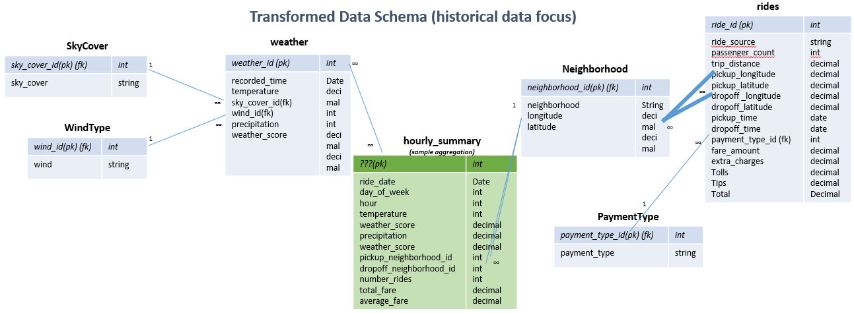
ERD (WIP)
Notes:
PK = primary key; FK = foreign key
Blue tables represent raw data, transformed from original sources (csv, etc.)
Green tables represent aggregations created for analysis
Weather: recorded time at hourly level
Weather: air temperature recorded in degrees Fahrenheit
Weather: weather score is an overall score, based on low/high temps, wind, and current precipitation (see documentation)
Payment Types: (1= Credit card, 2= Cash, 3= No charge, 4= Dispute, 5= Unknown, 6= Voided trip)
…

Slide 9
Technology stack
Python/Shell Scripting
Tableau
Amazon S3
Spark SQL
Hive
PostgreSQL
HDFS
EXT4

Slide 10
Results
We present a regional ride prediction for New York City
As expected, weather does impact ridership
  Extreme cold appears to raise ridership more than heat
Ridership has an annual seasonality
  More riders in moderate fall weather than in moderate spring weather. This warrants further analysis.

Slide 11
Scaling & Enhancement
Ride data is very large
  But we mostly JOIN our very large data set with a small data-set
    E.g. Weather is by day; only 365 days in a year
    Geographic references are combined into zip-codes/boroughs
    What could be an Order (MxN) operation turns into an Order(M) operation (or order M*Log(N) where N is small
Current solution not architected for more than one weather region
  US has 374 total Metropolitan Statistical Census areas
    Smaller than NYC, but still large in population
    Each region might have multiple weather patterns

Slide 12
Some Lessons Learned
Results: Weather impact is real; worth including in ridership models.
Project Development:
  Pre-calculation of results (like Lambda architecture) is almost unavoidable with big data sets
  Tableau is a good choice for rapid development of a user interface (write to sql table, Tableau does the rest)
  Don’t assume you need to do an SQL JOIN. With highly disparate sized tables, roll your own hash-join with pyspark shared routines/broadcast variables.

Slide 13
  DEMO

Slide 14
Backup Slides/Reference

Slide 15
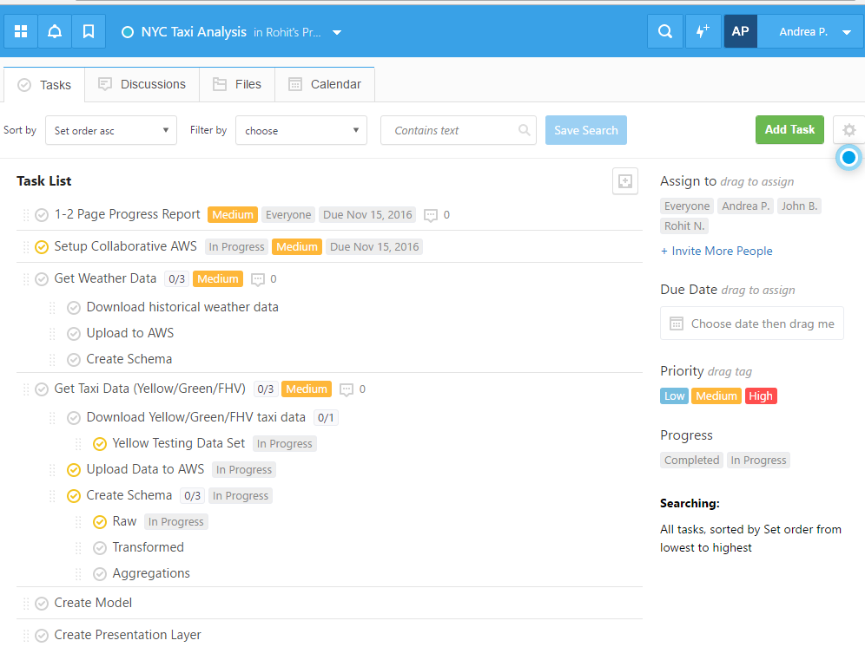
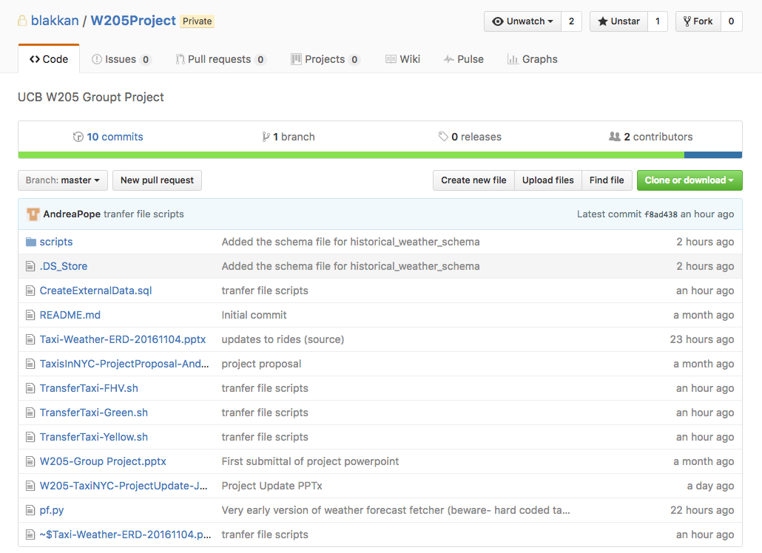
Team Administration
Team is leveraging FreedCamp and Github to organize tasks and show progress
https://github.com/blakkan/W205Project

Slide 16
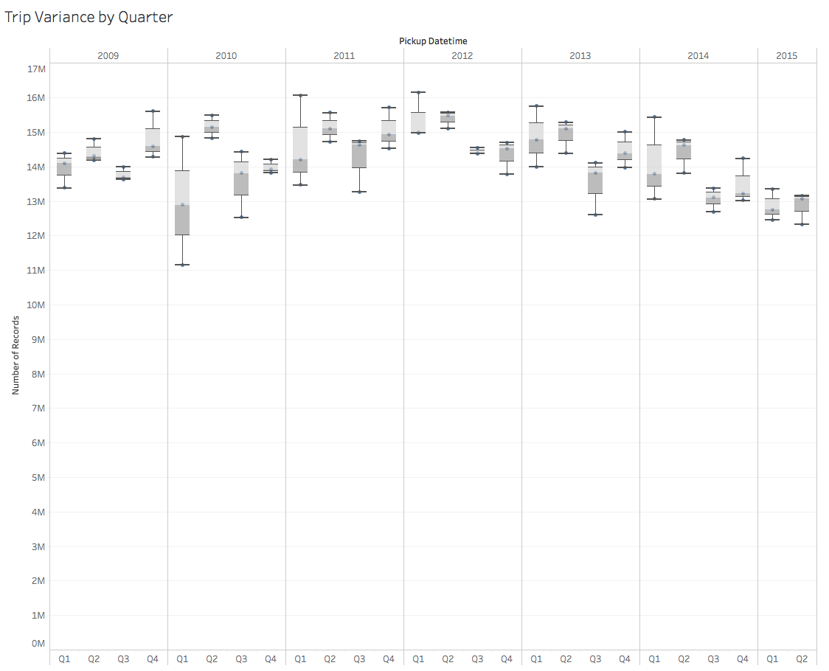
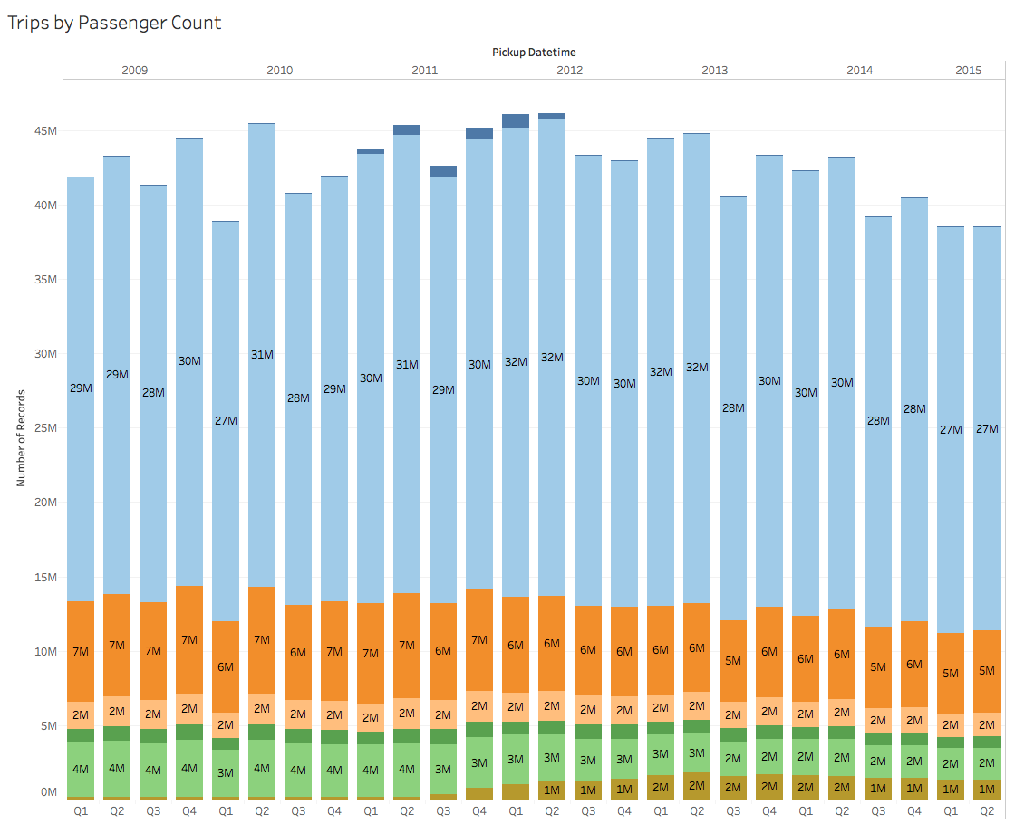
Exploratory Analysis

