Slide 1
Gauge Watcher
CNN distributed monitoring and alerting
John Blakkan, Cheng Cheng, Andrew Mamroth, John Tabbone

Slide 2

Issue: Monitoring Legacy Systems
We have many legacy systems built in an era of manual monitoring and control.
Some of these are not practical to fully rebuild or refit with modern remote monitoring systems
But no longer cost-effective to have a human simply watch them

Slide 3
Examples
Applications
  Industrial facilities, Utility/Public works, Military
Use cases:
  Gauge might be in an environment which is no longer considered safe for human operators.
  Gauge might be in reomote area
  No replacement electrical version of gauge may be available. (Due to cost or regulation)

Slide 4
Architecture of the system
Raspberry Pi with camera watches gauge
RPi-resident CNN classifies gauge reading
RPi Publishes gauge reading via MQTT pub/sub protocol
  MQTT broker also has capability to log
Results/alerts displayed via web interface (JavaScript)
Offline process for training CNN in cloud
Automated training data generation
  Raspberry pi can control training gauges, as well as photograph them

Slide 5
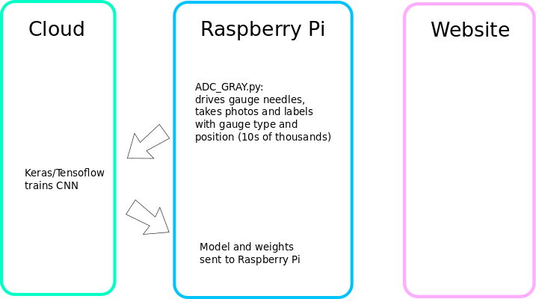
Overview: Training Phase

Slide 6
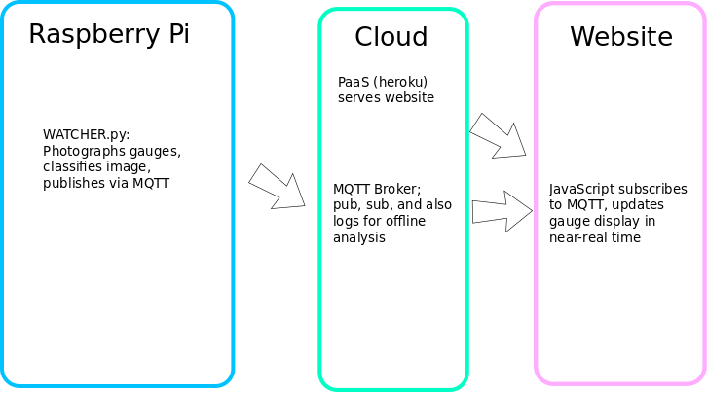
Overview: Running

Slide 7
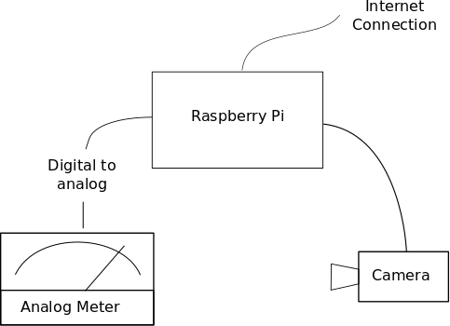
Hardware overview
Raspberry Pi w/Camera, DAC to drive meters

Slide 8
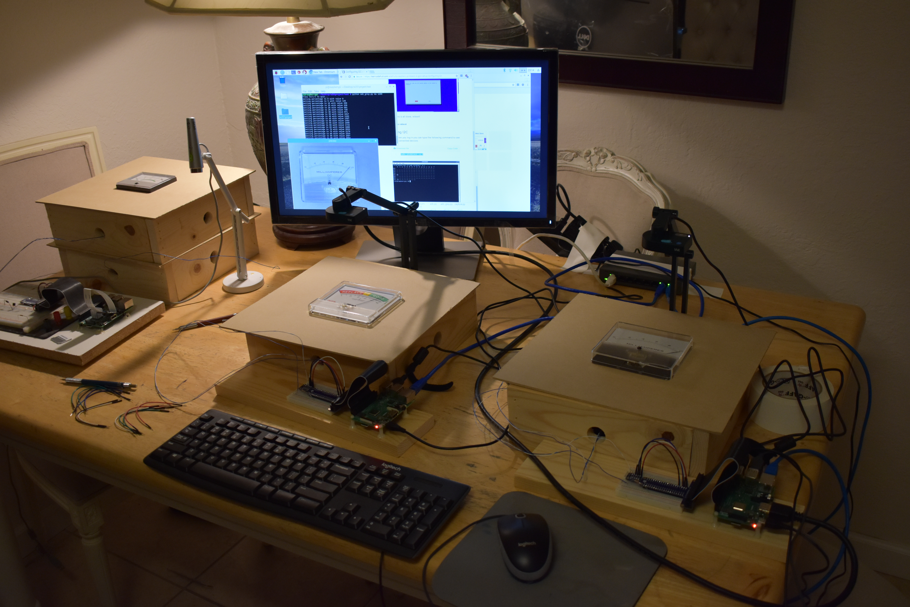
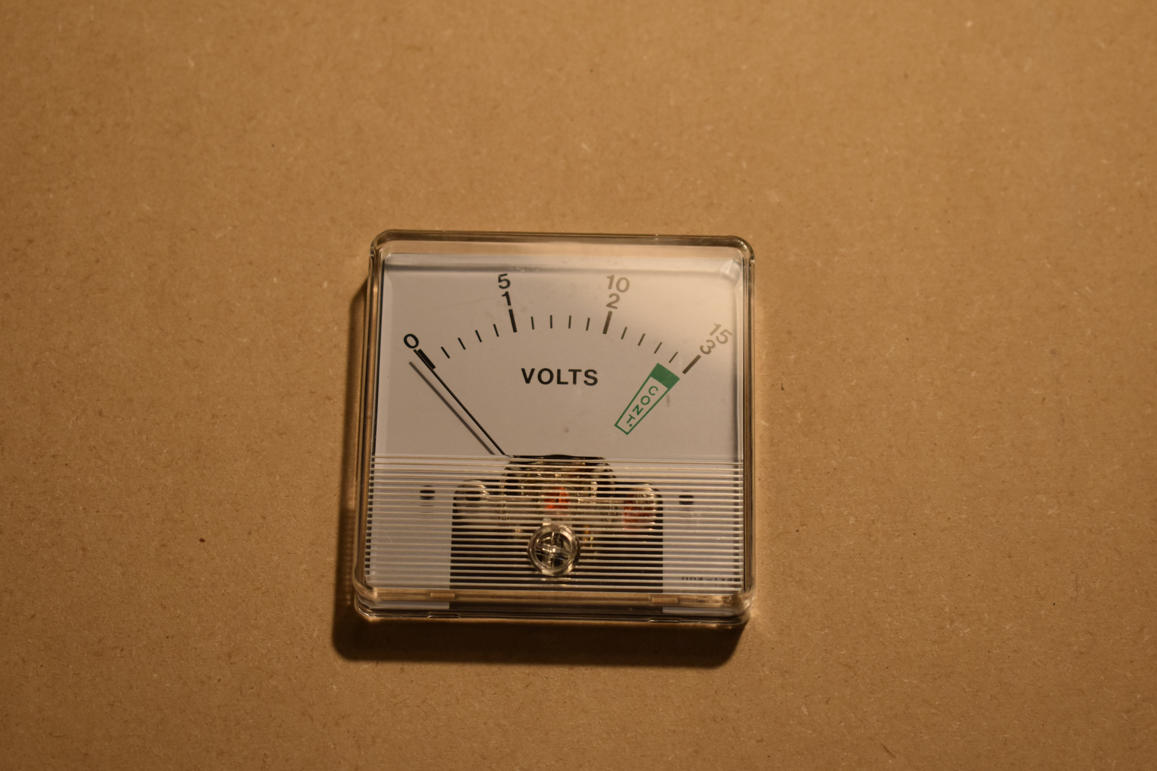
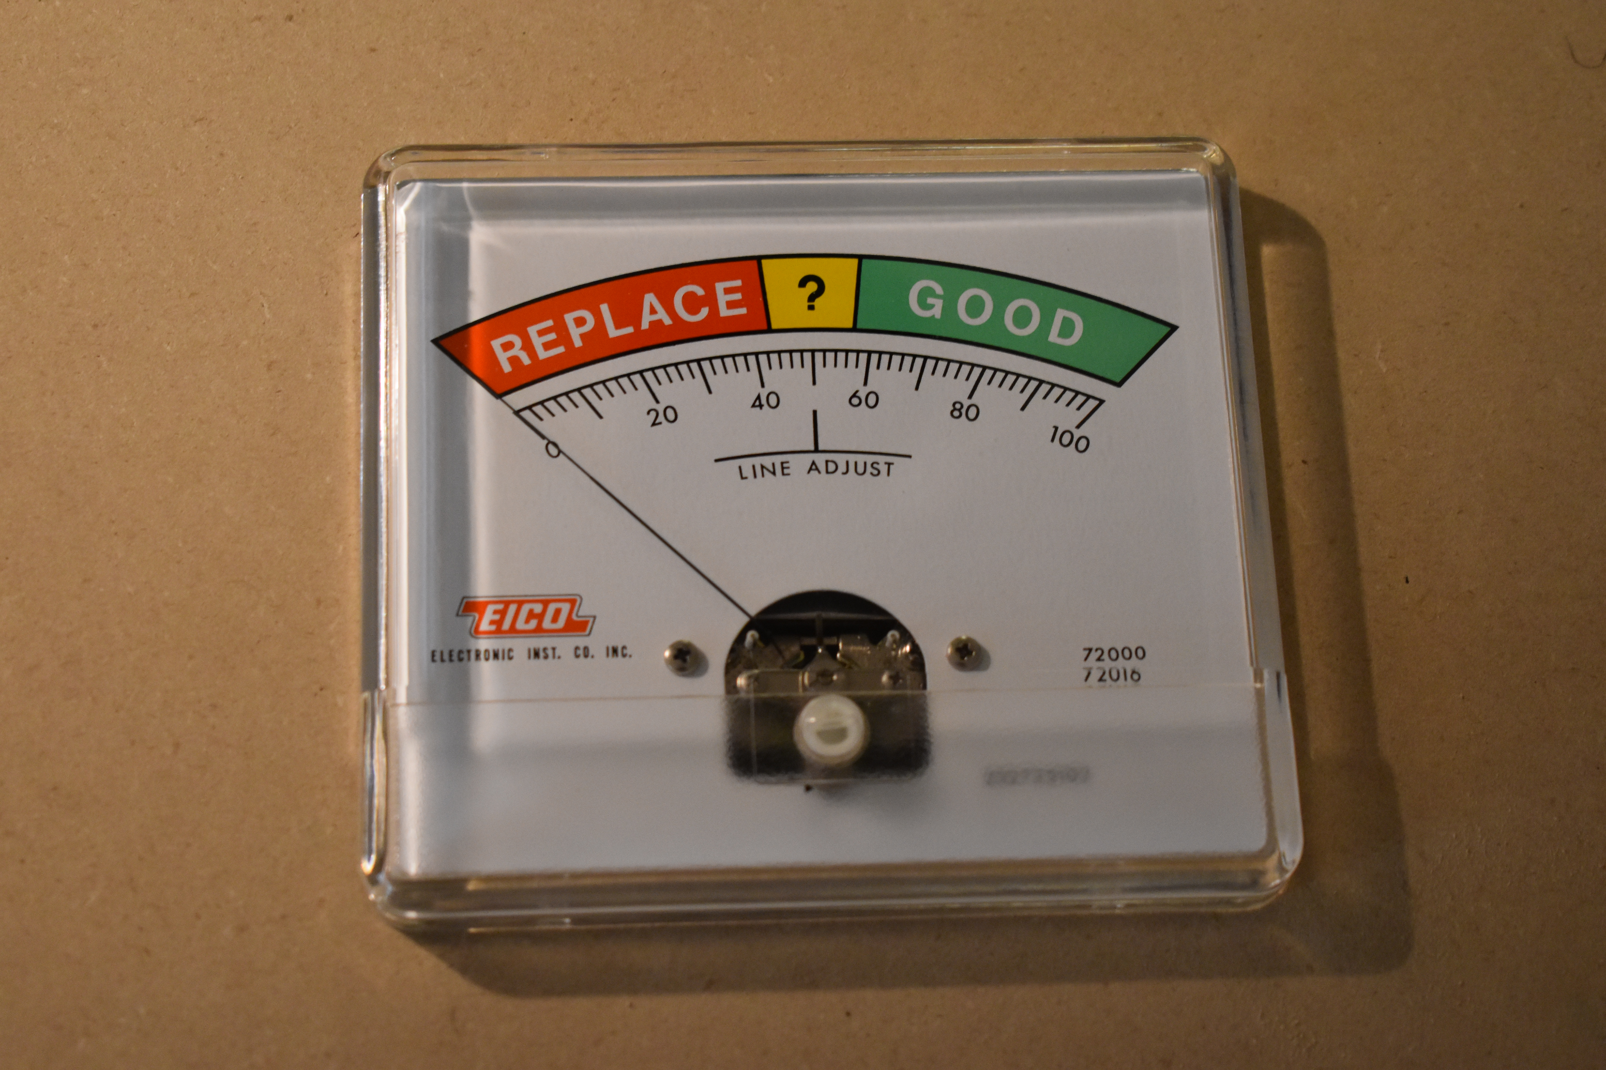
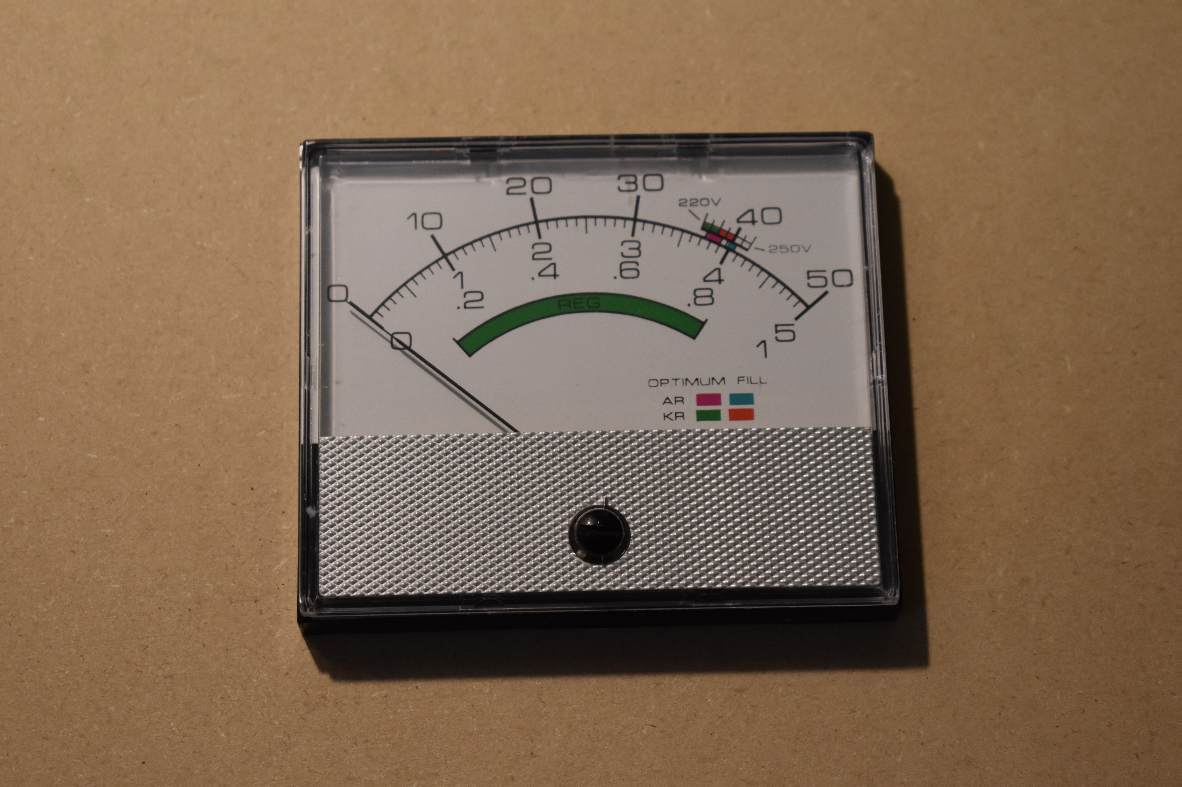
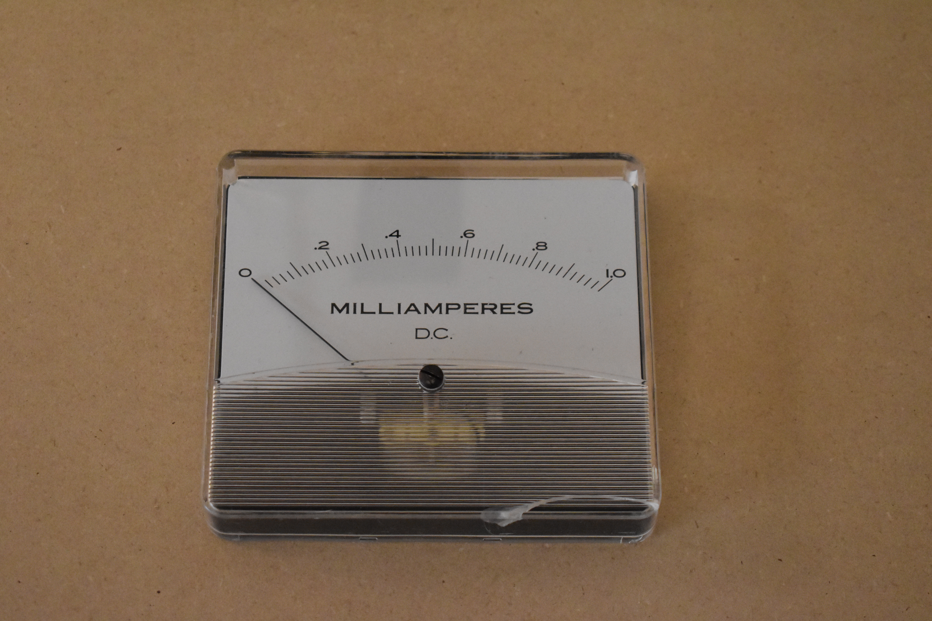
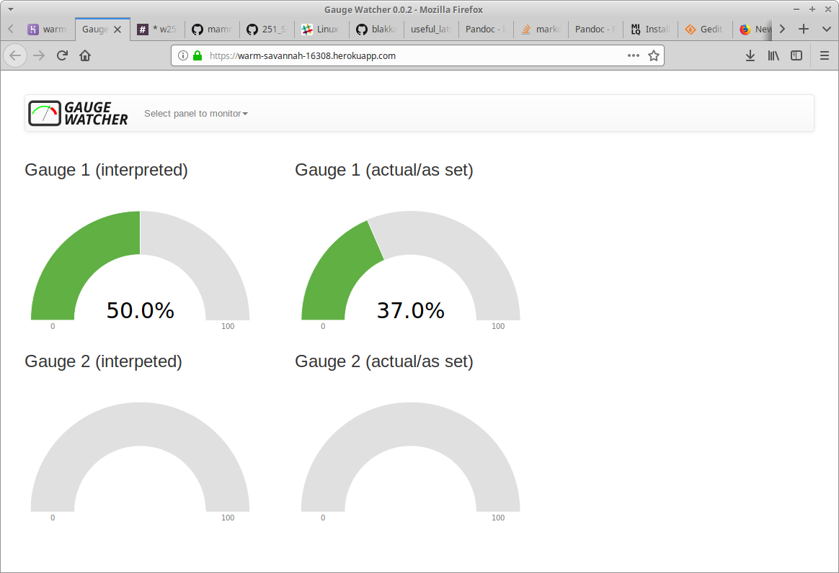
Hardware overview
In the real world...
Sample real gauges
Uniform display on website

Slide 9
Agenda
Demo: https://warm-savannah-16308.herokuapp.com/
Training: Andres & Cheng Cheng
MQTT and data flow: John T
Comments on technologies used: John B
  CNN, Keras/Tensorflow, MQTT (python & JavaScript), gpfs, Cloud: IaaS (softlayer), PaaS (heroku/AWS serving website), IoT, did a local GPU installation
Lessons learned, possible enhancements, and discussion: All

Slide 10
Q & A

