Slide 1
GPUs and NVIDIA Q1 results
Economic drivers

Slide 2

Graphics Co-processors
Early graphics gaming systems (pre-1990s) in mass market products were typically 2D
  Hardware concerned with rasterizing, object collisions, etc.
Rise of 3D games (with ray-tracing, sophisticated rendering, etc) and home consoles (or PC) drove a new paradigm: Graphics as a Linear Algebra Accelerator.
  Problems of moving or rotating modeled objects are transforms
  Problems of determining direction of reflected light, etc.

Slide 3
Linear Operations
Often organized into “layers” of library calls:
  Lowest layer: Vector primitives AXPY (A [times]X plus Y) “axe-pee”, scale, DOT (dot product)
  Middle layer: Matrix multiplication of vector (or matrix)
  Top Layer: LU decomposition (i.e. solve system), Invert Matrix, etc.
  Reference: “BLAS” https://www.gnu.org/software/gsl/manual/html_node/BLAS-Support.html

Slide 4
How to speed up?
Add instructions to CPU?
  Intel MMX (c2000) has load/store & arithmetic on chunks of vectors
  Might handle fixed length only (but would accelerate libraries- can partially “unroll” code loops)
  May impact cacheing- “striding” through memory can defeat cache
Make a separate GPU?
  Can also have own memory interface for frame buffer, with different (optimized) memory width/caching
  ATI (Now AMD), NVIDIA (Mid 1980s – Mid 1990s)

Slide 5
But what else can we do with it?
Many computational problems can be cast as linear algebra
Graphics cards can also address “embarrassingly parallel” computation, even if not vector/matrix operations
2007: Nvidia releases CUDA API for GPUs
  Linear algebra libraries
  FFT (signal processing) libraries
  Etc.
It’s not just for graphics anymore…
  Problems formerly in the realm of national supercomputer centers can now be approached with modest-sized servers
2017: Nvidia V100 adds support for direct 4x4 matrix multiplication

Slide 6
Example: Intel I7 vs Nvidia GTX 1080
(Chrzeszczyk & Anders, 2017 https://developer.nvidia.com/sites/default/files/akamai/cuda/files/Misc/mygpu.pdf)
Solving the general NxN linear system in single precision.
./testing_sgesv --lapack
% N NRHS CPU Gflop/s (sec) GPU Gflop/s (sec)
%==================================================
1088 1 75.89 ( 0.01) 74.72 ( 0.01)
9280 1 285.11 ( 1.87) 1220.60 ( 0.44)
Matrix-matrix product in single precision.
./testing_sgemm --lapack
% transA = No transpose, transB = No transpose
% M N K MAGMA Gflop/s (ms) cuBLAS Gflop/s (ms) CPU Gflop/s (ms)
%=============================================================================
1088 1088 1088 2985.30 ( 0.86) 5377.70 ( 0.48) 344.92 ( 7.47)
10304 10304 10304 4820.21 ( 453.92) 7505.78 ( 291.51) 418.97 (5222.33)

Slide 7
Nvidia market segments Nvidia Q1 results, subset
• Gaming revenue grew 68 percent from a year earlier to $1.72 billion.
• Datacenter revenue grew 71 percent from a year earlier to a record $701 million.
• Announced TensorRT 4™, the latest version of the TensorRT AI inference accelerator software, expanding its reach in the inference market by accelerating
deep learning across a much broader range of applications.
• Announced GPU acceleration for Kubernetes to facilitate enterprise inference deployment on multi-cloud GPU clusters.
• Professional Visualization revenue grew 22 percent from a year earlier to $251 million.
• Announced the Quadro® GV100 GPU with RTX technology, making real-time ray tracing possible on professional design and content creation applications.
• Automotive revenue grew 4 percent from a year earlier to a record $145 million.
New Platforms
• Introduced Project Clara, a medical imaging supercomputer, to revolutionize medical imaging.
• Announced that Arm will integrate the open-source NVIDIA Deep Learning Accelerator to bring AI inference to mobile, consumer electronics and Internet of
Things devices.

Slide 8
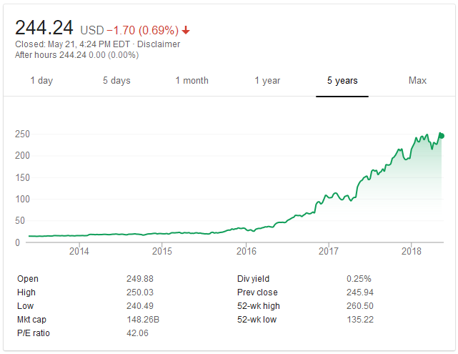
Nvidia stock price (From Google Finance)

Slide 9
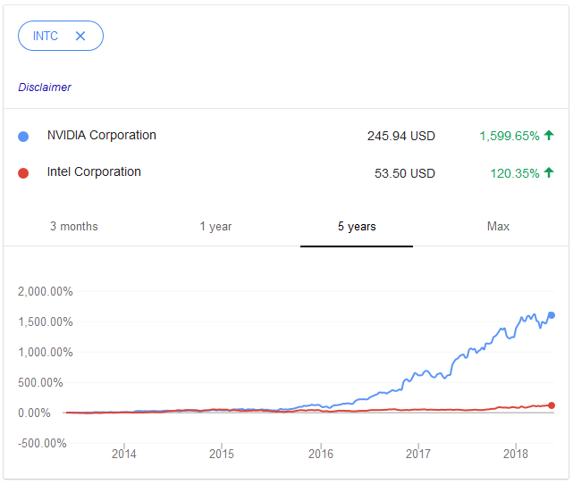
Nvidia & Intel stock price (From Google Finance)

Slide 10
Nvidia challenge & strategy
How to manage price discrimination?
  i.e. How to charge each customer’s maximum willingness to pay?
But Gaming is currently biggest part of business
  And if they raise prices there, they invite competition at low end (which could eventually compete at high end)
  Don’t want situation like CPUs and HDDs, where cloud providers moved to lowest cost commodity HW
And Cryptocurrency (i.e. “Proof of effort computations”) is altering demand
    But also may be helping the PE multiple of their stock….

Slide 11
Answer(?): A “non-market” strategy
Set up a legal barrier to prevent any “deep pocket” datacenter operators from using gaming cards.
  Might not actively pursue “small fry,” but would likely go after Fortune 100 and major clouds
But…. Don’t want to upset the analysts by deterring cryptocurrency boom (bubble?), so; this curious license on accelerator cards:
“No Datacenter Deployment. The SOFTWARE is not licensed for datacenter deployment, except that blockchain processing in a datacenter is permitted.” (So no licenses or libraries, etc.)

Slide 12
Likely near term impact:
Nvidia likely maintains higher prices/margins near term
  Might provide “price umbrella” giving other players (e.g. Intel, Xilinx) more room for a product.
The “Big Money” cloud players (AWS, IBM, Google) likely develop their own hardware.
  They also have big enough patent portfolios to defend against a suit.
  Matrix Multiplication – probably hard to get a basic utility patent, but may be many patent-able aspects relating to specialized pipelining and cacheing (fast matrix hardware ineffective if memory access is inefficient)
POSSIBLY reduces appeal in FOSS/academic community, with long-term impact
POSSIBLY improves Nvidia near-term profitability at a risk of future market share.

Slide 13
Discussion
Other interesting financials at:
  http://financials.morningstar.com/ratios/r.html?t=INTC
  http://financials.morningstar.com/ratios/r.html?t=NVDA

