Slide 1
Fault Detection in Continuous Chemical Processes
Gustavo Almeida
UFMG
Pedro Nardelli
LUT

Slide 2
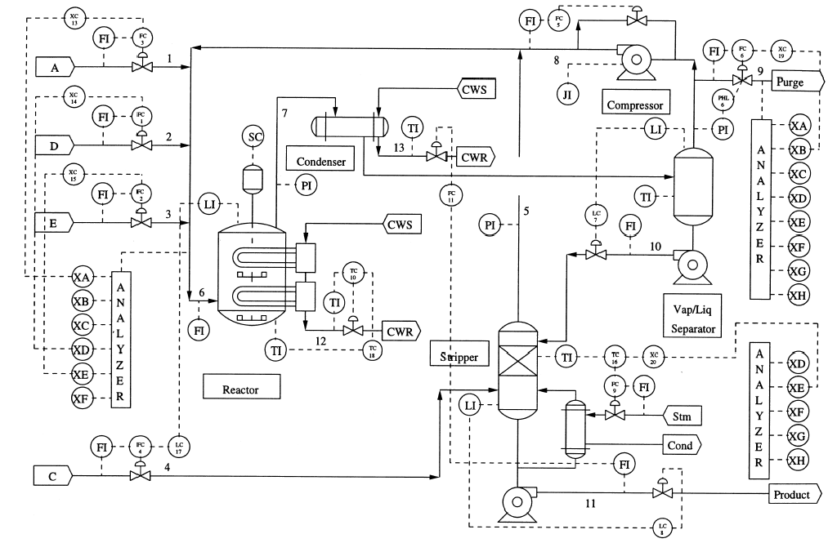
Tennessee benchmark
Goal: The Tennessee benchmark (Downs and Vogel, 1993) was made available by the Eastman company to supply realistic use case to academy community in order to study chemical control strategies for different processes. It is composed by 5 main equipments, the data sets are composed by 52 variables, and it is possible to investigate 21 faults.
Applications: It has been extensively used in different scenarios, like the classical work of Russell et al. (2000), who applied PCA and other multivariate techniques with the objective of fault detection.

Slide 3
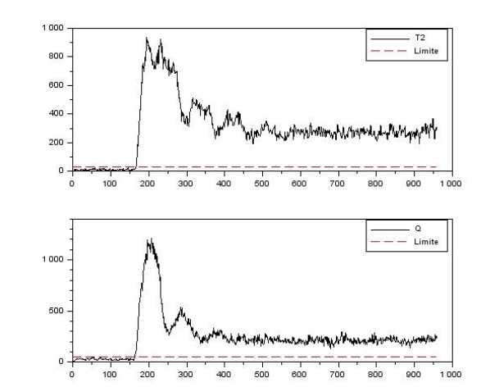
Results: PCA model
Example: Fault 1
T² and Q statistics beyond the control limit (dotted line) after fault start up (t = 160) given a false alarm rate of 1%
17 faults out of 21 were identified by the PCA model (81%)
In 8 of the identified faults, the method was late to find the fault instant occurrence (t = 160)
Another metric used to check model effectiveness was Missed Detection Rate
These results are based on the work of Russell et al. (2000).

