Slide 1
Synthesizing Multi-View Models of Software Systems
Lambeau Bernard
PhD. Private Defense
ICTeam Institute
Université catholique de Louvain
October 2011

Slide 2
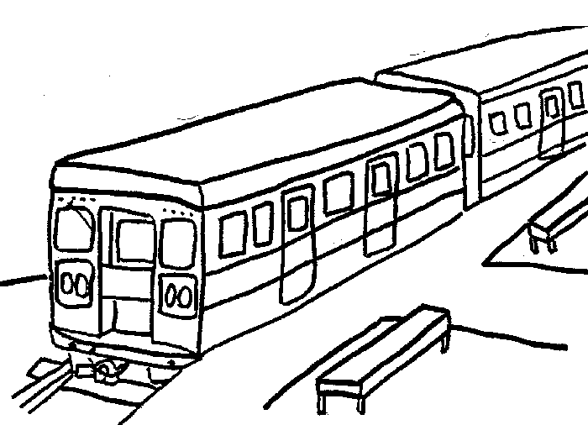
The Little Train System
The system is composed of
A train controller
A train actuator/sensor
A passenger
The train controller controls operations such as start, stop, open doors, and close doors
A safety goal requires train doors to remain closed while the train is moving
If the train is not moving and a passenger presses the alarm button, the controller must open the doors in emergency
If the train is moving and …, it must stop the train first and then open the doors in emergency

Slide 3

The Meeting Scheduler System [Fea97]
The system is composed of
A meeting initiator
Participants
An automated scheduler
Typical ideal scenario
An initiator issues a meeting request, specifying the expected participants and a date range for the meeting
The scheduler then sends an electronic invitation to each participant, requesting them to provide their date constraints
The meeting is automatically planned at a date meeting all constraints

Slide 4
Modeling Software Systems
Why ?
Elaborating requirements and exploring design
Reasoning about, verifying and documenting systems
Generating code, prototypes, etc.
Models have many advantages
Force stakeholders to be precise in their descriptions
Abstract from unnecessary details while enforcing separation of concerns
Enable the early detection and fixing of errors
Allow runtime monitoring and enactment of work processes

Slide 5
Multi-View Modeling
Different models focus on different system dimensions
Intentional: goal, rule-based models
Structural: object, agent, architecture models
Operational: task, process, workflow models
Behavioral: scenarios, state machines
Requirements on multi-view modeling languages and models
Multi-level, analyzable, adequate, complete, precise, consistent, comprehensible, …
Building high-quality models is hard
Tool-supported techniques are needed for supporting analysts and stakeholders
(Semi-)formal modeling approaches are needed here

Slide 6
Multi-view Model Synthesis
Promising approach for model building
High-quality models, especially towards increased completeness, consistency and precision
Works hand in hand with model analysis [Dam11]
Vertical model synthesis
To derive lower-level models from higher-level ones
Operational semantics from the latter and makes model checking tools available to them
Horizontal model synthesis
To build model fragments missing from a multi-view framework or complete existing ones
That is, using consistency rules the other way round

Slide 7
Vertical vs. Horizontal Model Synthesis
Abstraction level
From higher-level to lower-level models (operational sem.)
Not necessarily the case with horizontal synthesis
Lifetime of synthesized models
Shorter for vertical synthesis, e.g. limited to the analysis
Horizontal synthesis may yield requirement models and system documentation
Vertical synthesis is derivational by nature whereas horizontal synthesis may be inductive
User involvement
Models kept hidden from the user, who has a passive role
Versus models shown to (validated by) the user, who has an active role

Slide 8
Manuscript Content at a Glance
Background on a multi-view modeling framework
Derivation of State Machine Models from Process Models
Vertical synthesis enabling trace-based model checking of process models (operational semantics)
Inductive Synthesis of State Machines from Scenarios
Horizontal synthesis aimed at completing model fragments in a triangle made of scenarios, state machines and goals
Evaluation and Tool support
Evaluation of inductive synthesis
On case studies and synthetic datasets
Yielding a novel evaluation protocol and an online platform
Libraries and tools
a model checker for process models, an interactive state machine synthesizer, and a process model analyzer

Slide 9
Manuscript Content at a Glance
Background on a multi-view modeling framework
Derivation of State Machine Models from Process Models
Vertical synthesis enabling trace-based model checking of process models (operational semantics)
Inductive Synthesis of State Machines from Scenarios
Horizontal synthesis aimed at completing model fragments in a triangle made of scenarios, state machines and goals
Evaluation and Tool support
Evaluation of inductive synthesis
On case studies and synthetic datasets
Yielding a novel evaluation protocol and an online platform
Libraries and tools
a model checker for process models, an interactive state machine synthesizer, and a process model analyzer

Slide 10
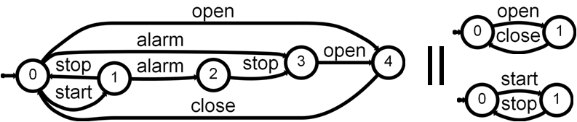
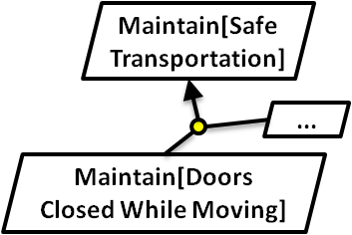
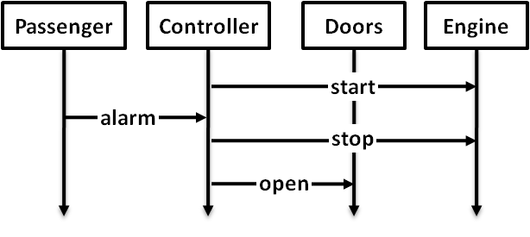
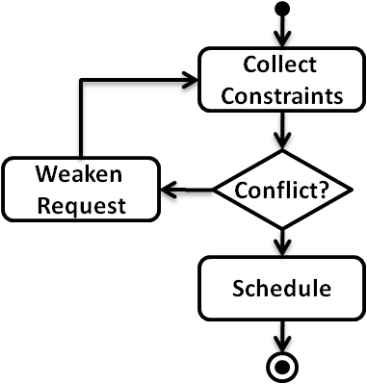
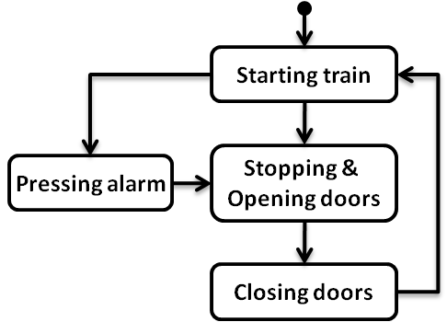
Multi-view Modeling Framework
Agent state machines (LTS)
Goals & Domain Properties (FLTL)
Scenarios (MSC)
Event traces (LTS) + State annotations (fluents)
High-level scenarios (hMSC)
Process
models (g-hMSC)

Slide 11
Derivation of State Machine Models from Process Models
Agent state machines (LTS)
Goals & Domain Properties (FLTL)
Scenarios (MSC)
Event traces (LTS) + State annotations (fluents)
High-level scenarios (hMSC)
Process
models (g-hMSC)

Slide 12
Inductive Synthesis of State Machines from Scenarios
Agent state machines (LTS)
Goals & Domain Properties (FLTL)
Scenarios (MSC)
Event traces (LTS) + State annotations (fluents)
High-level scenarios (hMSC)
Process
models (g-hMSC)

Slide 13
Traces & Labeled Transition Systems
Agent state machines (LTS)
Goals & Domain Properties (FLTL)
Scenarios (MSC)
Event traces (LTS) + State annotations (fluents)
High-level scenarios (hMSC)
Process
models (g-hMSC)

Slide 14
Traces & Labeled Transition Systems
Focus on agent and system behaviors
Defined as (infinite) sets of (finite) event traces exhibited by the system / agents
As observed by their environment
Trace behavioral equivalence [Hoa85]
P and Q are behavioraly equivalent if they exhibit the same sets of traces, i.e. the same languages :
P ≡_{tr} Q if and only if L(P) = L(Q)
Event traces (LTS) + State annotations (fluents)

Slide 15
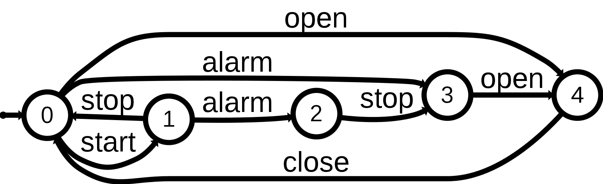
Traces & Labeled Transition Systems
Trace semantics through LTS
Captures the set of traces denoting existing paths in the transition system graph
A subclass of standard automata with all accepting states [Hop79]
Operators and algorithms
Inherited from regular languages theory (union, intersection, difference on sets of traces) [Hop79]
Composition and hiding [Mag99]

Slide 16
Trace Semantics of Multi-view Models
Agent state machines (LTS)
Goals & Domain Properties (FLTL)
Scenarios (MSC)
Event traces (LTS) + State annotations (fluents)
High-level scenarios (hMSC)
Process
models (g-hMSC)

Slide 17
Derivation of State Machine Models from Process Models
Agent state machines (LTS)
Goals & Domain Properties (FLTL)
Scenarios (MSC)
Event traces (LTS) + State annotations (fluents)
?
High-level scenarios (hMSC)
Process
models (g-hMSC)

Slide 18
Why deriving state machines from process models ?
Flawed process models can have dreadful consequences in safety critical areas
e.g. process modeling to improve medical safety
Models should be as error-free as possible
Techniques for building them and detecting sereve flaws, e.g. model checking
A formal semantics is therefore required
Enables analysis techniques in [Dam11]

Slide 19
Process models as Guarded hMSC
Tasks as MSCs or finer-grained guarded hMSC
Decisions on fluents
Initial condition C₀ on process instances
Total order among MSC events
We focus on global event traces exhibited by the process, not on specific agent behaviors
Collect Constraints
Weaken Request
Conflict?
Schedule
Fluent Conflict =
< { conflict_detected },
{ all_constraints_known } > C₀ = ¬ Conflict

Slide 20
Process models as Guarded hMSC
Collect Constraints
Invite & Collect
Conflict Notification
AllCstrKnown
Notification
Weaken Request
Conflict?
Schedule
Initiator
Scheduler
Participant
Fluent Conflict =
< { conflict_detected },
{ all_constraints_known } > C₀ = ¬ Conflict
initiate
invite
constraints

Slide 21
Operational Trace Semantics of Guarded hMSC
1) Derive g-hMSC as g-LTS
g-hMSC
model
g-LTS
model
LTS
model
Fluent
definitions
Fluent
automata
3) g-LTS composition + hiding
2) Fluent semantics as automata

Slide 22
Introducing guarded LTS
Transition system with transitions labeled either by a guard, an event, or τ
A structured form of LTS whose states denote classes of pure LTS states
A guard is a propositional formula over fluents
A condition C₀ restricts the fluent assignments admissible in the initial state

Slide 23
Declarative trace semantics of g-LTS
A g-LTS execution (Init, <l₀, …, l_{n}>) accepted if
Trace inclusion: <l₀, …, l_{n}> denotes an existing path
Admissible start: Init |= C₀
Guards satisfaction: guards are satisfied when encountered
Accepted g-LTS traces (Init, <e₀, …, e_{n}>)
Admissible executions where guards are hidden
Accepted pure LTS traces <e₀, …, e_{n}>
Existential quantification over admissible Init

Slide 24
Operational Trace Semantics of Guarded hMSC
1) Derive g-hMSC as g-LTS
g-hMSC
model
g-LTS
model
LTS
model
Fluent
definitions
Fluent
automata
3) g-LTS composition + hiding
2) Fluent semantics as automata

Slide 25
1) From g-hMSC to g-LTS
Collect Constraints
Weaken Request
Conflict?
Schedule
C₀ = ¬ Conflict

Slide 26
1) From g-hMSC to g-LTS
Collect Constraints
Weaken Request
Conflict?
CC_{start}
{…}
CC_{end}
Schedule
WR_{start}
{…}
C₀ = ¬ Conflict
WR_{end}
Sch_{start}
{…}
Sch_{end}

Slide 27
1) From g-hMSC to g-LTS
Collect Constraints
Weaken Request
Conflict?
CC_{start}
{…}
CC_{end}
Schedule
WR_{start}
{…}
C₀ = ¬ Conflict
WR_{end}
Sch_{start}
{…}
Sch_{end}

Slide 28
1) From g-hMSC to g-LTS
Collect Constraints
τ
Weaken Request
Conflict?
τ
CC_{start}
{…}
CC_{end}
τ
Schedule
[ Conflict ]
WR_{start}
{…}
C₀ = ¬ Conflict
WR_{end}
[ ¬ Conflict ]
Sch_{start}
{…}
Sch_{end}
τ
C₀ = ¬ Conflict

Slide 29
1) From g-hMSC to g-LTS
Collect Constraints
[ ¬ Conflict ]
τ
Weaken Request
Conflict?
τ
CC_{start}
{…}
CC_{end}
τ
Schedule
[ Conflict ]
WR_{start}
{…}
C₀ = ¬ Conflict
WR_{end}
[ ¬ Conflict ]
Sch_{start}
{…}
Sch_{end}
τ
C₀ = true

Slide 30
2) Fluents as g-LTS automata
Fluent Conflict =
< { conflict_detected },
{ all_constraints_known } >
q_{u}
[¬ Conflict]
[Conflict]
all_constraints_known
conflict_detected
conflict_detected
q_{f}
q_{t}
[¬ Conflict]
all_constraints_known
[Conflict]

Slide 31
3) Compose then hide guards
g-LTS
model
||
LTS
model
Fluent
automata
g-LTS composition
Synchronize on events and τ moves
Boolean conjunction on guards, pruned when unsatisfiable
g-LTS hiding
Replace guards by τ
Yields a pure LTS

Slide 32
Trace equivalent composed g-LTS
Guard satisfaction
(q₀, q_{t1}, q_{t2}, ...)
[ Fl₁ ]
...
[ ¬Fl₁ ]
Admissible start
(q₀, q_{f1}, q_{t2}, ...)
[ C₀ ∧ Fl₁ ∧ Fl₂ ∧ ...]
[ Fl₁ ]
[ C₀ ∧ ¬Fl₁ ∧ Fl₂ ∧ ...]
...
[ ¬Fl₁ ]
[ C₀ ∧ Fl₁ ∧ ¬Fl₂ ∧ ...]
[...]
(q_{start},q_{u1},q_{u2},...)
[...]
= pruning (unsatisfiable)
...

Slide 33
From operational semantics to trace-based model checking
1)
g-hMSC
model
g-LTS
model
3)
LTS
model
2)
Fluent
definitions
Fluent
automata
||
Search space automaton
||
Synchronizer
automaton
Tester
automaton
LTL2 Buchi
FLTL (ψ) Property
Buchi (¬ψ)
automaton
Cfr. Tool support

Slide 34
Inductive Synthesis of State Machines from Scenarios
Agent state machines (LTS)
Goals & Domain Properties (FLTL)
Scenarios (MSC)
Event traces (LTS) + State annotations (fluents)
High-level scenarios (hMSC)
Process
models (g-hMSC)

Slide 35
Problem statement (simplest)
Given a consistent collection of MSC scenarios showing examples and counterexamples of system behavior
Sc = (S⁺, S⁻)
Synthesize the system as a composition of agent LTSs
System = (Ag₁ || … || Ag_{n})
Such that Sc and System are consistent

Slide 36
Consistency post-conditions
Structural consistency
Synthesized state machines agree with scenarios on the agent decomposition and their respective interface
Consistent agent view
Timelines of positive scenarios and prefixes of negative ones specify existing paths in the corresponding agent state machines
Consistent system view
The system covers all positive scenarios and the preconditions of all negatives ones; it also excludes all negative scenarios

Slide 37
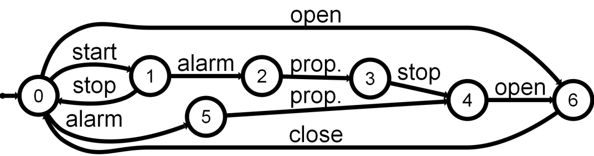
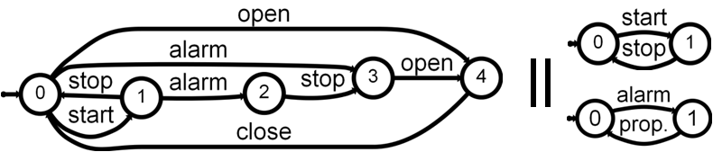
Synthesis Approach
Scenarios
Generalization (grammar induction)
System LTS
Decomposition (hiding)
Agent LTSs

Slide 38
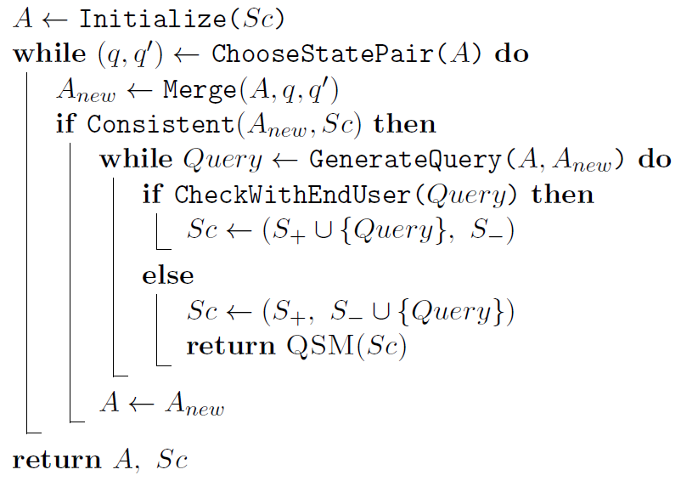
Query-driven State Merging (QSM)
Build an initial solution
Refine it incrementally
Under user control
Keep it if consistent
Return last solution considered

Slide 39
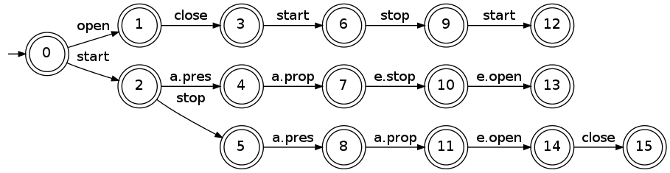
Initial solution: prefix tree acceptor
Largest deterministic automaton accepting all positive traces and rejecting all negative ones

Slide 40
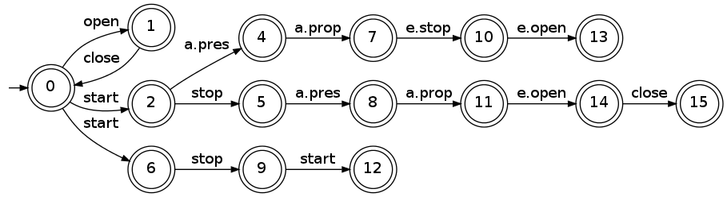
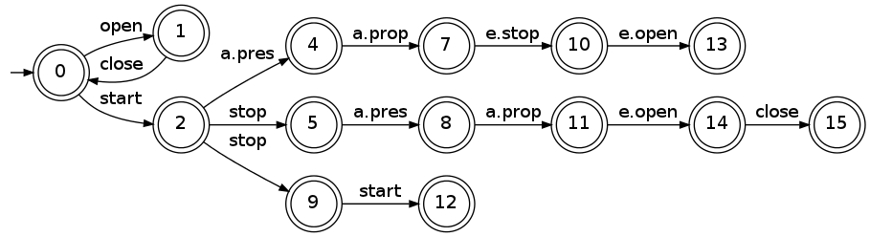
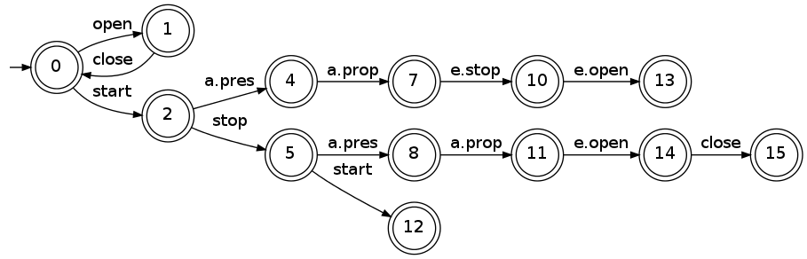
Refinement through state merging
Merge a candidate pair (q, q’) in A_{i}
Merge for determinization
Yields a candidate solution A_{i+1,} generalizing A_{i}
Keep it only if consistent with the negative traces
(q=3, q’=0)
2 and 6
(determ.)
5 and 9
(determ.)

Slide 41
User control through scenario queries
q=3
A_{i}
q’=0
Prefix of q’, suffix of q
Controller
Actuator/Sensor
Passenger
start
stop
start

Slide 42
User control through scenario queries
q=3
A_{i+1}
q’=0
Question mark to show the prefix already accepted
Controller
Actuator/Sensor
Passenger
start
stop
?
start

Slide 43
Scenarios as Message Sequence Charts
Event interactions between agent instances
Trace semantics
Agent traces L⁺_{Ag}(P)
System traces L⁺(P)
Up to a choice: partial or total order among events ?
Negative MSC
Positive MSC + prohibited event
Positive and negative traces
L⁺_{Ag}(N), L⁺(N) and L⁻(N)
Negative system traces only
Positive MSC P
Controller
Actuators & Sensors
Passenger
start
a. pressed
a. propagated
e. stop
e. open
Negative MSC N
Controller
Actuators & Sensors
Passenger
start
x
open

Slide 44
High-level MSC
Directed graph where nodes are MSCs
Structured form of scenarios allowing reuse, sequencing and loops
Trace semantics
Agent traces L⁺_{Ag}(H)
System traces L⁺(H)
Up to a choice
Ordering of MSC events
Synchronization of nodes
High-level MSC H
Starting train
Pressing alarm
Stopping & Opening doors
Closing doors
Controller
Actuators
Doors
close-signal
close

Slide 45
State variables as Fluents
Framework
Agent state variables are modeled with fluents
fluent F = <I_{Fl},T_{Fl}> initially Initially_{Fl}
I_{Fl} is a set of initiating events
T_{Fl} a set of terminating events
Initially_{Fl} (boolean) is the initial value of F
A fluent is
monitored by an agent if it “monitors” or performs all initiating and terminating events
controlled by an if it performs all initiating and terminating events
fluent examples
fluent moving = < {start},
{stop, emergency stop} >
initially false
start
stop, e.stop
moving
fluent doorsClosed = <
{close doors},
{open doors, emergency open} >
initially true
open doors, e.open
close doors
doorsClosed

Slide 46
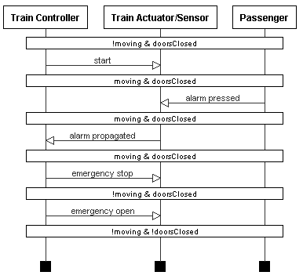
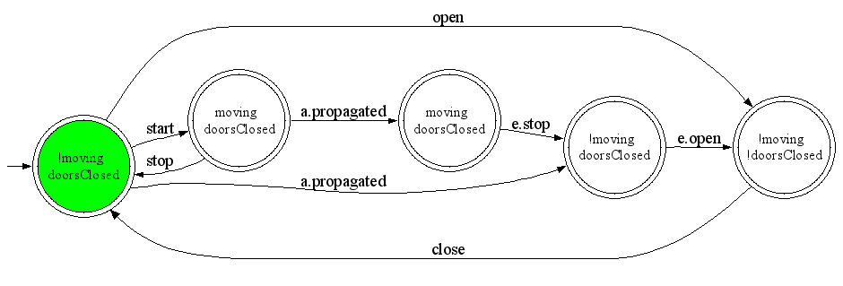
Decorations on behavior models
Decorated Scenario
Fluents can be used to decorate scenarios and state machines with state assertions [Dam05]
Extension to other kinds of decorations in [Dam10]
Used for analysing medical models with respect to cost, time & dosage constraints
Train Controller Decorated LTS

Slide 47
Goals as Fluent Linear Temporal Logic (FLTL)
Framework
Goals are objectives that the system should achieve through cooperation of agents [Avl09]
Pro & Cons
recognized paradigm for eliciting, elaborating, structuring, specifying, analyzing, and modifying software requirements
Sometimes too abstract
Hard to formalize for end-user
Maintain[Doors Closed While Moving]
Def: The train should always move with doors closed
FormalDef: □(moving → doorsClosed)
Maintain[Safe Transportation]
...
Maintain[Doors Closed While Moving]

Slide 48
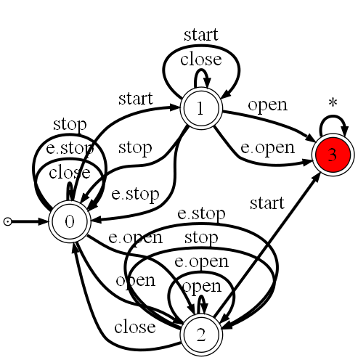
Goals and LTS Synthesis & Semantics
Framework
Goals in FLTL
A goal declaratively define a set of histories to be accepted and/or rejected by the system
A state machine typically captures a set of system histories
Available synthesis techniques
A Tester LTS capturing event traces violating a FLTL safety property can be synthesized using [Gia03]
Also, a Property LTS capturing event traces NOT violating it [Let08]
Maintain[Safe Transportation]
...
Maintain[Doors Closed While Moving]
[Gia03, Let08]
Tester LTS

Slide 49
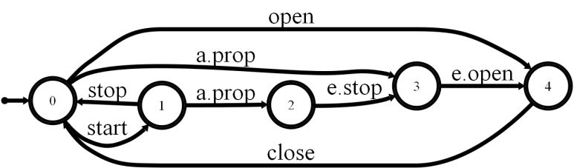
From MSC and hMSC to LTS Chapter 4
How to generalize a set of MSC scenarios as LTS state machines?
StationToStation TrainRide
AlarmPressed DuringTrainRide
BackToStation AfterEmergency
Controller
Actuators & Sensors
Passenger
State machines as LTS
start
a. propagated
a. pressed
e. stop
e. open
Scenarios as MSC and hMSC

Slide 50
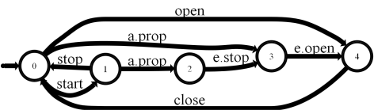


From MSC to LTS Problem statement
Inductive LTS synthesis
Given a scenario collection S_{c}=(S₊,S–) showing typical examples of the system usage, synthesize the system as a composition of agent LTS
S = A_{lts1} || … || A_{ltsn}
such that it correctly accepts S₊ and rejects S–
Positive & Negative MSCs
Controller
Actuators & Sensors
Passenger
start
a. pressed
a. propagated
e. stop
e. open
?
Agent LTS

Slide 51
Synthesis requirements
Inductive LTS synthesis
Because of end-user involvement, the solution should work
From end-user positive and negative scenarios …
… and scenarios only : avoid hMSC, state variables annotations, operations formalization (pre/post), etc.
but such additional information could/should be used when available
Initial scenario collection being incomplete, the approach
should support the elicitation of additional, “interesting” positive/negative scenarios
should be incremental : the models should be incrementally refinable as further scenarios become available

Slide 52
Solution overview
Inductive LTS synthesis
Positive & Negative MSCs
Generalization
Interactive automaton induction
Guided by generated scenario questions classified as positive or negative by the end-user
Query-Driven State Merging (QSM)
Constrained by additional state information when available (state variables, legacy components, goals, etc.)
Decomposition
Standard automaton algorithms (ε-moves, determinization, minimization)
Controller
Actuators & Sensors
Passenger
start
a. pressed
a. propagated
e. stop
e. open
System LTS
Generalization
Agent LTS
Decomposition
C. Damas, B. Lambeau, P. Dupont and A. van Lamsweerde, Generating Annotated Behavior Models from End-User Scenarios, IEEE Transactions on Software Engineering, Special Issue on Interaction and State-based Modeling, Vol. 31, No. 12, pp. 1056-1073, 2005 .

Slide 53
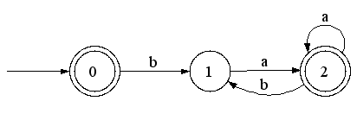
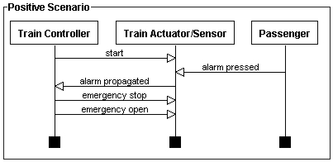
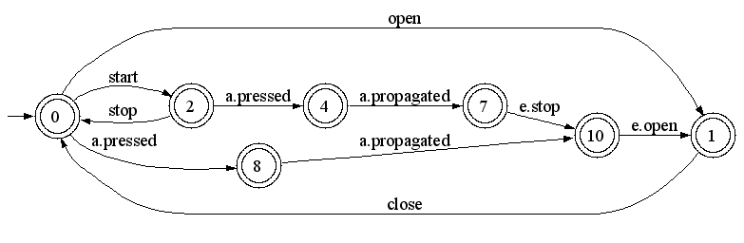
From grammar induction to LTS synthesis
Inductive LTS synthesis
Grammar induction
Learning a regular language L=(ba*a)*
Represented by a DFA
From positive and negative strings
S₊ = {ba,baa,baba,λ} and S– = {bb}
Regular Positive and Negative Inference (RPNI + variants)
LTS Synthesis
Learning a System
Represented by a LTS (a DFA)
From positive and negative scenarios
Grammar induction
Language sample
S₊ = {ba,baa,baba,λ} S– = {bb}
RPNI
L=(ba*a)*
Inductive LTS Synthesis
Sc=(S₊,S–)
RPNI
Syntesized LTS

Slide 54
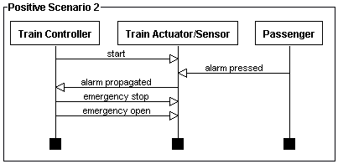
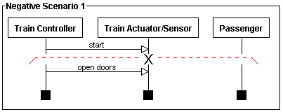
Scenarios as strings
Inductive LTS synthesis
The system LTS represents the learned language L
Scenarios are observed strings on L
LTS contains only accepting states
A positive scenario defines a set of positive strings
A negative scenario defines a set of positive strings and one negative string
System LTS
1
2
3
4
5
1
2

Slide 55
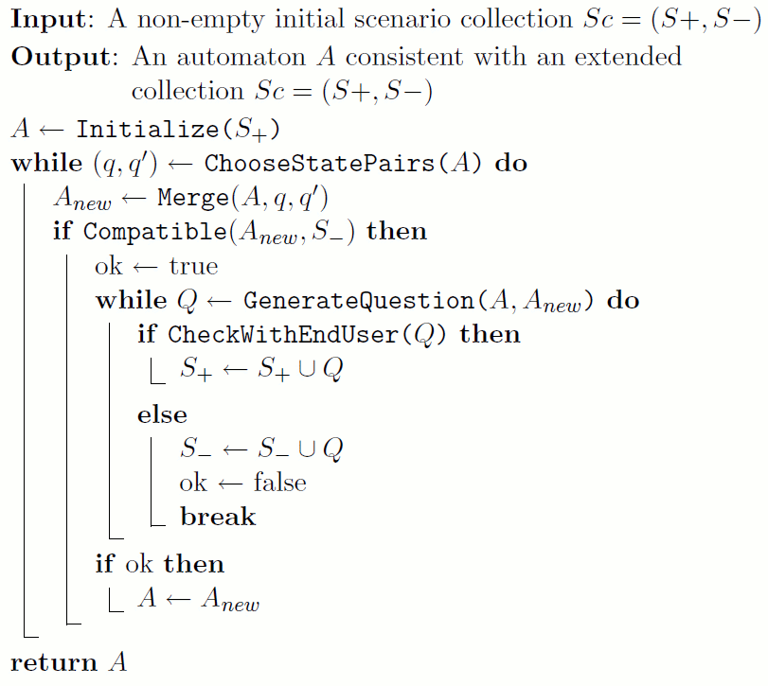
Query-Driven State Merging (QSM)
Inductive synthesis
1. Build an initial solution A
2. Generalize A → A_{new}
3. With user involvement
4. Keep it when correct
A_{new} → A
5. Return synthesized system

Slide 56
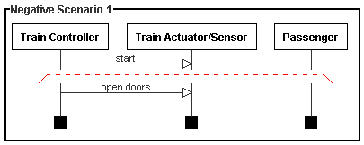
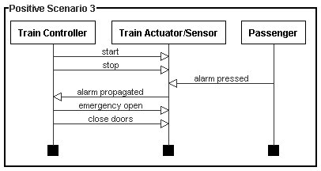
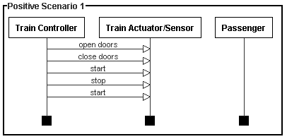
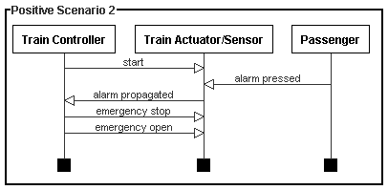
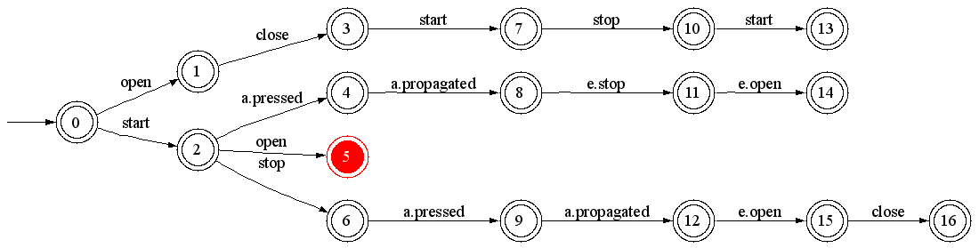
Initial solution, the PTA
Inductive synthesis
Prefix Tree Acceptor (PTA)
Largest DFA accepting S₊ while rejecting S–
No generalization of observed behaviors
Red states are error states
Prefix Tree Acceptor of the Train System

Slide 57
Generalization - merge
Inductive synthesis
q
q’
Consider merging of q=3 with q’=0

Slide 58
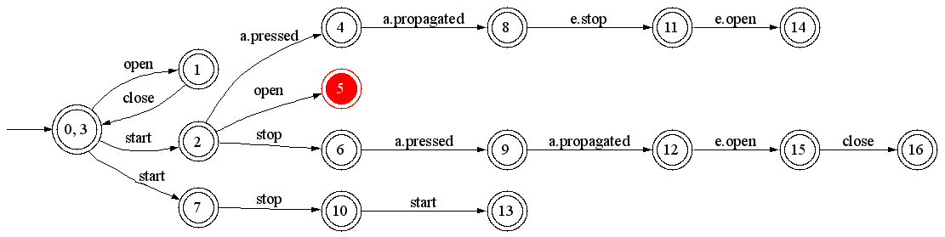
Generalization - determinize
Inductive synthesis
State 0 contains two outgoing transitions labeled « start »
merge 7 and 2 for determinization

Slide 59
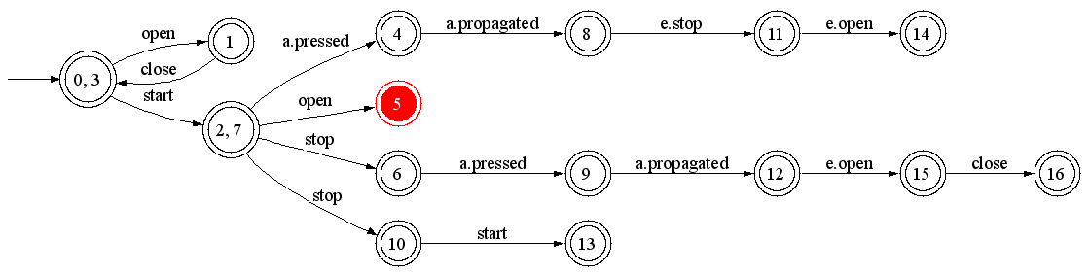
Generalization - determinize
Inductive synthesis
State 2 contains two outgoing transitions labeled « stop »
merge 10 and 6 for determinization

Slide 60
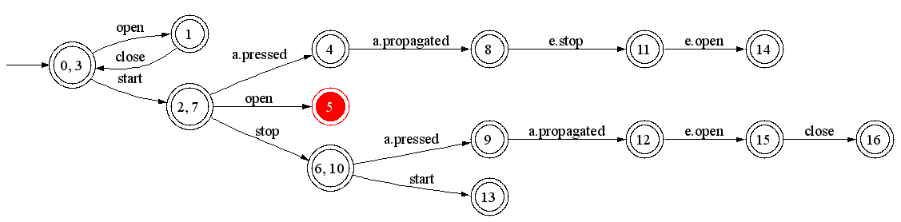
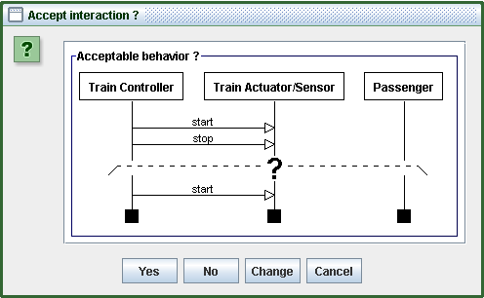
Generalization - questions
Inductive synthesis
prefix
suffix(es)
State 6 gains an outgoing transition labeled “start”
Leads to generated scenario questions
Used prefix is the shortest history leading to state 6
Suffixes are the gained continuations of 6 (only one here)
prefix
suffix

Slide 61
Generated scenarios
Inductive synthesis
Generated scenarios are
Classified by the user as positive or negative examples
Added to the initial scenario collection S_{c}=(S₊,S–)
Generation procedure
Constraints the generalization process with scenarios only
Relies on sound results from grammar induction
Notion of characteristic sample
Provides the elicitation of additional, “interesting” positive/negative scenarios

Slide 62
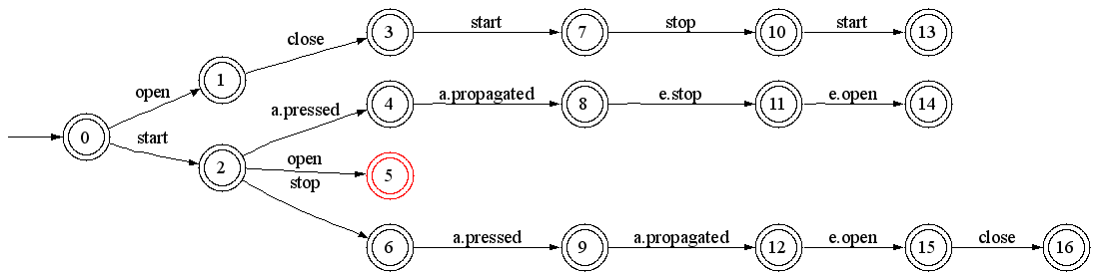
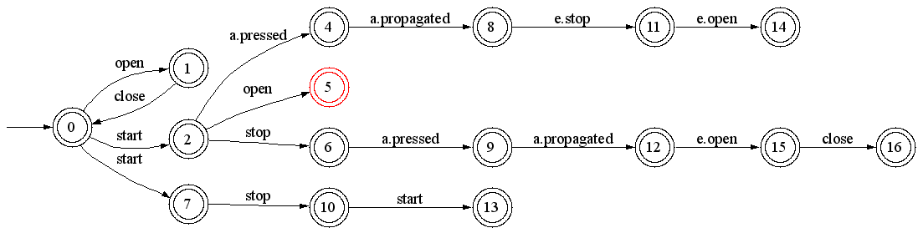
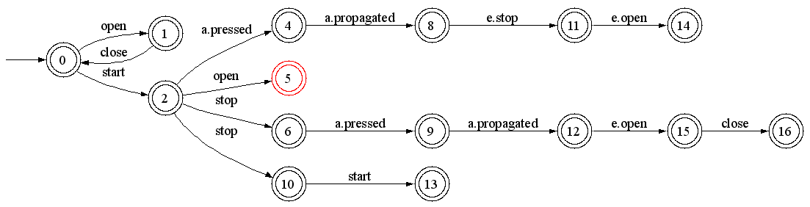
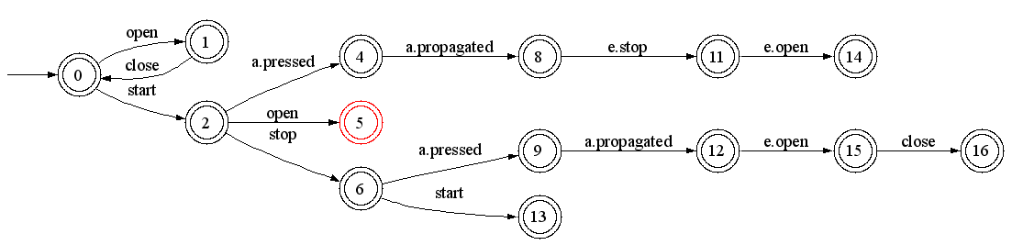
Intermediate solution
Inductive synthesis
States q=3 with q’=0 are merged, and stay merged forever (A ← A_{new}), if
The merging and determinization process does not lead to merge an error state with a non error one
All generated questions are classified as positive scenarios by the user
Otherwise, the solution A_{new} is discarded
The algorithm continues, choosing another merging pair (q, q’), until no pair is available
RPNI step
A
merge
determinize
A_{new}
determinize

Slide 63
Order of state pair selection
Inductive synthesis
RPNI considers state pairs in order
for each state q with rank i
for each state q’ with rank j<i
QSM relies on the Blue-Fringe heuristics
Evidence-driven state merging
Evaluate candidate state pair and choose the best one
Reduces the number of submitted questions in practice

Slide 64
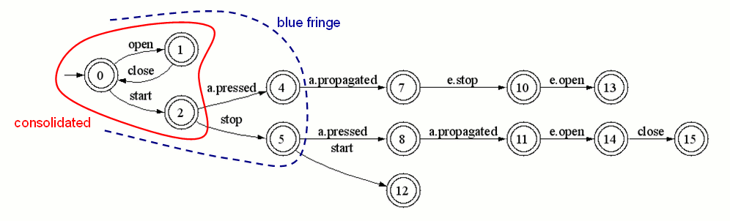
Evidence-driven merging
Inductive synthesis
Consider an intermediate solution A
Kernel states have been shown to be incompatible with each other
Fringe states are situated at one letter of a kernel state
RPNI tries to merge a fringe state with a kernel one, in standard order
questions here : (4,0) ; (4,1) ; (4,2) rejected ; (5,0) accepted
Blue-Fringe extension selects pairs (fringe,kernel) according to an evidence evaluation function, based on shared continuations
questions here : (5,2) rejected, (5,0) accepted
3 questions only on the entire train example (2 accepted and 1 rejected)

Slide 65
Pruning the search space
Inductive synthesis
Risk of poor generalization
Without questions (if no user available)
Due to high importance of negative scenarios (non intuitive in the first place)
Too many questions, often rejected
On the train example : 20 questions (3 to be accepted and 17 to be rejected)
=> Use available information to prune the search space
State information (e.g. fluents decorations)
Goals (safety properties in particular)
Control information (sequence, loops, ... from h-MSC)

Slide 66
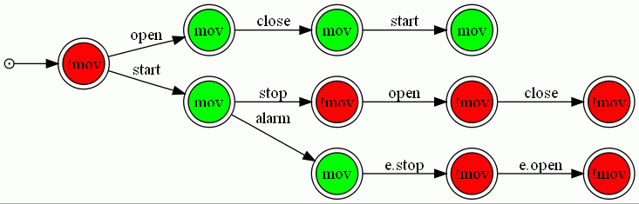
Pruning with fluent decorations
Inductive synthesis
A PTA can be decorated using available fluent definitions
fluent mov(ing) = <{start}, {stop, e.stop}> initially false
Induction can be constrained …
Avoid merging states with inconsistent decorations
e.g. avoid merging a state where the train is moving with another state where the train is not moving !

Slide 67
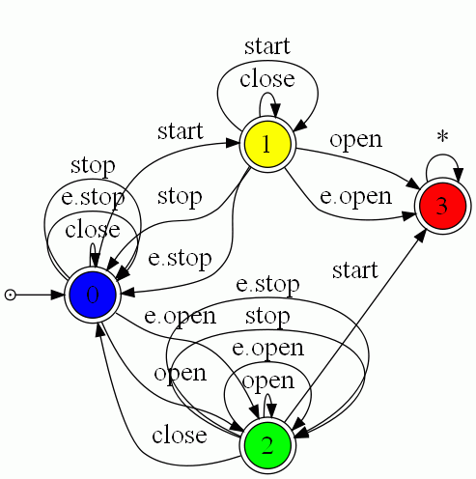
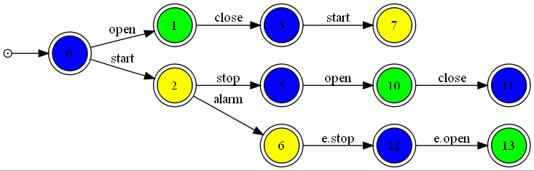
Pruning with goals
Inductive synthesis
Tester LTS for the safety property [Gia03]
Color PTA states with corresponding states
Avoid merging PTA states of different color
Enforces multi-model consistency by construction
Maintain[Doors Closed While Moving]

Slide 68
Pruning with control information
Inductive synthesis
What if PTA states are known to be equivalent ?
mandatory merge constraints
counterpart of state coloring
Alternatively, how to use a h-MSC instead of set of MSCs as input ?
Relax assumption of MSCs starting in same state
Allow using sequence, loops, ...
hMSC
StationToStation TrainRide
AlarmPressed DuringTrainRide
BackToStation AfterEmergency
?
Agent LTS

Slide 69
Pruning with control information The Uch03 + ASM approach
Automaton State Merging (ASM)
Generalizes a DFA under control of a negative sample (not shown)
No oracle / user query support
But still compatible with previous pruning methods
Also MSM & ASM* algorithms
hMSC
StationToStation TrainRide
AlarmPressed DuringTrainRide
BackToStation AfterEmergency
Equivalent LTS
Using [Uch03]
ASM
Agent LTS
Generalized LTS

