Slide 1
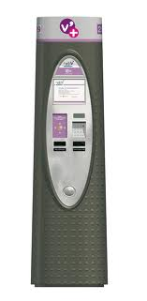
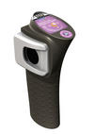


?

Slide 2
Avoid[Stolen Bicycles]
…
Unlocking => Cyclist Logged
press
request
unlock
pickup
released
return
0
1
2
3
4
5
6
press
lock

Slide 3
Subscribing and identification
subscribe
identify
authenticate
granted
welcome aboard

Slide 4
Pickup
press
request
unlock
pickup
released
ride start

Slide 5
Acceptable?
?
press
request
press
request

Slide 6
Invalid Pickup
press
request
X
unlock

Slide 7
press
request
unlock
pickup
released
return
0
1
2
3
4
5
6
press
lock
press
request
unlock
pickup
released
return
0
1
2
3
4
5
6
press
lock

Slide 8
Subscribing
Identification
Cancel
Pickup
Return

Slide 9
Pickup
request bicycle
Pickup
unlock 4
pickup
request bicycle 5
unlock 5
pickup

Slide 10
Pickup
press
request
unlock
pickup

Slide 11
subscribe
…
unlock
identify
pickup

