Slide 1
Synthesizing Multi-View Models of Software Systems
Lambeau Bernard
ICTEAM Institute
Université catholique de Louvain
November 2011
Notes:
Test, test, test

Slide 2
Outline
Introduction
A step-by-step explanation of the thesis title
Model synthesis as a promising approach for reasoning about software systems
Interactive synthesis of state machines from scenarios
Conclusion

Slide 3
Synthesizing Multi-view Models of Software Systems
with courtesy of egmcartech.com

Slide 4
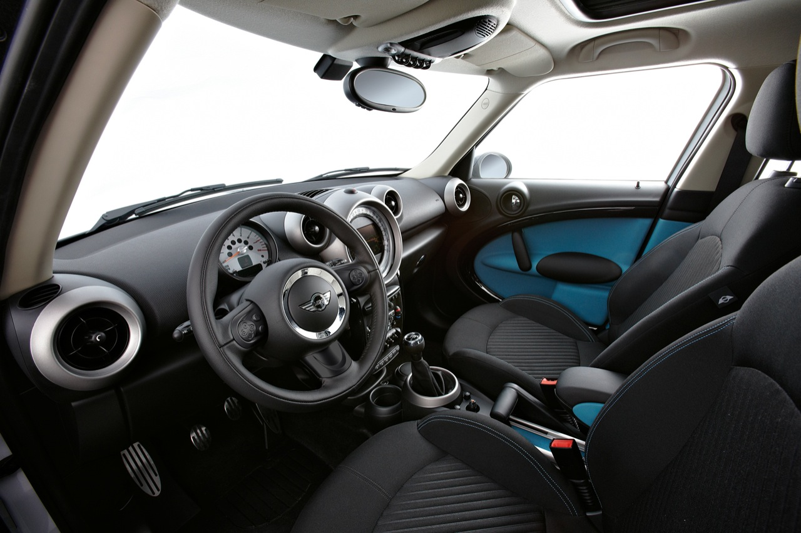
Synthesizing Multi-view Models of Software Systems
with courtesy of egmcartech.com
Notes:
Logiciel prend des décisions

Slide 5

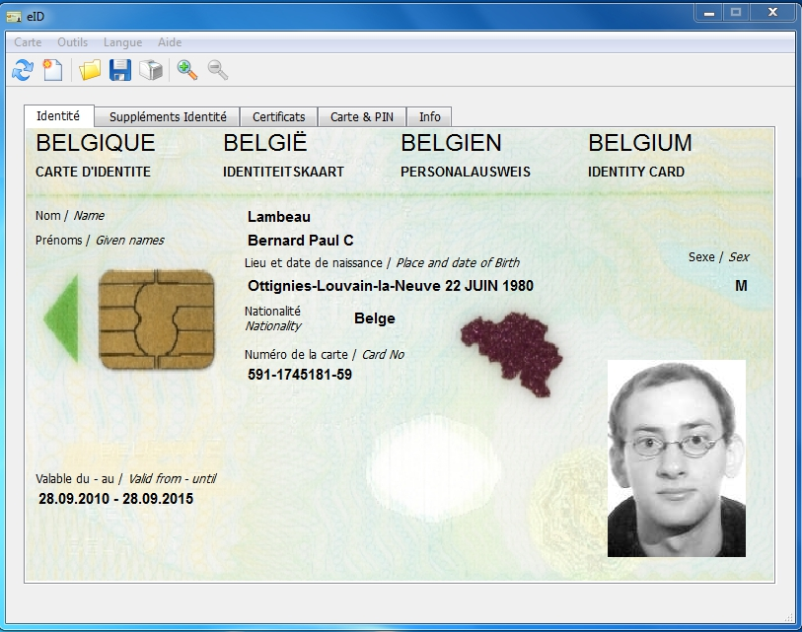
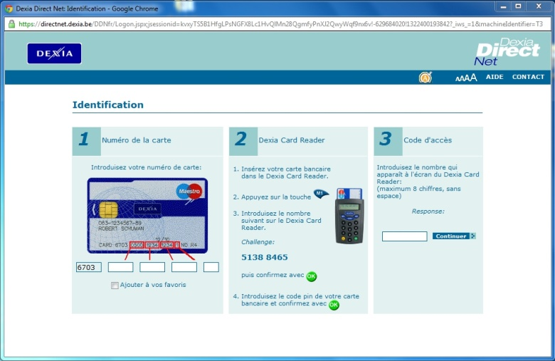
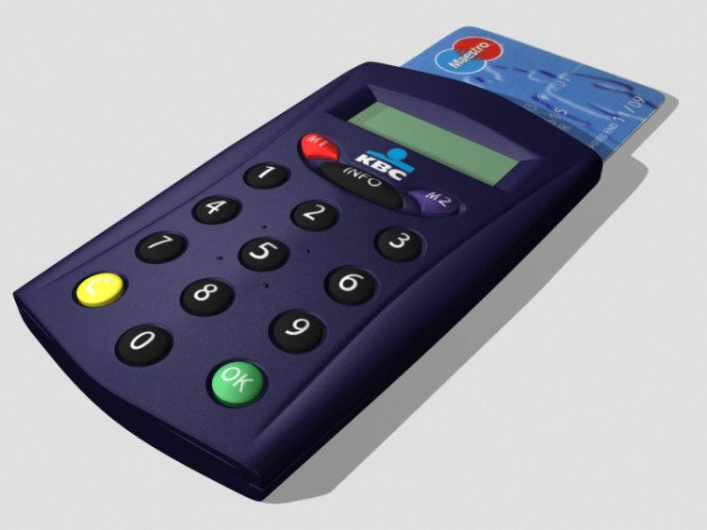

Synthesizing Multi-view Models of Software Systems
with courtesy of egmcartech.com
Notes:
Système = plusieurs composants

Slide 6
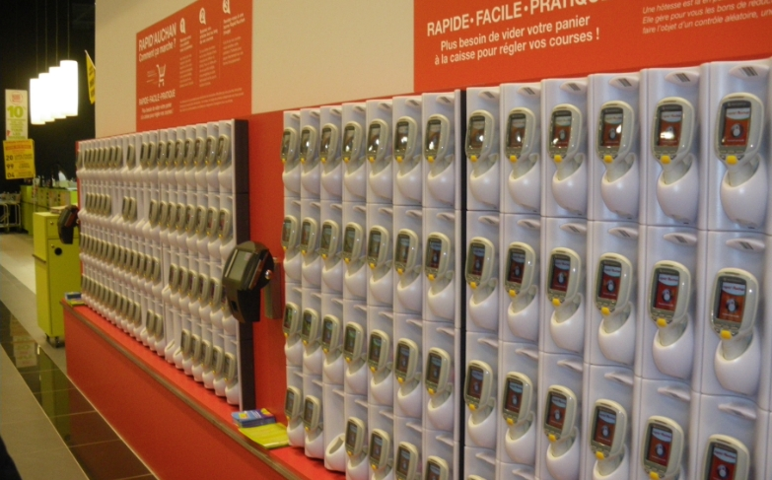
Synthesizing Multi-view Models of Software Systems
with courtesy of quechoisir.fr
Notes:
Le logiciel attribute le scanner

Slide 7
Synthesizing Multi-view Models of Software Systems
A system is a set of active components, called agents, that interact so as to fulfill goals
Agents restrict their behavior to meet the goals they are responsible for [Fea87, Avl09]
Some agents are software components, i.e. automated agents
Others are human beings, electronic devices, etc.
Notes:
Introduire bouquin d’Axel

Slide 8
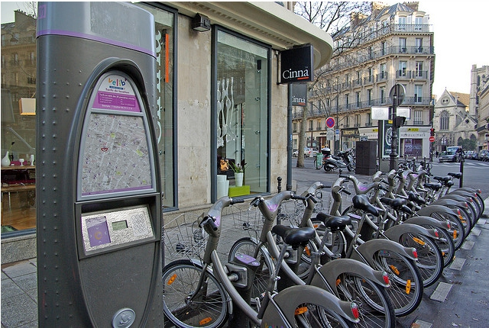
Running example
© Florence S.
Notes:
Introduire borne et point d’attache

Slide 9




Notes:
Introduire autre agents + interactions

Slide 10
Building software systems is hard

Slide 11
The solution is highly technical
website
internet, mobile
communications
electro-mechanical
devices
smart card, touch screen
Notes:
Technicité est compressible
Hier => aujourd’hui

Slide 12
What about the problem?
?
The hardest part of software development is determining what the system should do [Bro87]
Notes:
Incompressible
Hier => Aujourd’hui

Slide 13
?
Notes:
Image mentale
Informaticiens focalisent logiciel

Slide 14
Is this interaction right?
Pickup
Subscribing and identification […]
request bicycle
unlock 4
pickup 4
Notes:
C’est ce que j’ai pensé
Est-ce adéquat?

Slide 15
Not necessarily…
The hardest part of software development is determining what the system should (not) do
© Florence S.

Slide 16
Synthesizing Multi-view Models of Software Systems
Model
An abstract representation of the target system and its intent
subscribe
…
unlock
identify
pickup
Notes:
S’aider à raisonner
Diagramme de contexte
Evenements = phénomènes partagés

Slide 17
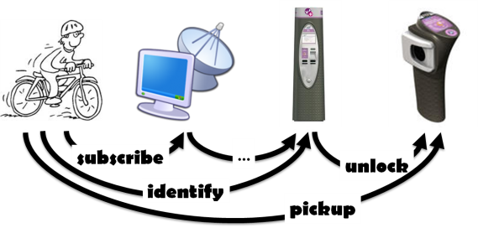
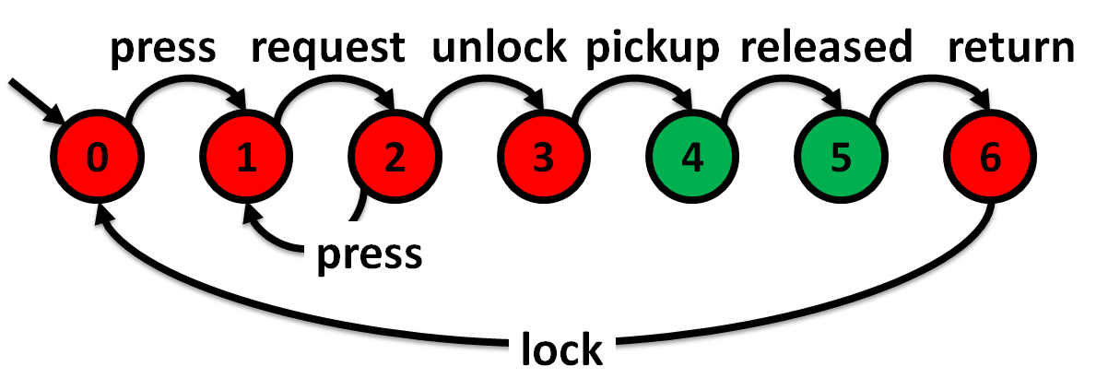
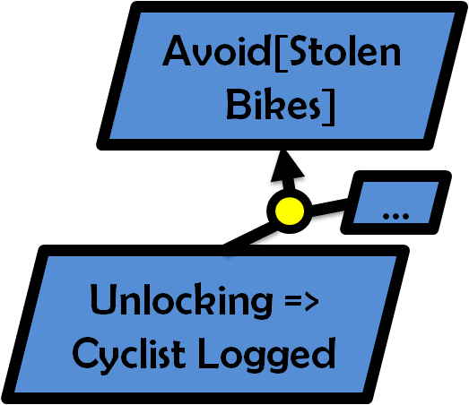
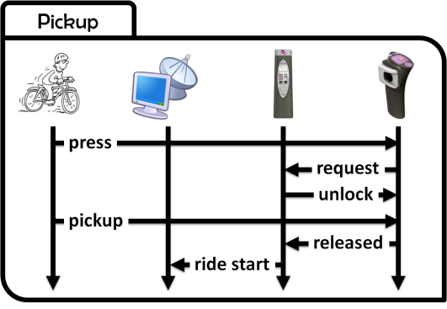
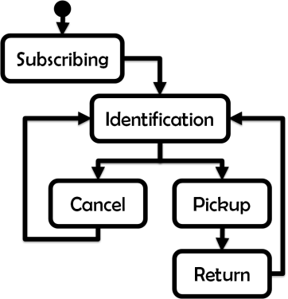
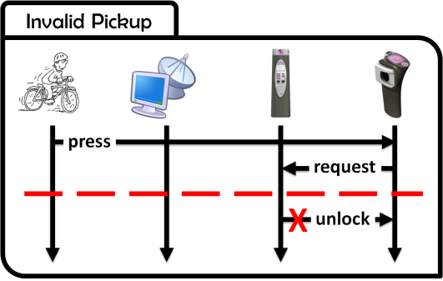
Synthesizing Multi-view Models of Software Systems
Different models cover complementary but overlapping system aspects
Structural
what? who?
Behavioral
how?
Intentional
why?
Notes:
Multiples aspects, pas seulement diagramme de contexte
Structural, Behavioral, Intentional
Différents aspects mais Overlapping
Dernier mot du titre

Slide 18
Multi-view models
A guided tour
Notes:
Ma vision
Overlapping (règles de cohérence) donc Navigation

Slide 19
Scenarios capture examples of agent interactions
Subscribing and identification
subscribe
identify
authenticate
access granted
welcome aboard

Slide 20
Flowcharting for temporal sequencing
Subscribing and identification
Pickup
press
request
unlock
pickup
released
ride start

Slide 21
High-level scenarios also support loops and alternatives
Subscribing
Identification
Cancel
Pickup
Return
Notes:
Scénarios structurés

Slide 22
Counterexamples through Negative scenarios
Invalid Pickup
press
request
X
unlock
Notes:
Ce qu’on ne veut pas que le logiciel fasse

Slide 23
Ask “ why? ” for effective model elicitation
Why (not) ?
Invalid Pickup
press
request
X
unlock

Slide 24
Goals are prescriptive statements of intent
Avoid[Stolen Bicycles]
Why?
Unlocking => Cyclist Logged
?
?
Agents restrict their behavior to meet the goals they are responsible for
Notes:
Objectif de haut niveau
Exigence
Comportement

Slide 25
Agent behaviors through State machines
press
request
unlock
pickup
released
press
request
unlock
pickup
released
return
0
1
2
3
4
5
6
press
lock
Notes:
Cohérence scénario <-> machine à état

Slide 26
System behavior through state machine composition
||
||
||
Parallel composition of agent behaviors [Hoa85]
Agents behave asynchronously but synchronize on shared events [Mil89, Mag99]
The composition is captured through a state machine
Notes:
Agent monolitique

Slide 27
Consistency links between state machines and goals
||
||
||
Avoid[Stolen Bicycles]
The composed system should meet high-level goals
✓
…
Unlocking => Cyclist Logged
Agents restrict their behavior to meet their requirements
Notes:
Encore des liens de cohérence

Slide 28
Goal predicates in terms of State variables
Unlocking => Cyclist Logged
…
access granted
fluent Cyclist Logged = <
{ granted },
{ released } > initially false
…
released
ride start
…
Notes:
Interface SC/SM -> Goals

Slide 29
Security goals are worth considering too
Avoid[Hijacked Accounts]
…
access granted
Log out the cyclist immediately after a bicycle is taken
…
…
released
ride start
…
Notes:
Valeurs fluent le long de la timeline

Slide 30
State variables may decorate state machines
fluent Free = <
{ pickup },
{ return } > initially false
press
request
unlock
pickup
released
return
0
1
2
3
4
5
6
press
Cfr. [Dam11]
lock

Slide 31
State variables may decorate state machines
fluent Locked = <
{ lock },
{ unlock } > initially true
press
request
unlock
pickup
released
return
0
1
2
3
4
5
6
press
Cfr. [Dam11]
lock
Notes:
=> Présentation Christophe

Slide 32
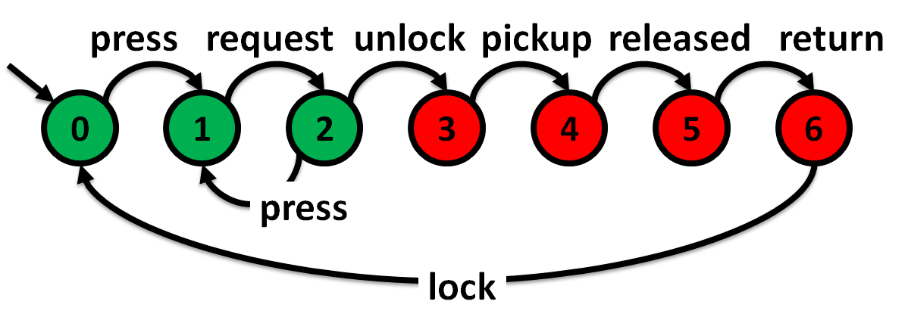
Some requirements are hidden behind variable assignments
Free
?
Locked
Notes:
Agent restreint son comportement => corrélations

Slide 33
Some requirements are hidden behind variable assignments
Free
Avoid[ Free and Locked ]
Locked
Notes:
Jamais deux états verts en même temps
Pas trop vite vers le side suivant

Slide 34
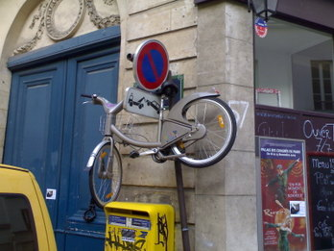
Avoid annoying people…!
Why?
Avoid[ Free and Locked ]
with courtesy of Marc D.

Slide 35
Multi-view models
End of the tour
Notes:
Vous êtes toujours là
Bcp d’info => normal de pas comprendre car…

Slide 36
Do you remember this slide?
?
The hardest part of software development is determining what the system should do [Bro87]
Notes:
Incompressibilité

Slide 37

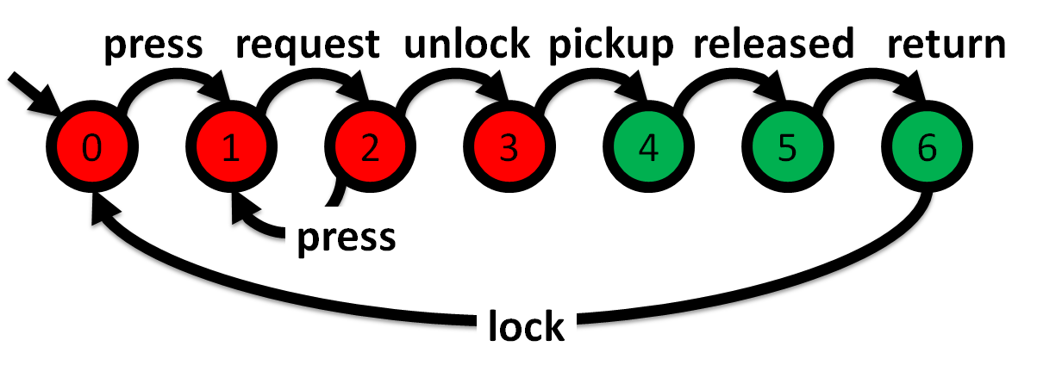
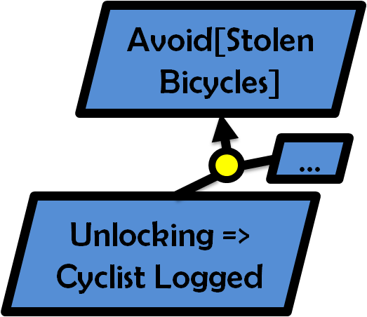

Modeling software systems could hardly be simpler….
?
High-quality models should be adequate, complete, consistent, precise, analyzable, comprehensible [Avl09]
Notes:
Adéquats, Complets, Cohérents

Slide 38


Automated support is needed for system modeling towards…
Better consistency
Build models, Claim properties, Check them, Correct the model and/or the properties…
Better completion
Build models, Infer properties, Validate them, Complete the model and/or the properties…
Notes:
…
Ce qui m’amène au dernier mot du titre!!

Slide 39
Automated support is needed for system modeling towards…
Model analysis
Better consistency
Build models, Claim properties, Check them, Correct the model and/or the properties…
Better completion
Build models, Infer properties, Validate them, Complete the model and/or the properties…
Model synthesis
Notes:
…
Ce qui m’amène au dernier mot du titre!!

Slide 40



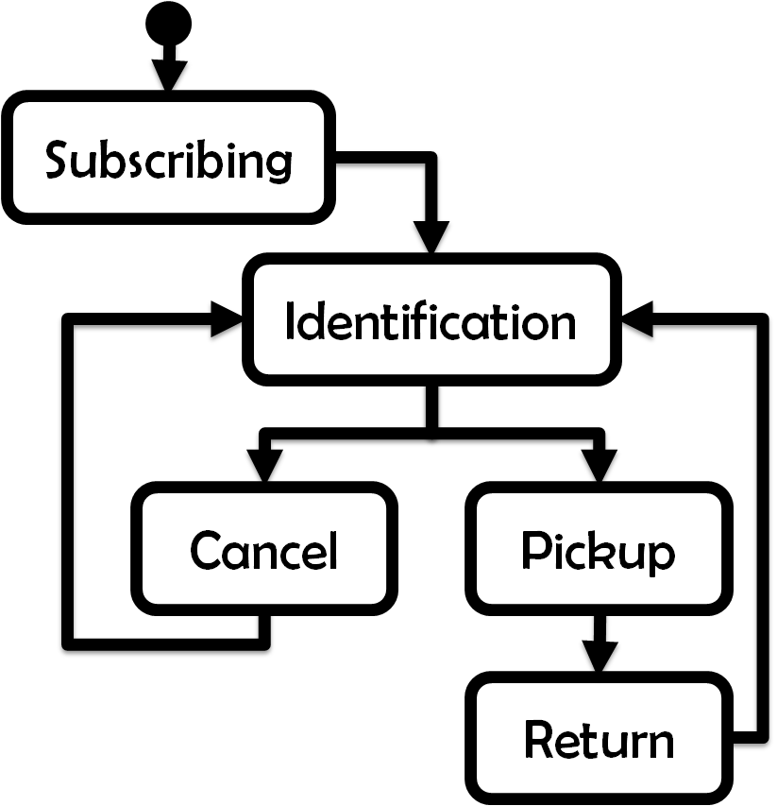

Synthesizing Multi-view Models of Software Systems
Notes:
Liens de cohérence inter-modèles

Slide 41
A formal framework for system modeling
Trace semantics

Slide 42

“Claim and check” consistency analysis
?
Temporal
Model checking
!
Notes:
Vérifier Règles de cohérence
Attention scénario négatif!!

Slide 43
“Claim and check” consistency analysis
?
Temporal
Model checking
!
Notes:
Vérifier Règles de cohérence
Attention scénario négatif!!

Slide 44
State machine induction from scenarios
Adapts
Grammar Induction
Methods [Onc92]
Notes:
Utiliser règles de cohérence dans l’autre sens

Slide 45
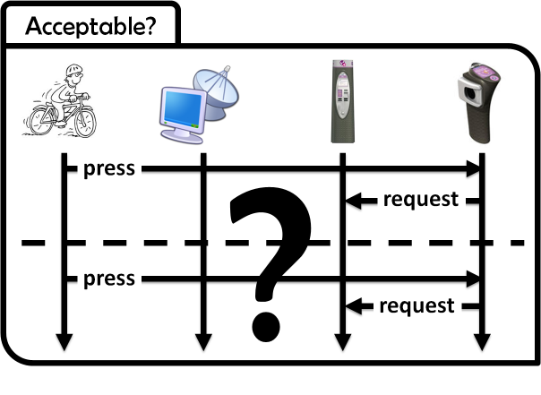
Interactive state machine induction from scenarios
QSM:
Query-driven
State Merging [Dam05, Dup08]
Notes:
Réflexion => buts!!

Slide 46
Interactive state machine induction from scenarios and goals
QSM
+ constraints
[Dam06, Dup08]

Slide 47
State machine induction from high-level scenarios
ASM:
Automaton
State
Merging
[Lam08]

Slide 48
Extra goodness: goal inference from scenarios [Dam06, Dam11]
Notes:
Règles de cohérence

Slide 49

Why are they GREAT synthesis techniques?
Effective support
for system building
Models should be adequate, consistent, complete, comprehensible, analyzable
From models to software […]

Slide 50
Input scenarios are comprehensible and easy to draw

Slide 51
Our techniques synthesize consistent state machines

Slide 52
State machines are analyzable and close to the source code
From models to software […]

Slide 53
Thought provoking for better adequacy and completeness

Slide 54
Knowing why makes you a much smarter software engineer

Slide 55
Synthesized state machines are consistent with known goals

Slide 56
The Operational changes, the Intentional stays

Slide 57
Scenario questions are thought provoking
?
Some examples…

Slide 58
What if the cyclist makes a second request?
Subscribing and identification
?
Pickup
Acceptable?
press
request
Notes:
Attention => même point d’attache

Slide 59
No bicycle here!
Subscribing and identification
Pickup
Acceptable?
press
X
request
beeeeeeeep

Slide 60
Keep it simple !!
Avoid[ Requesting When Free ]
…
Acceptable?
press
X
request
beeeeeeeep

Slide 61
Subscribing and identification
Pickup
press
?
request
unlock
press
request
unlock
Notes:
On ne prend pas le vélo
Deux interprétations

Slide 62
May the software unlock a bicycle twice?
Subscribing and identification
Pickup
press
?
request
unlock
press
request
unlock

Slide 63
No, it does not make sense!
Subscribing and identification
Pickup
Unlocking => Locked
press
request
unlock
press
request
X
unlock

Slide 64
May the cyclist unlock two bicycles?
Subscribing and identification
Pickup
press
request
?
unlock
press
request
unlock
Notes:
On ne prend pas le vélo

Slide 65
No !
Subscribing and identification
Pickup
press
request
unlock
press
request
lock
unlock

Slide 66
Alternative: Yes !
Subscribing and identification
Pickup
press
request
unlock
press
request
unlock

Slide 67
Ok, what if?
Subscribing and identification
Pickup
press
request
unlock
pickup
released
press
request
unlock

Slide 68
Beware of conflicts!
Unlocking => Cyclist Logged
Log out the cyclist immediately after a bicycle is taken
The cyclist is logged
request
unlock
released
The cyclist is no longer logged
request
X
unlock

Slide 69
Conclusion
Notes:
Anecdote

Slide 70
Why not this design?
Pickup
Subscribing and identification […]
request bicycle 5
unlock 5
pickup

Slide 71
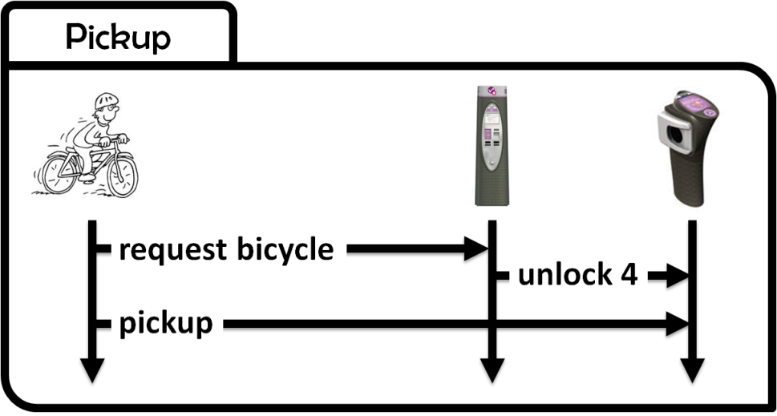

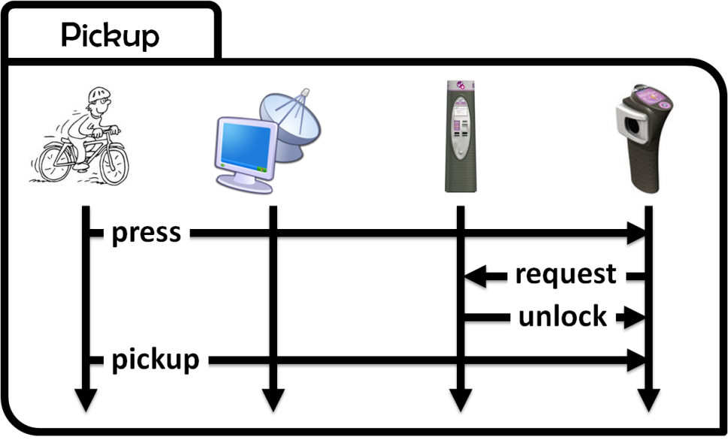
Models play a significant role for identifying requirements and exploring designs of software systems
Notes:
3 conceptions

Slide 72
The Operational changes, the Intentional stays
Avoid[ Free and Locked ]
Unlocking => Cyclist Logged
Avoid[Stolen Bicycles]
Avoid[Hijacked Accounts]
Unlocking => Locked

Slide 73
Goals are a safety belt for the next modeling iteration

Slide 74
?

Slide 75
How do you feel ?
About the models
You are confused about the different models and their relationships
About the target system
You forgot some features in the first place
You think about some features I haven’t considered
You agree with some of the features but disagree with others
You are confused about the system and what should be done now

Slide 76
Keep calm !
?
The hardest part of software development is determining what the system should do [Bro87]

Slide 77
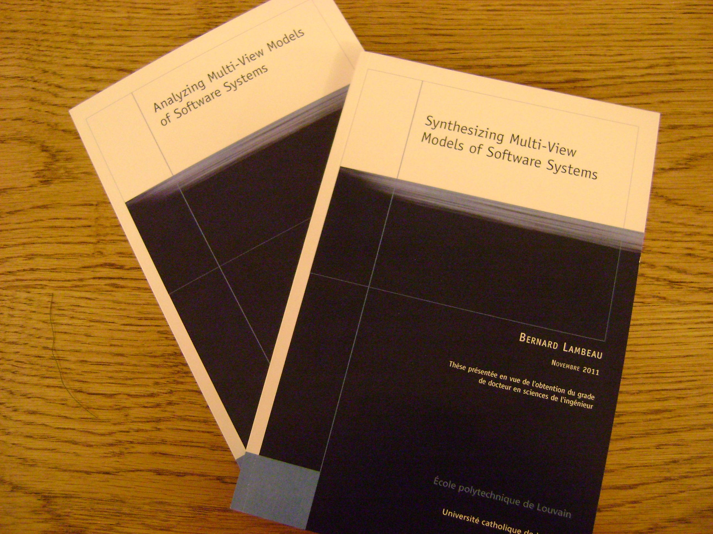
But there is support for this !

Slide 78
Thank you !

Slide 79
References
[Avl09] A. van Lamsweerde, Requirements Engineering: From System Goals to UML Models to Software Specifications. Wiley, March 2009.
[Bro87] F.P. Brooks, No silver bullet: Essence and accidents of software engineering. IEEE Computer, 20(4):10-19, April 1987.
[Dam05] C. Damas, B. Lambeau, P. Dupont and A. van Lamsweerde, Generating annotated behavior models from end-user scenarios. IEEE Transactions on Software Engineering, 31(12):1056-1073, 2005.
[Dam06] C. Damas, B. Lambeau and A. van Lamsweerde, Scenarios, goals, and state machines: a win-win partnership for model synthesis. In International ACM Symposium on the Foundations of Software Engineering, pages 197{207, Portland, Oregon, November 2006.
[Dam11] C. Damas, Analyzing Multi-View Models of Software Systems, PhD thesis, Université catholique de Louvain, Louvain-la-Neuve, 2011.
[Dup08] P. Dupont, B. Lambeau, C. Damas and A. van Lamsweerde, The QSM algorithm and its application to software behavior model induction. Applied Artificial Intelligence, 22:77-115, 2008.
[Fea87] M.S. Feather, Language support for the specification and development of composite systems. ACM Transactions on Programming Languages and Systems, 9:198-234, March 1987.

Slide 80
References
[Fin92] A. Finkelstein, J. Kramer, B. Nuseibeh, A. Finkelstein and M. Goedicke, Viewpoints: A Framework for Integrating Multiple Perspectives in System Development. 2:31-57+, 1992.
[Hoa85] C.A.R. Hoare, Communicating Sequential Processes, Prentice Hall International Series in Computing Science, Prentice Hall, April 1985.
[Lam08] B. Lambeau, C. Damas and P. Dupont, State-merging dfa induction algorithms with mandatory merge constraints. In ICGI'08: Proceedings of the 9th international colloquium on Grammatical Inference, pages 139{153, Berlin, Heidelberg, 2008. Springer-Verlag.
[Mil89] R. Milner, Communication and concurrency, Prentice-Hall, Inc., Upper Saddle River, NJ, USA, 1989.
[Mag99] J. Magee and J. Kramer. Concurrency: State Models and Java Programs, Wiley, 1999.
[Onc92] J. Oncina and P. Garcia, Inferring regular languages in polynomial update time. In N. Pierez de la Blanca, A. Sanfeliu, and E.Vidal, editors, Pattern Recognition and Image Analysis, volume 1 of Series in Machine Perception and Artificial Intelligence, pages 49-61. World Scientific, Singapore, 1992.

