Slide 1
Driver
Controller
Actuators
Passenger
start
motor on
alarm pressed
motor off
open doors

Slide 2
AlarmPressedDuringTrainRide
Driver
Controller
Actuators
Passenger
StationToStation TrainRide
AlarmPressed DuringTrainRide
start
motor on
BackToStationAfter Emergency
alarm pressed
motor off
open doors

Slide 3
AlarmPressedOutsideStation
C₀ = ¬at_station ∧ doors_closed
AlarmPressed
[moving]
[¬ moving]
StopTrain InEmergency
OpenDoors
BackToStationAfter Emergency

Slide 4
AlarmPressed_{start}
...
AlarmPressed_{end}
AlarmPressed
moving?
yes
no
StopTrain InEmergency
OpenDoors

Slide 5
AlarmPressed
moving?
yes
no
[moving]
StopTrain InEmergency
OpenDoors
[¬ moving]

Slide 6
AlarmPressed_{start}
...
AlarmPressed_{end}
AlarmPressed
τ
moving?
yes
no
[moving]
StopTrain InEmergency
OpenDoors
[¬ moving]

Slide 7
alarm pressed
[moving]
stop
[¬ moving]
open doors

Slide 8
sparsity of the training sample
100% 50% 25% 12.5%
2
5
10
20
50
1-5 6-10 ... ...
alphabet size
96-100

Slide 9
sparsity of the training sample
100% 50% 25% 12.5%
2
5
10
20
50
Equipo 0.67 0.66
DFASAT 0.60 0.51
DFASAT 0.50 0.50
DFASAT 0.54 0.50
DFASAT DFASAT 0.57 0.50
Broken
alphabet size
At least one problem broken
No problem broken
96-100

Slide 10
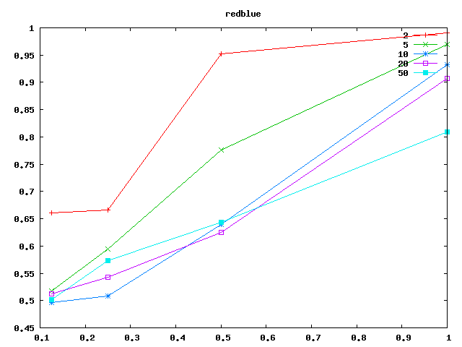
sparsity of the training sample
100% 50% 25% 12.5%
2
5
10
20
50
0.989 0.95 0.67 0.66
0.96 0.77 0.60 0.51
0.93 0.64 0.50 0.50
0.90 0.63 0.54 0.50
0.80 0.64 0.57 0.50
alphabet size

Slide 11
sparsity of the training sample
100% 50% 25% 12.5%
2
5
10
20
50
0.99 0.98 0.78 0.66
0.99 0.96
0.99 0.97
0.99 0.98
0.99 0.99 0.96
alphabet size

