Slide 1
Synthesizing Multi-View Models of Software Systems
Lambeau Bernard
ICTeam institute
Université catholique de Louvain
March 2011

Slide 2
Introduction
Why Modeling Software Systems ?
Elaborating requirements and exploring system design [Avl09]
Reasoning about, verifying and documenting systems
Generating code, prototypes, ...
Difficult for complex systems
How to check adequacy / correctness of big models ?
How to ensure consistency among multiple views ?
Need for tool-supported techniques
To build software models
To check them

Slide 3
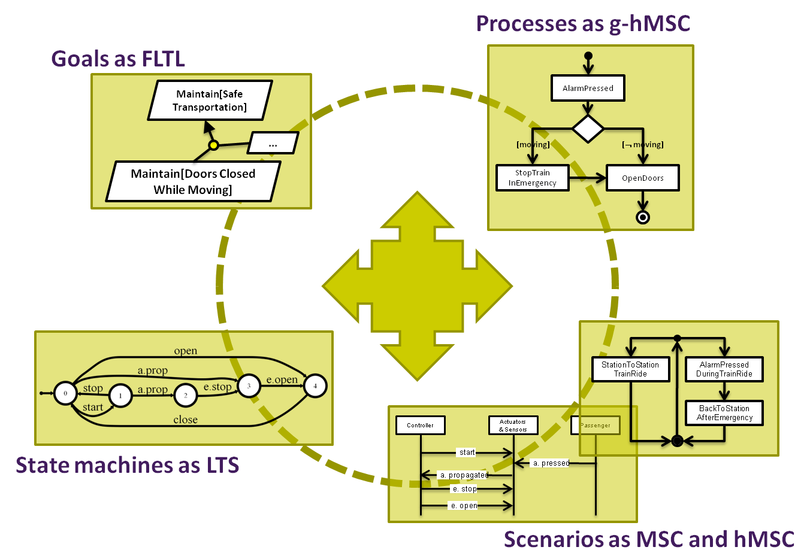
Multi-View Modeling
Different models have complementary focusses
single agent vs. multi agent
declarative vs. operational
partial vs. exhaustive coverage
Inter-model consistency rules
Consistent usage of models and their intent
Can be enforced through formal semantics
Multi-View formal frameworks
Offer model building and checking opportunities
Only a few available in practice

Slide 4
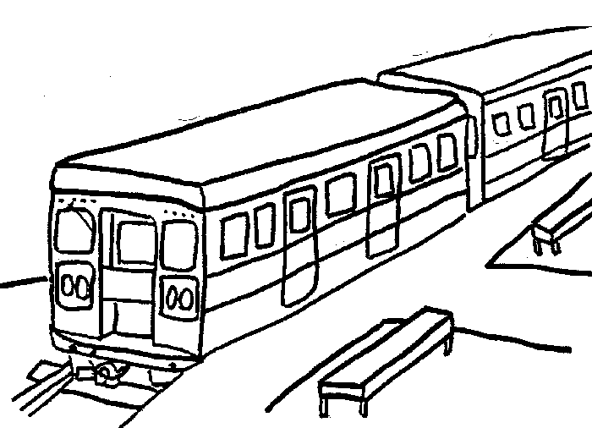
Running Example The Little Train System
Introduction
The system is composed of three agents
a train controller,
a train actuator/sensor,
and passengers
The train controller controls operations such as start, stop, open doors, and close doors
A safety goal requires train doors to remain closed while the train is moving
If the train is not moving and a passenger presses the alarm button, the controller must open the doors in emergency.
When the train is moving and the passenger presses the alarm button, the controller must stop the train first and then open the doors in emergency.

Slide 5
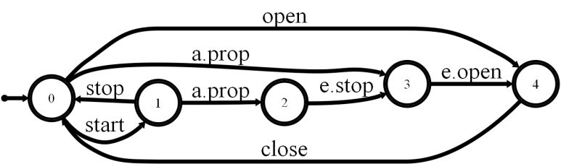
Multi-View Models Example: a Golden Triangle
Introduction
Scenarios
Interactions between the software-to-be and environment agents
Multi-agent, Operational
State machines
Classes of agent behaviors in terms of states & events firing transitions
Single-agent, Operational
Goals
Prescriptive statements of intent whose satisfaction requires cooperation among all agents
Single & Multi-agent, Declarative
Controller
Actuators & Sensors
Passenger
start
a. pressed
a. propagated
e. stop
e. open
Maintain[Safe Transportation]
Maintain[Doors Closed While Moving]
...

Slide 6
Multi-View Models Scenarios & State machine synergies
Introduction
A scenario defines
a path in each local state machine of corresponding agents
a path in the state machine of the composed system
Enforced in [Uch03]
Scenarios as Message Sequence Charts (MSC)
State machines as Labeled Transition Systems (LTS)
LTS Composition operator, as in [Mag99]
Controller
Actuators & Sensors
Passenger
start
a. pressed
a. propagated
e. stop
e. open

Slide 7
Multi-View Models Analysis vs. Synthesis opportunities
Introduction
Analysis of Multi-View Models
Detect violations of inter-consistency rules
Formal semantics used to precisely define these inter-consistency rules and check them on model artifacts
Example: model checking
Given formal semantics, check that traces admitted by state machines respect stated goals
Synthesizing Multi-View Models
Synthesize new models artifacts from existings ones
Formal semantics used to automate the synthesis process from precise inter-consistency rules
Example: controller synthesis
Given a set of scenarios, derive state machines so that semantics is preserved

Slide 8
Thesis overview Focus on model synthesis
Multi-View formal modeling framework (chapter 2)
Scenarios, State machines, Processes & Goals
Event-based & State-based abstractions
Overview of existing semantic links & synthesis techniques
New synthesis bricks (chapters 3 & 4)
From processes (g-hMSC) to state machines (LTS)
a step towards analyzable process models
From scenarios (hMSC) to state machines (LTS)
behavior generalization via grammar induction
under user supervision & control of other models (e.g. goals)
Evaluation & Tool Support (chapters 5 & 6)
Both case studies & synthetic data

Slide 9
Today A quick digression
Available slides
Deep technical details for almost all chapters
Only if required !?
Progress report: what was requested last time ?
Stamina contest - Done
Gisele tool support - Done
What would help me
Is the overal message clear (multi-model synthesis) ?
Shouldn't we move specific parts (see later) ?
How much about Stamina & Gisele tool support ?

Slide 10
A Multi-View Modeling Framework i.e. Chapter 2
Processes as g-hMSC
Goals as FLTL
Maintain[Safe Transportation]
AlarmPressed
...
[moving]
[¬ moving]
Maintain[Doors Closed While Moving]
StopTrain InEmergency
OpenDoors
StationToStation TrainRide
AlarmPressed DuringTrainRide
BackToStation AfterEmergency
Controller
Actuators & Sensors
Passenger
State machines as LTS
start
a. propagated
a. pressed
e. stop
e. open
Scenarios as MSC and hMSC

Slide 11
Scenarios as Message Sequence Charts (MSC)
Framework
Sequences of interactions between the software-to-be and agents in the environment
Positive & Negative
Pro & Cons
Informal description easily given by stakeholders
Effective means for elicitating software requirements
Partial
Leave required properties about the intended system implicit
Positive MSC
Controller
Actuators & Sensors
Passenger
start
a. pressed
a. propagated
e. stop
e. open
Negative MSC
Controller
Actuators & Sensors
Passenger
start
x
open

Slide 12
Scenarios Flowcharting with high-level MSC (hMSC)
Framework
Controller
Actuators & Sensors
Passenger
StationToStation TrainRide
AlarmPressed DuringTrainRide
start
a. pressed
a. propagated
BackToStation AfterEmergency
e. stop
e. open
Advantages
Reuse scenarios within a specification
Control information: sequence, loops, alternatives, ...

Slide 13
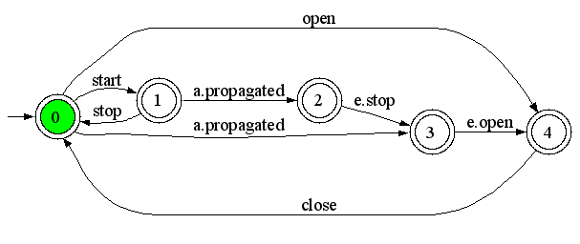
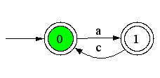
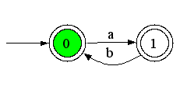
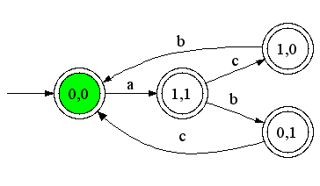
State Machines as Labelled Transition Systems (LTS)
Framework
A system is modeled as a set of LTS, one per agent
Pro & Cons
Visual abstraction of system behavior
Executable
Rich opportunities for analysis and code generation
Hard to build
The system can be modeled as the composition of agent behaviors [Mag99]
Each agent behaves asynchronously but synchronizes on shared events
composition operator ||
Train Controller LTS
Composition operator ∥
P
Q
⇓
P || Q

Slide 14
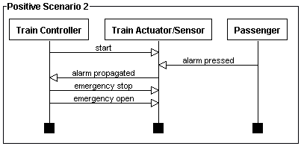
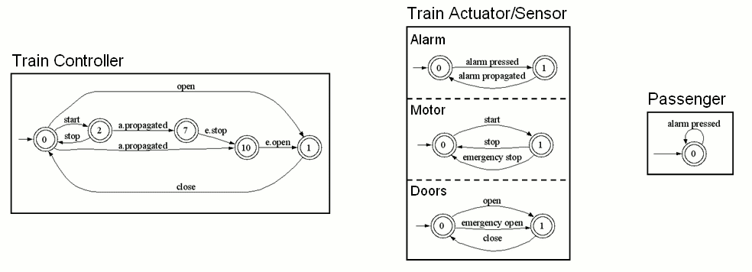
MSC & LTS Semantics
Framework
A scenario defines
a path in each local state machine of corresponding agents
a path in the state machine of the composed system
Semantics [Uch03]
In terms of composition operator ||
Extended to h-MSC, synthesis algorithm available
Semantics from [Uch03]
||
||

Slide 15
State variables as Fluents
Framework
Agent state variables are modeled with fluents
fluent F = <I_{Fl},T_{Fl}> initially Initially_{Fl}
I_{Fl} is a set of initiating events
T_{Fl} a set of terminating events
Initially_{Fl} (boolean) is the initial value of F
A fluent is
monitored by an agent if it “monitors” or performs all initiating and terminating events
controlled by an if it performs all initiating and terminating events
fluent examples
fluent moving = < {start},
{stop, emergency stop} >
initially false
start
stop, e.stop
moving
fluent doorsClosed = <
{close doors},
{open doors, emergency open} >
initially true
open doors, e.open
close doors
doorsClosed

Slide 16
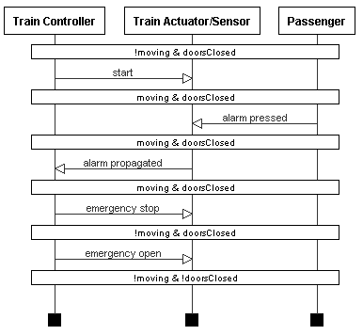
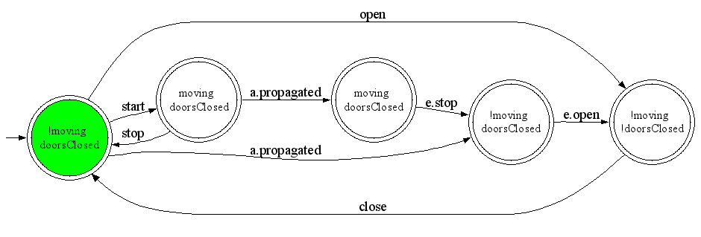
Decorations on behavior models
Framework
Decorated Scenario
Fluents can be used to decorate scenarios and state machines with state assertions [Dam05]
Extension to other kinds of decorations in [Dam10]
Used for analysing medical models with respect to cost, time & dosage constraints
Train Controller Decorated LTS

Slide 17
Process models Introducing guarded hMSC (g-hMSC)
Framework
hMSC + decision nodes
Outgoing transitions guarded with boolean conditions on fluents
Initial state
Relaxes the assumption of an initial value being known for each fluent
Initial state may be constrainted with an initial condition C₀
Semantics & Synthesis defined in chapter 3
C₀ = ¬ atStation ∧ doorsClosed
AlarmPressed
moving ?
yes
no
StopTrain InEmergency
OpenDoors
BackToStationAfter Emergency

Slide 18
Goals as Fluent Linear Temporal Logic (FLTL)
Framework
Goals are objectives that the system should achieve through cooperation of agents [Avl09]
Pro & Cons
recognized paradigm for eliciting, elaborating, structuring, specifying, analyzing, and modifying software requirements
Sometimes too abstract
Hard to formalize for end-user
Maintain[Doors Closed While Moving]
Def: The train should always move with doors closed
FormalDef: □(moving → doorsClosed)
Maintain[Safe Transportation]
...
Maintain[Doors Closed While Moving]

Slide 19
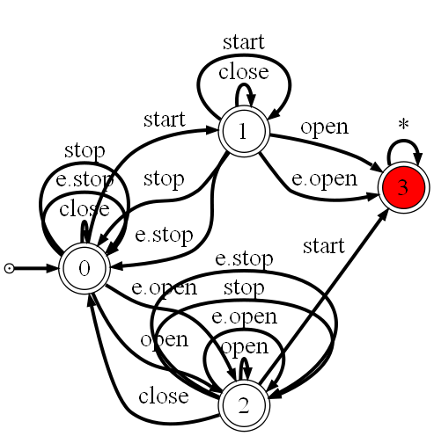
Goals and LTS Synthesis & Semantics
Framework
Goals in FLTL
A goal declaratively define a set of histories to be accepted and/or rejected by the system
A state machine typically captures a set of system histories
Available synthesis techniques
A Tester LTS capturing event traces violating a FLTL safety property can be synthesized using [Gia03]
Also, a Property LTS capturing event traces NOT violating it [Let08]
Maintain[Safe Transportation]
...
Maintain[Doors Closed While Moving]
[Gia03, Let08]
Tester LTS

Slide 20
From g-hMSC to LTS Chapter 3
Processes as g-hMSC
What is the set of event traces admitted by a guarded hMSC ?
AlarmPressed
[moving]
[¬ moving]
StopTrain InEmergency
OpenDoors
State machines as LTS

Slide 21
From g-hMSC to LTS Problem Statement
Guarded hMSC
What is the set of admissible event traces of a guarded hMSC ?
Needed for
Precising model semantics
Trace based model-checking (LTSA)
Decoration-driven model analysis [Dam10]
Roundtrip ?
Support friendly analysis feedback
C₀=...
AlarmPressed
moving ?
yes
no
StopTrain InEmergency
OpenDoors
?
LTS, set of event traces

Slide 22
From g-hMSC to LTS Solution overview
Guarded hMSC
Guarded LTS
Guards or events on transitions
C₀ condition, as in g-hMSC
Structured form of LTS avoiding state explosion
Synthesis sub bricks
From g-hMSC to g-LTS
From g-LTS to pure LTS
C₀=...
AlarmPressed
moving ?
yes
no
StopTrain InEmergency
OpenDoors
1
LTS, set of event traces
Guarded LTS, intermediate level
2
alarm pressed
[moving]
stop
[¬ moving]
open doors

Slide 23
From g-hMSC to g-LTS Synthesis algorithm
1
Bricks connected with unobservable τ transitions
Extension of [Uch03] from h-MSC to LTS
Introduction of start and end events to support more accurate fluent definitions
Mapping preserved for feedback of g-LTS-driven analysis
AlarmPressed_{start}
...
AlarmPressed_{end}
AlarmPressed
τ
moving ?
yes
no
[moving]
StopTrain InEmergency
OpenDoors
[¬ moving]

Slide 24
From g-LTS to pure LTS Declarative trace semantics
2
A trace (Init, <l₀,…>) is accepted from state q₀ by a guarded LTS (Q,Σ,Φ,δ,q₀,C₀) iff for every i:
trace inclusion
∃ q_{i+1} ∈ Q : (q_{i}, l_{i}, q_{i+1}) ∈ δ
admissible start
Init |= C₀
guard satisfaction
S_{i} |= l_{i} if l_{i} ∈ 2^{Φ}
S_{i} : state invariant after i-th event in trace (S₀ = Init)

Slide 25
From g-LTS to pure LTS Synthesis algorithm
2
Provides the set of event traces of a g-LTS
No roundtrip, no state mapping preserved
Allows model-checking g-hMSC and g-LTS against LTL safety properties
Algorithm for composing multiple automata
Super LTS
guarded LTS where guards are replaced by special events
to meet the trace inclusion condition
Initializer LTS
to meet the admissible start condition
Fluent LTS (one per fluent)
to meet the guard satisfaction condition

Slide 26
From MSC and hMSC to LTS Chapter 4
How to generalize a set of MSC scenarios as LTS state machines?
StationToStation TrainRide
AlarmPressed DuringTrainRide
BackToStation AfterEmergency
Controller
Actuators & Sensors
Passenger
State machines as LTS
start
a. propagated
a. pressed
e. stop
e. open
Scenarios as MSC and hMSC

Slide 27
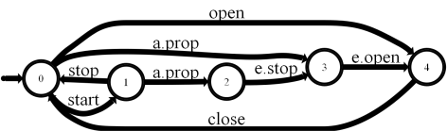


From MSC to LTS Problem statement
Inductive LTS synthesis
Given a scenario collection S_{c}=(S₊,S–) showing typical examples of the system usage, synthesize the system as a composition of agent LTS
S = A_{lts1} || … || A_{ltsn}
such that it correctly accepts S₊ and rejects S–
Positive & Negative MSCs
Controller
Actuators & Sensors
Passenger
start
a. pressed
a. propagated
e. stop
e. open
?
Agent LTS

Slide 28
Synthesis requirements
Inductive LTS synthesis
Because of end-user involvement, the solution should work
From end-user positive and negative scenarios …
… and scenarios only : avoid hMSC, state variables annotations, operations formalization (pre/post), etc.
but such additional information could/should be used when available
Initial scenario collection being incomplete, the approach
should support the elicitation of additional, “interesting” positive/negative scenarios
should be incremental : the models should be incrementally refinable as further scenarios become available

Slide 29
Solution overview
Inductive LTS synthesis
Positive & Negative MSCs
Generalization
Interactive automaton induction
Guided by generated scenario questions classified as positive or negative by the end-user
Query-Driven State Merging (QSM)
Constrained by additional state information when available (state variables, legacy components, goals, etc.)
Decomposition
Standard automaton algorithms (ε-moves, determinization, minimization)
Controller
Actuators & Sensors
Passenger
start
a. pressed
a. propagated
e. stop
e. open
System LTS
Generalization
Agent LTS
Decomposition
C. Damas, B. Lambeau, P. Dupont and A. van Lamsweerde, Generating Annotated Behavior Models from End-User Scenarios, IEEE Transactions on Software Engineering, Special Issue on Interaction and State-based Modeling, Vol. 31, No. 12, pp. 1056-1073, 2005 .

Slide 30
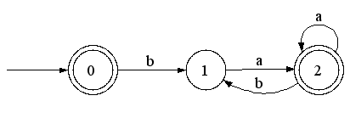
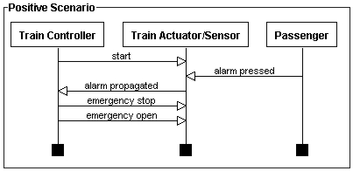
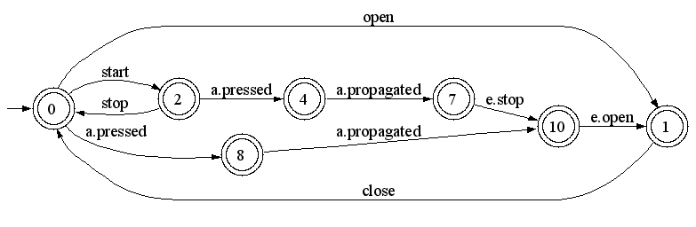
From grammar induction to LTS synthesis
Inductive LTS synthesis
Grammar induction
Learning a regular language L=(ba*a)*
Represented by a DFA
From positive and negative strings
S₊ = {ba,baa,baba,λ} and S– = {bb}
Regular Positive and Negative Inference (RPNI + variants)
LTS Synthesis
Learning a System
Represented by a LTS (a DFA)
From positive and negative scenarios
Grammar induction
Language sample
S₊ = {ba,baa,baba,λ} S– = {bb}
RPNI
L=(ba*a)*
Inductive LTS Synthesis
Sc=(S₊,S–)
RPNI
Syntesized LTS

Slide 31
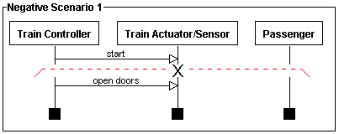
Scenarios as strings
Inductive LTS synthesis
The system LTS represents the learned language L
Scenarios are observed strings on L
LTS contains only accepting states
A positive scenario defines a set of positive strings
A negative scenario defines a set of positive strings and one negative string
System LTS
1
2
3
4
5
1
2

Slide 32
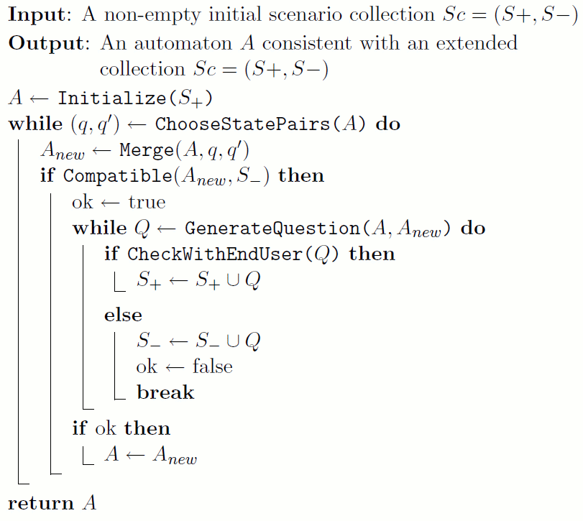
Query-Driven State Merging (QSM)
Inductive synthesis
1. Build an initial solution A
2. Generalize A → A_{new}
3. With user involvement
4. Keep it when correct
A_{new} → A
5. Return synthesized system

Slide 33
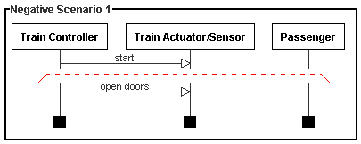
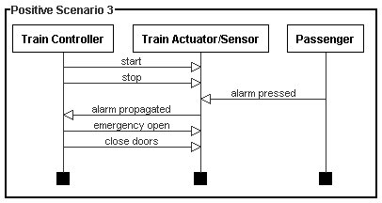
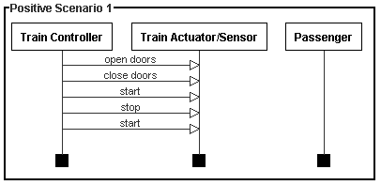
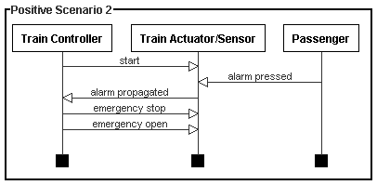
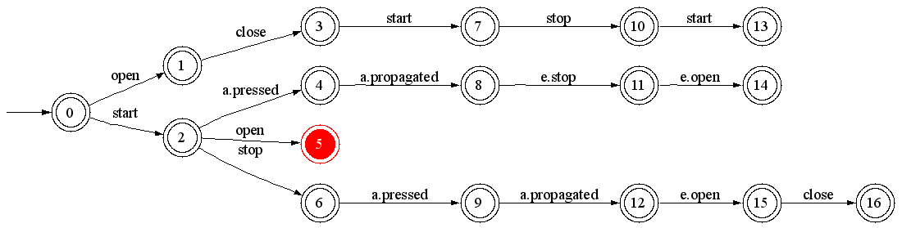
Initial solution, the PTA
Inductive synthesis
Prefix Tree Acceptor (PTA)
Largest DFA accepting S₊ while rejecting S–
No generalization of observed behaviors
Red states are error states
Prefix Tree Acceptor of the Train System

Slide 34
Generalization - merge
Inductive synthesis
q
q’
Consider merging of q=3 with q’=0

Slide 35
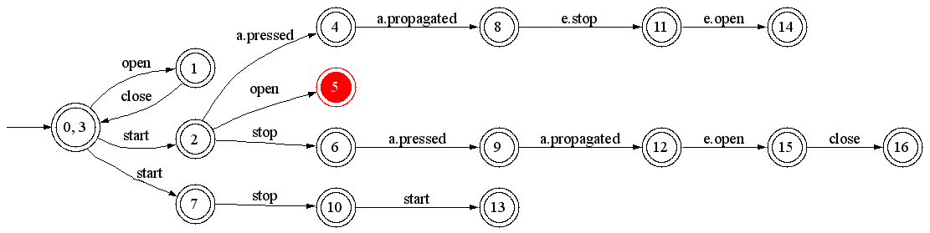
Generalization - determinize
Inductive synthesis
State 0 contains two outgoing transitions labeled « start »
merge 7 and 2 for determinization

Slide 36
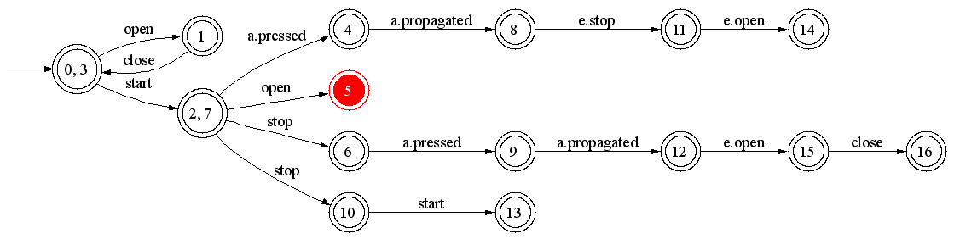
Generalization - determinize
Inductive synthesis
State 2 contains two outgoing transitions labeled « stop »
merge 10 and 6 for determinization

Slide 37
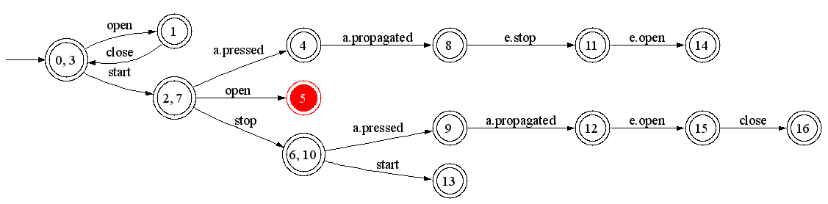
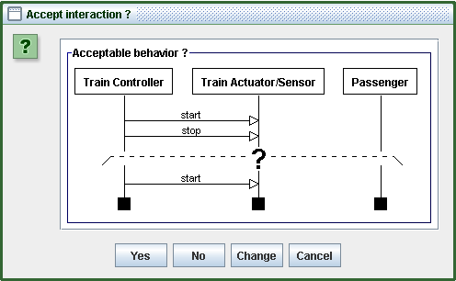
Generalization - questions
Inductive synthesis
prefix
suffix(es)
State 6 gains an outgoing transition labeled “start”
Leads to generated scenario questions
Used prefix is the shortest history leading to state 6
Suffixes are the gained continuations of 6 (only one here)
prefix
suffix

Slide 38
Generated scenarios
Inductive synthesis
Generated scenarios are
Classified by the user as positive or negative examples
Added to the initial scenario collection S_{c}=(S₊,S–)
Generation procedure
Constraints the generalization process with scenarios only
Relies on sound results from grammar induction
Notion of characteristic sample
Provides the elicitation of additional, “interesting” positive/negative scenarios

Slide 39
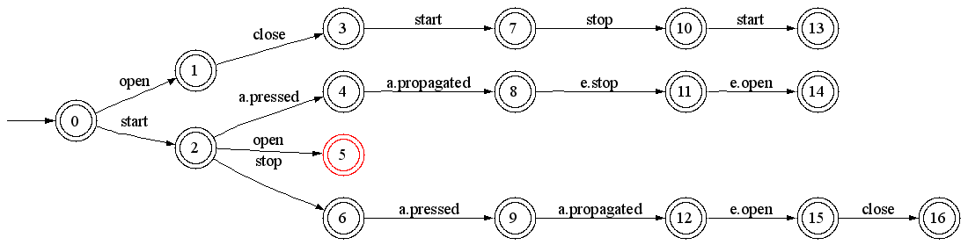
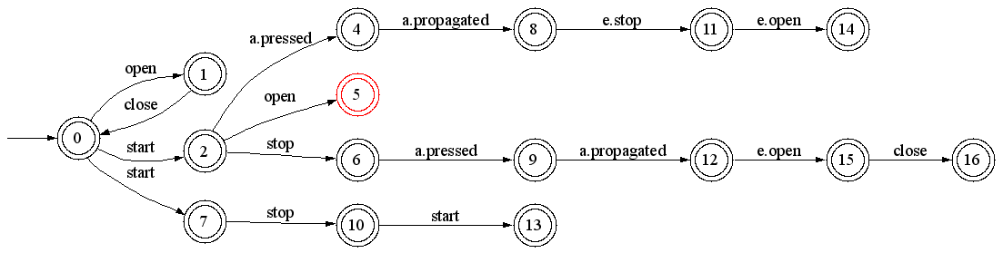
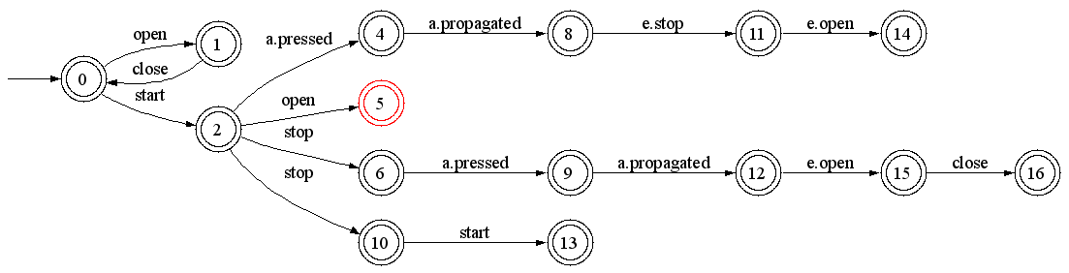
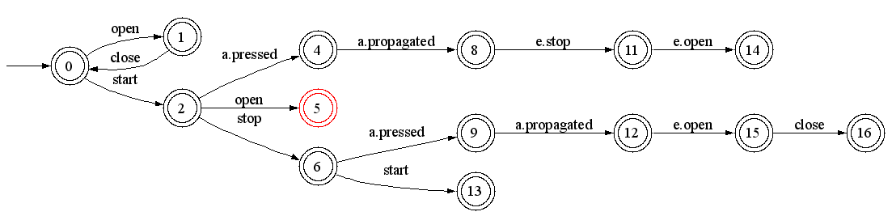
Intermediate solution
Inductive synthesis
States q=3 with q’=0 are merged, and stay merged forever (A ← A_{new}), if
The merging and determinization process does not lead to merge an error state with a non error one
All generated questions are classified as positive scenarios by the user
Otherwise, the solution A_{new} is discarded
The algorithm continues, choosing another merging pair (q, q’), until no pair is available
RPNI step
A
merge
determinize
A_{new}
determinize

Slide 40
Order of state pair selection
Inductive synthesis
RPNI considers state pairs in order
for each state q with rank i
for each state q’ with rank j<i
QSM relies on the Blue-Fringe heuristics
Evidence-driven state merging
Evaluate candidate state pair and choose the best one
Reduces the number of submitted questions in practice

Slide 41
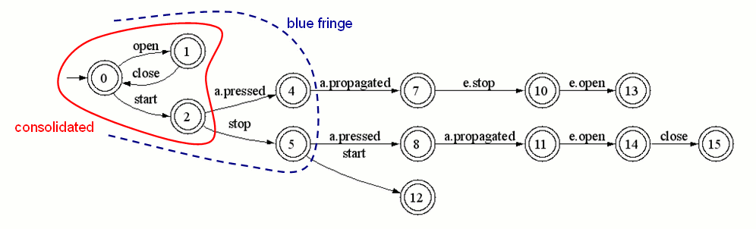
Evidence-driven merging
Inductive synthesis
Consider an intermediate solution A
Kernel states have been shown to be incompatible with each other
Fringe states are situated at one letter of a kernel state
RPNI tries to merge a fringe state with a kernel one, in standard order
questions here : (4,0) ; (4,1) ; (4,2) rejected ; (5,0) accepted
Blue-Fringe extension selects pairs (fringe,kernel) according to an evidence evaluation function, based on shared continuations
questions here : (5,2) rejected, (5,0) accepted
3 questions only on the entire train example (2 accepted and 1 rejected)

Slide 42
Pruning the search space
Inductive synthesis
Risk of poor generalization
Without questions (if no user available)
Due to high importance of negative scenarios (non intuitive in the first place)
Too many questions, often rejected
On the train example : 20 questions (3 to be accepted and 17 to be rejected)
=> Use available information to prune the search space
State information (e.g. fluents decorations)
Goals (safety properties in particular)
Control information (sequence, loops, ... from h-MSC)

Slide 43
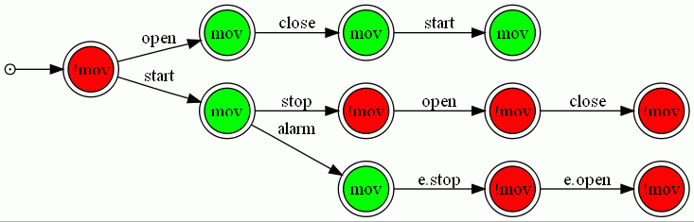
Pruning with fluent decorations
Inductive synthesis
A PTA can be decorated using available fluent definitions
fluent mov(ing) = <{start}, {stop, e.stop}> initially false
Induction can be constrained …
Avoid merging states with inconsistent decorations
e.g. avoid merging a state where the train is moving with another state where the train is not moving !

Slide 44
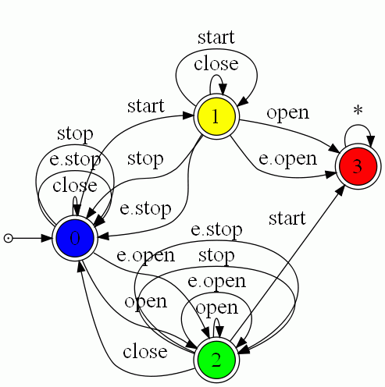
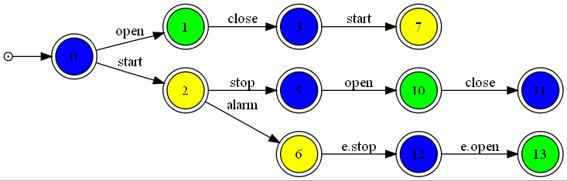
Pruning with goals
Inductive synthesis
Tester LTS for the safety property [Gia03]
Color PTA states with corresponding states
Avoid merging PTA states of different color
Enforces multi-model consistency by construction
Maintain[Doors Closed While Moving]

Slide 45
Pruning with control information
Inductive synthesis
What if PTA states are known to be equivalent ?
mandatory merge constraints
counterpart of state coloring
Alternatively, how to use a h-MSC instead of set of MSCs as input ?
Relax assumption of MSCs starting in same state
Allow using sequence, loops, ...
hMSC
StationToStation TrainRide
AlarmPressed DuringTrainRide
BackToStation AfterEmergency
?
Agent LTS

Slide 46
Pruning with control information The Uch03 + ASM approach
Automaton State Merging (ASM)
Generalizes a DFA under control of a negative sample (not shown)
No oracle / user query support
But still compatible with previous pruning methods
Also MSM & ASM* algorithms
hMSC
StationToStation TrainRide
AlarmPressed DuringTrainRide
BackToStation AfterEmergency
Equivalent LTS
Using [Uch03]
ASM
Agent LTS
Generalized LTS

Slide 47
Evaluation Chapter 5
How do the approach(es) perform
On RE case studies ?
On synthetic data ?
StationToStation TrainRide
AlarmPressed DuringTrainRide
BackToStation AfterEmergency
Controller
Actuators & Sensors
Passenger
State machines as LTS
start
a. propagated
a. pressed
e. stop
e. open
Scenarios as MSC and hMSC

Slide 48
RE case studies
Guarded hMSC → LTS
Medical case-studies can be found in [Dam09, Dam11]
Technique implicitely used by the model-checker (see tool support)
LTS Induction evaluated on three case studies
Small & medium sizes (mine pump, train, phone)
Blue-Fringe strategy required in practice
To avoid large number of user queries
To reach good model accuracy
Additional state information is very useful as well
Coloring & mandatory merge constraints help reaching better accuracy

Slide 49
Synthetic data
QSM & ASM evaluated
Machines & Sample generation following the protocol of Abbadingo Contest
Different state machine sizes & sample sparsities
Comparison with RPNI & Blue-Fringe
How well do queries help (i.e. accuracy & convergence) ?
How well do mandatory merge constraints help ?
In short, all experiments confirm what is expected
Inject all state information you can have
reaching better model accuracy
with less raw data as input (i.e. sample / scenarios)
and it goes faster

Slide 50
Discussion Evaluation on synthetic data - issues
Alphabet size
Binary alphabets only; state of the art in GI evaluations
In contrast, more than 30 events is commonly observed with behavior models
State machines
No variance of state degree, as a consequence of binary alphabet
States with high in-/out degrees are commonly observed with behavior model (capturing system idle, halt, immediate response)
Samples
Randomly generated from uniform distribution of strings
Not representative of what should be generated "from the
machine", especially on large alphabets

Slide 51
The Stamina Competition
Online Regular Induction Contest
Extends former competitions, especially Abbadingo
Cross-fertilization between the machine learning and software engineering communities
Previous issues adressed
Focus on the complexity of the learning with respect to the alphabet size
Adapted generation protocol for state machines and samples to mimic features of behavior models
Not an evaluation of the thesis techniques per se
Unsupervised learning (i.e. no oracle, no queries)
No pruning with fluents, goals, control information

Slide 52
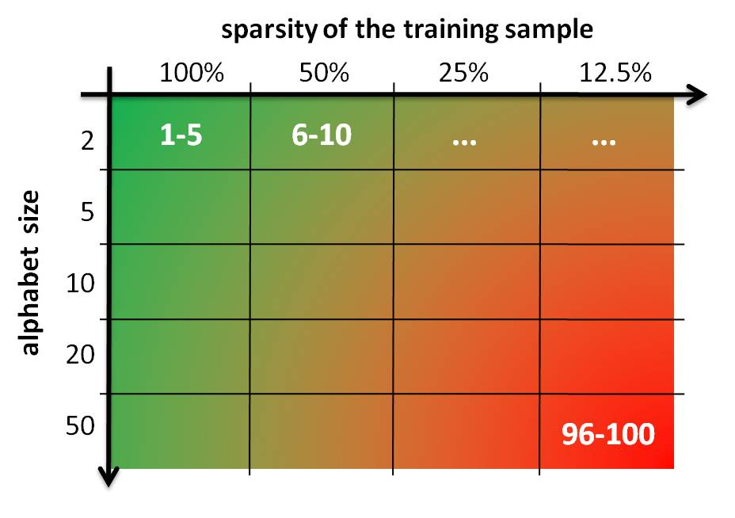
Competition overview
100 induction problems (20 cells of 5 problems)
Two difficulty dimensions
alphabet size vs. sparsity of learning sample
Solving a problem
Download learning (labeled) and test (unlabeled) samples
Learn a model (typically a DFA)
Label the test sample using learned model
Submit labeling on the competition server

Slide 53
Scientific setup State Machines
Approach
Review of SE litterature to identify representative features of behavior models
Tuning of the Forest-fire algorithm to mimic these features
Main features
Approximately 50 states (to avoid adding a third difficulty dimension to the competition)
Alphabet sizes ranging from 2 to 50 letters
Equal proportion of accepting vs. rejecting states
Large variance of degree distribution, to mimic behavior models

Slide 54
Scientific setup Samples
Controller
Actuators & Sensors
Passenger
start
a. pressed
a. propagated
e. stop
e. open
Approach
Generated by the target machine: random walk algorithm
Negative strings by randomly perturbing positive ones
three kinds of edit: substitution, insertion and deletion
Tuned to ensure good induction results using Blue-Fringe on the simplest problems
Main features
Learning and test samples do not overlap
Learning samples may contain duplicates, as a consequence of the random walk generation
String length distribution: centered on 5 + depth(automaton)

Slide 55
Scientific setup Submission & Scoring
Submission
Solutions submitted as binary strings labelling the test sample
Binary feedback (problem broken or not broken), to avoid hill-climbing
Scoring
Balanced Classification Rate to place equal emphasis on accuracy in terms of positive and negative strings
Problem broken if BCR score >= 0.99
A cell is broken if all problems it contains are broken

Slide 56
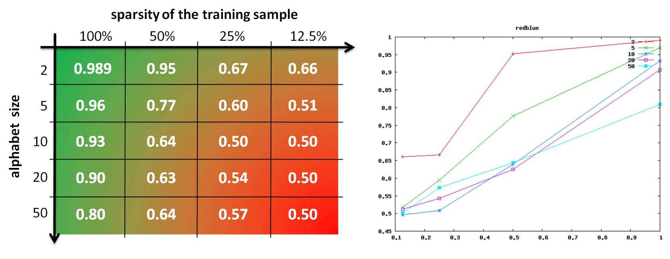
Scientific setup Baseline
Problem grid empirically ajusted
To ensure good induction results using Blue-Fringe on the simplest problems
Without breaking the cell

Slide 57
Scientific setup Baseline: lessons learned
RPNI and BlueFringe converge on largest alphabets
Theoretically expected, big samples needed in practice
Size of the alphabet "hurts" convergence in practice
Confirms experimentally what we expected theoretically
Supports the interest of launching Stamina

Slide 58
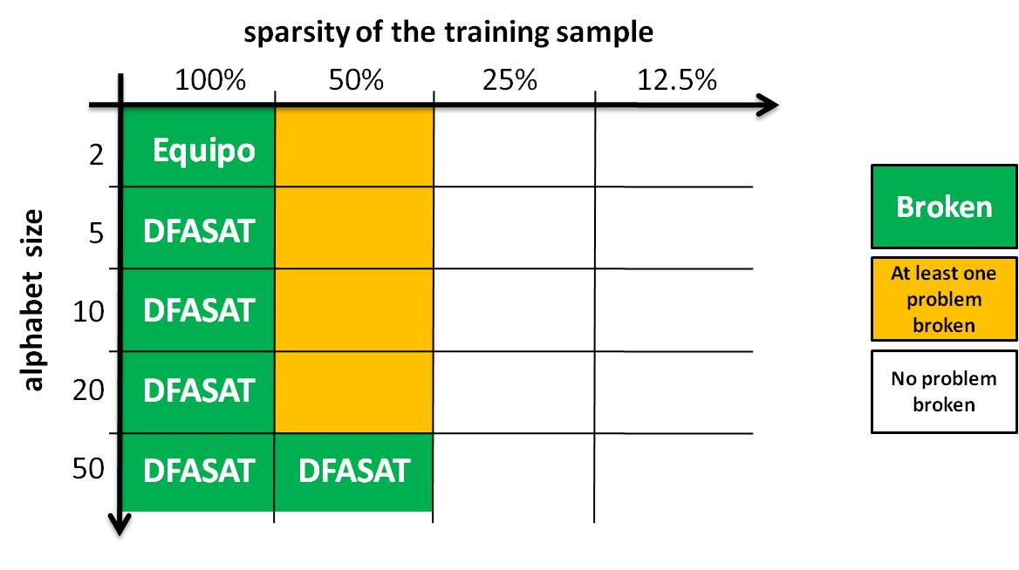
Participation overview
Between march and december 2010 (official)
1856 submissions made by 11 challengers
65 winning submissions broke 42 problems
6 cells broken, by 2 challengers (Equipo & DFASAT)

Slide 59
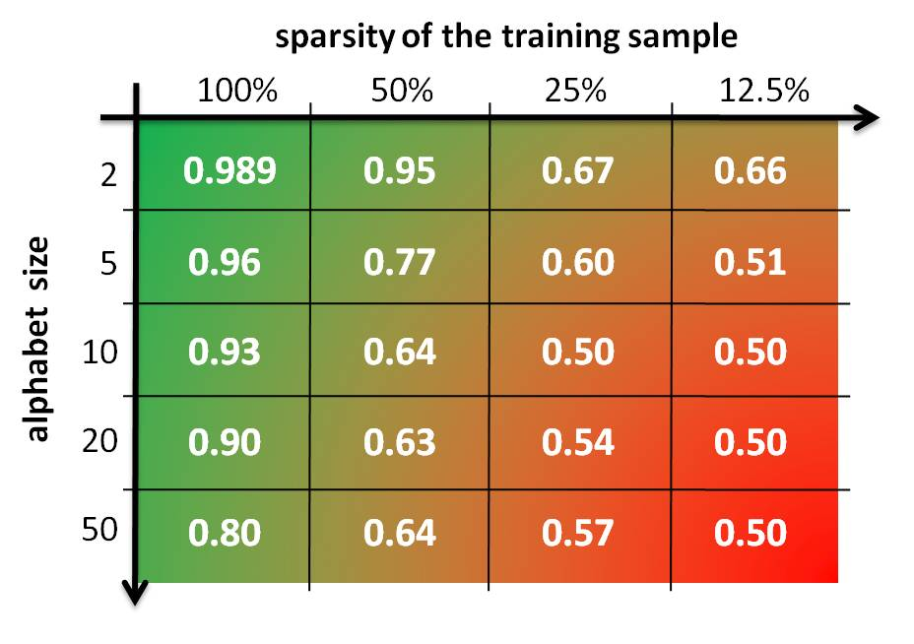
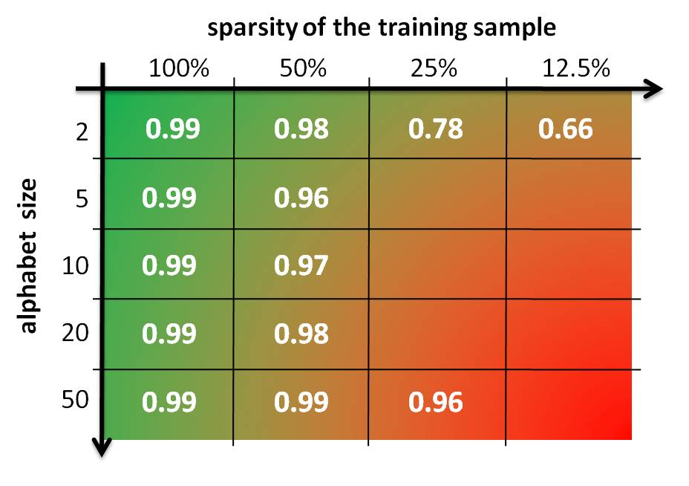
A big winner - DFASAT Marijn Heule & Sicco Verwer
Blue-Fringe
DFASAT

Slide 60
Tool Support Chapter 6
Processes as g-hMSC
A model-checker for guarded hMSC (chapter 3)
BDD-driven, efficient implementation of g-hMSC → g-LTS
AlarmPressed
[moving]
[¬ moving]
StopTrain InEmergency
OpenDoors
State machines as LTS

Slide 61
Tool Support Chapter 6
The ISIS Tool (chapter 4)
Interactive synthesis of LTS from positive & negative MSC
Under control of fluents and goals
Goals as FLTL
Maintain[Safe Transportation]
...
Maintain[Doors Closed While Moving]
Controller
Actuators & Sensors
Passenger
State machines as LTS
start
a. propagated
a. pressed
e. stop
e. open
Scenarios as MSC and hMSC

Slide 62
Tool Support Chapter 6
Processes as g-hMSC
The Gisele Clinical Pathway Analyzer
Implementation of decoration-driven model analysis (Damas thesis)
AlarmPressed
[moving]
[¬ moving]
StopTrain InEmergency
OpenDoors
State machines as LTS

Slide 63
Context & Motivation The Gisele Project
Health-care processes are safety critical
Medical errors => 98,000 deaths every year in the US, over 1 million of non-lethal injuries
E.g. wrong patient, wrong dose, wrong timing, wrong channel
Major causes
complex coordination among clinical tasks, communication problems among actors, complex decisions
Response
Clinical pathways, software support
Needed: models for analysis, error anticipation and enactment [Clarke08]

Slide 64
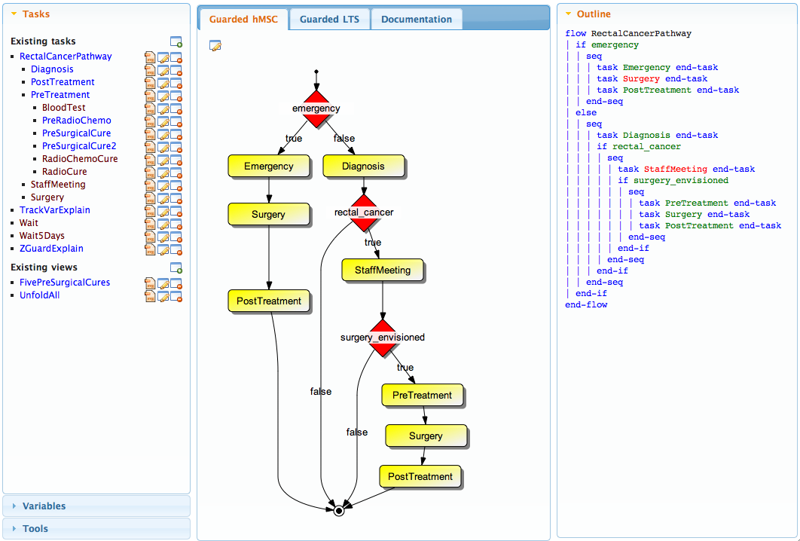
A Clinical Pathway Analyzer Tool support of the Gisele project

Slide 65
A Clinical Pathway Analyzer Tool support of the Gisele project
Variety of analyses (cf. Damas thesis)
verification of functional & non-functional requirements
state-based, event-based
Integrated within uniform formal framework and toolset
Guarded models (g-hMSC & g-LTS)
Fluents and tracking variables
Decoration-based analysis
Incremental analysis throughout model building
according to model refinement structure
early, local, stepwise on model of varying granularity

Slide 66
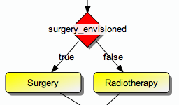

Process modeling language
Textual language
guarded commands
tasks and decisions
Graphical counterpart
guarded High-Level Message Sequence Charts (g-hMSC)
Semantics & analysis in terms of
guarded LTS (g-LTS), in turn defined by LTS (cf. chapter 3)
if surgery_envisioned
Surgery
else
Radiotherapy end

Slide 67
Discussion
Stamina
Related work or discussion in evaluation chapter ?
How far about presenting results ?
Gisele tool
Medical case-studies suddently appear...
Almost about decoration-based analysis (the other thesis)
Tool support
A quick poll: what are you interrested in?
MSM & ASM
Not interactive, no queries
Shouldn't we move it to another chapter ?

Slide 68
Thesis Outline
A Multi-View Modeling Framework
Event-based behavior models
State-based abstractions
Intentional models as goal graphs on uents
Deductive synthesis of LTS models from guarded hMSCs
From guarded hMSC to guarded LTS
From guarded LTS to pure LTS
Inductive synthesis of LTS models from MSC and hMSC models
From grammar induction to model induction
Interactive induction of LTS models from MSCs
Pruning the induction space with state information
Pruning the induction space with goals
Pruning the induction space with control information
Evaluation
...
Tool Support
...

Slide 69
C₀=...
Controller
Actuators & Sensors
Passenger
AlarmPressed
start
a. pressed
a. propagated
moving ?
e. stop
yes
no
e. open
StopTrain InEmergency
OpenDoors
StationToStation TrainRide
AlarmPressed DuringTrainRide
BackToStation AfterEmergency
Maintain[Safe Transportation]
Maintain[Doors Closed While Moving]
...

