Slide 1
Synthesizing Multi-View Models of Software Systems
Lambeau Bernard
PhD. Private Defense
ICTeam Institute
Université catholique de Louvain
October 2011

Slide 2
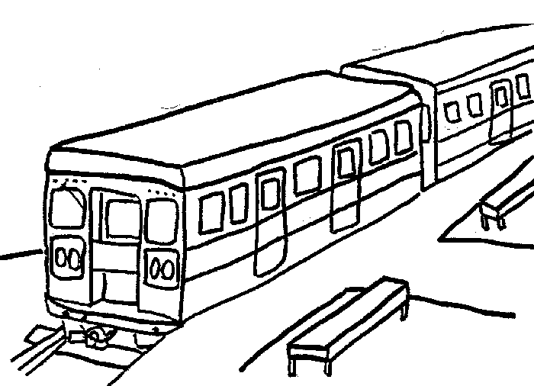
The Little Train System
The system is composed of
A train controller
A train actuator/sensor
A passenger
The train controller controls operations such as start, stop, open doors, and close doors
A safety goal requires train doors to remain closed while the train is moving
If the train is not moving and a passenger presses the alarm button, the controller must open the doors in emergency
If the train is moving and …, it must stop the train first and then open the doors in emergency

Slide 3

The Meeting Scheduler System [Fea97]
The system is composed of
A meeting initiator
Participants
An automated scheduler
Typical ideal scenario
An initiator issues a meeting request, specifying the expected participants and a date range for the meeting
The scheduler then sends an electronic invitation to each participant, requesting them to provide their date constraints
The meeting is automatically planned at a date meeting all constraints

Slide 4
Modeling Software Systems
Why ?
Elaborating requirements and exploring design
Reasoning about, verifying and documenting systems
Generating code, prototypes, etc.
Models have many advantages
Force stakeholders to be precise in their descriptions
Abstract from unnecessary details while enforcing separation of concerns
Enable the early detection and fixing of errors
Allow runtime monitoring and enactment of work processes

Slide 5
Multi-View Modeling
Different models focus on different system dimensions
Intentional: goal, rule-based models
Structural: object, agent, architecture models
Operational: task, process, workflow models
Behavioral: scenarios, state machines
Requirements on multi-view modeling languages and models
Multi-level, analyzable, adequate, complete, precise, consistent, comprehensible, …
Building high-quality models is hard
Tool-supported techniques are needed for supporting analysts and stakeholders
(Semi-)formal modeling approaches are needed here

Slide 6
Multi-view Model Synthesis
Promising approach for model building
High-quality models, especially towards increased completeness, consistency and precision
Works hand in hand with model analysis [Dam11]
Vertical model synthesis
To derive lower-level models from higher-level ones
Operational semantics from the latter and makes model checking tools available to them
Horizontal model synthesis
To build model fragments missing from a multi-view framework or complete existing ones
That is, using consistency rules the other way round

Slide 7
Vertical vs. Horizontal Model Synthesis
Abstraction level
From higher-level to lower-level models (operational sem.)
Not necessarily the case with horizontal synthesis
Lifetime of synthesized models
Shorter for vertical synthesis, e.g. limited to the analysis
Horizontal synthesis may yield requirement models and system documentation
Vertical synthesis is derivational by nature whereas horizontal synthesis may be inductive
User involvement
Models kept hidden from the user, who has a passive role
Versus models shown to (validated by) the user, who has an active role

Slide 8
Thesis Content at a Glance
Background on a multi-view modeling framework
Derivation of State Machine Models from Process Models
Vertical synthesis enabling trace-based model checking of process models (operational semantics)
Inductive Synthesis of State Machines from Scenarios
Horizontal synthesis aimed at completing model fragments in a triangle made of scenarios, state machines and goals
Evaluation and Tool support
Evaluation of inductive synthesis
On case studies and synthetic datasets
Yielding a novel evaluation protocol and an online platform
Libraries and tools
a model checker for process models, an interactive state machine synthesizer, and a process model analyzer

Slide 9
Thesis Content at a Glance
Background on a multi-view modeling framework
Derivation of State Machine Models from Process Models
Vertical synthesis enabling trace-based model checking of process models (operational semantics)
Inductive Synthesis of State Machines from Scenarios
Horizontal synthesis aimed at completing model fragments in a triangle made of scenarios, state machines and goals
Evaluation and Tool support
Evaluation of inductive synthesis
On case studies and synthetic datasets
Yielding a novel evaluation protocol and an online platform
Libraries and tools
a model checker for process models, an interactive state machine synthesizer, and a process model analyzer

Slide 10
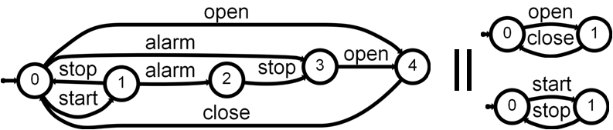
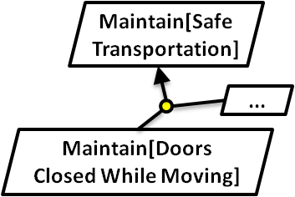
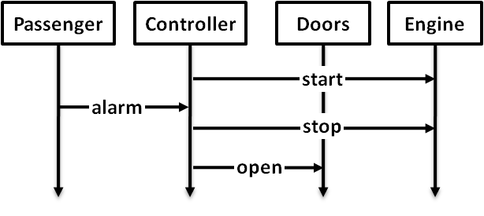
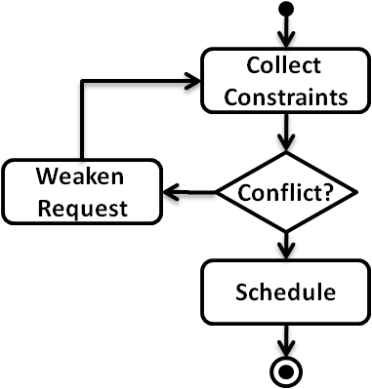
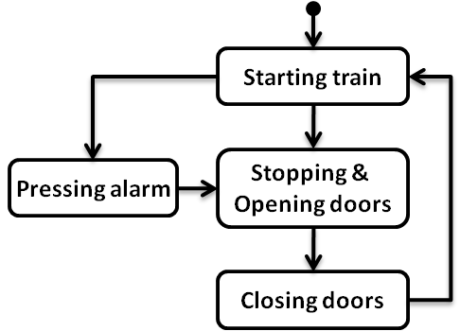
Multi-view Modeling Framework
Agent state machines (LTS)
Goals & Domain Properties (FLTL)
Scenarios (MSC)
Event traces (LTS) + State annotations (fluents)
High-level scenarios (hMSC)
Process
models (g-hMSC)

Slide 11
Derivation of State Machine Models from Process Models
Agent state machines (LTS)
Goals & Domain Properties (FLTL)
Scenarios (MSC)
Event traces (LTS) + State annotations (fluents)
High-level scenarios (hMSC)
Process
models (g-hMSC)

Slide 12
Inductive Synthesis of State Machines from Scenarios
Agent state machines (LTS)
Goals & Domain Properties (FLTL)
Scenarios (MSC)
Event traces (LTS) + State annotations (fluents)
High-level scenarios (hMSC)
Process
models (g-hMSC)

Slide 13
Traces & Labeled Transition Systems
Agent state machines (LTS)
Goals & Domain Properties (FLTL)
Scenarios (MSC)
Event traces (LTS) + State annotations (fluents)
High-level scenarios (hMSC)
Process
models (g-hMSC)

Slide 14
Traces & Labeled Transition Systems
Focus on agent and system behaviors
Defined as (infinite) sets of (finite) event traces exhibited by the system / agents
As observed by their environment
Trace behavioral equivalence [Hoa85]
P and Q are behavioraly equivalent if they exhibit the same sets of traces, i.e. the same languages :
P ≡_{tr} Q if and only if L(P) = L(Q)
Event traces (LTS) + State annotations (fluents)

Slide 15
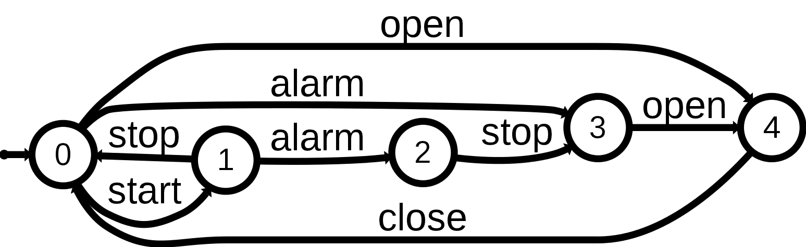
Traces & Labeled Transition Systems
Trace semantics through LTS
Captures the set of traces denoting existing paths in the transition system graph
A subclass of standard automata with all accepting states [Hop79]
Operators and algorithms
Inherited from regular languages theory (union, intersection, difference on sets of traces) [Hop79]
Composition and hiding [Mag99]

Slide 16
Trace Semantics of Multi-view Models
Agent state machines (LTS)
Goals & Domain Properties (FLTL)
Scenarios (MSC)
Event traces (LTS) + State annotations (fluents)
High-level scenarios (hMSC)
Process
models (g-hMSC)

Slide 17
Derivation of State Machine Models from Process Models
Agent state machines (LTS)
Goals & Domain Properties (FLTL)
Scenarios (MSC)
Event traces (LTS) + State annotations (fluents)
?
High-level scenarios (hMSC)
Process
models (g-hMSC)

Slide 18
Why deriving state machines from process models ?
Flawed process models can have dreadful consequences in safety critical areas
e.g. process modeling to improve medical safety
Models should be as error-free as possible
Techniques for building them and detecting sereve flaws, e.g. model checking
A formal semantics is therefore required
Enables analysis techniques in [Dam11]

Slide 19
Process models as Guarded hMSC
Tasks as MSCs or finer-grained guarded hMSC
Decisions on fluents
Initial condition C₀ on process instances
Total order among MSC events
We focus on global event traces exhibited by the process, not on specific agent behaviors
Collect Constraints
Weaken Request
Conflict?
Schedule
Fluent Conflict =
< { conflict_detected },
{ all_constraints_known } > C₀ = ¬ Conflict

Slide 20
Process models as Guarded hMSC
Collect Constraints
Invite & Collect
Conflict Notification
AllCstrKnown
Notification
Weaken Request
Conflict?
Schedule
Initiator
Scheduler
Participant
Fluent Conflict =
< { conflict_detected },
{ all_constraints_known } > C₀ = ¬ Conflict
initiate
invite
constraints

Slide 21
Operational Trace Semantics of Guarded hMSC
1) Derive g-hMSC as g-LTS
g-hMSC
model
g-LTS
model
LTS
model
Fluent
definitions
Fluent
automata
3) g-LTS composition + hiding
2) Fluent semantics as automata

Slide 22
Introducing guarded LTS
A g-LTS
A LTS with transitions labeled either by a guard, an event, or τ
A guard is a propositional formula over fluents
A condition C₀ restricting fluent assignments admissible in the initial state
A g-LTS is
A structured form of LTS whose states denote classes of pure LTS states
Hence, relaxing fluent initial values, introducing guards as well as C₀

Slide 23
Declarative trace semantics of g-LTS
A g-LTS execution (Init, <l₀, …, l_{n}>) accepted if
Trace inclusion: <l₀, …, l_{n}> denotes an existing path
Admissible start: Init |= C₀
Guards satisfaction: guards are satisfied when encountered
Accepted g-LTS traces (Init, <e₀, …, e_{n}>)
Admissible executions where guards are hidden
Accepted pure LTS traces <e₀, …, e_{n}>
Existential quantification over admissible Init

Slide 24
Operational Trace Semantics of Guarded hMSC
1) Derive g-hMSC as g-LTS
g-hMSC
model
g-LTS
model
LTS
model
Fluent
definitions
Fluent
automata
3) g-LTS composition + hiding
2) Fluent semantics as automata

Slide 25
1) From g-hMSC to g-LTS
Collect Constraints
Weaken Request
Conflict?
Schedule
C₀ = ¬ Conflict

Slide 26
1) From g-hMSC to g-LTS
Collect Constraints
Weaken Request
Conflict?
CC_{start}
{…}
CC_{end}
Schedule
WR_{start}
{…}
C₀ = ¬ Conflict
WR_{end}
Sch_{start}
{…}
Sch_{end}

Slide 27
1) From g-hMSC to g-LTS
Collect Constraints
Weaken Request
Conflict?
CC_{start}
{…}
CC_{end}
Schedule
WR_{start}
{…}
C₀ = ¬ Conflict
WR_{end}
Sch_{start}
{…}
Sch_{end}

Slide 28
1) From g-hMSC to g-LTS
Collect Constraints
τ
Weaken Request
Conflict?
τ
CC_{start}
{…}
CC_{end}
τ
Schedule
[ Conflict ]
WR_{start}
{…}
C₀ = ¬ Conflict
WR_{end}
[ ¬ Conflict ]
Sch_{start}
{…}
Sch_{end}
τ
C₀ = ¬ Conflict

Slide 29
1) From g-hMSC to g-LTS
Collect Constraints
[ ¬ Conflict ]
τ
Weaken Request
Conflict?
τ
CC_{start}
{…}
CC_{end}
τ
Schedule
[ Conflict ]
WR_{start}
{…}
C₀ = ¬ Conflict
WR_{end}
[ ¬ Conflict ]
Sch_{start}
{…}
Sch_{end}
τ
C₀ = true

Slide 30
2) Fluents as g-LTS automata
Fluent Conflict =
< { conflict_detected },
{ all_constraints_known } >
q_{u}
[¬ Conflict]
[Conflict]
all_constraints_known
conflict_detected
conflict_detected
q_{f}
q_{t}
[¬ Conflict]
all_constraints_known
[Conflict]

Slide 31
3) Compose then hide guards
g-LTS
model
||
LTS
model
Fluent
automata
g-LTS composition
Synchronize on events and τ moves
Boolean conjunction on guards, pruned when unsatisfiable
g-LTS hiding
Replace guards by τ
Yields a pure LTS

Slide 32
Trace equivalent composed g-LTS
Guard satisfaction
(q₀, q_{t1}, q_{t2}, ...)
[ Fl₁ ]
...
[ ¬Fl₁ ]
Admissible start
(q₀, q_{f1}, q_{t2}, ...)
[ C₀ ∧ Fl₁ ∧ Fl₂ ∧ ...]
[ Fl₁ ]
[ C₀ ∧ ¬Fl₁ ∧ Fl₂ ∧ ...]
...
[ ¬Fl₁ ]
[ C₀ ∧ Fl₁ ∧ ¬Fl₂ ∧ ...]
[...]
(q_{start},q_{u1},q_{u2},...)
[...]
= pruning (unsatisfiable)
...

Slide 33
From operational semantics to trace-based model checking
1)
g-hMSC
model
g-LTS
model
3)
LTS
model
2)
Fluent
definitions
Fluent
automata
||
Search space automaton
||
Synchronizer
automaton
Tester
automaton
LTL2 Buchi
FLTL (ψ) Property
Buchi (¬ψ)
automaton
Cfr. Tool support

Slide 34
Scenarios as Message Sequence Charts
Event interactions between agent instances
Trace semantics
Agent traces L⁺_{Ag}(P)
System traces L⁺(P)
Up to a choice: partial or total order among events ?
Negative MSC
Positive MSC + prohibited event
Positive and negative traces
L⁺_{Ag}(N), L⁺(N) and L⁻(N)
Negative system traces only
Positive MSC P
Controller
Actuators & Sensors
Passenger
start
a. pressed
a. propagated
e. stop
e. open
Negative MSC N
Controller
Actuators & Sensors
Passenger
start
x
open

Slide 35
High-level MSC
Directed graph where nodes are MSCs
Structured form of scenarios allowing reuse, sequencing and loops
Trace semantics
Agent traces L⁺_{Ag}(H)
System traces L⁺(H)
Up to a choice
Ordering of MSC events
Synchronization of nodes
High-level MSC H
Starting train
Pressing alarm
Stopping & Opening doors
Closing doors
Controller
Actuators
Doors
close-signal
close

Slide 36
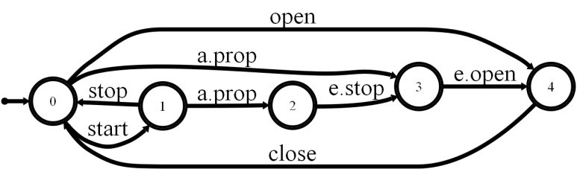
Multi-View Models Scenarios & State machine synergies
Introduction
A scenario defines
a path in each local state machine of corresponding agents
a path in the state machine of the composed system
Enforced in [Uch03]
Scenarios as Message Sequence Charts (MSC)
State machines as Labeled Transition Systems (LTS)
LTS Composition operator, as in [Mag99]
Controller
Actuators & Sensors
Passenger
start
a. pressed
a. propagated
e. stop
e. open

Slide 37
Scenarios Flowcharting with high-level MSC (hMSC)
Framework
Controller
Actuators & Sensors
Passenger
StationToStation TrainRide
AlarmPressed DuringTrainRide
start
a. pressed
a. propagated
BackToStation AfterEmergency
e. stop
e. open
Advantages
Reuse scenarios within a specification
Control information: sequence, loops, alternatives, ...

Slide 38
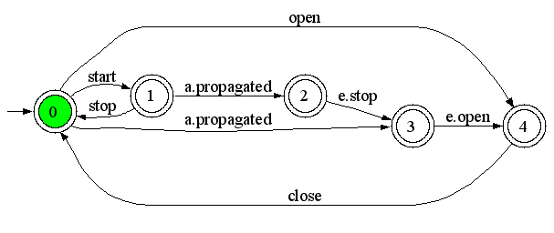
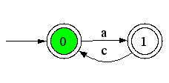
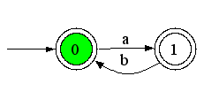
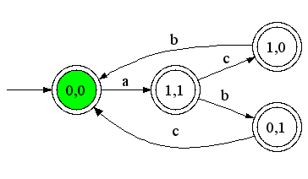
State Machines as Labelled Transition Systems (LTS)
Framework
A system is modeled as a set of LTS, one per agent
Pro & Cons
Visual abstraction of system behavior
Executable
Rich opportunities for analysis and code generation
Hard to build
The system can be modeled as the composition of agent behaviors [Mag99]
Each agent behaves asynchronously but synchronizes on shared events
composition operator ||
Train Controller LTS
Composition operator ∥
P
Q
⇓
P || Q

Slide 39
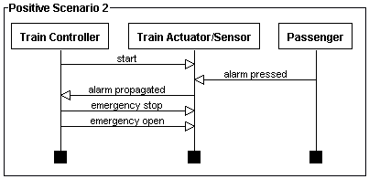
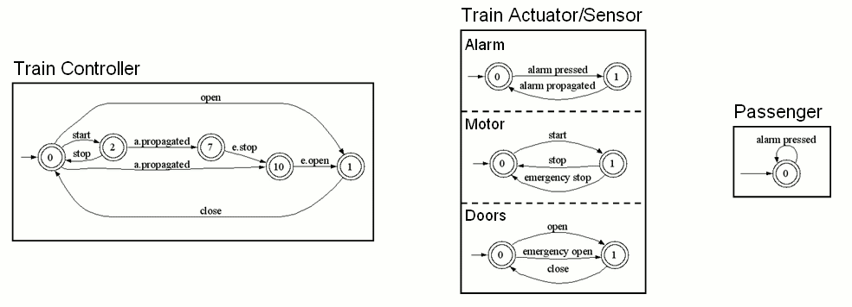
MSC & LTS Semantics
Framework
A scenario defines
a path in each local state machine of corresponding agents
a path in the state machine of the composed system
Semantics [Uch03]
In terms of composition operator ||
Extended to h-MSC, synthesis algorithm available
Semantics from [Uch03]
||
||

Slide 40
State variables as Fluents
Framework
Agent state variables are modeled with fluents
fluent F = <I_{Fl},T_{Fl}> initially Initially_{Fl}
I_{Fl} is a set of initiating events
T_{Fl} a set of terminating events
Initially_{Fl} (boolean) is the initial value of F
A fluent is
monitored by an agent if it “monitors” or performs all initiating and terminating events
controlled by an if it performs all initiating and terminating events
fluent examples
fluent moving = < {start},
{stop, emergency stop} >
initially false
start
stop, e.stop
moving
fluent doorsClosed = <
{close doors},
{open doors, emergency open} >
initially true
open doors, e.open
close doors
doorsClosed

Slide 41
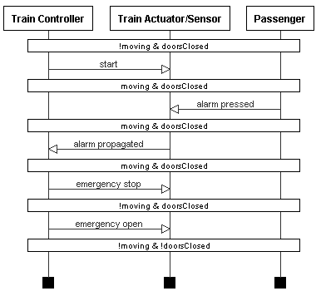
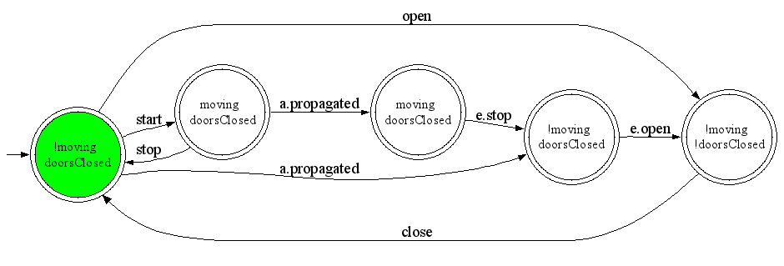
Decorations on behavior models
Framework
Decorated Scenario
Fluents can be used to decorate scenarios and state machines with state assertions [Dam05]
Extension to other kinds of decorations in [Dam10]
Used for analysing medical models with respect to cost, time & dosage constraints
Train Controller Decorated LTS

Slide 42
Process models Introducing guarded hMSC (g-hMSC)
Framework
hMSC + decision nodes
Outgoing transitions guarded with boolean conditions on fluents
Initial state
Relaxes the assumption of an initial value being known for each fluent
Initial state may be constrainted with an initial condition C₀
Semantics & Synthesis defined in chapter 3
C₀ = ¬ atStation ∧ doorsClosed
AlarmPressed
moving ?
yes
no
StopTrain InEmergency
OpenDoors
BackToStationAfter Emergency

Slide 43
Goals as Fluent Linear Temporal Logic (FLTL)
Framework
Goals are objectives that the system should achieve through cooperation of agents [Avl09]
Pro & Cons
recognized paradigm for eliciting, elaborating, structuring, specifying, analyzing, and modifying software requirements
Sometimes too abstract
Hard to formalize for end-user
Maintain[Doors Closed While Moving]
Def: The train should always move with doors closed
FormalDef: □(moving → doorsClosed)
Maintain[Safe Transportation]
...
Maintain[Doors Closed While Moving]

Slide 44
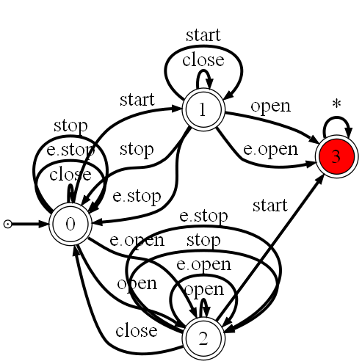
Goals and LTS Synthesis & Semantics
Framework
Goals in FLTL
A goal declaratively define a set of histories to be accepted and/or rejected by the system
A state machine typically captures a set of system histories
Available synthesis techniques
A Tester LTS capturing event traces violating a FLTL safety property can be synthesized using [Gia03]
Also, a Property LTS capturing event traces NOT violating it [Let08]
Maintain[Safe Transportation]
...
Maintain[Doors Closed While Moving]
[Gia03, Let08]
Tester LTS

Slide 45
From g-hMSC to LTS Chapter 3
Processes as g-hMSC
What is the set of event traces admitted by a guarded hMSC ?
AlarmPressed
[moving]
[¬ moving]
StopTrain InEmergency
OpenDoors
State machines as LTS

Slide 46
From g-hMSC to LTS Problem Statement
Guarded hMSC
What is the set of admissible event traces of a guarded hMSC ?
Needed for
Precising model semantics
Trace based model-checking (LTSA)
Decoration-driven model analysis [Dam10]
Roundtrip ?
Support friendly analysis feedback
C₀=...
AlarmPressed
moving ?
yes
no
StopTrain InEmergency
OpenDoors
?
LTS, set of event traces

Slide 47
From g-hMSC to LTS Solution overview
Guarded hMSC
Guarded LTS
Guards or events on transitions
C₀ condition, as in g-hMSC
Structured form of LTS avoiding state explosion
Synthesis sub bricks
From g-hMSC to g-LTS
From g-LTS to pure LTS
C₀=...
AlarmPressed
moving ?
yes
no
StopTrain InEmergency
OpenDoors
1
LTS, set of event traces
Guarded LTS, intermediate level
2
alarm pressed
[moving]
stop
[¬ moving]
open doors

Slide 48
From g-hMSC to g-LTS Synthesis algorithm
1
Bricks connected with unobservable τ transitions
Extension of [Uch03] from h-MSC to LTS
Introduction of start and end events to support more accurate fluent definitions
Mapping preserved for feedback of g-LTS-driven analysis
AlarmPressed_{start}
...
AlarmPressed_{end}
AlarmPressed
τ
moving ?
yes
no
[moving]
StopTrain InEmergency
OpenDoors
[¬ moving]

Slide 49
From g-LTS to pure LTS Declarative trace semantics
2
A trace (Init, <l₀,…>) is accepted from state q₀ by a guarded LTS (Q,Σ,Φ,δ,q₀,C₀) iff for every i:
trace inclusion
∃ q_{i+1} ∈ Q : (q_{i}, l_{i}, q_{i+1}) ∈ δ
admissible start
Init |= C₀
guard satisfaction
S_{i} |= l_{i} if l_{i} ∈ 2^{Φ}
S_{i} : state invariant after i-th event in trace (S₀ = Init)

Slide 50
From g-LTS to pure LTS Synthesis algorithm
2
Provides the set of event traces of a g-LTS
No roundtrip, no state mapping preserved
Allows model-checking g-hMSC and g-LTS against LTL safety properties
Algorithm for composing multiple automata
Super LTS
guarded LTS where guards are replaced by special events
to meet the trace inclusion condition
Initializer LTS
to meet the admissible start condition
Fluent LTS (one per fluent)
to meet the guard satisfaction condition

Slide 51
From MSC and hMSC to LTS Chapter 4
How to generalize a set of MSC scenarios as LTS state machines?
StationToStation TrainRide
AlarmPressed DuringTrainRide
BackToStation AfterEmergency
Controller
Actuators & Sensors
Passenger
State machines as LTS
start
a. propagated
a. pressed
e. stop
e. open
Scenarios as MSC and hMSC

Slide 52
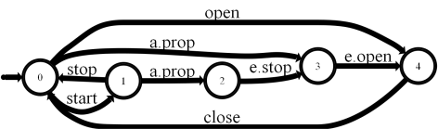


From MSC to LTS Problem statement
Inductive LTS synthesis
Given a scenario collection S_{c}=(S₊,S–) showing typical examples of the system usage, synthesize the system as a composition of agent LTS
S = A_{lts1} || … || A_{ltsn}
such that it correctly accepts S₊ and rejects S–
Positive & Negative MSCs
Controller
Actuators & Sensors
Passenger
start
a. pressed
a. propagated
e. stop
e. open
?
Agent LTS

Slide 53
Synthesis requirements
Inductive LTS synthesis
Because of end-user involvement, the solution should work
From end-user positive and negative scenarios …
… and scenarios only : avoid hMSC, state variables annotations, operations formalization (pre/post), etc.
but such additional information could/should be used when available
Initial scenario collection being incomplete, the approach
should support the elicitation of additional, “interesting” positive/negative scenarios
should be incremental : the models should be incrementally refinable as further scenarios become available

Slide 54
Solution overview
Inductive LTS synthesis
Positive & Negative MSCs
Generalization
Interactive automaton induction
Guided by generated scenario questions classified as positive or negative by the end-user
Query-Driven State Merging (QSM)
Constrained by additional state information when available (state variables, legacy components, goals, etc.)
Decomposition
Standard automaton algorithms (ε-moves, determinization, minimization)
Controller
Actuators & Sensors
Passenger
start
a. pressed
a. propagated
e. stop
e. open
System LTS
Generalization
Agent LTS
Decomposition
C. Damas, B. Lambeau, P. Dupont and A. van Lamsweerde, Generating Annotated Behavior Models from End-User Scenarios, IEEE Transactions on Software Engineering, Special Issue on Interaction and State-based Modeling, Vol. 31, No. 12, pp. 1056-1073, 2005 .

Slide 55
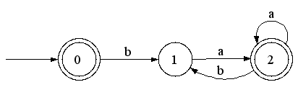
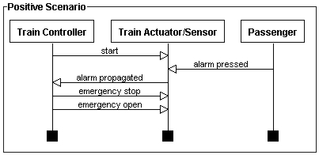
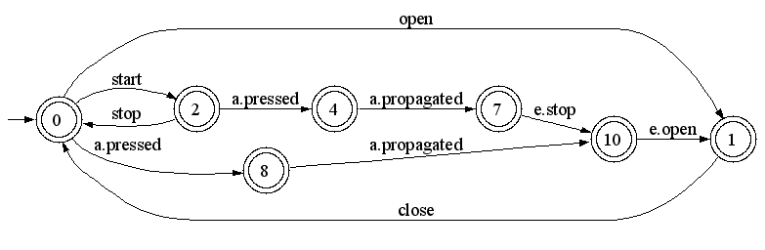
From grammar induction to LTS synthesis
Inductive LTS synthesis
Grammar induction
Learning a regular language L=(ba*a)*
Represented by a DFA
From positive and negative strings
S₊ = {ba,baa,baba,λ} and S– = {bb}
Regular Positive and Negative Inference (RPNI + variants)
LTS Synthesis
Learning a System
Represented by a LTS (a DFA)
From positive and negative scenarios
Grammar induction
Language sample
S₊ = {ba,baa,baba,λ} S– = {bb}
RPNI
L=(ba*a)*
Inductive LTS Synthesis
Sc=(S₊,S–)
RPNI
Syntesized LTS

Slide 56
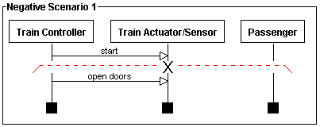
Scenarios as strings
Inductive LTS synthesis
The system LTS represents the learned language L
Scenarios are observed strings on L
LTS contains only accepting states
A positive scenario defines a set of positive strings
A negative scenario defines a set of positive strings and one negative string
System LTS
1
2
3
4
5
1
2

Slide 57
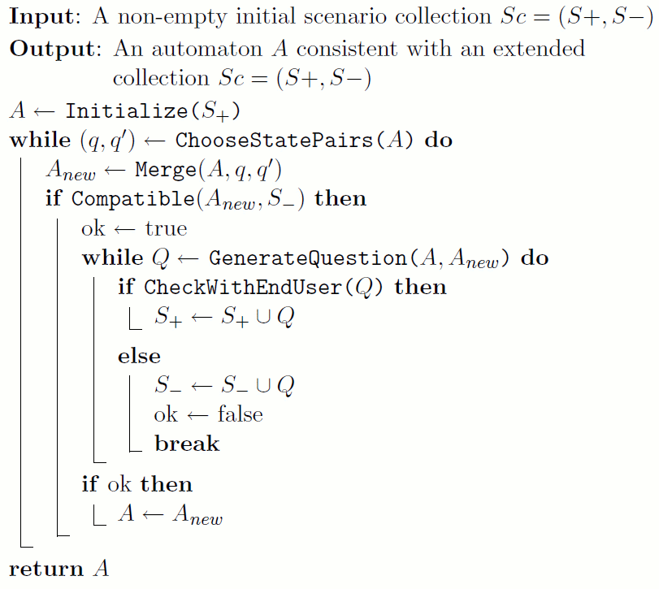
Query-Driven State Merging (QSM)
Inductive synthesis
1. Build an initial solution A
2. Generalize A → A_{new}
3. With user involvement
4. Keep it when correct
A_{new} → A
5. Return synthesized system

Slide 58
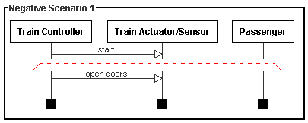
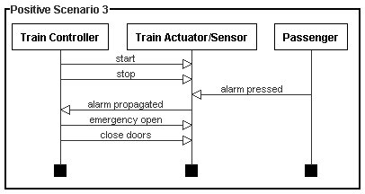
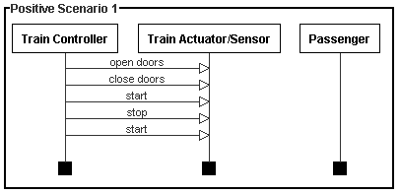
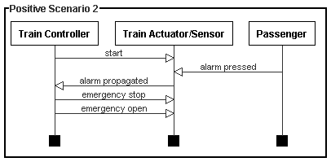
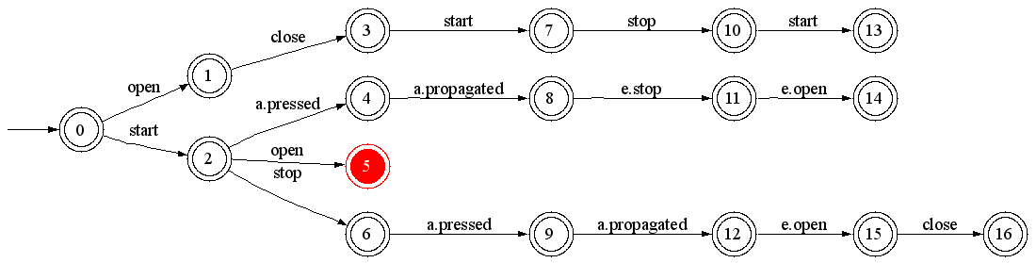
Initial solution, the PTA
Inductive synthesis
Prefix Tree Acceptor (PTA)
Largest DFA accepting S₊ while rejecting S–
No generalization of observed behaviors
Red states are error states
Prefix Tree Acceptor of the Train System

Slide 59
Generalization - merge
Inductive synthesis
q
q’
Consider merging of q=3 with q’=0

Slide 60
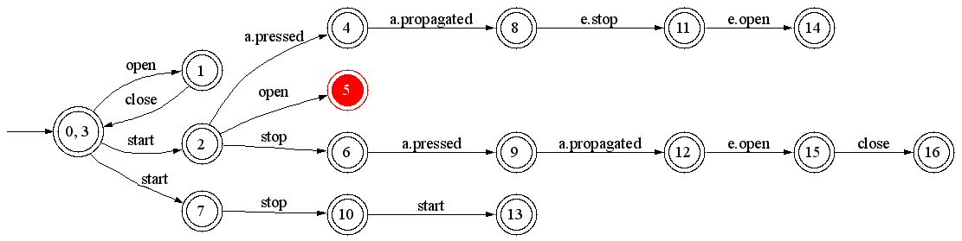
Generalization - determinize
Inductive synthesis
State 0 contains two outgoing transitions labeled « start »
merge 7 and 2 for determinization

Slide 61
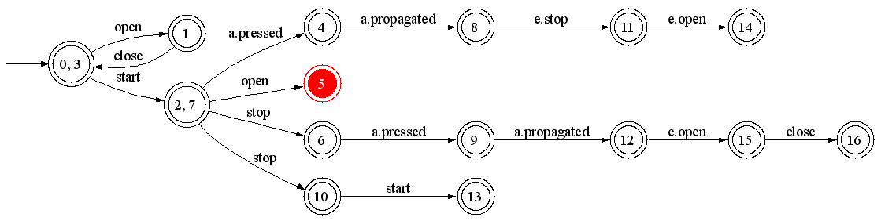
Generalization - determinize
Inductive synthesis
State 2 contains two outgoing transitions labeled « stop »
merge 10 and 6 for determinization

Slide 62
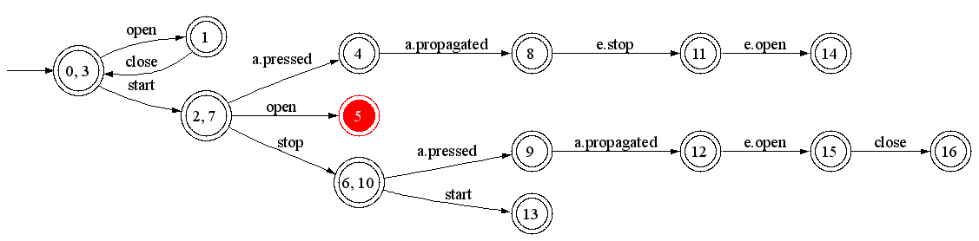
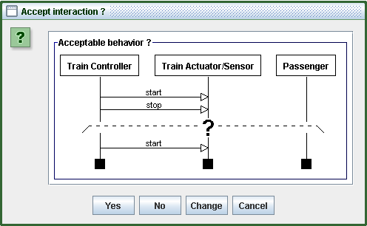
Generalization - questions
Inductive synthesis
prefix
suffix(es)
State 6 gains an outgoing transition labeled “start”
Leads to generated scenario questions
Used prefix is the shortest history leading to state 6
Suffixes are the gained continuations of 6 (only one here)
prefix
suffix

Slide 63
Generated scenarios
Inductive synthesis
Generated scenarios are
Classified by the user as positive or negative examples
Added to the initial scenario collection S_{c}=(S₊,S–)
Generation procedure
Constraints the generalization process with scenarios only
Relies on sound results from grammar induction
Notion of characteristic sample
Provides the elicitation of additional, “interesting” positive/negative scenarios

Slide 64
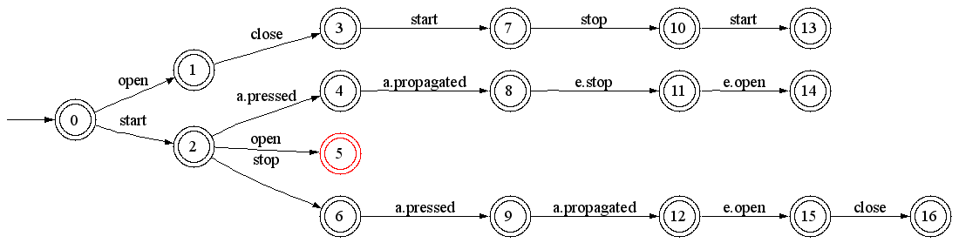
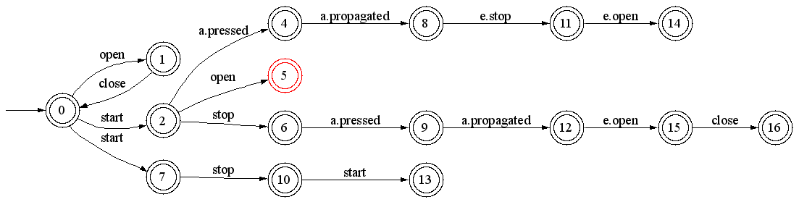
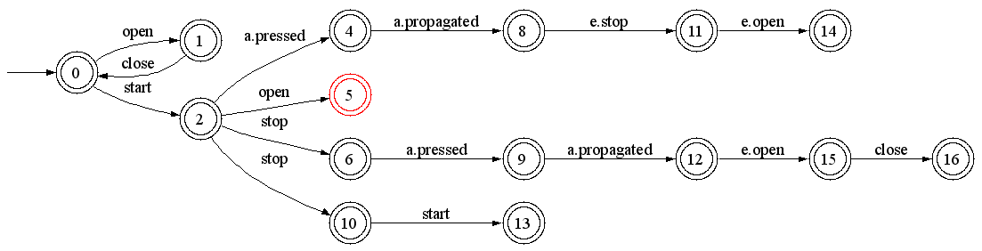
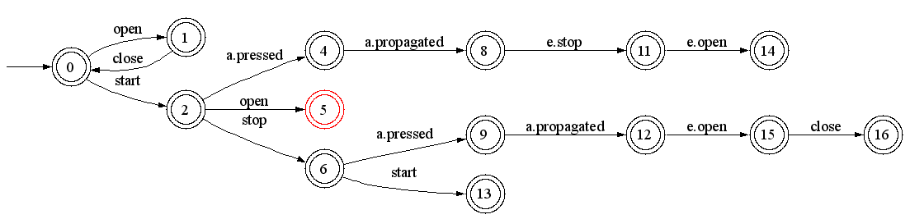
Intermediate solution
Inductive synthesis
States q=3 with q’=0 are merged, and stay merged forever (A ← A_{new}), if
The merging and determinization process does not lead to merge an error state with a non error one
All generated questions are classified as positive scenarios by the user
Otherwise, the solution A_{new} is discarded
The algorithm continues, choosing another merging pair (q, q’), until no pair is available
RPNI step
A
merge
determinize
A_{new}
determinize

Slide 65
Order of state pair selection
Inductive synthesis
RPNI considers state pairs in order
for each state q with rank i
for each state q’ with rank j<i
QSM relies on the Blue-Fringe heuristics
Evidence-driven state merging
Evaluate candidate state pair and choose the best one
Reduces the number of submitted questions in practice

Slide 66
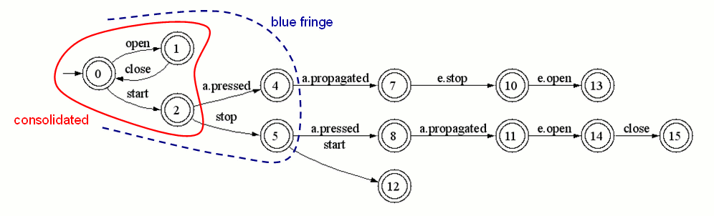
Evidence-driven merging
Inductive synthesis
Consider an intermediate solution A
Kernel states have been shown to be incompatible with each other
Fringe states are situated at one letter of a kernel state
RPNI tries to merge a fringe state with a kernel one, in standard order
questions here : (4,0) ; (4,1) ; (4,2) rejected ; (5,0) accepted
Blue-Fringe extension selects pairs (fringe,kernel) according to an evidence evaluation function, based on shared continuations
questions here : (5,2) rejected, (5,0) accepted
3 questions only on the entire train example (2 accepted and 1 rejected)

Slide 67
Pruning the search space
Inductive synthesis
Risk of poor generalization
Without questions (if no user available)
Due to high importance of negative scenarios (non intuitive in the first place)
Too many questions, often rejected
On the train example : 20 questions (3 to be accepted and 17 to be rejected)
=> Use available information to prune the search space
State information (e.g. fluents decorations)
Goals (safety properties in particular)
Control information (sequence, loops, ... from h-MSC)

Slide 68
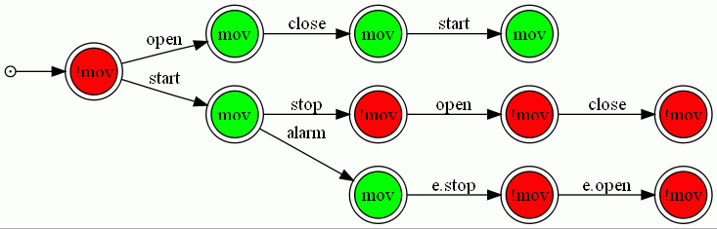
Pruning with fluent decorations
Inductive synthesis
A PTA can be decorated using available fluent definitions
fluent mov(ing) = <{start}, {stop, e.stop}> initially false
Induction can be constrained …
Avoid merging states with inconsistent decorations
e.g. avoid merging a state where the train is moving with another state where the train is not moving !

Slide 69
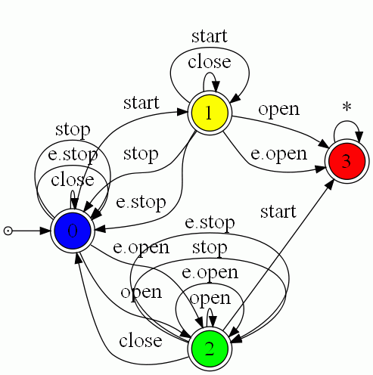
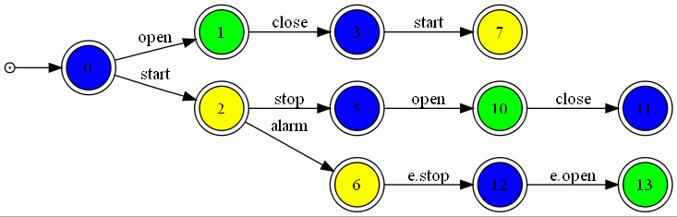
Pruning with goals
Inductive synthesis
Tester LTS for the safety property [Gia03]
Color PTA states with corresponding states
Avoid merging PTA states of different color
Enforces multi-model consistency by construction
Maintain[Doors Closed While Moving]

Slide 70
Pruning with control information
Inductive synthesis
What if PTA states are known to be equivalent ?
mandatory merge constraints
counterpart of state coloring
Alternatively, how to use a h-MSC instead of set of MSCs as input ?
Relax assumption of MSCs starting in same state
Allow using sequence, loops, ...
hMSC
StationToStation TrainRide
AlarmPressed DuringTrainRide
BackToStation AfterEmergency
?
Agent LTS

Slide 71
Pruning with control information The Uch03 + ASM approach
Automaton State Merging (ASM)
Generalizes a DFA under control of a negative sample (not shown)
No oracle / user query support
But still compatible with previous pruning methods
Also MSM & ASM* algorithms
hMSC
StationToStation TrainRide
AlarmPressed DuringTrainRide
BackToStation AfterEmergency
Equivalent LTS
Using [Uch03]
ASM
Agent LTS
Generalized LTS

Slide 72
Evaluation Chapter 5
How do the approach(es) perform
On RE case studies ?
On synthetic data ?
StationToStation TrainRide
AlarmPressed DuringTrainRide
BackToStation AfterEmergency
Controller
Actuators & Sensors
Passenger
State machines as LTS
start
a. propagated
a. pressed
e. stop
e. open
Scenarios as MSC and hMSC

Slide 73
RE case studies
Guarded hMSC → LTS
Medical case-studies can be found in [Dam09, Dam11]
Technique implicitely used by the model-checker (see tool support)
LTS Induction evaluated on three case studies
Small & medium sizes (mine pump, train, phone)
Blue-Fringe strategy required in practice
To avoid large number of user queries
To reach good model accuracy
Additional state information is very useful as well
Coloring & mandatory merge constraints help reaching better accuracy

Slide 74
Synthetic data
QSM & ASM evaluated
Machines & Sample generation following the protocol of Abbadingo Contest
Different state machine sizes & sample sparsities
Comparison with RPNI & Blue-Fringe
How well do queries help (i.e. accuracy & convergence) ?
How well do mandatory merge constraints help ?
In short, all experiments confirm what is expected
Inject all state information you can have
reaching better model accuracy
with less raw data as input (i.e. sample / scenarios)
and it goes faster

Slide 75
Discussion Evaluation on synthetic data - issues
Alphabet size
Binary alphabets only; state of the art in GI evaluations
In contrast, more than 30 events is commonly observed with behavior models
State machines
No variance of state degree, as a consequence of binary alphabet
States with high in-/out degrees are commonly observed with behavior model (capturing system idle, halt, immediate response)
Samples
Randomly generated from uniform distribution of strings
Not representative of what should be generated "from the
machine", especially on large alphabets

Slide 76
The Stamina Competition
Online Regular Induction Contest
Extends former competitions, especially Abbadingo
Cross-fertilization between the machine learning and software engineering communities
Previous issues adressed
Focus on the complexity of the learning with respect to the alphabet size
Adapted generation protocol for state machines and samples to mimic features of behavior models
Not an evaluation of the thesis techniques per se
Unsupervised learning (i.e. no oracle, no queries)
No pruning with fluents, goals, control information

Slide 77
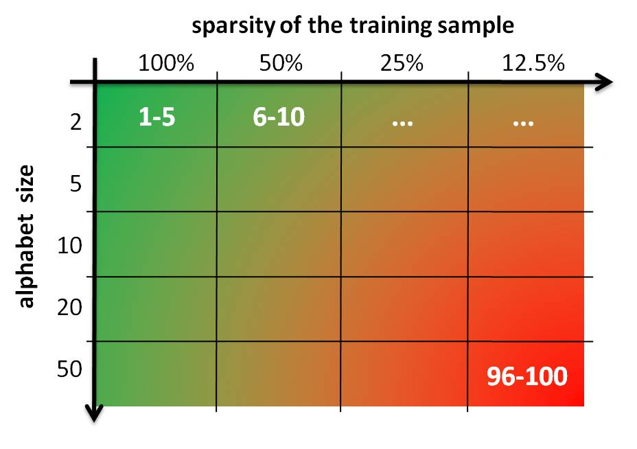
Competition overview
100 induction problems (20 cells of 5 problems)
Two difficulty dimensions
alphabet size vs. sparsity of learning sample
Solving a problem
Download learning (labeled) and test (unlabeled) samples
Learn a model (typically a DFA)
Label the test sample using learned model
Submit labeling on the competition server

Slide 78
Scientific setup State Machines
Approach
Review of SE litterature to identify representative features of behavior models
Tuning of the Forest-fire algorithm to mimic these features
Main features
Approximately 50 states (to avoid adding a third difficulty dimension to the competition)
Alphabet sizes ranging from 2 to 50 letters
Equal proportion of accepting vs. rejecting states
Large variance of degree distribution, to mimic behavior models

Slide 79
Scientific setup Samples
Controller
Actuators & Sensors
Passenger
start
a. pressed
a. propagated
e. stop
e. open
Approach
Generated by the target machine: random walk algorithm
Negative strings by randomly perturbing positive ones
three kinds of edit: substitution, insertion and deletion
Tuned to ensure good induction results using Blue-Fringe on the simplest problems
Main features
Learning and test samples do not overlap
Learning samples may contain duplicates, as a consequence of the random walk generation
String length distribution: centered on 5 + depth(automaton)

Slide 80
Scientific setup Submission & Scoring
Submission
Solutions submitted as binary strings labelling the test sample
Binary feedback (problem broken or not broken), to avoid hill-climbing
Scoring
Balanced Classification Rate to place equal emphasis on accuracy in terms of positive and negative strings
Problem broken if BCR score >= 0.99
A cell is broken if all problems it contains are broken

Slide 81
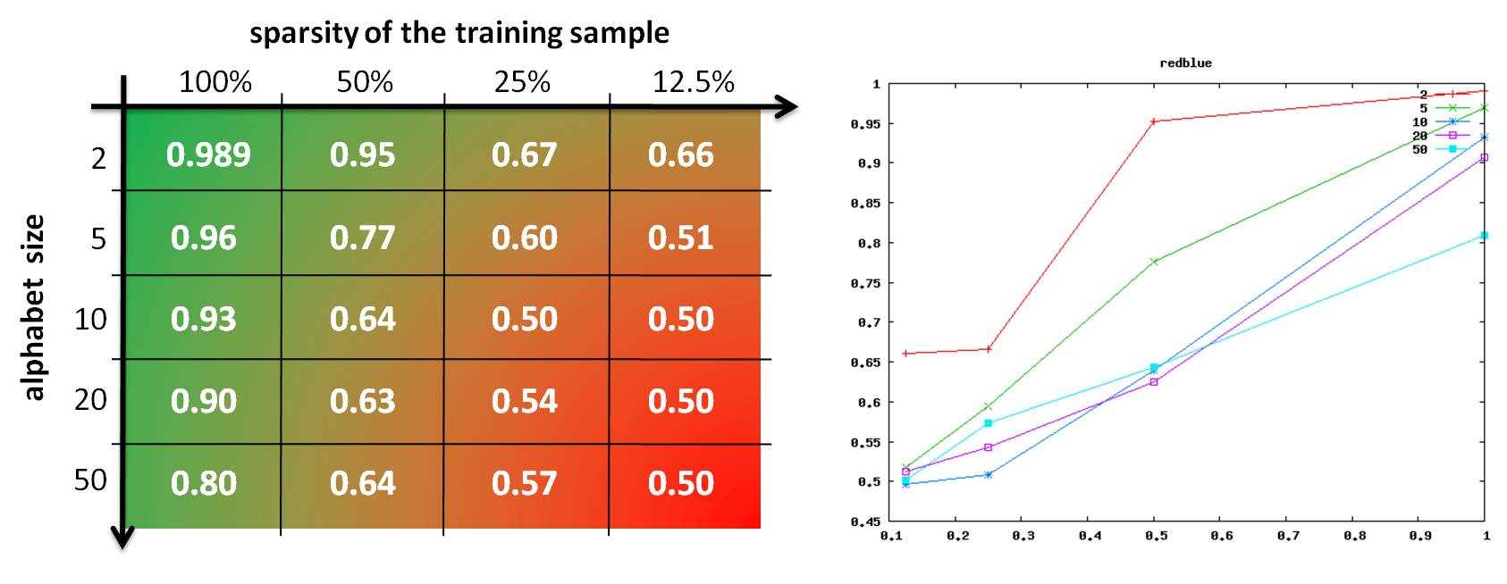
Scientific setup Baseline
Problem grid empirically ajusted
To ensure good induction results using Blue-Fringe on the simplest problems
Without breaking the cell

Slide 82
Scientific setup Baseline: lessons learned
RPNI and BlueFringe converge on largest alphabets
Theoretically expected, big samples needed in practice
Size of the alphabet "hurts" convergence in practice
Confirms experimentally what we expected theoretically
Supports the interest of launching Stamina

Slide 83
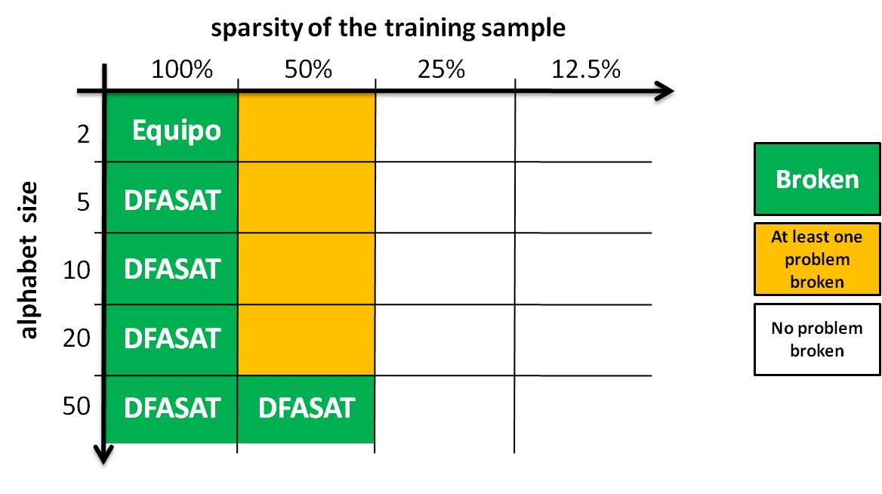
Participation overview
Between march and december 2010 (official)
1856 submissions made by 11 challengers
65 winning submissions broke 42 problems
6 cells broken, by 2 challengers (Equipo & DFASAT)

Slide 84
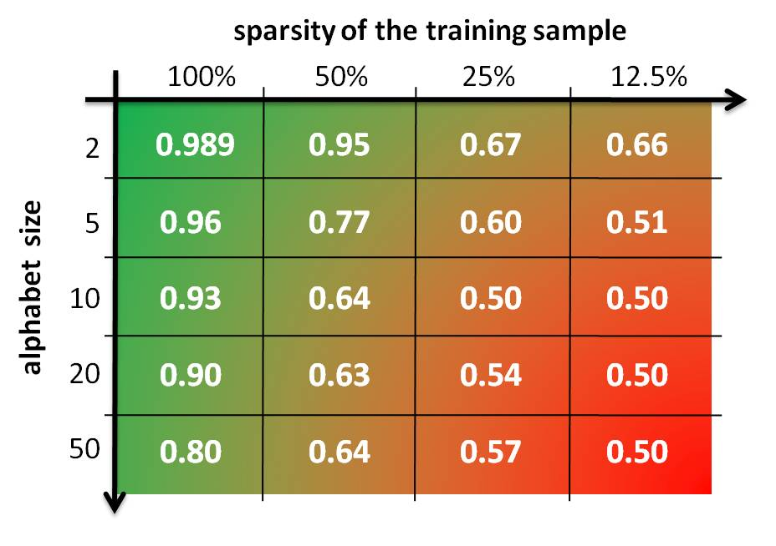
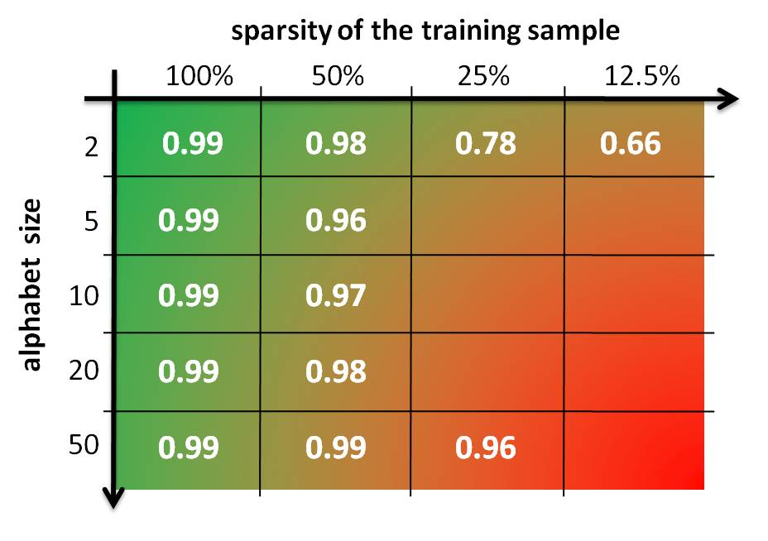
A big winner - DFASAT Marijn Heule & Sicco Verwer
Blue-Fringe
DFASAT

Slide 85
Tool Support Chapter 6
Processes as g-hMSC
A model-checker for guarded hMSC (chapter 3)
BDD-driven, efficient implementation of g-hMSC → g-LTS
AlarmPressed
[moving]
[¬ moving]
StopTrain InEmergency
OpenDoors
State machines as LTS

Slide 86
Tool Support Chapter 6
The ISIS Tool (chapter 4)
Interactive synthesis of LTS from positive & negative MSC
Under control of fluents and goals
Goals as FLTL
Maintain[Safe Transportation]
...
Maintain[Doors Closed While Moving]
Controller
Actuators & Sensors
Passenger
State machines as LTS
start
a. propagated
a. pressed
e. stop
e. open
Scenarios as MSC and hMSC

Slide 87
Tool Support Chapter 6
Processes as g-hMSC
The Gisele Clinical Pathway Analyzer
Implementation of decoration-driven model analysis (Damas thesis)
AlarmPressed
[moving]
[¬ moving]
StopTrain InEmergency
OpenDoors
State machines as LTS

Slide 88
Context & Motivation The Gisele Project
Health-care processes are safety critical
Medical errors => 98,000 deaths every year in the US, over 1 million of non-lethal injuries
E.g. wrong patient, wrong dose, wrong timing, wrong channel
Major causes
complex coordination among clinical tasks, communication problems among actors, complex decisions
Response
Clinical pathways, software support
Needed: models for analysis, error anticipation and enactment [Clarke08]

Slide 89
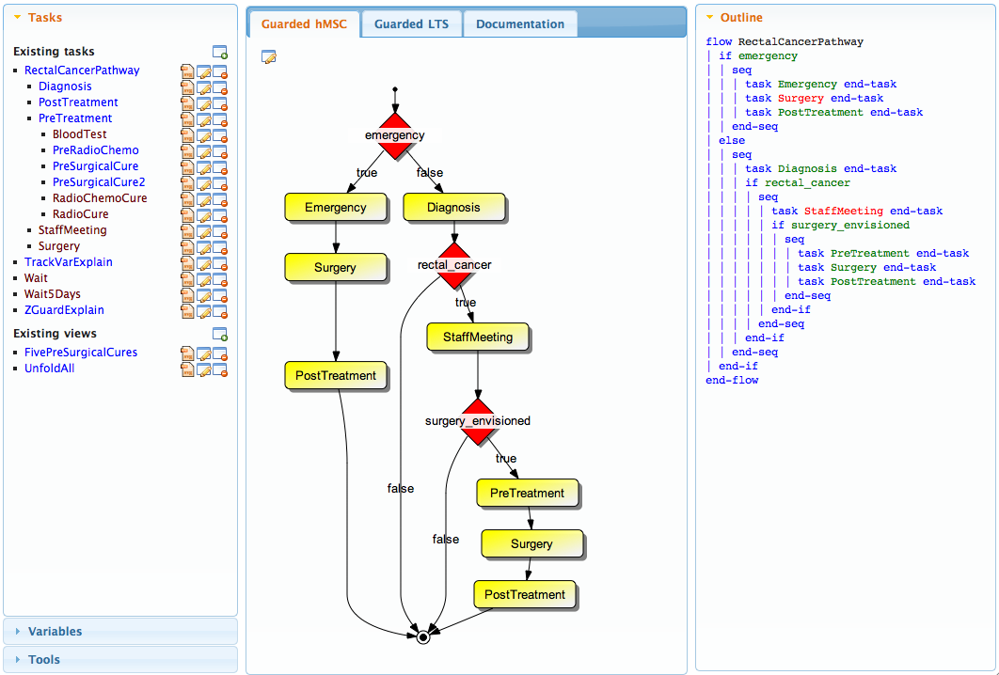
A Clinical Pathway Analyzer Tool support of the Gisele project

Slide 90
A Clinical Pathway Analyzer Tool support of the Gisele project
Variety of analyses (cf. Damas thesis)
verification of functional & non-functional requirements
state-based, event-based
Integrated within uniform formal framework and toolset
Guarded models (g-hMSC & g-LTS)
Fluents and tracking variables
Decoration-based analysis
Incremental analysis throughout model building
according to model refinement structure
early, local, stepwise on model of varying granularity

Slide 91
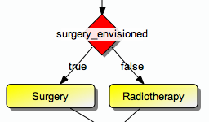

Process modeling language
Textual language
guarded commands
tasks and decisions
Graphical counterpart
guarded High-Level Message Sequence Charts (g-hMSC)
Semantics & analysis in terms of
guarded LTS (g-LTS), in turn defined by LTS (cf. chapter 3)
if surgery_envisioned
Surgery
else
Radiotherapy end

Slide 92
Discussion
Stamina
Related work or discussion in evaluation chapter ?
How far about presenting results ?
Gisele tool
Medical case-studies suddently appear...
Almost about decoration-based analysis (the other thesis)
Tool support
A quick poll: what are you interrested in?
MSM & ASM
Not interactive, no queries
Shouldn't we move it to another chapter ?

Slide 93
Thesis Outline
A Multi-View Modeling Framework
Event-based behavior models
State-based abstractions
Intentional models as goal graphs on uents
Deductive synthesis of LTS models from guarded hMSCs
From guarded hMSC to guarded LTS
From guarded LTS to pure LTS
Inductive synthesis of LTS models from MSC and hMSC models
From grammar induction to model induction
Interactive induction of LTS models from MSCs
Pruning the induction space with state information
Pruning the induction space with goals
Pruning the induction space with control information
Evaluation
...
Tool Support
...

Slide 94
C₀=...
Controller
Actuators & Sensors
Passenger
AlarmPressed
start
a. pressed
a. propagated
moving ?
e. stop
yes
no
e. open
StopTrain InEmergency
OpenDoors
StationToStation TrainRide
AlarmPressed DuringTrainRide
BackToStation AfterEmergency
Maintain[Safe Transportation]
Maintain[Doors Closed While Moving]
...

