Slide 1
Passenger
Automated
Controller
Doors Actuator
Engine
Actuator
Speed Sensor
Doors
Engine
start-signal
start
non-zero-speed
alarm pressed
stop-signal
stop
zero-speed
open-signal
open

Slide 2
Machine
Passenger
Sensors
Controller
Actuators
Doors
Engine
start-signal
start
alarm-pressed
alarm-signal
stop-signal
stop
open-signal
open
Controller
Actuators
Doors
Engine
start-signal
start
X
open-signal

Slide 3
Controller
Actuators
Engine
Controller
Actuators
Doors
Engine
start-signal
stop-signal
start
stop
open-signal
open
Starting train
Passenger
Sensors
Controller
Stopping & Opening doors
alarm-pressed
Starting train
alarm-signal
Pressing alarm
Pressing alarm
Stopping & Opening doors
Controller
Actuators
Doors
close-signal
Closing doors
close
Closing doors

Slide 4




Starting train
τ
τ
τ
Pressing alarm
Stopping & Opening doors
τ
τ
Closing doors
τ
Starting train
Pressing alarm
Stopping & Opening doors
Closing doors

Slide 5
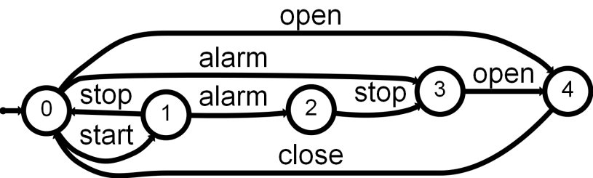
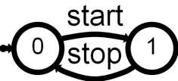
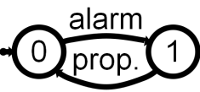
Starting train
Maintain[Safe Transportation]
Collect Constraints
Stopping & Opening doors
...
Pressing alarm
Weaken Request
Conflict?
Maintain[Doors Closed While Moving]
Closing doors
Schedule
Passenger
Controller
Doors
Engine
start
alarm
stop
open
||

Slide 6
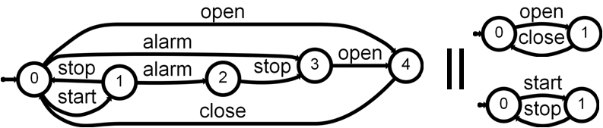
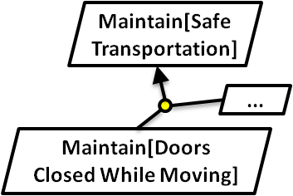
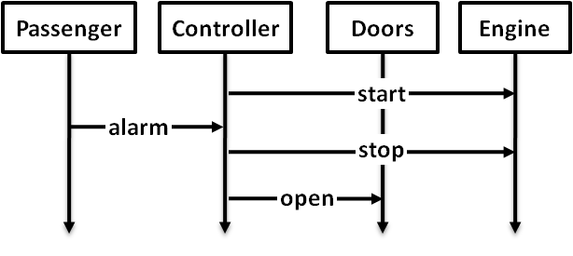
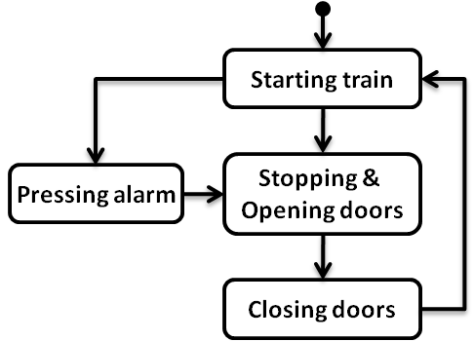
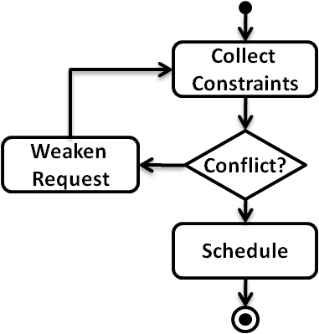
Agent state machines (LTS)
Scenarios (MSC)
Event traces (LTS) + State annotations (fluents)
Goals & Domain Properties (FLTL)
Process models (g-hMSC)
High-level scenarios (hMSC)

Slide 7
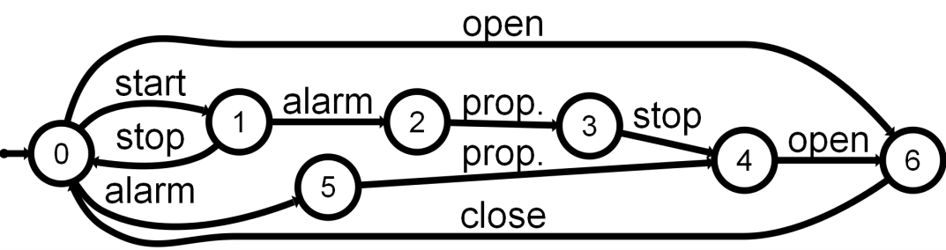
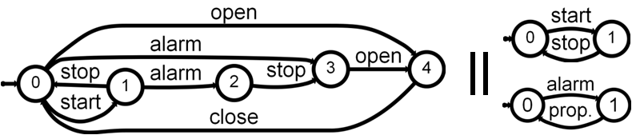
Scenarios
Generalization
(grammar induction)
System LTS
Decomposition
(hiding + determinization + minimization)
Agent LTSs

Slide 8
Initiator
Scheduler
Participant
set_date_range
Initiate Meeting
set_participants
confirm
meeting_initiated
send_invitations
Extend
Date Range
Acquire
Constraints
[date_conflict ∧ ¬ second_cycle]
?
[¬ date_conflict ∨ second_cycle]
Arbitrate
Weaken Constraints
Schedule
Meeting
[¬ resolve_by_weakening]
[resolve_by_weakening]
?

Slide 9
τ
Initiate Meeting
Initiate Meeting_{start}
set_date_range
set_participants
confirm
Initiate Meeting_{end}
meeting_initiated
send_invitations
τ
Extend Date Range
Acquire Constraints
EDR_{start}
{…}
EDR_{end}
τ
AC_{start}
{…}
AC_{end}
τ
?
[date_conflict ∧ ¬ second_cycle]
[¬ date_conflict ∨ second_cycle]
τ
Arbitrate
Weaken Constraints
Schedule Meeting
A_{start}
{…}
A_{end}
WC_{start}
{…}
WC_{end}
SM_{start}
{…}
SM_{end}
τ
τ
[¬ resolve_by_weakening]
[resolve_by_weakening]
?

Slide 10
q_{u}
[ ¬Fl ]
[ Fl ]
{Term_{Fl}}
{Init_{Fl}}
{Init_{Fl}}
q_{f}
q_{t}
[ ¬Fl ]
{Term_{Fl}}
[ Fl ]
q_{u}
[¬ second_cycle]
[second_cycle]
ExtendRange_{end}
{ ExtendRange_{end,}
WeakenConstraints_{end} }
InitiateMeeting_{end}
q_{f}
WeakenConstraints_{end}
q_{t}
[¬second_cycle]
InitiateMeeting_{end}
[second_cycle]
...
q_{start}
q₀
[ C₀ ]
G

Slide 11
= pruning (unsatisfiable)
(q₀,q_{t1},q_{t2},...)
[ Fl₁ ]
...
[ ¬Fl₁ ]
(q₀,q_{f1},q_{t2},...)
[ C₀ ∧ Fl₁ ∧ Fl₂ ∧ ...]
[ Fl₁ ]
[ C₀ ∧ ¬Fl₁ ∧ Fl₂ ∧ ...]
...
[ ¬Fl₁ ]
[ C₀ ∧ Fl₁ ∧ ¬Fl₂ ∧ ...]
[...]
(q_{start},q_{u1},q_{u2},...)
[...]
...

Slide 12
Collect
Abritrate
yes
Conflict?
no
Schedule
Collect_{start}
Arbitrate_{end}
…
Collect_{end}
…
[conflict]
[¬ conflict]
Schedule_{start}
Arbitrate_{start}
…
Schedule_{end}
…
Collect_{end}
Arbitrate_{start}
Collect_{start}
Arbitrate_{end}
…
Schedule_{end}
…
Schedule_{start}

Slide 13
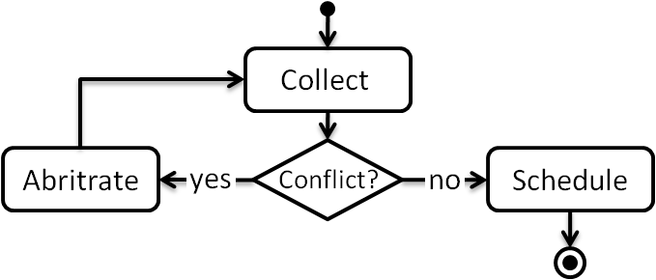
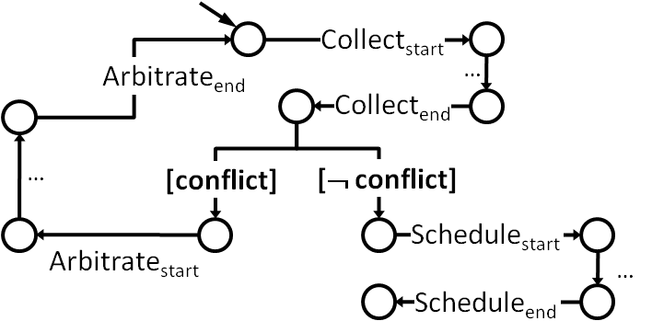
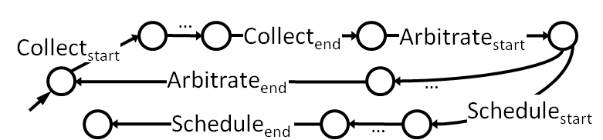
Guarded hMSC
Process modeling language
Guarded LTS
Analyses based on symbolic execution
LTS
Trace-based model-checking

Slide 14
Initiate Meeting
Initiated(m) ∧ ¬InvitationsSent (m)
Extend
Date Range
Acquire
Constraints
¬ AllConstraintsKnown(m)
AllConstraintsKnown(m)
DateConflict(m) ∧ ResolveByWeakening(m)
[date_conflict]
?
[¬ date_conflict]
AllConstraintsKnown(m) ∧ ¬DateConflict(m)
AllConstraintsKnown(m) ∧ DateConflict(m)
Arbitrate
Weaken Constraints
Schedule
Meeting
DateConflict(m) ∧ ¬ResolveByWeakening(m)
[¬ resolve_by_weakening]
[resolve_by_weakening]
?
AllConstraintsKnown(m) ⇒ Initiated(m) ⇒ InvitationsSent(m)

Slide 15
Train Controller
Actuator/Sensor
Passenger
Train Controller
Actuator/Sensor
Passenger
open doors
start
close doors
start
alarm pressed
stop
alarm propagated
start
emergency stop
emergency open
Train Controller
Actuator/Sensor
Passenger
Train Controller
Actuator/Sensor
Passenger
start
start
stop
alarm pressed
alarm propagated
X
emergency open
open doors
close doors
Train Controller
Actuator/Sensor
Passenger
start
stop
?
start

Slide 16
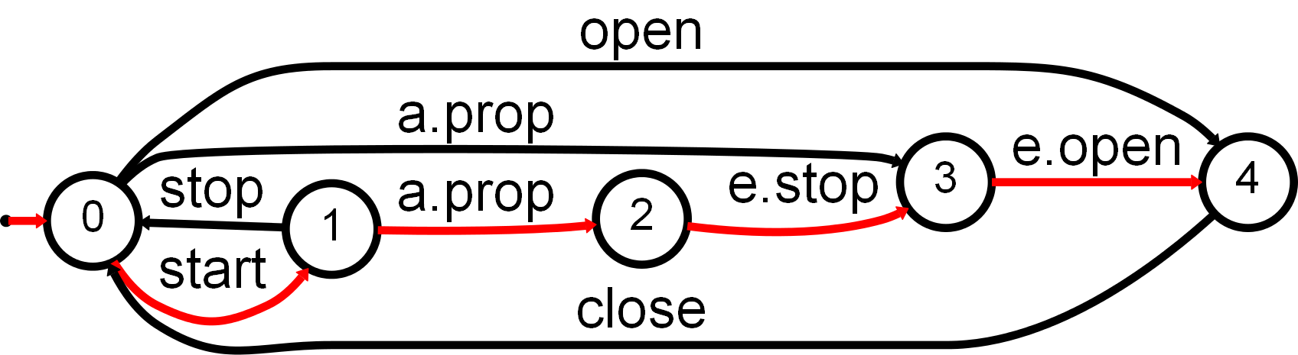
Train Controller
Actuator/Sensor
Passenger
start
alarm pressed
alarm propagated
emergency stop
emergency open

Slide 17
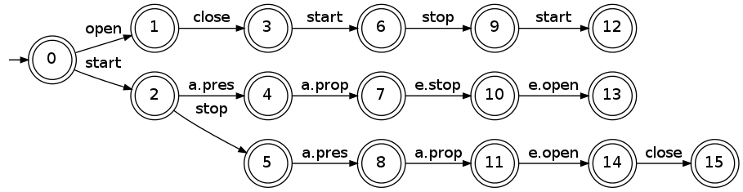
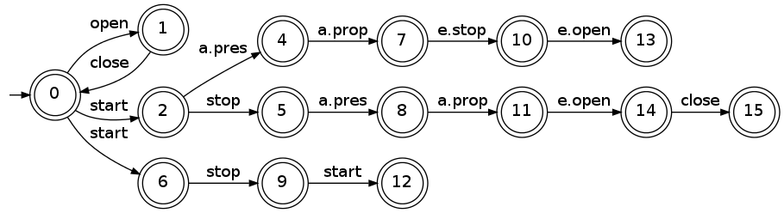
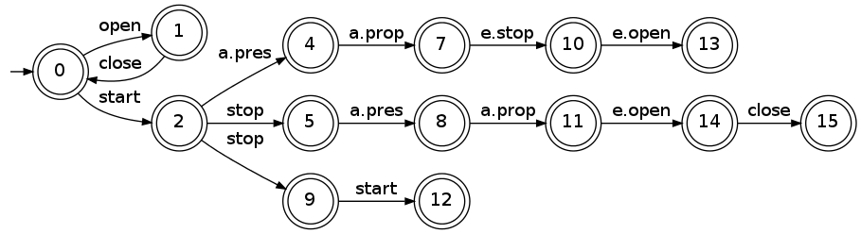
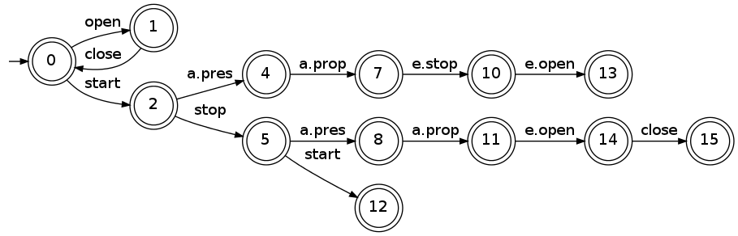
Merging q=3 and q’=0
Merging 2 and 6
(for determinization)
Merging 5 and 9
(for determinization)

Slide 18
blue fringe
red states
(consolidated)
white states

Slide 19
H
H₁
…
H_{n}
S⁺₁
…
S⁺_{n}

Slide 20
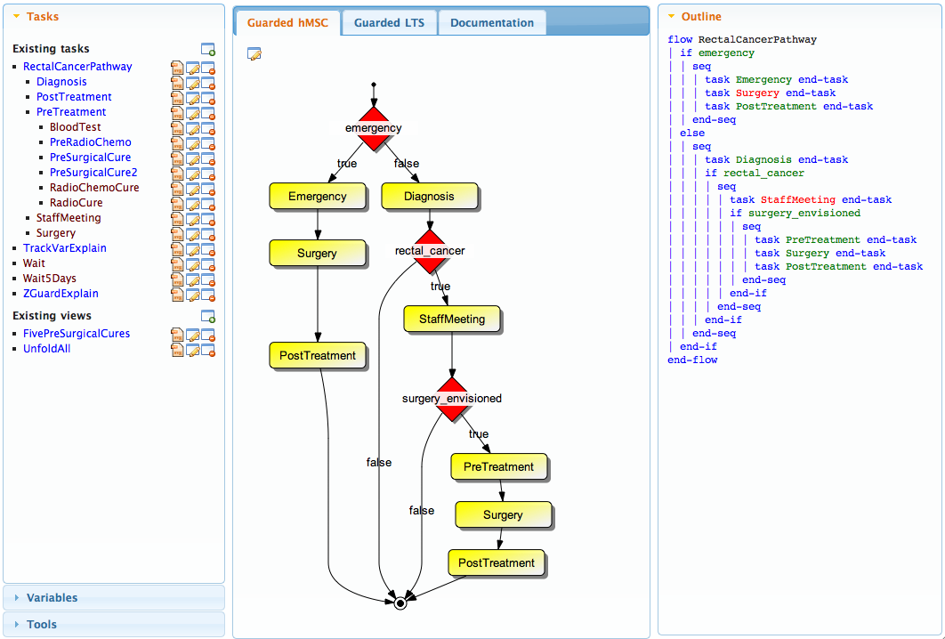
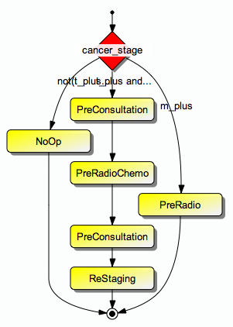

Slide 21
Web GUI
Proactive
Process
Model
Model
analyzer
Binary Decision Diagrams (Buddy)
Automaton toolkit (Stamina)
Model
converter
Graph Toolkit
(Yargi)
Graphviz dot
(graphviz.org)
Parser + AST rewriting
Parser generator + AST tools (Anagram)
SQL Persistence (sqlite)
Use

Slide 22
Model
Checker
g-hMSC
Use
Binary Decision Diagrams
(JBuddy)
g-LTS
Automaton Toolkit
(Jail)
FLTL
LTL2Buchi

Slide 23
Scenarios
L⁺(Sc) / L⁻(Sc)
RPNI QSM ASM
LTS hiding
+ minimization
System LTS
L(System)
Agent LTSs
L(Ag_{i})
LTS ||
Composed LTS
L(Ag₁ || … || Ag_{n})

Slide 24
Algo
Chap. 3
g-hMSC
model
g-LTS
model
g-LTS || +hiding
LTS
model
Def. 3.1
Fluent
definitions
Fluent
automata
LTS ||
Search space automaton
g-LTS || +hiding
Synchronizer
automaton
Tester
automaton
LTL2 Buchi
FLTL (ψ) Property
Buchi (¬ψ)
automaton

