Slide 1
Synthesizing Multi-View Models of Software Systems
Lambeau Bernard
ICTeam Institute
Université catholique de Louvain
November 2011

Slide 2
Outline
Introduction
A step-by-step explanation of the thesis title
Inductive synthesis of state machines from scenarios
A model synthesis technique in action
Conclusion
What should you remember?

Slide 3
Synthesizing Multi-view Models of Software Systems
with courtesy of egmcartech.com

Slide 4
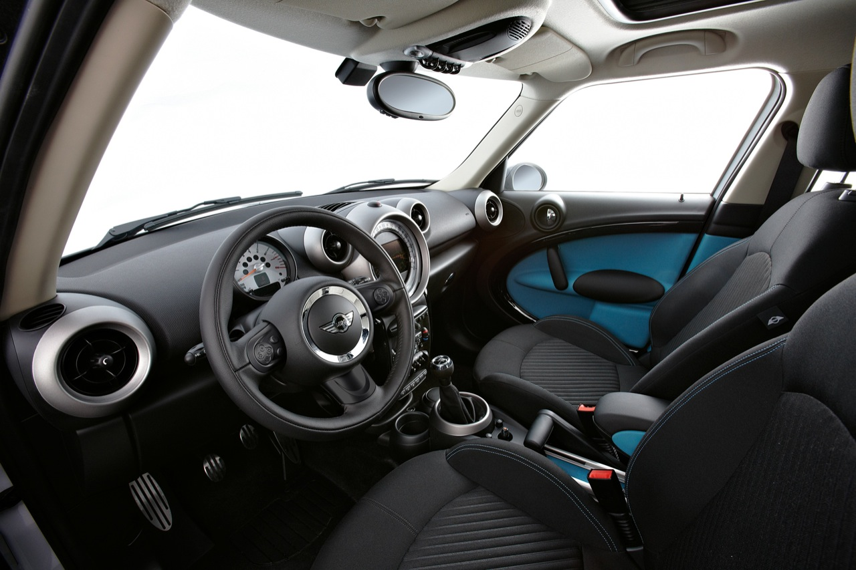
Synthesizing Multi-view Models of Software Systems
with courtesy of egmcartech.com

Slide 5

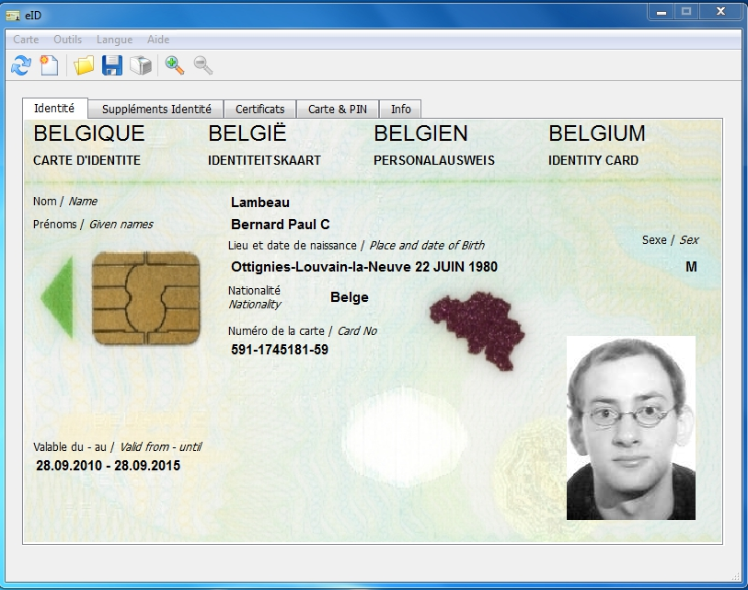
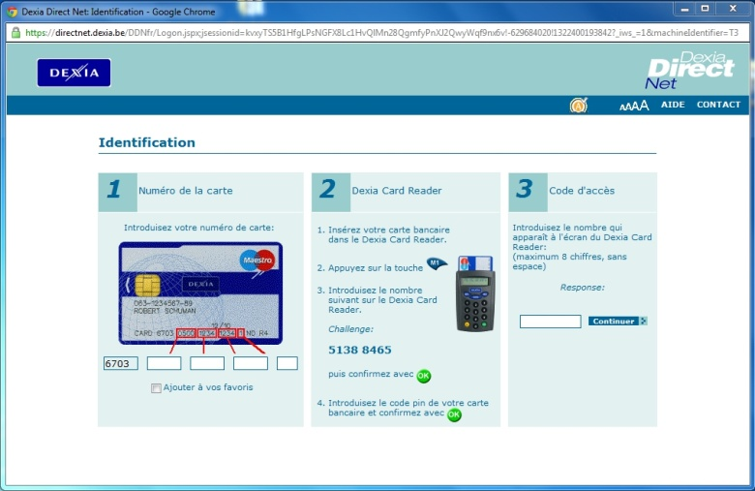
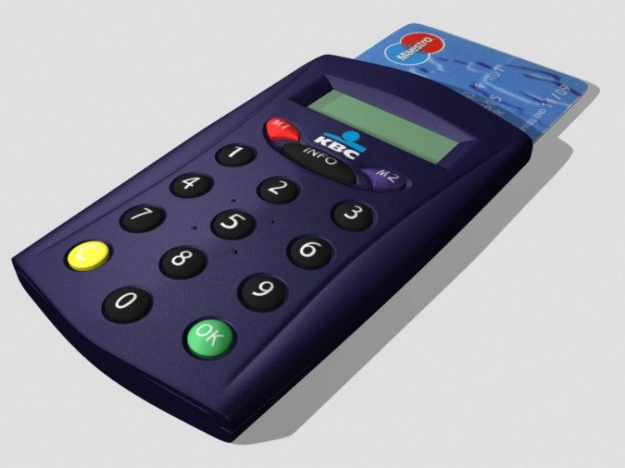

Synthesizing Multi-view Models of Software Systems
with courtesy of egmcartech.com

Slide 6
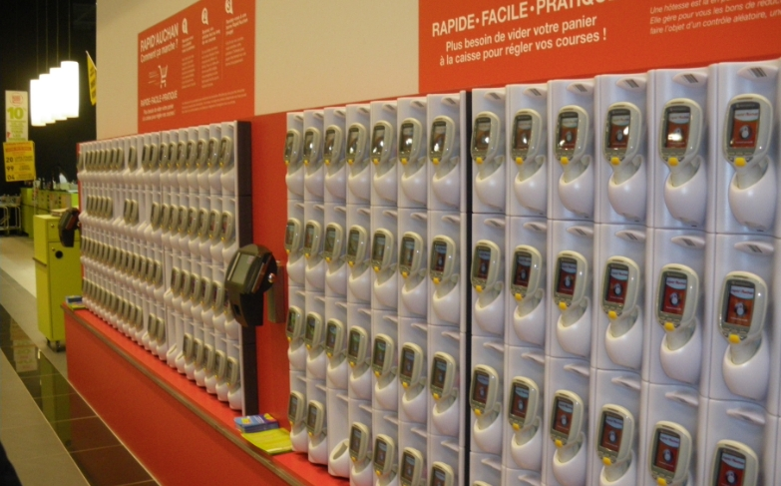
Synthesizing Multi-view Models of Software Systems
with courtesy of quechoisir.fr

Slide 7
Synthesizing Multi-view Models of Software Systems
A system is a set of active components, called agents, that interact so as to fulfill goals
Agents restrict their behavior to meet the goals they are responsible for [Fea87, Avl09]
Some agents are software components, i.e. automated agents
Others are human beings, electronic devices, etc.

Slide 8
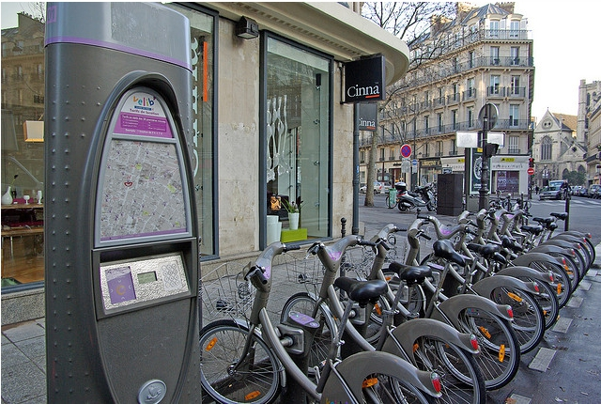
Running example
© Florence S.

Slide 9
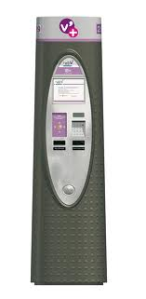




Building software systems is hard

Slide 10
The solution is highly technical
website
electro-mechanical devices
internet
mails, sms, etc.
smart card, keyboard, touch screen

Slide 11
What about the problem?
?
The hardest part of software development is determining what the system should do [Bro87]

Slide 12
Is this interaction right?
Pickup
Subscribing and identification […]
request bicycle
unlock
pickup

Slide 13
Not necessarily…
The hardest part of software development is determining what the system should (not) do
© Florence S.

Slide 14
Synthesizing Multi-view Models of Software Systems
Model
An abstract representation of the target system and its intent

Slide 15
Synthesizing Multi-view Models of Software Systems
Models help reasoning about the problem
Elaborating requirements and exploring designs
They also help building the solution
Code generation from high-level abstractions

Slide 16
Synthesizing Multi-view Models of Software Systems
Models
A set of useful abstractions for building such representation
Multi-view
Multiple stakeholders [Fin92]
Multiple aspects: what? who? why? how?

Slide 17
Synthesizing Multi-view Models of Software Systems
Models
A set of useful abstractions for building such representation
A system is a set of agents that interact so as to fulfill goals. They restrict their behavior to meet specific requirements.

Slide 18
Synthesizing Multi-view Models of Software Systems
Models
A set of useful abstractions for building such representation
A system is a set of agents that interact so as to fulfill goals. They restrict their behavior to meet specific requirements.

Slide 19
Scenarios
Subscribing and identification
subscribe
identify
authenticate
granted
welcome aboard

Slide 20
High-level Scenarios
Subscribing and identification
Pickup
press
request
unlock
pickup
released
ride start

Slide 21
High-level Scenarios
Subscribing
Identification
Cancel
Pickup
Return

Slide 22
Negative Scenarios
Invalid Pickup
press
request
X
unlock

Slide 23
Negative Scenarios
Why (not) ?
Invalid Pickup
press
request
X
unlock

Slide 24
Goals & Requirements
Avoid[Stolen Bikes]
Unlocking => Cyclist Logged
?
?
Agents restrict their behavior to meet their requirements, i.e. the goals they are responsible for

Slide 25
Agent behaviors through state machines
press
request
unlock
pickup
released
press
request
unlock
pickup
released
return
0
1
2
3
4
5
6
press
lock

Slide 26
System behavior through composition
||
||
||
Parallel composition of individual agent behaviors [Hoa85]
Agents behave asynchronously but synchronize on shared events [Mil89, Mag99]

Slide 27
System behavior through composition
||
||
||
Avoid[Stolen Bikes]
The composed system should meet high-level goals
…
Unlocking => Cyclist Logged
Agents restrict their behavior to meet their requirements

Slide 28
Agent state variables
fluent Cyclist Logged = <
{ granted },
{ ride start } > initially false
…
granted
…
The cyclist is automatically unlogged when a bicycle is released and the ride started accordingly
released
ride start
…

Slide 29
Agent state variables
fluent Free = <
{ pickup },
{ return } > initially false
press
request
unlock
pickup
released
return
0
1
2
3
4
5
6
press
lock

Slide 30
Agent state variables
fluent Locked = <
{ lock },
{ unlock } > initially true
press
request
unlock
pickup
released
return
0
1
2
3
4
5
6
press
lock

Slide 31
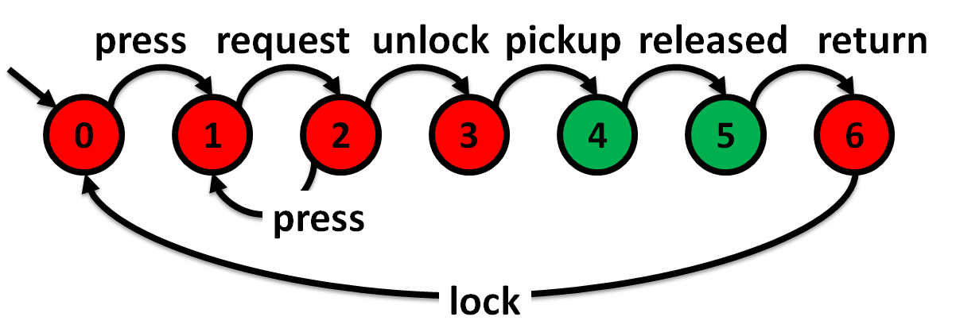
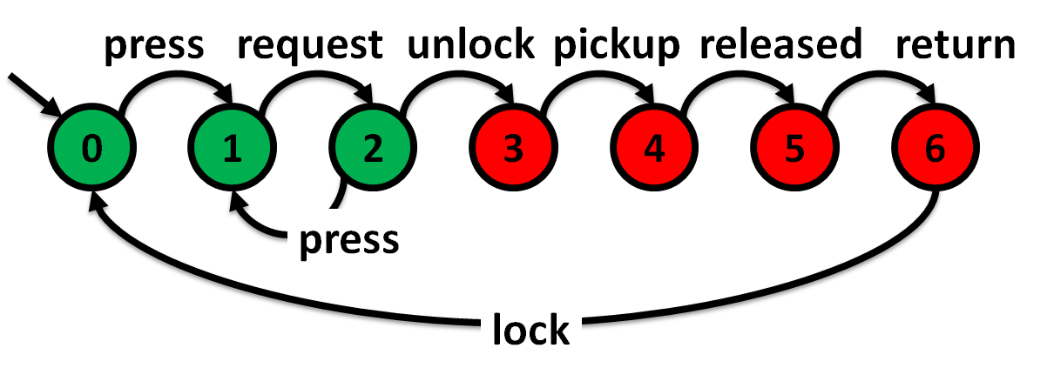
Hidden requirements behind fluent assignments
Free
?
Locked

Slide 32
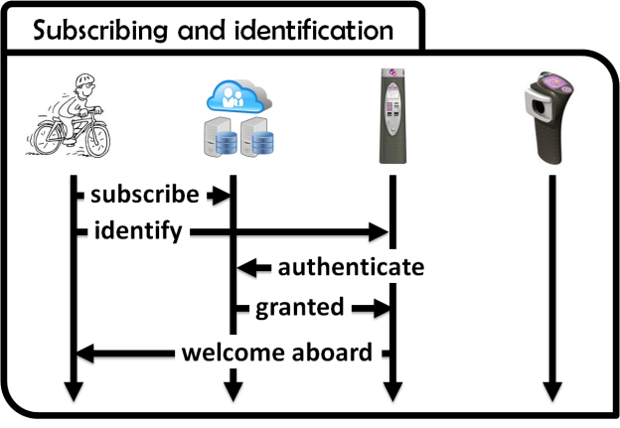
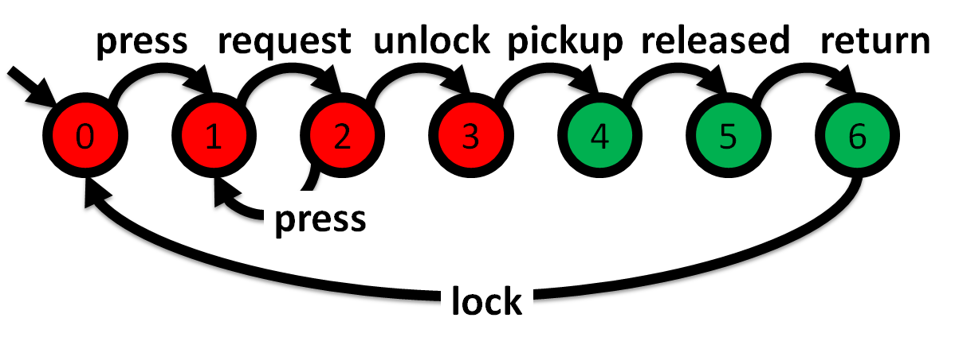
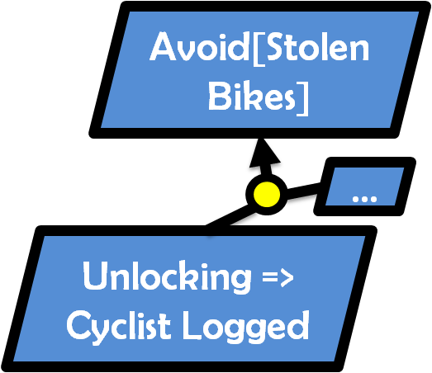
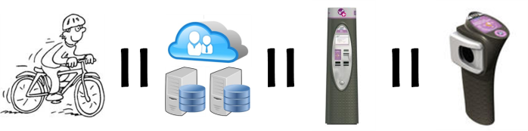
Modeling software systems is hard
?
High-quality models should be adequate, consistent, complete, precise, analyzable, comprehensible [Avl09]

Slide 33


Automated support for high-quality system modeling
Consistency
Build a model, Claim properties, Check them, Correct the model and the properties…
Completion
Build a model, Infer properties, Validate them, Complete the model and the properties…

Slide 34
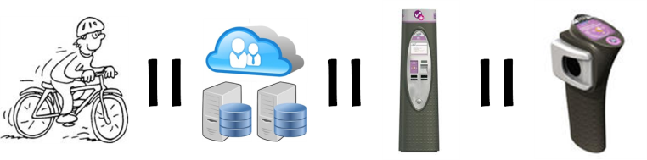

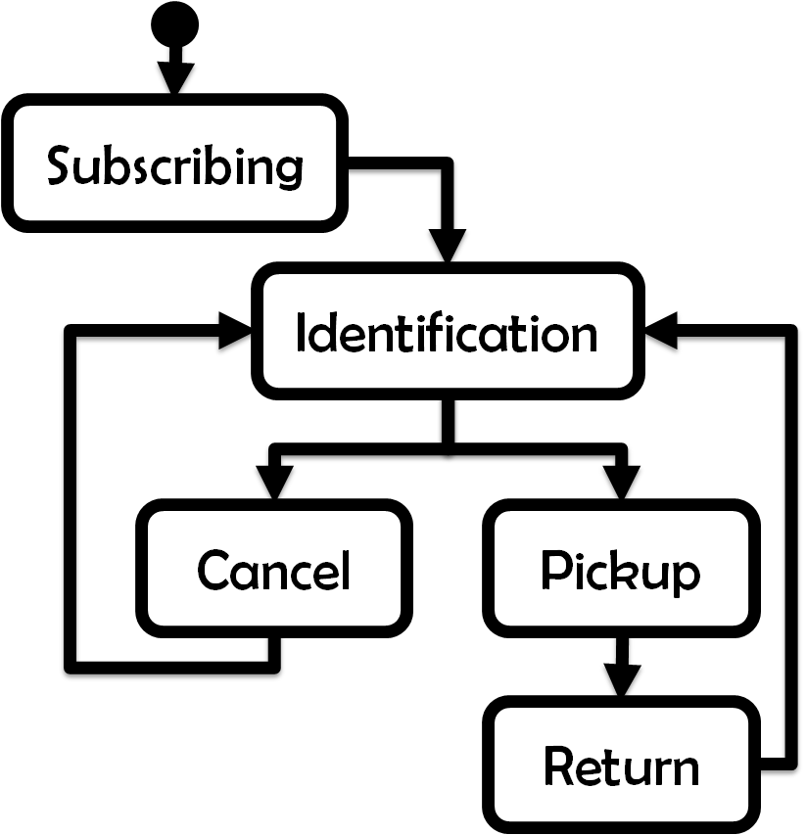
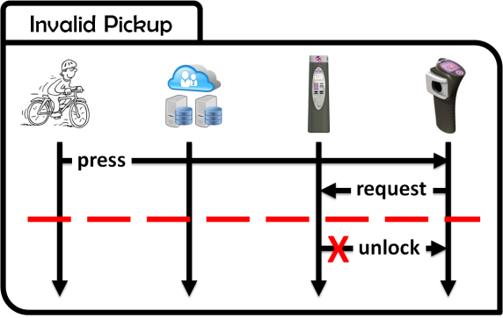
Formal framework for system modeling
Trace semantics

Slide 35

Synthesizing Multi-view Models of Software Systems

Slide 36
State machine induction from scenarios and goals

Slide 37
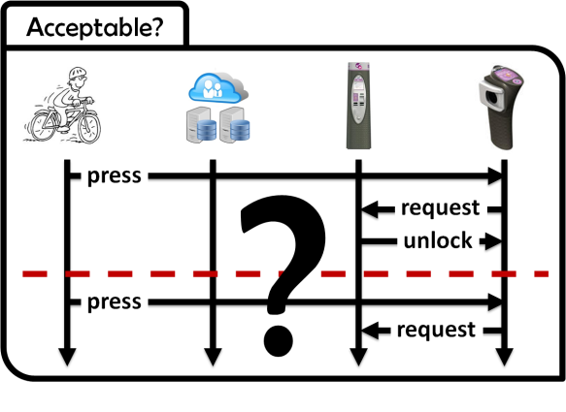

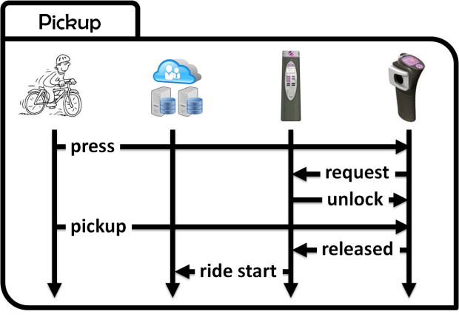
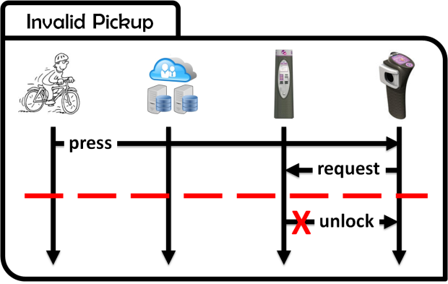

Interactive state machine induction from scenarios
QSM

Slide 38
Scenario questions
Subscribing and identification
?
Pickup
Acceptable?
press
request

Slide 39
Scenario questions
Subscribing and identification
?
Pickup
Acceptable?
X
press

Slide 40
Scenario questions
Subscribing and identification
?
Pickup
Acceptable?
press
X
request

Slide 41
Scenario questions
Subscribing and identification
?
Pickup
Acceptable?
press
request
press
request

Slide 42
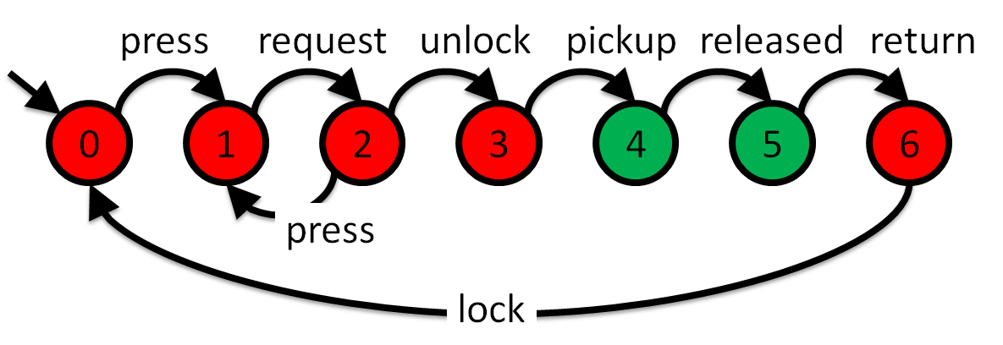
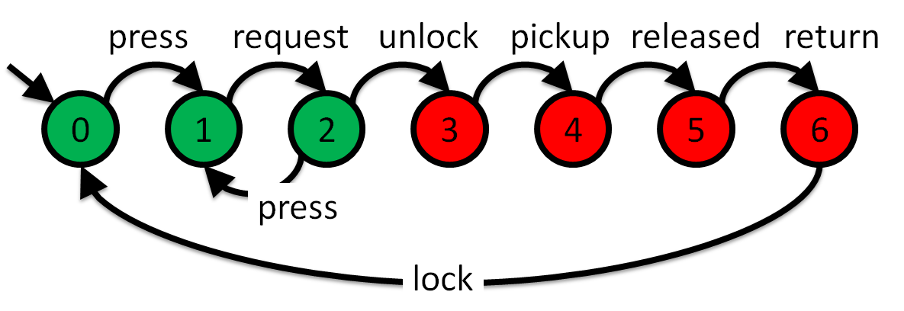
Extra goodness [Dam11]
?
Avoid[ Free and Locked ]
Free
Locked

Slide 43
Questions ?

Slide 44
References
[Avl09] A. van Lamsweerde, Requirements Engineering: From System Goals to UML Models to Software Specifications. Wiley, March 2009.
[Bro87] Brooks, F.P. No silver bullet: Essence and accidents of software engineering. IEEE Computer, 20(4):10-19, April 1987.
[Dam11] C. Damas, Analyzing Multi-View Models of Software Systems, PhD thesis, Université catholique de Louvain, Louvain-la-Neuve, 2011.
[Fea87] M.S. Feather, Language support for the specification and development of composite systems. ACM Transactions on Programming Languages and Systems, 9:198-234, March 1987.
[Fin92] A. Finkelstein, J. Kramer, B. Nuseibeh, A. Finkelstein, M. Goedicke, Viewpoints: A Framework for Integrating Multiple Perspectives in System Development. 2:31-57+, 1992.
[Hoa85] C.A.R. Hoare, Communicating Sequential Processes, Prentice Hall International Series in Computing Science, Prentice Hall, April 1985.
[Mil89] R. Milner, Communication and concurrency, Prentice-Hall, Inc., Upper Saddle River, NJ, USA, 1989.
[Mag99] J. Magee and J. Kramer. Concurrency: State Models and Java Programs, Wiley, 1999.

Slide 45
Avoid[Stolen Bikes]
…
Unlocking => Cyclist Logged
press
request
unlock
pickup
released
return
0
1
2
3
4
5
6
press
lock

Slide 46
Subscribing and identification
subscribe
identify
authenticate
granted
welcome aboard

Slide 47
Pickup
press
request
unlock
pickup
released
ride start

Slide 48
Acceptable?
?
press
request
unlock
press
request

Slide 49
Invalid Pickup
press
request
X
unlock

Slide 50
press
request
unlock
pickup
released
return
0
1
2
3
4
5
6
press
lock
press
request
unlock
pickup
released
return
0
1
2
3
4
5
6
press
lock

Slide 51
Subscribing
Identification
Cancel
Pickup
Return

