Slide 1
The Stamina Competition
April 2011

Slide 2
Overview
Online Regular Induction Contest
Extends former competitions, especially Abbadingo
Cross-fertilization between the machine learning and software engineering communities
Key points
Focus on the complexity of the learning with respect to the alphabet size
Adapted generation protocol for state machines and samples to mimic features of behavior models
Not an evaluation of the thesis techniques per se
Unsupervised learning (i.e. no oracle, no queries)
No pruning with fluents, goals, control information

Slide 3
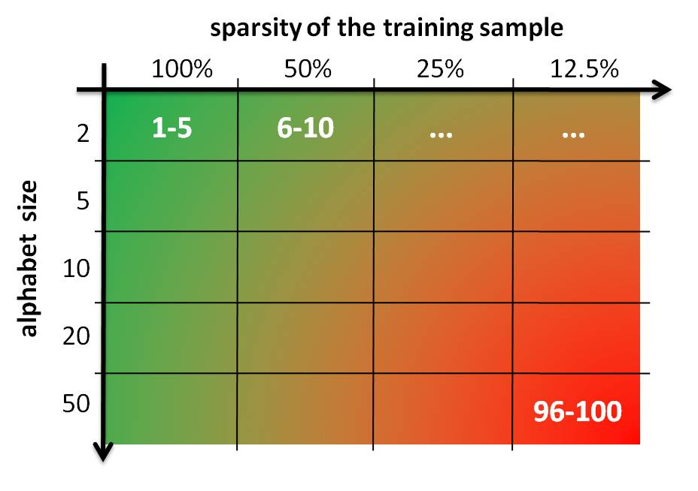
Competition overview
100 induction problems (20 cells of 5 problems)
Two difficulty dimensions
alphabet size vs. sparsity of learning sample
Solving a problem
Download learning (labeled) and test (unlabeled) samples
Learn a model (typically a DFA)
Label the test sample using learned model
Submit labeling on the competition server

Slide 4
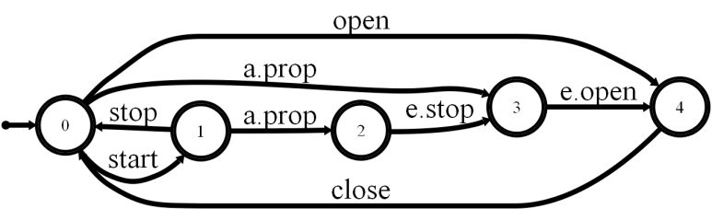
Scientific setup State Machines
Approach
Review of SE litterature to identify representative features of behavior models
Tuning of the Forest-fire algorithm to mimic these features
Main features
Approximately 50 states (to avoid adding a third difficulty dimension to the competition)
Alphabet sizes ranging from 2 to 50 letters
Equal proportion of accepting vs. rejecting states
Large variance of degree distribution, to mimic behavior models

Slide 5
Scientific setup Samples
Controller
Actuators & Sensors
Passenger
start
a. pressed
a. propagated
e. stop
e. open
Approach
Generated by the target machine: random walk algorithm
Negative strings by randomly perturbing positive ones
three kinds of edit: substitution, insertion and deletion
Tuned to ensure good induction results using Blue-Fringe on the simplest problems
Main features
Learning and test samples do not overlap
Learning samples may contain duplicates, as a consequence of the random walk generation
String length distribution: centered on 5 + depth(automaton)

Slide 6
Scientific setup Submission & Scoring
Submission
Solutions submitted as binary strings labelling the test sample
Binary feedback (problem broken or not broken), to avoid hill-climbing
Scoring
Balanced Classification Rate to place equal emphasis on accuracy in terms of positive and negative strings
Problem broken if BCR score >= 0.99
A cell is broken if all problems it contains are broken

Slide 7
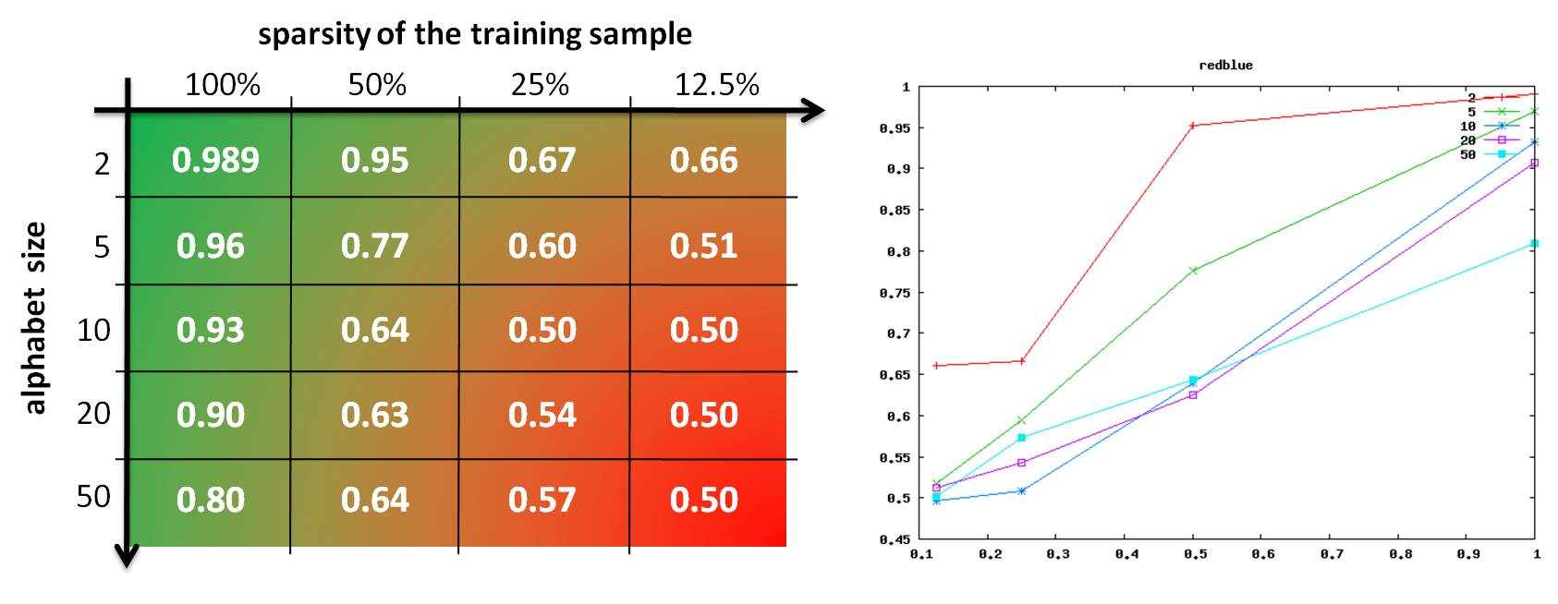
Scientific setup Baseline
Problem grid empirically ajusted
To ensure good induction results using Blue-Fringe on the simplest problems
Without breaking the cell

Slide 8
Scientific setup Baseline: lessons learned
RPNI and BlueFringe converge on largest alphabets
Theoretically expected, big samples needed in practice
Size of the alphabet "hurts" convergence in practice
Confirms experimentally what we expected theoretically
Supports the interest of launching Stamina

Slide 9
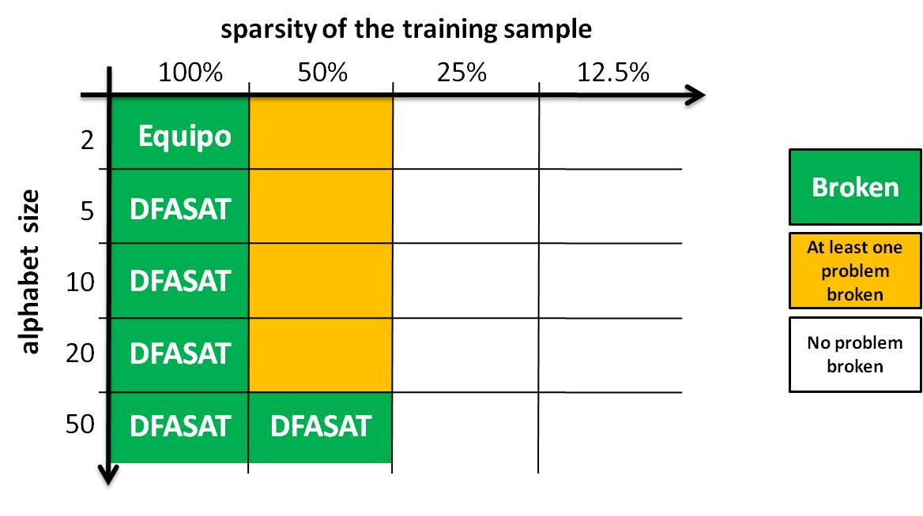
Participation overview
Between march and december 2010 (official)
1856 submissions made by 11 challengers
65 winning submissions broke 42 problems
6 cells broken, by 2 challengers (Equipo & DFASAT)

Slide 10
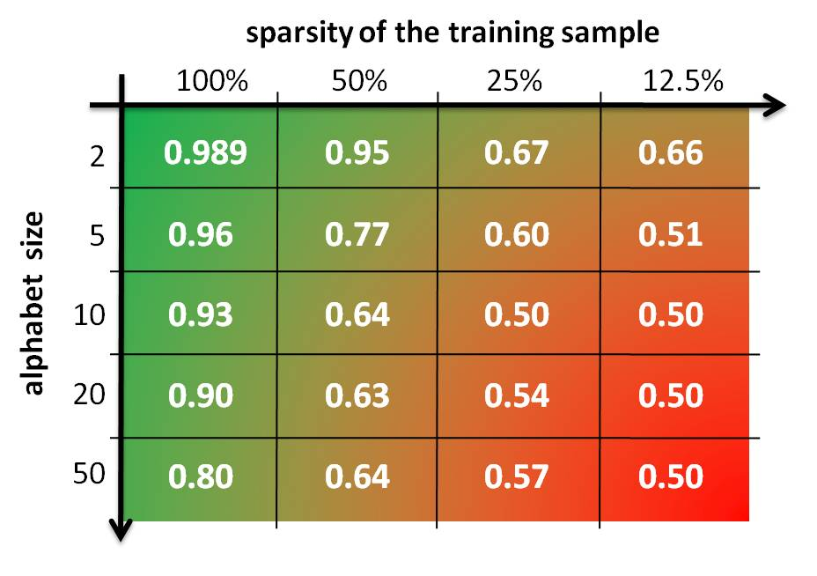
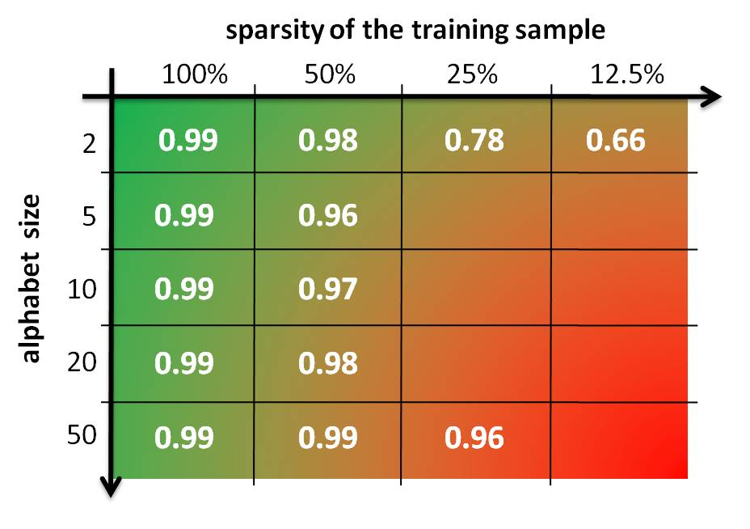
A big winner - DFASAT Marijn Heule & Sicco Verwer
Blue-Fringe
DFASAT

