Slide 1
Synthesizing Multi-View Models of Software Systems
PhD dissertation
Lambeau Bernard
ICTeam Institute
Université catholique de Louvain
November 2011

Slide 2
Outline
Introduction
A step-by-step explanation of the thesis title
Two model synthesis techniques
Model synthesis for formal process analysis
Inductive synthesis of state machines from scenarios
Conclusion
Stuff you should remember

Slide 3
Synthesizing Multi-view Models of Software Systems
A system is a set of active components, called agents, that behave and interact so as to fulfill goals
Agents restrict their behavior to ensure the goals they are responsible for [Fea87, Avl09]

Slide 4
Synthesizing Multi-view Models of Software Systems
A system is a set of active components, called agents, that behave and interact so as to fulfill goals
Agents restrict their behavior to ensure the goals they are responsible for [Fea87, Avl09]
Some agents are software components, i.e. automated agents

Slide 5
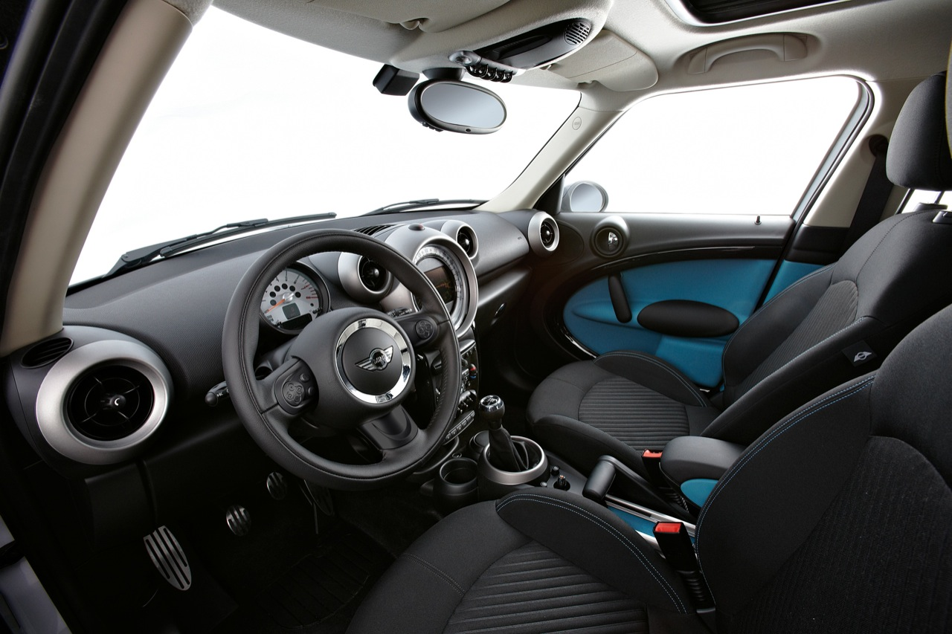
Examples
with courtesy of egmcartech.com

Slide 6

Examples
with courtesy of 20minutes.fr

Slide 7
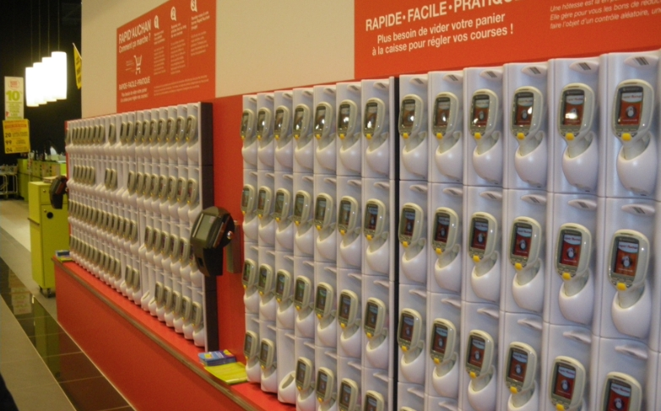
Examples
with courtesy of quechoisir.fr

Slide 8
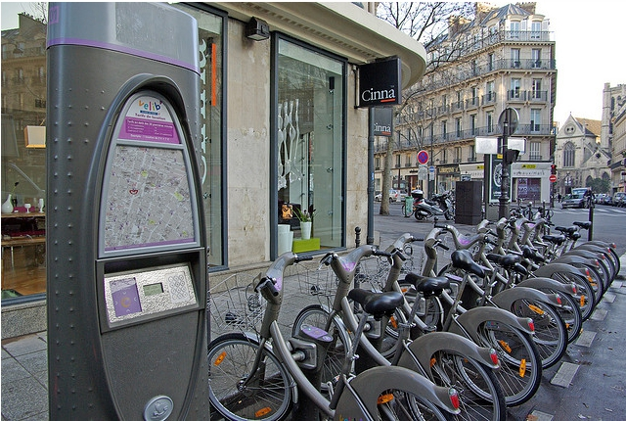
Examples
© Florence S.

Slide 9





Synthesizing Multi-view Models of Software Systems
subscribe
unlock
authenticate
identify
pickup / return

Slide 10
Building software systems is hard

Slide 11
The solution is highly technical
website
electro-mechanical devices
internet
mails, sms, etc.
smart card, keyboard, touch screen

Slide 12
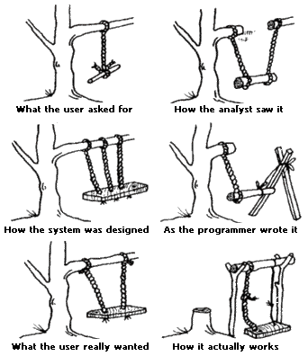
What is the problem?
The hardest part of software development is determining what the system should do and why it should do so [Bro87]

Slide 13
What is the problem?
The hardest part of software development is determining what the system should NOT do and why it should NOT do so
© Florence S.

Slide 14
Synthesizing Multi-view Models of Software Systems
Models help reasoning about the problem
Elaborating requirements and exploring designs
Abstracting from numerous details
They also help building the solution
Code generation from higher-level abstractions
Design documentation

Slide 15
Synthesizing Multi-view Models of Software Systems
Different models capture different system aspect
Structural: agents and their interfaces?
Behavioral: how do they behave?
Intentional: why do they behave that way?
Operational: what tasks, in what order?
Models also overlap in their description of the target system

Slide 16
Scenarios
Subscribing and identification
subscribe
identify
authenticate
granted
welcome aboard

Slide 17
High-level Scenarios
Subscribing and identification
Pickup
request bicycle
pick one
press
request
unlock
pickup
free
ride start

Slide 18
Negative Scenarios
Invalid Pickup
press
request
X
unlock

Slide 19
Negative Scenarios
Why (not) ?
Invalid Pickup
press
request
X
unlock

Slide 20
Goals & Requirements
Avoid[Stolen Bicycles]
Maintain[ Unlocking => User Authenticated]
…
…
fluent Authenticated = <
{ access granted },
{ ride start } > initially false

Slide 21
Agent state machines
press
request
unlock
pickup
free
press
request
unlock
pickup
free
return
0
1
2
3
4
5
6
press
timeout
lock

Slide 22
Agent state variables
fluent BicyclePresent = <
{ return },
{ pickup } > initially true
press
request
unlock
pickup
free
return
0
1
2
3
4
5
6
press
timeout
lock

Slide 23
Agent state variables
fluent Locked = <
{ lock },
{ unlock } > initially true
press
request
unlock
pickup
free
return
0
1
2
3
4
5
6
press
timeout
lock

Slide 24
System behavior
||
||
||
Parallel composition of agent behaviors
Agents behave asynchronously but synchronize on shared events
System behavior captured through a state machine

Slide 25
Modeling software systems is hard
||
||
||
High-quality models should be
Adequate, consistent, complete, precise, analyzable, comprehensible, etc.
Natural consequence of the “building software systems is hard” claim

Slide 26
Synthesizing Multi-view Models of Software Systems

Slide 27
Model synthesis for formal analysis
press
request
unlock
pickup
free
return
¬ Locked ⇒ o (¬ BicyclePresent ∨ Locked)
0
1
2
3
4
5
6
press
timeout
lock

