Slide 1
Synthesizing Multi-View Models of Software Systems
Lambeau Bernard
ICTeam Institute
Université catholique de Louvain
November 2011

Slide 2
Outline
Introduction
A step-by-step explanation of the thesis title
Inductive synthesis of state machines from scenarios
A model synthesis technique in action
Conclusion
What should you remember?

Slide 3
Synthesizing Multi-view Models of Software Systems
A system is a set of active components, called agents, that interact so as to fulfill goals
Agents restrict their behavior to ensure the goals they are responsible for [Fea87, Avl09]

Slide 4
Synthesizing Multi-view Models of Software Systems
A system is a set of active components, called agents, that interact so as to fulfill goals
Agents restrict their behavior to meet the goals they are responsible for [Fea87, Avl09]
Some agents are software components, i.e. automated agents

Slide 5
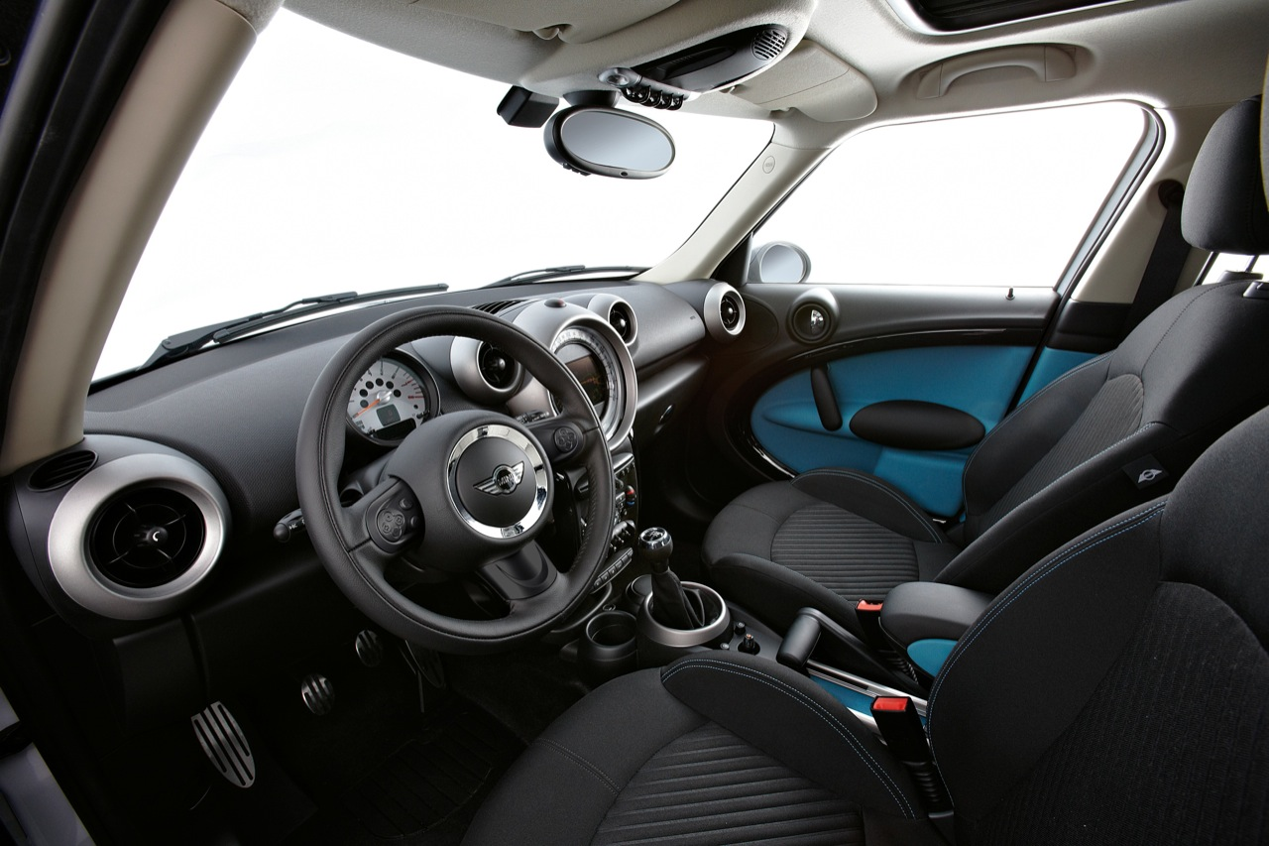
Examples
with courtesy of egmcartech.com

Slide 6
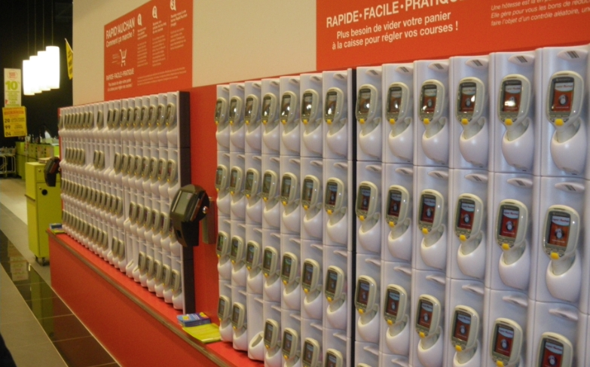
Examples
with courtesy of quechoisir.fr

Slide 7
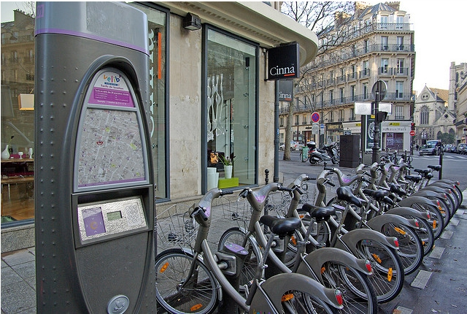
Examples
© Florence S.

Slide 8
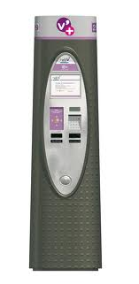




Building software systems is hard

Slide 9
The solution is highly technical
website
electro-mechanical devices
internet
mails, sms, etc.
smart card, keyboard, touch screen

Slide 10
What about the problem?
?
The hardest part of software development is determining what the system should do [Bro87]

Slide 11
Is this interaction right?
Pickup
request bike
unlock
pickup

Slide 12
Not necessarily…
The hardest part of software development is determining what the system should (not) do
© Florence S.

Slide 13
Synthesizing Multi-view Models of Software Systems
Models help reasoning about the problem
Elaborating requirements and exploring designs
Abstracting from numerous details
They also help building the solution
Code generation from high-level abstractions
Documentation and traceability of design decisions

Slide 14
Synthesizing Multi-view Models of Software Systems
Different models capture different system aspects
Structural: agents and their interfaces?
Behavioral: how do they behave?
Intentional: why do they behave that way?
Operational: what tasks, in what order?

Slide 15
Scenarios
Subscribing and identification
subscribe
identify
authenticate
granted
welcome aboard

Slide 16
High-level Scenarios
Subscribing and identification
Pickup
press
request
unlock
pickup
released
ride start

Slide 17
Negative Scenarios
Invalid Pickup
press
request
X
unlock

Slide 18
Negative Scenarios
Why (not) ?
Invalid Pickup
press
request
X
unlock

Slide 19
Goals & Requirements
Avoid[Stolen Bikes]
Unlocking => Authenticated
?
?
Agents restrict their behavior to meet the goals they are responsible for

Slide 20
Agent behaviors through state machines
press
request
unlock
pickup
released
press
request
unlock
pickup
released
return
0
1
2
3
4
5
6
press
lock

Slide 21
System behavior through composition
||
||
||
Parallel composition of individual agent behaviors [Hoa85]
Agents behave asynchronously but synchronize on shared events [Mil89, Mag99]

Slide 22
System behavior through composition
||
||
||
Avoid[Stolen Bikes]
The composed system should meet high-level goals
…
Agents restrict their behavior to meet the goals they are responsible for
Unlocking => Authenticated

Slide 23
Agent state variables
fluent Authenticated = <
{ granted },
{ ride start } > initially false
…
granted
…
The user is automatically unlogged when a bike has been
picked up and the ride started accordingly
ride start
…

Slide 24
Agent state variables
fluent Free = <
{ pickup },
{ return } > initially false
press
request
unlock
pickup
released
return
0
1
2
3
4
5
6
press
lock

Slide 25
Agent state variables
fluent Locked = <
{ lock },
{ unlock } > initially true
press
request
unlock
pickup
released
return
0
1
2
3
4
5
6
press
lock

Slide 26
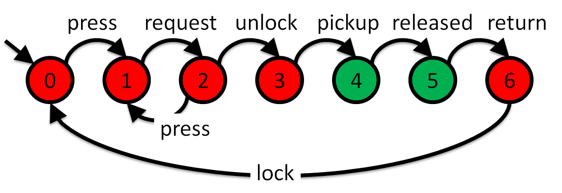
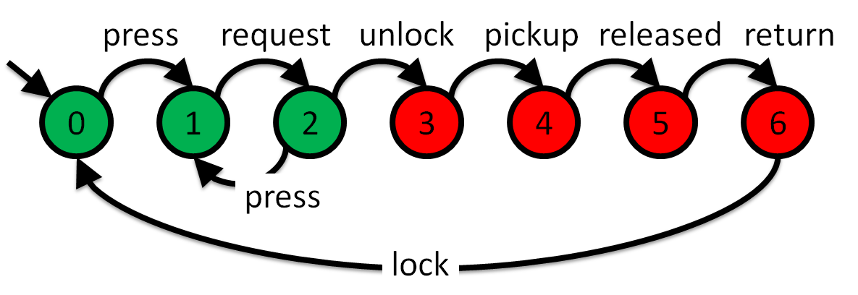
Hidden goals behind assignments
Free
?
Locked

Slide 27
Modeling software systems is hard
?
High-quality models should be adequate, consistent, complete, precise, analyzable, comprehensible [Avl99]

Slide 28


Automated support for system modeling
Model analysis
Build a model, Claim properties, Check them, Correct/Complete the model and the properties…
Model synthesis
Build a model, Infer properties, Validate them, Correct/Complete the model and the properties…

Slide 29
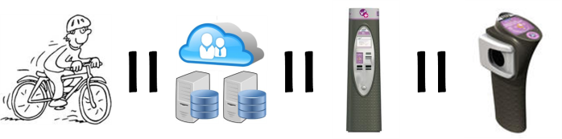
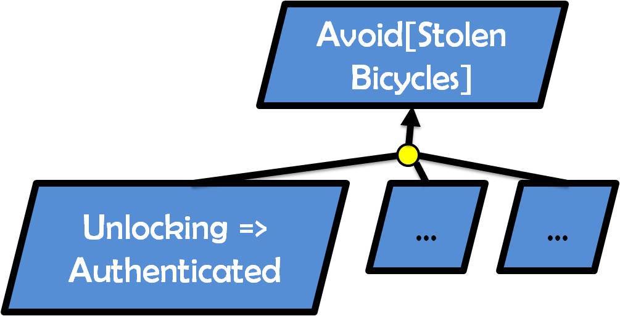
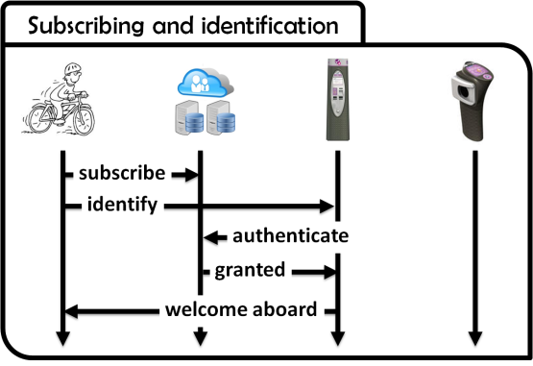
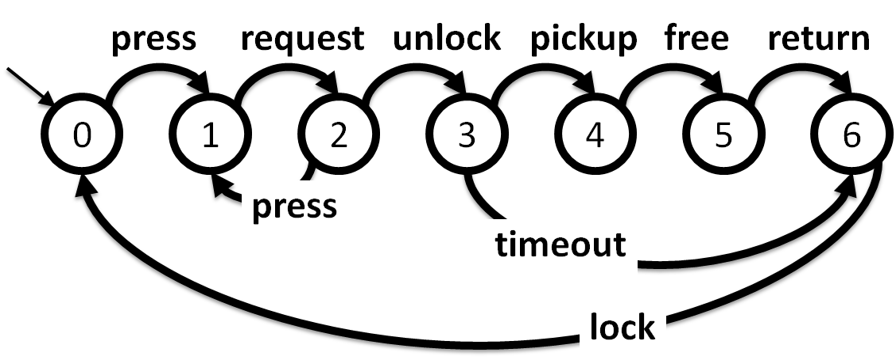
Formal framework for system modeling
Trace semantics

Slide 30
Synthesizing Multi-view Models of Software Systems
Operational semantics of process models
Formal support enabling a variety of model checks on process models [Dam11]
Interactive state machine induction from scenarios
Reasoning about agent and system behaviors with scenarios, state machines, and goals
Tool-supported, evaluated techniques

Slide 31
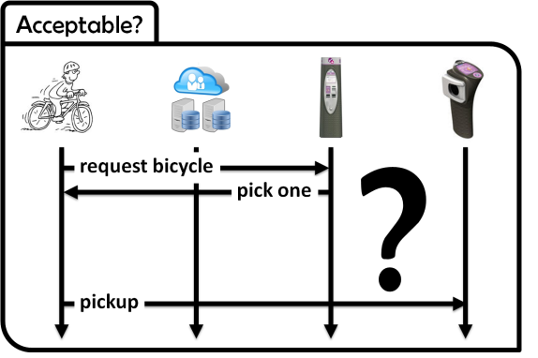

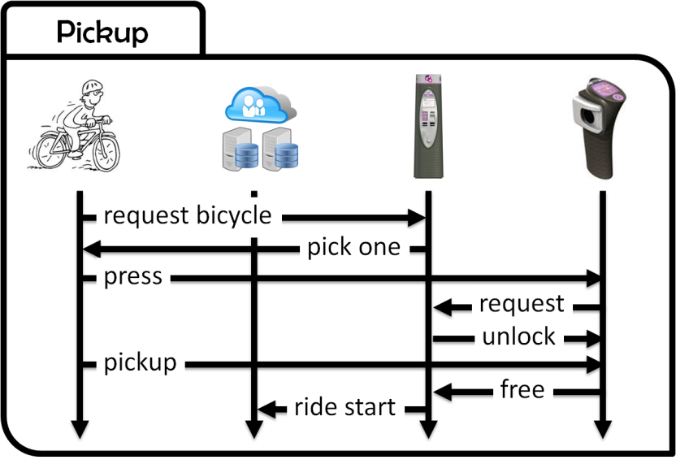
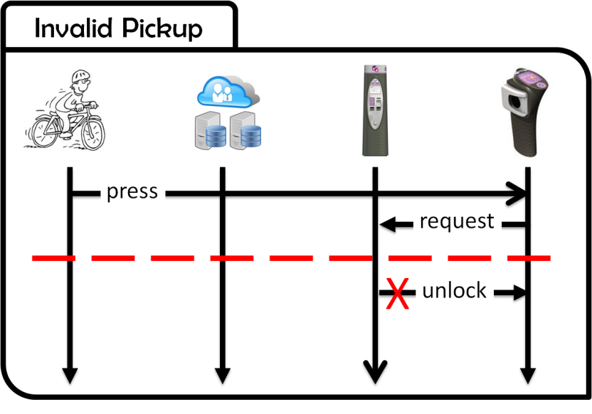

Interactive state machine induction from scenarios
QSM

Slide 32
Scenario questions
Subscribing and identification
?
Pickup
Acceptable?
press
request

Slide 33
Scenario questions
Subscribing and identification
?
Pickup
Acceptable?
X
press

Slide 34
Scenario questions
Subscribing and identification
?
Pickup
Acceptable?
press
X
request

Slide 35
Scenario questions
Subscribing and identification
?
Pickup
Acceptable?
press
request
press
request

Slide 36
Extra goodness [Dam11]
?
Avoid[ Free and Locked ]
Free
Locked

