Slide 1
Synthesizing Multi-View Models of Software Systems
Lambeau Bernard
PhD. Private Defense
ICTeam Institute
Université catholique de Louvain
October 2011

Slide 2
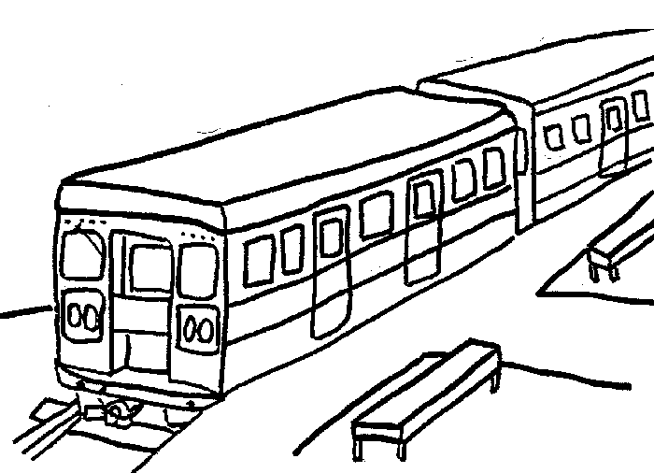
The Little Train System
The system is composed of
A train controller
A train actuator/sensor
A passenger
The train controller controls operations such as start, stop, open doors, and close doors
A safety goal requires train doors to remain closed while the train is moving
If the train is not moving and a passenger presses the alarm button, the controller must open the doors in emergency
If the train is moving and …, it must stop the train first and then open the doors in emergency

Slide 3

The Meeting Scheduler System [Fea97]
The system is composed of
A meeting initiator
Participants
An automated scheduler
Typical ideal scenario
An initiator issues a meeting request, specifying the expected participants and a date range for the meeting
The scheduler then sends an electronic invitation to each participant, requesting them to provide their date constraints
The meeting is automatically planned at a date meeting all constraints

Slide 4
Modeling Software Systems
Why ?
Elaborating requirements and exploring design
Reasoning about, verifying and documenting systems
Generating code, prototypes, etc.
Models have many advantages
Force stakeholders to be precise in their descriptions
Abstract from unnecessary details while enforcing separation of concerns
Enable the early detection and fixing of errors

Slide 5
Multi-View Modeling
Different models focus on different system dimensions
Intentional: goal, rule-based models
Structural: object, agent, architecture models
Operational: task, process, workflow models
Behavioral: scenarios, state machines
Requirements on multi-view modeling languages and models
Multi-level, analyzable, adequate, complete, precise, consistent, comprehensible, …
Building high-quality models is hard
Tool-supported techniques are needed for supporting analysts and stakeholders
(Semi-)formal modeling approaches are needed here

Slide 6
Multi-view Model Synthesis
Promising approach for model building
High-quality models, especially towards increased completeness, consistency and precision
Works hand in hand with model analysis [Dam11]
Vertical model synthesis
To derive lower-level models from higher-level ones
Operational semantics from the latter and makes model checking tools available to them
Horizontal model synthesis
To build model fragments missing from a multi-view framework or complete existing ones
That is, using consistency rules the other way round

Slide 7
Manuscript Content at a Glance
Background on a multi-view modeling framework
Derivation of State Machine Models from Process Models
Vertical synthesis enabling trace-based model checking of process models (operational semantics)
Inductive Synthesis of State Machines from Scenarios
Horizontal synthesis aimed at completing model fragments in a triangle made of scenarios, state machines and goals
Evaluation of inductive synthesis
On case studies and synthetic datasets
Yielding a novel evaluation protocol and an online platform
Tool support
A model checker for process models; an interactive state machine synthesizer; a process model analyzer

Slide 8
Manuscript Content at a Glance
Background on a multi-view modeling framework
Derivation of State Machine Models from Process Models
Vertical synthesis enabling trace-based model checking of process models (operational semantics)
Inductive Synthesis of State Machines from Scenarios
Horizontal synthesis aimed at completing model fragments in a triangle made of scenarios, state machines and goals
Evaluation of inductive synthesis
On case studies and synthetic datasets
Yielding a novel evaluation protocol and an online platform
Tool support
A model checker for process models; an interactive state machine synthesizer; a process model analyzer

Slide 9
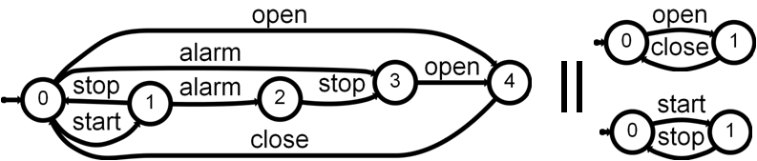
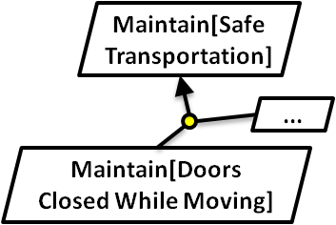
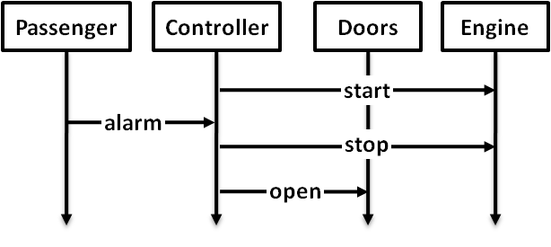
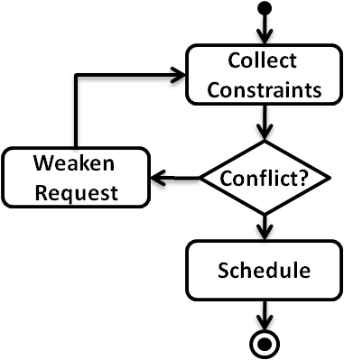
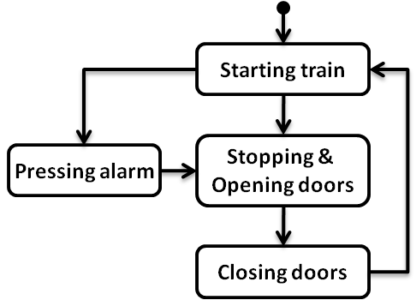
Derivation of State Machine Models from Process Models
Agent state machines (LTS)
Goals & Domain Properties (FLTL)
Scenarios (MSC)
Event traces (LTS) + State annotations (fluents)
High-level scenarios (hMSC)
Process
models (g-hMSC)

Slide 10
Inductive Synthesis of State Machines from Scenarios
Agent state machines (LTS)
Goals & Domain Properties (FLTL)
Scenarios (MSC)
Event traces (LTS) + State annotations (fluents)
High-level scenarios (hMSC)
Process
models (g-hMSC)

Slide 11
Multi-view Modeling Framework
Agent state machines (LTS)
Goals & Domain Properties (FLTL)
Scenarios (MSC)
Event traces (LTS) + State annotations (fluents)
High-level scenarios (hMSC)
Process
models (g-hMSC)

Slide 12
Traces & Labeled Transition Systems
Agent state machines (LTS)
Goals & Domain Properties (FLTL)
Scenarios (MSC)
Event traces (LTS) + State annotations (fluents)
High-level scenarios (hMSC)
Process
models (g-hMSC)

Slide 13
Traces & Labeled Transition Systems
Focus on agent and system behaviors
Defined as (infinite) sets of (finite) traces exhibited by the system / agents
Traces are sequences of events
As observed by the environment
Trace behavioral equivalence [Hoa85]
Event traces (LTS) + State annotations (fluents)

Slide 14
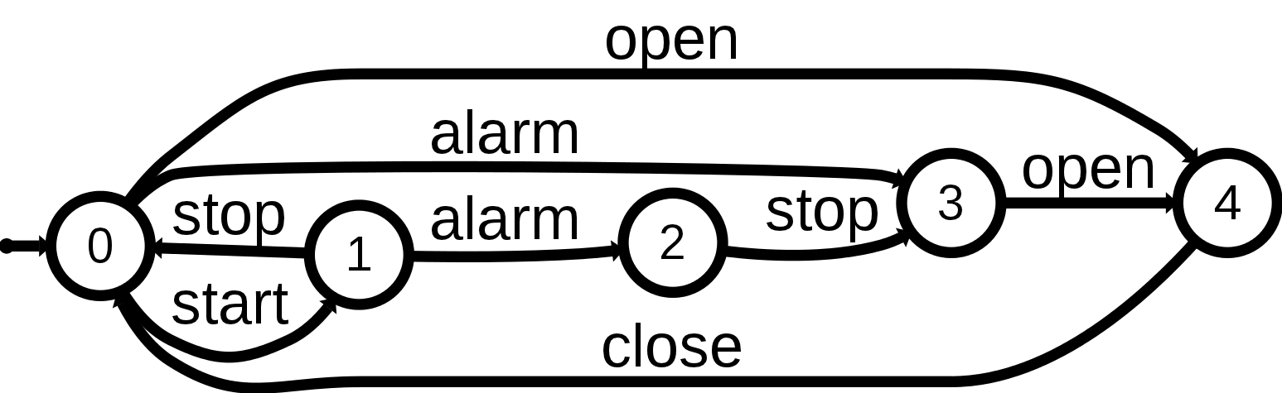
Traces & Labeled Transition Systems
Trace semantics through LTS [Kel76, Mag99]
Set of traces ≅ existing paths in the graph
A subclass of standard automata with all accepting states [Hop79]
Operators and algorithms
Inherited from regular languages theory (union, intersection, difference, complement) [Hop79]
Composition and hiding [Mag99]

Slide 15
Semantics of the Various Models
Agent state machines (LTS)
Goals & Domain Properties (FLTL)
Scenarios (MSC)
Event traces (LTS) + State annotations (fluents)
High-level scenarios (hMSC)
Process
models (g-hMSC)

Slide 16
Semantics of the Various Models
Positive and negative traces
State machines (LTS)
L(Ag)
L(Ag₁ || … || Ag_{n})
Scenarios (MSC)
L⁺(M), L⁺(N), L⁻(N)
L⁺(Sc), L⁻(Sc)
MSC, Negative MSC, Sc collection
High-level scenarios (hMSC)
L⁺_{strong}(H), L⁺_{weak}(H), L⁺_{arch}(H)
Three possible semantics
Goals & DomProp (FLTL)
L⁺(G), L⁻(G)

Slide 17
Consistency rules
…
…
…
…
…
…
…
A system S = (Ag₁ || … || Ag_{n}) is consistent with a goal G (safety property) if
L(Ag₁ || … || Ag_{n}) ∩ L⁻(G) = ∅
…
…
…

Slide 18
Derivation of State Machine Models from Process Models
Agent state machines (LTS)
Goals & Domain Properties (FLTL)
Scenarios (MSC)
Event traces (LTS) + State annotations (fluents)
?
High-level scenarios (hMSC)
Process
models (g-hMSC)

Slide 19
Why deriving state machines from process models ?
Flawed process models can have dreadful consequences in safety critical areas
e.g. process modeling to improve medical safety
Models should be as error-free as possible
Techniques for building them and detecting sereve flaws, e.g. model checking
A formal semantics is therefore required
Enabling analysis techniques from [Dam11]

Slide 20
Process models as Guarded hMSC
Collect Constraints
Invite & Collect
Conflict Notification
AllCstrKnown
Notification
Weaken Request
yes
Conflict?
no
Schedule
Initiator
Scheduler
Participant
Fluent Conflict =
< { conflict_detected },
{ all_constraints_known } > C₀ = ¬ Conflict
initiate
invite
constraints
Cfr. [Dam09, Dam11]

Slide 21
Process models as Guarded hMSC
Tasks as MSCs or finer-grained guarded hMSC
Decisions on fluents
Initial condition C₀ on process instances
Total order among MSC events
We focus on global event traces exhibited by the process, not on specific agent behaviors
Collect Constraints
Weaken Request
yes
Conflict?
no
Schedule
Fluent Conflict =
< { conflict_detected },
{ all_constraints_known } > C₀ = ¬ Conflict

Slide 22
Operational Trace Semantics of Guarded hMSC
1) Rewrite g-hMSC as g-LTS
g-hMSC
model
g-LTS
model
LTS
model
Fluent
definitions
Fluent
g-LTSs
3) g-LTS composition + hiding
2) Fluent operational semantics

Slide 23
Introducing guarded LTS
Transition system with transitions labeled either by a guard, an event, or τ
A structured form of LTS whose states denote classes of pure LTS states
A guard is a propositional formula over fluents
A condition C₀ restricts the admissible fluent assignments in the initial state

Slide 24
Declarative trace semantics of g-LTS
A g-LTS execution (Init, <l₀, …, l_{n}>) accepted if
Trace inclusion: <l₀, …, l_{n}> denotes an existing path
Admissible start: Init |= C₀
Guards satisfaction: guards are satisfied when encountered
Accepted g-LTS traces (Init, <e₀, …, e_{n}>)
Admissible executions where guards are hidden
Accepted LTS traces <e₀, …, e_{n}>
Existential quantification over admissible Init

Slide 25
1) From g-hMSC to g-LTS
1) Rewrite g-hMSC as g-LTS
g-hMSC
model
g-LTS
model
LTS
model
Fluent
definitions
Fluent
g-LTSs
3) g-LTS composition + hiding
2) Fluent operational semantics

Slide 26
1) From g-hMSC to g-LTS
Collect Constraints
Weaken Request
Conflict?
Schedule
C₀ = ¬ Conflict

Slide 27
1) From g-hMSC to g-LTS
Collect Constraints
Weaken Request
Conflict?
CC_{start}
{…}
CC_{end}
Schedule
WR_{start}
{…}
C₀ = ¬ Conflict
WR_{end}
Sch_{start}
{…}
Sch_{end}

Slide 28
1) From g-hMSC to g-LTS
Collect Constraints
Weaken Request
Conflict?
CC_{start}
{…}
CC_{end}
Schedule
WR_{start}
{…}
C₀ = ¬ Conflict
WR_{end}
Sch_{start}
{…}
Sch_{end}

Slide 29
1) From g-hMSC to g-LTS
Collect Constraints
τ
Weaken Request
Conflict?
τ
CC_{start}
{…}
CC_{end}
τ
Schedule
[ Conflict ]
WR_{start}
{…}
C₀ = ¬ Conflict
WR_{end}
[ ¬ Conflict ]
Sch_{start}
{…}
Sch_{end}
τ
C₀ = ¬ Conflict

Slide 30
1) From g-hMSC to g-LTS
Collect Constraints
[ ¬ Conflict ]
τ
Weaken Request
Conflict?
τ
CC_{start}
{…}
CC_{end}
τ
Schedule
[ Conflict ]
WR_{start}
{…}
C₀ = ¬ Conflict
WR_{end}
[ ¬ Conflict ]
Sch_{start}
{…}
Sch_{end}
τ
C₀ = true

Slide 31
2) Fluents as g-LTS automata
1) Rewrite g-hMSC as g-LTS
g-hMSC
model
g-LTS
model
LTS
model
Fluent
definitions
Fluent
g-LTSs
3) g-LTS composition + hiding
2) Fluent operational semantics

Slide 32
2) Fluents as g-LTS automata
Fluent Conflict =
< { conflict_detected },
{ all_constraints_known } >
q_{u}
[¬ Conflict]
[Conflict]
all_constraints_known
conflict_detected
conflict_detected
q_{f}
q_{t}
[¬ Conflict]
[Conflict]
all_constraints_known

Slide 33
3) Compose then hide guards
1) Derive g-hMSC as g-LTS
g-hMSC
model
g-LTS
model
LTS
model
Fluent
definitions
Fluent
g-LTSs
3) g-LTS composition + hiding
2) Fluent operational semantics

Slide 34
3) Compose then hide guards
g-LTS
model
||
LTS
model
Fluent
g-LTSs
g-LTS composition
Synchronize on events
Boolean conjunction on guards, pruned when unsatisfiable
g-LTS hiding
Replace guards by τ
Yields a pure LTS

Slide 35
Composition outline
Initial g-LTS model
q_{start}
[ Fl ]
[ C₀ ]
q₀
…
[ ¬Fl ]
||
q_{u}
[ ¬Fl ]
[ Fl ]
{Term_{Fl}}
{Init_{Fl}}
{Init_{Fl}}
q_{f}
q_{t}
[ ¬Fl ]
{Term_{Fl}}
[ Fl ]

Slide 36
Trace equivalent composed g-LTS
Guard satisfaction
(q₀, q_{t1}, q_{t2}, ...)
[ Fl₁ ]
...
[ ¬Fl₁ ]
Admissible start
(q₀, q_{f1}, q_{t2}, ...)
[ C₀ ∧ Fl₁ ∧ Fl₂ ∧ ...]
[ Fl₁ ]
[ C₀ ∧ ¬Fl₁ ∧ Fl₂ ∧ ...]
...
[ ¬Fl₁ ]
[ C₀ ∧ Fl₁ ∧ ¬Fl₂ ∧ ...]
[...]
(q_{start},q_{u1},q_{u2},...)
[...]
= pruning (unsatisfiable)
...

Slide 37
From operational semantics to trace-based model checking [Gia03]
1)
g-hMSC
model
g-LTS
model
3)
LTS
model
2)
Fluent
definitions
Fluent
g-LTSs
||
Search space automaton
||
Synchronizer
automaton
Tester
automaton
LTL2 Buchi
FLTL (ψ) Property
Buchi (¬ψ)
automaton
Cfr. Tool support

Slide 38
Derivation of State Machine Models from Process Models
Agent state machines (LTS)
Goals & Domain Properties (FLTL)
Scenarios (MSC)
Event traces (LTS) + State annotations (fluents)
High-level scenarios (hMSC)
Process
models (g-hMSC)

Slide 39
Inductive Synthesis of State Machines from Scenarios
Agent state machines (LTS)
Goals & Domain Properties (FLTL)
Scenarios (MSC)
Event traces (LTS) + State annotations (fluents)
High-level scenarios (hMSC)
Process
models (g-hMSC)

Slide 40
Problem statement (simplest)
Given a consistent collection of MSC scenarios showing examples and counterexamples of system behavior
Sc = (S⁺, S⁻)
Synthesize the system as a composition of agent LTSs
System = (Ag₁ || … || Ag_{n})
Such that Sc and System are consistent

Slide 41
Consistency post-conditions
Structural consistency
Synthesized state machines agree with scenarios on the agent decomposition and their respective interface
Consistent agent view
Timelines of positive scenarios and prefixes of negative ones specify existing paths in the corresponding agent state machines
Consistent system view
The system covers all positive scenarios and the preconditions of all negatives ones; it also excludes all negative scenarios

Slide 42
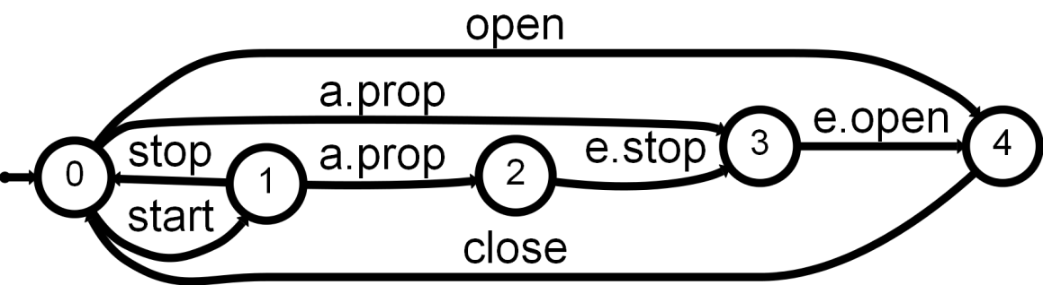
Consistency agent view
Train Controller
Actuator/Sensor
Passenger
start
alarm pressed
alarm propagated
emergency stop
emergency open

Slide 43

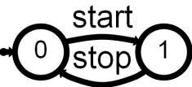
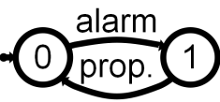
Consistency system view (1/2)
Train Controller
Actuator/Sensor
Passenger
start
alarm pressed
alarm propagated
emergency stop
emergency open
||

Slide 44

Consistency system view (2/2)
Train Controller
Actuator/Sensor
Passenger
start
alarm pressed
alarm propagated
emergency open
||

Slide 45
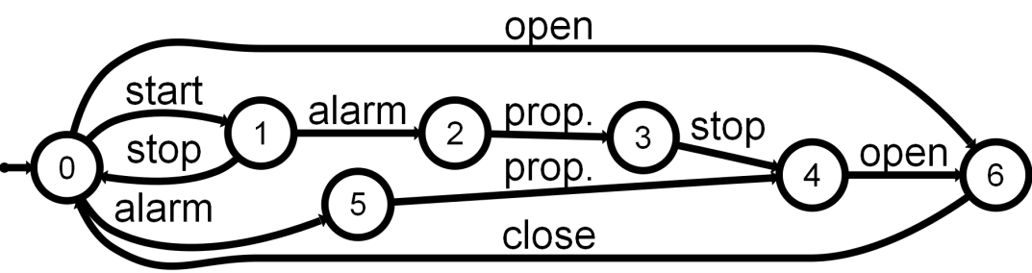
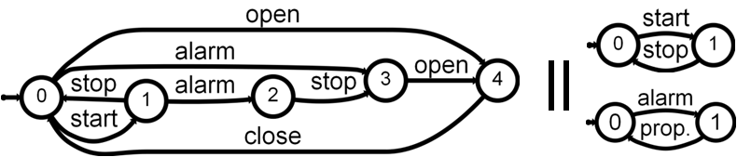
Synthesis Approach
Scenarios
1) Generalization
System LTS
2) Decomposition
Agent LTSs

Slide 46
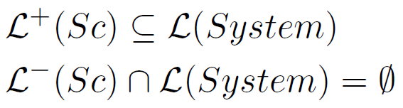
1) Generalization: QSM algorithm
Scenarios
Grammar induction [Onc92], QSM [Dam05, Dup08]
System LTS
Weakened form of the “consistent system view” condition

Slide 47
2) Decomposition: Hiding
Given a consistent System LTS, hiding ensures
Structural consistency
Consistent agent view
Consistent system view (in absence of neg. implied scenarios)
System LTS
Decomposition: hiding [Hop79,Mag99]
Agent LTSs

Slide 48
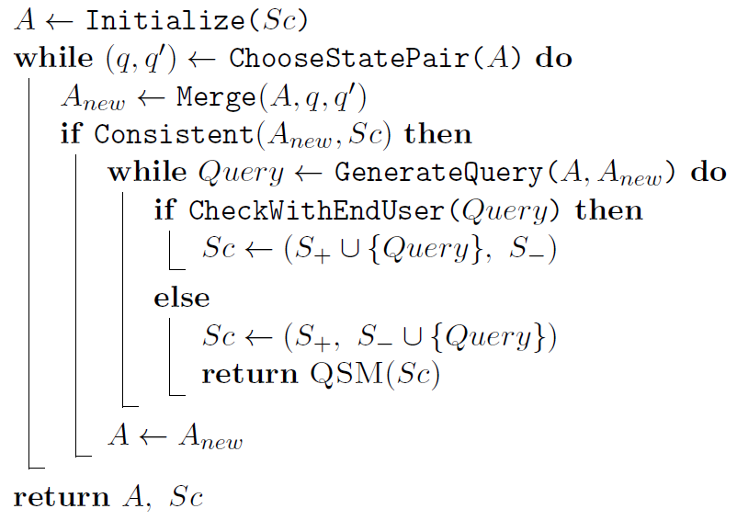
Query-driven State Merging (QSM)
Build an initial solution
Refine it incrementally
Under user control
Keep it if consistent
Return the last solution considered

Slide 49
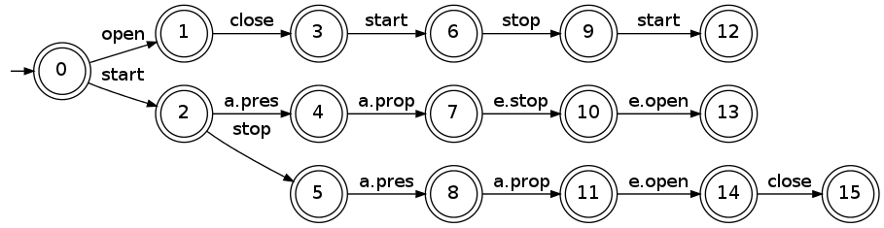
Initial solution: prefix tree acceptor
Largest deterministic automaton accepting all positive traces and rejecting all negative ones
All scenarios start in the same system state

Slide 50
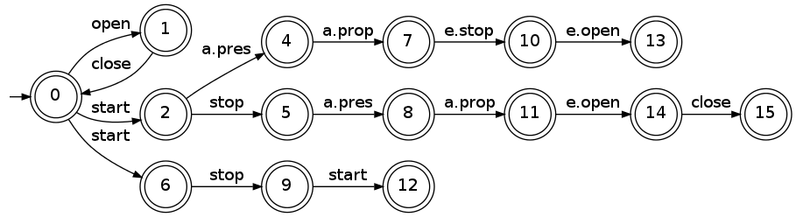
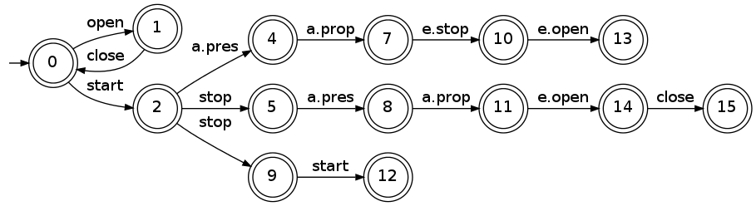
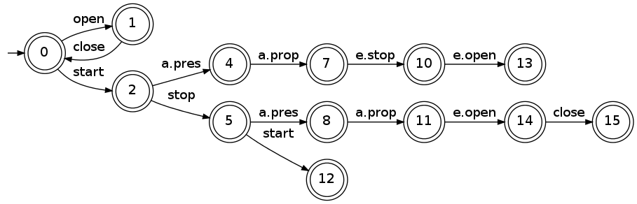
Refinement through state merging
Merge a candidate pair (q, q’) in A
Merging for determinization
Yields a candidate solution A_{new} generalizing A
(q=3, q’=0)
2 and 6
(determ.)
5 and 9
(determ.)

Slide 51
Query-driven State Merging (QSM)
Build an initial solution
Refine it incrementally
Under user control
Keep it if consistent
Return the last solution considered

Slide 52
User control: scenario questions
q=3
q’=0
A
Prefix of q’, suffix of q
Controller
Actuator/Sensor
Passenger
start
stop
start

Slide 53
User control: scenario questions
q=3
q’=0
A_{new}
Question mark to show the prefix already accepted
Controller
Actuator/Sensor
Passenger
start
stop
?
start

Slide 54
Query-driven State Merging (QSM)
Build an initial solution
Refine it incrementally
Under user control
Keep it if consistent
Return the last solution considered

Slide 55
Two axes of improvement
Make the synthesis technique “smarter”
Better generalization accuracy
Reducing the number of scenario questions
Make it more adequate
Strengthening the specification in the presence of domain knowledge and goals
Weakening assumptions on input scenarios, notably the fact that they all start in the same system state

Slide 56
Injection of goals in the process
Agent state machines (LTS)
Goals & Domain Properties (FLTL)
Scenarios (MSC)
Event traces (LTS) + State annotations (fluents)
High-level scenarios (hMSC)
Process
models (g-hMSC)

Slide 57
Injection of goals in the process
Given a consistent collection of scenarios and a set of goals to be met by the system
Sc = (S⁺, S⁻)
G = (G₁, …, G_{n})
Synthesize the system as a composition of agent LTSs
System = (Ag₁ || … || Ag_{n})
Such that Sc, G, and System are consistent

Slide 58
Consistency of a system with goals
A composed system
System = (Ag₁ || … || Ag_{n})
Is consistent with a set of goals
G = (G₁, …, G_{n})
If the following condition holds
L(System) ∩ L⁻(G₁ ∧ … ∧ G_{n}) = ∅
L⁻(G) is captured by an LTS using [Gia03] provided that G denotes a safety property

Slide 59
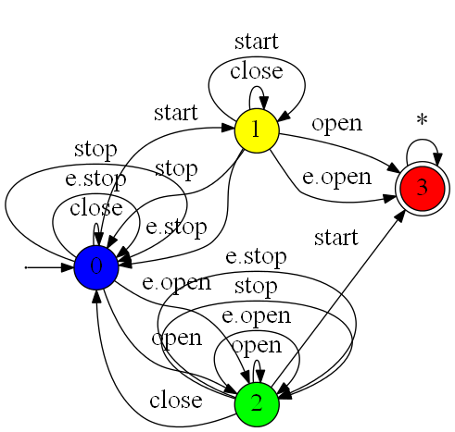

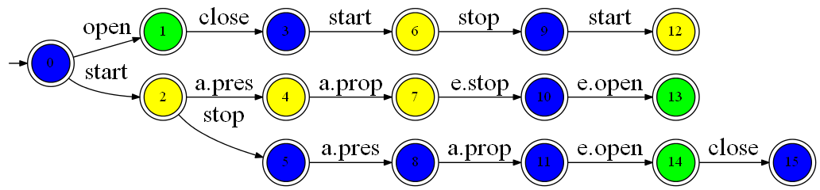
Pruning QSM merging space
[Gia03]
state coloring decoration
Only PTA states sharing the same color are considered for merging by QSM

Slide 60
About knowledge injection
Similar PTA decoration + QSM pruning for
Agent state variables, i.e. fluents
Goals and domain properties
Models of legacy components (known agent LTS)
The technique can be instantiated with any equivalence relation on PTA states
To further guarantee multi-model consistency, prune the search space and speed up induction
*Not* limited to equivalence relations that are invariant under state merging

Slide 61
Structured forms of scenarios
Agent state machines (LTS)
Goals & Domain Properties (FLTL)
Scenarios (MSC)
Event traces (LTS) + State annotations (fluents)
High-level scenarios (hMSC)
Process
models (g-hMSC)

Slide 62
Problem statement revisited
Given a collection of scenarios consistent with a set of hMSCs
Sc = (S⁺, S⁻)
H = (H₁, …, H_{n})
Synthesize the system as a composition of agent LTSs
System = (Ag₁ || … || Ag_{n})
Such that Sc, H, and System are consistent

Slide 63
What about induction samples?
Positive traces: equivalent to only one hMSC
H
H₁
…
H_{n}
S⁺₁
…
S⁺_{n}
Negative traces, from negative scenarios
S⁻₁, …, S⁻_{n}

Slide 64
What about induction samples?
Positive traces: equivalent to only one hMSC
Infinite sets of traces → languages, not samples
L_{weak}(H), L_{strong}(H) or L_{arch}(H) ?
Negative traces, from negative scenarios
As in original statement → a negative sample

Slide 65
Induction from a positive language
Does *not* fit in the theoretical grammar induction framework
“Identification in the limit” supposes samples
Convergence criteria needs to be revisited
*Can* be tackled using state merging algorithms
We adapted RPNI → ASM
No blue-fringe heuristics, no scenario questions, no induction constraints (so far)

Slide 66
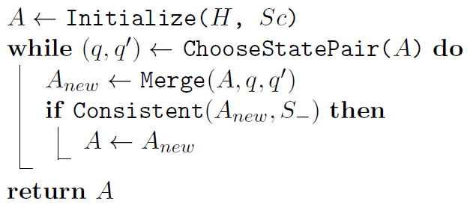
From RPNI to ASM
L(H ∪ Sc⁺) as LTS [Uch03]
Order based on a DFS
No change (but accidental ones)
No change
Automaton State Merging: A is no longer a PTA
Scenario questions, injection of domain knowledge and goals are further discussed

Slide 67
Main Contributions
A vertical synthesis technique of state machines from process models
Operational semantics of guarded hMSC
Supported by two tools: analyzer & model-checker
An horizontal synthesis technique of state machines from scenarios
Inductive & Interactive
Taking domain knowledge and goals into account
Integrated, with other techniques, in the ISIS tool
Contributions to grammar induction
Query-driven & Automaton State Merging
New evaluation framework: Stamina

Slide 68
Questions ?

Slide 69
Perspectives
Goals’
L–(G’)
Goals
L–(G)
QSM*
System
L(Ag₁ || … || Ag_{n})
Scenarios
L⁺(Sc)
Scenarios’
L⁺(Sc’)
oracle
QSM*, natural successor of QSM and ASM
All features integrated within a new framework

Slide 70
Perspectives
Goals’
L–(G’)
Goals
L–(G)
QSM*
QSM*
System
L(Ag₁ || … || Ag_{n})
System
L(Ag₁ || … || Ag_{n})
Scenarios
L⁺(Sc)
Scenarios’
L⁺(Sc’)
oracle

Convergence criteria
Does not yield a new modeling iteration


Slide 71
Perspectives
Goals’
L–(G’)
Goals
L–(G)
QSM*
System
L(Ag₁ || … || Ag_{n})
Goals’’
L–(G’’)
?
Scenarios
L⁺(Sc)
Scenarios’
L⁺(Sc’)
Scenarios’’
L⁺(Sc’’)
oracle
Measuring introduced generalization
Implied scenario analysis [Uch04]

Slide 72
Perspectives
Goals’
L–(G’)
Goals’’
L–(G’’)
Goals
L–(G)
?
QSM*
System
L(Ag₁ || … || Ag_{n})
Scenarios’’
L⁺(Sc’’)
Scenarios
L⁺(Sc)
Scenarios’
L⁺(Sc’)
oracle
Behaviors neither proscribed nor exhibited ?
Related to the use of partial behavior models (MTS) in [Uch09]

Slide 73
Vertical vs. Horizontal Model Synthesis
Abstraction level
From higher-level to lower-level models (operational sem.)
Not necessarily the case with horizontal synthesis
Lifetime of synthesized models
Shorter for vertical synthesis, e.g. limited to the analysis
Horizontal synthesis may yield requirement models and system documentation
Vertical synthesis is derivational by nature whereas horizontal synthesis may be inductive
User involvement
Models kept hidden from the user, who has a passive role
Versus models shown to (validated by) the user, who has an active role

Slide 74
References
[Dam05] C. Damas, B. Lambeau, P. Dupont, and A. van Lamsweerde. Generating annotated behavior models from end-user scenarios. IEEE Transactions on Software Engineering, 31(12):1056-1073, 2005.
[Dam09] C. Damas, B. Lambeau, F. Roucoux, and A. van Lamsweerde. Analyzing critical process models through behavior model synthesis. In ICSE'09: 31th International Conference on Software Engineering, Vancouver, Canada, May 2009.
[Dam11] Christophe Damas. Analyzing Multi-View Models of Software Systems. PhD thesis, Universit catholique de Louvain, Louvain-la-Neuve, 2011.
[Dup08] P. Dupont, B. Lambeau, C. Damas, and A. van Lamsweerde. The QSM algorithm and its application to software behavior model induction. Applied Articial Intelligence, 22:77-115, 2008.
[Gia03] Dimitra Giannakopoulou and Je Magee. Fluent model checking for event-based systems. In ESEC/FSE-11: Proceedings of the 9th European software engineering conference held jointly with 11th ACM SIGSOFT international symposium on Foundations of software engineering, pages 57-266, New York, NY, USA, 2003. ACM.
[Hoa85] C. A. R. Hoare. Communicating Sequential Processes (Prentice Hall International Series in Computing Science). Prentice Hall, April 1985.
[Hop79] J.E. Hopcroft and J.D. Ullman. Introduction to Automata Theory, Languages and Computation. Addison Wesley, Reading, Massachusetts, 1979.

Slide 75
References
[Kel76] Robert M. Keller. Formal verication of parallel programs. Commun. ACM, 19:371{384, July 1976.
[Mag99] J. Magee and J. Kramer. Concurrency: State Models and Java Programs. Wiley, 1999.
[Onc92] J. Oncina and P. Garcia. Inferring regular languages in polynomial update time. In N. Pérez de la Blanca, A. Sanfeliu, and E.Vidal, editors, Pattern Recognition and Image Analysis, volume 1 of Series in Machine Perception and Artificial Intelligence, pages 49-61. World Scientic, Singapore, 1992.
[Uch03] S. Uchitel, J. Kramer, and J. Magee. Synthesis of behavorial models from scenarios. IEEE Transactions on Software Engineering, 29(2):99-115, 2003.
[Uch04] Sebastian Uchitel, Jeff Kramer, and Jeff Magee. Incremental elaboration of scenario-based specifications and behavior models using implied scenarios. ACM Trans. Softw. Eng. Methodol., 13:37{85, January 2004.
[UBC09] Sebastian Uchitel, Greg Brunet, and Marsha Chechik. Synthesis of partial behavior models from properties and scenarios. IEEE Trans. Softw. Eng., 35:384{406, May 2009.

