Slide 1
Synthesizing Multi-View Models of Software Systems
Lambeau Bernard
ICTeam Institute
Université catholique de Louvain
November 2011

Slide 2
Outline
Introduction
A step-by-step explanation of the thesis title
Inductive synthesis of state machines from scenarios
A model synthesis technique in action
Conclusion
What should you remember?

Slide 3
Synthesizing Multi-view Models of Software Systems
with courtesy of egmcartech.com

Slide 4
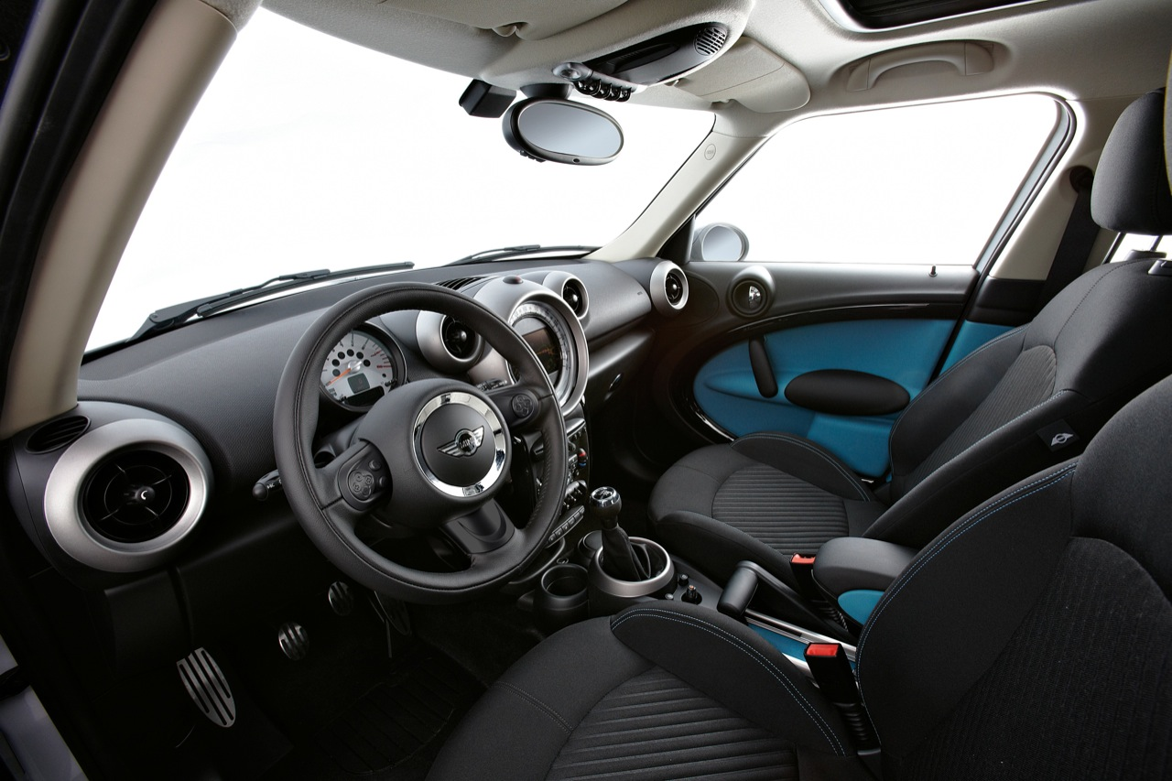
Synthesizing Multi-view Models of Software Systems
with courtesy of egmcartech.com

Slide 5

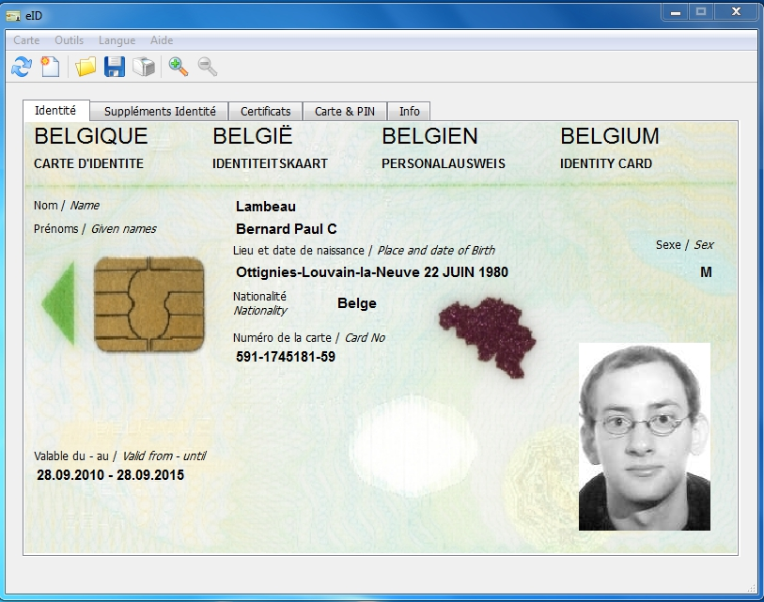
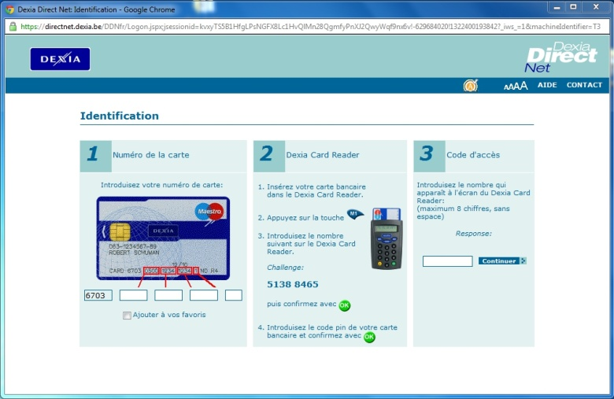
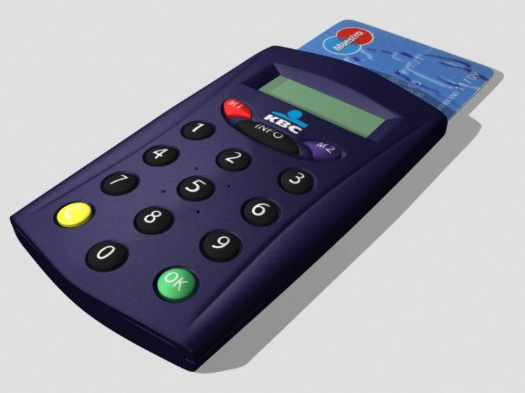

Synthesizing Multi-view Models of Software Systems
with courtesy of egmcartech.com

Slide 6
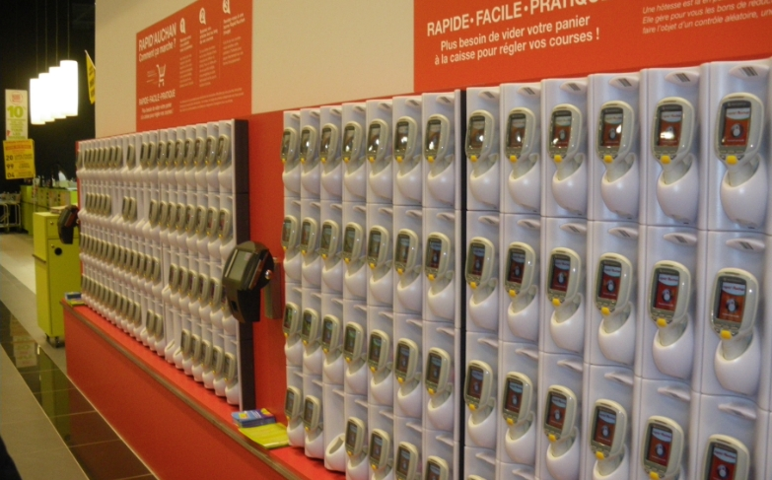
Synthesizing Multi-view Models of Software Systems
with courtesy of quechoisir.fr

Slide 7
Synthesizing Multi-view Models of Software Systems
A system is a set of active components, called agents, that interact so as to fulfill goals
Agents restrict their behavior to meet the goals they are responsible for [Fea87, Avl09]
Some agents are software components, i.e. automated agents
Others are human beings, electronic devices, etc.

Slide 8
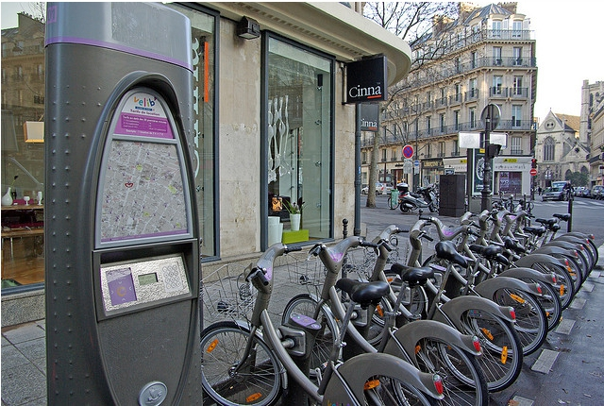
Running example
© Florence S.

Slide 9





Building software systems is hard

Slide 10
The solution is highly technical
website
electro-mechanical devices
internet
mails, sms, etc.
smart card, keyboard, touch screen

Slide 11
What about the problem?
?
The hardest part of software development is determining what the system should do [Bro87]

Slide 12
Is this interaction right?
Pickup
Subscribing and identification […]
request bicycle
unlock
pickup

Slide 13
Not necessarily…
The hardest part of software development is determining what the system should (not) do
© Florence S.

Slide 14
Building software systems is hard
?
The hardest part of software development is determining what the system should do [Bro87]

Slide 15
Synthesizing Multi-view Models of Software Systems
Model
An abstract representation of the target system and its intent
subscribe
…
unlock
identify
pickup

Slide 16
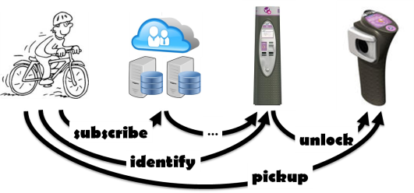
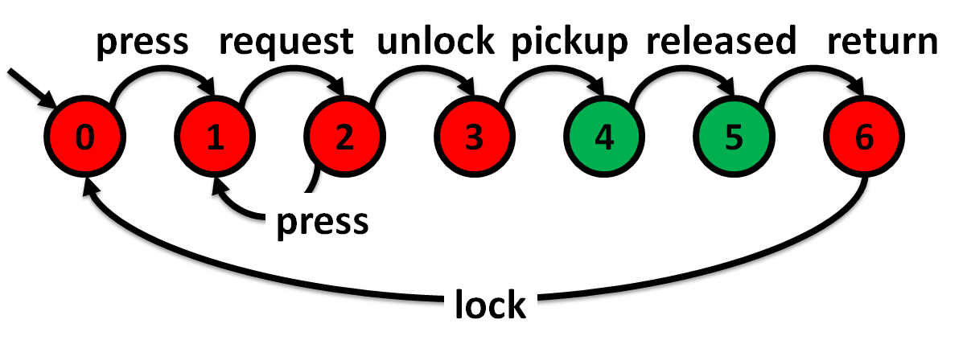
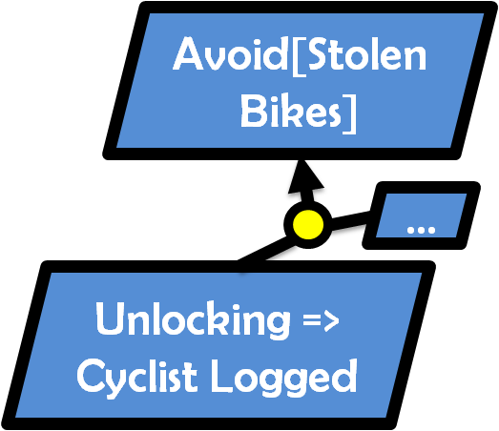
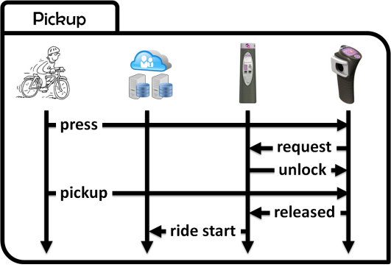
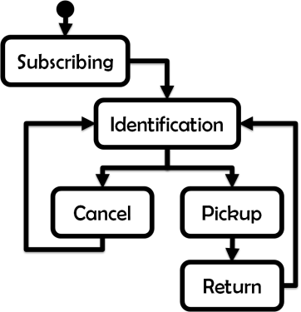
Synthesizing Multi-view Models of Software Systems
Different models cover complementary but overlapping system aspects
Structural
what? who?
Behavioral
how?
Intentional
why?

Slide 17
Scenarios capture examples of agent interactions
Subscribing and identification
subscribe
identify
authenticate
granted
welcome aboard

Slide 18
Flowcharting for temporal sequencing
Subscribing and identification
Pickup
press
request
unlock
pickup
released
ride start

Slide 19
High-level scenarios also support loops and alternatives
Subscribing
Identification
Cancel
Pickup
Return

Slide 20
Counterexamples through Negative Scenarios
Invalid Pickup
press
request
X
unlock

Slide 21
Ask “ why? ” for effective model elicitation
Why (not) ?
Invalid Pickup
press
request
X
unlock

Slide 22
Goals are prescriptive statements of intent
Avoid[Stolen Bikes]
Why?
Unlocking => Cyclist Logged
?
?
Agents restrict their behavior to meet their requirements, i.e. the goals they are responsible for

Slide 23
Agent behaviors through state machines
press
request
unlock
pickup
released
press
request
unlock
pickup
released
return
0
1
2
3
4
5
6
press
lock

Slide 24
System behavior through composition
||
||
||
Parallel composition of individual agent behaviors [Hoa85]
Agents behave asynchronously but synchronize on shared events [Mil89, Mag99]

Slide 25
System behavior through composition
||
||
||
Avoid[Stolen Bikes]
The composed system should meet high-level goals
…
Unlocking => Cyclist Logged
Agents restrict their behavior to meet their requirements

Slide 26
Declarative agent state variables
fluent Cyclist Logged = <
{ granted },
{ ride start } > initially false
…
granted
…
The cyclist is automatically unlogged when a bicycle is released and the ride started accordingly
released
ride start
…

Slide 27
Declarative agent state variables
fluent Free = <
{ pickup },
{ return } > initially false
press
request
unlock
pickup
released
return
0
1
2
3
4
5
6
press
lock

Slide 28
Declarative agent state variables
fluent Locked = <
{ lock },
{ unlock } > initially true
press
request
unlock
pickup
released
return
0
1
2
3
4
5
6
press
lock

Slide 29
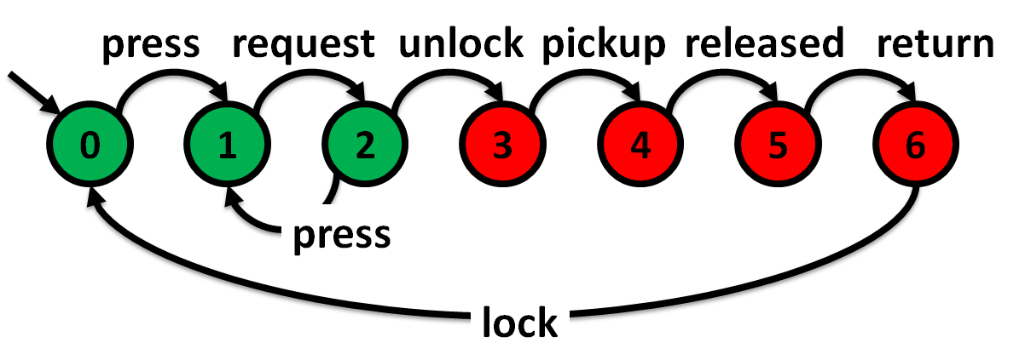
Some requirements are hidden behind fluent assignments
Free
?
Locked

Slide 30
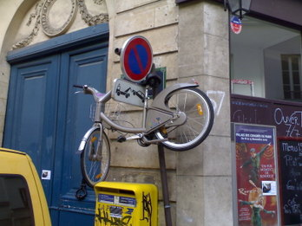
Avoid annoying people… always!
Avoid[ Free and Locked ]
with courtesy of Marc D.

Slide 31
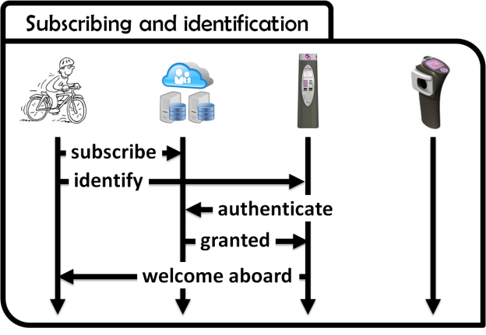
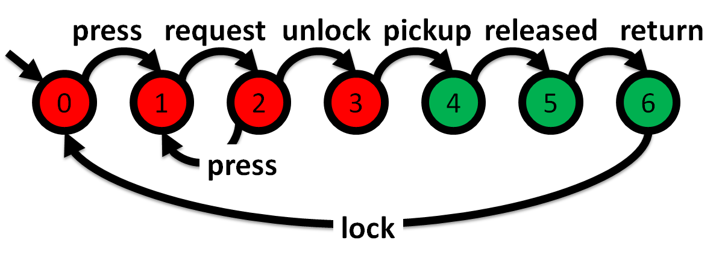

Modeling software systems is hard
?
High-quality models should be adequate, consistent, complete, precise, analyzable, comprehensible [Avl09]

Slide 32


Automated support is needed for system modeling towards…
Model analysis
Better consistency
Build a model, Claim properties, Check them, Correct the model and/or the properties…
Better completion
Build a model, Infer properties, Validate them, Complete the model and/or the properties…
Model synthesis

Slide 33


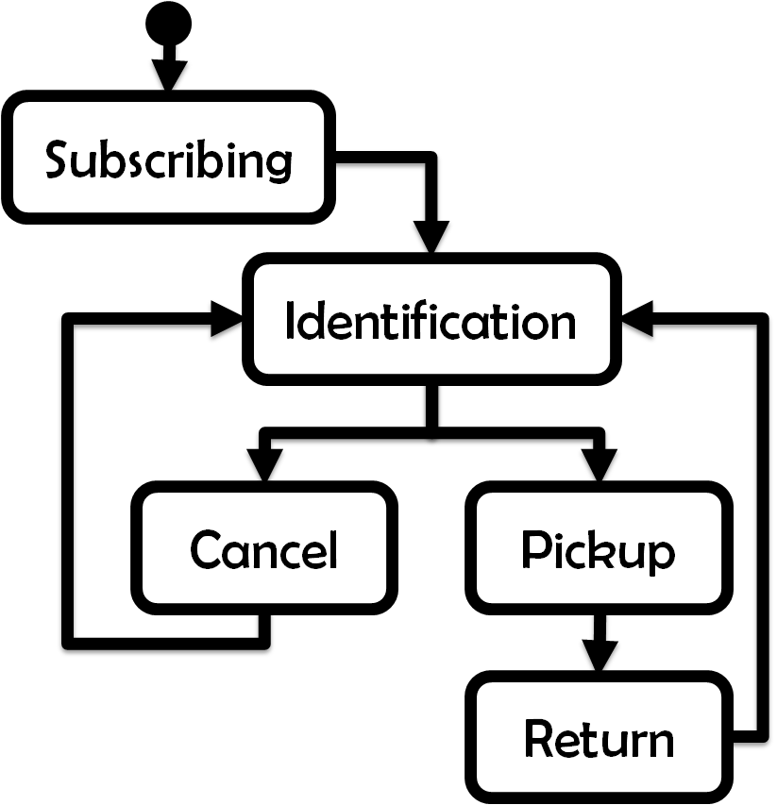
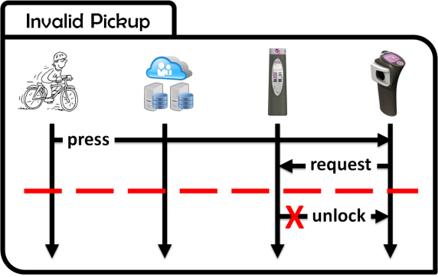
A formal framework for system modeling
Formal trace semantics

Slide 34

“Claim and check” consistency analysis
?
Temporal
Model checking
!

Slide 35

Synthesizing Multi-view Models of Software Systems

Slide 36
State machine induction from scenarios
Adapts
Grammar Induction
Methods [Onc92]

Slide 37
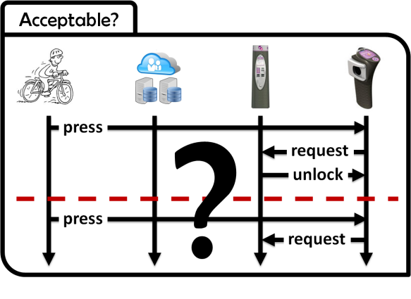
Interactive state machine induction from scenarios
QSM:
Query-driven
State Merging [Dam05, Dup08]

Slide 38
Interactive state machine induction from scenarios and goals
QSM
+ constraints
[Dam06, Dup08]

Slide 39
State machine induction from high-level scenarios
ASM:
Automaton
State
Merging
[Lam08]

Slide 40
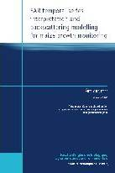
Why are they GREAT synthesis techniques?
Effective support
for system building
Models should be adequate, consistent, complete, comprehensible, analyzable
From models to software […]

Slide 41
Input scenarios are comprehensible and easy to draw

Slide 42
Our techniques synthesize consistent state machines

Slide 43
State machines are analyzable and close to the source code
From models to software […]

Slide 44
Thought provoking for better adequacy and completeness

Slide 45
Knowing why makes you a much smarter software engineer

Slide 46
Goals come with lots of analysis and synthesis tools

Slide 47
Scenario questions are thought provoking
Subscribing and identification
?
Pickup
Acceptable?
press
request

Slide 48
No bicycle here!
Subscribing and identification
Pickup
Acceptable?
press
request
beeeeeeeep

Slide 49
No bicycle here!
Subscribing and identification
Pickup
Acceptable?
press
beeeeeeeep

Slide 50
Keep it simple !!
Avoid[ Requesting When Free ]
…
Acceptable?
press
beeeeeeeep

Slide 51
Two possible interpretations
Subscribing and identification
Pickup
press
?
request
unlock
press
request
unlock

Slide 52
May the software unlock a bicycle twice?
Subscribing and identification
Pickup
press
?
request
unlock
press
request
unlock

Slide 53
No, it does not make sense!
Subscribing and identification
Pickup
Unlocking => Locked
press
request
unlock
press
request
X
unlock

Slide 54
May the cyclist unlock two bicycles?
Subscribing and identification
Pickup
press
request
?
unlock
press
request
unlock

Slide 55
Questions ?

Slide 56
References
[Avl09] A. van Lamsweerde, Requirements Engineering: From System Goals to UML Models to Software Specifications. Wiley, March 2009.
[Bro87] Brooks, F.P. No silver bullet: Essence and accidents of software engineering. IEEE Computer, 20(4):10-19, April 1987.
[Dam11] C. Damas, Analyzing Multi-View Models of Software Systems, PhD thesis, Université catholique de Louvain, Louvain-la-Neuve, 2011.
[Fea87] M.S. Feather, Language support for the specification and development of composite systems. ACM Transactions on Programming Languages and Systems, 9:198-234, March 1987.
[Fin92] A. Finkelstein, J. Kramer, B. Nuseibeh, A. Finkelstein, M. Goedicke, Viewpoints: A Framework for Integrating Multiple Perspectives in System Development. 2:31-57+, 1992.
[Hoa85] C.A.R. Hoare, Communicating Sequential Processes, Prentice Hall International Series in Computing Science, Prentice Hall, April 1985.
[Mil89] R. Milner, Communication and concurrency, Prentice-Hall, Inc., Upper Saddle River, NJ, USA, 1989.
[Mag99] J. Magee and J. Kramer. Concurrency: State Models and Java Programs, Wiley, 1999.

Slide 57
Avoid[Stolen Bikes]
…
Unlocking => Cyclist Logged
press
request
unlock
pickup
released
return
0
1
2
3
4
5
6
press
lock

Slide 58
Subscribing and identification
subscribe
identify
authenticate
granted
welcome aboard

Slide 59
Pickup
press
request
unlock
pickup
released
ride start

Slide 60
Acceptable?
?
press
request
unlock
press
request

Slide 61
Invalid Pickup
press
request
X
unlock

Slide 62
press
request
unlock
pickup
released
return
0
1
2
3
4
5
6
press
lock
press
request
unlock
pickup
released
return
0
1
2
3
4
5
6
press
lock

Slide 63
Subscribing
Identification
Cancel
Pickup
Return

Slide 64
subscribe
…
unlock
identify
pickup

Slide 65
Synthesizing Multi-view Models of Software Systems
Models help reasoning about the problem
Elaborating requirements and exploring designs
They also help building the solution
Code generation from high-level abstractions

