Slide 1
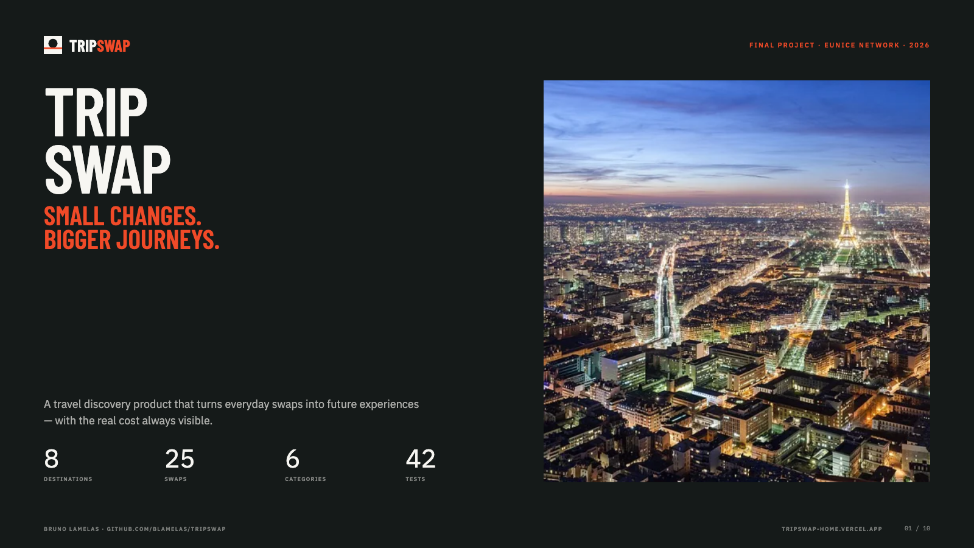
Notes:
TripSwap — small changes, bigger journeys. A travel discovery product funded by everyday swaps.

Slide 2
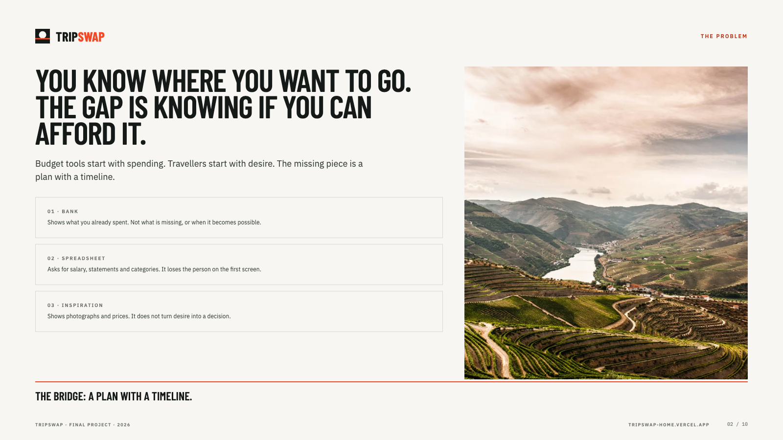
Notes:
The problem: desire exists, but there is no plan with a timeline. Budget tools lose the person.

Slide 3
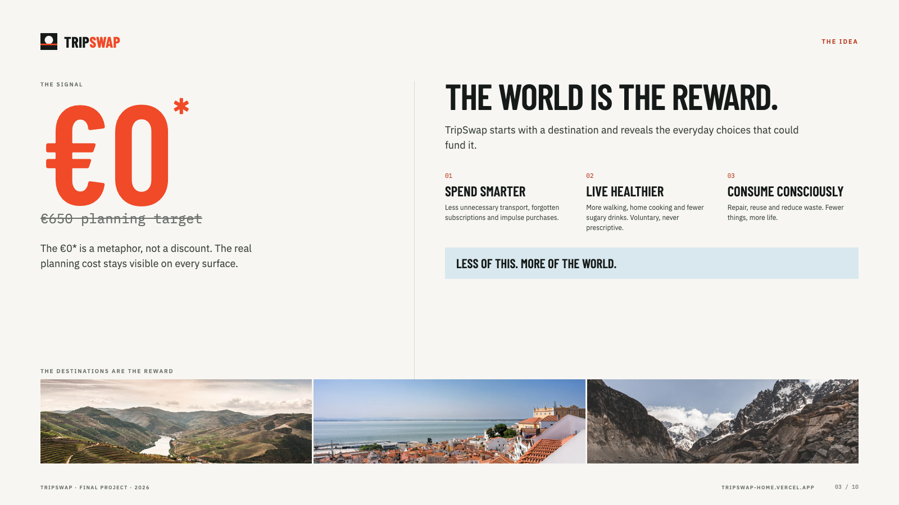
Notes:
The idea: the destination is the reward. €0* is a metaphor; the planning target stays visible.

Slide 4
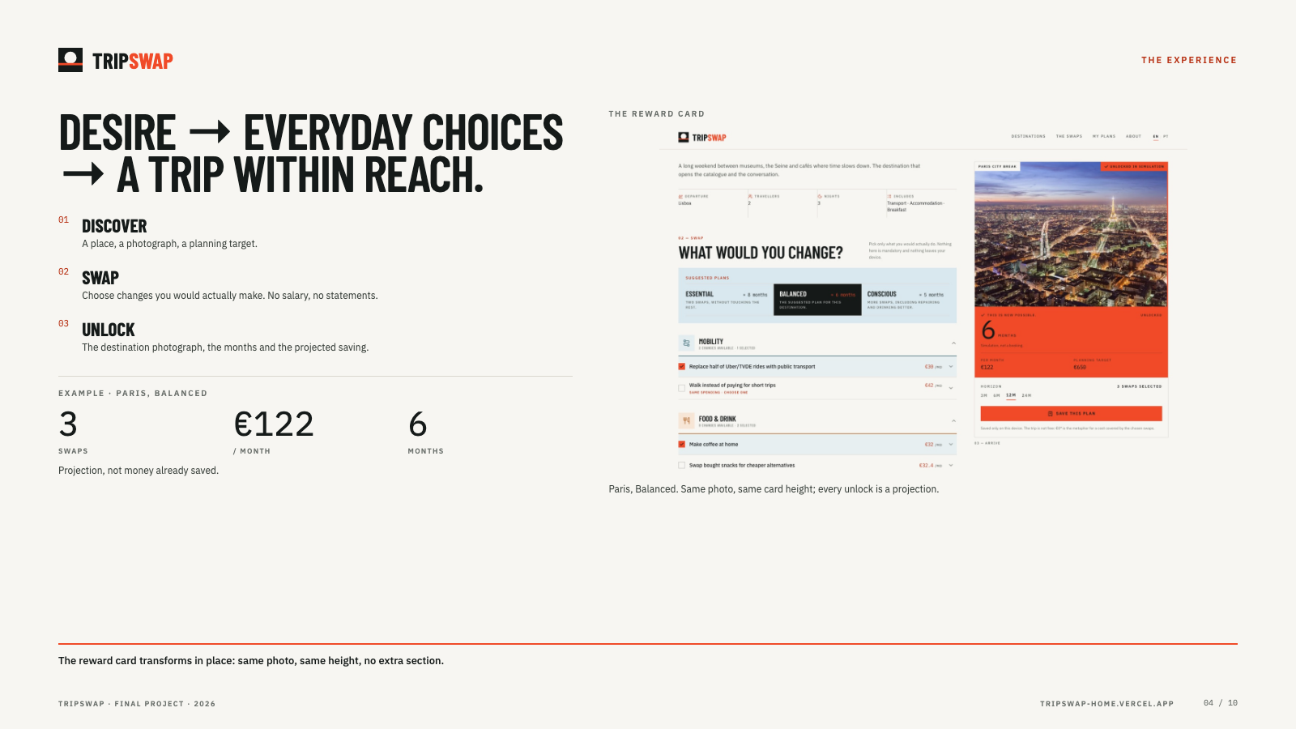
Notes:
The flow: discover, swap, unlock. Example: Paris, Balanced, 3 swaps, €122/month, 6 months.

Slide 5
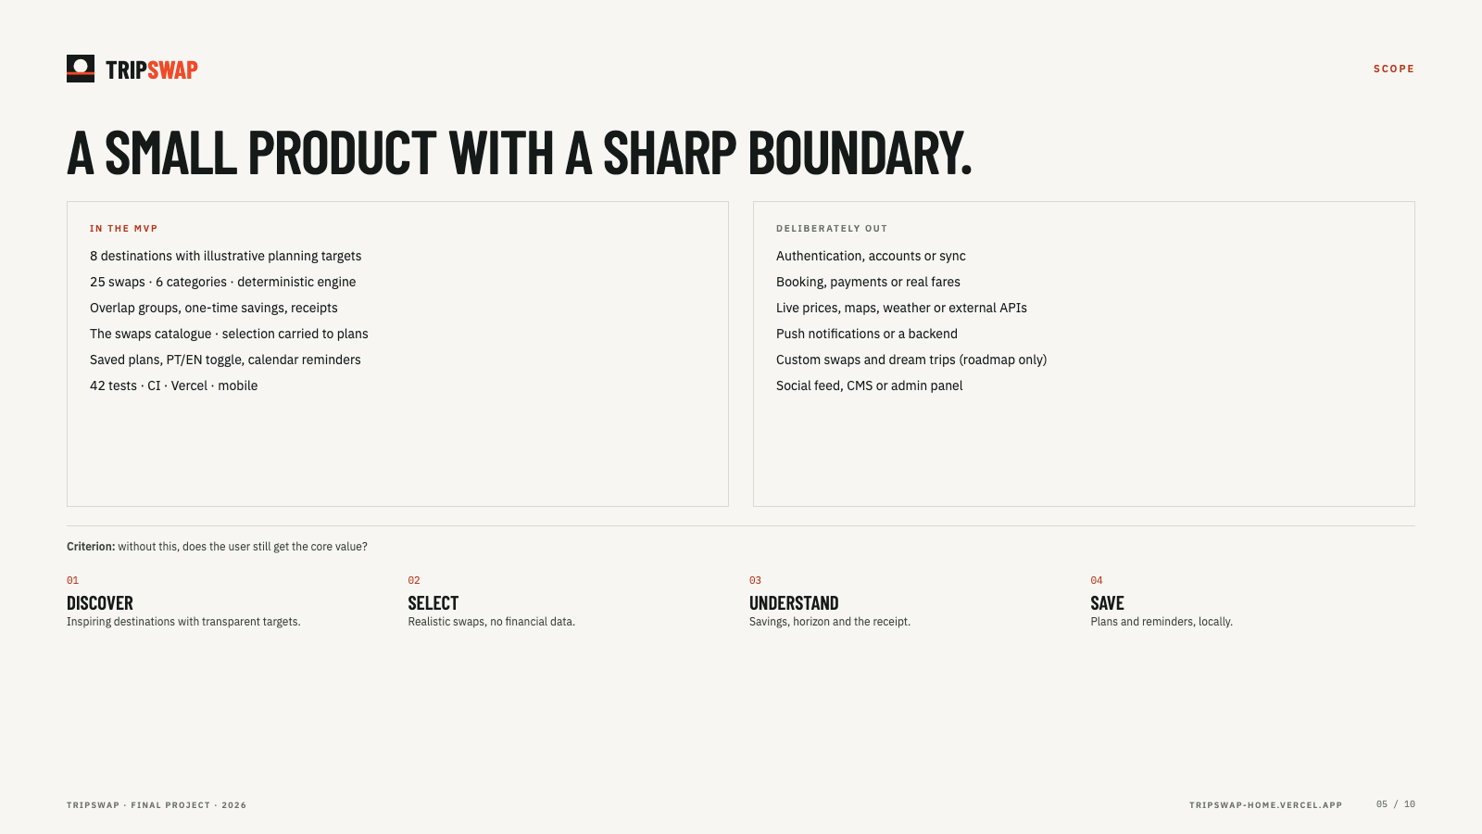
Notes:
Scope: a four-story MVP with a sharp boundary. No backend, booking or live prices.

Slide 6
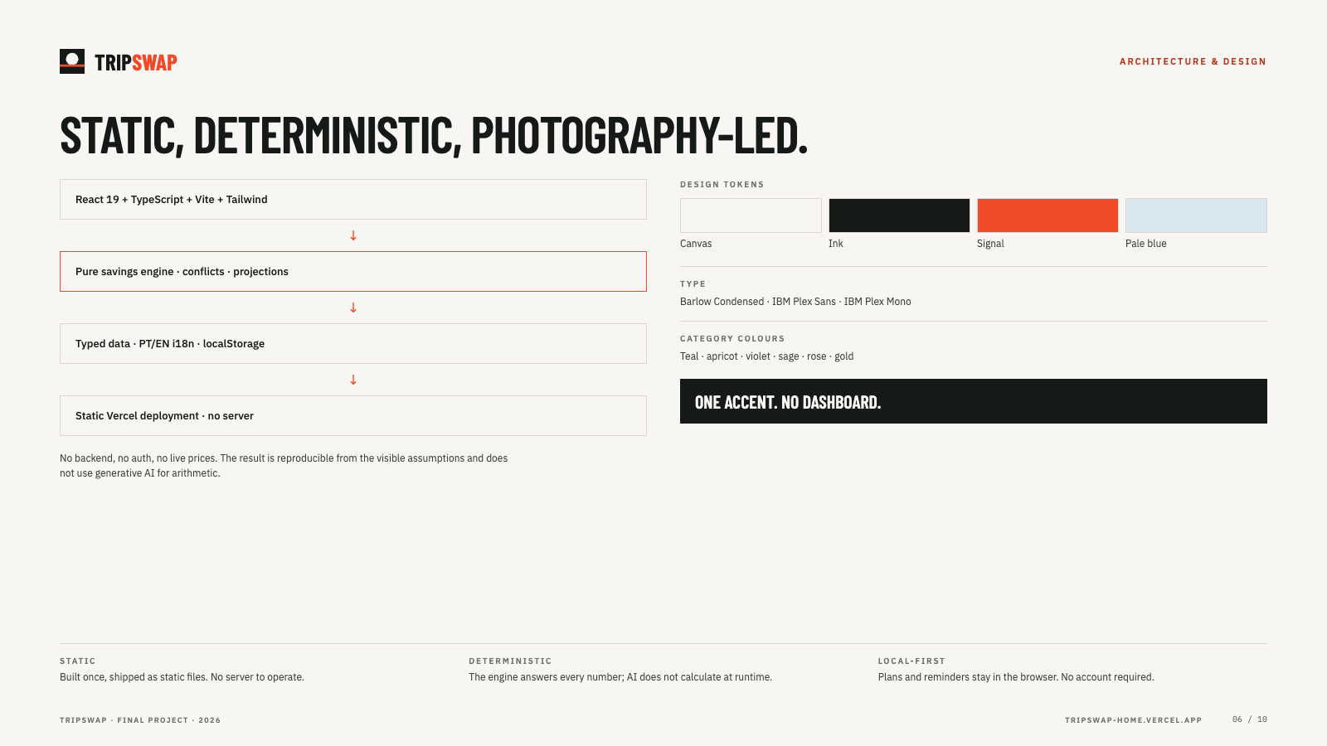
Notes:
Architecture: static React/TypeScript app, deterministic engine, localStorage, Vercel. Design is photography-led.

Slide 7
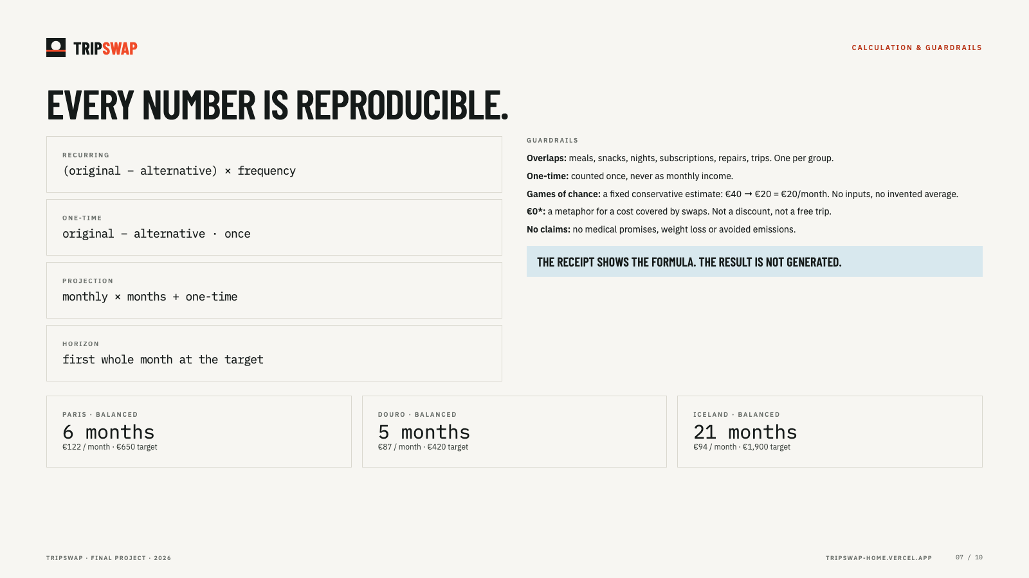
Notes:
Calculation and guardrails: recurring and one-time savings, overlap groups, a fixed €20/month games estimate, honest €0*.

Slide 8
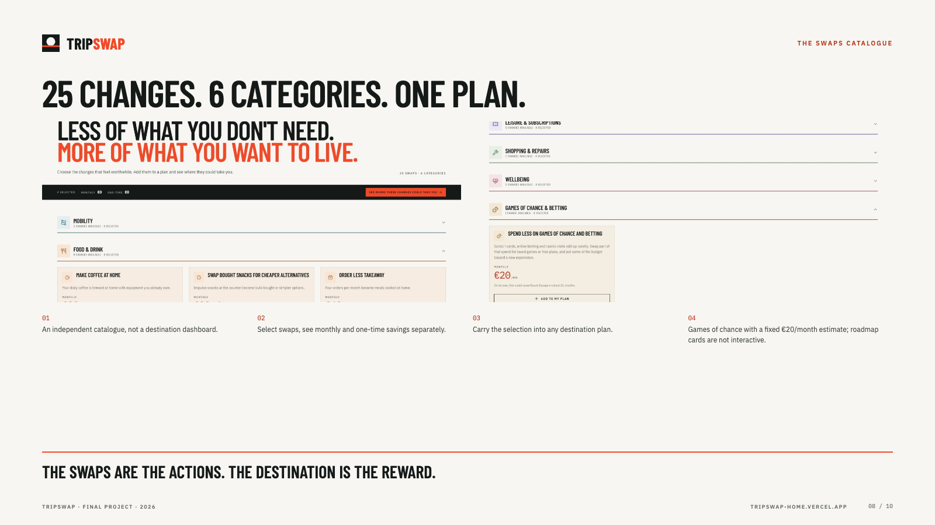
Notes:
The swaps catalogue: 25 changes, 6 categories, carry-over into plans, fixed games estimate, roadmap cards.

Slide 9
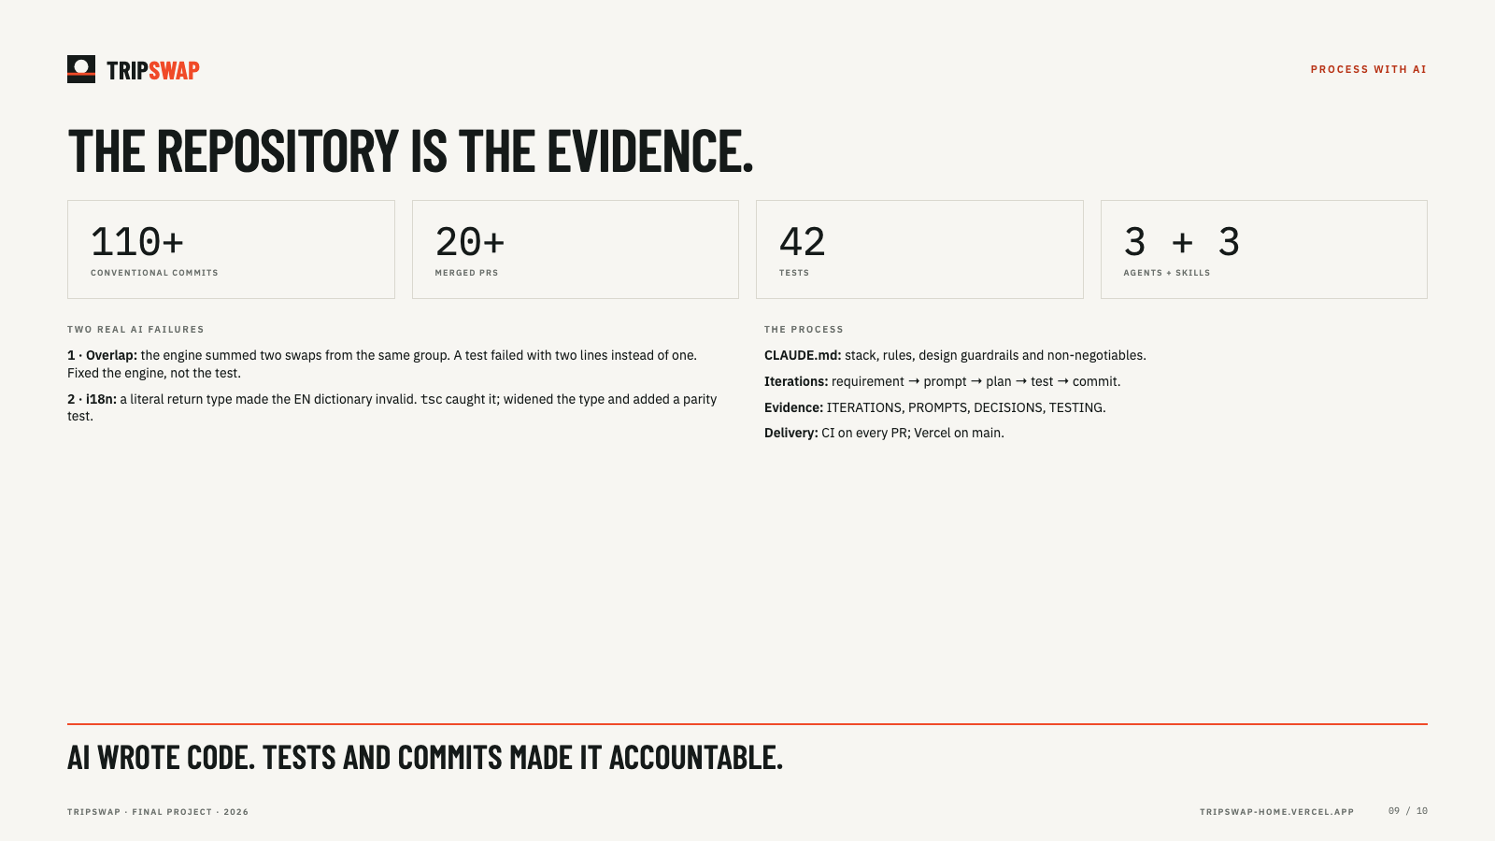
Notes:
Process: CLAUDE.md, agents, skills, iterations, 42 tests and two real AI failures caught by checks.

Slide 10
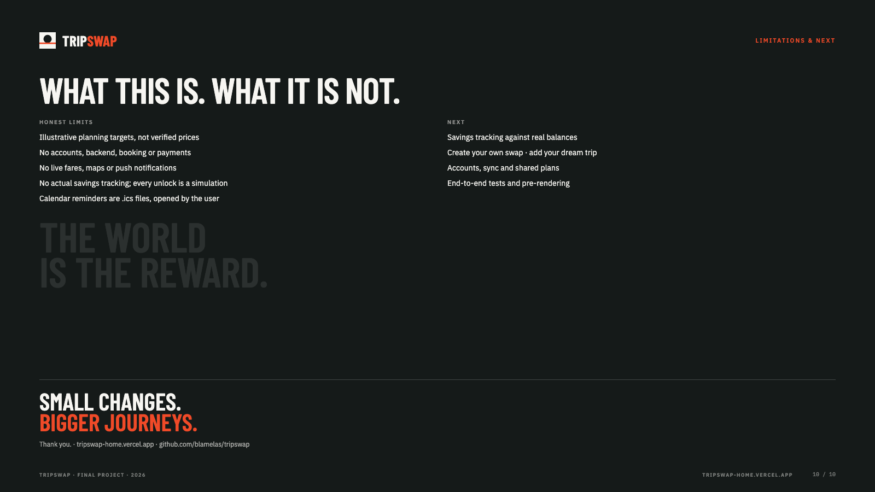
Notes:
Limits and next steps. Thank you.

