Slide 1
Excitation
Direct
Echo
Distorsion
North
South
North
South

Slide 2
North
South
North
South

Slide 4
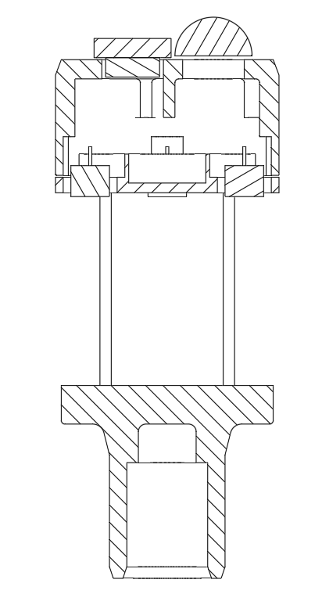






Pitch (D)
Silicone Glue
Transducers
$$α$$
Wind
Sound travel path
$$C$$
$$B$$
Height
(H)
$$α$$
$$D$$
$$A$$
Composition of motion
Reflector

Slide 5
Transmitter
Receiver
Ideal Sound path
Pillars
Reflector

Slide 6
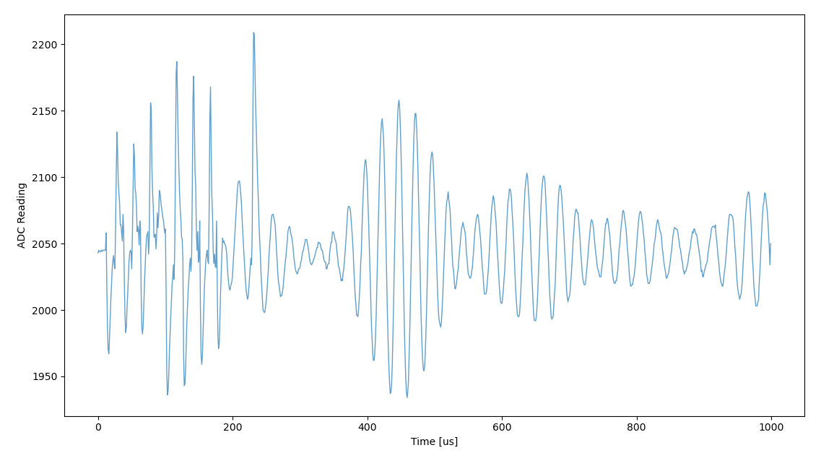
-
-
-
+
+
+
1st echo
2nd echo
3rd echo

Slide 7
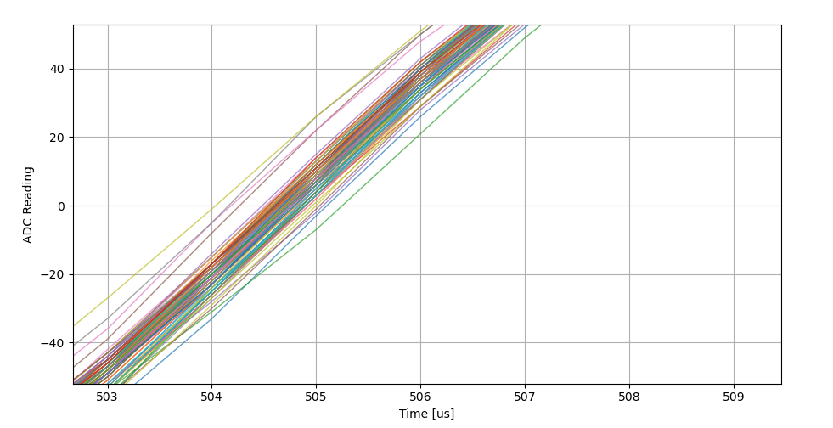
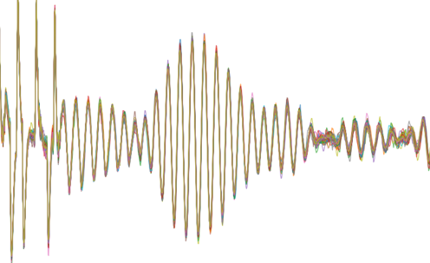

Slide 9
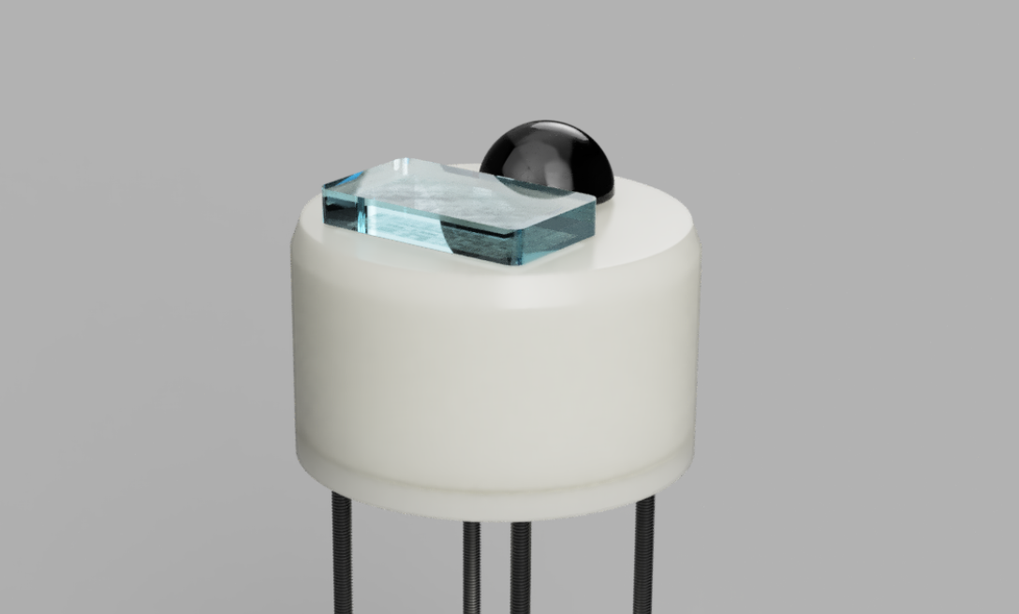
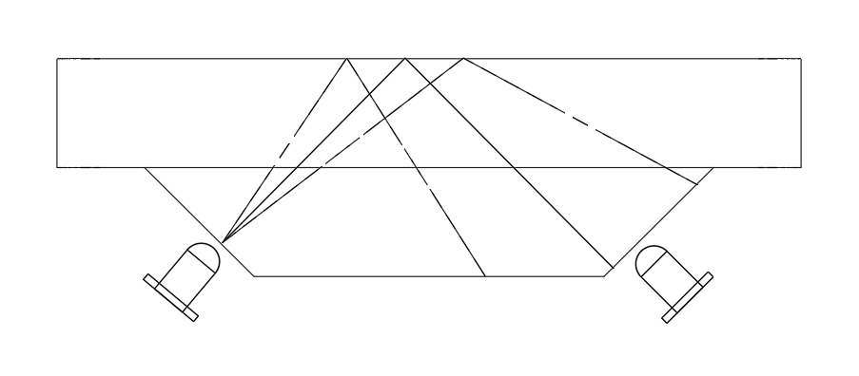
Rain Sensor

Slide 10
Zone 1
Zone 2

Slide 11
Single drops

Slide 12
Light rain

Slide 13
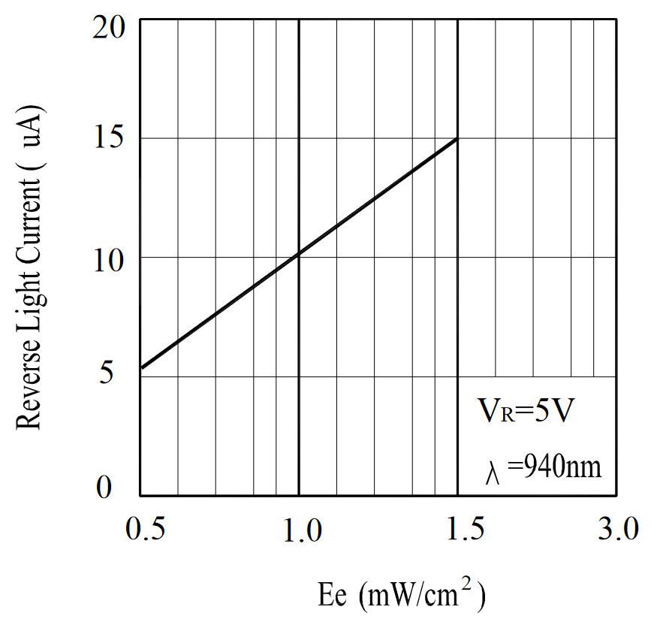
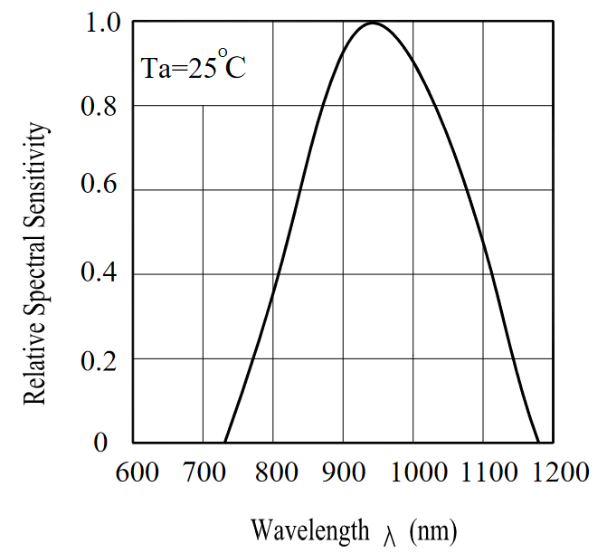

Slide 14
Boot
Is App debug FM
Yes
No
SD card Boot
Validate App FM
Key Pressed
No
Jump to App
Validate OTA FM
Fail
Yes
SD Card Bin Search
OTA != APP
No
Yes
Write to OTA and App
Copy OTA to APP

Slide 15
0x08000000
Bootloader
(64kB)
Flash bank 1
0x08010000
App Firmware
(446kB)
0x0807F800
App tag
(2kB)
0x08080000
OTA tag
(2kB)
0x08080800
Flash bank 2
OTA Firmware
(>446kB)
?
Reserve
0x0808FFFFF

Slide 16
Initial
Type (8bit)
Firmware tag (str)
Data Pack
Type (8bit)
Pack ID (16b)
Size (16b)
Payload (N*8b)
Checksum(16b)
Close Pack
Type (8bit)
Payload (str)
Ack Pack
Type (8bit)
“pack id,true” or “pack id,false” (str)

