Slide 1
Excitation
Direct
Echo
Distorsion
North
South
North
South

Slide 2
North
South
North
South

Slide 4
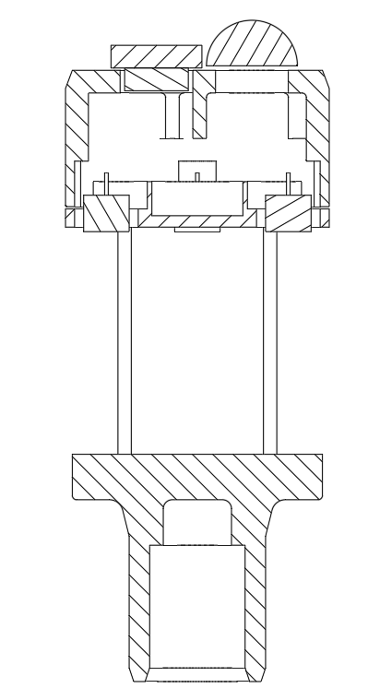






Pitch (D)
Silicone Glue
Transducers
$$α$$
Wind
Sound travel path
$$c$$
$$b$$
Height
(H)
$$α$$
$$d$$
$$a$$
Composition of motion
Reflector

