Slide 1
Excitation
Direct
Echo
Distorsion
North
South
North
South

Slide 2
North
South
North
South

Slide 4
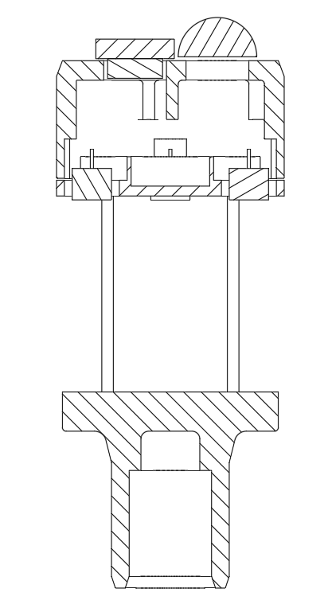






Pitch (D)
Silicone Glue
Transducers
$$α$$
Wind
Sound travel path
$$C$$
$$B$$
Height
(H)
$$α$$
$$D$$
$$A$$
Composition of motion
Reflector

Slide 5
Transmitter
Receiver
Ideal Sound path
Pillars
Reflector

Slide 6
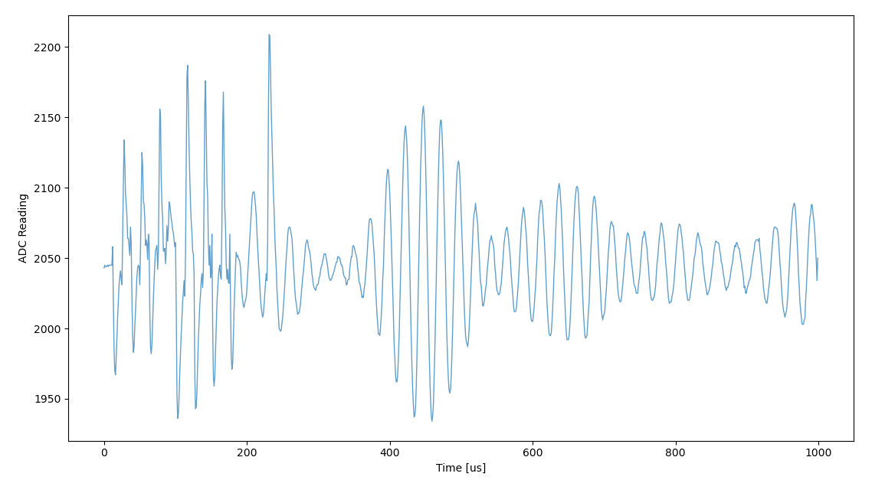
-
-
-
+
+
+
1st echo
2nd echo
3rd echo

Slide 7
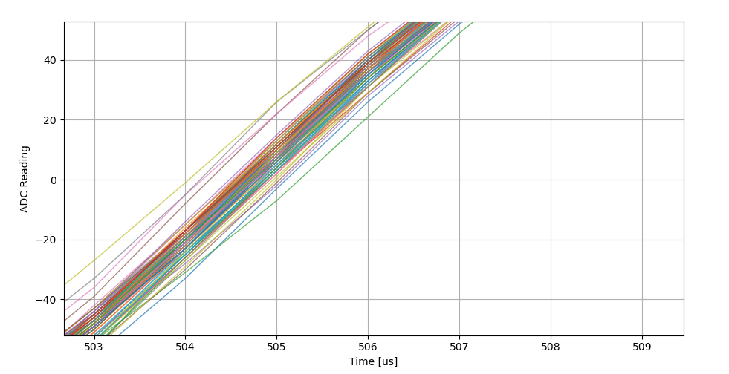
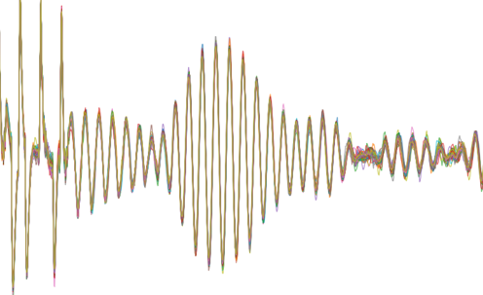

Slide 9
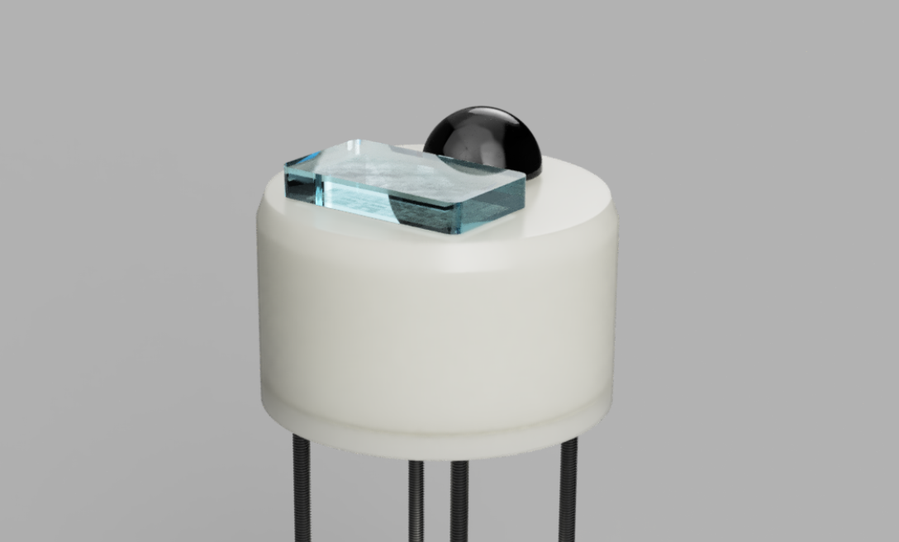
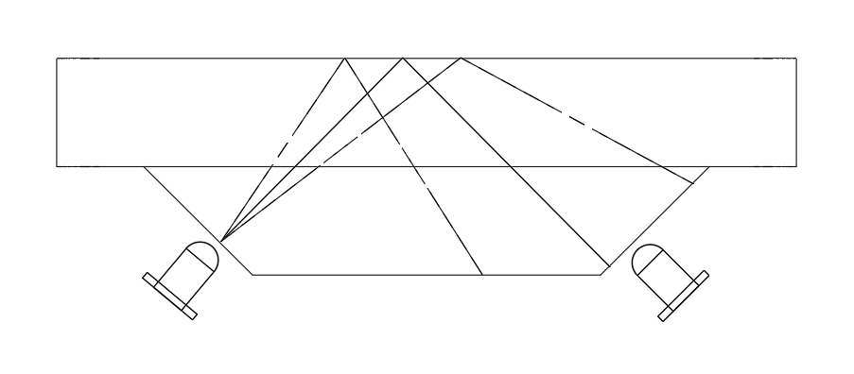
Rain Sensor

Slide 10
Zone 1
Zone 2

Slide 11
Single drops

Slide 12
Light rain

