Slide 1
Objects First with Java A Practical Introduction using BlueJ
David J. Barnes
Michael Kölling
6.0
Notes:
Replace this with your course title and your name/contact details.

Slide 2
Course Contents
Introduction to object-oriented programming…
…with a strong software engineering foundation…
…aimed at producing and maintaining large, high-quality software systems.

Slide 3
Buzzwords
responsibility-driven design
inheritance
encapsulation
iterators
overriding
coupling
cohesion
javadoc
interface
collection classes
mutator methods
polymorphic method calls

Slide 4
Course overview (1)
Objects and classes
Understanding class definitions
Object interaction
Grouping objects
More sophisticated behavior - libraries
Designing classes
Well-behaved objects - testing, maintaining, debugging

Slide 5
Course overview (2)
Inheritance
Polymorphism
Extendable, flexible class structures
Building graphical user interfaces
Handling errors
Designing applications

Slide 6
Classes and objects
Fundamental to much of the early parts of this course.
Class: category or type of ‘thing’. Like a template or blueprint.
Object: belongs to a particular class and has individual characteristics.
Explore through BlueJ …

Slide 7
Demo of figures project
Notes:
Here, I start discussing objects and classes. I talk to the students
about it for a while, then I do an extensive demo of the shapes example in
BlueJ. All important points of this lecture are encountered and pointed
out during this demo.
All following slides serve only as summary, or reminder. No new material
is introduced after the demo.

Slide 8
Fundamental concepts
It is vital to understand these concepts as soon as possible.
object
class
method
parameter
data type

Slide 9
Classes and Objects
A class
represents all similar objects of a kind (example: “car”)
objects
represent ‘things’ from the real world, or from some problem domain;
example: “that red car in the parking lot”.

Slide 10
Methods and Parameters
Objects have operations which can be invoked (Java calls them methods).
Methods may have parameters to pass additional information needed to execute.
Parameters introduce variation into the effect of method calls.
Argument is another name for parameter

Slide 11
Other observations
Many distinct instances can be created from a single class.
An object has attributes: values stored in fields.
The class defines what fields an object has, but each object stores its own set of values (the state of the object).

Slide 12
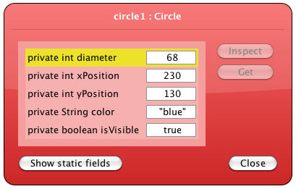
State

Slide 13
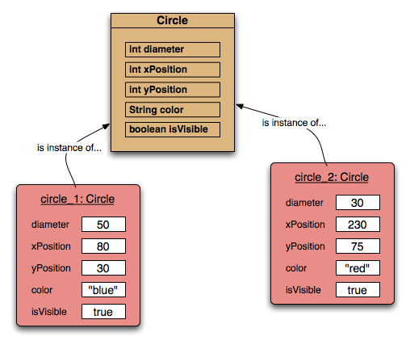
Two circle objects

Slide 14
Source code
Each class has source code associated with it that defines its details (attributes and methods).
The source code is written to obey the rules of a particular programming language.
We will explore this in detail in the next chapter.

Slide 15
Return values
All the methods in the figures project have void return types; but …
… methods may return a result via a return value.
Such methods have a non-void return type.
More on this in the next chapter.

Slide 16
Review
Classes model concepts.
classes are definitions
Source code realises those concepts.
Source code defines:
What objects can do (methods).
What data they store (attributes).
Objects are created with pre-defined attribute values.
objects take up memory
objects are "instantiated"
The methods determine what objects do with their data.

Slide 17
Review
When a method is called an object:
Alters its state, and/or
Uses its data to decide what to do.
Some methods take parameters that affect their actions.
Methods without parameters typically use their state to decide what to do.
Some methods return a value.

Slide 18
Review
Most programs contain multiple classes.
At runtime, objects interact with each other to realize the overall effect of the program.

