Slide 1
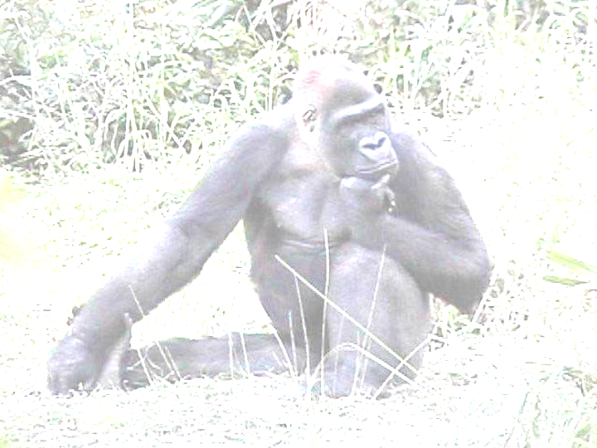
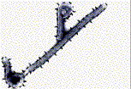
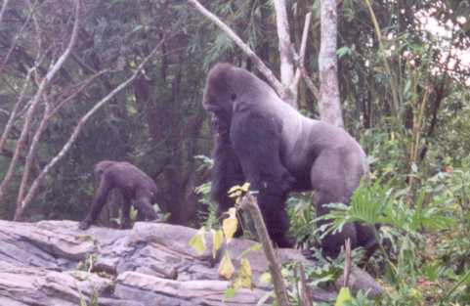
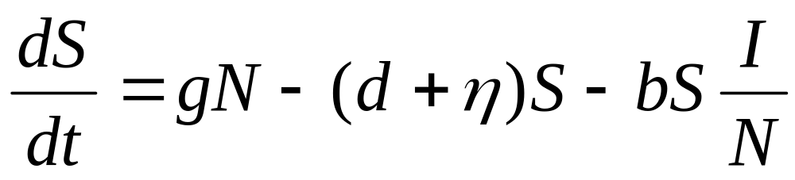
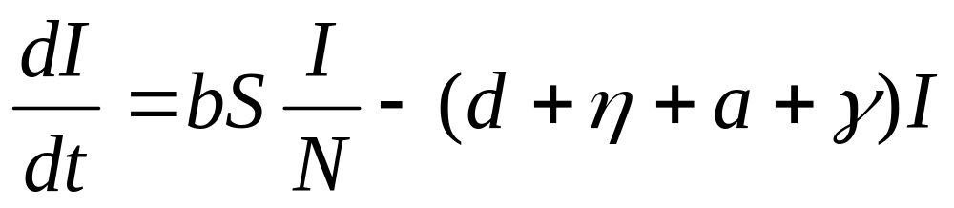
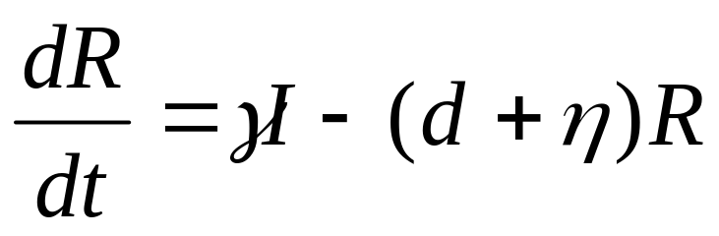
Modeling the Impact of Ebola and Bushmeat Hunting
on Western Lowland Gorillas
Carol E. Rizkalla ¹, Francisco Blanco-Silva ², and Stephanie Gruver ²
¹ Department of Forestry and Natural Resources, ² Department of Mathematics, Purdue University
ABSTRACT
The 2003 outbreak of Ebola in the Republic of Congo killed 114 people and up to 800 western lowland gorillas. This outbreak began with human handling of infected animal carcasses. Ebola has since spread, putting the entire gorilla population at risk. An epidemiological model is presented to describe the combined effects of Ebola and harvest on persistence of gorillas. The number of infected gorillas also provides a means of assessing the risk of transmission to humans. Under current harvest rates and the estimated annual probability of an outbreak occurring, mean time to extinction was approximately 44 years. Controlling hunting may not be enough to prevent extinction if frequent outbreaks occur.
EBOLA
In 2003, a Congolese outbreak of Ebola-Zaire killed 114 out of the 128 humans who contracted it. Around the same time, 600-800 western lowland gorillas (Gorilla gorilla gorilla), encompassing two-thirds of the local population, disappeared from the nearby Lossi Gorilla Sanctuary. Ebola virus was confirmed in 6 carcasses. By 2005, nearby Odzala National Park, home to 20,000 gorillas, had also been devastated. Congo and neighboring Gabon hold 80% of the world’s gorilla population, and all of these individuals appear to be potentially at risk of infection.
BUSHMEAT
The 2003 human outbreak began with the consumption of an infected carcass. Wild animals have been hunted and eaten in Africa for years, but bushmeat hunting has increased in recent years because roads provide easier access to the forest. Though great apes make up only about 1% of the bushmeat trade, approximately 6,000 gorillas are killed each year across Africa.
OBJECTIVE
The combined threats of Ebola and overhunting prompted us to develop an epidemiological model to describe the persistence of Ebola and its effects on western lowland gorillas concurrently being harvested. The Kermack-McKendrick model, also known as the SIR model, consists of three differential equations, and has been applied to a variety of infectious diseases. When another organism is involved in disease transmission, the SIR model is typically coupled with an SIR model for the reservoir. For simplicity, we ignore the unknown host here. We have speculated on the annual probability of an outbreak occurring, and provide population projections. The model provides the additional value of estimating the risk to humans of harvesting an infected gorilla.
THE MODEL
RESULTS & DISCUSSION
The model was most sensitive to harvest rate, so we simulated a combination of harvest rates (η = 0, 0.04, and the current rate of 0.06) with three probabilities of outbreak (α = 0.1, 0.3, and the estimated probability of 0.636). Under current harvest rates with the estimated outbreak probability, mean time to extinction was 44.11 ± 3.38 years. Walsh et al. (2003)¹ used historical surveys to estimate an 80% decline in ape populations within 33 years. Although we did not have historical data to validate our model, this scenario resulted in an 80% decline in 36 years on average. We believe this adds support to our findings. Our results suggest that even with no harvest, gorillas cannot survive a high frequency of Ebola outbreaks. Increased control of harvesting may be able to buy us the time we need to develop an effective vaccine.
The proportion of infected gorillas in the population ranged from 0.33 – 5.5%. This translates to a 0.002-0.33% chance that a harvested gorilla is infected; i.e. one of every 300-5000 harvested gorillas would carry Ebola. Thus, to a hunter risking transmission, this may not serve as a deterrent. In actuality, Ebola outbreaks are localized to a subset of the gorilla population. Additionally, other hunted species such as chimpanzees and duikers would also likely be infected. Therefore, the risk in these areas would be much higher. If education efforts on the link between bushmeat and Ebola can succeed, the source of one mode of transmission to humans can be controlled, and gorilla populations may continue to persist.
Birth
(g = 0.113)
Natural Mortality
(d = 0.066)
Susceptible (S = 99150)
Hunted
(η = 0.06)
Outbreak (α = 0.636)
Transmission (b = 0.5)
Natural Mortality
(d = 0.066)
Infected (I = 800)
Hunted
(η = 0.06)
Ebola Mortality
(a = 0.937)
Recovery ( = 0.063)
Natural Mortality
(d = 0.066)
Recovered (R = 50)
Hunted
(η = 0.06)
N = S + I + R
Mean time to extinction of gorillas from 100 simulations under 3 harvest rates (η) and 3 probabilities of outbreak (α). NA: positive population growth.
Conceptual flow chart of the SIR model with parameter values and initial conditions. Projections were run for 500 years. 100 simulations were performed.
η = 0
η = 0.04
η = 0.06
α = 0.1
NA
206.07 ± 37.25
110 ± 15.74
α = 0.3
NA
95.41 ± 11.41
65.71 ± 7.51
α = 0.636
197.67 ± 35.78
56.62 ± 4.44
44.11 ± 3.38
Mathematical form of the model
Assumptions:
Exponential population growth
No spatial structure (individuals in entire geographic range at risk)
Susceptible gorillas become infected by transmission from infected gorillas or through contact with the Ebola host during an outbreak
Infected animals either die or move to the recovered class by the next
time step (one year)
Recovered animals become immune to further infection
The probability of being harvested is equal for each population class
If an outbreak occurs, 0.8% of the susceptible population is infected
¹ Walsh et al. 2003. Catastrophic ape decline in western equatorial Africa. Nature 422:611-614.

