Slide 1
Team Name:CompView
-Blandine Mizero
-Shenevra Govender
-Tara Niyigena

Slide 2
Problem Solution:
The Gender Pay Gap
South Africa’s gender pay gap median is still between 23% and 25%; meaning, men earn at least 23% more than women.
The gender pay gap is a problem that contributes towards holding women back from achieving financial security.
Also a sub-problem of economic inequality is that there women are overrepresented in low-paying jobs while being underrepresented in higher-paying jobs.

Slide 3
Prototype of the Application:
We have created a website called CompView which allows submissions and comparisons of compensation data across industries and skills.

Slide 4
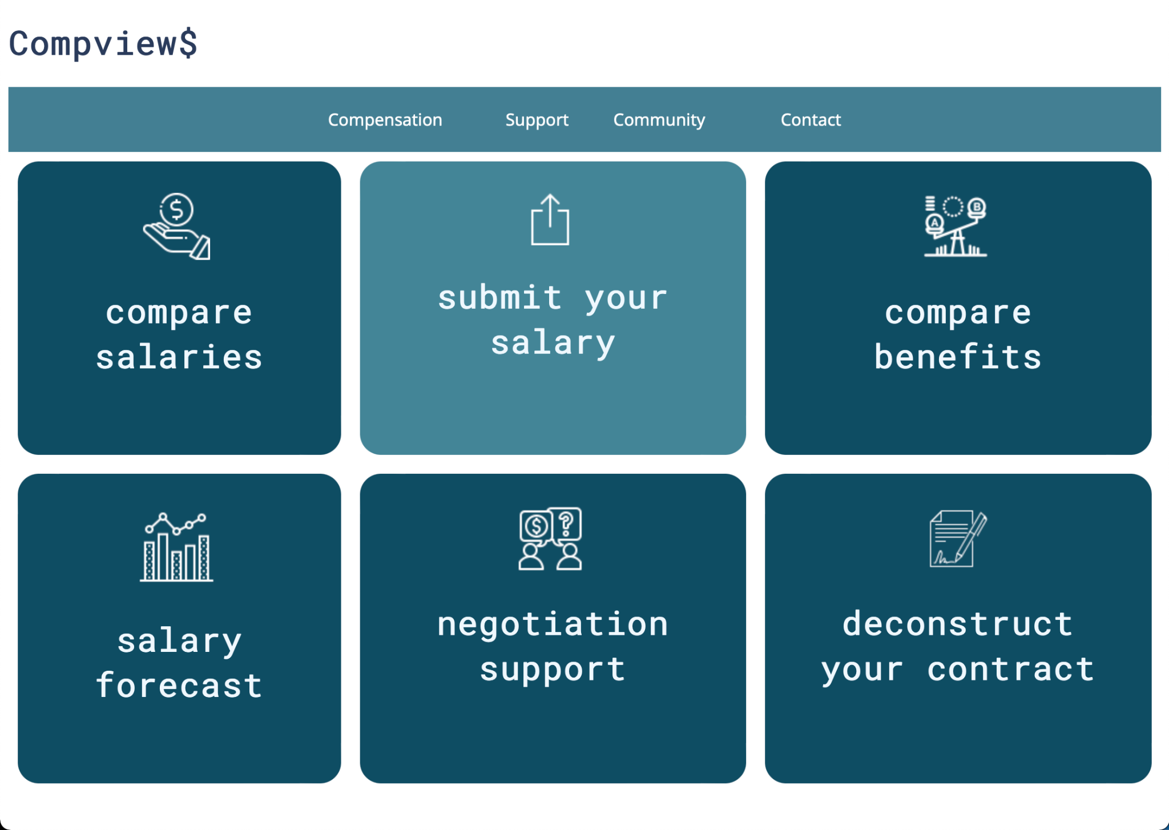
Demo of the Application

