Slide 1
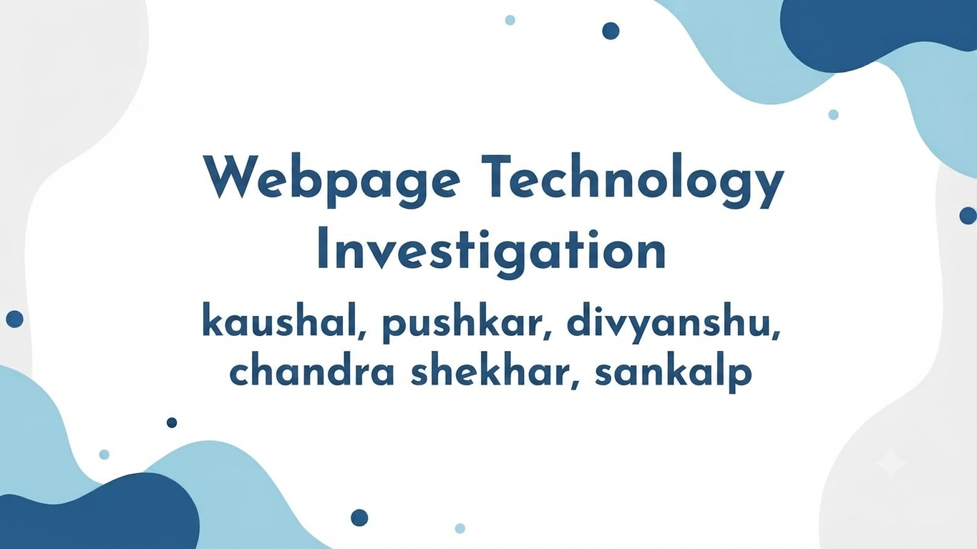
Webpage Technology Investigation
Kaushal, Pushkar, Divyanshu,
Chandra Shekhar, Sankalp

Slide 2

01 · WEBSITE INTRODUCTION
Wikipedia
language
hme
URL: https://www.wikipedia.org — the multilingual portal for all Wikipedia language editions
Type: Free, non-profit, collaboratively-edited online encyclopedia
Owner: Wikimedia Foundation (registered non-profit, no paid advertising)
Founded: January 2001 — the homepage banner marks its 25th anniversary
Purpose of this page: A landing/portal page: it doesn't hold articles itself, it routes visitors to the right language edition
Target Users: The general public, students, researchers, and information seekers worldwide
300+
language editions linked from this single page
"The homepage currently runs a fundraising banner, framing Wikipedia as a people-built, non-commercial alternative to big tech platforms."
— paraphrased from the homepage banner
Website Analysis · wikipedia.org
1 / 8

Slide 3

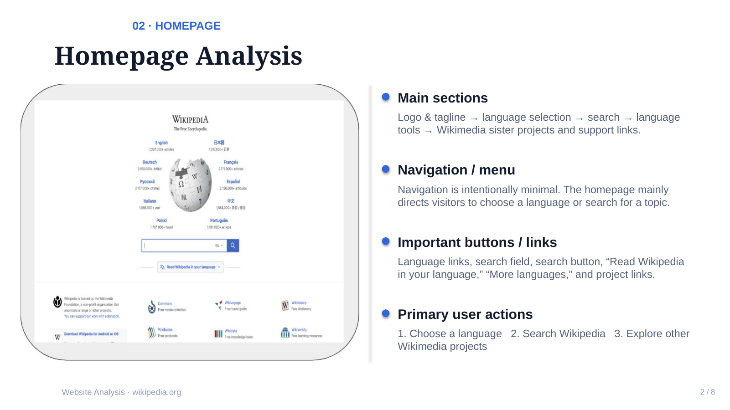
hoe

Slide 4
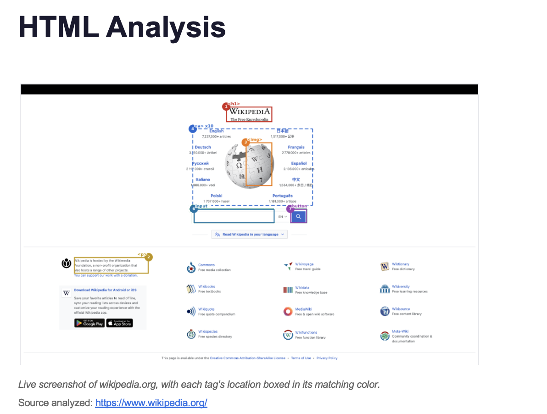
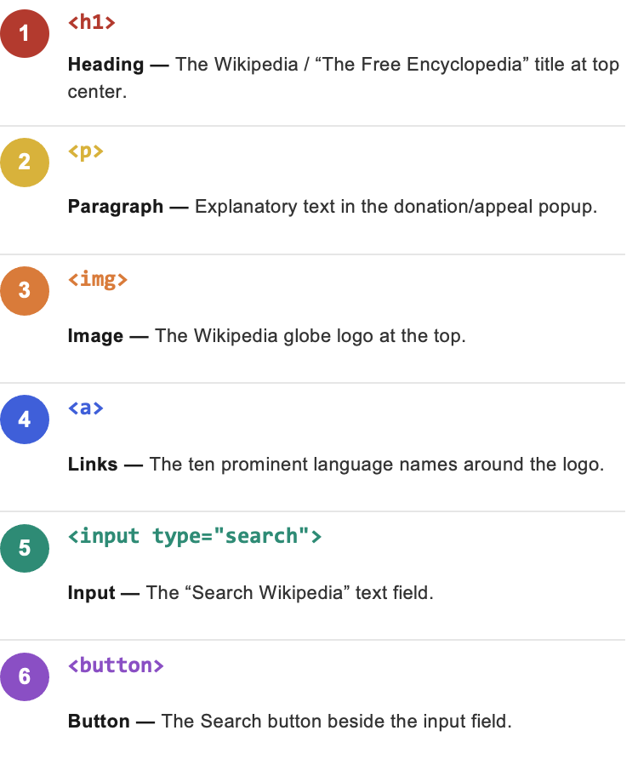

Slide 5
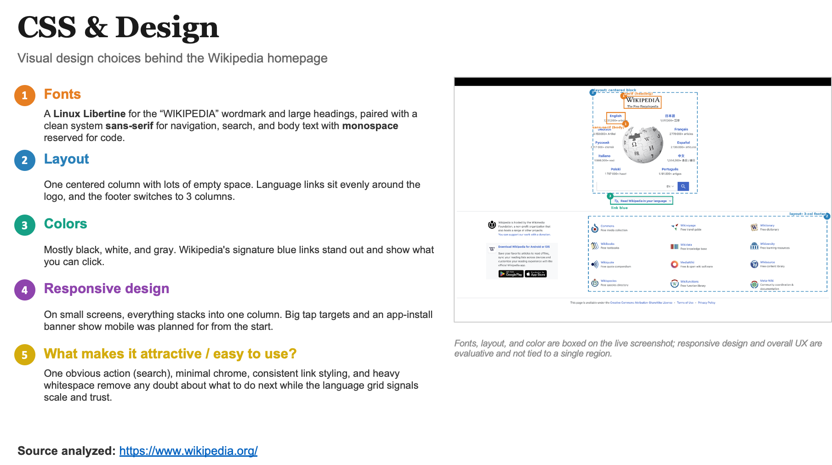

Slide 6
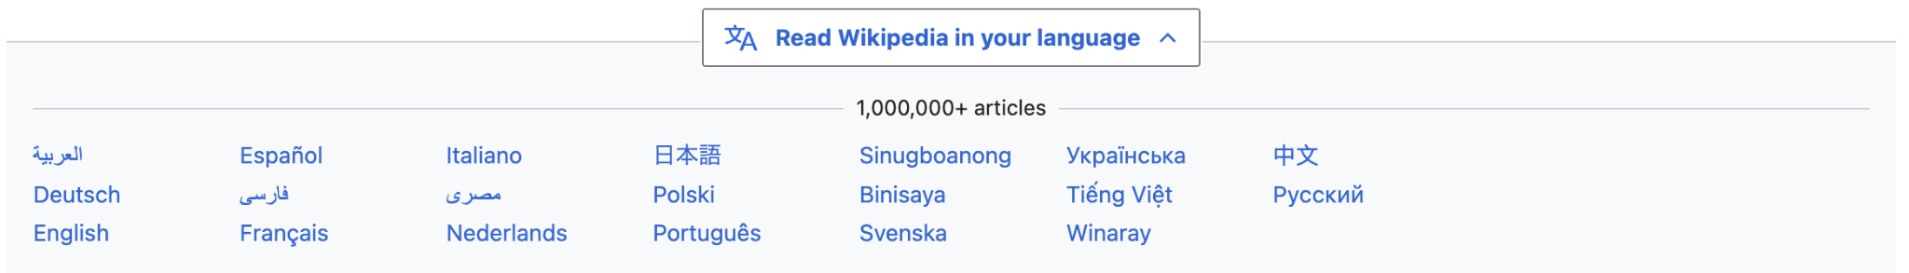
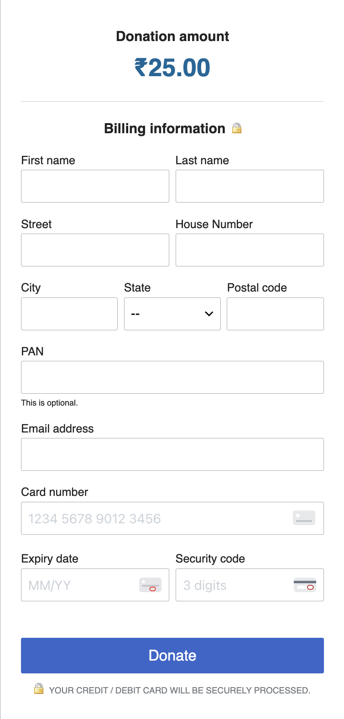
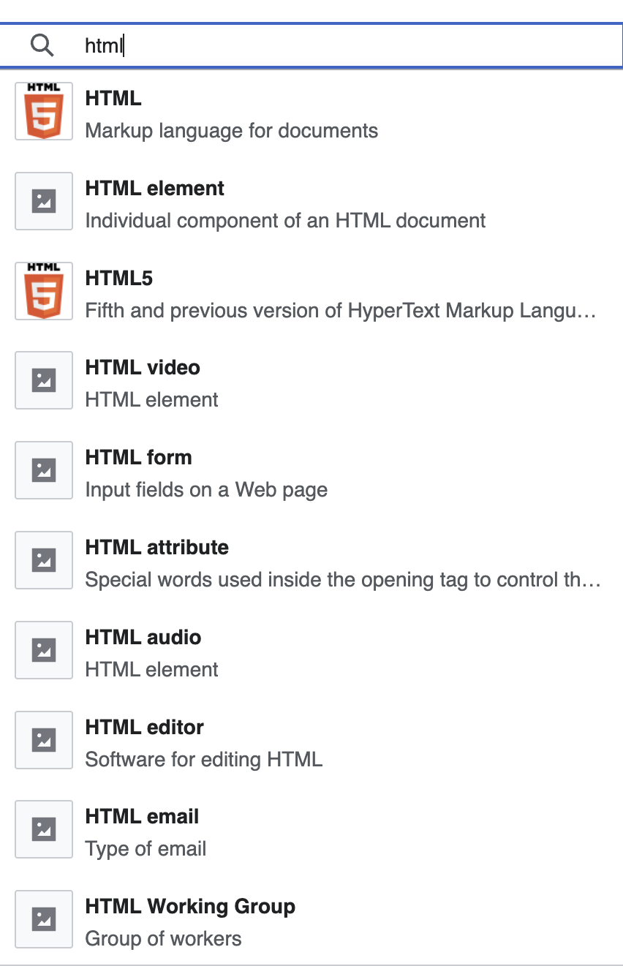
05 · BEHAVIOUR
JavaScript & Interactivity
hom
touch_app
1. Click buttons
Makes the website interactive by letting users open menus, navigate sections, and access info.
arrow_drop_down_circle
2. Dropdown menus
Helps users access options and navigate Wikipedia easily without cluttering pages.
tune
3. Sliders
Used in specific features to let users adjust values or explore data seamlessly.
flip_to_front
4. Pop-ups
No login/ad pop-ups to ensure a simple, distraction-free non-profit platform.
fact_check
5. Form validation
Validates forms for activities such as donations, accounts, and editing articles.
widgets
6. Other interactive features
Uses search suggestions, tabs, and dynamic images to enhance browsing.
Website Analysis :- https://www.wikipedia.org/
1 / 8

Slide 7
06 · INFRASTRUCTURE
Internet & Web Technologies
home
https
1. HTTP vs HTTPS
language
2. Domain Name
dns
3. Web Server & Hosting
Protocol: Enforces HTTPS (TLS 1.3) encryption.
Secures data transfer, protects privacy, and prevents tampering between client and Wikimedia servers.
Host: https://www.wikipedia.org/
Managed by Wikimedia Foundation. Uses dynamic subdomains (e.g., en.wikipedia.org) for language localization.
Infrastructure: Private Wikimedia CDN.
Uses Varnish HTTP accelerators for edge caching and Apache MediaWiki application servers backend.
cookie
4. Cookies & Storage
sync_alt
5. Browser Requests
api
6. Network APIs
Policy: Minimal, privacy-focused.
Stores user preferences, session tokens, and GeoIP language settings. Zero third-party tracking cookies.
DevTools Inspection: ~25-35 requests.
Fetches HTML document, aggregated CSS/JS modules via ResourceLoader, SVG logo assets, and web fonts.
Endpoints Identified:
• Action API: /w/api.php (Search suggestions)
• REST API v1: /api/rest_v1/ (Page previews)
Website Analysis · wikipedia.org
6 / 8

Slide 8
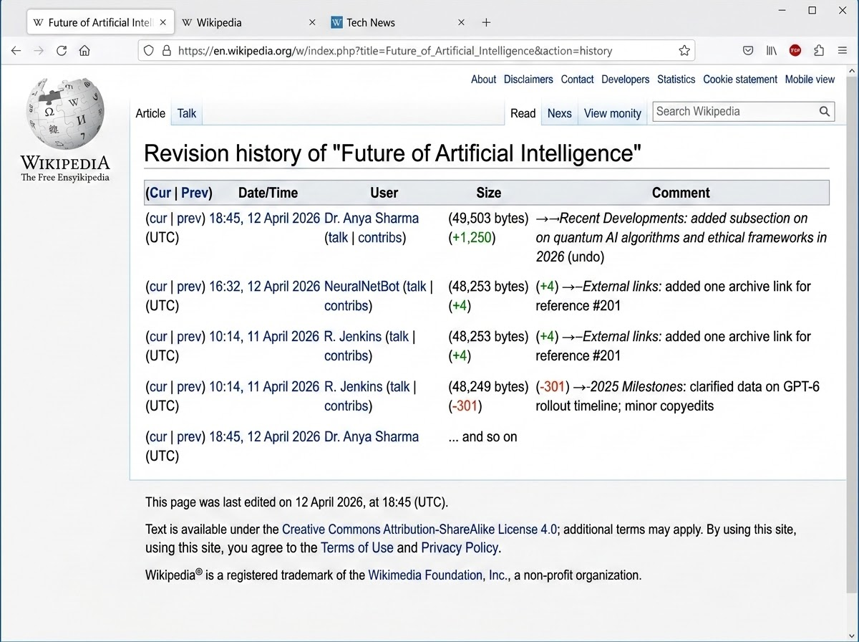
07 · CONTENT FRESHNESS
Web Page Last Updated
home
event
1. Publication & Update Dates
Published Date: Originally launched Jan 15, 2001.
Last Updated: Dynamic / Real-time updates.
Screenshot Evidence
Page Footer & Revision History Stamp
find_in_page
2. Evidence & Location
Location: Site footer & "View history" tab.
Verification: "This page was last edited on..." stamp.
verified_user
3. Currency Assessment
Status: Highly current and actively maintained.
Mechanism: Global editor community & automated bots.
history
4. Revision & Audit Trail
Version Control: Complete change log per page.
Transparency: Timestamped edits and byte diffs.
Website Analysis · wikipedia.org
7 / 8

Slide 9
Final Evaluation
Pushkar |  | Kaushal |  | Divyanshu |  | Chandra |  | Sankalp
Design | 8 | Design | 8 | Design | 9 | Design | 8 | Design | 9
Navigation | 10 | Navigation | 8 | Navigation | 9 | Navigation | 9 | Navigation | 9
Speed | 10 | Speed | 8 | Speed | 10 | Speed | 10 | Speed | 8
Mobile Friendliness | 7 | Mobile Friendliness | 8 | Mobile Friendliness | 9 | Mobile Friendliness | 8 | Mobile Friendliness | 9
Security | 8 | Security | 8 | Security | 8 | Security | 9 | Security | 8
Content | 6 | Content | 7 | Content | 7 | Content | 7 | Content | 7
Overall |  |  |  |  |  |  |  |  | 8.37

