Slide 1

Principle and Practice of Putback-based Bidirectional Programming in BiGUL
Zhenjiang Hu, Hsiang-Shang Ko
National Institute of Informatics, Japan
BX Summer School, Oxford
July 25-29, 2016

Slide 2
Overview
Lecture 1: Introduction to BiGUL
Why is putback-based BX?
What is its foundation?
How to program in BiGUL?
Lecture 2: Into BiGUL’s Bidirectionality
How is BiGUL implemented?
Lecture 3: Three Applications using BiGUL
Matching/delta lenses in BiGUL
Bidirectionalize relational queries with BiGUL
Parsing and reflective printing (BiYacc)
https://goo.gl/MdJeyk: lecture notes and codes

Slide 3
Bidirectional Programming (using Functions)

Slide 4
Bidirectional Transformation (BX)
[Nate Foster, et al: POPL 2005]

Slide 5
Roundtrip Properties
Get-Put:
put s (get s) = s
Put-Get:
get (put s t) = t

Slide 6
Challenges
One may “solve” the problem just by sticking together two arbitrary functions in any programming language you like.
Tricky to get right... and even trickier to maintain
Need to find a way of deriving both functions from a single description.

Slide 7
Get-based Approach
“get” (forward transformation)
“put” (backward transformation)
Domain Specific Bidirectional Languages (lens1, lens2, …)
Automatic Bidirectionization of ATL, XQuery, UnQL

Slide 8
Ambiguity of “Put”
Since get is generally non-injective, many suitable puts
correspond to one get, each being useful in different context.

Slide 9
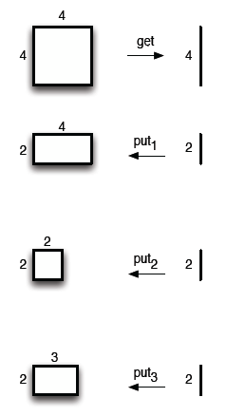
getHeight (w,h) = h
putHeight1 (w,h) h’ = (w,h’)
PutHeight2 (w,h) h’ = (w*h’/h, h’)
putHeight3 (w,h) h’ | h==h’ = (w,h)
| otherwise = (3,h’)

Slide 10
One Solution: Enriching “get”
Enrich “get” with more and more control over “put”
Get-based BX Combinator Library Lenses
(Foster et al.: POPL 2005)
…
Relational Lenses
(Bohannon et al.: PODS’06)
Quotient Lenses
(Foster et al.: POPL’08)
Matching Lenses
(Foster et al.: ICFP’10)
➔ We will have too many versions of “get” …

Slide 11
Foundation of Putback-based Bidirectional Programming

Slide 12
Putback is the essence of BX!
An important but little-known fact:
put uniquely determines get

Slide 13
Derived “get”: Uniqueness
Lemma: Given a put function, there exists at most one get function such that GetPut and PutGet hold.
Proof:
Suppose we have two get functions, say get and get′.
get s
=> { GetPut }
get (put s (get′ s))
== { PutGet }
get′ s

Slide 14
Derived “get”: Uniqueness
Lemma: Given a put function, there exists at most one get function such that GetPut and PutGet hold.
Proof:
Suppose we have two get functions, say get and get′.
get s
=> { GetPut }
get (put s (get′ s))
== { PutGet }
get′ s

Slide 15
Derived “get”: Existence
Lemma: Given a surjective put function (for any s, there exist s’, v, such that s = put s’ v), the get function defined by
get s = v such that put s v = s
satisfies GetPut and PutGet.
put s (get s)
= { definition of get }
put s v
= { condition for put }
s
Proof:
get (put s v)
= { condition for put }
get s
= { definition of get}
v
Notes:
For all x, exist y. R(x,y) => for all x, exist f. R(x, f(x)).: axiom

Slide 16
Derived “get”: Existence
Lemma: Given a surjective put function (for any s, there exist s’, v, such that s = put s’ v), the get function defined by
get s = v such that put s v = s
satisfies GetPut and PutGet.
put s (get s)
= { definition of get }
put s v
= { condition for put }
s
Proof:
get (put s v)
= { condition for put }
get s
= { definition of get}
v
Notes:
For all x, exist y. R(x,y) => for all x, exist f. R(x, f(x)).: axiom

Slide 17
Remark
Lemma: if there exists a v satisfying put s’ v = s, then so does put s v = s.
Proof:
put s’ v = s
=> { put }
put (put s’ v) v = put s v
== { PutTwice: forall s v. put (put s v) v = put s v }
put s’ v = put s v
== { Assumtion: put s’ v = s }
s = put s v
Notes:
putTwice:
put (put s v) v
= put (put s v) (get (put s v))
= put s v

Slide 18
Well-behaved “put”
Definition: A “put” function is said to be well-behaved, if there exists a (unique) “get” function such that GetPut and PutGet hold.
Exercise
Which of the following puts are well-behaved?
put1 s v = s
put2 s v = v
put2 s v = v+1

Slide 19
Well-behaved “put”
Lemma:
put is well-behaved, iff
View-deterministic
put s1 v1 = put s2 v2 ➔ v1 = v2
View-stable
for any s, there exists a v, such that put s v = s
Sebastian Fischer, Zhenjiang Hu, Hugo Pacheco, Pearl: A Clear Picture of Lenses, MPC 2015.
Notes:
➔
put (put s v) v
= { PutGet }
put (put s v) (get (put s v))
= { GetPut }
put s v
⬅
1 => PutGet
2+3 => GetPut
put s (get s)
= { surjective of put: s = put s’ v }
put (put s’ v) (get (put s’ v)
= { PutGet }
put (put s’ v) s’
= { PutTwice }
put s’ v
= { assumption above }
s

Slide 20
Validity Check of “Put”
Theorem:
Well-behavedness of a put defined in treeless languages is decidable.
Validation Algorithm:
(Soundness): A validated put is well-behaved.
(Completeness): Any well-behaved put can be validated.
Zhenjiang Hu, Hugo Pacheco, Sebastian Fischer, Validity Verification of Putback Transformations in Treeless Languages in Bidirectional Programming, FM 2014.

Slide 21
Putback-based Bidirectional Programming in BiGUL
Full control of bidirectional behavior
Put is not that difficult to write

Slide 22
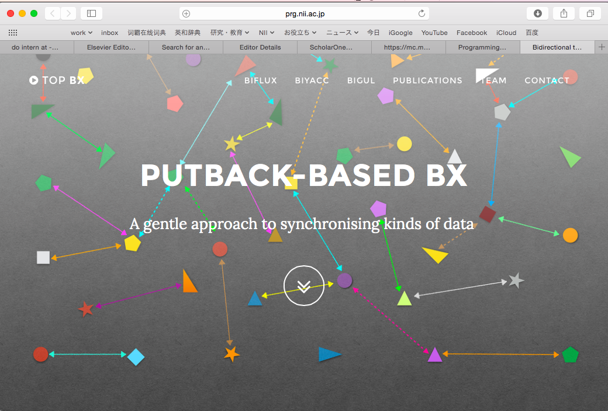
http://www.prg.nii.ac.jp/bx/

Slide 23
Installing BiGUL
1. Get the Glasgow Haskell Compiler (GHC) version 7.10.3. The easiest way is to install the Haskell Platform:
https://www.haskell.org/platform/
Use Haskell's default build system "cabal" to install BiGUL 1.0 (as a library). Start your terminal and run
> cabal update
> cabal install BiGUL

Slide 24
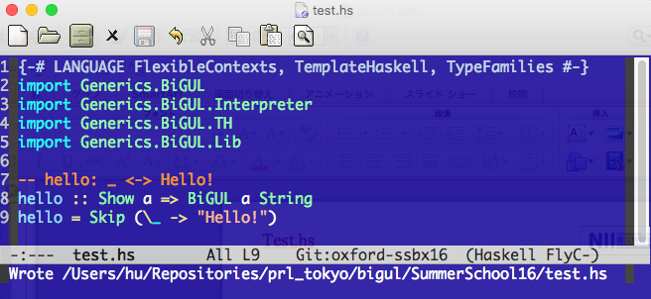
Test.hs

Slide 25
Put and Its Bidirectional Interpretation
A putback function:
px :: BiGUL s v
desrcibes how to use the view to update the source.
Bidirectional Interpretation:
get px :: s → Maybe v
put px :: s → v → Maybe s

Slide 26
-- hello: _ <-> Hello!
hello :: Show a => BiGUL a String
hello = Skip (\_ -> "Hello!")
*Main> get hello 1
Just "Hello!”
*Main> get hello 2
Just "Hello!”
*Main> put hello 2 "Hello!"
Just 2
*Main> put hello 2 "Hello!!!"
Nothing

Slide 27
A Quick Tour of BiGUL
Skip
Replace
Product
Source/View Rearragement
Case

Slide 28
1. Skip
Disallow any change on the view
Skip :: (s → v) → BiGUL s v
*Main> put (Skip square) 10 100
Just 10
*Main> put (Skip square) 10 250
Nothing
*Main> get (Skip square) 5
Just 25
skip1 :: BiGUL s ()
skip1 = Skip (const ())

Slide 29
2. Replace
Use the view to completely replace the source
Replace :: BiGUL s s
*Main> put Replace 1 100
Just 100
*Main> put Replace (1,1) (100,200)
Just (100,200)

Slide 30
3. Prod: Production of two puts
Prod :: BiGUL s1 v1 → BiGUL s2 v2
→ BiGUL (s1,s2) (v1,v2)
*Main> put (skip1 `Prod` Replace) (5,1) ((),100)
Just (5,100)
*Main> put ((skip1 ‘Prod‘ Replace) ‘Prod‘ Replace) ((5,1),2) (((),100),200)
Just ((5,100),200)

Slide 31
4. Source/View Rearrangements
Rearrange the source/view through a natural transformation tau to make the view and the source have the same structure.
$(rearrS [| tau :: s1 -> s2 |]) :: BiGUL s2 v -> BiGUL s1 v
$(rearrV [| tau :: v1 -> v2 |]) :: BiGUL s v2 -> BiGUL s v1
putPairOverNPair :: (Show s1, Show s2) => BiGUL ((s0,s1),s2) (s1,s2)
putPairOverNPair = $(rearrS [| \((s0,s1),s2) -> (s1,s2) |]) Replace
putPairOverNPair' :: (Show s0, Show s1, Show s2) => BiGUL ((s0,s1),s2) (s1,s2)
putPairOverNPair' = $(rearrV [| \(v1,v2) -> (((),v1),v2) |]) $
(skip1 `Prod` Replace) `Prod` Replace

Slide 32
A syntactic sugar:
$(update [p| source-pattern |]
[p| view-pattern |]
[d| updating-strategy |])
putPairOverNPair’’ :: (Show s1, Show s2) => BiGUL ((s0,s1),s2) (s1,s2)
putPairOverNPair’’ = $(update [p| ((_,s1),s2) |]
[p| (s1,s2) |]
[d| s1 = Replace; s2 = Replace |])

Slide 33
Exercise:
Define pHead to use the view to replace to first element of
the source list.
pHead :: BiGUL [s] s
pHead :: Show s => BiGUL [s] s
pHead = $(rearrS [| \(s:_) -> s |]) Replace
pHead :: Show s => BiGUL [s] s
pHead = $(update [p| s:_ |] [| s |] [d| s = Replace |]

Slide 34
Exercise:
Define pNth to use the view to replace to the ith element of
the source list.
pNth :: Int → BiGUL [s] s
pNth :: Show s => Int -> BiGUL [s] s
pNth i = if i == 0 then pHead
else $(rearrS [| \(x:xs) -> (x,xs) |]) $
$(rearrV [| \v -> ((), v) |]) $
skip1 `Prod` pNth (i-1)
*PBasic> put (pNth 3) [1..10] 100
Just [1,2,3,100,5,6,7,8,9,10]
*PBasic> get (pNth 3) [1..10]
Just 4

Slide 35
5. Case
Case [ $(normal [| enteringCond1 :: s -> v -> Bool |] [|exitCond1 :: s -> Bool |])
==> (bx1 :: BiGUL s v)
, $(adaptive [| enteringCond1' :: s -> v -> Bool |])
==> (f1 :: s -> v -> s)
, ...
, $(normal [| enteringCondn :: s -> v -> Bool |] [|exitCond1 :: s -> Bool |])
==> (bxn :: BiGUL s v)
, ...
, $(adaptive [| enteringCondm' :: s -> v -> Bool |])
==> (fm :: s -> v -> s)
]
:: BiGUL s v

Slide 36
pHead :: Show s => BiGUL [s] s
pHead = $(rearrS [| \(s:_) -> s |]) Replace
repHead :: BiGUL [Int] Int
repHead = Case [
$(normal [| \s v -> length s > 0 |] [| \s -> length s > 0 |])
==> $(rearrS [| \(x:_) -> x |]) Replace,
$(adaptive [| \s v -> length s == 0 |])
==> \s v -> [0]
]

Slide 37
Exercise
Define a safe embedding of a pair of well-behaved get and put as a putback transformation.
emb :: Eq v => (s -> v) -> (s -> v -> s) -> BiGUL s v
emb g p = Case [ $(normal [| \s v -> g s == v |] [p| _ |])
==> Skip g
, $(adaptive [| \s v -> {- g s /= v -} True |])
==> p
]
distSum :: BiGUL (Int, Int) Int
distSum = emb g p
where g (x,y) = x+y; p (x,y) v = (v-y,y)

Slide 38
Bidirectionalization of Functions on Lists

Slide 39
Foldr
Foldr is one of the important higher order functions for defining useful functions on lists:
foldr f e [] = e
foldr f e (x:xs) = f x (foldr f e xs)
Examples:
sum = foldr (+) 0
map f = foldr (\a r -> f a : r) []
reverse p = foldr (\a r -> r ++ [a]) []

Slide 40
lensFoldr
lensFoldr :: (Show a, Show b)
=> BiGUL (a, b) b -> (b->Bool) -> BiGUL ([a], b) b

Slide 41
lensFoldr
lensFoldr :: (Show a, Show b)
=> BiGUL (a, b) b -> (b->Bool) -> BiGUL ([a], b) b
lensFoldr bx pv =
Case [
, $(normal [| \(s,_) v -> null s |] [| \(s,_) -> null s |])
, $(normalSV [p| _ |] [p| _ |] [| \(s,_) -> not (null s) |])
]

Slide 42
lensFoldr
lensFoldr :: (Show a, Show b)
=> BiGUL (a, b) b -> (b->Bool) -> BiGUL ([a], b) b
lensFoldr bx pv =
Case [ $(adaptive [| \(s,?) v -> pv v && length s /= 0 |])
==> \(s,y) _ -> ([],y)
, $(normal [| \(s,_) v -> null s |] [| \(s,_) -> null s |])
==> $(update [p| (_, v) |] [p| v |] [d| v = Replace |])
, $(normalSV [p| _ |] [p| _ |] [| \(s,_) -> not (null s) |])
==> $(rearrS [| \((x:xs), e) -> (x, (xs,e)) |])
(Replace `Prod` lensFoldr bx pv) `Compose` bx
]

Slide 43
lensFoldr
lensFoldr :: (Show a, Show b)
=> BiGUL (a, b) b -> (b->Bool) -> BiGUL ([a], b) b
lensFoldr bx pv =
Case [
, $(normal [| \(s,_) v -> null s |] [| \(s,_) -> null s |])
==> $(update [p| (_, v) |] [p| v |] [d| v = Replace |])
, $(normalSV [p| _ |] [p| _ |] [| \(s,_) -> not (null s) |])
]

Slide 44
lensFoldr
lensFoldr :: (Show a, Show b)
=> BiGUL (a, b) b -> (b->Bool) -> BiGUL ([a], b) b
lensFoldr bx pv =
Case
, $(normal [| \(s,_) v -> null s |] [| \(s,_) -> null s |])
==> $(update [p| (_, v) |] [p| v |] [d| v = Replace |])
, $(normalSV [p| _ |] [p| _ |] [| \(s,_) -> not (null s) |])
==> $(rearrS [| \((x:xs), e) -> (x, (xs,e)) |])
(Replace `Prod` lensFoldr bx pv) `Compose` bx
]

Slide 45
lensFoldr
lensFoldr :: (Show a, Show b)
=> BiGUL (a, b) b -> (b->Bool) -> BiGUL ([a], b) b
lensFoldr bx pv =
Case [ $(adaptive [| \(s,?) v -> pv v && length s /= 0 |])
==> \(s,y) _ -> ([],y)
, $(normal [| \(s,_) v -> null s |] [| \(s,_) -> null s |])
==> $(update [p| (_, v) |] [p| v |] [d| v = Replace |])
, $(normalSV [p| _ |] [p| _ |] [| \(s,_) -> not (null s) |])
==> $(rearrS [| \((x:xs), e) -> (x, (xs,e)) |])
(Replace `Prod` lensFoldr bx pv) `Compose` bx
]

Slide 46
lensMap
lensMap :: (Show a, Show b)
=> BiGUL a b -> BiGUL ([a],[b]) [b]
lensMap bx = lensFoldr bx' null
where bx‘ = $(update [p| (a,b) |] [| (a,b) |] [d| a = bx; b = Replace) $

Slide 47
LensReverse
Exercise:
Can you bidirectionalize reverse using lensFoldr?
lensReverse :: Show a => BiGUL [a] [a]
lensReverse = Case [
$(adaptive [| \s v -> length s < length v |])
==> \s v -> v
, $(normalSV [p| _ |] [p| _ |] [| \ s -> True |])
==> $(rearrS [| \s -> (s,[]) |]) $
lensFoldr (lensSwap `Compose` lensSnoc) null
]

Slide 48
Bidirectionalizing relational queries with BiGUL

Slide 49
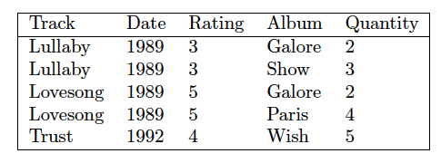
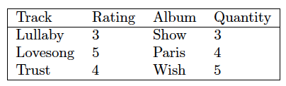
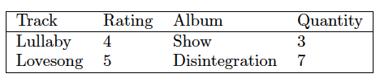
View Updating for Relational Database
Q
?
Q
Q: select Track, Rating, Album, Quantity as v
from s where Quantity > 2

Slide 50
Brul [BX 2015]
Two library functions to describe “update policies” using put:
relAlign: dealing with selection/projection
unJoin: dealing with join
Features
All SPJ queries can be derived (query-completeness)
All update policies discussed in the literature can be described (expressiveness)
We will focus on relAlign in this tutorial.

Slide 51
Relational Table
type RT = [Record]
type Record = [RType]
data RType = RInt Int | RString String | RFloat Float | RDouble Double
deriving (Show, Eq, Ord)
deriveBiGULGeneric ''RType
s = [ [RString "Lullaby", RInt 1989, RInt 3, RString "Galore", RInt 1]
, [RString "Lullaby", RInt 1989, RInt 3, RString "Show" , RInt 3]
, [RString "Lovesong", RInt 1989, RInt 5, RString "Galore", RInt 1]
, [RString "Lovesong", RInt 1989, RInt 5, RString "Disintegration" , RInt 4]
, [RString "Trust", RInt 1992, RInt 4, RString "Wish" , RInt 5]
]

Slide 52
Functional Dependency
Track → Data, Rating Album → Quantity
type FDMap = Map.Map Int [Int]
sfdMap :: FDMap
sfdMap = Map.fromList [(0,[1,2]), (3,[4])]

Slide 53
From keyAlign to relAlign
relAlign is similar to keyAlign except that
We need to consider filtering of source elements
We need to recover function dependency when updates happen
Idea: keyAlign ➔ pAlign ➔ relAlign

Slide 54
Review: keyAlign
keyAlign :: forall s v k. (Show s, Show v, Eq k)
=> (s -> k) -> (v -> k) -> BiGUL s v -> (v -> s) -> BiGUL [s] [v]
keyAlign ks kv b c = Case
[ $(normalSV [p| [] |] [p| [] |] [p| [] |])
==> $(update [p| [] |] [p| [] |] [d| |])
, $(normal [| \(s:ss) (v:vs) -> ks s == kv v |] [p| _ : _ |])
==> $(update [p| x:xs |] [p| x:xs |]
[d| x = b; xs = keyAlign ks kv b c |])
, $(adaptiveSV [p| _ : _ |] [p| [] |])
==> \ _ _ -> []
, $(adaptive [| \ss (v:vs) -> kv v `elem` map ks ss |])
==> \ss (v : _) -> uncurry (:) (extract (kv v) ss)
, $(adaptiveSV [p| _ |] [p| _ : _ |])
==> \ss (v : _) -> c v : ss
]

Slide 55
From keyAlign to pAlign
pAlign :: forall s v k. (Show s, Show v, Eq k)
=> (s -> Bool) {- predicate -}
-> (s -> k) -> (v -> k) -> BiGUL s v -> (v -> s)
-> (s -> Maybe s) {- conceal/hide function -}
-> BiGUL [s] [v]
pAlign p ks kv b c h = Case
[ $(normalSV [p| [] |] [p| [] |] [p| [] |])
==> $(update [p| [] |] [p| [] |] [d| |])
, $(normal [| \(s:ss) (v:vs) -> p s && ks s == kv v |] [| \(s:ss) -> p s |])
==> $(update [p| x:xs |] [p| x:xs |] [d| x = b; xs = pAlign p ks kv b c h |])
, $(adaptive [| \(s:ss) v -> p s && null v|])
==> \(s:ss) v -> maybe [] (:[]) (h s) ++ ss
, $(normal [| \(s:ss) v -> not (p s) |] [| \(s:ss) -> not (p s) |])
==> $(update [p| _:xs |] [p| xs |] [d| xs = pAlign p ks kv b c h |])
, $(adaptive [| \ss (v:vs) -> kv v `elem` map ks (filter p ss) |])
==> \ss (v:_) -> uncurry (:) (extract (kv v) ss)
, $(adaptiveSV [p| _ |] [p| _:_ |])
==> \ss (v:_) -> filterCheck p (c v) : ss
]
Add 2 new parameters

Slide 56
From keyAlign to pAlign
pAlign :: forall s v k. (Show s, Show v, Eq k)
=> (s -> Bool) {- predicate -}
-> (s -> k) -> (v -> k) -> BiGUL s v -> (v -> s)
-> (s -> Maybe s) {- conceal/hide function -}
-> BiGUL [s] [v]
pAlign p ks kv b c h = Case
[ $(normalSV [p| [] |] [p| [] |] [p| [] |])
==> $(update [p| [] |] [p| [] |] [d| |])
, $(normal [| \(s:ss) (v:vs) -> p s && ks s == kv v |] [| \(s:ss) -> p s |])
==> $(update [p| x:xs |] [p| x:xs |] [d| x = b; xs = pAlign p ks kv b c h |])
, $(adaptive [| \(s:ss) v -> p s && null v|])
==> \(s:ss) v -> maybe [] (:[]) (h s) ++ ss
, $(normal [| \(s:ss) v -> not (p s) |] [| \(s:ss) -> not (p s) |])
==> $(update [p| _:xs |] [p| xs |] [d| xs = pAlign p ks kv b c h |])
, $(adaptive [| \ss (v:vs) -> kv v `elem` map ks (filter p ss) |])
==> \ss (v:_) -> uncurry (:) (extract (kv v) ss)
, $(adaptiveSV [p| _ |] [p| _:_ |])
==> \ss (v:_) -> filterCheck p (c v) : ss
]
Consider the cases according to “p on source elements”

Slide 57
From keyAlign to pAlign
pAlign :: forall s v k. (Show s, Show v, Eq k)
=> (s -> Bool) {- predicate -}
-> (s -> k) -> (v -> k) -> BiGUL s v -> (v -> s)
-> (s -> Maybe s) {- conceal/hide function -}
-> BiGUL [s] [v]
pAlign p ks kv b c h = Case
[ $(normalSV [p| [] |] [p| [] |] [p| [] |])
==> $(update [p| [] |] [p| [] |] [d| |])
, $(normal [| \(s:ss) (v:vs) -> p s && ks s == kv v |] [| \(s:ss) -> p s |])
==> $(update [p| x:xs |] [p| x:xs |] [d| x = b; xs = pAlign p ks kv b c h |])
, $(adaptive [| \(s:ss) v -> p s && null v|])
==> \(s:ss) v -> maybe [] (:[]) (h s) ++ ss
, $(normal [| \(s:ss) v -> not (p s) |] [| \(s:ss) -> not (p s) |])
==> $(update [p| _:xs |] [p| xs |] [d| xs = pAlign p ks kv b c h |])
, $(adaptive [| \ss (v:vs) -> kv v `elem` map ks (filter p ss) |])
==> \ss (v:_) -> uncurry (:) (extract (kv v) ss)
, $(adaptiveSV [p| _ |] [p| _:_ |])
==> \ss (v:_) -> filterCheck p (c v) : ss
]
Guarantee the new source elements satisfying p.

Slide 58
From pAlign to relAlign
relAlign :: … -> (s -> s) {- dependency maintaining function -}
-> BiGUL [s] [v]
relAlign p ks kv b c h fd = Case
[ …
, $(adaptive [| \(s:ss) v -> p s && null v|])
==> \(s:ss) v -> maybe [] ((:[]) . filterCheck p . fd) (h s) ++ ss
, $(normal [| \(s:ss) v -> not (p s) |] [| \(s:ss) -> not (p s) |])
==> Case
[ $(adaptive [| \(s:_) _ -> fd s /= s |])
==> \(s:ss) _ -> filterCheck (not.p) (fd s) : ss
, $(normal [|\_ _ -> True |] [| const True |])
==> $(update [p| _:xs |] [p| xs |] [d| xs = relAlign p ks kv b c h fd |])
]
…
]
Perform fd on those source elements that does not satisfy p or
has no matching element in the view.

Slide 59
Use of relAlign
Define an update policy: if an element is removed from the view,
the corresponding source elements should be removed.
u0 :: RType -> (Record -> Record) -> BiGUL [Record] [Record]
u0 d =
relAlign
(\r -> (r !! 4) > RInt 2)
(\s -> (s !! 0, s!!3))
(\v -> (v !! 0, v !! 2))
$(update [p| (t: _: r: a: q: [])|]
[p| (t: r: a: q: []) |]
[d| t = Replace; r = Replace; a = Replace; q = Replace |])
(\(t: r: a: q: []) -> (t: d: r: a: q: []))
(\rs -> Nothing)

Slide 60
Testing the forward transformation:
*Brul> get (u0 (RInt (-1)) id) s
Just
[[RString "Lullaby",RInt 3,RString "Show",RInt 3],
[RString "Lovesong",RInt 5,RString "Disintegration",RInt 4],
[RString "Trust",RInt 4,RString "Wish",RInt 5]]
Suppose that the view is changed to:
v = [ [RString "Lullaby" , RInt 4, RString "Show" , RInt 3]
, [RString "Lovesong", RInt 5, RString "Disintegration" , RInt 7]
]

Slide 61
Testing the backward transformation:
*Brul> put (u0 (RInt (-1)) (fdFun sfdMap vfdMap svMap v)) s v
Just
[[RString "Lullaby",RInt 1989,RInt 4,RString "Galore",RInt 1],
[RString "Lullaby",RInt 1989,RInt 4,RString "Show",RInt 3],
[RString "Lovesong",RInt 1989,RInt 5,RString "Galore",RInt 1],
[RString "Lovesong",RInt 1989,RInt 5,RString "Disintegration",RInt 7]]

Slide 62
Define a new update policy: if an element is removed from the view,
the corresponding source elements will have quantity 0.
u0 :: RType -> (Record -> Record) -> BiGUL [Record] [Record]
u0 d =
relAlign
(\r -> (r !! 4) > RInt 2)
(\s -> (s !! 0, s!!3))
(\v -> (v !! 0, v !! 2))
$(update [p| (t: _: r: a: q: [])|]
[p| (t: r: a: q: []) |]
[d| t = Replace; r = Replace; a = Replace; q = Replace |])
(\(t: r: a: q: []) -> (t: d: r: a: q: []))
(\(t: d: r: a: _: []) -> Just (t: d: r: a: Rint 0:[]))

Slide 63
Summary
Putback-based programming is fun and not that difficult.
Putback-based BX can be served as the basis for developing various domain specific BX languages.
BiYacc/BiFluX/Brul …
Putback-based BX is promising to be used to develop BIG BX systems:
Bidirectionalization of pandoc is ongoing

Slide 64
Future Work
Adding effects to BiGUL
BiGUL for graphs (GRoundTram …)
Static analysis (validatity checking) of BiGUL programs
Putback-based bidirectional computing machine and compilation

