Slide 1
Dec 04, 2019
Dee Hwa Liong Academy Grade Management System
Mendoza, Nico C.

Slide 2
INTRODUCTION
Dec 04, 2019
Background of the Study

Slide 3
K to 12 Program in the Philippines
THE PHILIPPINES RECENTLY IMPLEMENTED A COMPREHENSIVE REFORM ON ITS BASIC EDUCATION.
The Philippines is slowly matching the global standards in secondary education. The main objectives of the program are:
To better prepare students for higher education
To gain eligibility for domestic and overseas educational institutions
To provide immediate employability upon graduating

Slide 4
K to 12 Program in the Philippines
A NEW CURRICULUM WAS INTRODUCED TOGETHER WITH ITS SUBJECTS.
Kindergarten curriculum framework implements the general principles of the National Early Learning Framework.
Students in grades 1 to 10 will encounter an improved, context-based, and spiral progression learning curriculum with several subjects.
Senior High School (SHS) will choose a career track - Academic, Technical-Vocational-Livelihood, and Sports and Arts.

Slide 5
K to 12 Program in the Philippines
THE DEPARTMENT OF EDUCATION (DEPED) PROVIDED TEACHERS A FREE COPY OF ELECTRONIC CLASS RECORD (ECR) TEMPLATES
ECR templates are MS Excel based. It has three (3) components for grades:
Written Work
Performance Tasks
Quarterly Assessment

Slide 6
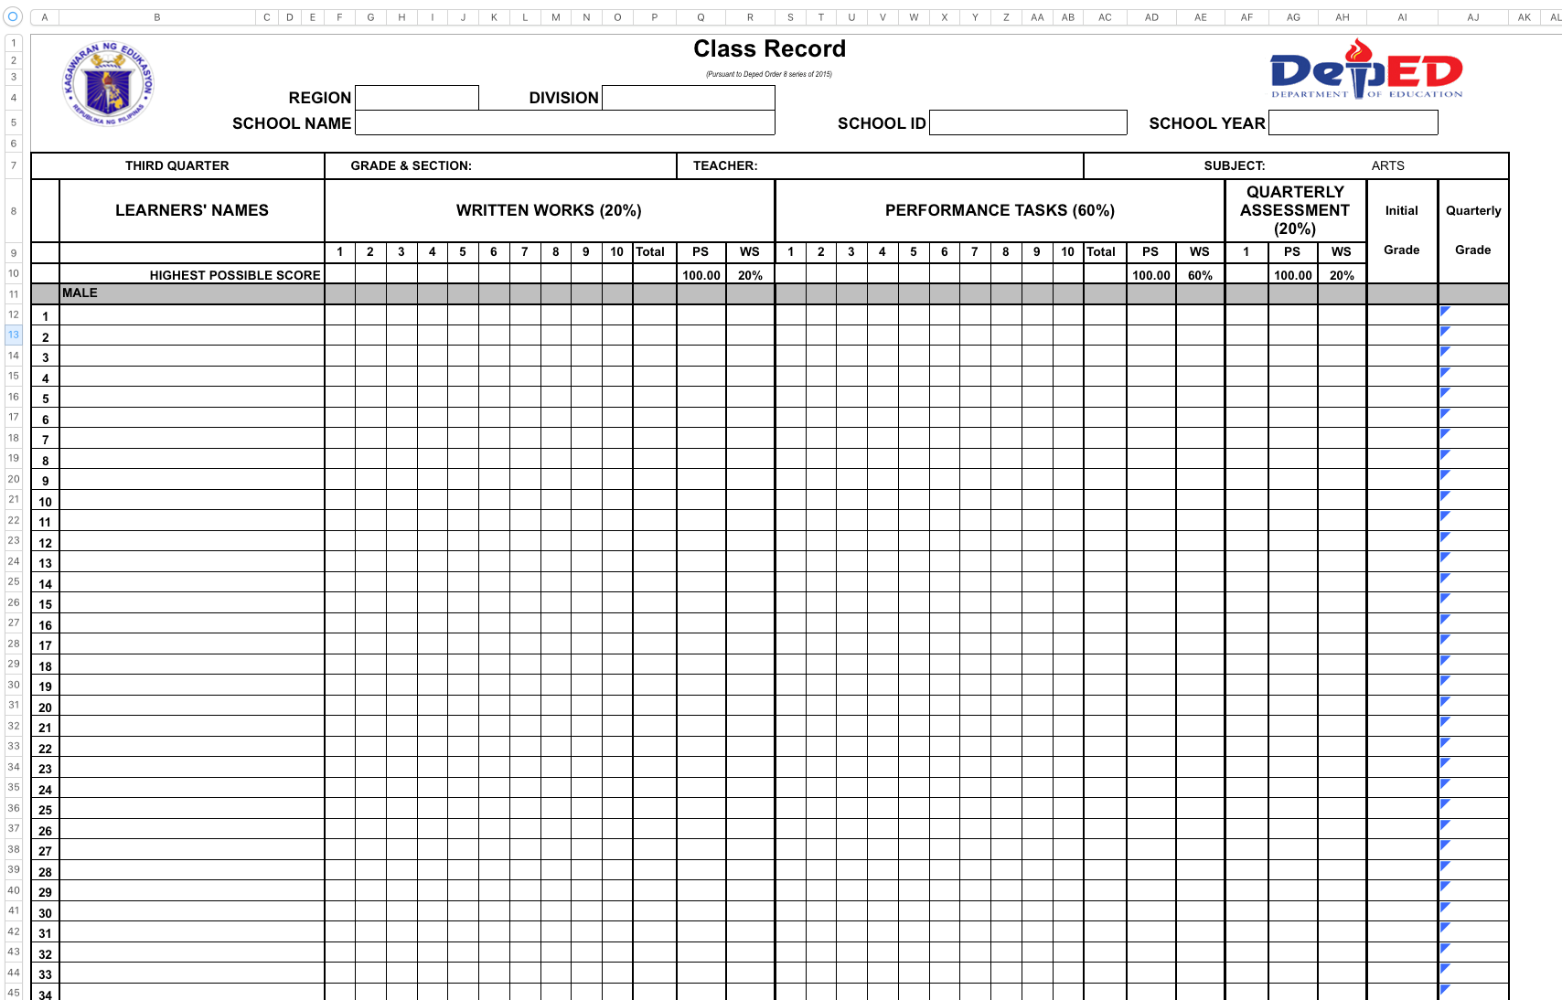

Slide 7
K to 12 Program in the Philippines
CLASS RECORDS ARE ONE OF THE MOST IMPORTANT THINGS KEPT BY TEACHERS.
At present, creating an online or web-based class record system is possible. Teachers and school administrators are also updated with technology.
Even though spreadsheets have proven to be a useful tool for keeping records, creating an application with better management capabilities is possible.

Slide 8
INTRODUCTION
Dec 04, 2019
Statement of the Problem

Slide 9
Dee Hwa Liong Academy
DEE HWA LIONG ACADEMY IS AN EDUCATIONAL INSTITUTION THAT IMPLEMENTS THE K TO 12 PROGRAM.
This academy uses spreadsheet to keep student records. In result, the academy faces several difficulties, which includes:
Tedious process of storing student records,
Long preparation time
Lack of security

Slide 10
Dee Hwa Liong Academy
THE ACADEMY SUFFERS LONG PREPARATION TIME FOR CREATING SPREADSHEET FILES FOR EACH TEACHER.
The Information Technology (IT) head manually generates a teacher-centric spreadsheet files from these data from each teacher, adding the teacher's current load with corresponding students enrolled in that subject. The load of each teacher can vary, thus spreadsheet files contain multiple grade sheets.
The said preparation will be repeated twice a year for Senior Highschool teachers and once a year for non-SHS teachers

Slide 11
Dee Hwa Liong Academy
AN INDIVIDUAL DELIBERATION AFTER SUBMISSION OF GRADES IS TAKEN PLACE.
This deliberation process includes a face-to-face meeting with the IT head and registrar, running down all the student scores, and checking for possible incorrect or missing fields. Late submission of grades can cause a delay of the group deliberation.

Slide 12
Dee Hwa Liong Academy
ONE OF THE DIFFICULTIES THAT THE IT HEAD AND REGISTRAR ALSO ENCOUNTER IS THE LACK OF SECURITY IN THE SPREADSHEET FILES
The submission of grades is usually done through flash drive or via facebook messenger. In effect, these excel files can easily be duplicated (losing track of the most updated file) and a possible modification can be done without the permission of certain authorities. Moreover, these records are also prone to data corruption.

Slide 13
Dee Hwa Liong Academy
AFTER CHECKING EVERY GRADE SHEETS OF ALL TEACHERS, THE IT HEAD THEN MANUALLY GENERATES A SECTION-CENTRIC SPREADSHEET FILES.
These spreadsheet files contain lists of students under a given subject. It also includes the condensed grade of each students as well as their grade for each corresponding subjects. This process involves linking multiple teacher-centric grade sheets to a single spreadsheet file.

Slide 14
Dee Hwa Liong Academy
GENERATING STUDENT-CENTRIC REPORT CARDS CAN BE A TEDIOUS PROCESS MOST ESPECIALLY FOR SHS STUDENTS
The problem arose when the academy's population started to increase, thus also increases the number of students with backlog subjects. The IT head has to personalize the report cards for irregular students, since they have a different set of currently taking subjects.

Slide 15
INTRODUCTION
Dec 04, 2019
Objectives of the Study

Slide 16
Objectives of the Study
THE MAIN GOAL OF THE STUDY IS TO DEVELOP A WEB-BASED APPLICATION FOR RECORD KEEPING OF STUDENTS' GRADES WITH THE FOLLOWING FUNCTIONALITIES:
The application will have a System Administrator who will be able to:
Login and logout
Change administrator password
View and update profile
Create teachers and other (Director and Registrar) user accounts
Create student accounts
SDCC • 2020

Slide 17
Objectives of the Study
THE MAIN GOAL OF THE STUDY IS TO DEVELOP A WEB-BASED APPLICATION FOR RECORD KEEPING OF STUDENTS' GRADES WITH THE FOLLOWING FUNCTIONALITIES:
f. Activate and deactivate an account
i. Account deactivation will only happen if the owner of the account is no longer affiliated with the school or is suspended from work and other reasons for deactivation.
g. View the edit/update log of the grade sheets
SDCC • 2020

Slide 18
Objectives of the Study
THE MAIN GOAL OF THE STUDY IS TO DEVELOP A WEB-BASED APPLICATION FOR RECORD KEEPING OF STUDENTS' GRADES WITH THE FOLLOWING FUNCTIONALITIES:
2. The application will have a Director's account. The director will be able to:
a. Login and logout
b. View and update profile
c. Change his/her password
d. View grades from each subjects
i. It will also provide student information, name, student number, and section.The administrator has also the option to view the records in teacher-centric, section-centric, or student-centric.
SDCC • 2020

Slide 19
Objectives of the Study
THE MAIN GOAL OF THE STUDY IS TO DEVELOP A WEB-BASED APPLICATION FOR RECORD KEEPING OF STUDENTS' GRADES WITH THE FOLLOWING FUNCTIONALITIES:
e. View condensed grades of each section
i. Condensed grades will not only show grades. It will also give information about the teachers assigned to each subject and the adviser of the section being viewed.
f. View list and number of students who passed/failed
g. View list and number of honor students
SDCC • 2020

Slide 20
Objectives of the Study
THE MAIN GOAL OF THE STUDY IS TO DEVELOP A WEB-BASED APPLICATION FOR RECORD KEEPING OF STUDENTS' GRADES WITH THE FOLLOWING FUNCTIONALITIES:
3. A Registrar's account will be able to do the following functionalities:
a. Login and logout
b. View and update profile
c. Change his/her password
d. Set deadline for submission of grades
i. Deadline of submission of grades will be set to be able to see who submitted late since a fine is to be collected.
SDCC • 2020

Slide 21
Objectives of the Study
THE MAIN GOAL OF THE STUDY IS TO DEVELOP A WEB-BASED APPLICATION FOR RECORD KEEPING OF STUDENTS' GRADES WITH THE FOLLOWING FUNCTIONALITIES:
e. View student records
i. The student record view can be teacher-centric, section-centric, and student-centric
f. View and produce report cards
g. View school information, Elementary Learners Data, Elementary Learners Age Profile, Junior High School Learners Data, JHS Learners Age Profile, Senior High School Repeaters Age Profile, SHS Learners Data by Track, SHS Learners Data in Technical-Vocational-Livelihood Trach Specialization, Total Number of Enrollees by Sex,
SDCC • 2020

Slide 22
Objectives of the Study
THE MAIN GOAL OF THE STUDY IS TO DEVELOP A WEB-BASED APPLICATION FOR RECORD KEEPING OF STUDENTS' GRADES WITH THE FOLLOWING FUNCTIONALITIES:
Age, Grade Level and etc., needed by DepEd and Private Educational Assistance Committee (PEAC).
h. Add/Update the names of sections
i. Add students to a section
j. Add students load to teachers
k. View grade submission logs of teachers
SDCC • 2020

Slide 23
Objectives of the Study
THE MAIN GOAL OF THE STUDY IS TO DEVELOP A WEB-BASED APPLICATION FOR RECORD KEEPING OF STUDENTS' GRADES WITH THE FOLLOWING FUNCTIONALITIES:
4. Teacher's account will be able to do the following functionalities:
a. Login and logout
b. View and update profile
c. Change his/her password
d. Input and update grades sheets
e. View grade sheets
f. Submit grades
SDCC • 2020

Slide 24
Objectives of the Study
THE MAIN GOAL OF THE STUDY IS TO DEVELOP A WEB-BASED APPLICATION FOR RECORD KEEPING OF STUDENTS' GRADES WITH THE FOLLOWING FUNCTIONALITIES:
If the teacher is also an adviser, additional functionalities will be available:
a. View condensed grades of the section he/she is handling
b. View his/her advisee's report cards in pdf format
A pdf file will be available once the condensed grades have been finalized.
5. Student account will be able to do the following functionalities:
a. Login and logout
b. View and update profile
SDCC • 2020

Slide 25
Objectives of the Study
THE MAIN GOAL OF THE STUDY IS TO DEVELOP A WEB-BASED APPLICATION FOR RECORD KEEPING OF STUDENTS' GRADES WITH THE FOLLOWING FUNCTIONALITIES:
c. Change his/her password
d. View report cards from past grade levels to present
6. Parent/Guardian account will be able to do the following functionalities:
a. Login and logout
b. View and update profile
c. Change his/her password
d. View student's report cards from past grade levels to present
SDCC • 2020

Slide 26
INTRODUCTION
Dec 04, 2019
Significance of the Project

Slide 27
USING SPREADSHEETS ARE PROVEN TO BE A USEFUL TOOL FOR KEEPING STUDENT RECORDS. BUT IT ALSO HAS DISADVANTAGES WHICH INCLUDES LONG PREPARATION TIME AND INTEGRITY OF FILES.
Dee Hwa Liong Academy Grade Management System will:
Lessen the time needed for post-enrollment processes, grade submission, and deliberation.
Eradicate the need of using flash drives and facebook messenger for submission of grades.
Tracking late submission of grades will also be easier.
Provide security for students' records since grades will not be easily modified and an update log will also be available.
SDCC • 2020

Slide 28
INTRODUCTION
Dec 04, 2019
Scope and Limitations

Slide 29
The system will be created based on the process followed by Dee Haw Liong Academy.
The system will only cover the Kinder2 and Grade 12 students.
The deliberation of grades will still be done personally by the registrar, subject teachers, advisers, and possibly, by the director and principal.
Character traits of students will also be included in the system
The system will be created to solve bottle neck problems of the grade management system of Dee Hwa Liong Academy. These bottle neck problems include the preparation and distribution of grade sheets per subject teacher, produce condensed grade sheet per section, and formatting of grades for printing.
The system will be fully online, no offline counterpart, and accounts cannot be requested through the system. Accounts will be created by the system administrator.
SDCC • 2020

Slide 30
INTRODUCTION
Dec 04, 2019
Assumptions

Slide 31
Listed below are the assumptions for the Dee Hwa Liong Academy Grade Management System:
Active student users are assumed to be officially enrolled by the school registrar. Enrollment is done outside the system
React.JS and Express.JS will be used for developing the web application therefore the server to be used by the client must support a Node.JS server environment
The grading system is provided by the academy and follows the K to 12 program grading system.
SDCC • 2020

Slide 32
REVIEW OF RELATED LITERATURE
Dec 04, 2019
Review of Related Literature

Slide 33
WEB-BASED INFORMATION SYSTEM PLAYS A VITAL ROLE IN THE EDUCATIONAL INSTITUTES OR COLLEGES IN ORDER TO MAINTAIN A RECORD OF THE STUDENTS EASILY.
It is very important to manage the accurate record and up-to-date information so that they can easily access it.
Information system deals with all types of details of the students like course registration, notifications, semester calendar, academic record, exam components, exam slip, timetable, etc.
It does not only save time but also the problems faced by the staff. They don't have to use any ink and paper in order to do any sort of work related to that institution.
SDCC • 2020

Slide 34
SCHOOL ADMINISTRATIVE PROCESSES AND THE OFFICIAL PROCEDURES OF SCHOOL SUCH AS GRADE MANAGEMENT AND ENROLLMENT PERIOD CAN BE DONE IN A MORE EFFECIENT WAY BY THE USE OF MANAGEMENT INFORMATION SYSTEMS.
The implementation of information systems in universities can result in a significant decreased use of paper and turning most of the school office documents in an electronic format.
It can range from simple interactive software for classroom teaching up to automation of system administrator processes such as admission and grade management.
SDCC • 2020

Slide 35
INFORMATION AND COMMUNICATION TECHNOLOGIES (ICT) CONTINUES TO INNOVATE AND IMPROVE THE EFFICIENCY OF SEVERAL SYSTEMS ACROSS THE WORLD.
The exposure of students to application of ICT has a major role in learning process for university students both outside and inside the campus settings.
The technical modernization and campus network construction is an important way to achieve the current student data management information construction. The role of this system is associated mainly with the instructor, administrator, and student.
SDCC • 2020

Slide 36
MOSTLY THE INSTITUTIONS ARE RATED ON THE AVAILABILITY OF SERVICES AS WELL AS SATISFACTION PROVIDED TO THE USERS.
Web-based student information system plays a vital role. Therefore, in many universities, students are assisted by in the form of registration, issuance of the transcript of certificates, and financial recording.
Students information system has helped students to view their grades by just enterring their roll number in student login panel of university. They do not need to waste their time by standing for hours in a queue.
SDCC • 2020

Slide 37
93.5% OF THE PROCESSES WHICH INCLUDES GRADE MANAGEMENT AND ADMISSION INTO EXCLUSIVE PRIVATE SCHOOLS ARE PERFORMED MANUALLY USING PAPER AND INK.
Fujo et. al. (2018) discusses the limitations and problems of having a manual system which include loss of forms which can caused by misplaced documents, long preparation time, finding an appropriate school and subjects an applicant can get admission, and disfigurement of forms handled by the students througout the process for admission.
SDCC • 2020

Slide 38
AN ELECTRONIC CLASS RECORD WHICH WAS DEVELOPED FOR THE FACULTY MEMBERS OF THE LYCEUM OF THE PHILIPPINES-LAGUNA INTERNATIONAL SCHOOL IS PROVEN TO FOLLOW THE GRADING STANDARDS OF THE INSTITUTION.
Class records can easily be managed and processes including computation of grades can be done in an efficient and convenient way.
But one of the system's limitation is the class record, which is made using Microsoft Excel, lacks security features. The end users and administrator suggest locking the file once it is submitted.
SDCC • 2020

Slide 39
A KEY COMPONENT OF E-UP PROJECT IS THE ESTABLISHING OF MULTIPLE WEB-BASED INFORMATION SYSTEMS WHICH INCLUDE OUR OWN STUDENT ACADEMIC INFORMATION SYSTEM (SAIS), FINANCIAL MANAGEMENT INFORMATION SYSTEM (FMIS), ETC.
The system also aims to provide a platform that solves the existing problems which involve human errors due to manual operations.
It also aims to harmonize, integrate, and interoperate the ICT systems and across all Constituent Universities (CUs). The implementation of such system will also allow for the improvement on the efficiency of its core functions.
SDCC • 2020

Slide 40
DEVELOPING AN INFORMATION SYSTEM SUCH AS STUDENTS' RECORD MANAGEMENT INFORMATION SYSTEM (SRMIS) PROVIDES CUMULATIVE GRADE POINT AVERAGE (CGPA) COMPUTATION IN THE UNIVERSITY OF CALABAR
This allows efficient and convenient access to students' information such as grades and student records.
It also can enable the implementation of layers of security by allocating access privileges and monitoring of mischievous acts of altering scores in the result sheet.
SDCC • 2020

Slide 41
WEB-BASED STUDENT INFORMATION SYSTEM ALSO HAS A MAJOR ROLE IN PROVIDING THE REQUIREMENTS OF EFFECTIVE MANAGEMENT OF STUDENTS' CATALOG AND RECORDS IN EDUCATIONAL ORGANIZATIONS
The implementation of Mzuzu University Student Online Management System (SOMS) resulted to the increase of performance in the school's registration process and it also provide access to examination results amongst the student community
Lubanga et. al. also discusses the seamless transfer of information between the university management and the students with the help of internet technologies.
SDCC • 2020

Slide 42
THEORETICAL FRAMEWORK
Dec 04, 2019
THEORETICAL FRAMEWORK

Slide 43
Assessment of Students
DEE HWA LIONG ACADEMY HANDLES STUDENTS FROM NURSERY, KINDER1, KINDER2, AND GRADES 1 TO 12.
Nursery and Kinder 1
Nursery and Kinder 1 use a progressive curriculum, and the basis for assessing a student is a checklist. Checklists are called Developmental Assessment Scale. This scale is divided into four developmental skills - Physical Development, Self-help Skills, Socio-emotional Development and Pre-academic Development
SDCC • 2020

Slide 44
Assessment of Students
DEE HWA LIONG ACADEMY HANDLES STUDENTS FROM NURSERY, KINDER1, KINDER2, AND GRADES 1 TO 12.
Kinder 2, Grades 1 to 10
Kinder 2 and Grades 1 to 10 use the K to 12 curriculum. Teachers are given ECRs to input students' scores for each component. The basis for assessment are written work, performance task, and exams. The spreadsheet file has columns for formative tasks. Similar to nursery and kinder1 students, grades are combined and deliberated quarterly.
SDCC • 2020

Slide 45
Assessment of Students
DEE HWA LIONG ACADEMY HANDLES STUDENTS FROM NURSERY, KINDER1, KINDER2, AND GRADES 1 TO 12.
Grades 11 to 12
Grade sheets for grades 11 and 12 are similar to kiner 2 and grades 1 to 10. The only difference is instead of combining the grades quarterly, it is done per semester. Each semester, two exms are taken by students: midterm and final exams
Character traits are also graded by teachers. 50% of the character trait grades comes from the adviser while the remaining 50% will come from the subject teachers.
SDCC • 2020

Slide 46
Teacher-centric Grade Sheet
A teacher-centric grade sheet is a spreadsheet file which contains lists of students currently handled by the teacher. The spreadsheet contains multiple tabs. Each tab represents the subject currently handled by the teacher. It contains a list of students taking that subject and their corresponding scores for each component. The final grade is automatically computed for every addition or adjustment of scores.
SDCC • 2020

Slide 47
Condensed Grade
Condensed grade is a term used to descibe the average grade of the student. It is obtained from the section-centric grade sheet.
SDCC • 2020

Slide 48
Section-centric Grade Sheet
A section-centric grade sheet is a spreadsheet file which contains a list of students under a given subject. The first column has the student names. The remaining columns are populated by the grades of each student from a given subject. The last column contains the condensed grade.
SDCC • 2020

Slide 49
Student-centric Grade Sheet
A student-centric grade sheet is used for the printing of report cards. It is a spreadsheet file which contains a list of subjects the student is currently taking. The list of subjects is then followed by their corresponding grades.
SDCC • 2020

Slide 50
Grade Submission
Submission of grades are done per semester for SHS students, and quarterly for kinder2 to grade 10. Submission of grades is done through messenger or passing a flash drive to the registrar.
The registrar also keeps track of the submission date of the teachers. This is done manually by writing down the date the teacher submitted his/her grade sheet(s).
Character traits and attendance sheets will also be checked by the registrar.
SDCC • 2020

Slide 51
Individual Deliberation of Grades
Deliberation of grades is done after the teacher has submitted his/her grade sheets. It is always done personally with the registrar and the IT head. This is to ensure that all grades are correctly collected and final adjustments have been made before the creation of the condensed grades.
The registrar will talk and review the students' grades with the subject teacher. If no issues were raised during the talk, the registrar will accept the grade sheet to be added to the condensed grades according to the sections, generating section-centric records. Adding students to the grade sheet will also be done during the discussion with the subject teacher.
SDCC • 2020

Slide 52
Group Deliberation of Grades
Group deliberation is done for the section-centric grade sheets. In this deliberation, the subject teachers, adviser, and registrar will sit down together to talk about a section's grade sheet. Grade clarifications and student's behaviors are also discussed during the deliberation
Grade adjustments are still possible in this process. The teacher can readjust the student scores, component weights, and the transmuted grade from the teacher-centric grade sheet.
SDCC • 2020

Slide 53
Printing of Report Cards
Report card is a teacher-centric record which is reviewed by each adviser to check if there are any errors in the input. It includes the grades for both academic and character traits. It will also include the student's attendance and tardiness record.
Report cards are created based on the condensed grade file. These cards are printed on a normal sheet of paper for the first three quarters. For the final quarter, it is printed on a card. These cards are distributed to parents quarterly.
SDCC • 2020

Slide 54
Node.JS
Node.js is an open source run-time environment. This was built in Chrome's V8 JavaScript engine. It provides a long term efficiency through event-driven and non-blocking I/O model and server-size JavaScript. Unlike apache web servers which uses PHP as a default language, this allows the creation of Web Applications and server connections using Javascript and a collection of external "modules" that manages various core functionality.
SDCC • 2020

Slide 55
Express.JS
Express.js covers the core Node.js \textit{http} module (http://nodejs.org/api/http.html) to provide extensive functionalities and features. This framework consists of many plugin modules called middleware. Express acts as a foundation for a custom-built framework which fits the web application project.
SDCC • 2020

Slide 56
React.JS
React.js is a javascript library for building modern user interfaces. It was created by Facebook and independent contributors and organizations. One of the key features of this library is the use of a "Virtual Document Object Model" or "Virtual DOM". It enables developers to build a whole web application as if the entire webpage is rendered on each individual page but only web components that actually change. It also uses Javascript XML (JSX), which is an extension to the Javascript syntax. Its syntax is similar to the Hypertext Markup Tool (HTML), which makes it similar to existing web developers.
SDCC • 2020

Slide 57
MySQL
My Structured Query Language (MySQL) is an open-source relational database management system (RDBMS), and has around 6 million installations worldwite. This is available as free software and is under GNU General Public License (GPL).
Some of the advantages of MySQL includes portability, good security features, flexible table structure, can be integrated with various programming languages, and small RAM usage.
SDCC • 2020

Slide 58
DESIGN AND IMPLEMENTATION
Dec 04, 2019
Design and Implementation

Slide 59
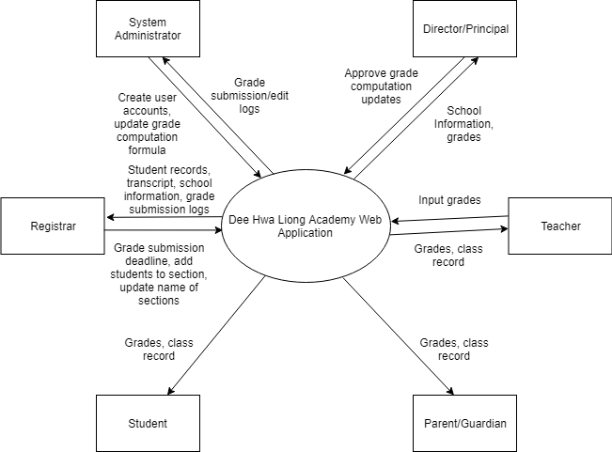
Context Diagram

Slide 60
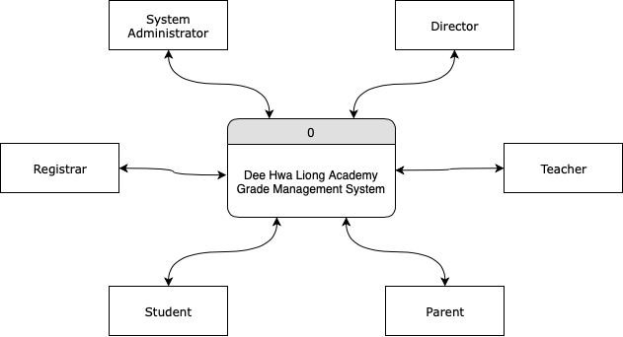
Top Level Data Flow Diagram

Slide 61
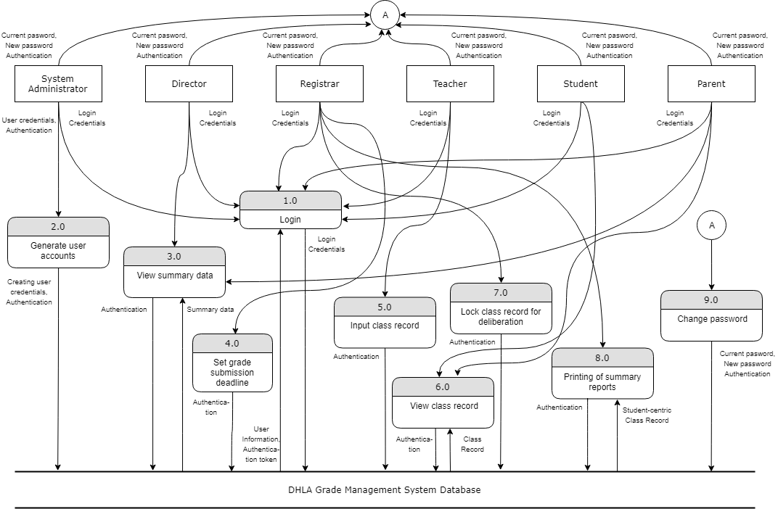

Slide 62
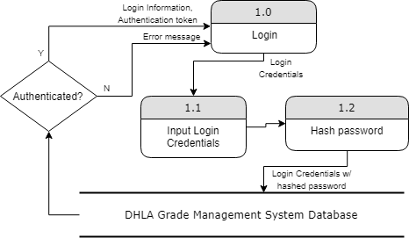
Level 2 Data Flow Diagram for Process 1.0

Slide 63
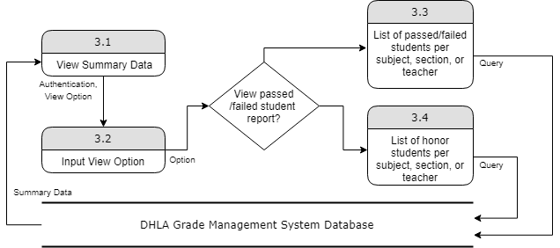
Level 2 Data Flow Diagram for Process 3.0

Slide 64
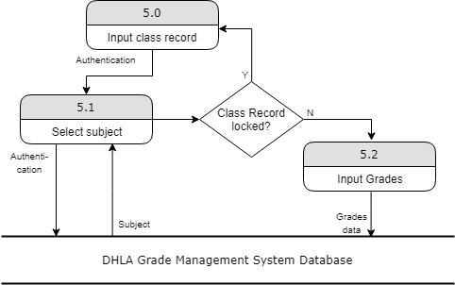
Level 2 Data Flow Diagram for Process 5.0

Slide 65
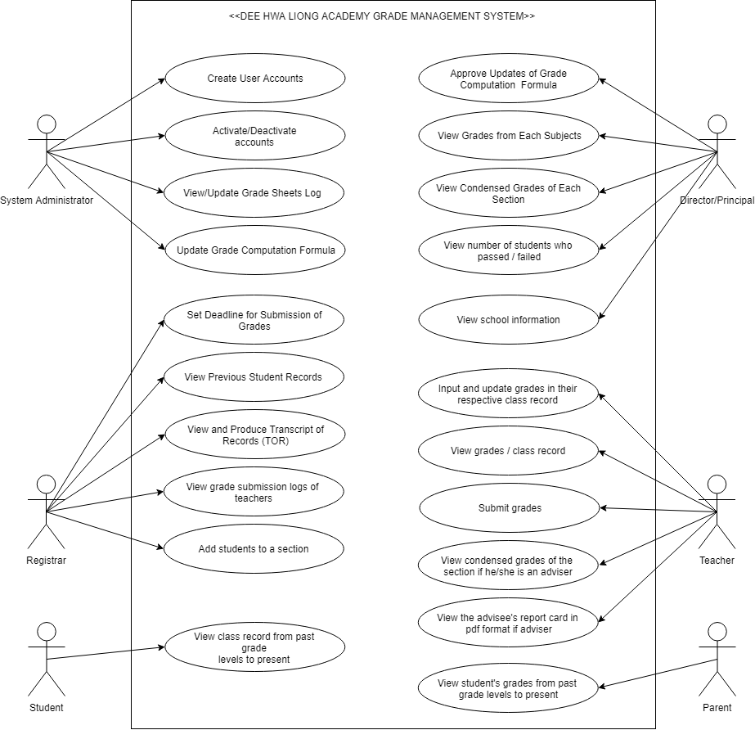
Use Case Diagram, DHLA Grade Management System

Slide 66
Use Case Diagram, DHLA Grade Management System

Slide 67
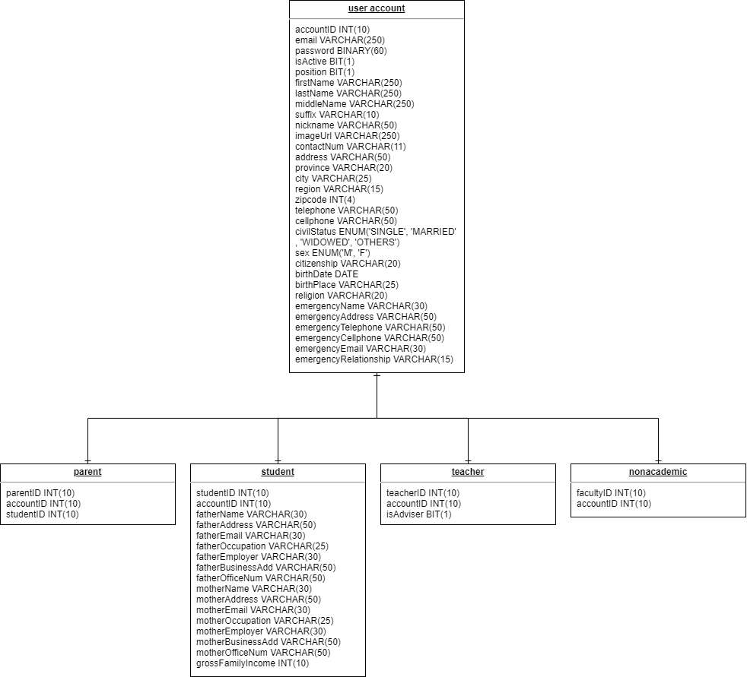
Entity Relationship Diagram (ERD) (user account)

Slide 68
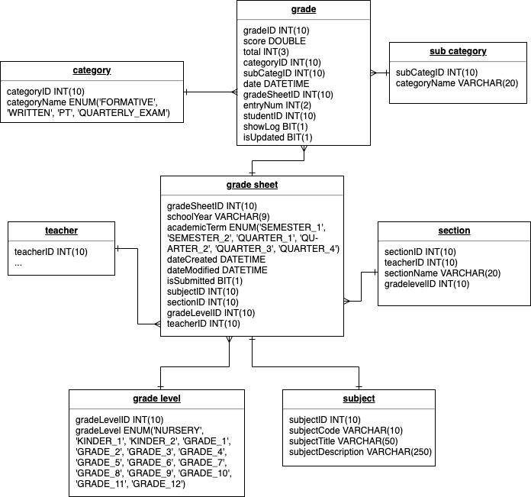
Entity Relationship Diagram (ERD) (grade sheet)

Slide 69
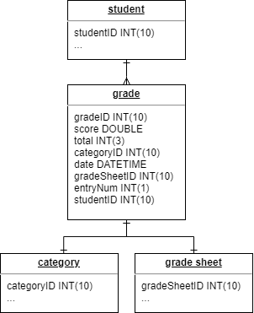
Entity Relationship Diagram (ERD) (grade)

Slide 70
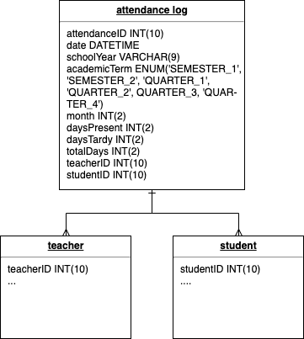
Entity Relationship Diagram (ERD) (attendance log)

Slide 71
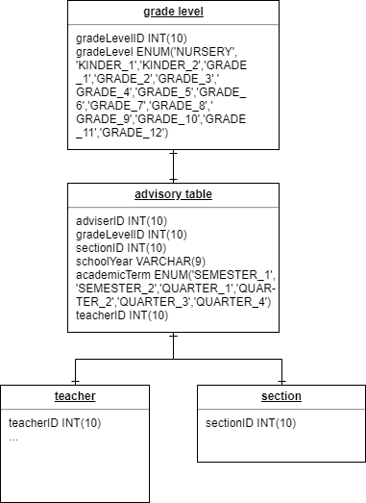
Entity Relationship Diagram (ERD) (advisory table)

Slide 72
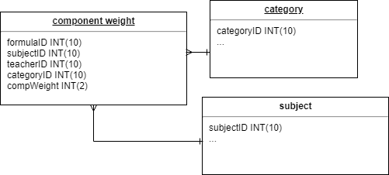
Entity Relationship Diagram (ERD) (component weight)

Slide 73
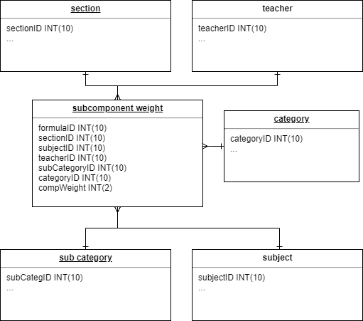
Entity Relationship Diagram (ERD) (subcomponent weight)

Slide 74
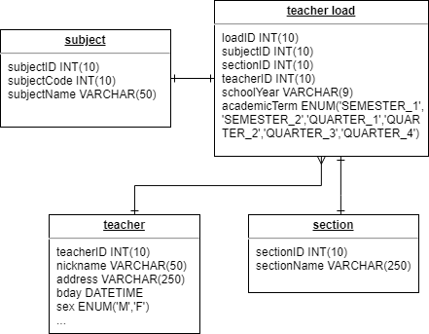
Entity Relationship Diagram (ERD) (teacher load)

Slide 75
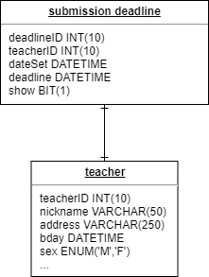
Entity Relationship Diagram (ERD) (submission deadline)

Slide 76
DESIGN AND IMPLEMENTATION
Dec 04, 2019
Data Dictionary

Slide 77
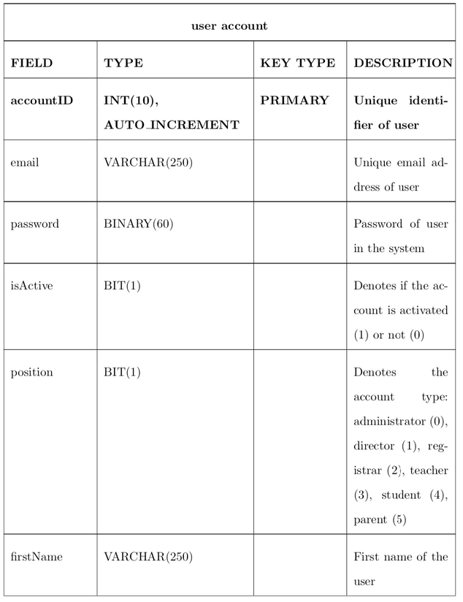
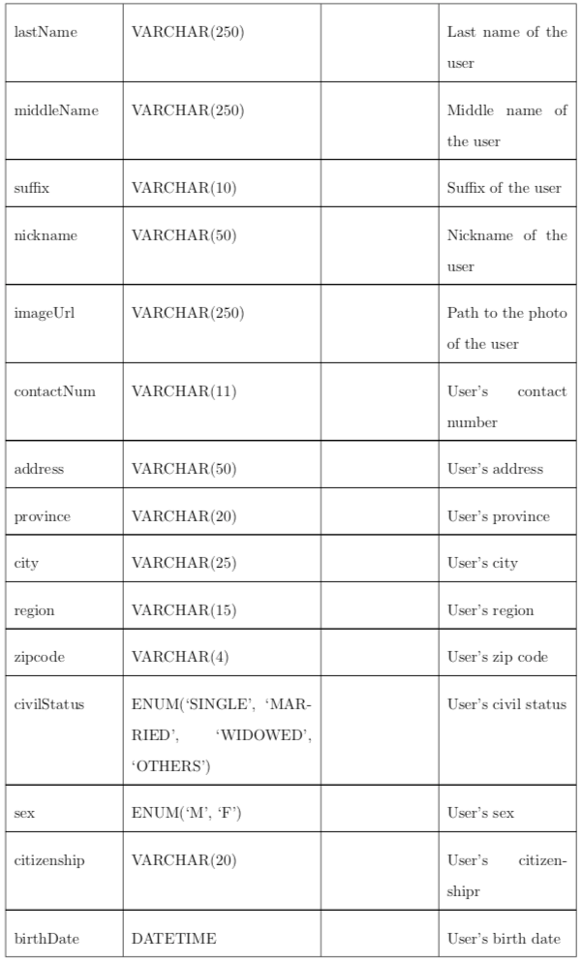
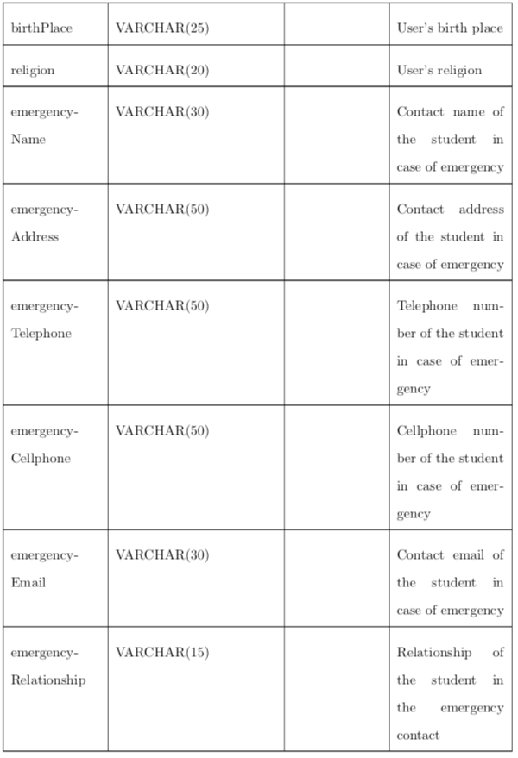
Data Dictionary for user account table

Slide 78
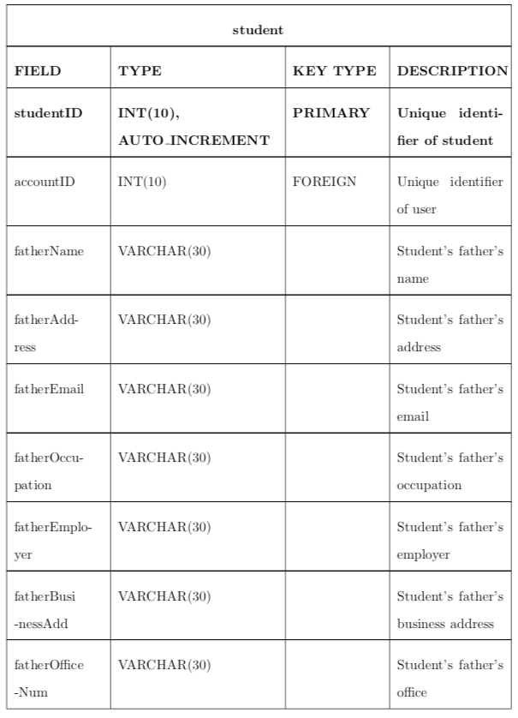
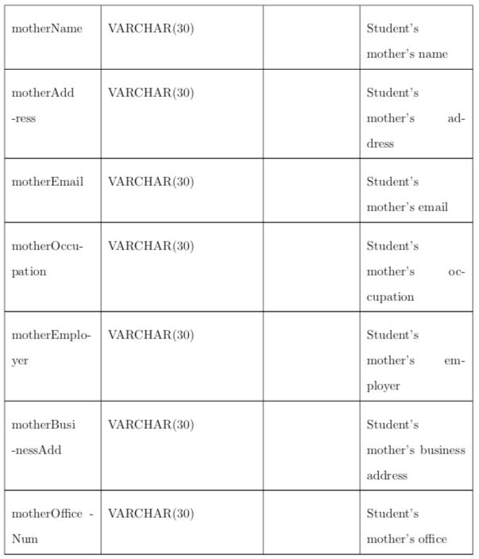
Data Dictionary for student table

Slide 79
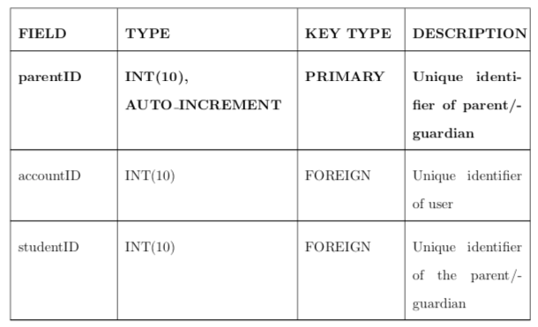
Data Dictionary for parent guardian table

Slide 80
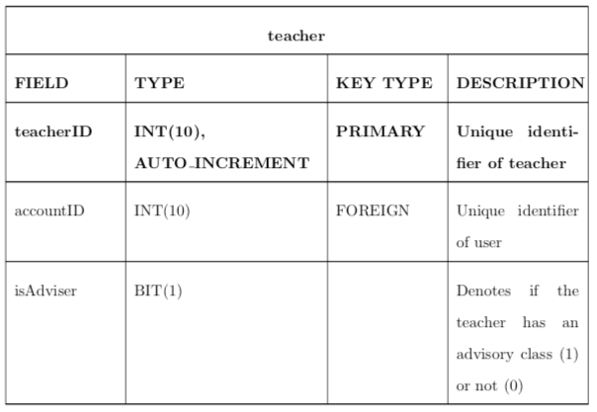
Data Dictionary for teacher table

Slide 81
Data Dictionary for teacher table

Slide 82
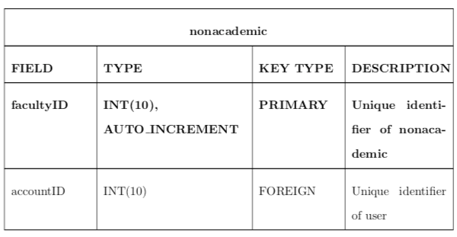
Data Dictionary for nonacademic table

Slide 83
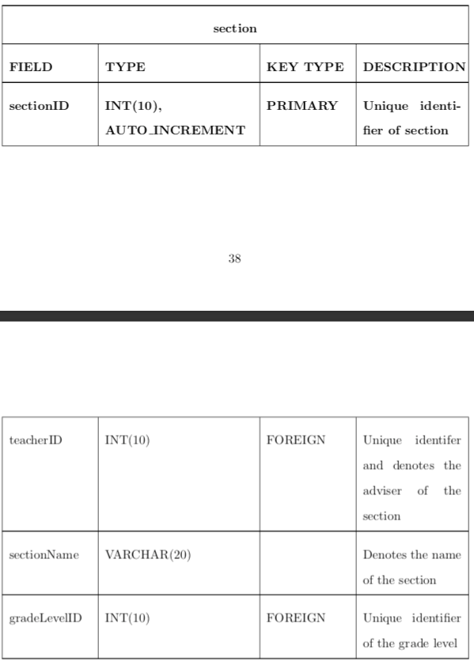
Data Dictionary for section table

Slide 84
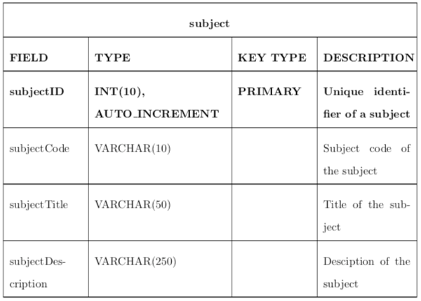
Data Dictionary for subject table

Slide 85
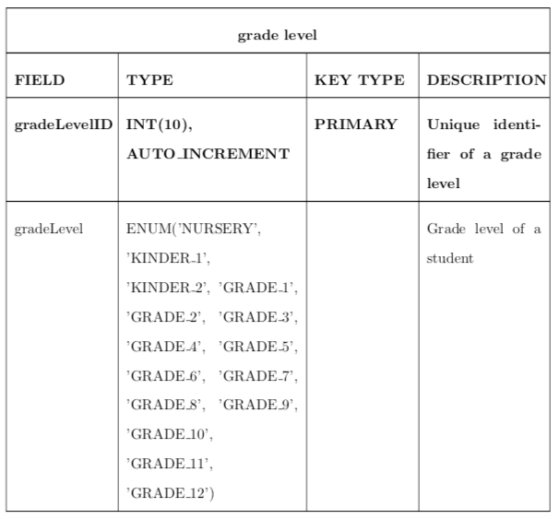
Data Dictionary for grade level table

Slide 86
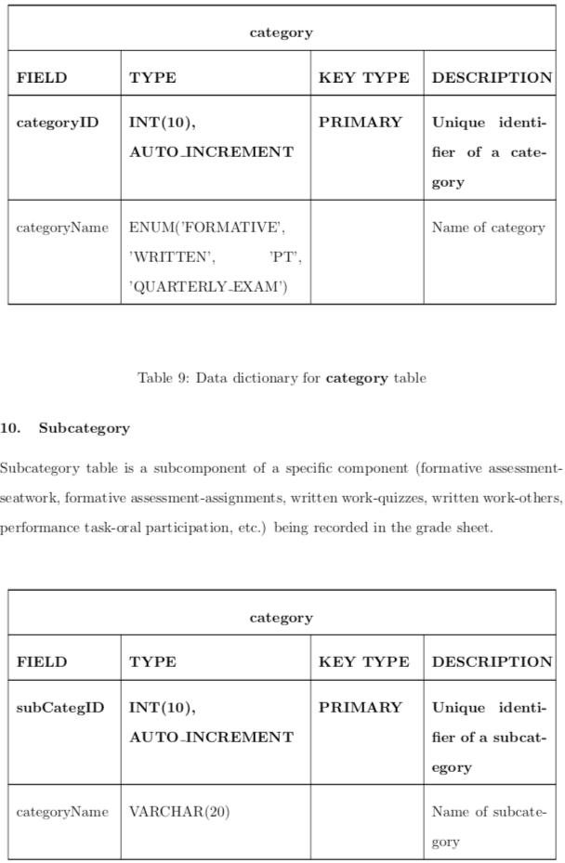
Data Dictionary for category table

Slide 87
Data Dictionary for subcategory table

Slide 88
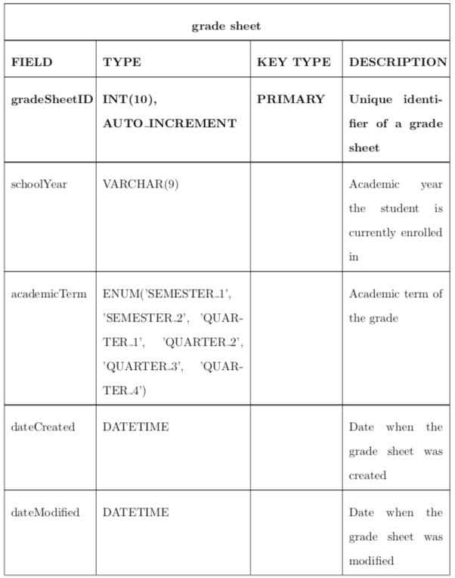
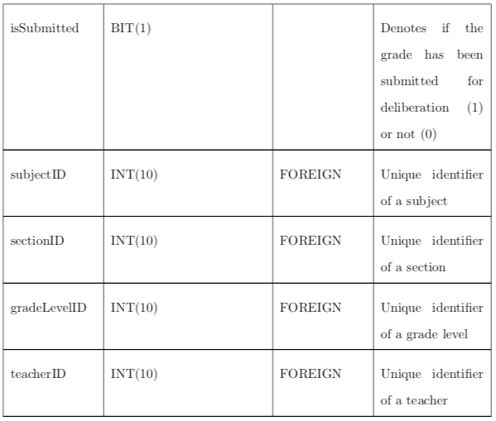
Data Dictionary for grade sheet table

Slide 89
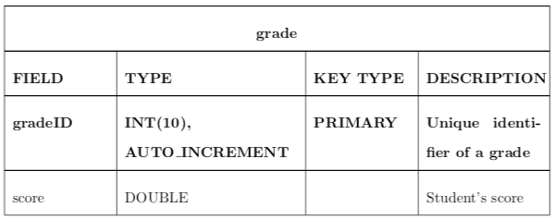
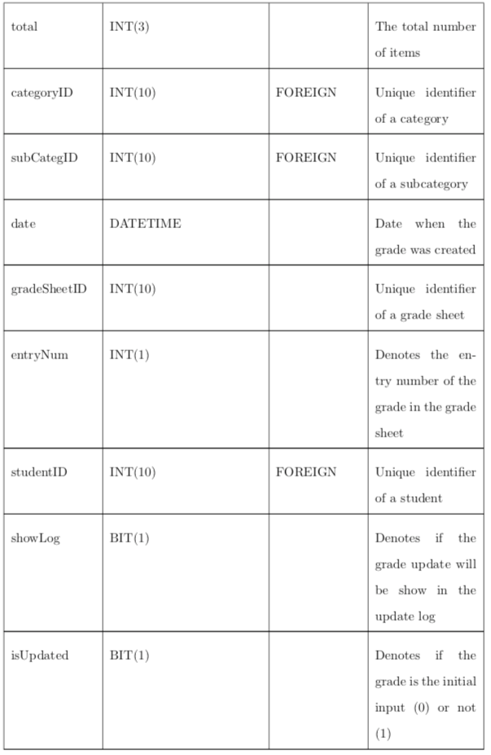
Data Dictionary for grade table

Slide 90
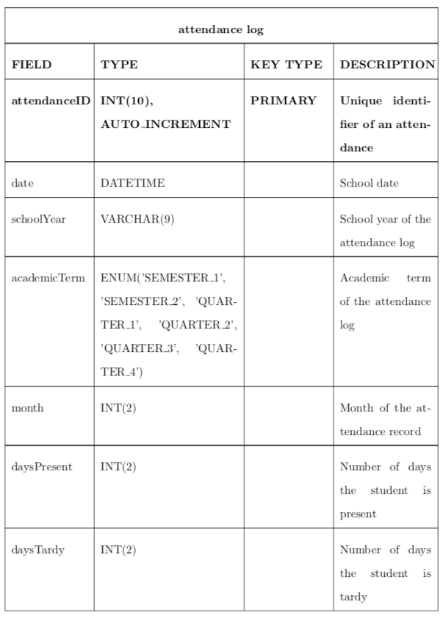
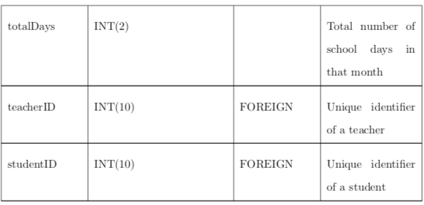
Data Dictionary for attendance log table

Slide 91
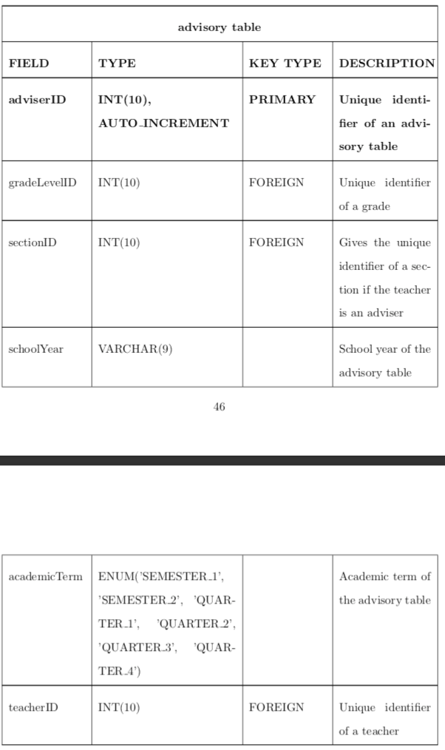
Data Dictionary for advisory table

Slide 92
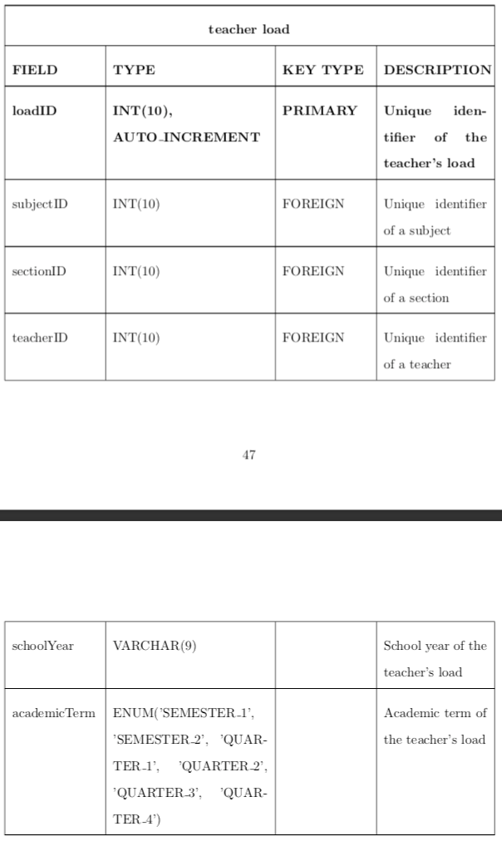
Data Dictionary for teacher load table

Slide 93
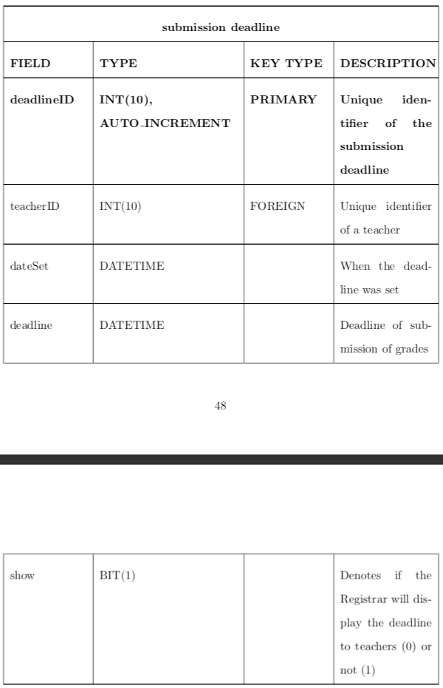
Data Dictionary for submission deadline table

Slide 94
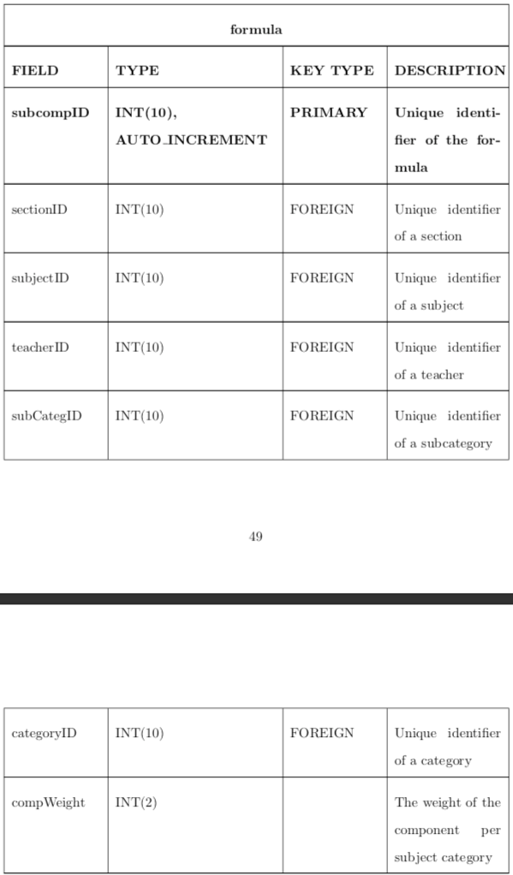
Data Dictionary for subcomponent weight table

Slide 95
DESIGN AND IMPLEMENTATION
Dec 04, 2019
System Architecture

Slide 96
Dee Hwa Liong Academy Web Application will be built under the Node.js server environment. Express.js will be used as a library for fetching data through API calls (using routers). The system will be using React.js library as the main front-end backbone. For the user interface, Ant Design, a design language made for React environment, alongside with Tabler React, an open-source UI framework for building dashboard applications will be used to make the website more responsive. MySQL will be used as the database of the system.
SDCC • 2020
04

Slide 97
DESIGN AND IMPLEMENTATION
Dec 04, 2019
Technical Architecture

Slide 98
DHLA Grade Management System will be accessed online. It follows a client-server-database architecture. The main server should have the following specifications (minimum requirements):
Node.js Run-time Environment for the Server (12.1.0 or higher)
MySQL (7.2.10 or higher)
Google Chrome (70.0.3538.102 or higher)
Opera (56.0.3051.104 or higher)
Microsoft Edge (42.17134.1.0 or higher)
Internet Connection
SDCC • 2020
04

