Slide 1
Universal Plastic Shredder V2.0
Team: I’m so Shredded Inc.
Bao Nguyen · Fearghus Tyler · Yaqoub Rabiah · Fox Kang

Slide 2
Project Objectives(Electrical Only)
Drive an electric motor to power a plastic shredder
Ensure safe operation with buttons and/or HMI display
Design and wire the system to industry standards
NEMA compliant electrical system
NFPA 70 installation guidelines
$1000 Budget for EE team
Consumer electronics, but with an extra zero

Slide 3

Group Objectives(if budget and time allows)
Display and clear errors or lockouts on an HMI
Popup warning messages for faults and unsafe conditions
Telemetry data display
Motor speed (RPM)
Temperature
Amps/Volts/Watts
System status
Auto unjam/retry
Capacitive Touch Safety Interlock(CTSI)
Why add all this complexity?
4 EE team members + 6 months

Slide 4
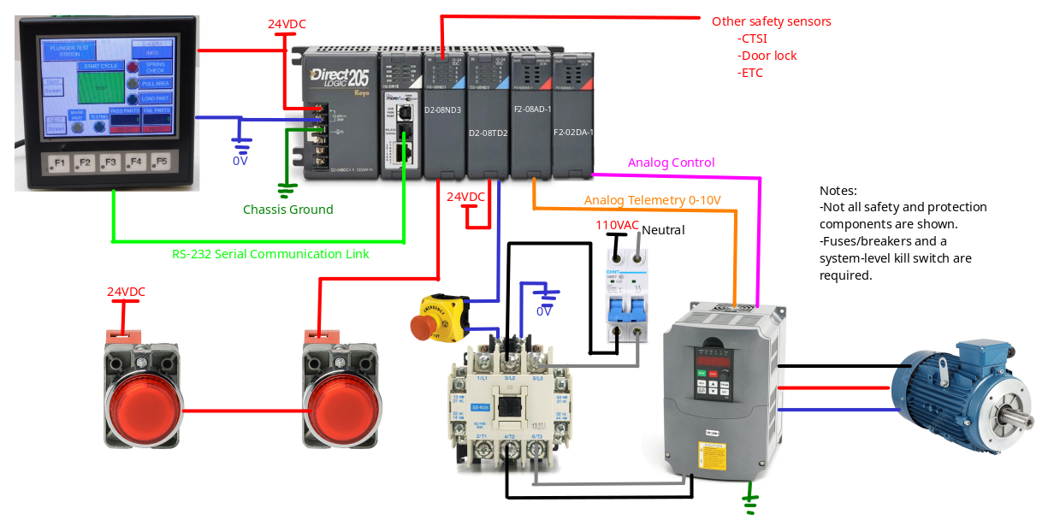
Circuit Overview(WIP)

Slide 5
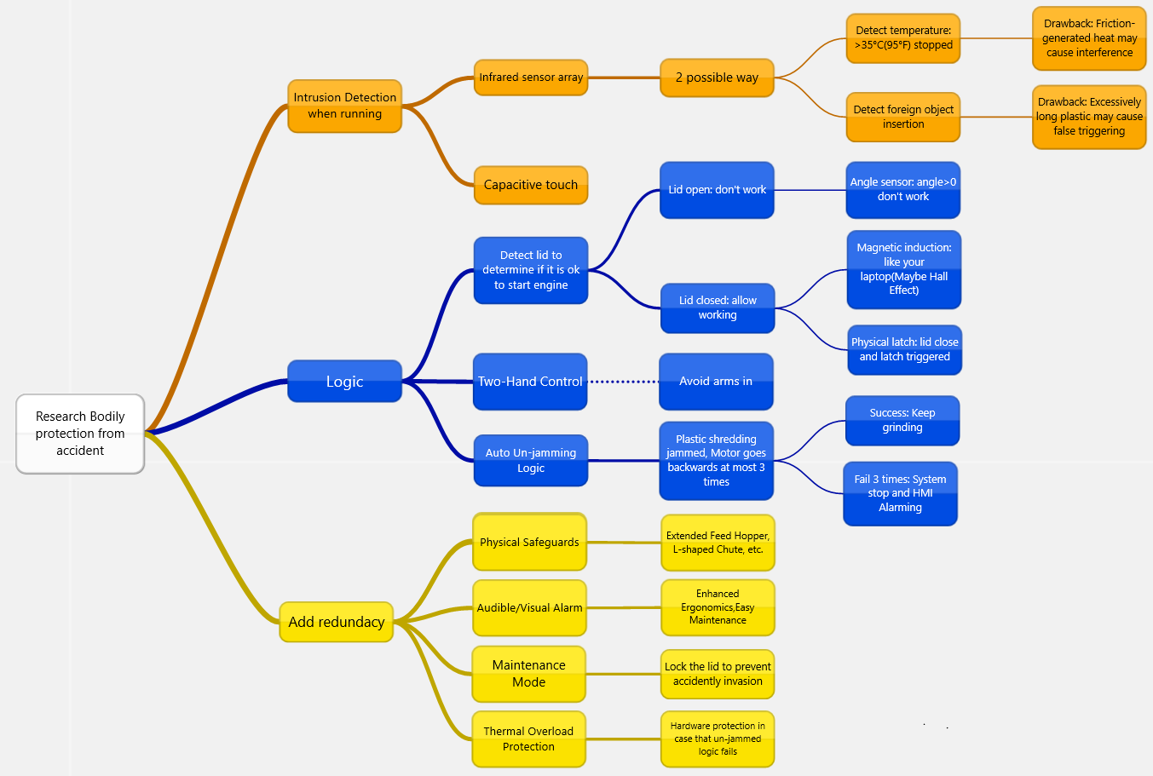

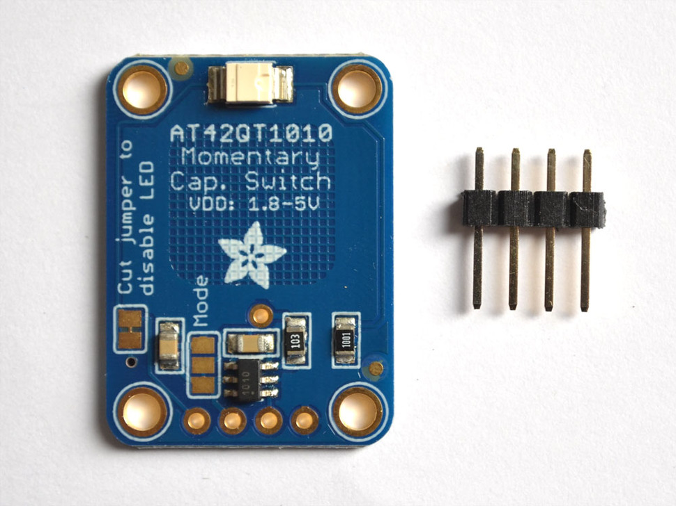
Safety Logic

Slide 6
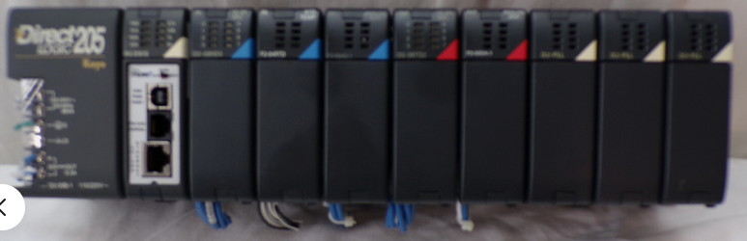
PLC Modules(DL205+H2-DM1E+Modules)
Ebay 350 used PLC rack+cpu+Modules
H2-DM1E- CPU
D2-08ND3- 8ch Digital input module
F2-04RTD - Analog Temp module
F2-08AD-1 -8ch Analog input module
D2-08TD2 - 8ch Digital output module
F2-02DA-1 -2ch Output module
Comes with analog I/O and Digital I/O
Analog: Control VFD RPM
Digital: Button/sensor inputs, control contactor output
Very expandable(for additional sensors)
Up to 8 switches
Program
Do-more designer

Slide 7
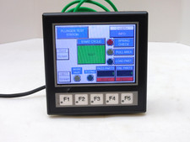
HMI (AutomationDirect EA1-T4CL)
120-130 used
C-more programming software
Simple, tag based programming
Matching IDs to the PLC
RS-232 protocol
24VDC power
Touchscreen + Buttons

Slide 8
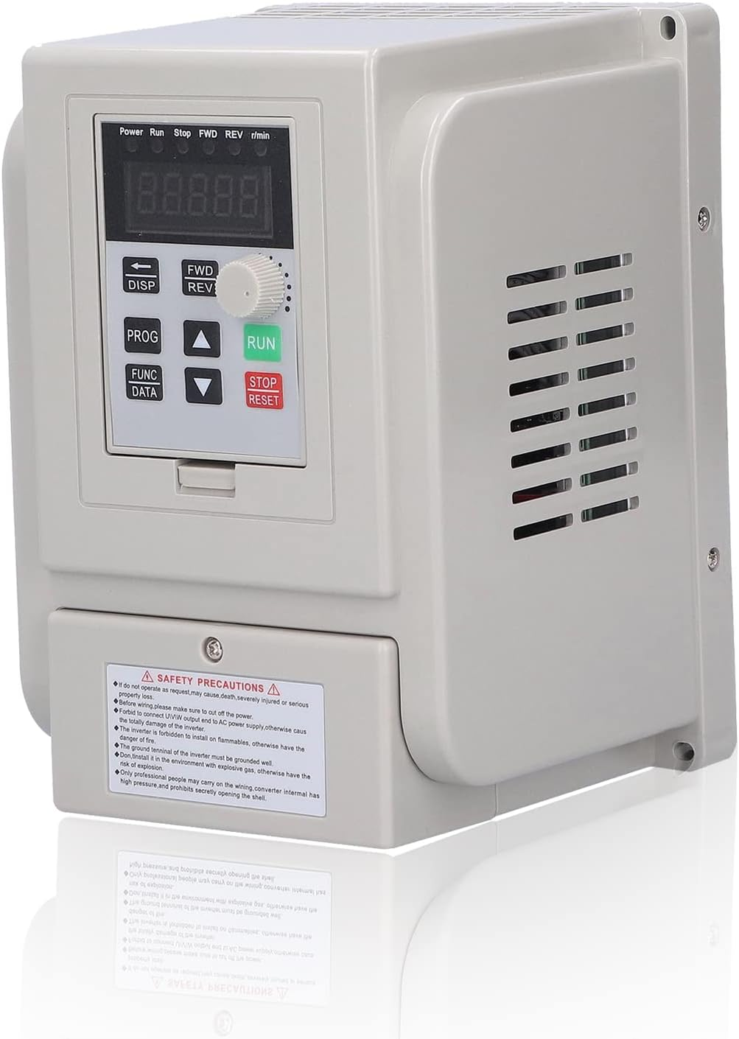
VFD(AT5‑1500X)(We dont use this
$108
Single phase 115V in to 230V 3 Phase out
Two analog outputs
For getting RPM, Current, Watts, Volts, Temp, etc
One analog input
RPM Control
Has Modbus
Allow for more than two telemetry
Not limited by the analogo
Allows for the use of better 3-phase motors
More efficient than 1-phase and Brushed motors
Better throttle control

Slide 9
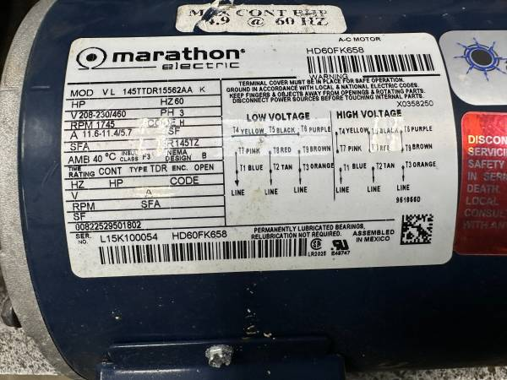
Motor
Craigslist ad, listed at $100, 3HP 230V 1750 RPM (Powered by a VFD with an inverter 115/230V single phase to 3 phase at 3HP)

Slide 10
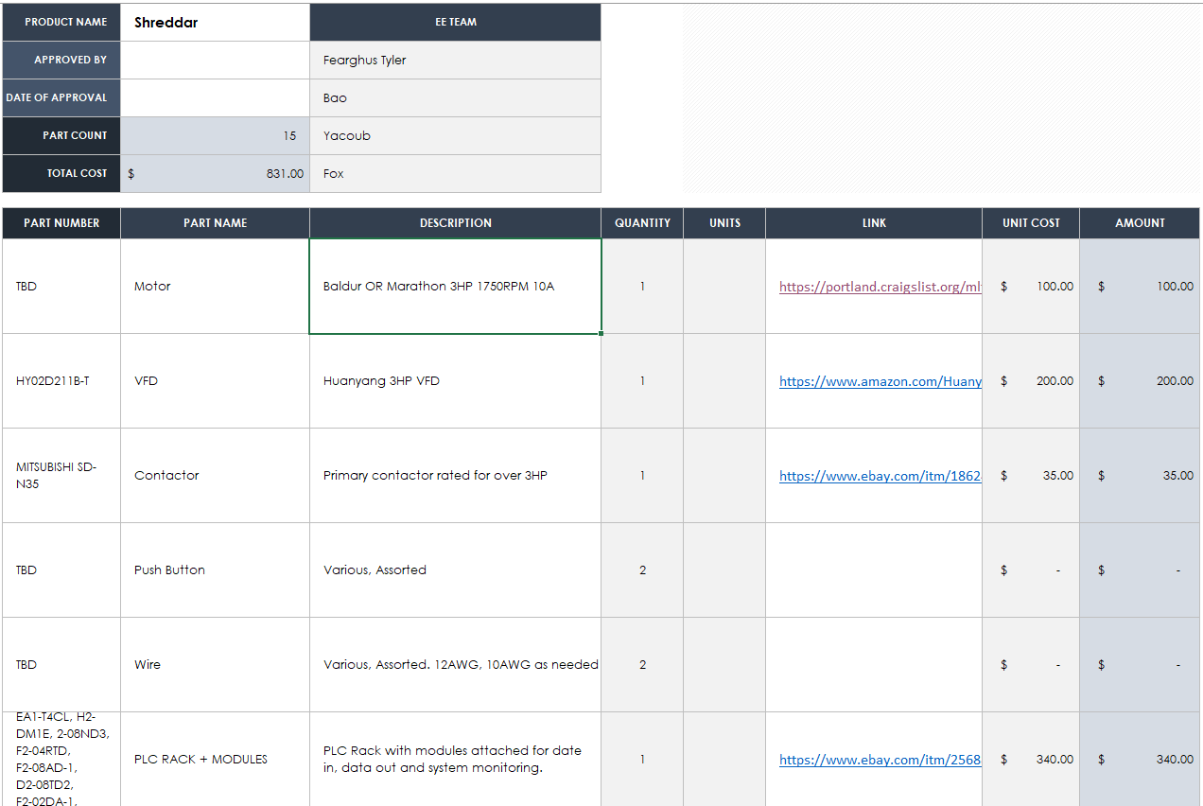
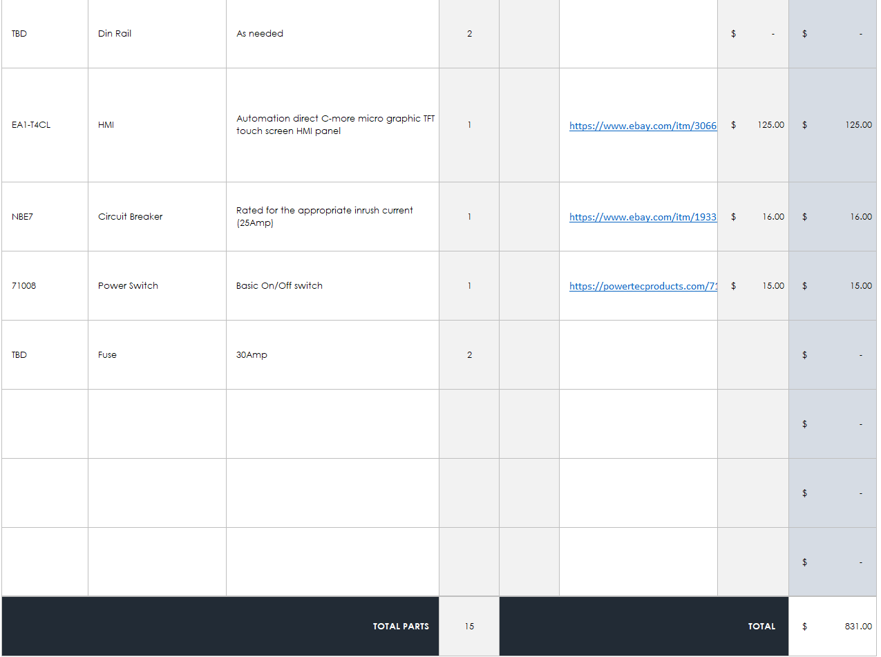
BOM
Best Estimate So Far:

Slide 11
Questions/Suggestions/Concerns

