Slide 1
Plastic Shredder V2
Yaqoub Rabiah, Bao Nguyen, Fearghus Tyler, Fox Khang

Slide 2
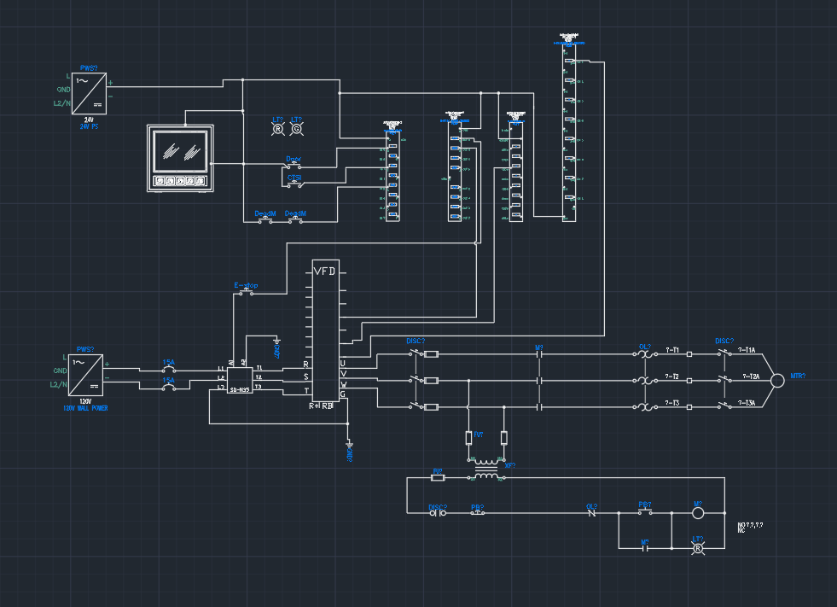
Introduction
The team: “I’m so Shredded Inc”
The Client: Ichor Systems
The Problems
Excess waste from 0.25" to 0.5" rigid plastic sheets (PVC, PP).
Commercial shredders are either underpowered or expensive.
Telemetry: Jam coint, temp, power, amps, volts
Industry standard
1000 bucks
The Mission: Build an industrial-grade, NEC-compliant electrical control system for the "Universal Plastic Shredder V2.0."

Slide 3
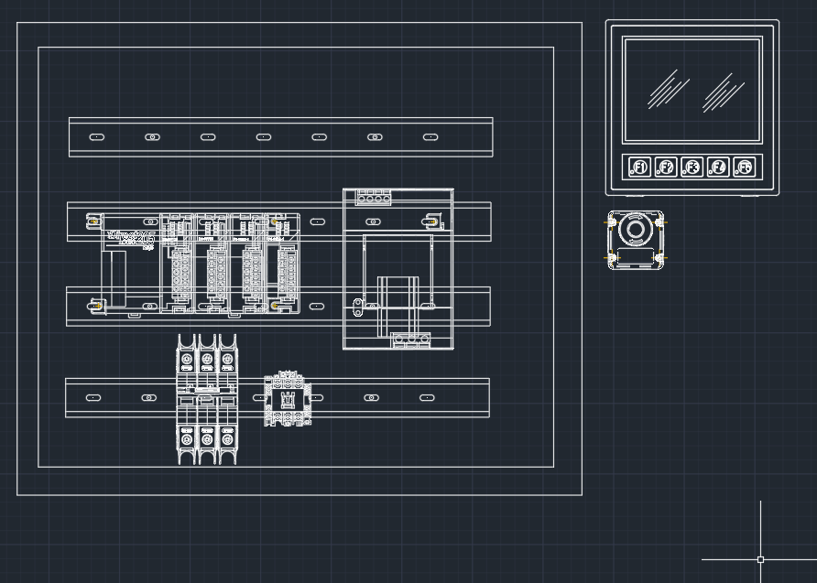
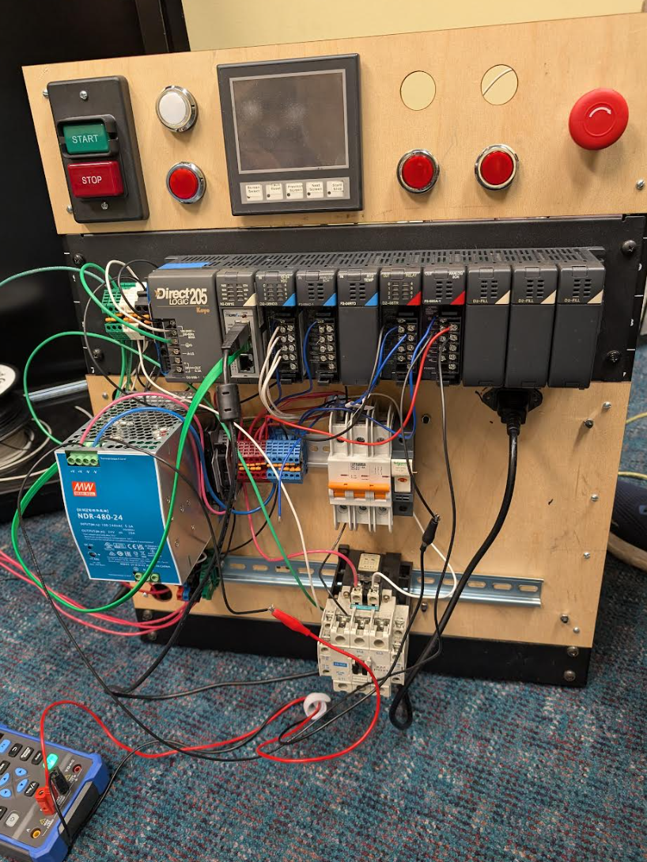
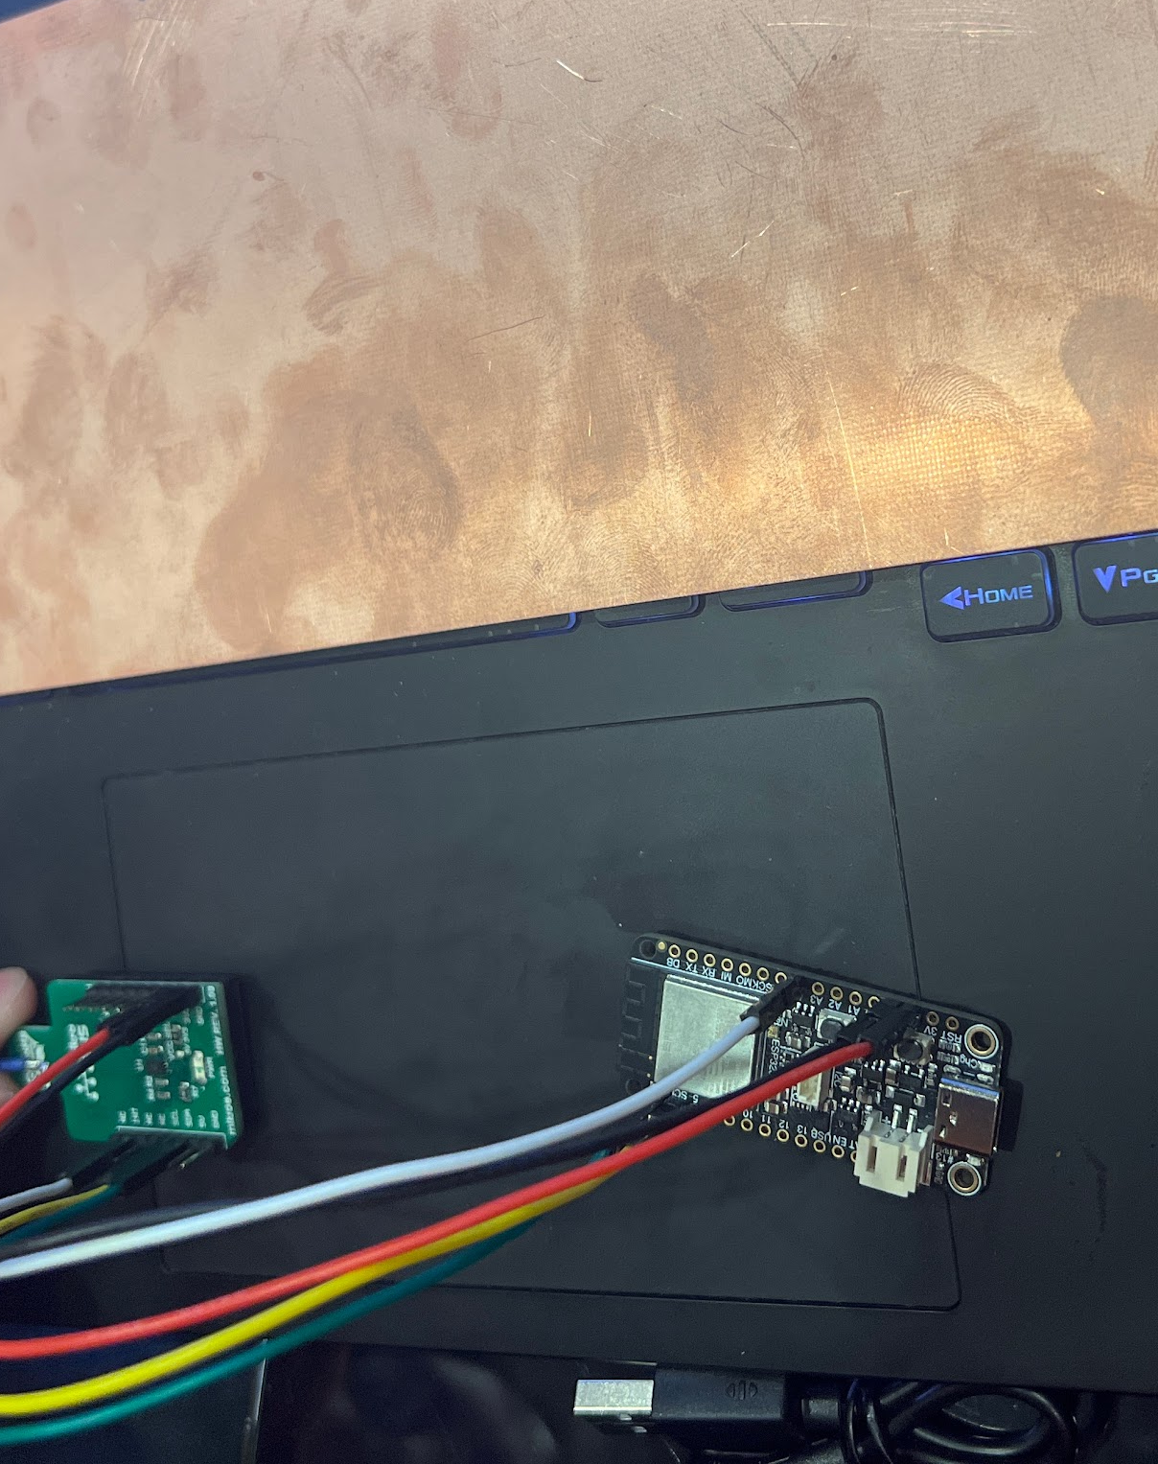
Demo
There are two buttons that switch the direction of the motor.
Forwards
Reverse
Both deadman switches must be pressed to operate the motor.
Rpm can be controlled through the HMI
E-Stop resets the rpm to zero
Vfd allows 120v house voltage inverts to 240v 3-phase power with 3 hp capabilities
Motor receives signal to stop the VFD after 2 seconds
Capacitive touch module

Slide 4
Whats on the agenda for May
Our primary goals for May:
User manual
Final paper
Integration and completion of the CTSI sensor
Program VDF/PLC for current, voltage, watts, jam count, auto unjam
Brake Resistor/(Final last minute items)
Make it look purdy, or in the words of the late Amy Winehouse, put it in the box

