Slide 2
OPERATING SYSTEMS 2025.2

Slide 3

ZFSLite: a lightweight ZFS file system implementation
Vũ Nguyễn Anh Tuân 202417212
Nguyễn Phan Vĩ 202417218

Slide 4
Table of Contents
ZFS overview
ZFS features & implementation analysis
Demo

Slide 5
I. ZFS overview
File system with volume management capabilities.
Designed to ensure that data stored on disks cannot be lost.
Includes a mechanism for dataset and pool-level snapshots and replication, including snapshot cloning
Is a 128-bit file system

Slide 6
II. ZFS features & implementation analysis
Pooled Storage
Copy-on-Write (CoW)
Data Integrity and Self-Healing
Snapshots and Clones

Slide 7
II. ZFS features & implementation analysis
Pooled Storage
Instead of creating rigid partitions on individual disks, ZFS abstracts your physical drives into a shared pool of storage called a zpool.
Multiple file systems (called "datasets") are created on top of this single pool.
Datasets dynamically share the available space

Slide 8
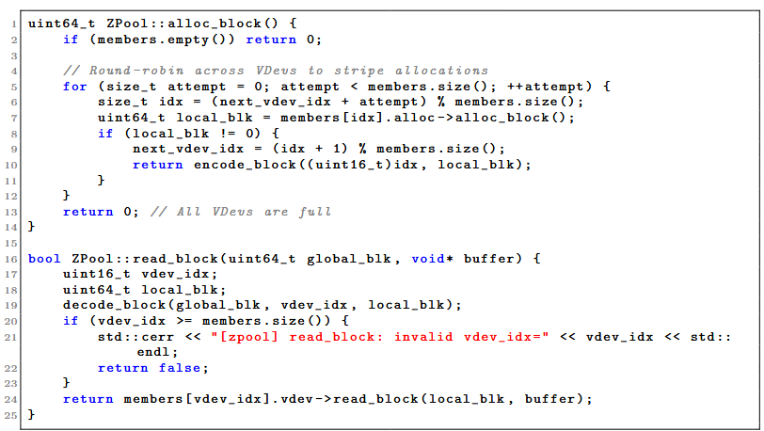
II. ZFS features & implementation analysis

Slide 9
II. ZFS features & implementation analysis
Copy-on-Write (CoW)
Traditional file systems modify data by overwriting the old data in place.
ZFS takes a different approach.
When a change is made, ZFS writes the new data to a completely new, empty block on the disk.
Only after the write is fully completed does ZFS update the system's pointers to reference the new block, subsequently freeing up the old one.
=> Guarantees that your data is never left in an incomplete or corrupt state if the system crashes or loses power mid-write, eliminates the need for time-consuming file system checks (fsck) on reboot.

Slide 10
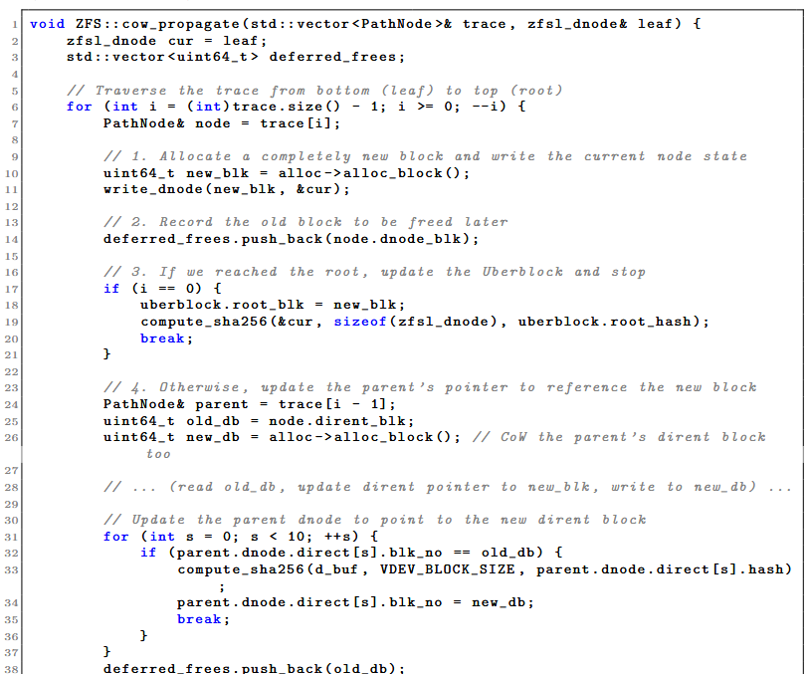
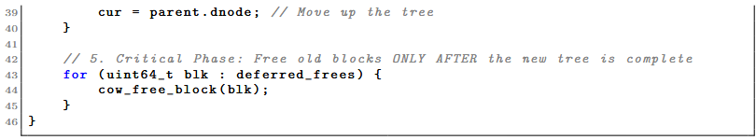
II. ZFS features & implementation analysis

Slide 11
II. ZFS features & implementation analysis
Data Integrity and Self-Healing
Isolated Checksumming (Merkle Trees): Stores cryptographic hashes in a block's parent pointer => Guarantees that misplaced writes/silent disk errors are mathematically impossible to hide.
Continuous Read-Time Verification: Every single time a file is requested, ZFS recalculates the hash of the data being read and compares it against the stored pointer.
Instant Redundant Retrieval: Corruption is detected during a read
Intercepts the error and fetches the correct data from a redundant source

Slide 12
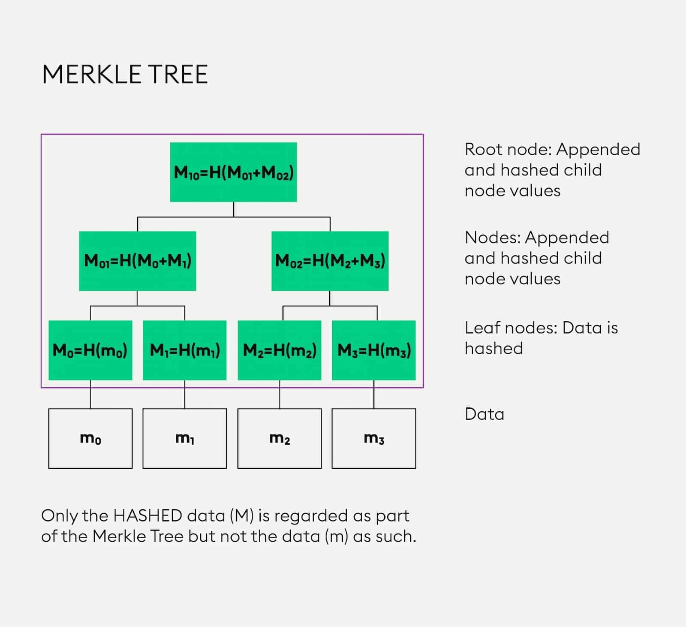
II. ZFS features & implementation analysis

Slide 13
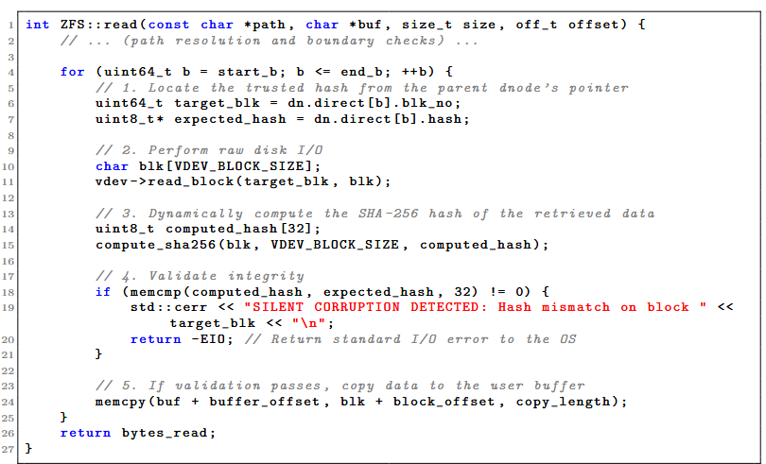
II. ZFS features & implementation analysis

Slide 14
II. ZFS features & implementation analysis
Snapshots and Clones
Instantaneous Creation (uses CoW)
Zero Initial Space Cost (preserves the existing data blocks)
Immutable
Writable Clones
Efficient Sandboxing (clones only consume space for the new changes made to them)

Slide 15
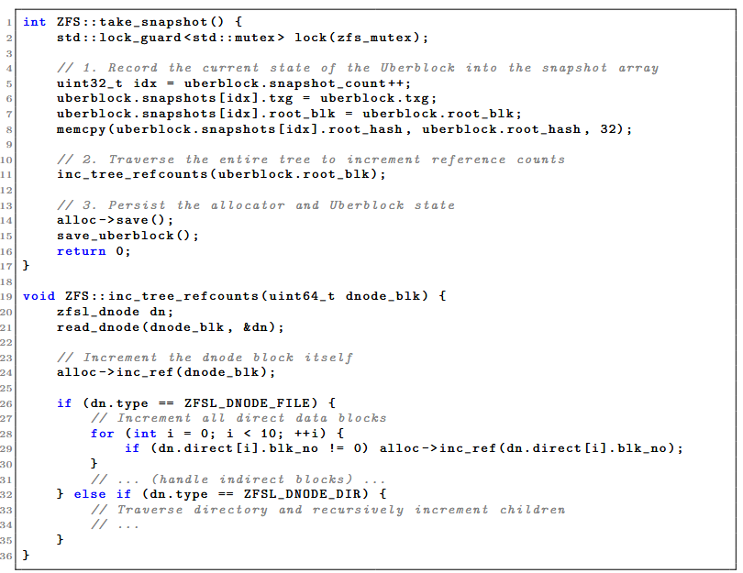
II. ZFS features & implementation analysis

Slide 16
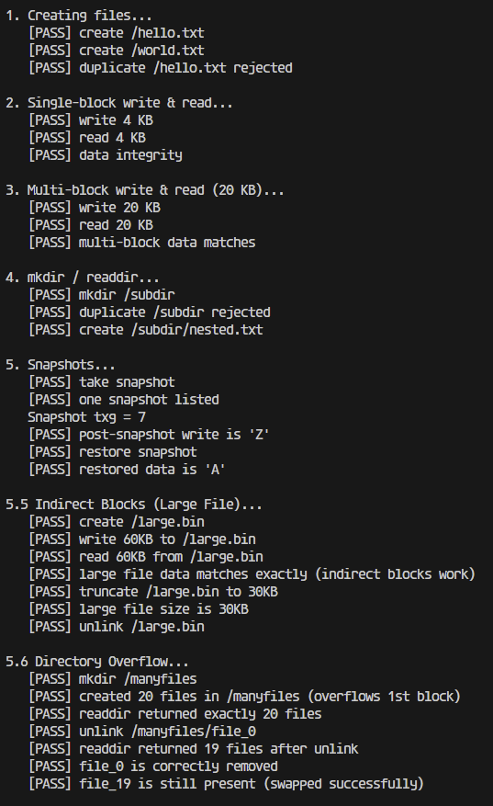
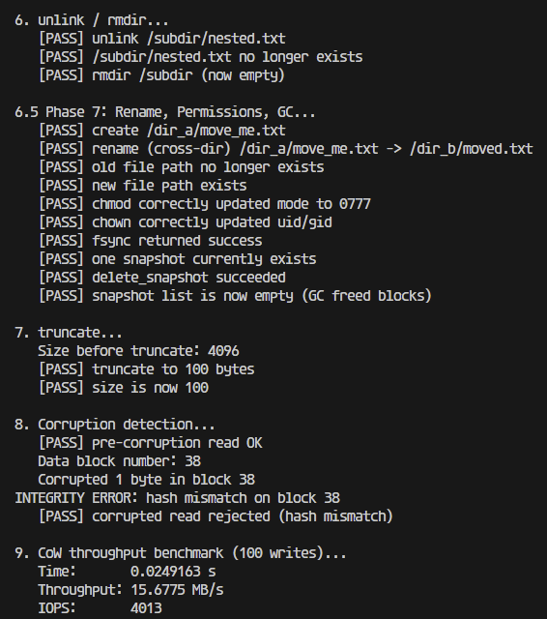
II. ZFS features & implementation analysis
Tests & Benchmark

Slide 17
DEMO

Slide 18
THANK YOU !

