Slide 1
Data storytelling and visualization-Technology & INNOVATION
Prodipto debsarma

Slide 2
Problem Statement
The smartphone industry is evolving rapidly, driven by advancements in technology and innovation. This project aims to explore how core features — such as battery, charging speed, CPU speed, and display — impact pricing and user ratings.
We seek to uncover patterns, trends, and outliers that can provide strategic insights for manufacturers and consumers alike.

Slide 3
Project Objectives
Clean and prepare a real-world smartphone dataset
Treat outliers to ensure statistical consistency
Perform pivot analysis on key features like price, battery, charging, and display
Create meaningful visuals to highlight trends and anomalies
Draw insights to understand the innovation trajectory across brands

Slide 4
Dataset Overview
Total Rows: 100 smartphone entries
Columns: 35 (e.g., Brand, Price, Rating, CPU Speed, Battery, NFC, Charging, etc.)
The dataset was created using Python and Pandas in CSV format, later converted to Excel for analysis, with ChatGPT referencing GSMArena to assist in generating accurate phone spec sheets in JSON format.
Cleaned manually for if any found missing or duplicate value and false data
Added derived columns: e.g., CPU Speed (GHz)
Focus on factual features, no assumptions used for missing specs

Slide 5
Data Cleaning & Preparation
Removed duplicate smartphones entries
Replaced if any missing numerical values by referring to GSMArena
Filled if any incorrect CPU speed manually by referring to accurate processor benchmarks in GSMArena
Handled if any 0-values in charging speed contextually based on feature support taken from GSMArena
Changed logical data from bool vals TRUE/FALSE → Yes/No
Treated outliers using IQR method (created "Before" and "After" columns)

Slide 6
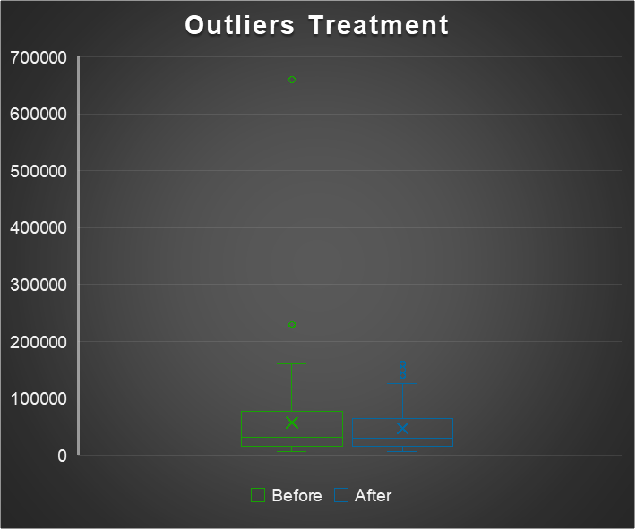
Price Analysis
Boxplots show significant outliers in original price column
After treatment, distribution normalized
Pivot Table highlights high-end brands like Vertu, Huawei, and Apple dominating top prices
Price does not always correlate with higher ratings or performance

Slide 7
Battery & Charging Speed
Battery mAh: Most phones hover around 5000mAh
Unihertz (23800mAh) is an outlier, treated with median
Charging speed: High variation (5W to 210W); many brands average around 30–60W
Fast charging is a differentiator in mid- and high-end devices

Slide 8
CPU Speed & Display Size
CPU Speed: Highest averages from HiSilicon and Google chips
Most brands use Qualcomm or MediaTek processors around 2.5 GHz
Display Size: Bigger displays (>6.5") are now standard
Brands like Honor, Huawei, and Vivo lead with large displays

Slide 9
Additional Visuals
Pie Chart: % of features , category and grade distribution among smartphones
Box Plots & Whiskers: Price distribution (after removing outliers)
Bar Chart: Average Price and CPU speed by Brand
Coln Chart & Slicers: Model Grade and Count by Brand

Slide 10
Interactive Dashboard Snapshot
A summary sheet created with:
Pivot charts
Filters/slicers
Brand-wise comparisons
KPIs
Enables dynamic exploration of trends by price, specs, and ratings

Slide 11
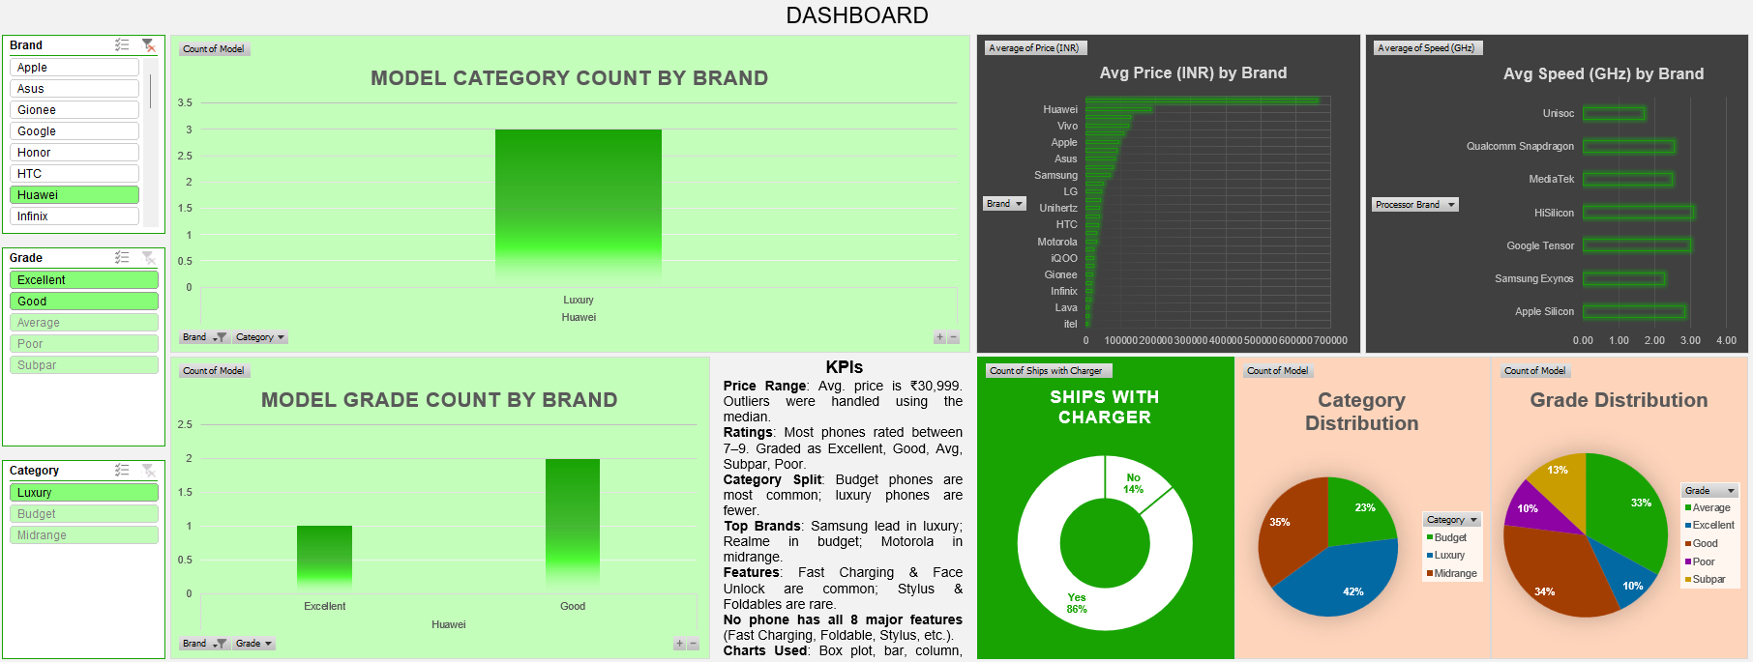
DASHBOARD

Slide 12
Insights & Conclusion
Most phones are priced between ₹15,000–₹40,000 after treating outliers
Battery capacity and fast charging are strong selling points
CPU performance varies by brand but clusters around 2.5–3.0 GHz
Large displays and 5G are now industry standards
Not all premium-priced phones are the best rated — brand perception matters

Slide 13
THANK YOU
For further queries & doubts pls mail me at prodiptodebsarma@gmail.com

