Slide 1
AI-POWERED TASK TRACKER
Prodipto Debsarma

Slide 2
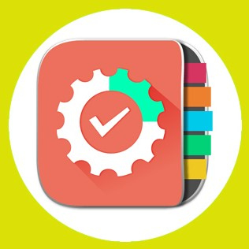
About Task Tracker
🤖 AI-Powered Task Tracker boosts productivity through efficient task management
✅ Users can add, edit, delete, and search tasks
🔥 AI-driven recommendations for smart scheduling and prioritization
📂 Features task categorization, progress tracking, and error handling
📊 Provides insightful analytics for better decision-making
📁 Uses CSV-based storage for seamless data management
TASK TRACKER

Slide 3
What are we working on?
🤖 AI-Powered Task Tracker designed to enhance productivity
✅ Allows users to add, edit, delete, and search tasks
🔥 AI-driven recommendations for better task prioritization
📂 Features task categorization, progress tracking, and filtering
📊 Provides insightful analytics to keep users organized
📁 Uses CSV-based storage for data management
⚡ Seamless AI integration for a data-driven approach to task management

Slide 4
About
the project
🐍 Python-based Task Tracker for efficient task management
🤖 AI-driven recommendations to optimize workflow
✅ Users can create, track, and manage tasks seamlessly
📂 Task categorization by priority for better organization
📊 Generates insights on task completion and overdue tasks
🔥 AI-powered smart scheduling for enhanced productivity
📁 Uses CSV for persistent storage to maintain structured data

Slide 5
Table of contents
01.
02.
04.
Problem Statement
Key Features
How It Works
Technology Stack
05.
06.
07.
Future Enhancements
Conclusion
03.
Tools and technologies used in development
The challenge of managing tasks efficiently
Overview of Task Tracker’s features
Step-by-step explanation of task flow
Challenges and Solutions
Problems faced and how they were resolved
Possible upgrades and new features
Summary of projects and final thoughts

Slide 6
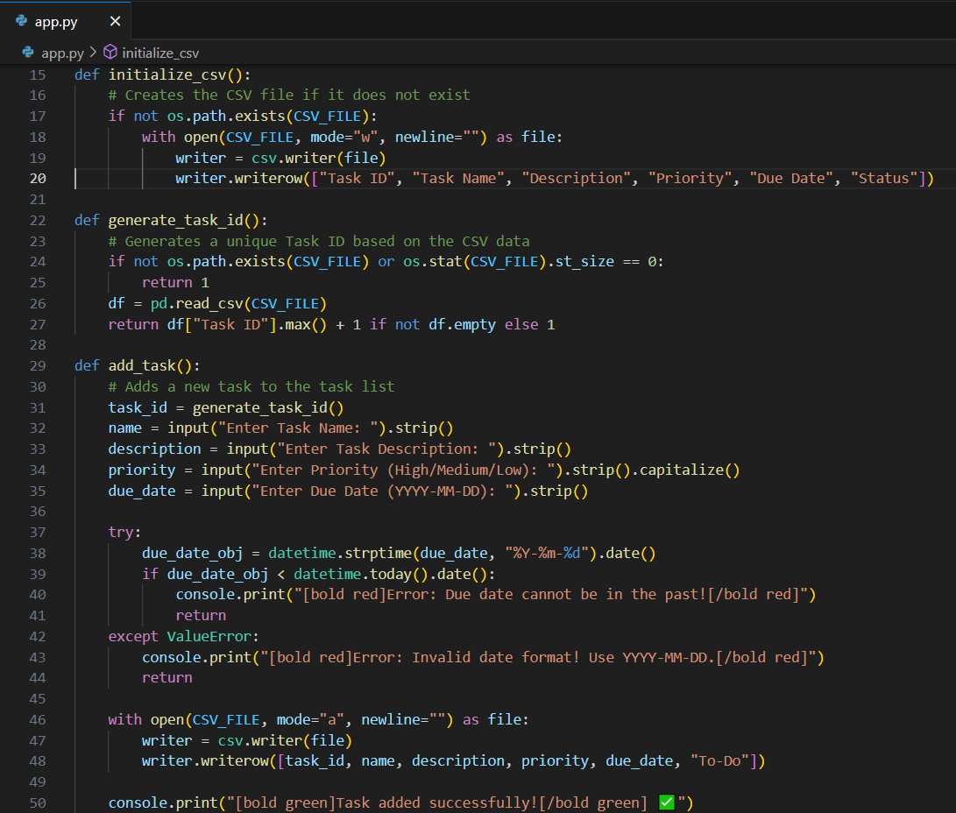
Problem Statement
Managing multiple tasks efficiently is challenging.
Users struggle with prioritization, tracking progress, and organization.
Example: A student juggling multiple assignments struggles to prioritize tasks efficiently.
Solution: Our AI-powered system intelligently prioritizes and organizes tasks, reducing workload stress.

Slide 7
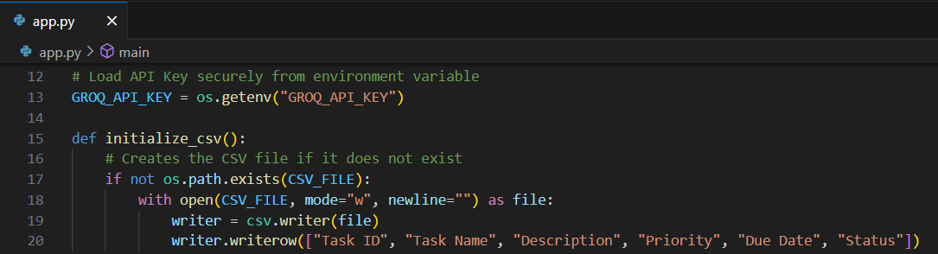
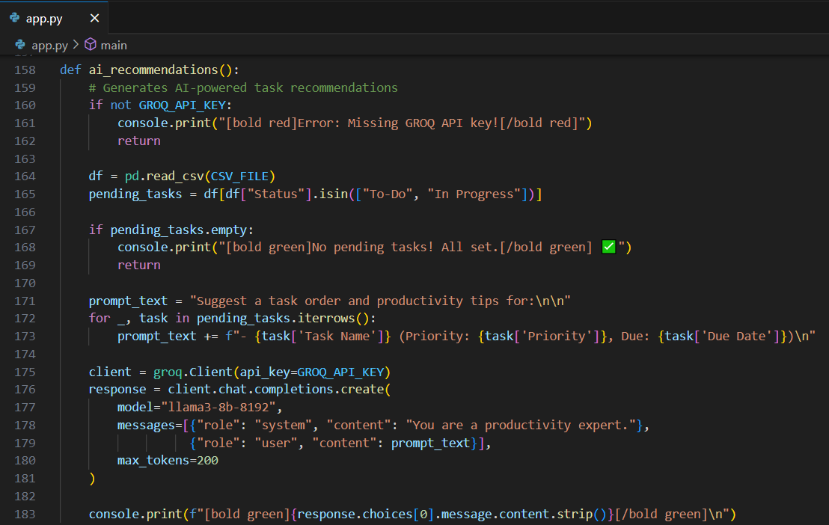
1. Task Management: Add, edit, delete, categorize tasks 2. AI-Powered Recommendations: Prioritization based on workload 3. Progress Tracking: Task status (To-Do, In Progress, Completed) 4. Data Storage: CSV-based structured storage Insights & Reports: Task completion trends & overdue tasks 5. Secure API Key Handling: Uses environment variables for security
Key Problems

Slide 8
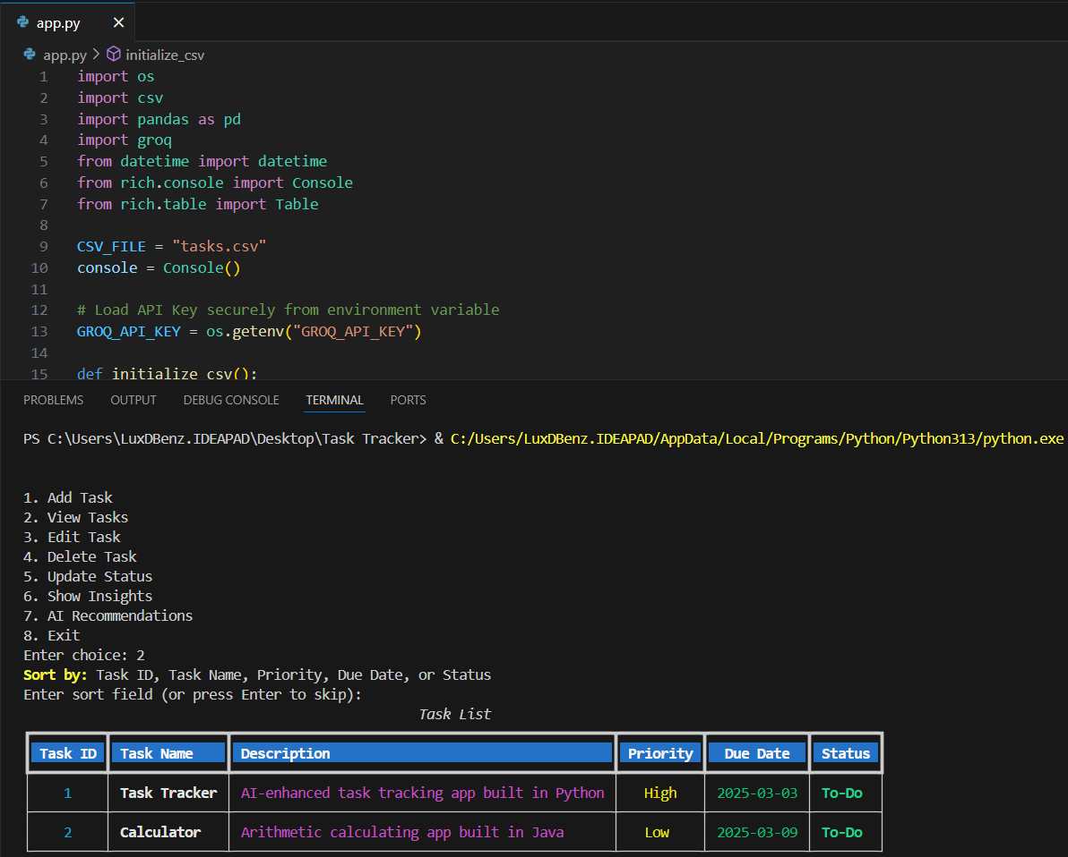
How It Works
Users input task details (title, priority, due date, etc.).
Tasks are structured & stored in a CSV file for easy retrieval.
AI automatically suggests priority tasks based on workload & deadlines.
Users update progress, and the system tracks overdue tasks.
Automated reports provide insights on completion rates & workload distribution.

Slide 9
Project infographics
AI Integration
Groq for recommendations
Programming Language
Python
Libraries
Pandas, CSV, Groq API, Datetime and Rich
Security
Environment variables for API key handling
Storage
CSV-based persistent storage
Performance
Optimized CSV handling for quick task retrieval

Slide 10
Future Enhancements
🔥 Graphical dashboard for visual task insights.
🔥 Multi-user support & team collaboration features.
🔥 AI-based smart deadline estimations & adaptive prioritization based on user behaviour.
🔥 Automated reminders & notifications for upcoming tasks.
🔥 Cloud-based storage integration for accessibility across devices.

Slide 11
Challenges & Solutions
Challenges:
🤔 Task Prioritization: Users struggle to determine which tasks need immediate attention. 🤔 Tracking Progress: Manually updating task statuses can be inefficient. 🤔 Data Organization: Managing tasks without a structured format leads to clutter. 🤔 Overdue Task Management: Users often miss deadlines due to lack of reminders.
Solutions:
✅ AI-Powered Recommendations: AI intelligently suggests priority tasks based on workload. ✅ Progress Tracking System: Tasks update dynamically with statuses (To-Do, In Progress, Completed). ✅ CSV-Based Storage: Organizes and saves tasks for easy retrieval & tracking. ✅ Automated Alerts: Overdue tasks trigger reminders, ensuring deadlines aren’t missed.

Slide 12

Conclusion
🤖 AI-Powered Task Tracker simplifies task management
🔥 AI-driven recommendations for smarter task prioritization
📂 Structured storage ensures organized task handling
📊 Insightful analytics for better decision-making
✅ Automates progress tracking & overdue alerts to boost productivity
🚀 Future upgrades:
👥 Multi-user collaboration
⏳ Smart deadlines
☁️ Cloud integration
🖥️ User-friendly GUI for better accessibility

Slide 13

Thanks. C u on nxt ppt ;)

