Slide 1
DEAL PIPELINE TRACKER
A trusted deal pipeline
A walkthrough of the product, its safeguards, and the choices behind its design.
Product walkthrough and engineering decisions
Notes:
Introduce the product as a multi-tenant pipeline for a small investment team. The examples use fictional companies and synthetic accounts. The deck reflects the locally verified build on 30 October 2026.
Project sources: README.md, AGENTS.md, docs/HANDOFF.md, docs/PROGRESS.md, docs/PRESENTATION_NOTES.md, docs/design/mockup-review.md, docs/features/02-auth-onboarding/progress.md, docs/features/05-realtime/progress.md, docs/features/03-deals-core/progress.md, docs/features/04-approvals/progress.md, docs/features/08-storage-avatars/progress.md. Local UI evidence appears in docs/evidence/ui/.

Slide 2
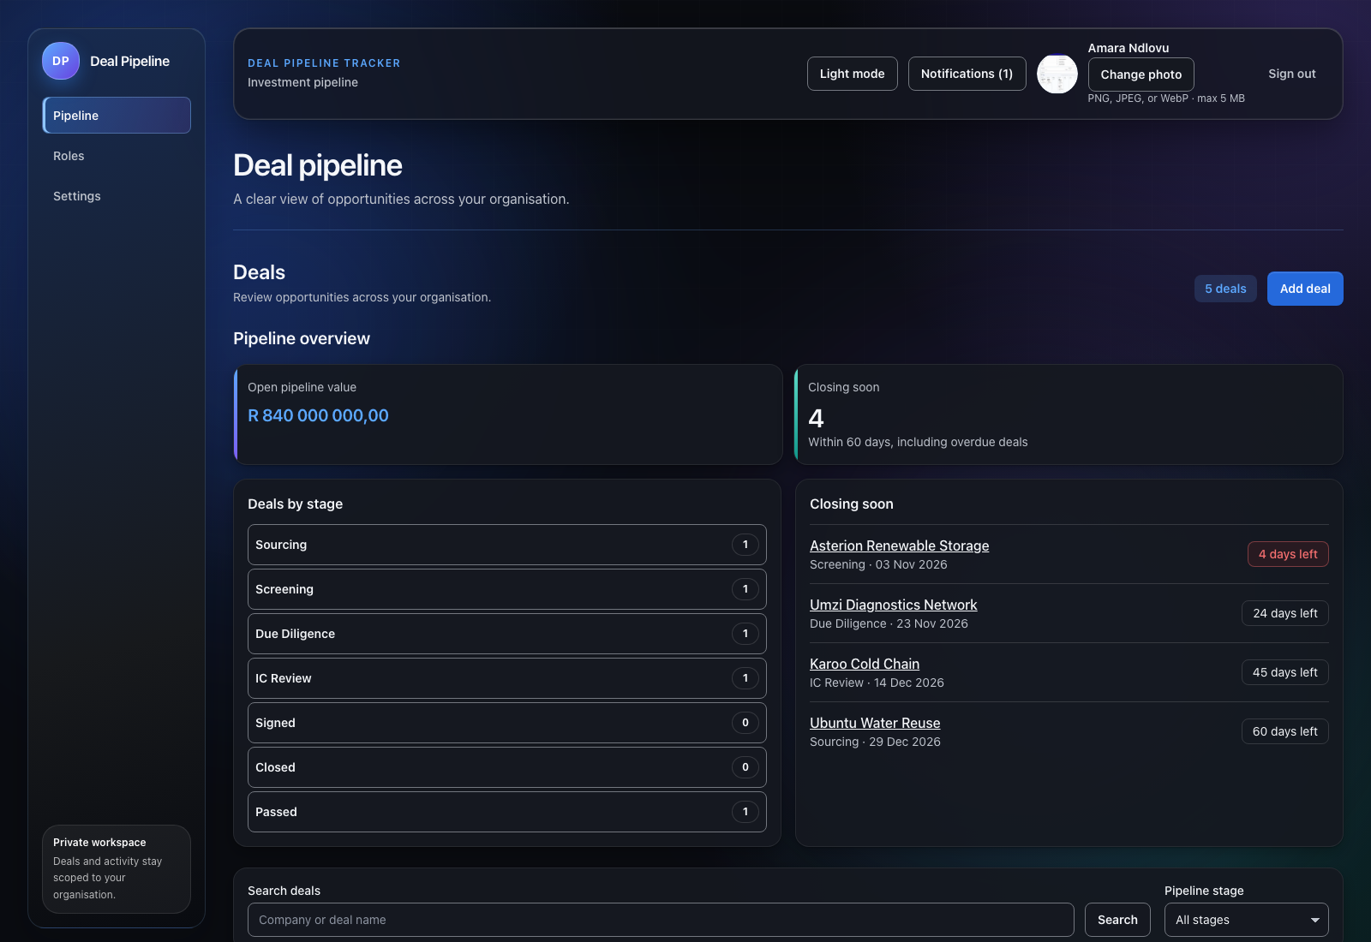
PRODUCT OVERVIEW
One place to see the pipeline
Teams can scan deal health, deadlines, and work in progress from the dashboard.
List and Board views share the same filters, pagination, stage rules, and permission checks.
The dashboard keeps financial totals separated by currency to avoid misleading sums.
Current local seeded build · dashboard
Notes:
Walk from the top level. Point out the overview, deals approaching close, and the shared navigation. Mention that pipeline totals do not combine different currencies.
Project sources: README.md, AGENTS.md, docs/HANDOFF.md, docs/PROGRESS.md, docs/PRESENTATION_NOTES.md, docs/design/mockup-review.md, docs/features/02-auth-onboarding/progress.md, docs/features/05-realtime/progress.md, docs/features/03-deals-core/progress.md, docs/features/04-approvals/progress.md, docs/features/08-storage-avatars/progress.md. Local UI evidence appears in docs/evidence/ui/.

Slide 3
IDENTITY AND ONBOARDING
Accounts follow a verified, resumable path
A person verifies their email before password sign-in creates a session. The owner onboarding flow then creates the organisation and sets its defaults.
Invitees accept an email-bound, single-use invitation, then complete the shorter member setup flow.
Onboarding steps live in the database, so the server selects the current step and users can resume safely.
The browser stores an opaque httpOnly session cookie. Rotating Supabase tokens stay on the API and use a Postgres lease across API instances.
Notes:
Explain why email verification comes before tenant creation: unverified identities cannot create organisations. Invitations are bound to the invited email and expire. A single-use token is stored as a hash. The browser never receives Supabase refresh tokens. The project chose password auth with verification, and did not add magic links or SSO.
Project sources: README.md, AGENTS.md, docs/HANDOFF.md, docs/PROGRESS.md, docs/PRESENTATION_NOTES.md, docs/design/mockup-review.md, docs/features/02-auth-onboarding/progress.md, docs/features/05-realtime/progress.md, docs/features/03-deals-core/progress.md, docs/features/04-approvals/progress.md, docs/features/08-storage-avatars/progress.md. Local UI evidence appears in docs/evidence/ui/.

Slide 4
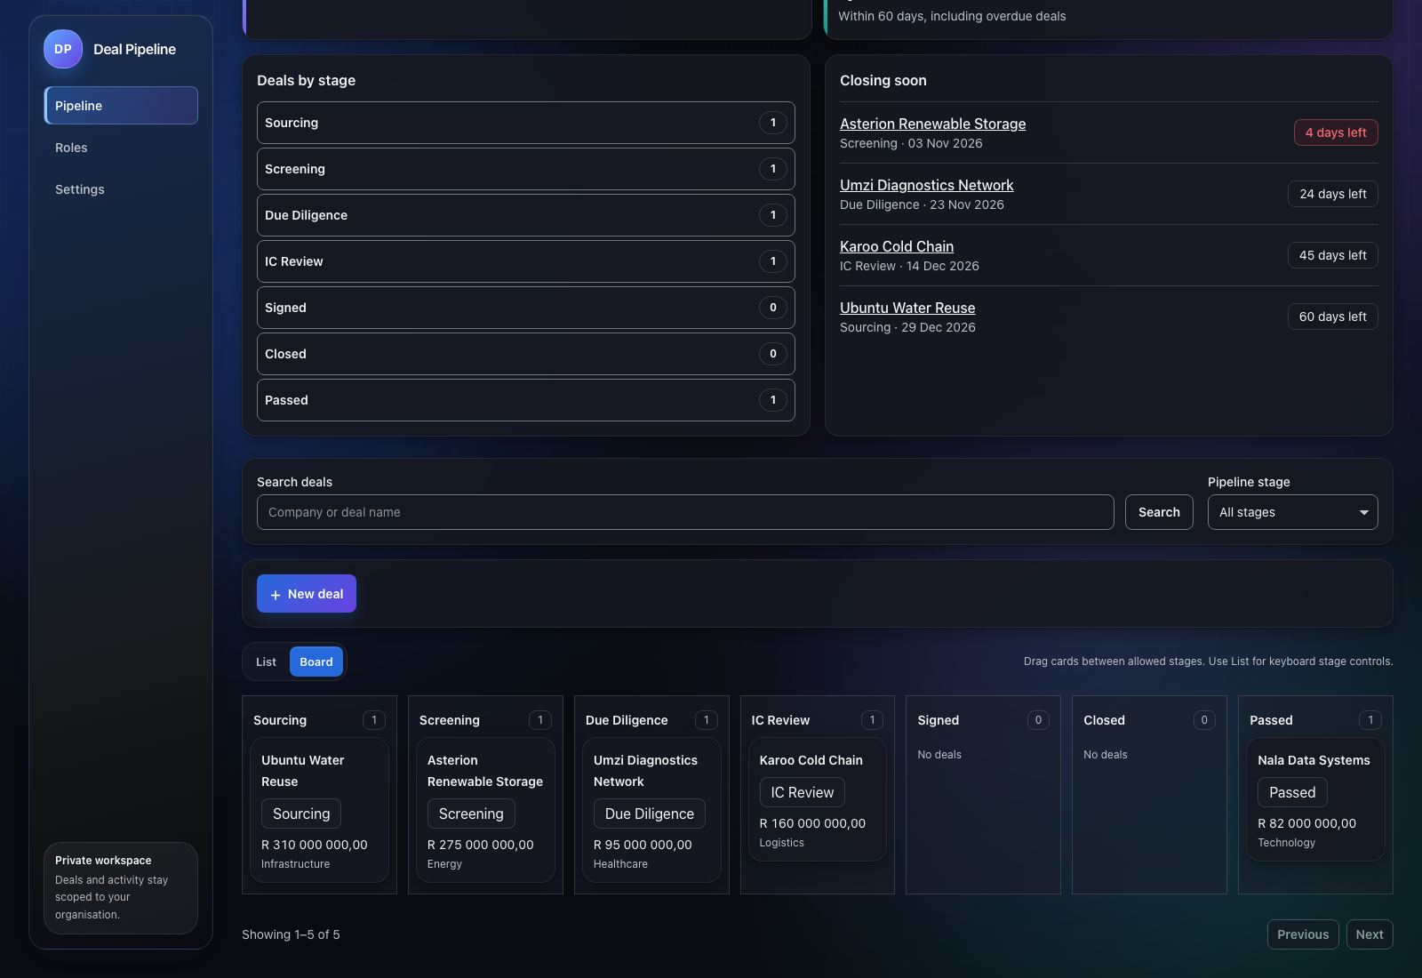
DEAL WORKFLOW
Move deals with the stage rules
The Board shows the six progression stages and the Passed outcome separately. A rejected drop explains the rule that blocked it.
Postgres owns the stage machine. Board drops and List actions call the same versioned API and database transition function.
An IC quorum moves a deal to Signed. Closing requires the recorded deal details. The keyboard-accessible List remains available.
Current local seeded build · Board view
Notes:
Demonstrate the Board as a Kanban view. Explain that columns reflect the same allowed stage machine used by the API and database. Dragging provides immediate feedback while stale versions and invalid transitions are rejected server-side.
Project sources: README.md, AGENTS.md, docs/HANDOFF.md, docs/PROGRESS.md, docs/PRESENTATION_NOTES.md, docs/design/mockup-review.md, docs/features/02-auth-onboarding/progress.md, docs/features/05-realtime/progress.md, docs/features/03-deals-core/progress.md, docs/features/04-approvals/progress.md, docs/features/08-storage-avatars/progress.md. Local UI evidence appears in docs/evidence/ui/.

Slide 5
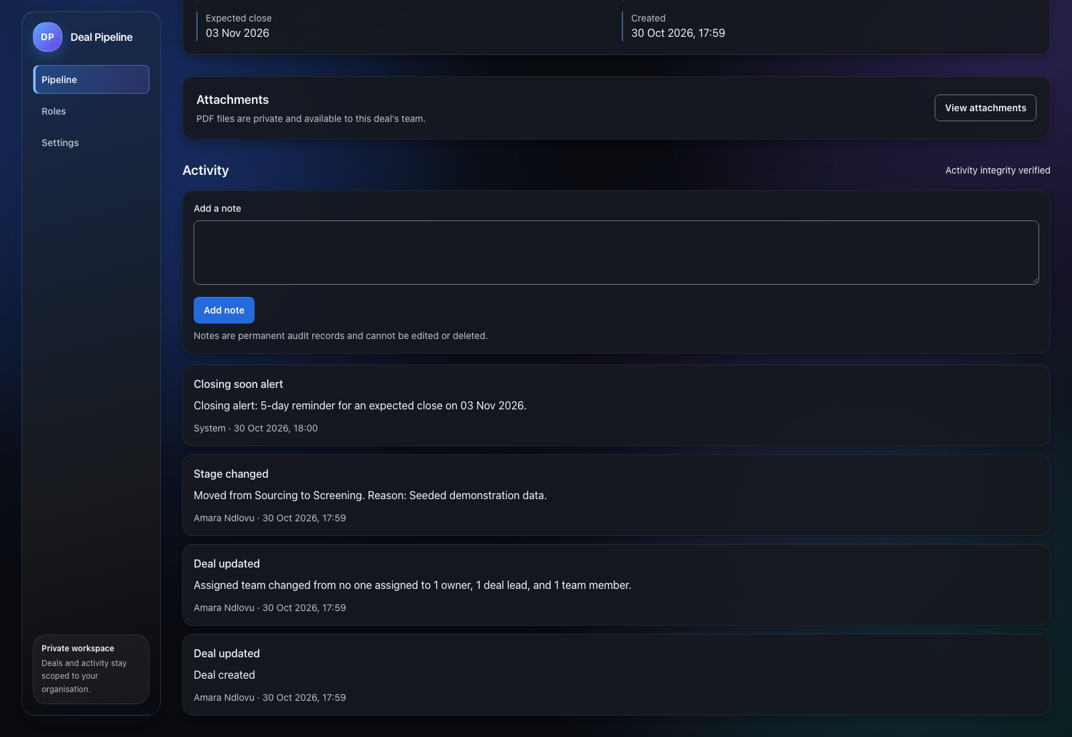
DEAL HISTORY
An activity feed people can read
Important changes appear in a single chronological, append-only deal ledger.
Stage names, assignments, approvals, and closing alerts use human-readable summaries.
The database records the actor and time, and chains event hashes so tampering is detectable.
Current local seeded build · deal activity
Notes:
Show the activity feed and explain that event rows are never edited in place. Corrections link to the original event. Hash chaining detects changes to an existing ledger, while the honest limit is that a database superuser can disable protections unless an external anchor is added.
Project sources: README.md, AGENTS.md, docs/HANDOFF.md, docs/PROGRESS.md, docs/PRESENTATION_NOTES.md, docs/design/mockup-review.md, docs/features/02-auth-onboarding/progress.md, docs/features/05-realtime/progress.md, docs/features/03-deals-core/progress.md, docs/features/04-approvals/progress.md, docs/features/08-storage-avatars/progress.md. Local UI evidence appears in docs/evidence/ui/.

Slide 6
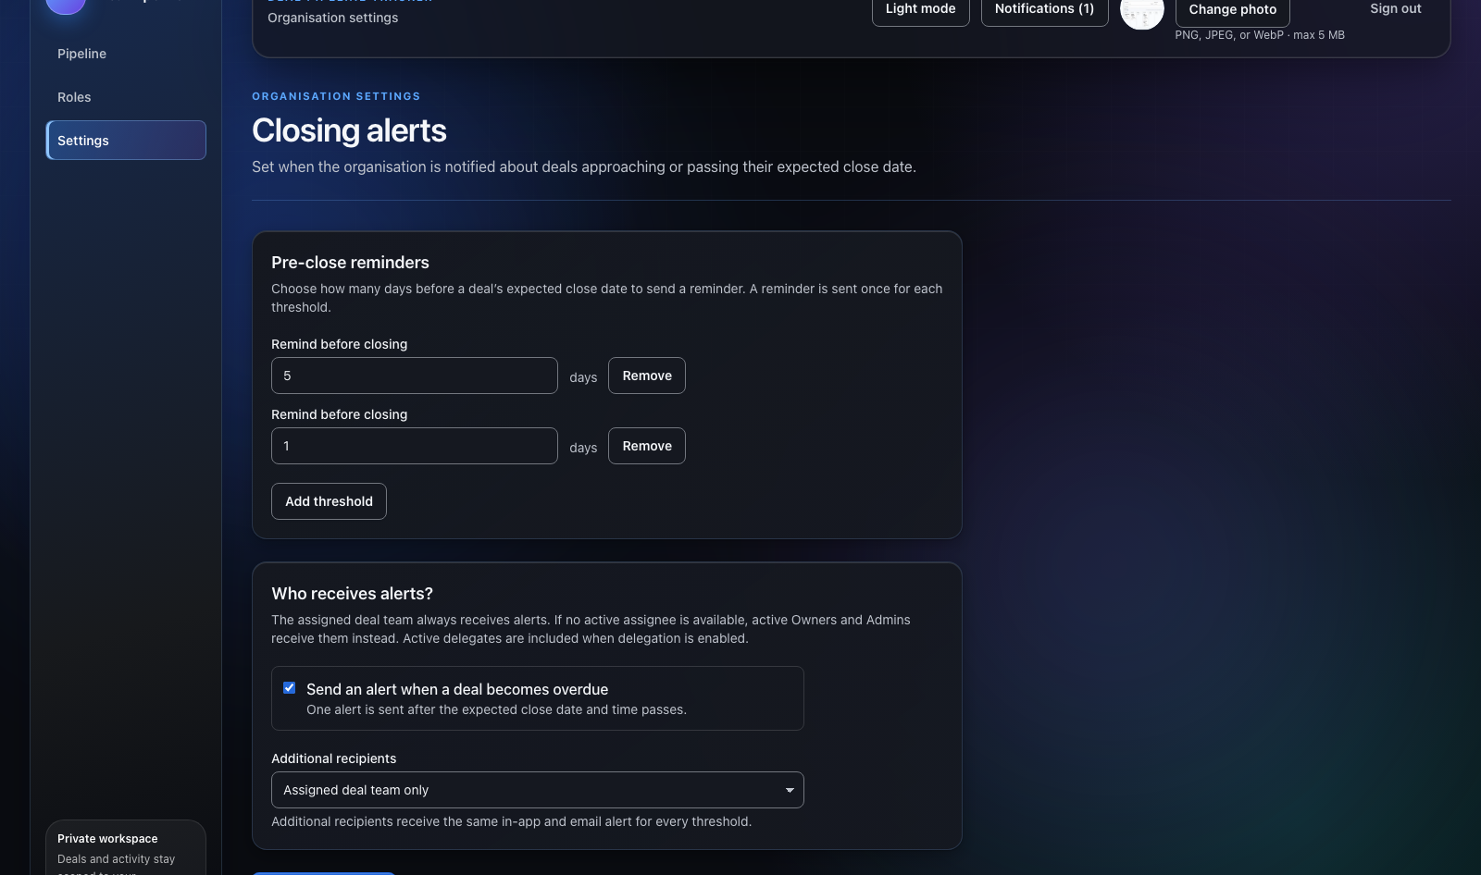
CLOSING ALERTS
Alerts run even when nobody is signed in
An hourly database scan creates idempotent reminders and overdue alerts.
Tenant admins choose reminder thresholds and extra recipients. The assigned deal team and valid delegates remain covered.
A unique key prevents duplicate alerts when a scan retries. Email delivery uses a leased outbox.
Current local seeded build · closing alert settings
Notes:
Explain the default reminder thresholds and tenant-level settings. The scan is database-driven so it operates when no user has the app open. Email delivery has a documented rare duplicate window if SMTP succeeds but saving completion fails.
Project sources: README.md, AGENTS.md, docs/HANDOFF.md, docs/PROGRESS.md, docs/PRESENTATION_NOTES.md, docs/design/mockup-review.md, docs/features/02-auth-onboarding/progress.md, docs/features/05-realtime/progress.md, docs/features/03-deals-core/progress.md, docs/features/04-approvals/progress.md, docs/features/08-storage-avatars/progress.md. Local UI evidence appears in docs/evidence/ui/.

Slide 7
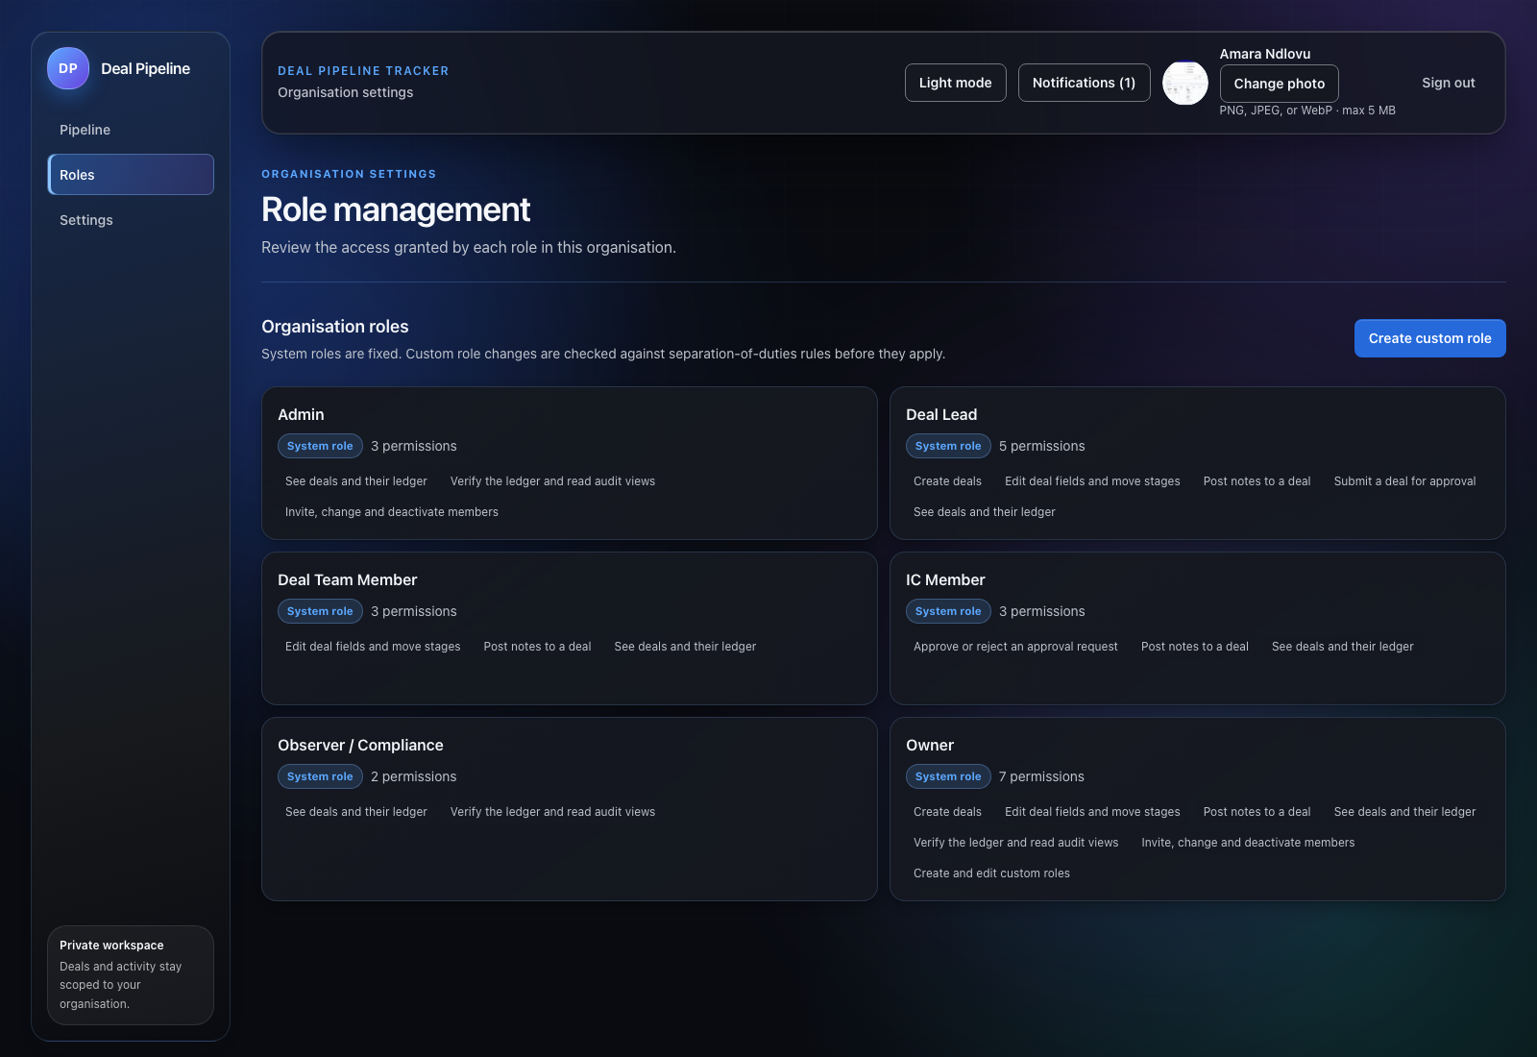
ROLES AND APPROVALS
Permissions come from the tenant role model
System roles are fixed. Owners and role managers can define tenant-specific custom roles.
Postgres validates permission combinations and prevents conflicting separation-of-duties grants.
The agreed approval workflow uses the existing IC gate, quorum decisions, absence handling, delegation, and a 24-hour notification-only SLA escalation.
Current local seeded build · role management
Notes:
Show the role catalog. Explain capability-based checks: the UI is a guide, while database functions enforce tenant membership, permissions, approval quorum and separation of duties. Scope includes the IC approval gate and notification after 24 hours, not approval gates at every stage.
Project sources: README.md, AGENTS.md, docs/HANDOFF.md, docs/PROGRESS.md, docs/PRESENTATION_NOTES.md, docs/design/mockup-review.md, docs/features/02-auth-onboarding/progress.md, docs/features/05-realtime/progress.md, docs/features/03-deals-core/progress.md, docs/features/04-approvals/progress.md, docs/features/08-storage-avatars/progress.md. Local UI evidence appears in docs/evidence/ui/.

Slide 8
ARCHITECTURE
The browser has one trusted backend
Browser → Caddy gateway → Next.js UI and Hono API → internal Supabase services.
The API owns sessions, Supabase access, realtime subscriptions, and file streaming.
Only the gateway publishes a host port. The browser never talks directly to Supabase or object storage.
The same-origin WebSocket endpoint carries tenant-filtered realtime changes.
Notes:
Walk the audience through the request boundary. The gateway presents a same-origin surface. The Hono backend authenticates an opaque cookie and uses caller context so Postgres Row Level Security applies to database reads and realtime delivery.
Project sources: README.md, AGENTS.md, docs/HANDOFF.md, docs/PROGRESS.md, docs/PRESENTATION_NOTES.md, docs/design/mockup-review.md, docs/features/02-auth-onboarding/progress.md, docs/features/05-realtime/progress.md, docs/features/03-deals-core/progress.md, docs/features/04-approvals/progress.md, docs/features/08-storage-avatars/progress.md. Local UI evidence appears in docs/evidence/ui/.

Slide 9
SECURITY MODEL
Postgres enforces the consequential rules
Tenant isolation uses forced row-level security and tenant-scoped relationships.
Writes to core deal and audit tables go through narrowly granted database functions.
Notes, approval decisions, and audit events stay append-only for every application role.
The web app has no Supabase client. API guards provide clearer errors, while the database remains authoritative.
Notes:
Point to the negative tests: forged tenant claims do not expand reads, direct writes fail, users cannot cross tenant boundaries, and service roles cannot mutate append-only records. Explain the DBA limit honestly: the chain detects tampering, but cannot make a hostile superuser powerless.
Project sources: README.md, AGENTS.md, docs/HANDOFF.md, docs/PROGRESS.md, docs/PRESENTATION_NOTES.md, docs/design/mockup-review.md, docs/features/02-auth-onboarding/progress.md, docs/features/05-realtime/progress.md, docs/features/03-deals-core/progress.md, docs/features/04-approvals/progress.md, docs/features/08-storage-avatars/progress.md. Local UI evidence appears in docs/evidence/ui/.

Slide 10
APPROVALS
The IC gate fails closed
Requests snapshot the required approver slots. Decisions record their actor and remain immutable.
Quorum is checked in the database under a row lock, with separation-of-duties rules and stale-version protection.
Absence and opt-in delegation preserve the original approver slot. If no eligible replacement exists, the request remains blocked.
After 24 hours, the scheduled process notifies people about an overdue request without auto-approving it.
Notes:
Emphasize that no approval is automatic. Delegates vote for the original slot, not their own. SLA escalation is a notification and does not change approval state. Gates at other stages were explicitly out of scope.
Project sources: README.md, AGENTS.md, docs/HANDOFF.md, docs/PROGRESS.md, docs/PRESENTATION_NOTES.md, docs/design/mockup-review.md, docs/features/02-auth-onboarding/progress.md, docs/features/05-realtime/progress.md, docs/features/03-deals-core/progress.md, docs/features/04-approvals/progress.md, docs/features/08-storage-avatars/progress.md. Local UI evidence appears in docs/evidence/ui/.

Slide 11
REALTIME AND NOTIFICATIONS
Changes arrive without weakening tenant checks
The API validates the session and origin, then subscribes with the signed-in user’s JWT.
Postgres evaluates row-level security for each realtime subscriber. The active-tenant filter narrows the feed further.
Client caches update from the event stream, while reconnects refresh from the API.
Presence remains a documented cut-list item.
Notes:
Mention that a real Realtime smoke test passes through the internal gateway. A tenant A user does not receive tenant B rows. The product chose the simpler per-user postgres_changes path; private broadcast channels remain a scale path if load requires them.
Project sources: README.md, AGENTS.md, docs/HANDOFF.md, docs/PROGRESS.md, docs/PRESENTATION_NOTES.md, docs/design/mockup-review.md, docs/features/02-auth-onboarding/progress.md, docs/features/05-realtime/progress.md, docs/features/03-deals-core/progress.md, docs/features/04-approvals/progress.md, docs/features/08-storage-avatars/progress.md. Local UI evidence appears in docs/evidence/ui/.

Slide 12
FILES AND PROFILES
Files pass through the BFF
A tenant-scoped file record authorizes each upload and download.
The API streams bytes through an ObjectStore port. Local Compose uses filesystem storage; an S3-compatible driver is available for R2.
No presigned URLs or public storage port expose files. Avatar images are re-encoded before serving.
The RustFS S3 contract test covers the driver. A real Cloudflare R2 smoke test still needs bucket-scoped credentials.
Notes:
Explain the BFF choice: it keeps storage authorization and secrets on the API. The cost is API bandwidth for file transfers. R2 credentials were not available for a live Cloudflare smoke test; the RustFS-compatible path and local filesystem flow were tested.
Project sources: README.md, AGENTS.md, docs/HANDOFF.md, docs/PROGRESS.md, docs/PRESENTATION_NOTES.md, docs/design/mockup-review.md, docs/features/02-auth-onboarding/progress.md, docs/features/05-realtime/progress.md, docs/features/03-deals-core/progress.md, docs/features/04-approvals/progress.md, docs/features/08-storage-avatars/progress.md. Local UI evidence appears in docs/evidence/ui/.

Slide 13
INTERFACE DECISIONS
The UI borrows the structure, with a shared control system
The project adapts DoorSprint’s token, theme, and material approach to this React app, with a saved dark/light theme choice.
Shared buttons, navigation, surfaces, and form controls now use consistent hierarchy, focus, spacing, and semantic variants across the core screens.
The pass kept native controls for predictable keyboard and screen-reader behavior. No extra component dependency was needed for the interactions in scope.
The reference informed navigation and workflow shape. Its branding, low-contrast colors, and unsupported features were excluded.
Notes:
Show the refreshed UI evidence in the preceding slides. The project initially had inconsistent native styles. Shared wrappers now align buttons and inputs to a common baseline and semantic token set. More complex interactions can adopt a primitive library later when it clearly improves accessibility or behavior.
Project sources: README.md, AGENTS.md, docs/HANDOFF.md, docs/PROGRESS.md, docs/PRESENTATION_NOTES.md, docs/design/mockup-review.md, docs/features/02-auth-onboarding/progress.md, docs/features/05-realtime/progress.md, docs/features/03-deals-core/progress.md, docs/features/04-approvals/progress.md, docs/features/08-storage-avatars/progress.md. Local UI evidence appears in docs/evidence/ui/.

Slide 14
VERIFICATION
The current repository passes its local CI recipe
707 Vitest tests passed and one was skipped. Typecheck, lint, stylelint, format check, and production build passed.
The local Compose stack rebuilt successfully, migrations completed, and seeded demo accounts signed in through the gateway.
pgTAP passed 661 assertions across 35 files. CI status could not be refreshed because GitHub API access was unavailable in this session.
Earlier Actions runs were blocked before runner steps by the repository billing limit. Do not treat those runs as green.
Notes:
These are the local results from 30 October 2026 on the current branch source. The first check attempt was denied permission to open loopback sockets; the same full check passed when rerun with local loopback access. GitHub workflow status could not be refreshed from this environment because api.github.com was unreachable.
Project sources: README.md, AGENTS.md, docs/HANDOFF.md, docs/PROGRESS.md, docs/PRESENTATION_NOTES.md, docs/design/mockup-review.md, docs/features/02-auth-onboarding/progress.md, docs/features/05-realtime/progress.md, docs/features/03-deals-core/progress.md, docs/features/04-approvals/progress.md, docs/features/08-storage-avatars/progress.md. Local UI evidence appears in docs/evidence/ui/.

Slide 15
SCOPE AND OPERATING LIMITS
Complete for the agreed review scope
Core features and the owner-approved extended work are implemented. Feature 07 document extraction remains optional stretch work.
The repo does not claim production readiness or a hosted deployment. Production SMTP, Cloudflare R2 credentials, and Docker Desktop / amd64 behavior need environment-specific verification.
Other deliberate limits include no FX conversion, no per-deal information barriers, no legal sign-off on POPIA retention, and no external WORM ledger anchor.
These are clear follow-up decisions rather than hidden application behavior.
Notes:
State the project completion boundary clearly. The core and owner-approved extended features are built and locally verified. Document extraction was never part of the required scope. No production credentials or deployment target were supplied, so live operational validation remains outside this local take-home review.
Project sources: README.md, AGENTS.md, docs/HANDOFF.md, docs/PROGRESS.md, docs/PRESENTATION_NOTES.md, docs/design/mockup-review.md, docs/features/02-auth-onboarding/progress.md, docs/features/05-realtime/progress.md, docs/features/03-deals-core/progress.md, docs/features/04-approvals/progress.md, docs/features/08-storage-avatars/progress.md. Local UI evidence appears in docs/evidence/ui/.

Slide 16
LIVE DEMO PATH
A short walkthrough of the product
1. Sign in as an Owner and review the dashboard, closing-soon list, and organisation context.
2. Open the Board, drag a deal through an allowed transition, then compare with List controls.
3. Open a deal to review readable activity, add a PDF, and download the private attachment.
4. Change the profile photo, then review IC approval, quorum, delegation, and SLA behavior.
5. Review roles and alert settings; close with the tenant-isolation and immutable-ledger evidence.
Notes:
The repository README lists local setup and dev-only credentials. Do not use those credentials outside the local Compose stack. The clean local smoke proves the seeded reviewer sign-in path. For a presentation run, keep the stack online and use a separate browser session if showing realtime behavior.
Project sources: README.md, AGENTS.md, docs/HANDOFF.md, docs/PROGRESS.md, docs/PRESENTATION_NOTES.md, docs/design/mockup-review.md, docs/features/02-auth-onboarding/progress.md, docs/features/05-realtime/progress.md, docs/features/03-deals-core/progress.md, docs/features/04-approvals/progress.md, docs/features/08-storage-avatars/progress.md. Local UI evidence appears in docs/evidence/ui/.

Slide 17
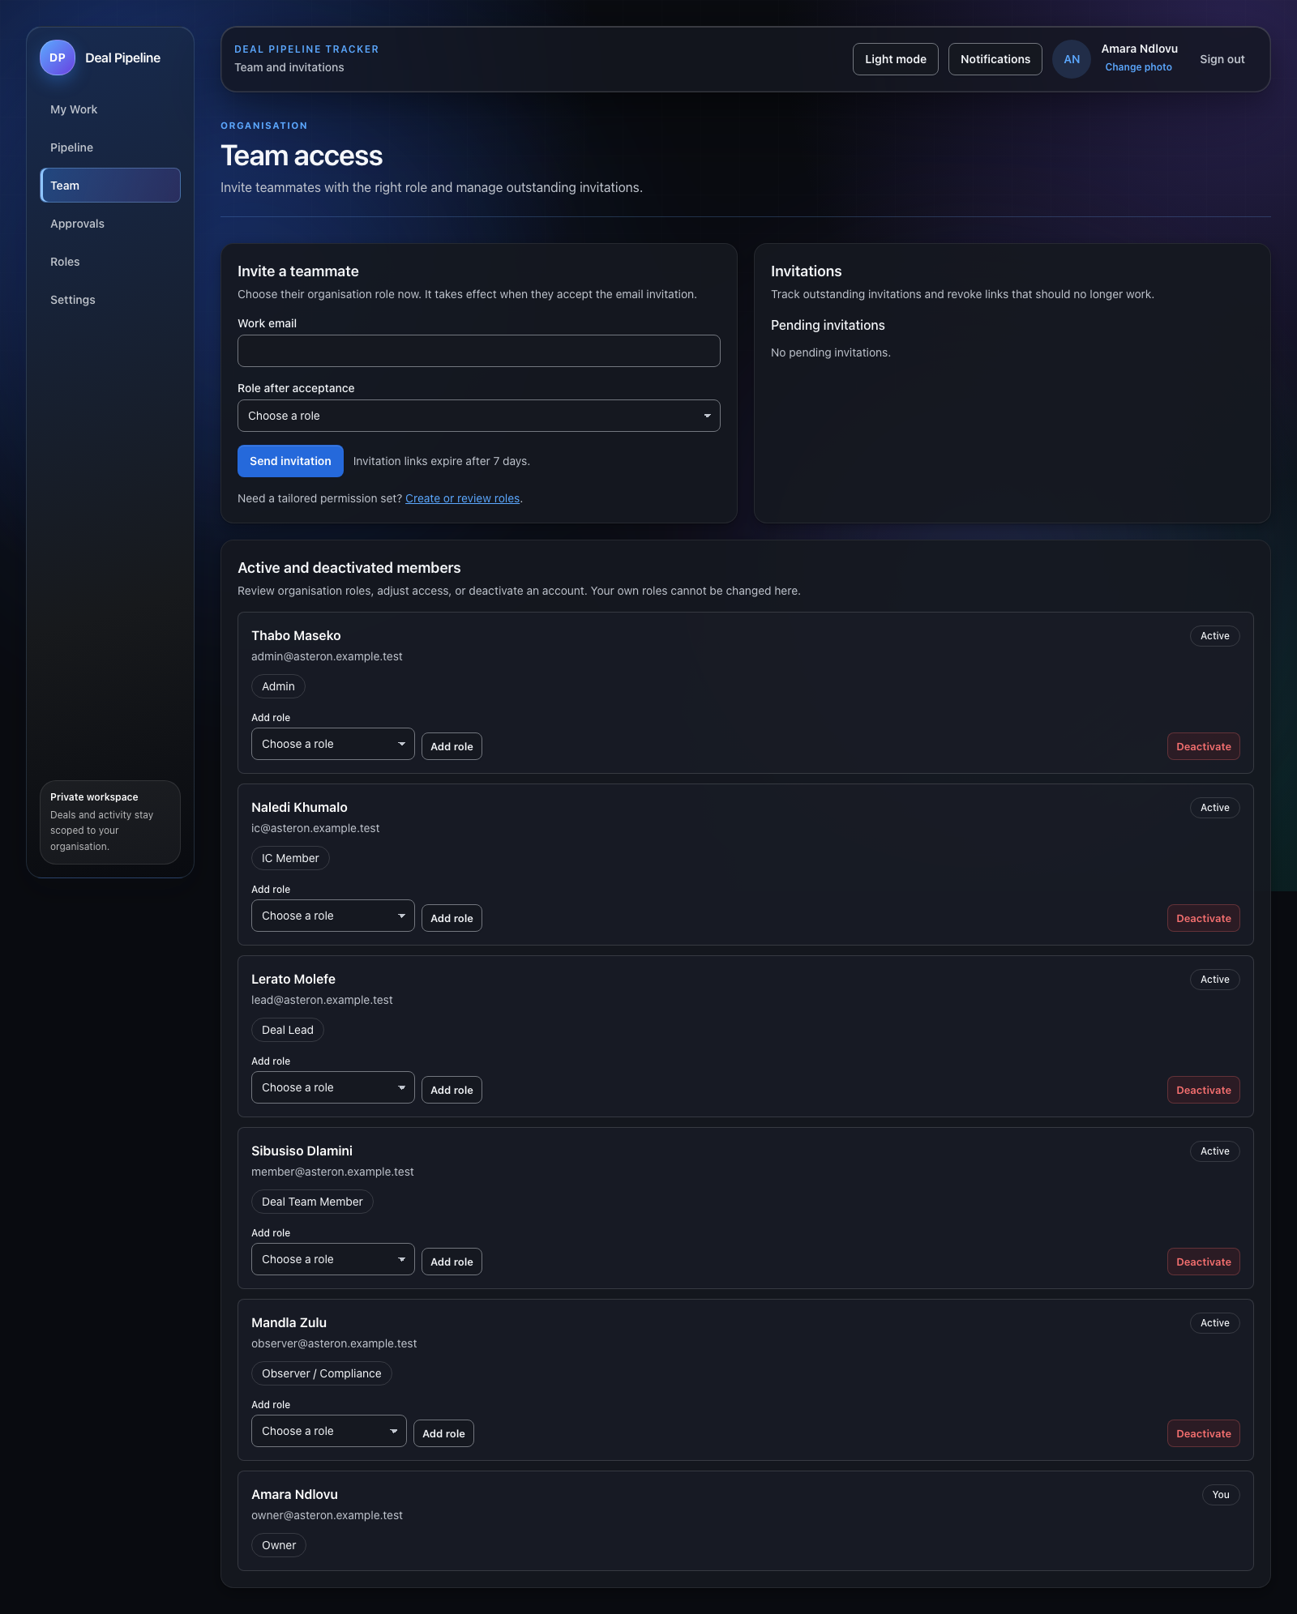
TEAM ACCESS
Invite people with the right role
Owners and admins invite a teammate, choose the role that takes effect when the invitation is accepted, and track pending invitations.
The roster makes current access visible. Managers can adjust roles or deactivate an account, while database rules protect tenant boundaries and the last Owner.
Seeded Asteron workspace · local development build
Notes:
Walk through Team access. Explain that the chosen role applies on invitation acceptance, and that management controls are permission-gated. Do not send a live invitation during a presentation unless the demo environment is explicitly intended for that action.

Slide 18
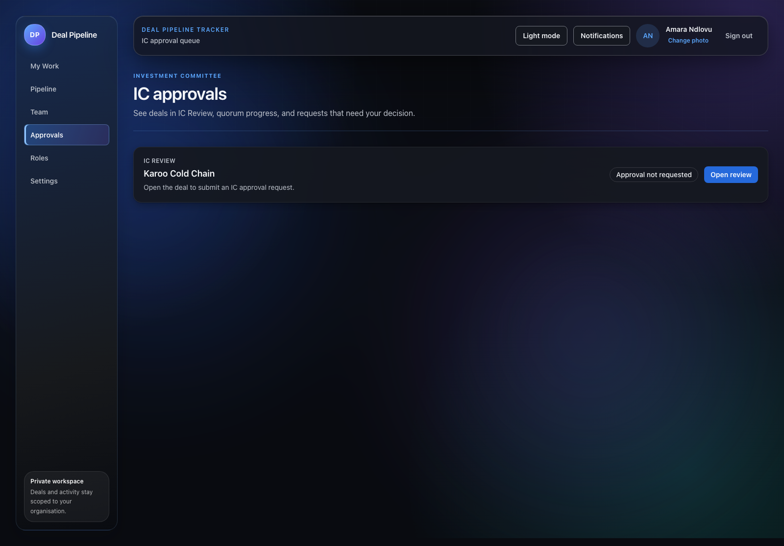
INVESTMENT COMMITTEE
See review status before opening a deal
The Approvals page lists deals in IC Review and shows whether an approval request is open, complete, or still needs to be requested.
A Deal Lead submits the request from the deal review. Eligible IC Members record independent decisions. Postgres enforces quorum and separation of duties before Signed.
Seeded Asteron workspace · local development build
Notes:
Use the approvals inbox to find an IC Review deal. Explain that the screenshot shows an approval not yet requested. The approval cycle uses a Deal Lead to submit and eligible IC Members to decide. The demo seed intentionally avoids pre-writing immutable approval decisions.

Slide 19
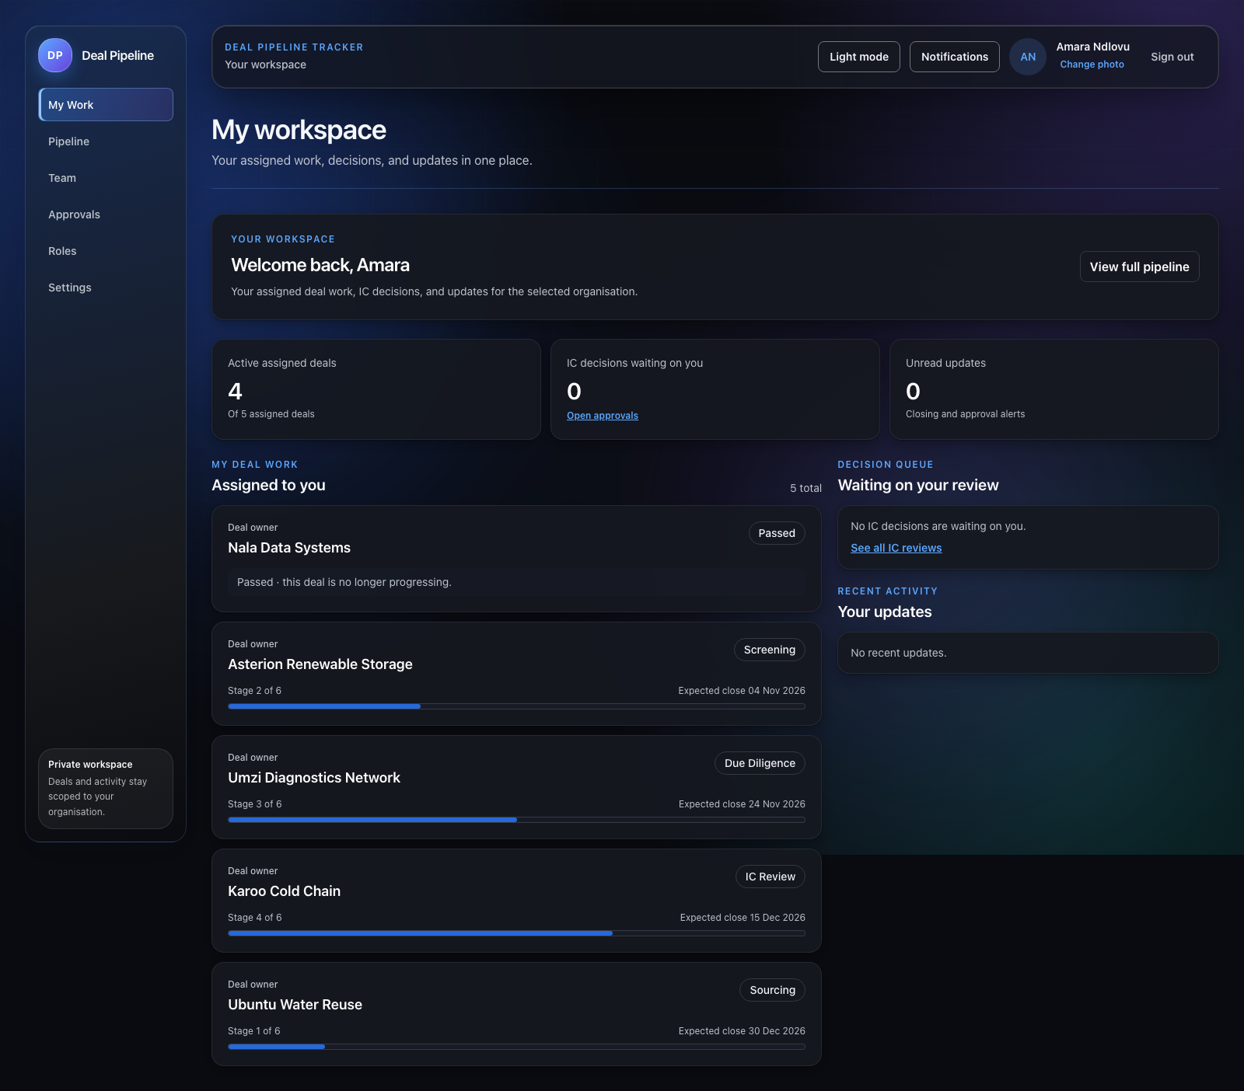
PERSONAL WORKSPACE
Show each person what needs their attention
My Work puts a person’s assigned deals, stage progress, pending decisions, and recent updates in one place.
A separate Pipeline page keeps the organisation-wide view. Passed deals remain visible as outcomes but do not count as active progression.
Seeded Asteron workspace · local development build
Notes:
Explain the difference between My Work and the organisation Pipeline. My Work is filtered to the signed-in user and current organisation. Stage indicators follow the canonical six progression stages; Passed is terminal.

Slide 20
LIVE WALKTHROUGH
A complete path through the product
1. Sign in as an Owner, choose an organisation, and review My Work.
2. Open Pipeline, compare List and Board, and read the stage-movement rules.
3. Review a deal’s details, progress, activity history, and private files.
4. Open Team to inspect invitations and role-scoped member management.
5. Open Approvals, follow the IC request and quorum rules, and review notifications.
6. Sign in as Deal Lead, IC Member, and Observer to compare access and assigned work.
Tenant isolation, database-enforced permissions, and append-only audit history support the workflow.
Notes:
Close with a role comparison. The seeded demo password is documented in README.md and is only for local development. To exercise a live approval request, first use a Deal Lead and then an eligible IC Member. The owner-approved workflow requires IC quorum; approval decisions are immutable audit records.

