Slide 1


BUILD • LAUNCH • SOAR
Advanced Aerial Robotics with PX4 and ROS: Custom Flight Modes and Beyond
github.com/Dronecode/roscon-25-workshop
Beniamino Pozzan
beniamino.pozzan@gmail.com
Patrik Pordi
pordipatrik@gmail.com
Alexis Guijarro
totonzx@gmail.com

Slide 2

Pre Workshop Survey

Slide 3

whoami
5+ years in GNC for aerial robotics
PX4 maintainer (ROS 2 integration)
3 years in GNSS-denied navigation
PhD in Control System Engineering
Beniamino Pozzan
Senior Robotics Engineer
Archangel Autonomy
Build, launch, and soar with Dronecode

Slide 4

whoami
ROS2 teaching experience
3 years of PX4 experience
PX4 driver development for ARK
PhD fellow in nature conservation project
Patrik Pordi
Robotics & Drone Engineer
University of Southern Denmark
Build, launch, and soar with Dronecode

Slide 5
whoami
9 years in OSS for aerial robotics
Co-Lead ROS Aerial Robotics CWG
PX4 Board Maintainer for 3DR/mRo
MS in CS / Mechatronics Eng
Alexis Guijarro
Lead Software Engineer
3DR
Build, launch, and soar with Dronecode

Slide 6
Day overview
08:00 – Introduction & Environment Setup
09:30 – PX4 ROS 2 Interface Library, Custom Flight Modes
11:00 – Mode Executors and Multi-Vehicle Control
12:00 – Lunch Break
13:00 – Advanced Control & Perception Applications
15:30 – From Simulation to Hardware & Architecture Patterns
16:30 – Q&A, Open Lab & Individual Consultations
20:00 – Aerial Robotics Meetup, sponsored by Dronecode

Slide 7


Aerial Robotics Meetup, tonight!
Tonight, 8:00 to 11:00 PM
CRAFT Beer Market, 1 Adelaide St E (short walk from the venue)
Sponsored by Dronecode. Food and drinks are on us.
Talk shop on control architectures, state estimation, and open source flight stacks with the people who actually maintain them.
Notes:
You've been stuck in a room with us all day, so come argue about EKFs over a beer tonight instead. 36 people are already in, space is limited

Slide 8
Prerequisites - environment setup - architecture overview
In this section you will
Understand the requirements for running the exercise
Set up the simulation environment
Fly a drone in Gazebo without ROS 2
Attach ROS 2 to the simulation
Echo PX4 topics in ROS 2
Visualize PX4 data with Foxglove

Slide 9
Environment Setup
REQUIREMENTS:
Install Foxglove https://foxglove.dev/download
Download and install QGC https://qgroundcontrol.com
Clone PX4 repo: https://docs.px4.io/main/en/sim_gazebo_gz/#installation-ubuntu-linux
git clone -b release/1.18 https://github.com/PX4/PX4-Autopilot.git
Prepare workspace and clone workshop repo https://github.com/Dronecode/roscon-25-workshop :
mkdir -p ~/workspaces/px4_roscon26_ws/src
cd ~/workspaces/px4_roscon26_ws/src
git clone git@github.com:Dronecode/roscon-25-workshop.git px4-roscon-workshop
git clone https://github.com/Dronecode/roscon-25-workshop.git px4-roscon-workshop
cd ~/workspaces/px4_roscon26_ws
vcs import src < ./src/px4-roscon-workshop/jazzy.repos

Slide 10
Environment Setup, dockerless, Ubuntu 22.04/24.04, WSL 2
Follow PX4 simulation setup instructions https://docs.px4.io/main/en/sim_gazebo_gz/#installation-ubuntu-linux
To setup PX4 SITL build toolchain and download Gazebo Harmonic
Verify it by starting a simple simulation over Gazebo, no ROS 2 involved:
cd ~/PX4-Autopilot
make px4_sitl gz_x500
Install ROS 2 (Jazzy or Humble depending on OS version)
https://docs.ros.org/en/jazzy/Installation/Ubuntu-Install-Debs.html. Pick ros-jazzy-desktop
https://docs.ros.org/en/humble/Installation/Ubuntu-Install-Debs.html. Pick ros-humble-desktop
Install ROS 2 developer tools: sudo apt install ros-dev-tools
Install dependencies:
cd ~/workspaces/px4_roscon26_ws
source /opt/ros/jazzy/setup.bash # source /opt/ros/humble/setup.bash
rosdep install -i --from-paths src --skip-keys OpenCV

Slide 11
Environment Setup, docker
Retrieve px4io/px4-dev-ros2-gazebo:main-jazzy docker image or build it yourself https://github.com/PX4/PX4-Autopilot/pull/28730
Start the container
cd ~/workspaces/px4_roscon26_ws/src/px4-roscon-workshop
./docker/docker_run.sh ~/PX4-Autopilot
Set HEADLESS=1 if you don’t want GUI to run
To leverage GPU acceleration, if available, refer to https://docs.px4.io/main/en/simulation/gazebo_container_gui
From inside the container, install the workspace dependencies and build the workspace
apt update
rosdep install -y -i --from-paths src --skip-keys OpenCV
source /opt/ros/jazzy/setup.bash
colcon build --symlink-install

Slide 12
Build, launch, and soar with Dronecode

Slide 13


Slide 14
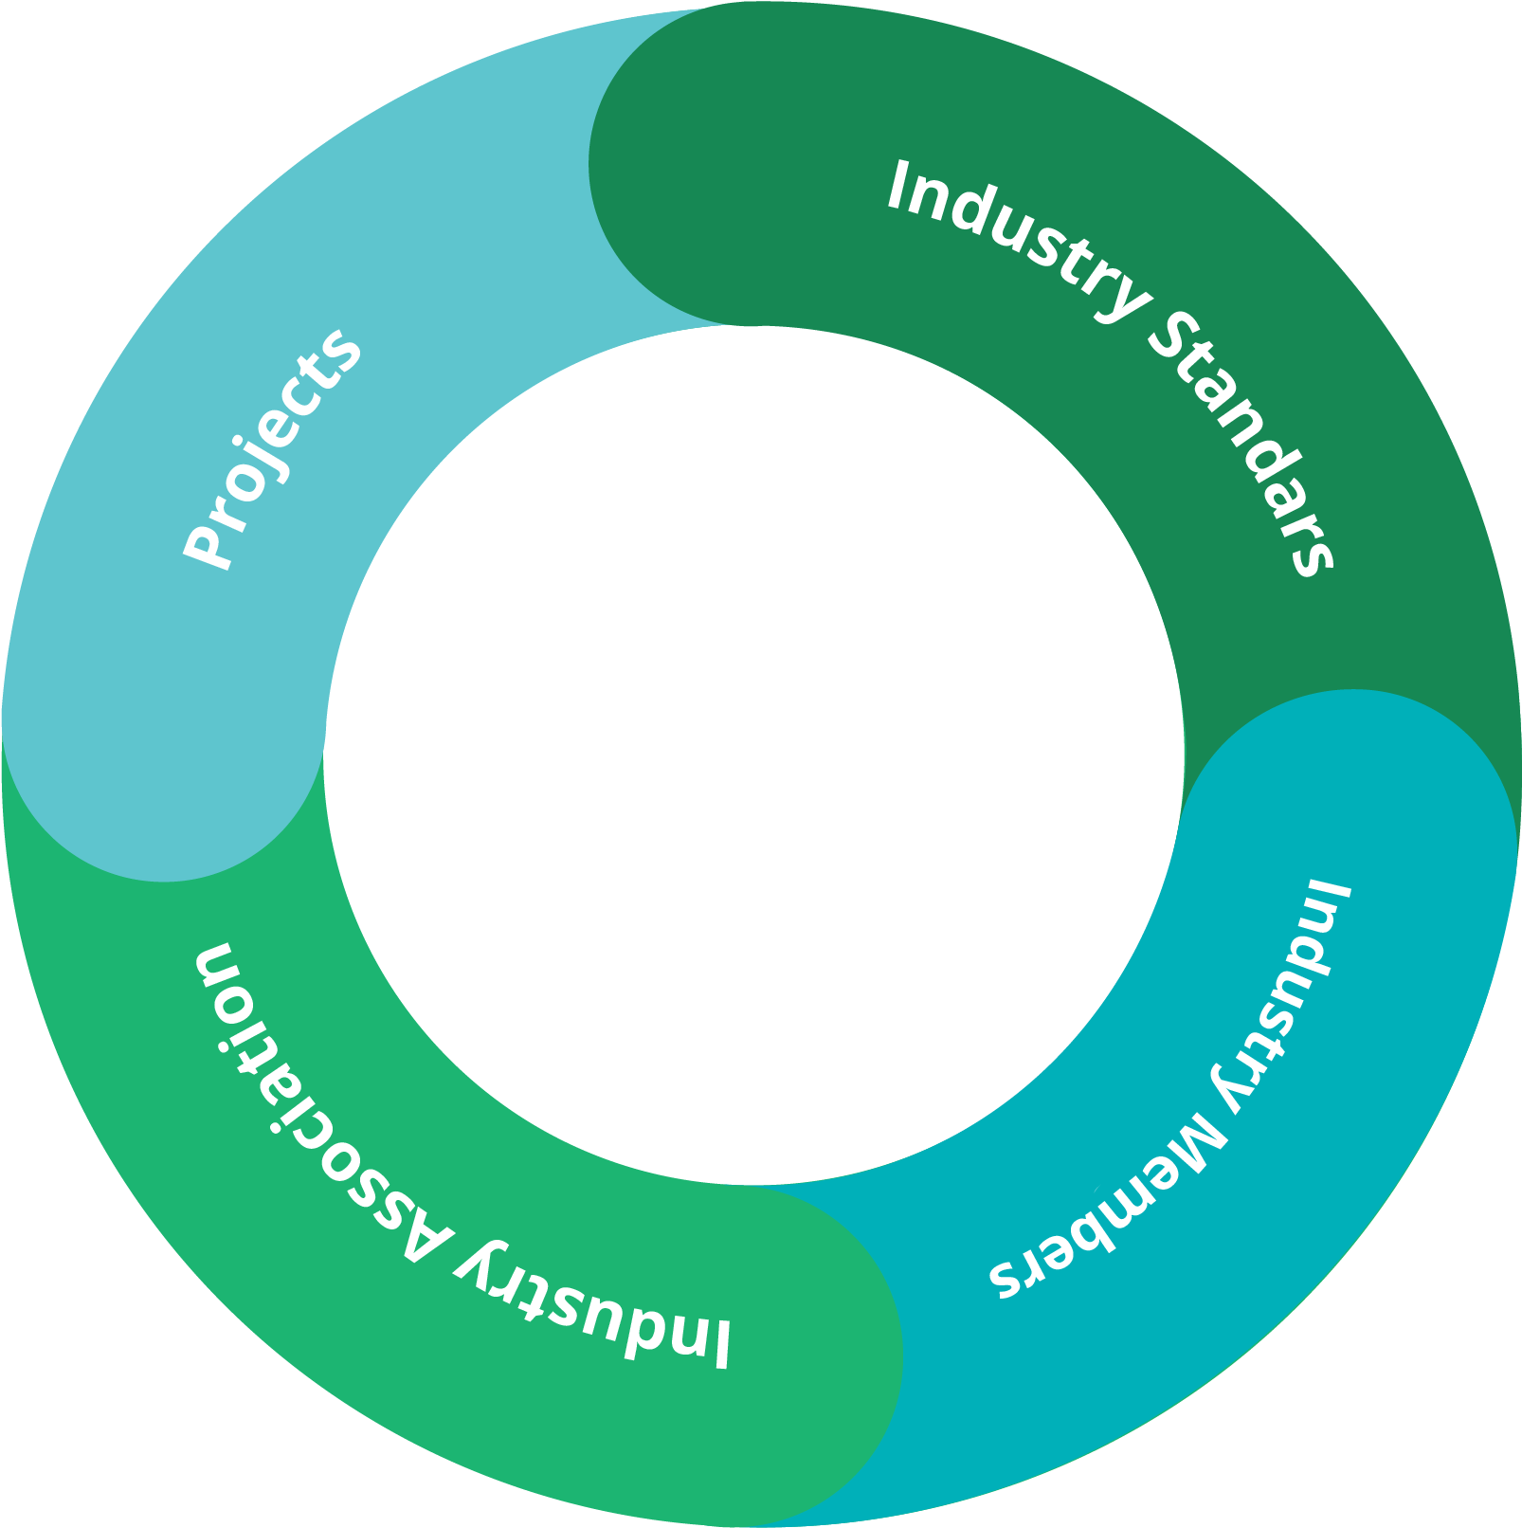



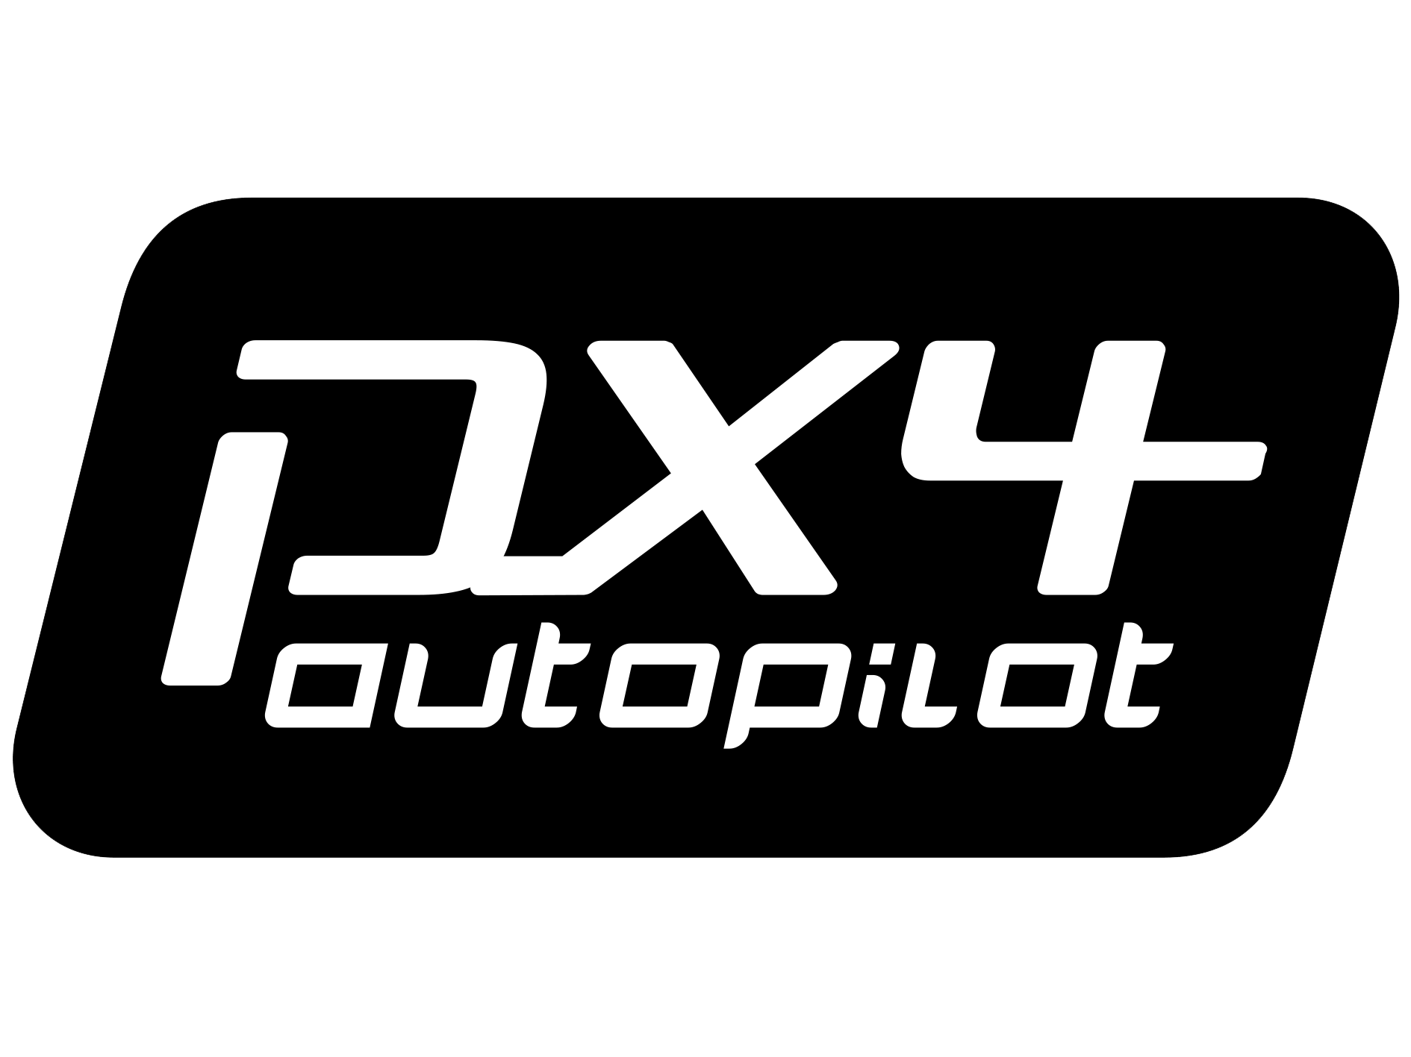









Neutral standards body for the drone industry since 2014
25 Years of being the place where competitors collaborate.
Members trust us with IP, governance, and brand. Maintainers trust us not to favor one company. Regulators trust our specs. That trust took 25 years, and is structurally hard for a new entity to replicate.
Global community of 15,000+ contributors
Production ready used by over 1 million drones
Convener, host, standards body, operator.

Slide 15
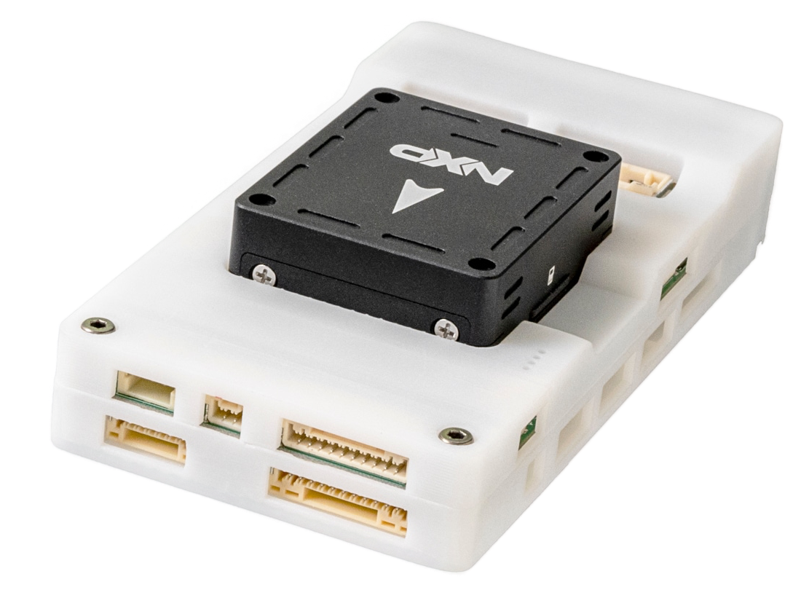
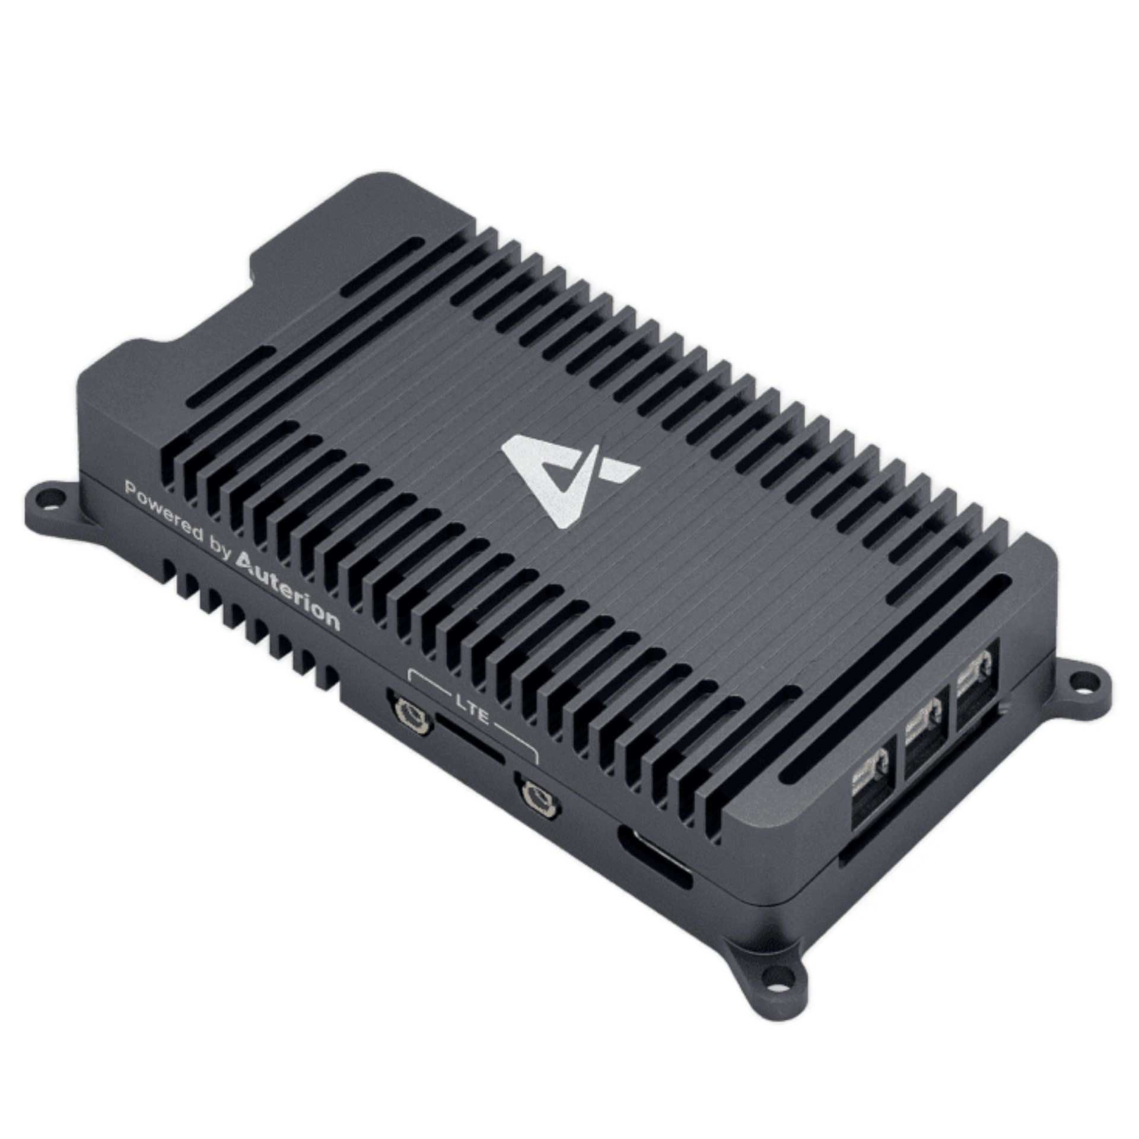
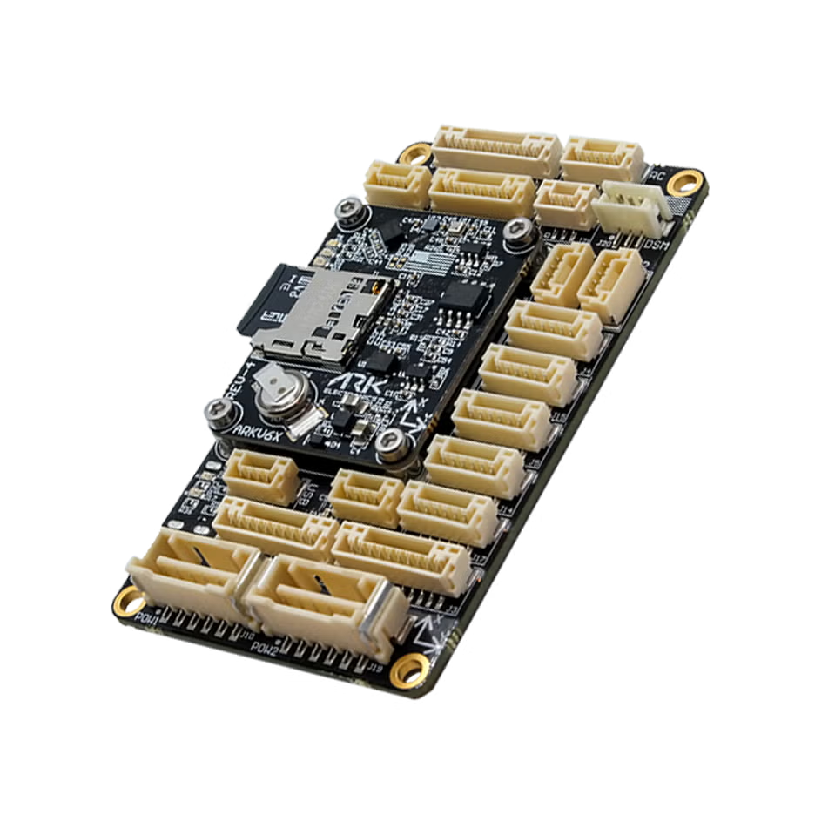
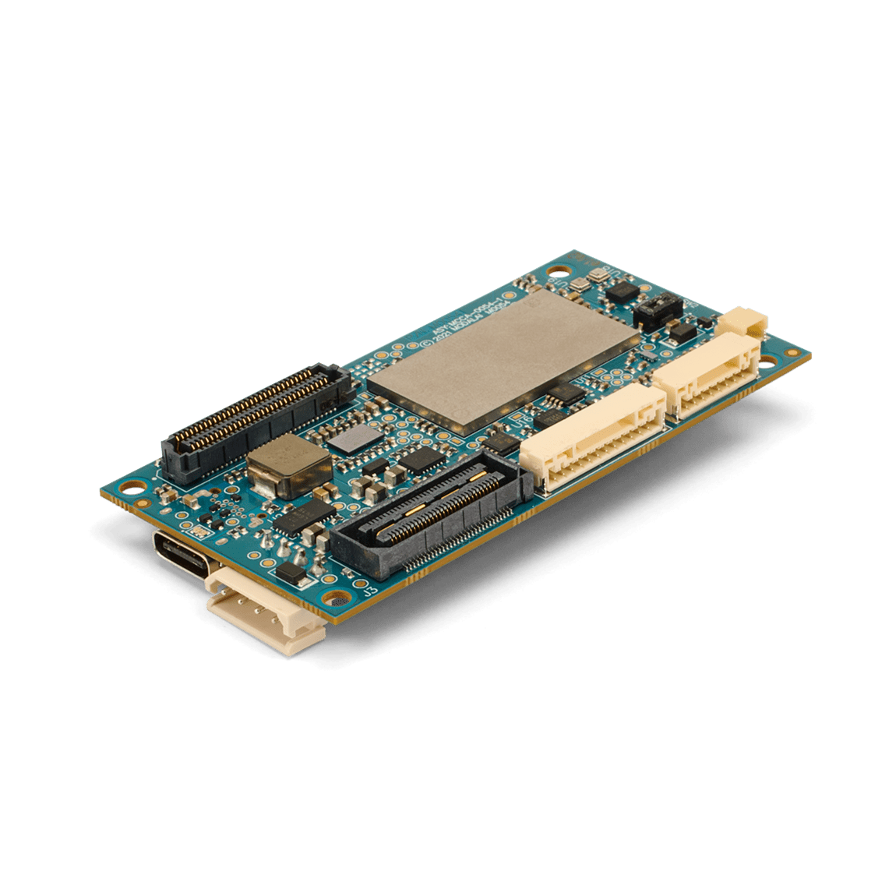
Lifting the Industry
Open Source Autonomy Firmware and Compute Platforms

Slide 16
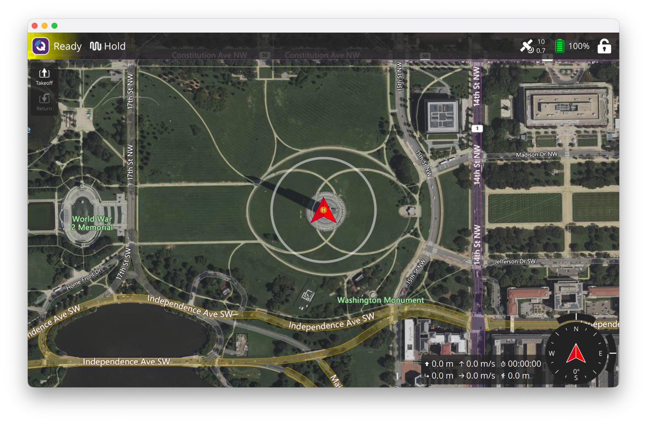
Lifting the Industry
Open Source Mission Planning and Telemetry

Slide 17
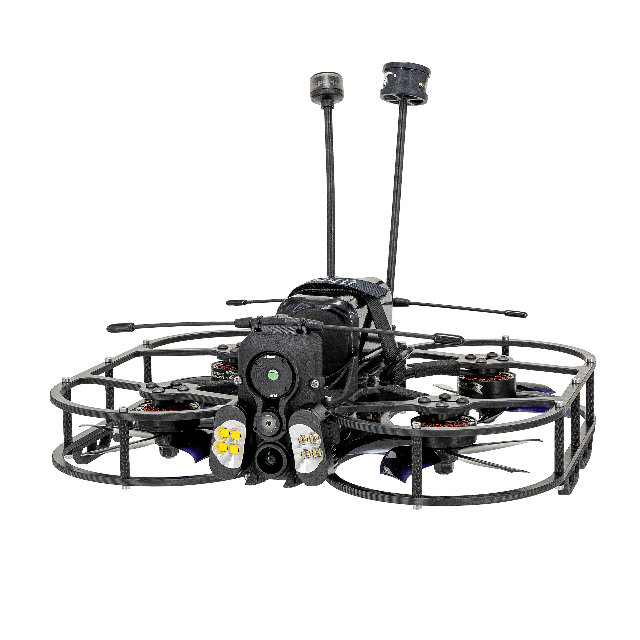
Lifting the Industry
Open Source Development Platforms

Slide 18

Lifting the Industry
Limitless vehicle type support from traditional Quadcopters to highly reliable VTOLs of all sizes

Slide 19

Lifting the Industry
Guinness record breaking drone swarms

Slide 20

Lifting the Industry
Battlefield tested drone swarms

Slide 21



Member Community
Platinum
Gold

Slide 22



























Member Community
Silver

Slide 23
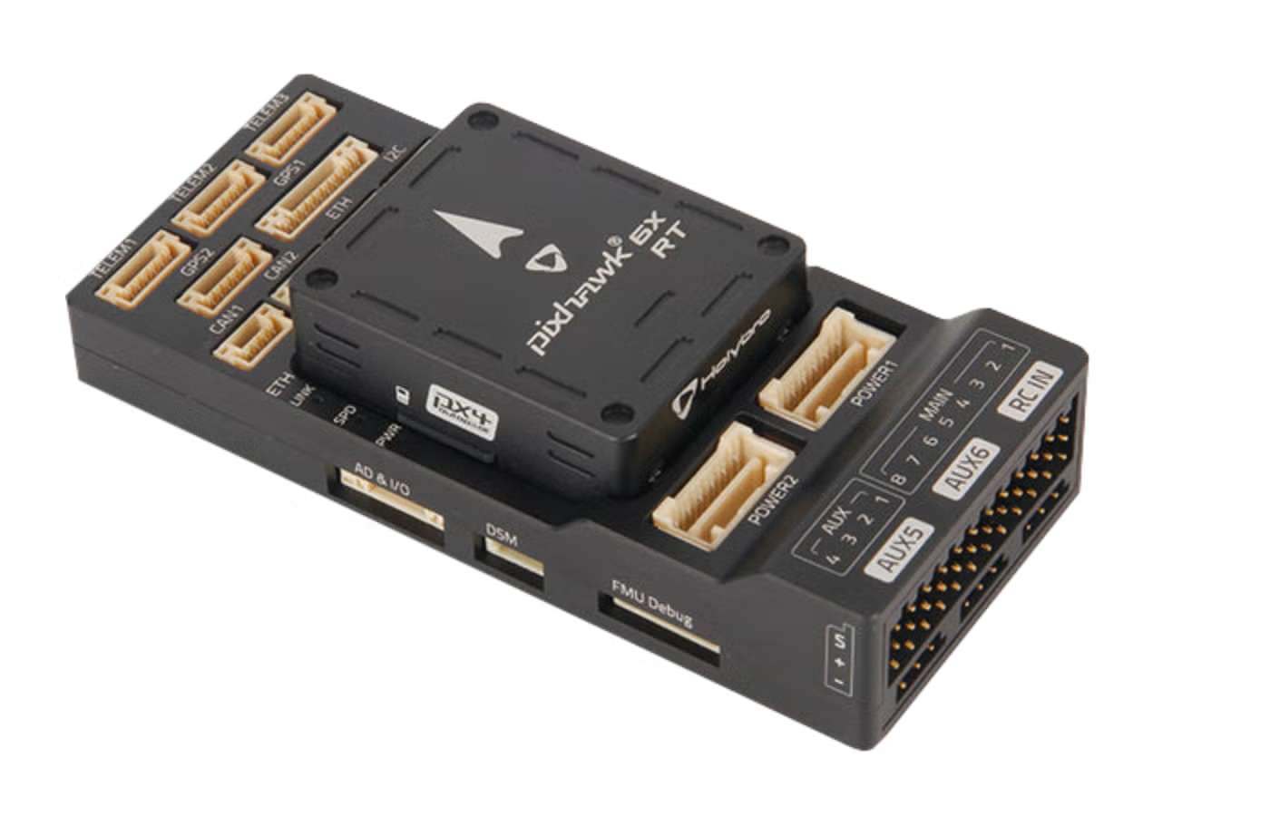
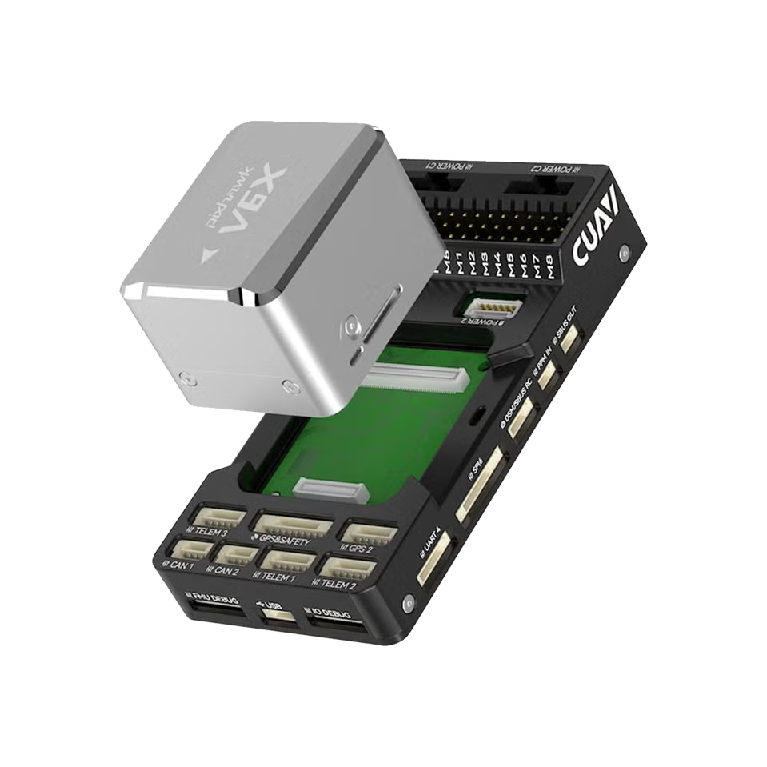
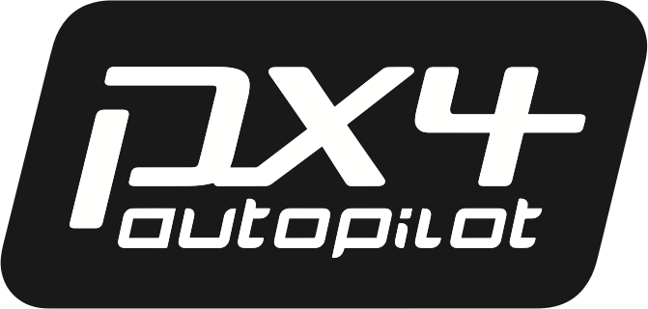




Putting things into perspective
Lifetime Achievements
$800M Project Value
+60M Total Lines of Code
+15K Total Unique Contributors
Data Provided by
Build, launch, and soar with Dronecode

Slide 24
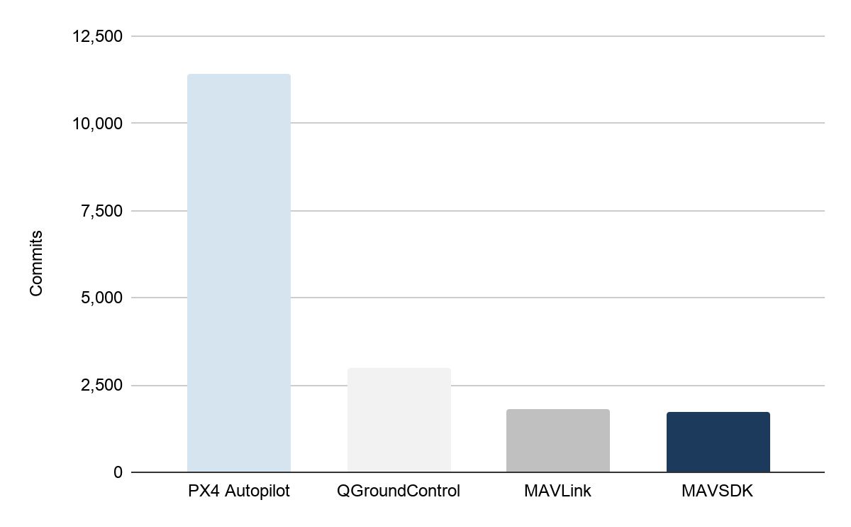
Contribution Distribution by Project (2025)
Numbers from 2025
+17,900 Commits
+3,300 PRs submitted
+2,800 PRs merged
+650 Contributors
+99 Organizations

Slide 25

2025 Annual Report: Year In Review
Read the full report for contribution metrics, project information, membership roster, and event reports

Slide 26
The Dronecode Stack

Slide 27
The Dronecode Stack
Autonomy Firmware. PX4 Autopilot.
The flight stack. Every domain: air, ground, water, and space
Autonomy Hardware. Pixhawk Open Standards.
Open hardware standards. 100-plus boards, 40-plus manufacturers.
Telemetry Protocols. MAVLink.
The messaging protocol. The lingua franca of uncrewed systems.
Telemetry SDK. MAVSDK.
The library developers use to talk to MAVLink. Multiple languages.
Mission Planner. QGroundControl.
The cross-platform ground control station. Desktop and mobile

Slide 28
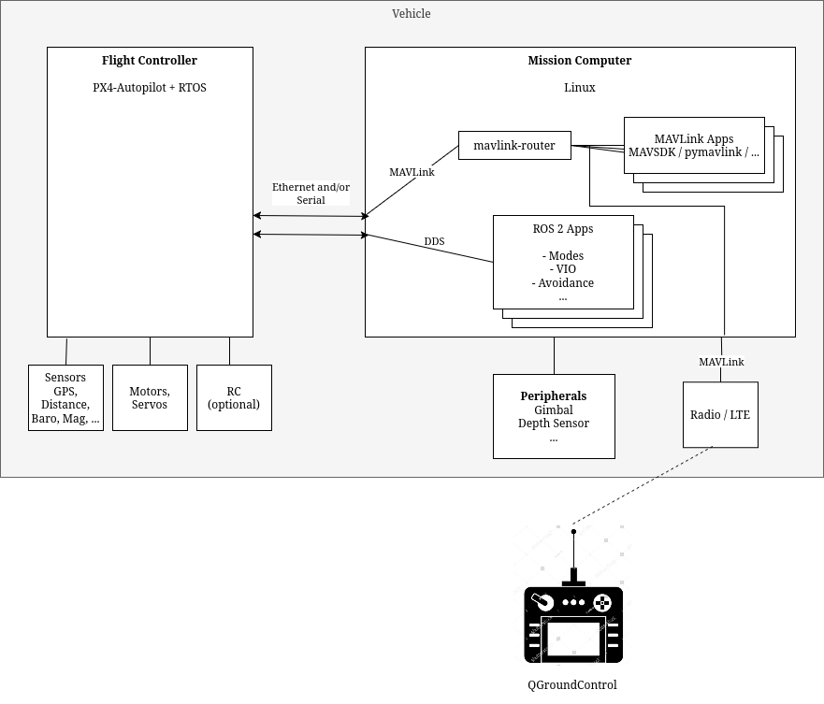
The Stack
at a Glance
Pixhawk
PX4 Autopilot
MAVLink
MAVSDK
QGroundControl
ROS 2
Build, launch, and soar with Dronecode

Slide 29
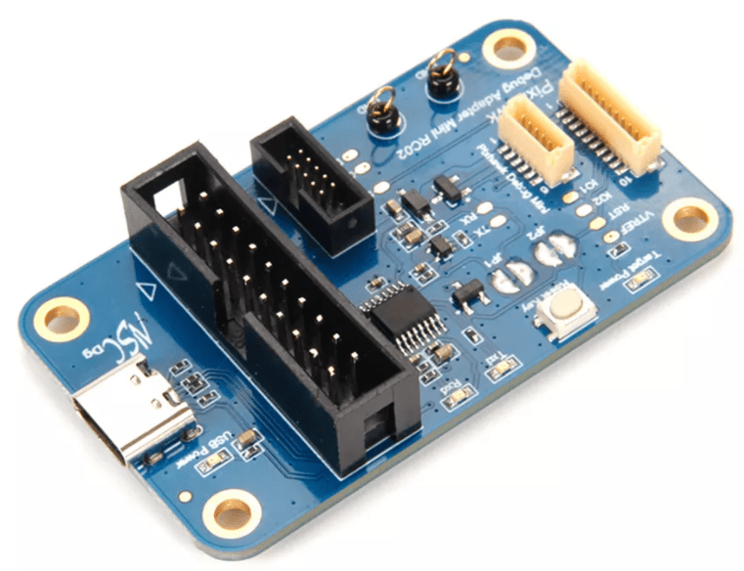
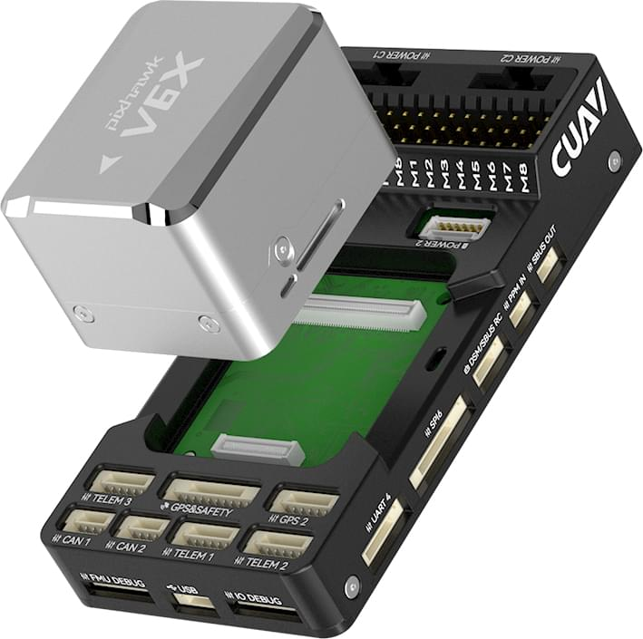

Slide 30
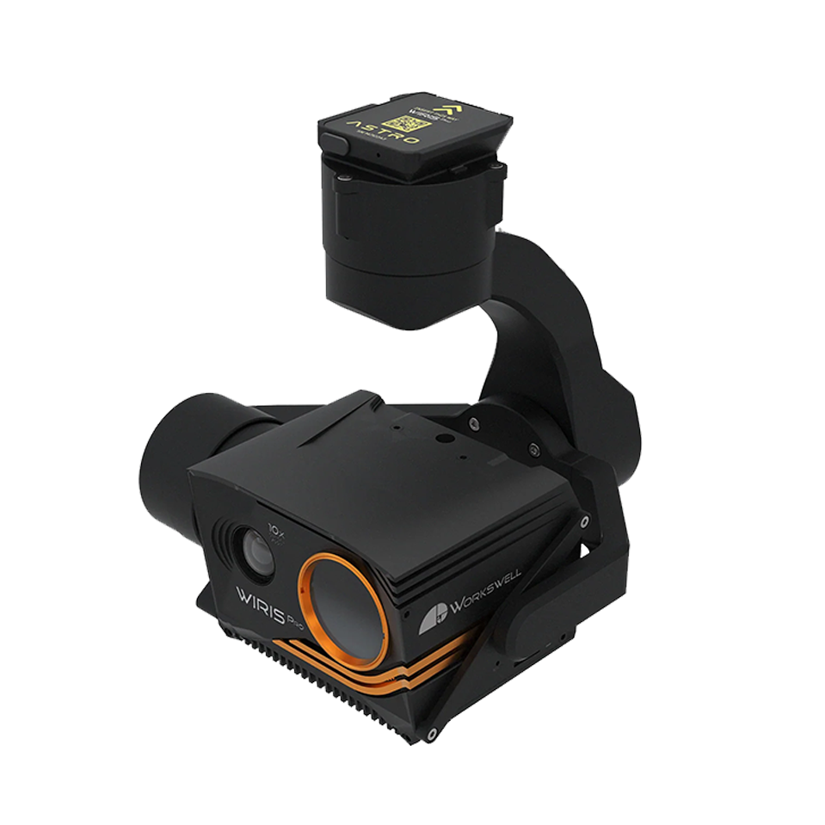
Pixhawk Project: Autonomy Hardware
Open Hardware & Open Standards
Started as a flight controller open hardware project with the first versions of Pixhawk’s
Evolved into an Open Standard for
Flight controllers
Payloads (Gimbals)
Smart Batteries
Connectors
Debuggers
Build, launch, and soar with Dronecode

Slide 31
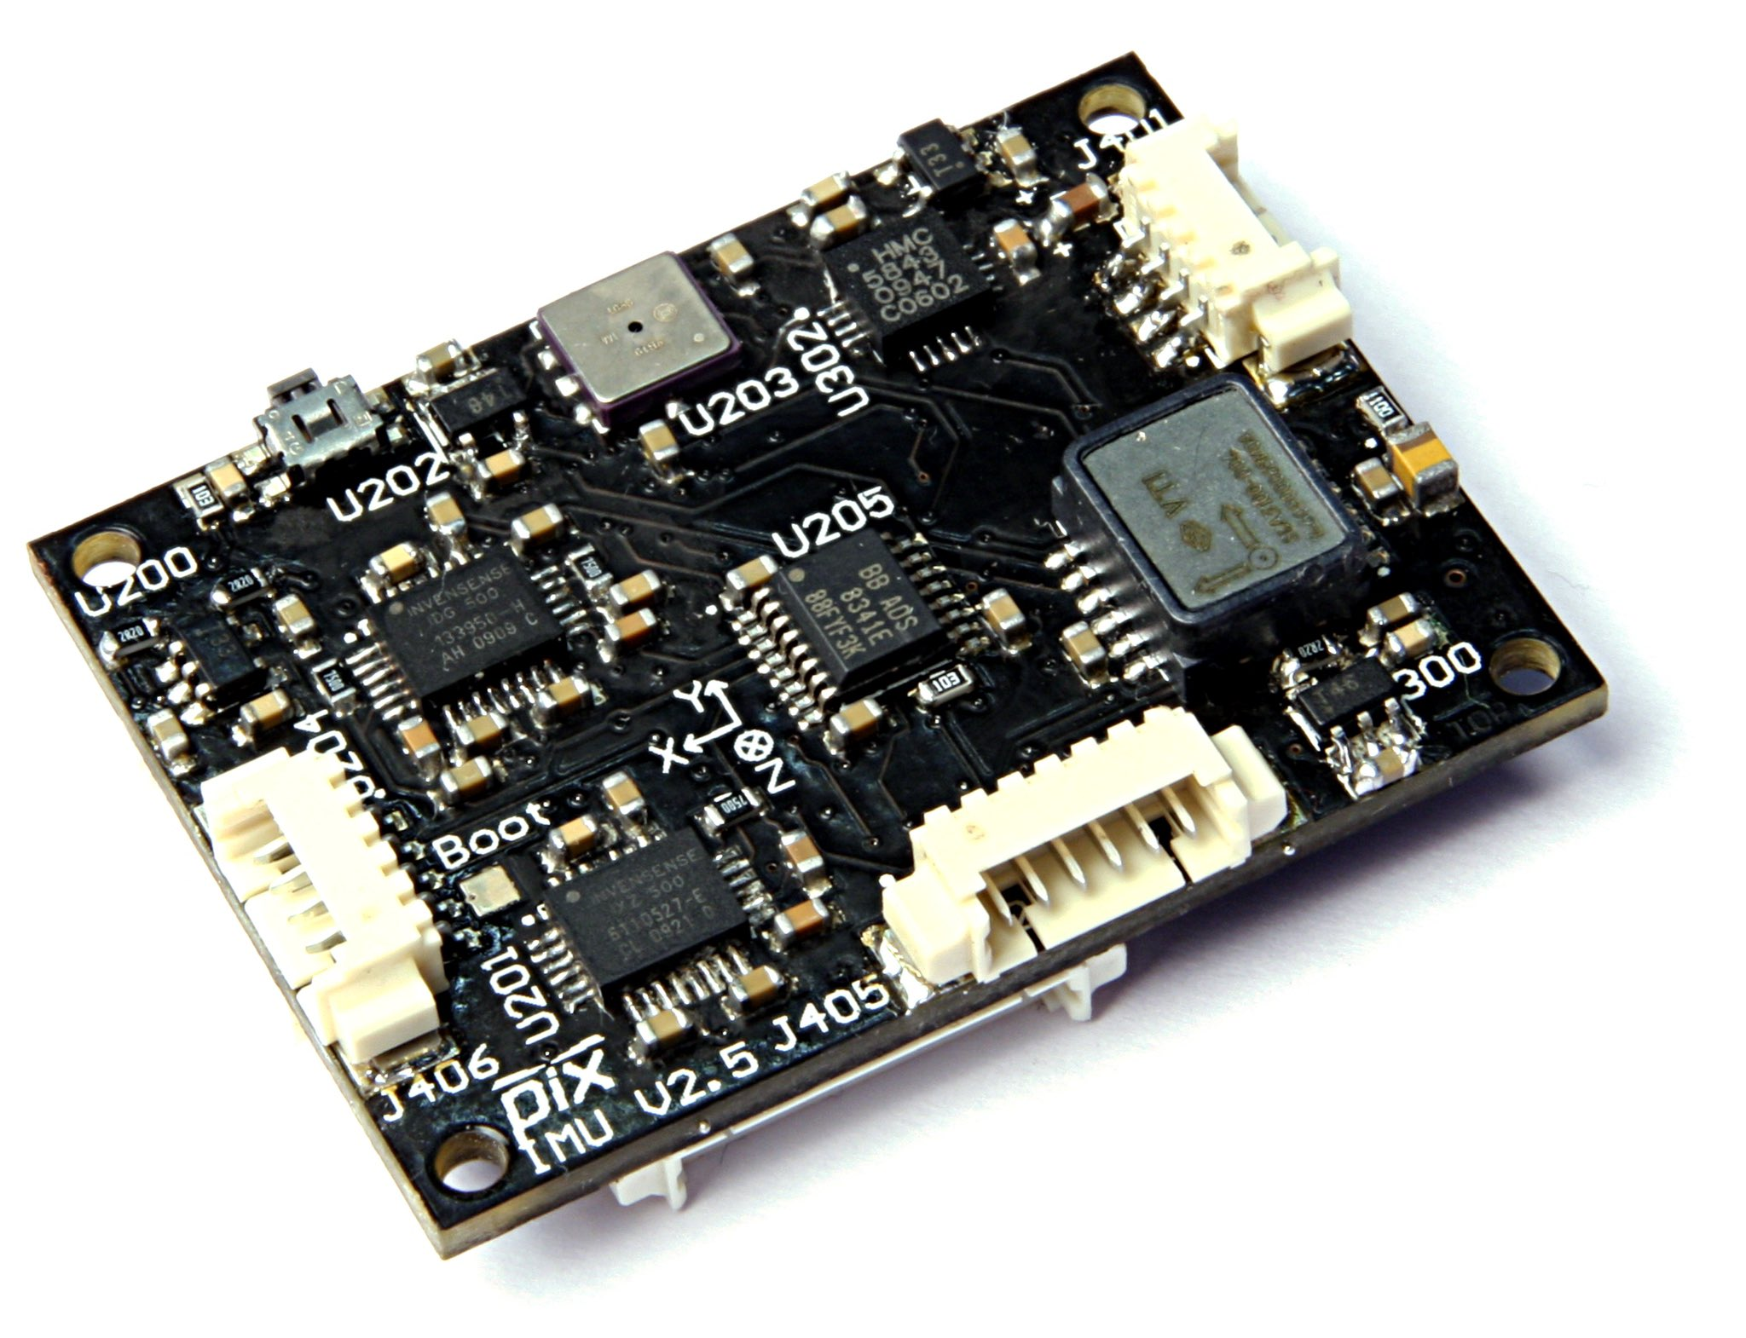
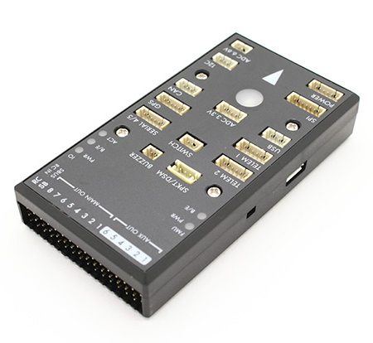
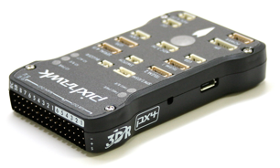
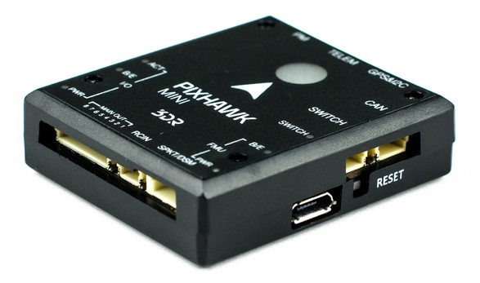
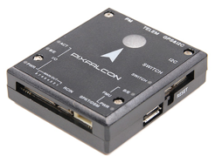
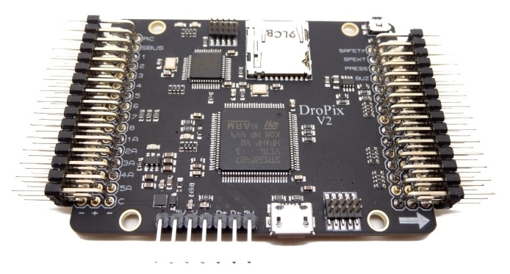
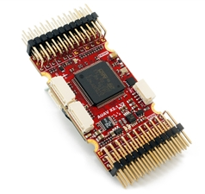
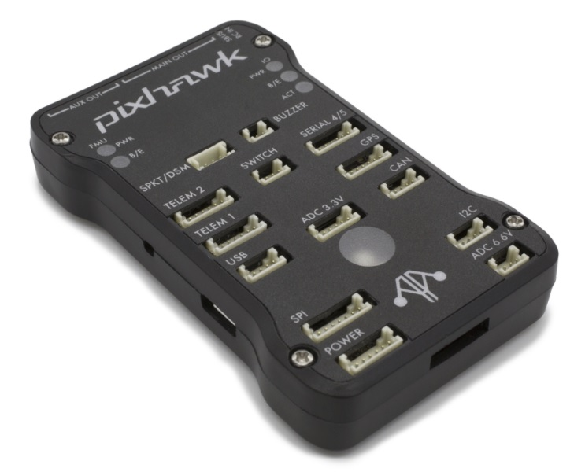
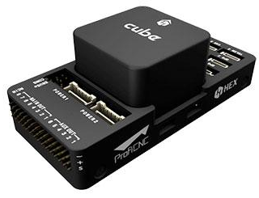
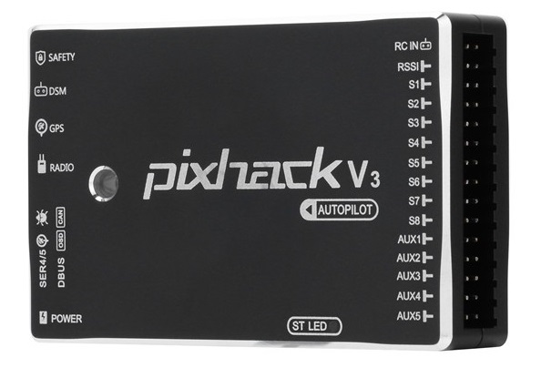
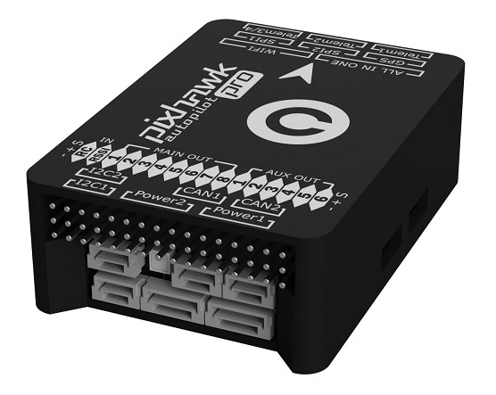
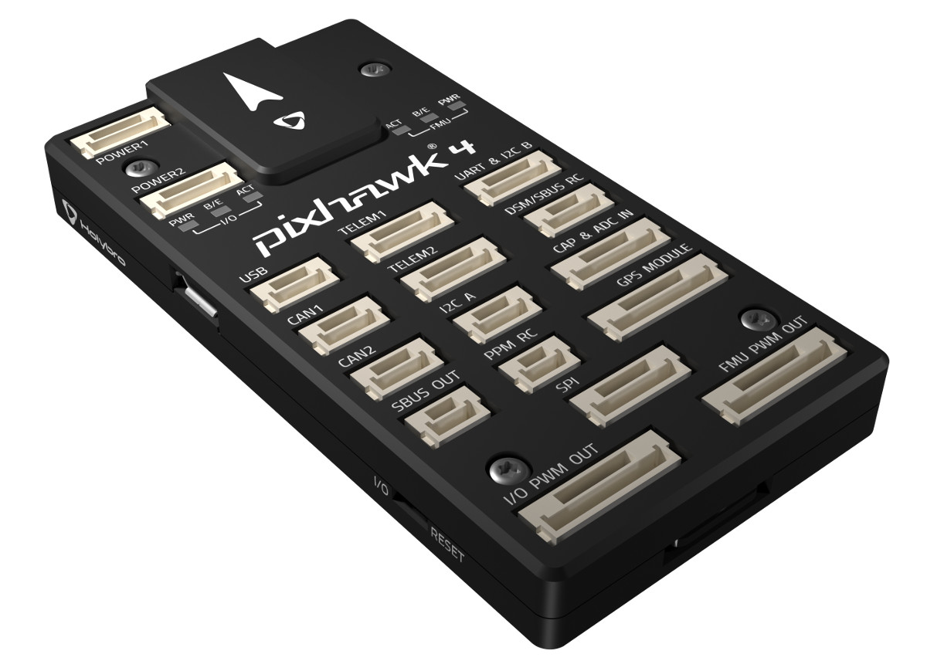
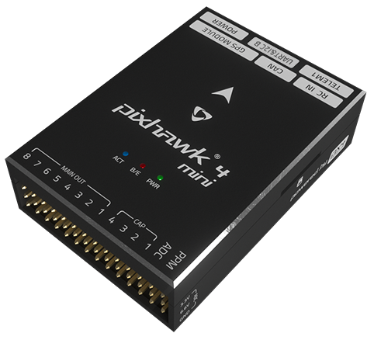
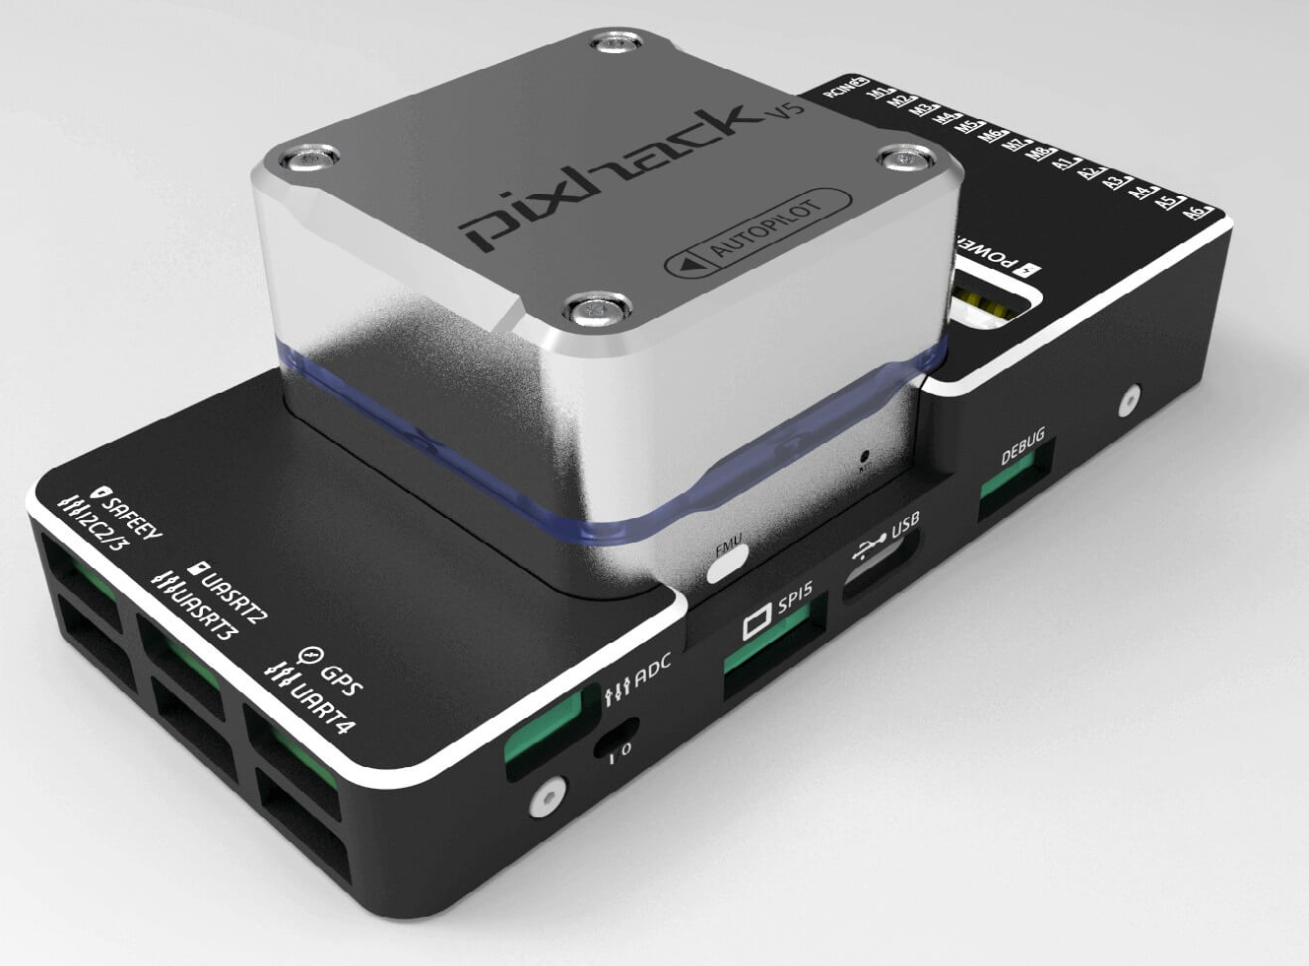
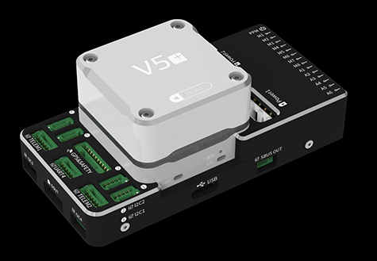
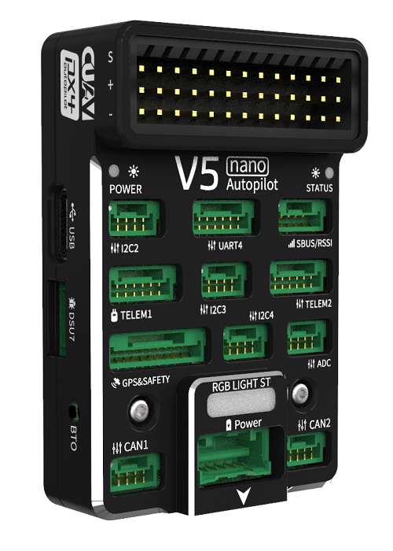
Pixhawk: +16 years of community trust
Build, launch, and soar with Dronecode

Slide 32
Pixhawk: Latest Hardware
ARK Electronics ARKV6X
$400
NXP MR-VMU-RT1176
$300
Build, launch, and soar with Dronecode

Slide 33

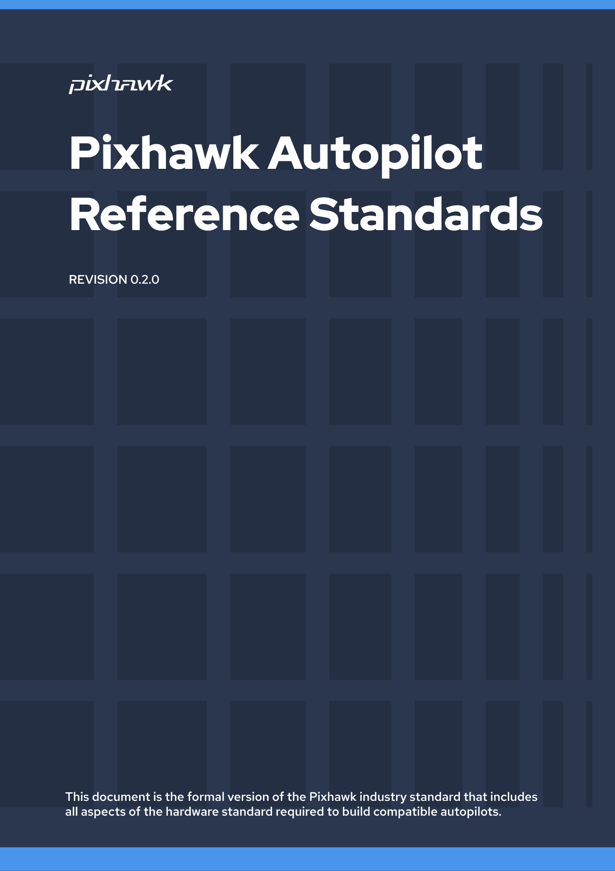

Pixhawk: Drone Open Standards
The Pixhawk project evolved from an Open Hardware effort into an Open Standards project
Our open standards are lifting the drone industry
From serial connectors, to full blown flight controller architectures, we excel in quality and safety
The latest generation of Pixhawk autopilots are the most advanced yet.
https://pixhawk.org/

Slide 34
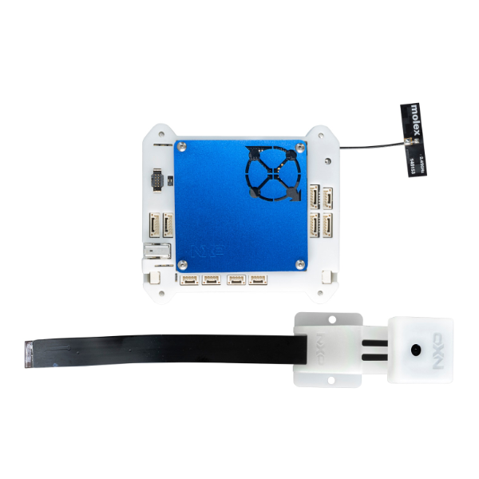
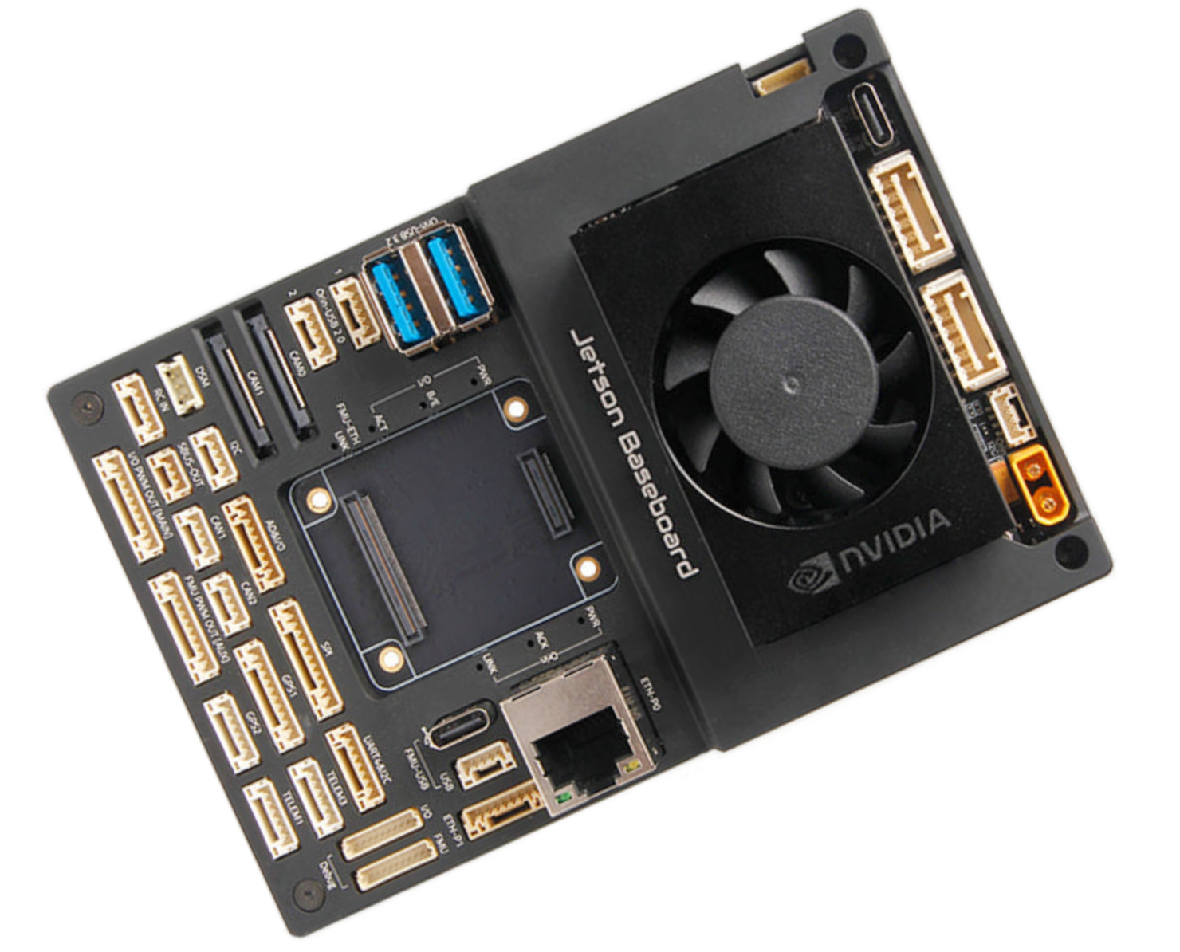
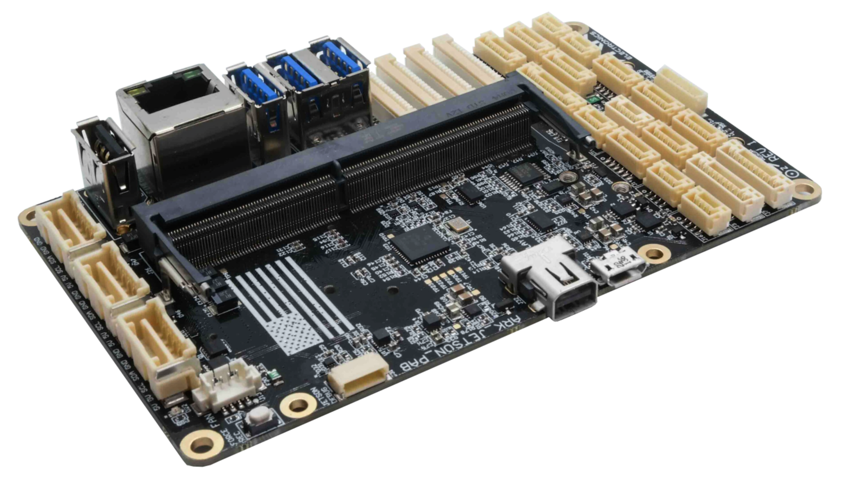
Pixhawk: AI-ready Compute Hardware
ARK Electronics
$1,100.00
ARK V6X
NVidia Jetson Family
ModalAI
$1,249.99
Qualcomm RB5
Holybro
$1,940
Pixhawk 6X
NVidia Jetson Family
NXP
$299.00
NavQPlus i.MX 8M Plus
Build, launch, and soar with Dronecode

Slide 35
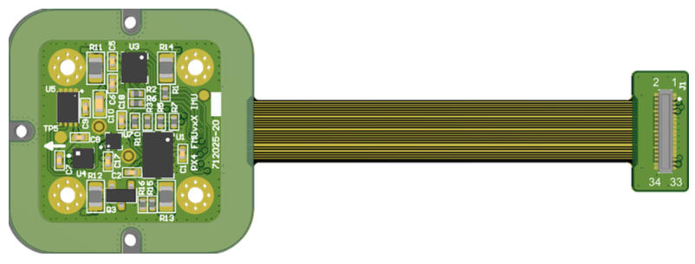
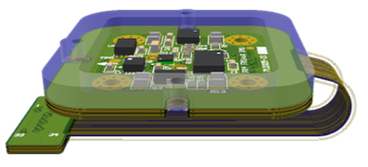
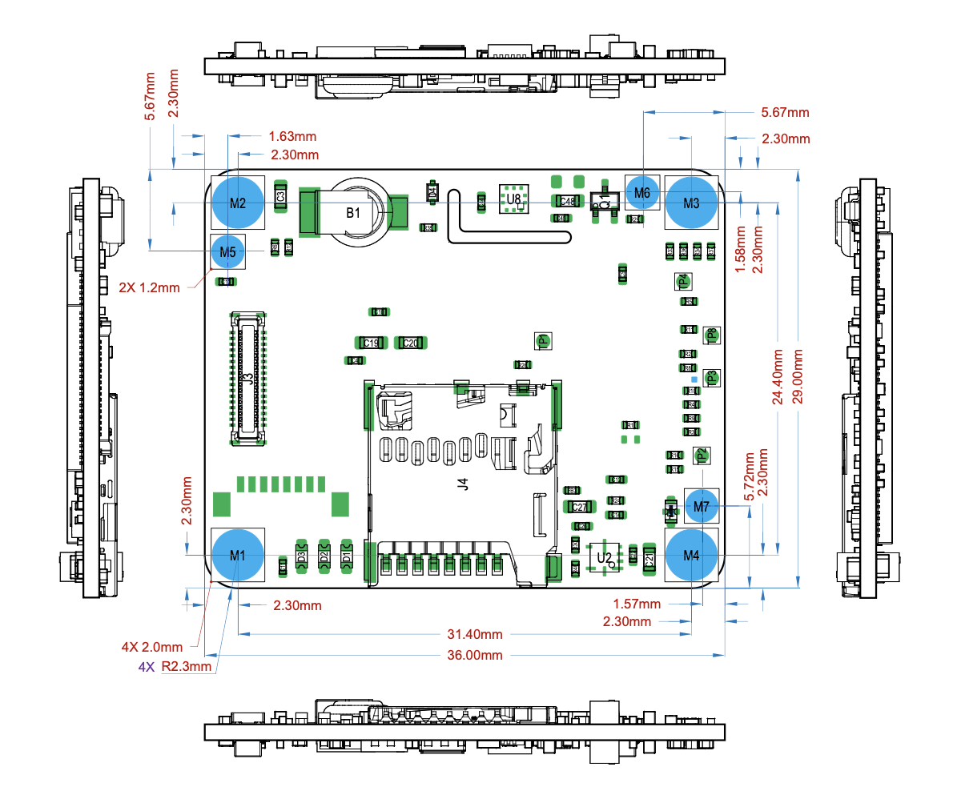
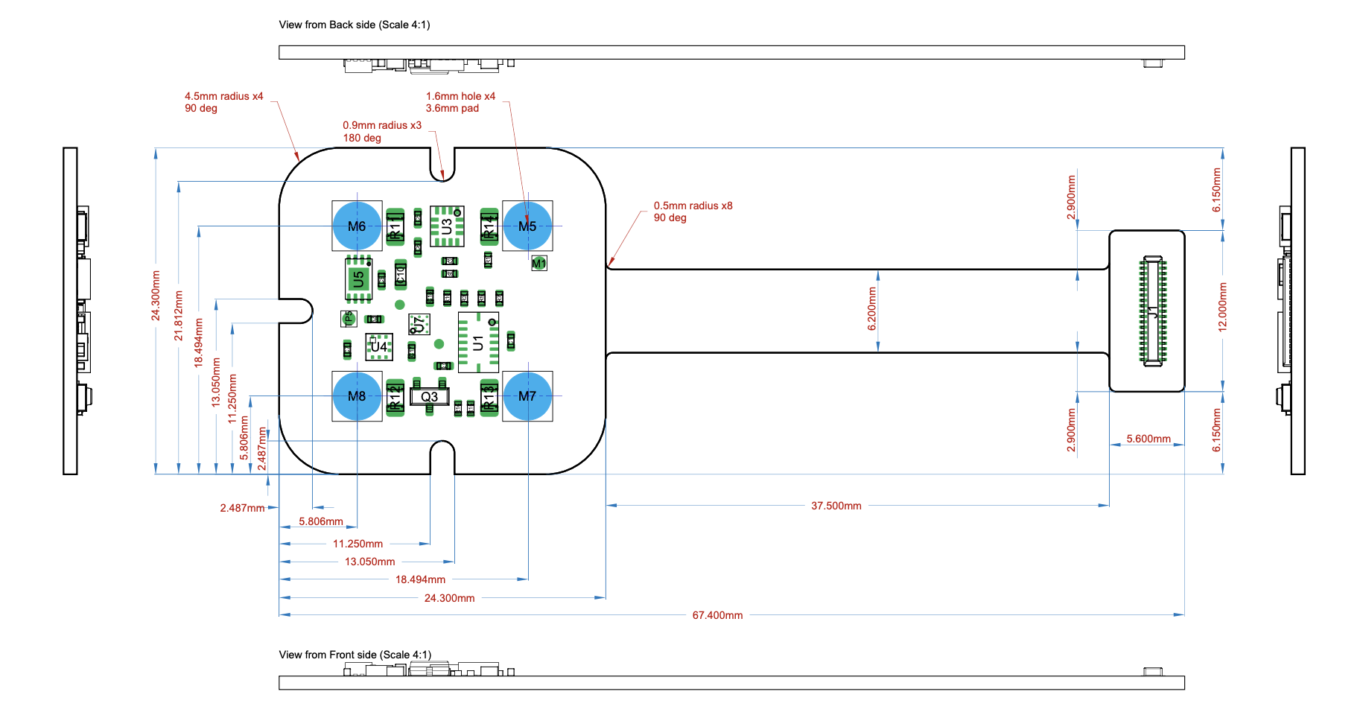
Pixhawk Flight Controller FMUv6X

Slide 36
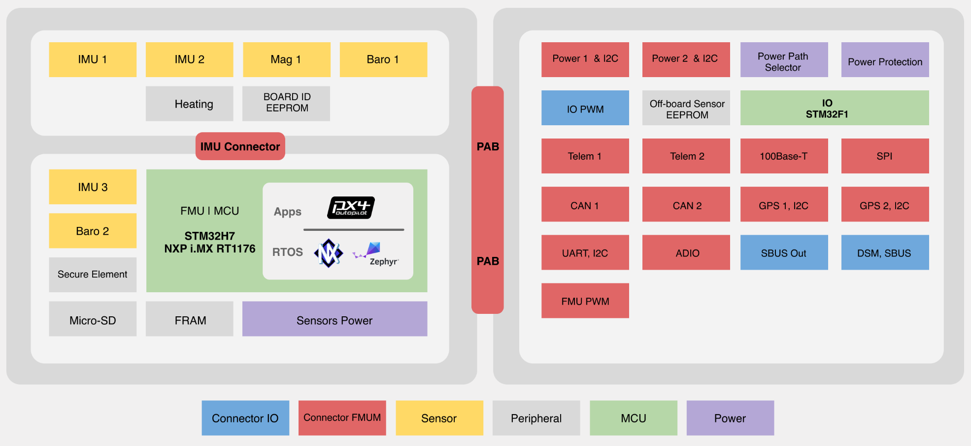
Pixhawk Flight Controller FMUv6X

Slide 37
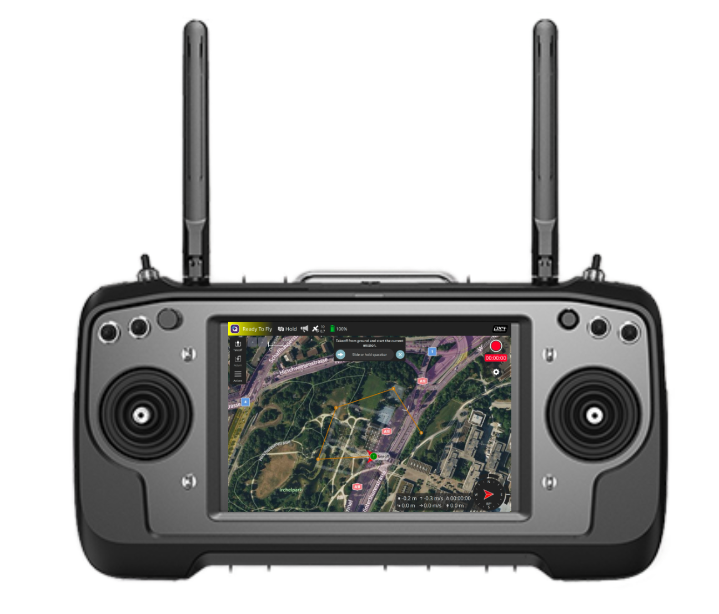

Slide 38
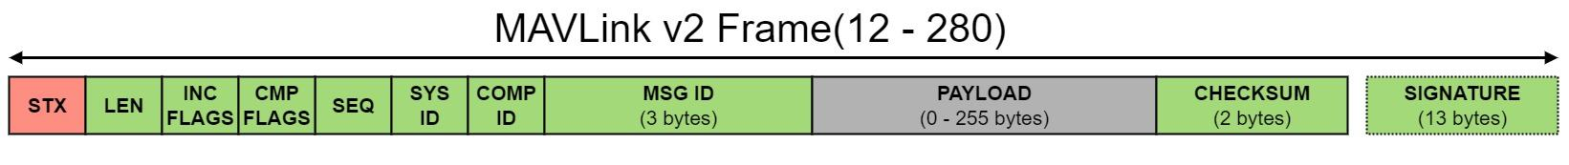
MAVLink: The messaging protocol that connects it all
Open, lightweight messaging protocol
One neutral steward
Open governance, public dialect process, transparent releases
Backwards compatibility taken seriously across a decade-plus
Adopted across the industry, on every continent, by hundreds of vendors
Publish Subscribe streams
Point to Point sub protocols with retransmission
Runs on every major autopilot and GCS
  PX4 Autopilot, ArduPilot, QGroundControl, Mission Planner
Microservices & Dialects
Seventeen years of backwards compatibility

Slide 39
MAVLink Dialects: extend without forking
Dialects are XML message set extensions layered on top of the core messages.
A dialect includes common.xml and adds its own messages in an allocated ID range. No core message is touched, dialects never collide.
Systems that don't speak a dialect ignore its messages and keep interoperating on the core set.
Proven for over a decade: ArduPilot runs its own dialect (ardupilotmega.xml), vendors ship dialects for gimbals, ADS-B, and companion devices.
Every improvement to the core is inherited automatically. Forks diverge. Dialects ride along.
dialect.xml
CUSTOM.xml
common.xml
standard.xml
minimal.xml

Slide 40
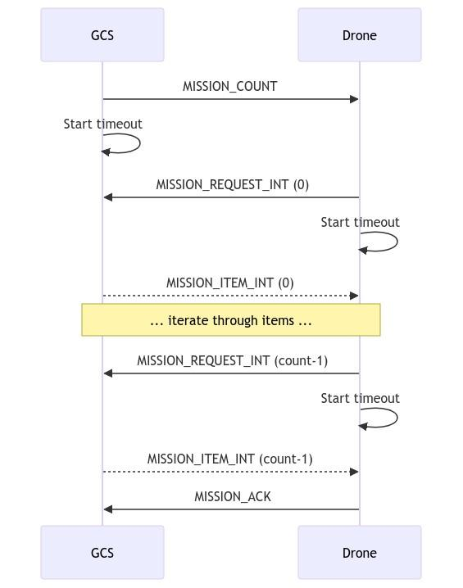
MAVLink: Microservices
Heartbeat/Connection
Mission Protocol
Parameter Protocol
Camera Protocol
Gimbal Protocol
Battery Protocol
Traffic Management
Standard Flight Modes
Time Synchronization
Open Drone ID
etc..

Slide 41
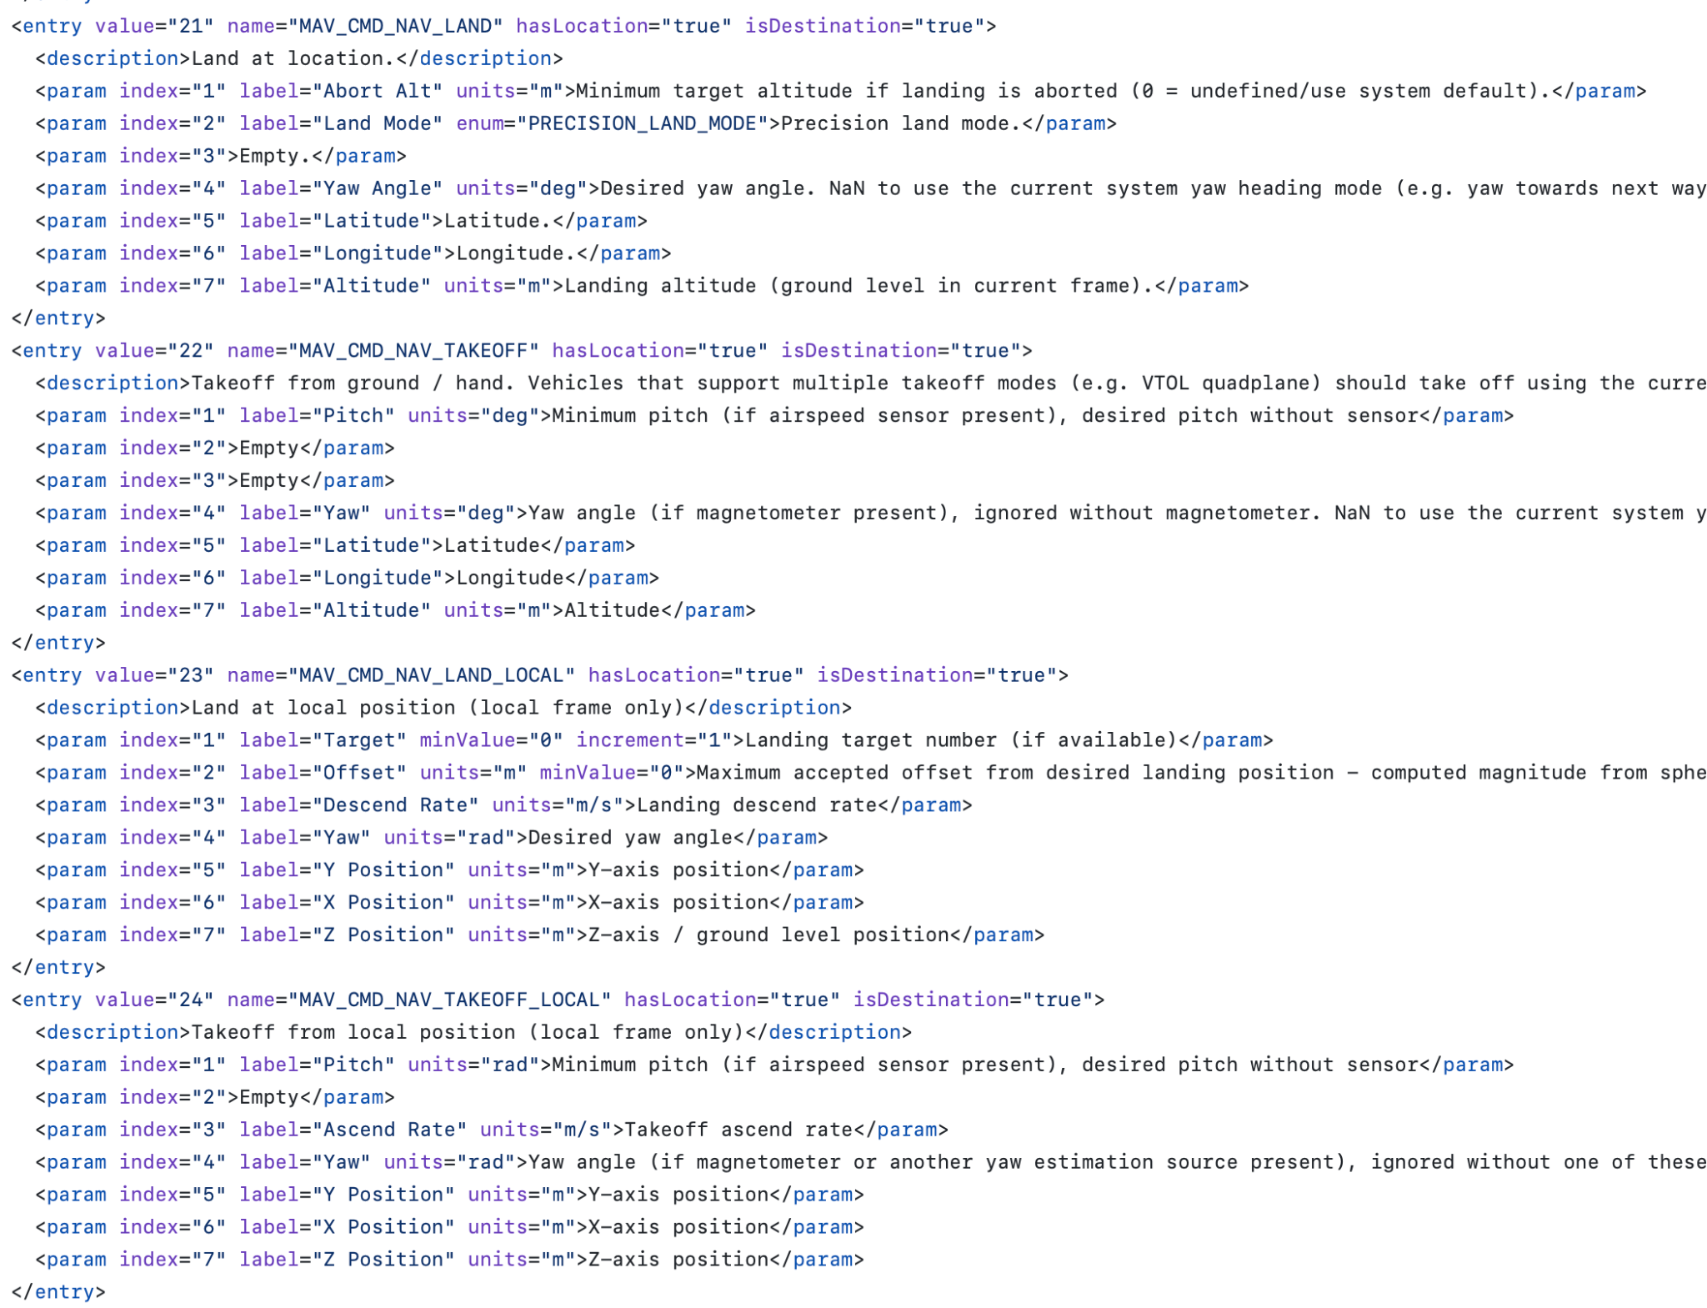
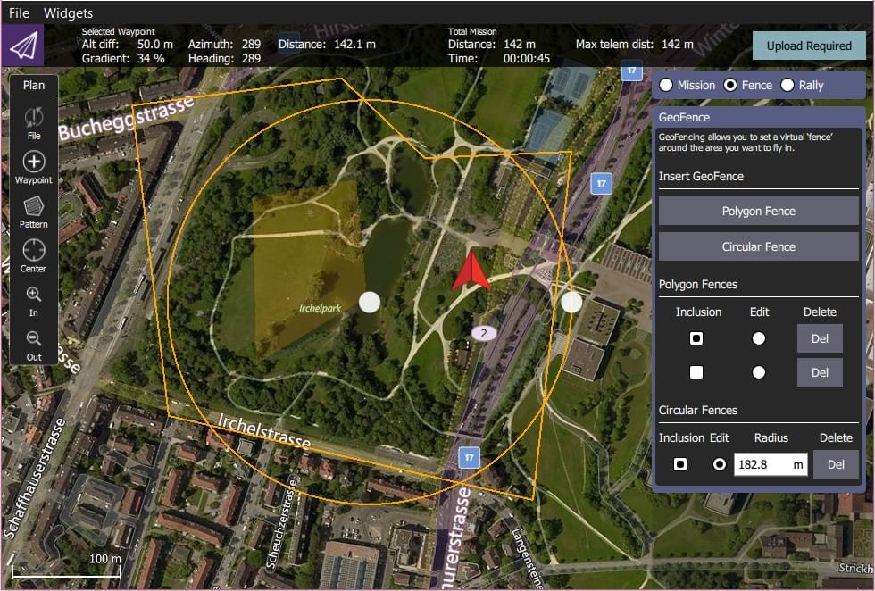
MAVLink: Ground Stations

Slide 43
MAVSDK
SDK for MAVLink
Because you writing XML is not meant for humans.
Available for the most widely used programming languages:
  C++, Swift, Python, Java, Go, JS, CSharp, Rust
Server / Client architecture
  Both can be embedded in the same library
  Server / Client communication is through gRPC
Widely used and adopted by industry
Top Features I like
Plugin Architecture
Events Interface
Error Handling
Shared Vehicle Control
Multiple resources available: example code and tutorials
Build, launch, and soar with Dronecode

Slide 45
QGroundControl
Ground Station that features a wide range of functionality from all aspects of vehicle control for setup and tuning, to mission based control. All of this thanks to MAVLink
Can be deployed to multiple platforms: Linux, Windows, macOS, Android and iOS
Vendors usually customize QGC for their end-users, allowing them to provide a fully featured Mission Control app.
Can be themed, you can remove any unwanted functionality.
Build, launch, and soar with Dronecode

Slide 46
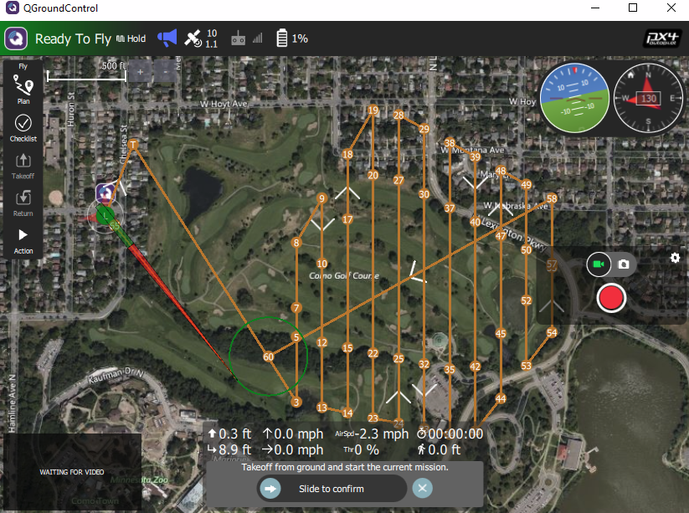
QGroundControl
Open Source Mission Planner
Fully themable interface
Support for all MAVLink compliant flight stacks
Vendor Neutral governance
Permissively licensed: Apache 2.0
Qt-based application
Cross-platform: Mobile, Tablets, Linux, Windows, and macOS
Can control every aspect of a drone, from firmware setup, to advanced mission planning

Slide 47
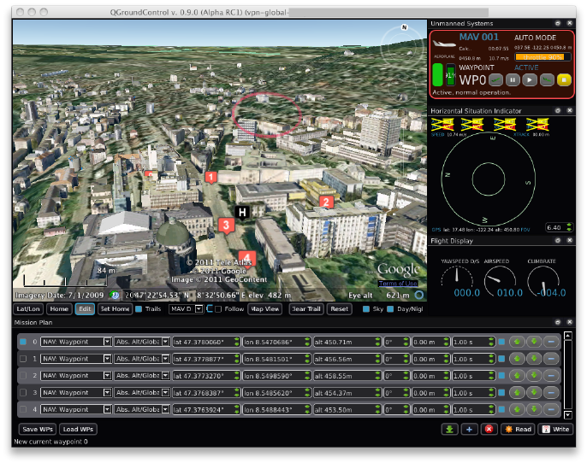
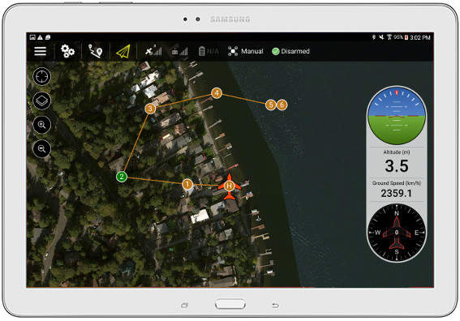

Slide 48
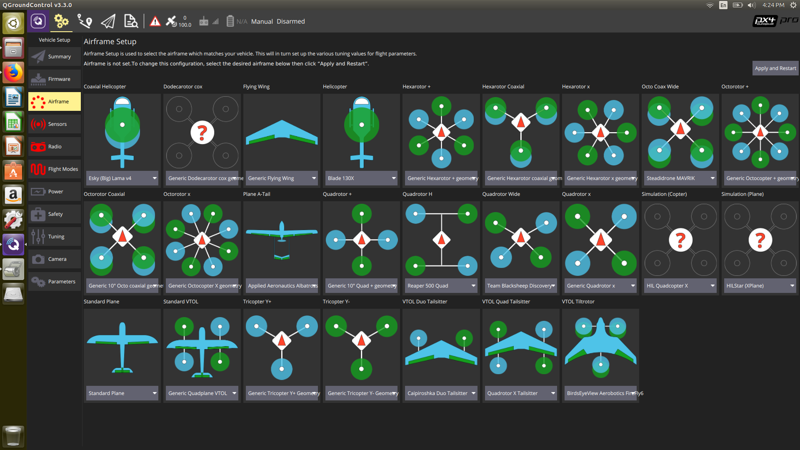
QGroundControl
Top Features I like
Full setup and control of PX4 vehicles. (Also supports other MAVLink based platforms)
Mission Planning for Autonomous Flight
Flight Map with all telemetry, waypoints and vehicle instruments.
3D Viewer
Video Streaming
Support for managing multiple Vehicles
Multi-Platform

Slide 50
PX4 Autopilot
Open Source Autopilot Stack
Developer friendly with vibrant community participation
Support for a wide range of boards and sensors
Vendor Neutral governance
Business friendly license: BSD-3
Modular architecture with a DDS-compatible middleware (uORB)
Modules are fully parallelized, and thread safe
Support for custom builds, trim what you don’t need
MAVLink
DDS / ROS 2
Modules
Middleware
Telemetry
Sensors
Actuators
RTOS

Slide 51
PX4 Autopilot
Multi-Vehicle type support
  Multicopter
  Fixed Wing
  VTOL
  Rover
  Under Surface
  Above Surface
  Balloons
  Satellites
  Jetpack
Developer Friendly Interfaces
  Flight Modes provide a set of helpers to control autonomy
  Flight Tasks allowing developers to extend flight modes
  Parameter database exposing functionality back to users
  Events interface giving developers a system-wide API for notifications
Control allocation translates thrust and torque commands into actuator commands which control motors and servos
  Controllers do not require special handling for airframe geometry
Native ROS 2 Support through DDS

Slide 52

PX4’s Stack Architecture
Developer Friendly Interfaces
  Flight Modes provide a set of helpers to control autonomy
  Flight Tasks allowing developers to extend flight modes
  Parameter database exposing functionality back to users
  Events interface giving developers a system-wide API for notifications
Control allocation translates thrust and torque commands into actuator commands which control motors and servos
  Controllers do not require special handling for airframe geometry
Native ROS 2 Support through DDS

Slide 53
PX4’s Stack Architecture
System Storage:
  Database
  Parameters
  Logging
Drivers:
  GPS
  Airspeed
  IMU
  Baro
  etc…
External Interfaces:
  MAVLink
  XRCE-DDS for ROS 2

Slide 54
PX4’s Stack Architecture
State Machine
Sensor Hub
Autonomous Flight (Navigation)
  Position Controller
  Attitude & Rate Controller
  Control Allocation
RC Handling

Slide 55
Parameter based configuration
The burden of such a generic platform falls upon our Parameter system. Parameters are stored in the filesystem. We have two types of parameters: Runtime and Boot time.
Main Concepts
Data types: float & int32_t
You can export / import parameters
YAML metadata & C/C++ API
Everything can be configurable approach
What works for us?
We give developers the tools to allow their end users to configure aspects of their system
Think of how to a pilot would define the takeoff altitude
Really powerful when paired with a ground station
Thanks to metadata we can build cool online reference lists

Slide 56


Slide 57


Control Allocation (mixing)
Control allocation in PX4 maps desired forces and torques from the controller into actuator outputs like motors or servos. It abstracts the vehicle geometry, so the same control logic works for multirotors, planes, or hybrids by handling the mixing and actuator mapping behind the scenes.

Slide 58


Slide 59

PX4’s *Internal* Flight Modes
Running realtime inside the Embedded Controller.
Position: When the sticks are released the vehicle will remain locked to a position in 3D space.
Altitude: When the sticks are released the vehicle will maintain current altitude.
Hold: Vehicle stops and hovers at its current GPS position.
Takeoff: Vehicle takes off to a specified height and waits further input.
Land: Lands vehicle at the position where the mode was engaged.
Mission: Starts a mission that was preloaded to the drone
Modes can be Manual or Autonomous
The API to create modes is “Flight Task”

Slide 60

Controller diagrams, Multicopters

Slide 61
uORB Middleware - Connecting apps!
u(Micro) Object Request Broker
It’s a really simple middleware, and arguably the top feature of PX4, at least in my opinion. It’s one of the first applications that launch on boot since most of PX4 depends on it.
Main Concepts
Messages - field information, typically reused by multiple topics
Topics - what you subscribe and publish
Modules - apps that depend on pub/sub of topics
What we like about uORB?
Fast!
DDS-like… compatible
Offers a comprehensive way to build interfaces between modules/apps
Priorities, rates, queues
Messages are defined in .msg and generated at build time (.h / .cpp)
NuttX Shell (NSH) Tooling
  ls /obj
  listener <message_name> <num_messages>
  uorb top

Slide 62


Slide 63

ROS 2 Support - DDS
Thanks to uORB middleware we can communicate directly with the ROS 2 middleware (XRCE-DDS based)
PX4 internal modules can share data with ROS 2 nodes
Agent / Client approach
Ethernet and Serial support
ROS 2 QoS Supported!

Slide 64

ROS 2 Support - Zenoh
Direct uORB ↔ ROS 2 data exchange
Uses Zenoh-pico client on PX4
Connects via TCP, UDP, or UART (multicast supported)
Works with rmw_zenoh
Topic mapping via SD card config
Experimental but ready for testing

Slide 65

ROS 2 Interface Library
C++ library bridging ROS 2 with PX4
Three high-level interfaces:
  Control → send set-points / actuate vehicle
  Navigation → feed pose / odometry
  Waypoint Missions → run full mission logic
Enables ROS 2-native modes that register with PX4 and look like built-in modes.
DDS ready
Zenoh experimental

Slide 66

External Flight Modes
External Flight Modes are Flight Modes that can be developed and executed from outside the Flight Controller and in a non-real time system.
When do External Flight Modes matter?
When you don’t need low-level access for direct motor control
When you have a compute module where you can run ROS 2
When the mode is not Safety Critical
Advantages
You don’t need to deal with low level embedded constraints and requirements
Crashing the app won’t result in a catastrophic failure
Easier to maintain outside of the PX4 codebase
Take advantage of high-level functionality like dynamic data structures, and the ROS 2 library ecosystem.
More advanced compute for greater processing

Slide 67

PX4 Simulation
Gazebo is our default simulation agent, we support both classic and modern gazebo, with multiple worlds and models to choose from.
Other Simulation Engines Supported
Gazebo Classic
AirSim
Flight Gear
jMAVSim
Gazebo Simulation Docs

Slide 68

PX4 Simulation
Gazebo is our default simulation agent, we support both classic and modern gazebo, with multiple worlds and models to choose from.
Other Simulation Engines Supported
Gazebo Classic
AirSim
Flight Gear
jMAVSim
Gazebo Simulation Docs

Slide 69


Supported Hardware Architectures
Cortex-M4, Cortex-M7 & Cortex-M7 dual-core
32 & 64 bit

Slide 70


Supported RTOS
(*Coming Soon)

Slide 71

Hardware Support
Support for more than 80 boards from 30+ manufacturers
Drivers for more than 100+ sensors
  IMU, Baro, Actuators, GPS, INS, CAN, UWB… etc.
Main Architectures Supported
  STM32 - STMicro
  Snapdragon - Qualcomm
  iMX - NXP Semiconductors
  RISCV-V

Slide 72



Official PX4 Developer Kits
DroneBlocks
$1,999.00
ModalAI
$2,749.99
Holybro
$507.99
Build, launch, and soar with Dronecode

Slide 73
Quick Break
Coming Next: Developer Environment

Slide 74
Aerial Robotics Meetup, tonight!
Tonight, 8:00 to 11:00 PM
CRAFT Beer Market, 1 Adelaide St E (short walk from the venue)
Sponsored by Dronecode. Food and drinks are on us.
Talk shop on control architectures, state estimation, and open source flight stacks with the people who actually maintain them.
Notes:
You've been stuck in a room with us all day, so come argue about EKFs over a beer tonight instead. 36 people are already in, space is limited

Slide 75
Prerequisites - environment setup - architecture overview
In this section you will
Understand the requirements for running the exercise
Set up the simulation environment
Fly a drone in Gazebo without ROS 2
Attach ROS 2 to the simulation
Echo PX4 topics in ROS 2
Visualize PX4 data with Foxglove

Slide 76
Environment Setup
REQUIREMENTS:
Install Foxglove https://foxglove.dev/download
Download and install QGC https://qgroundcontrol.com
Clone PX4 repo: https://docs.px4.io/main/en/sim_gazebo_gz/#installation-ubuntu-linux
git clone -b release/1.18 https://github.com/PX4/PX4-Autopilot.git
Prepare workspace and clone workshop repo https://github.com/Dronecode/roscon-25-workshop :
mkdir -p ~/workspaces/px4_roscon26_ws/src
cd ~/workspaces/px4_roscon26_ws/src
git clone git@github.com:Dronecode/roscon-25-workshop.git px4-roscon-workshop
cd ~/workspaces/px4_roscon26_ws
vcs import src < ./src/px4-roscon-workshop/jazzy.repos

Slide 77
Environment Setup, dockerless, Ubuntu 22.04/24.04, WSL 2
Follow PX4 simulation setup instructions https://docs.px4.io/main/en/sim_gazebo_gz/#installation-ubuntu-linux
To setup PX4 SITL build toolchain and download Gazebo Harmonic
Verify it by starting a simple simulation over Gazebo, no ROS 2 involved:
cd ~/PX4-Autopilot
make px4_sitl gz_x500
Install ROS 2 (Jazzy or Humble depending on OS version)
https://docs.ros.org/en/jazzy/Installation/Ubuntu-Install-Debs.html. Pick ros-jazzy-desktop
https://docs.ros.org/en/humble/Installation/Ubuntu-Install-Debs.html. Pick ros-humble-desktop
Install ROS 2 developer tools: sudo apt install ros-dev-tools
Install dependencies:
cd ~/workspaces/px4_roscon26_ws
source /opt/ros/jazzy/setup.bash # source /opt/ros/hummble/setup.bash
rosdep install -i --from-paths src --skip-keys OpenCV

Slide 78
Environment Setup, docker
Retrieve px4io/px4-dev-ros2-gazebo:main-jazzy docker image or build it yourself https://github.com/PX4/PX4-Autopilot/pull/28730
Start the container
cd ~/workspaces/px4_roscon26_ws/src/px4-roscon-workshop
./docker/docker_run.sh ~/PX4-Autopilot
Set HEADLESS=1 if you don’t want GUI to run
To leverage GPU acceleration, if available, refer to https://docs.px4.io/main/en/simulation/gazebo_container_gui
From inside the container, install the workspace dependencies and build the workspace
apt update
rosdep install -y -i --from-paths src --skip-keys OpenCV
source /opt/ros/jazzy/setup.bash
colcon build --symlink-install

Slide 79
PX4 - ROS 2 interaction
Notes:
Use this slide to briefly explain again how PX4 and ROS 2 interacts regardless sim / real vehicle

Slide 80

PX4 - ROS 2 interaction
Motors
Sensors
ROS 2 node
ROS 2
uart/udp
MicroXRCEAgent
PX4-enabled FCU
Companion Computer
Notes:
Now explain how it happens and where the different components are when operating on a real drone

Slide 81



PX4 - ROS 2 interaction in Simulation
Your cool ROS 2 node
GZ-transport
ROS 2
uart/udp
MicroXRCEAgent
Simulator host (posix)
Notes:
General simulation scenario now. Where px4 runs? Where is the sensors data coming from? And the actuation?

Slide 82



PX4 - ROS 2 interaction in Simulation
ROS - GZ
ros_gz
px4_msgs
px4-ros2-interface-lib
Micro-XRCE-DDS-Agent
GZ-transport
px4_roscon_workshop
Offboard demo
Custom mode demo
Aruco marker detector
Teloperation
Precision landing
Formation control
Micro XRCE DDS
Notes:
Finally, explain how this is packaged in a Docker image

Slide 83
PX4 - Gz Simulation startup
Starting Gazebo and PX4: make px4_sitl gz_{model}_{world}
E.g. make px4_sitl gz_x500
Flexible configuration: https://docs.px4.io/main/en/sim_gazebo_gz/#usage-configuration-options
Starting PX4 and gazebo from ros: px4_roscon_workshop/launch/px4.launch.py
References:
https://github.com/PX4/PX4-gazebo-models
https://docs.px4.io/main/en/sim_gazebo_gz/

Slide 84
Linking Gazebo and PX4 to ROS 2
GZ => ROS 2 connection
PX4 <=> ROS 2 connection
Inspecting PX4 topics from ROS 2
Getting TF data from PX4
Running Foxglove bridge
ros2 run ros_gz_bridge parameter_bridge /clock@rosgraph_msgs/msg/Clock[gz.msgs.Clock
MicroXRCEAgent udp4 -p 8888
ros2 topic list
ros2 topic echo /fmu/out/vehicle_status_v1
ros2 run px4_tf px4_tf_publisher --ros-args -p use_sim_time:=true
ros2 run foxglove_bridge foxglove_bridge --ros-args -p use_sim_time:=true

Slide 85
Prerequisites - environment setup - architecture overview
Now you know how
Set up the simulation environment
Fly a drone in Gazebo without ROS 2
Attach ROS 2 to the simulation
Echo PX4 topics in ROS 2
Visualize PX4 data with Foxglove

Slide 86
Quick Break
Coming Next: Control Pipelines

Slide 87
Aerial Robotics Meetup, tonight!
Tonight, 8:00 to 11:00 PM
CRAFT Beer Market, 1 Adelaide St E (short walk from the venue)
Sponsored by Dronecode. Food and drinks are on us.
Talk shop on control architectures, state estimation, and open source flight stacks with the people who actually maintain them.
Notes:
You've been stuck in a room with us all day, so come argue about EKFs over a beer tonight instead. 36 people are already in, space is limited

Slide 88
Control Pipelines (Patrik)
Understanding how high-level control can be moved from the flight controller (PX4) to the onboard computer (ROS 2).
Exploring how PX4 and ROS 2 share responsibilities for stability, autonomy, and perception-driven behavior.
Learning when and why to let ROS 2 take over command generation while PX4 ensures real-time safety and actuator control.
Why take control from the flight controller:
To implement custom autonomy, AI, or perception-based navigation.
To integrate external sensor data (LiDAR, cameras, etc.) not directly handled by PX4.
To test new control strategies without flashing or modifying flight firmware.
To coordinate multi-robot systems from a common ROS 2 framework.

Slide 89
Taking Control of the Flight Controller
Why do we want to do that?
Enable autonomous behavior and custom logic
Integrate with ROS 2 nodes for perception & planning
Test new control strategies safely in simulation
Go beyond built-in flight modes
Risks involved
Loss of failsafe protections
Unstable flight if setpoints are wrong or too slow
Direct control = direct responsibility
Always test in SITL first

Slide 90
How Can We Take Control Using ROS 2?
Offboard Mode — the classic approach
Built around MAVLink, not ROS 2
Works in C++ or Python
Great for quick testing
Old method — not ROS 2-native
https://docs.px4.io/main/en/ros2/offboard_control.html
PX4 ROS 2 Interface (External Modes)
Uses px4_ros2::ModeBase → direct PX4–ROS 2 bridge
C++, requires more experience (Python binders are available)
Supports complex behaviors and autonomy logic
Integrates PX4 safety + lifecycle hooks
Modern, flexible, ROS 2-native control
https://docs.px4.io/main/en/ros2/px4_ros2_control_interface.html

Slide 91

What's New
Python bindings — prototype modes in Python, not just C++ (great for teaching, rapid iteration) (verify exact package/API name on your slide)
Rover & VTOL support — setpoint types beyond multicopter
Direct actuator control — DirectActuatorsSetpointType and PeripheralActuatorControls for motors, servos, and payload actuators
Same registration/lifecycle model across all of the above
https://docs.px4.io/main/en/ros2/px4_ros2_control_interface

Slide 92
What's New
Let’s try the Python example
examples/python/modes/goto/example_mode_goto_py
ros2 run example_mode_goto_py goto
Let’s try the rover teleop example
ros2 launch rover_teleop rover_launch.py
ros2 run teleop_twist_keyboard teleop_twist_keyboard

Slide 93


Slide 94
Custom Modes: Mode vs Mode Executor
Mode (px4_ros2::ModeBase)
Defines how the vehicle behaves during a custom flight mode.
Inherits from px4_ros2::ModeBase
Implements:
  onActivate() / onDeactivate()
  updateSetpoint() → generates control setpoints
Uses PX4 objects (e.g. ManualControlInput, RatesSetpointType)
Registered with mode->doRegister()
Focus: control logic, what the drone does right now
Think of this as the “brain” for a single flight mode.
Mode Executor (px4_ros2::ModeExecutorBase)
Coordinates multiple modes or actions into a higher-level behavior.
Inherits from px4_ros2::ModeExecutorBase
Owns one Mode (MyMode)
Defines states → e.g. TakingOff → MyMode → RTL
Uses helper actions: takeoff(), scheduleMode(), rtl()
Registered via executor->doRegister()
Focus: mission flow, when and in what order things happen
Think of this as the “mission director” controlling the brains.
Concept | Purpose | Example
Mode | Implements a specific behavior | Manual, Teleop, Offboard-like
ModeExecutor | Sequences modes/actions | Takeoff → Custom → Land

Slide 95
Custom Mode example
Node setup
Uses NodeWithModeExecutor<CustomModeExecutor, CustomWaypoints, CustomYaw>
Launches a ROS 2 node with two custom modes and one executor
Custom Modes
CustomWaypoints
  Generates and publishes position setpoints
  Drone moves through a list of waypoints
  Calls completed() when all waypoints reached
CustomYaw
  Commands slow yaw rotation setpoints
  Tracks total rotation angle
  Finishes after one full 360° turn
Mode Executor
Implements a small state machine:
Takeoff → CustomWaypoints → CustomYaw → Land → WaitUntilDisarmed
Calls high-level actions (takeoff(), land(), waitUntilDisarmed())
Uses scheduleMode() to run each custom mode in sequence
Control Flow
Each step triggers a callback when done
On success → moves to the next state
Logs status at each transition
Takeaway
Combines multiple ROS 2-native modes into one autonomous flow
Clean separation:
  Modes → what to do
  Executor → when to do it
No MAVLink commands needed directly
Robust, modular, and fully extensible for new behaviors

Slide 96

Custom Mode Video

Slide 97
Custom mode exercises
Problems
GOTO/Trajectory Setpoint replacement
Explore what happens if you want to change the Mode order

Slide 98
Break (30 min)
Coming Next: Mode Executors and Multi-Vehicle Control

Slide 99
Mode Executors
VTOL = two regimes in one airframe: multicopter (MC) hover and fixed-wing (FW) cruise, plus the transitions between them
Pick setpoint types — MC setpoints in hover, forward-flight setpoints in cruise; don't reuse an MC-only type in FW
MC takeoff → transition to FW → cruise / run custom FW mode → transition back to MC → land

Slide 100
Custom Modes: Mode vs Mode Executor
Mode (px4_ros2::ModeBase)
Defines how the vehicle behaves during a custom flight mode.
Inherits from px4_ros2::ModeBase
Implements:
  onActivate() / onDeactivate()
  updateSetpoint() → generates control setpoints
Uses PX4 objects (e.g. ManualControlInput, RatesSetpointType)
Registered with mode->doRegister()
Focus: control logic, what the drone does right now
Think of this as the “brain” for a single flight mode.
Mode Executor (px4_ros2::ModeExecutorBase)
Coordinates multiple modes or actions into a higher-level behavior.
Inherits from px4_ros2::ModeExecutorBase
Owns one Mode (MyMode)
Defines states → e.g. TakingOff → MyMode → RTL
Uses helper actions: takeoff(), scheduleMode(), rtl()
Registered via executor->doRegister()
Focus: mission flow, when and in what order things happen
Think of this as the “mission director” controlling the brains.
Concept | Purpose | Example
Mode | Implements a specific behavior | Manual, Teleop, Offboard-like
ModeExecutor | Sequences modes/actions | Takeoff → Custom → Land

Slide 101
VTOL executor exercise
workspaces/px4_roscon26_ws/src/px4-roscon-workshop/px4_roscon_workshop/vtol_executor
Problems
Change land to RTL

Slide 102

VTOL executor video

Slide 103

Quick video - MC mode executor

Slide 104
Multi-Vehicle Control (Patrik & Beniamino)
Each PX4 instance runs its own uXRCE-DDS client with a unique instance ID / topic namespace; one agent bridges them all into the ROS 2 graph
Run one executor node per vehicle, scoped to that vehicle's ROS 2 namespace (e.g. /px4_1, /px4_2) — the library binds to the matching instance
Add a coordinator/orchestrator node above the executors for fleet logic: task allocation, formation, synchronized takeoff, deconfliction
Executors handle per-vehicle safety and sequencing; the orchestrator handles inter-vehicle decisions — clean separation of concerns
SITL: launch N PX4 instances with distinct instance IDs + DDS namespaces; all appear in QGC and Gazebo together

Slide 105
Notes:
VIDEO

Slide 106
Multi-Vehicle Control exercise
workspaces/px4_roscon26_ws/src/px4-roscon-workshop/px4_roscon_workshop/formation_control
Problem
Formation Control: make it an executor that auto takes off and then transit to formation control (this could actually be how we present formation control).

Slide 107
Lunch Break (60 min)
Coming Next: Perception & Applications

Slide 108
Aerial Robotics Meetup, tonight!
Tonight, 8:00 to 11:00 PM
CRAFT Beer Market, 1 Adelaide St E (short walk from the venue)
Sponsored by Dronecode. Food and drinks are on us.
Talk shop on control architectures, state estimation, and open source flight stacks with the people who actually maintain them.
Notes:
You've been stuck in a room with us all day, so come argue about EKFs over a beer tonight instead. 36 people are already in, space is limited

Slide 109


Application Example: Search And Rescue (SAR) modes
Scenario
SAR swarm: a rover is the active rescuer, drones extend its "instruments and perspective."
V-Sweep = wide aerial scan while it moves
Orbital = 360° when it stops to investigate
V-Sweep
Orbital
Didactic example only, not a search-and-rescue readiness demo

Slide 110

SAR modes architecture + SAR executor (Auto)
Solid = inherits & Dashed = executor schedules (holds references, not a subclass)

Slide 111
SAR Modes vs Formation Control
SAR Modes
Target relative: every drone tracks one external target (rover)
Reads a single rover pose (/rover/pose)
Formation: V-Sweep wedge or Orbital circle
No inter-drone awareness (yet)
Formation Control
Peer-to-peer: every drone tracks its neighbors
Reads TF transforms between vehicles
Formation: Fixed
Spring-based separation controller
Shared infrastructure, different brain

Slide 112

Quick Video

Slide 113
Exercises
sar_modes:
  Verify the formation actually re-arranges when you flip modes manually in QGC
  Build a third SAR mode of your own
sar_auto_executor:
  Verify in SAR (Auto) that QGC switches on its own as the rover moves, with the console open alongside to watch the executor’s state transitions
  Build either a take-off step for the executor, or take-off plus a state driven by rover’s behavior (e.g. stays still for t seconds)

Slide 114

Gimbal control
Three axis gimbal system
yaw -> roll -> pitch
Simulated in gazebo by the vtol_gimbal model
Low level controlled in PX4 SITL by the gz_bridge
  Supports MAVLink Gimbal V2 protocol
  Support direct control over gimbal_controls uorb topic
We will control the gimbal from ROS 2 directly publishing on /fmu/in/gimbal_controls

Slide 115
Perception & Applications
Build a perception pipeline for ArUco marker landing and LiDAR mapping
Demo vision-guided precision landing
Architecture diagrams and code snippets

Slide 116

Aruco Marker detection
What is an ArUco Marker?
A binary square fiducial marker used for camera pose estimation.
Encodes a unique ID that can be easily detected in images.
Used to determine position and orientation of objects relative to a camera.
Why Use ArUco Markers
Fast and lightweight — works in real time on CPUs.
Highly reliable under varied lighting and partial occlusion.
No training data required, unlike AI-based object detection.
Deterministic performance — consistent and easy to debug.
Why OpenCV (vs. AI)
Open-source and widely supported in ROS and C++.
Low computational cost — ideal for embedded and robotics systems.
Easy integration with camera calibration and PnP solvers.
Predictable results without needing neural network inference.
3D Coordinate Frame Visualization
The 3D axes (X, Y, Z) show the marker’s orientation in space.
Allows intuitive visualization of camera–marker geometry.
Essential for pose estimation, control, and navigation tasks.
Helps debug spatial alignment in simulation and real-world setups.

Slide 117

Aruco Marker detection
Step | Description | Output
Image Acquisition | Subscribes to /camera and /camera_info | Raw RGB + calibration data
Marker Detection | Detects marker corners and IDs using OpenCV ArUco. | Marker corner pixel coords
Undistortion | Corrects corner coordinates using camera intrinsics. | Undistorted 2D points
Pose Estimation | Solves PnP to get marker position and orientation. | tvec, rvec
Pose Conversion | Converts rotation to quaternion for ROS compatibility. | PoseStamped message
Annotation & Publish | Draws axes, overlays text, publishes processed image and target pose. | /image_proc, /target_pose

Slide 118

Aruco Marker exercise
Implement a ROS 2 subscription that verifies the size of a detected ArUco marker using the distance measured by a rangefinder.
In this exercise, we estimate the real-world size of a detected ArUco marker using only the camera image, its intrinsic parameters, and the vehicle's measured altitude. Show this estimated marker size on the annotated image.
Hint: https://docs.px4.io/main/en/msg_docs/VehicleLocalPosition

Slide 119

Quick video

Slide 120
Teleoperation & Lidar Scanning
Teleoperation Overview
Direct control of the drone via joystick or keyboard (Twist commands).
Integration with PX4 through ROS 2 topics (/cmd_vel → PX4 setpoints).
Supports manual navigation in indoor/outdoor environments.
Enables real-time response to operator inputs.
Can be combined with autonomous routines for hybrid control.
LiDAR Scanning Overview
Collects high-resolution 3D point cloud data of the environment.
Provides obstacle detection and mapping capabilities.
Uses ROS 2 sensor messages (sensor_msgs::PointCloud2) for integration.
Supports real-time visualization in tools like RViz or Foxglove Studio.
Useful for mapping, inspection, and SLAM experiments.

Slide 121
Teleoperation & Lidar Scanning
Mode with Executor
Takeoff state->TeleOperation->Land
Teleoperation
Teleop_twist_keyboard
ENU/NED conversion
Holonomic control
Lidar Scan
2d laserscan is mounted on the drone
Live visualization on Foxglove

Slide 122
Teleoperation & Lidar Scanning exercise
Navigate the drone to the target in Foxglove using teleoperation. Do not use the Gazebo simulation—rely solely on the LiDAR (laser scan) data for guidance.
Hint: Observe and record a few key waypoints along the path; these will be useful for a subsequent exercise. https://docs.px4.io/main/en/msg_docs/VehicleLocalPosition

Slide 123

Quick video

Slide 124

Precision Land - Mode
Precision landing is the process of autonomously guiding a drone to land at a specific target (e.g., a marker or pad) with high accuracy, using onboard sensors (like cameras or LiDAR) to detect and track the target.
Key Features in this Implementation:
Uses Aruco markers as landing targets.
Performs spiral search pattern if the target is not immediately visible.
Maintains approach altitude, then descends once target is acquired.
XY motion uses a velocity controller with proportional–integral (PI) gains.
Uses land detection feedback to confirm landing success.
The drone must convert target measurements from the camera’s frame (optical) to the drone’s local NED (North-East-Down) frame.
Transform Steps in Code:
Convert Aruco tag pose from optical frame to NED frame using a rotation matrix.
Transform tag position relative to the drone body frame.
Transform to world frame by combining drone position & orientation (affine transform).

Slide 125

Quick video

Slide 126
Precision Land on moving target
px4_roscon_workshop/precision_land/landing_on_moving_target.md

Slide 127
Quick Break
Coming Next: Precision Landing

Slide 128
Aerial Robotics Meetup, tonight!
Tonight, 8:00 to 11:00 PM
CRAFT Beer Market, 1 Adelaide St E (short walk from the venue)
Sponsored by Dronecode. Food and drinks are on us.
Talk shop on control architectures, state estimation, and open source flight stacks with the people who actually maintain them.
Notes:
You've been stuck in a room with us all day, so come argue about EKFs over a beer tonight instead. 36 people are already in, space is limited

Slide 129
Teleoperation & Precision Land Exercise
Integrate all the concepts from today. Create a ROS2 package with a Mode Executor for Precision Landing and perform a precision landing in the maze we explored, using teleoperation. Incorporate the custom waypoints you recorded along the way (Create a CustomWaypoints Mode).
Hint: You can start by copying the Custom Mode package. Replace CustomYaw with PrecisionLand and add the waypoints you collected earlier.

Slide 130

Quick video

Slide 131
Quick Break
Coming Next:
SIM 2 Real, Q&A Resources & Show and Tell

Slide 132
Aerial Robotics Meetup, tonight!
Tonight, 8:00 to 11:00 PM
CRAFT Beer Market, 1 Adelaide St E (short walk from the venue)
Sponsored by Dronecode. Food and drinks are on us.
Talk shop on control architectures, state estimation, and open source flight stacks with the people who actually maintain them.
Notes:
You've been stuck in a room with us all day, so come argue about EKFs over a beer tonight instead. 36 people are already in, space is limited

Slide 133
From simulation to real vehicles: Safety First
Prop guards (indoor in particular)
Geofence
Extensive pre-flight checklist
Always inspect the vehicle
Configure the failsafes

Slide 134
SIM vs REAL
SIM
Timing is of relative importance
ROS 2 nodes run on high performance hosts
No startup issues
No PX4-ROS 2 comms issues
MAVLink always available
REAL
Timing is of GREAT importance
ROS 2 nodes run on low/mid performance hosts
Startup can be critical
PX4-ROS 2 comms over serial can cause bandwidth issues
MAVLink might not be available

Slide 135

Hardware Architecture
PX4 enabled flight controller + Companion computer
All in same chip
All in same package
Splitted architectures

Slide 136
PX4 - ROS 2 transport layer selection
 | SERIAL | UDP
Support zenoh | NO | YES
Price | Cheaper | More expensive
Bandwidth | Limited | YES
MAVLink | Requires second serial | Included
Isolation | Intrinsic | Depends on network

Slide 137
Q&A, Resources & Hardware Show-and-Tell
Open discussion and troubleshooting tips
Review of key resources (links provided)
Demo table with flight controllers, companion computers, and sensors

Slide 138
Open Lab & Individual Consultations
One-on-one help with exercises
Lightning talk

Slide 139
Resources
Community
Meetings (dev call)
Discord
Forums
Github (PX4, Dronecode, MAVLink, Pixhawk)
Website
Youtube
Social media (linkedin, x)

Slide 140
Kahoot

Slide 141
Aerial Robotics Meetup, tonight!
Tonight, 8:00 to 11:00 PM
CRAFT Beer Market, 1 Adelaide St E (short walk from the venue)
Sponsored by Dronecode. Food and drinks are on us.
Talk shop on control architectures, state estimation, and open source flight stacks with the people who actually maintain them.
Notes:
You've been stuck in a room with us all day, so come argue about EKFs over a beer tonight instead. 36 people are already in, space is limited

