Slide 1
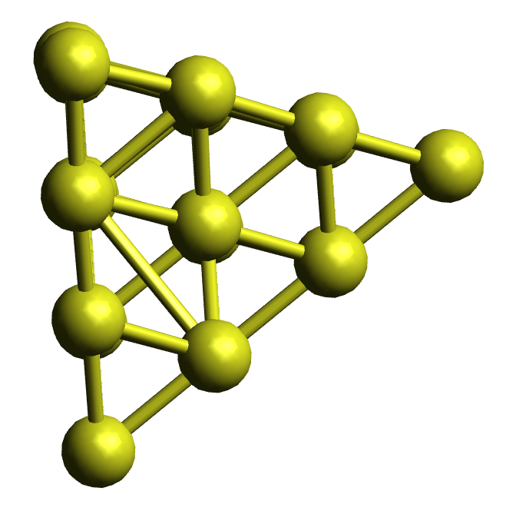
K_{L}
K_{R}
e₁

Slide 2
K
h
K
e₀
e₀

Slide 3
e₂
K
K
h
e₁

