Slide 1

Amazon Redshift
Data lakes and Machine Learning Capabilities
CSIT 565
Professor: Aijuan Dong
Author: Brandon Lasher
Email: bl7@hood.edu

Slide 2
Overview
Project description
What is Amazon Redshift?
Data Lakes
AWS Lake Formation
AWS Glue
Redshift Machine Learning Demo
Summary

Slide 3
Project Description
Goals
Learn about the different AWS services and how they interact
Learn how ML models are integrated into Amazon Redshift
Create an end-to-end implementation from data storage to application of an ML model in the AWS and Amazon Redshift environment

Slide 4
What is Amazon RedShift?
Amazon’s Cloud Data Warehousing platform
Divided into clusters, each clusters is made of one or more compute nodes.
If a cluster has at least 2 compute nodes, a leader node coordinates the operations
The leader note also manages interactions with the client
Warehouse data is stored in a separate storage tier Redshift Managed Storage (RMS).
This allows the scaling to the petabyte level using Amazon S3 storage
A cluster contains one or mode databases. User data is stored on the compute nodes.
“Amazon Redshift is optimized for high-performance analysis and reporting of very large datasets.”

Slide 5
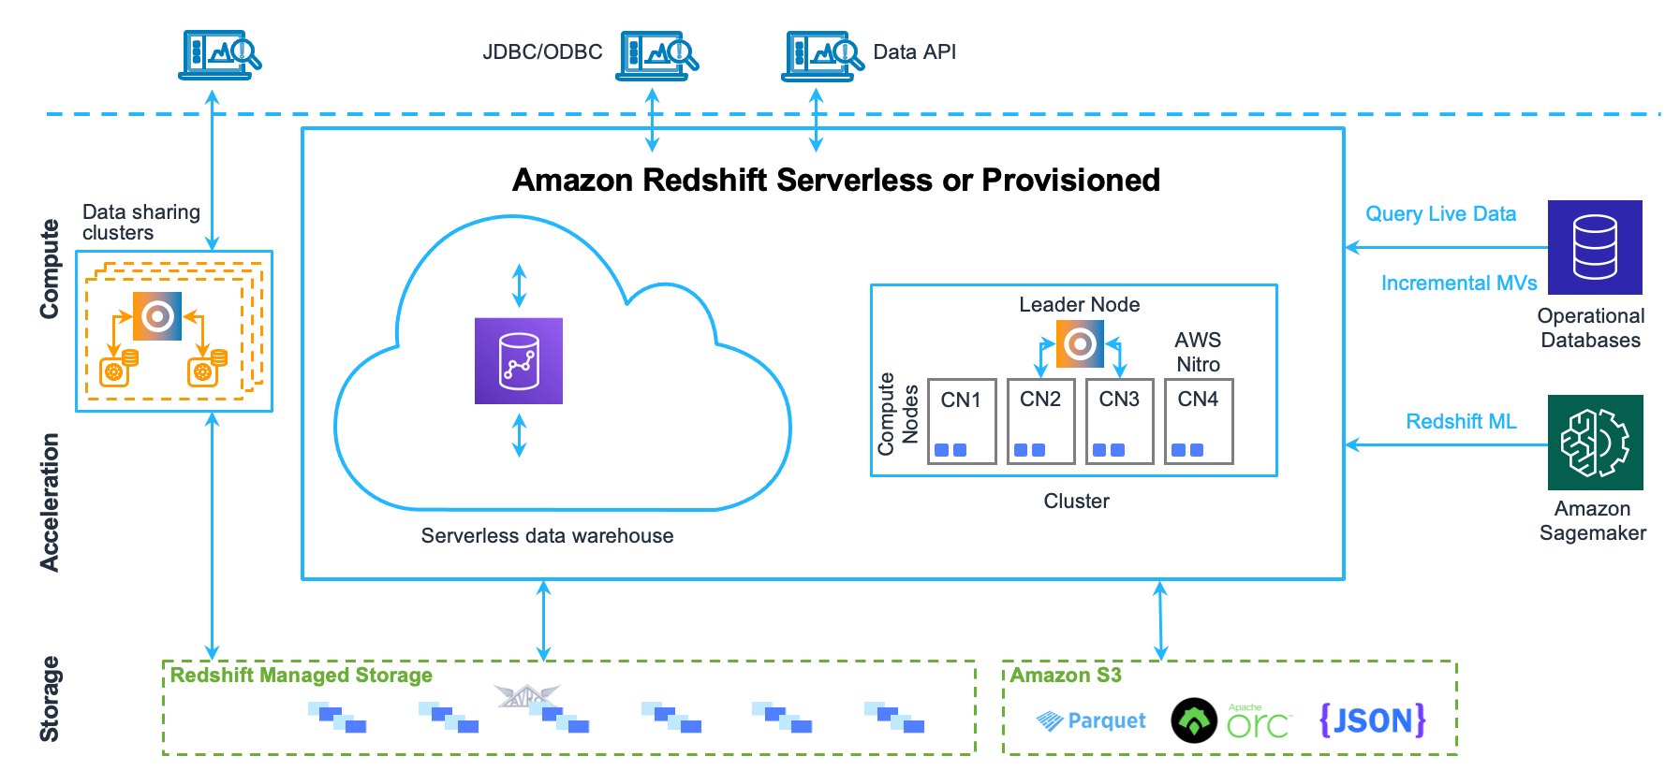
What is Amazon RedShift?

Slide 6
What is Amazon RedShift?
Storage
Utilizes columnar storage as it drastically reduces the overall disk I/O requirements and reduces the amount of data you need to load from the disk.
Since each block holds the same type of data, block data can use a compression scheme selected specifically for the column data type, further reducing disk space and I/O.
Amazon Redshift uses a block size of 1 MB, to further reduces the number of I/O requests needed to perform any database loading or other operations that are part of a query.

Slide 7
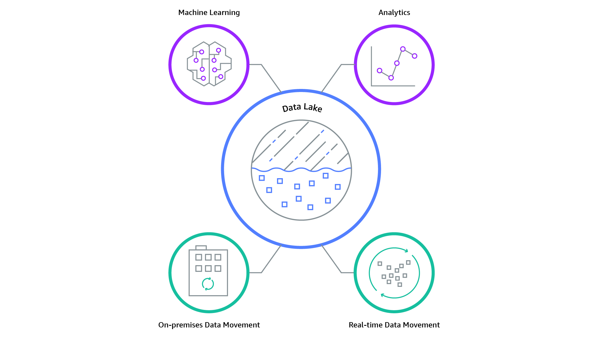
What is a Data Lake?
A data lake is a centralized repository that allows you to store all your structured and unstructured data.
Data can be stored in its raw format
Data still needs to be cataloged and labeled
Amazon Simple Storage Service (Amazon S3) is typically used in AWS applications as the data store location.

Slide 8
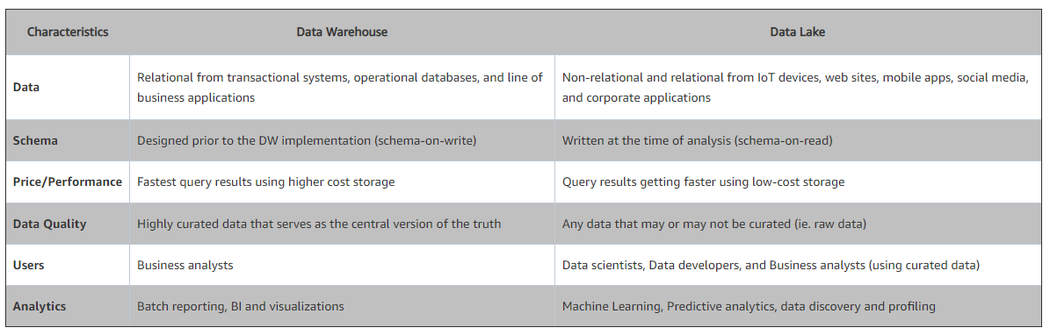
What is a Data Lake?

Slide 9
AWS Lake Formation
AWS tool to import and catalog new data into a data lake
Features
Data can be clean and reformatted
Applies encryption and access control
Optimization of partitions
Uses Crawlers to catalog and scan data

Slide 10
AWS Glue
AWS Glue is a utility services that allow facilitates the passing of data between the different AWS services
Can automatically trigger transfers between the services
Can apply formatting and data cleaning
Amazon S3
Data Lake
AWS Glue
Amazon Redshift

Slide 11
Redshift Support for Machine Learning
Redshift supports ML functions directly in the SQL interface.
To utilize ML functions user policies, have to be setup to connect to Amazon SageMaker, Amazon S3 and Redshift.
Redshift allow the creation of models which then can be stored as SQL objects.
Once a model is created and trained it can be used to make predictions about similar data.

Slide 12
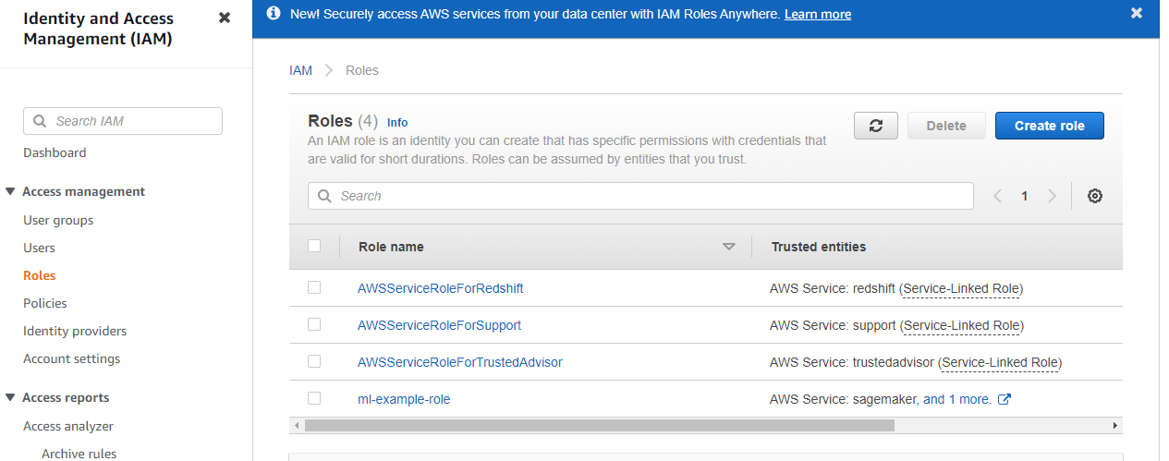
Redshift ML Demo - IAM
Creation of Role in Identity and Access Management (IAM)
Click roles on the left-hand side.

Slide 13
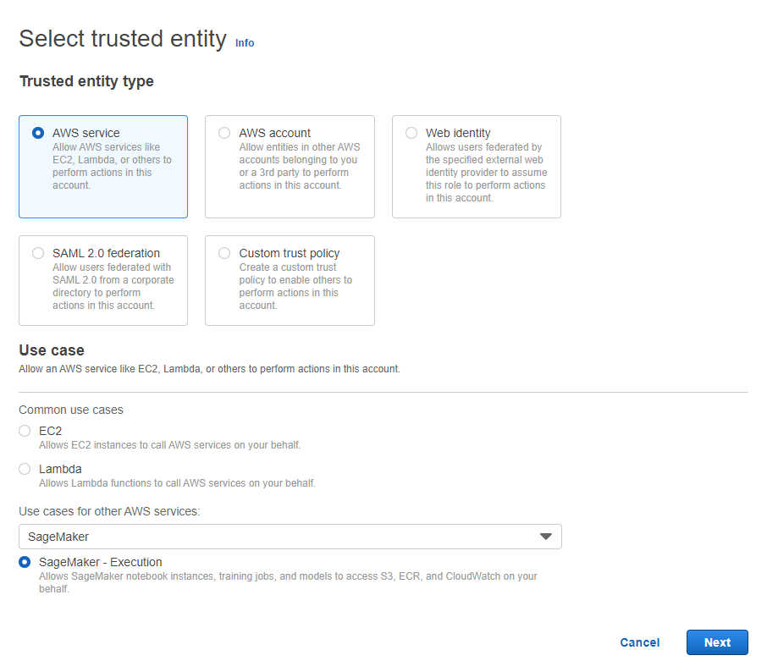
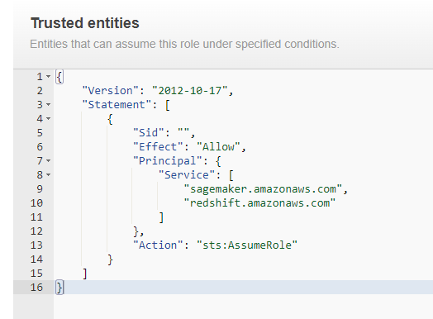
Redshift ML Demo - IAM
Create Role
Modify Trusted Entities

Slide 14
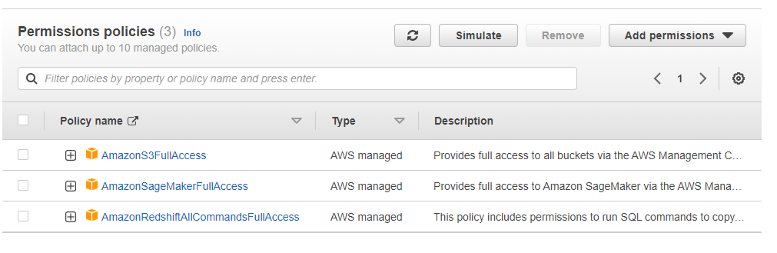
Redshift ML Demo - IAM
Create the Role
Edit the role and add two additional permissions
AmazonS3FullAccess
AmazonRedshiftAllCommandsFullAccess

Slide 15
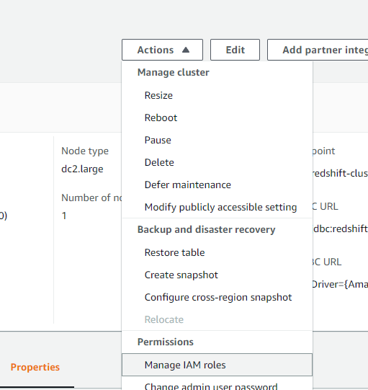
Redshift ML Demo – Cluster configuration
Associate the role on the cluster by selecting Actions, Manage IAM roles
Choose the role you created and click associate

Slide 16
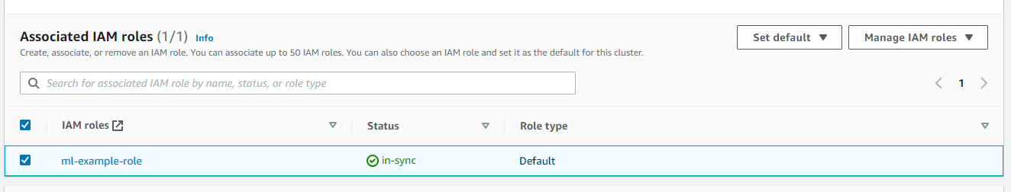
Redshift ML Demo – Cluster configuration
Set the newly associated role as the default
This is for ease of coding; it is possible to call the role directly in the ML queries
Properties -> Associated IAM roles
Select the role you just added and set as default

Slide 17
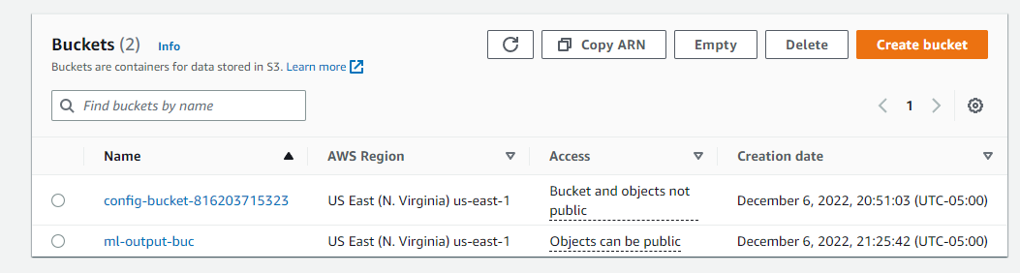
Redshift ML Demo – S3 configuration
Create a new bucket where the model will be stored

Slide 18
Redshift ML Demo – ML implementation
Go to Cluster information and Open Query Editor V2
From here you will be able to create a notebook to enter the following queries
/*Create dist table*/
DROP TABLE IF EXISTS customer_activity;
CREATE TABLE customer_activity (
state varchar(2),
account_length int,
area_code int,
phone varchar(8),
intl_plan varchar(3),
vMail_plan varchar(3),
vMail_message int,
day_mins float,
day_calls int,
day_charge float,
total_charge float,
eve_mins float,
eve_calls int,
eve_charge float,
night_mins float,
night_calls int,
night_charge float,
intl_mins float,
intl_calls int,
intl_charge float,
cust_serv_calls int,
churn varchar(6),
record_date date
);
/*Copy CSV file into table dist table*/
COPY customer_activity
FROM 's3://redshift-downloads/redshift-ml/customer_activity/'
REGION 'us-east-1' IAM_ROLE default
FORMAT AS CSV IGNOREHEADER 1;
Create the table which will reside in redshift
Copy the data from outside source into the table

Slide 19
Redshift ML Demo – ML implementation
Build the model
Model Name
CREATE MODEL customer_churn_auto_model
FROM
(
SELECT state,
account_length,
area_code,
total_charge/account_length AS average_daily_spend,
cust_serv_calls/account_length AS average_daily_cases,
churn
FROM customer_activity
WHERE record_date < '2020-01-01'
)
TARGET churn FUNCTION ml_fn_customer_churn_auto
IAM_ROLE default SETTINGS (
S3_BUCKET 'ml-output-buc'
);
Setup the features which will be used to train the model
Target data, model type, and storage location

Slide 20
Redshift ML Demo – ML implementation
Check the status of the model using
SHOW MODEL customer_churn_auto_model;
It will return a table with the information about the model
Key Value
Model Name customer_churn_auto_model
Schema Name public
Owner awsuser
Creation Time Wed, 07.12.2022 04:06:38
Model State READY
validation:binary_f_beta 0.368351
Estimated Cost 10.436314
TRAINING DATA:
Query SELECT STATE, ACCOUNT_LENGTH, AREA_CODE, TOTAL_CHARGE/ACCOUNT_LENGTH AS AVERAGE_DAILY_SPEND, CUST_SERV_CALLS/ACCOUNT_LENGTH AS AVERAGE_DAILY_CASES, CHURN
FROM CUSTOMER_ACTIVITY
WHERE RECORD_DATE < '2020-01-01'
Target Column CHURN
PARAMETERS:
Model Type mlp
Problem Type BinaryClassification
Objective F1
AutoML Job Name redshiftml-20221207040638573674
Function Name ml_fn_customer_churn_auto
ml_fn_customer_churn_auto_prob
Function Parameters state account_length area_code average_daily_spend average_daily_cases
Function Parameter Types varchar int4 int4 float8 int4
IAM Role default-aws-iam-role
S3 Bucket ml-output-buc
Max Runtime 5400
Will indicate when the model is done

Slide 21
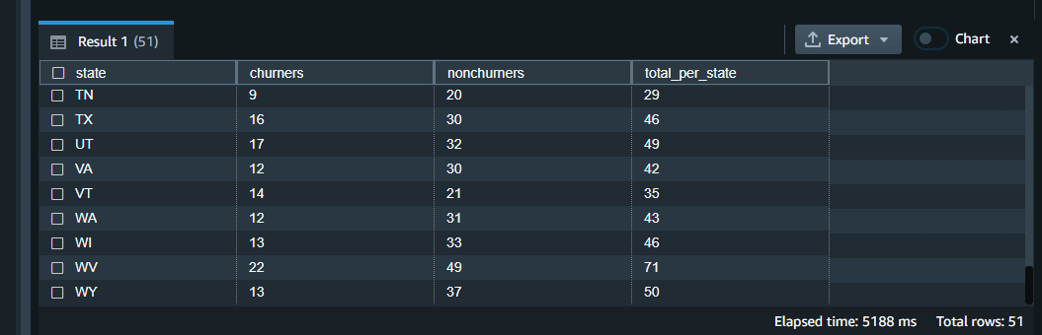
Redshift ML Demo – ML implementation
To run a prediction
WITH predicted AS (
SELECT
state,
ml_fn_customer_churn_auto(
state,
account_length,
area_code,
total_charge / account_length,
cust_serv_calls / account_length
) :: varchar(6) AS active
FROM
customer_activity
WHERE
record_date > '2020-01-01'
)
SELECT
state,
SUM(
CASE
WHEN active = 'True.' THEN 1
ELSE 0
END
) AS churners,
SUM(
CASE
WHEN active = 'False.' THEN 1
ELSE 0
END
) AS nonchurners,
COUNT(*) AS total_per_state
FROM
predicted
GROUP BY
state
ORDER BY
state;

Slide 22
Redshift ML Demo - Other Demos
Other ML demos can be found at:
https://docs.aws.amazon.com/redshift/latest/dg/tutorials_for_amazon_redshift_ml.html
Other Demo topics include
Remote inference
K-means
Multi-class classification
Various regression models

Slide 23
Summary
In this project I had hoped to build an end-to-end demonstration from data storage to application of an ML model.
I was not able to complete the full task due to its large scope.
I also had a very difficult time setting up the roles and policies to allow ML to run on the redshift cluster
This process shows how data can be captured and stored in a data lake, by any number of devices, and then processed and applied to a ML model to do a prediction.
The process discussed can be applied to real world data captured in real time by any number of methods, and that data can be easily and automatically fed to an ML model.

Slide 24
References
Redshift Developers Guide
https://docs.aws.amazon.com/redshift/latest/dg/welcome.html
Amazon Solutions
https://aws.amazon.com/solutions/implementations/data-lake-solution/
AWS Dojo
https://aws-dojo.com/

Slide 25
Thank you!

