Slide 1

Buffalo River Networks-Creating a Neural Network for Predicting Water Quality from Precipitation
Riley Blasiak
CIE 500-Xudong Fan
5/5/2025

Slide 2
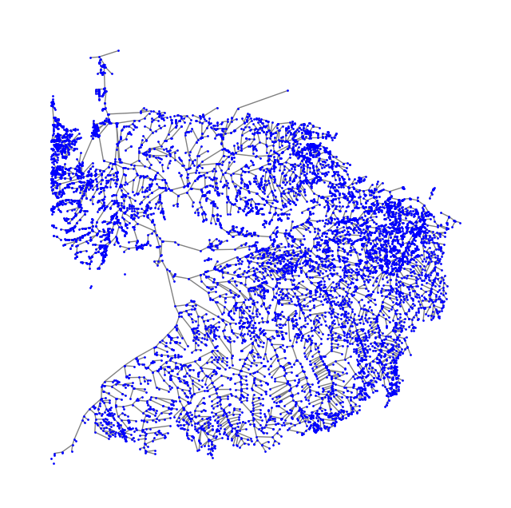
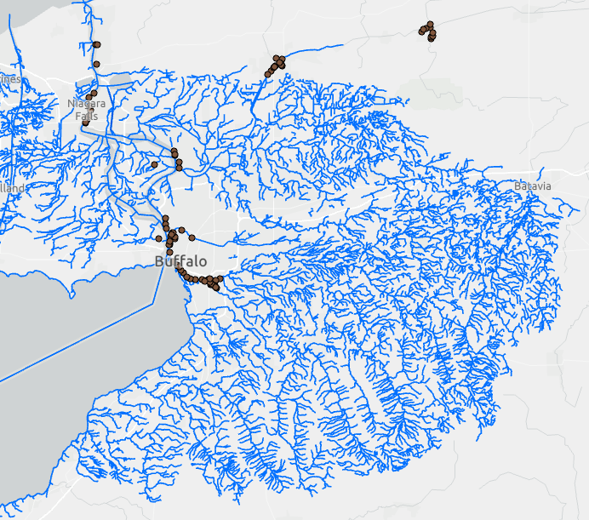
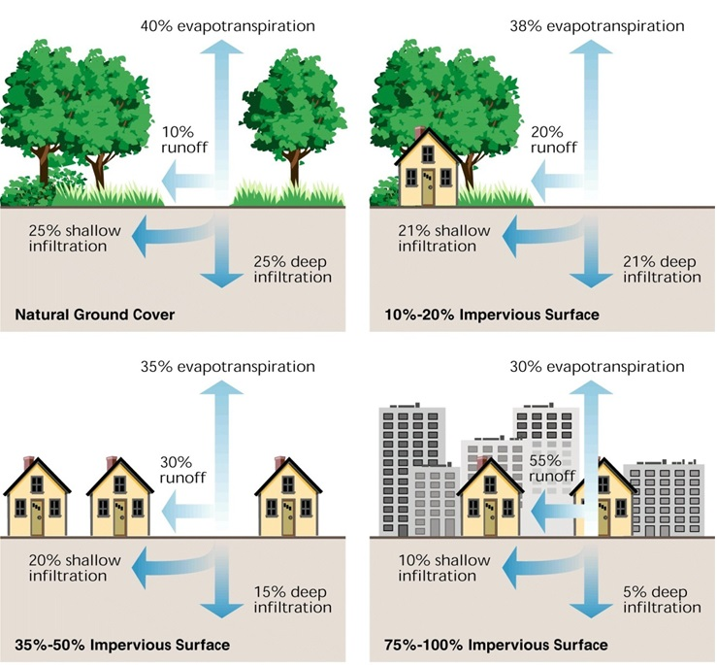
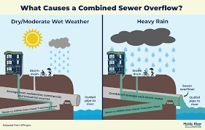
Background
Buffalo’s River water quality is highly dependent on precipitation
Runoff
Combined Sewer Overflows
https://www.google.com/url?sa=i&url=https%3A%2F%2Fmegamanual.geosyntec.com%2Fnpsmanual%2Fsectionintrourbanstormwaterrunoff.aspx&psig=AOvVaw2wUGs7K8qJCehLzKEhkP_V&ust=1746543322747000&source=images&cd=vfe&opi=89978449&ved=0CBoQ3YkBahcKEwjA-qmLy4yNAxUAAAAAHQAAAAAQCg

Slide 3
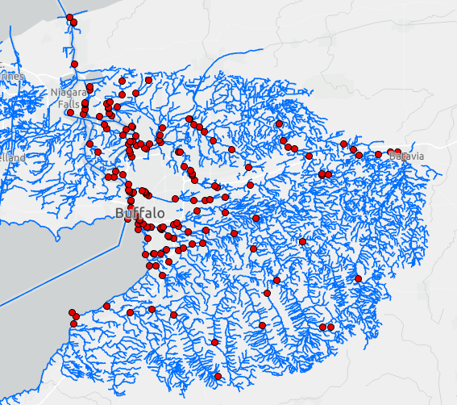
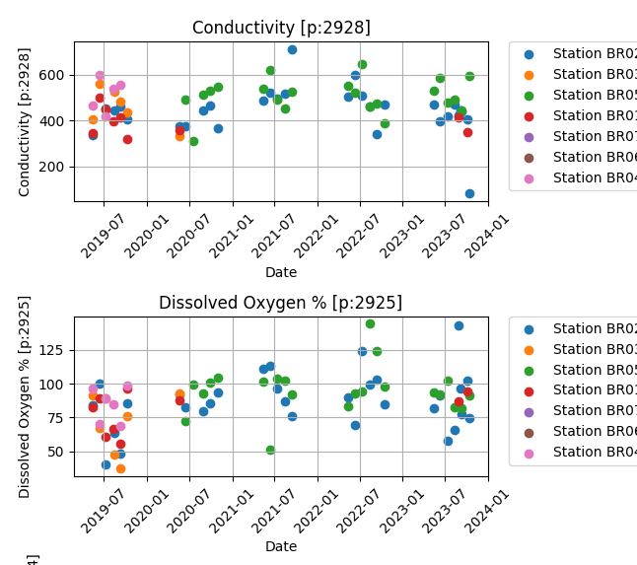
Data Collection
Buffalo Niagara Waterkeeper river water quality data

Slide 4
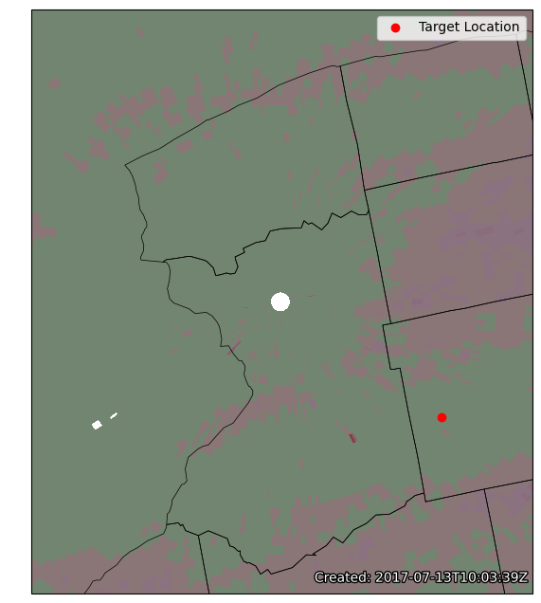
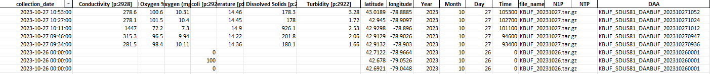
Data Collection
NEXRAD L3 radar data-from NOAA
For now, we used DAA data subcategory (Storm total Precipitation inch).
Pulled a single point value for each location and each time
Used MetPy to read these data files [1]

Slide 5
Research Question/ Motivation
How can we develop a Neural Network to predict water quality variables from a variable that is consistent across the study area?
For this project we are using storm total precipitation as our consistent variable.
With consistent parameters and data throughout the network we can create a Graphical Neural Network for the river systems which will be useful for predicting water quality, and Combined sewer overflows.
How can we develop a Neural Network to predict water quality variables from a variable that is consistent across the study area?
For this project we are using storm total precipitation as our consistent variable.

Slide 6
Creating the Neural Network
Parameters of interest
Scale features and targets
Split into training and testing set
3 hidden layers with p-> 100, 100->60, 60->1 neurons using ReLU activation
Create batches to train and test model
Train model
Evaluate model performance on test set
Check unscaled predictions vs actual data
1 | Precipitation
2 | Turbidity
3 | Dissolved oxygen %
4 | Conductivity
5 | TDS
6 | Latitude
7 | Longitude
8 | Temperature

Slide 7
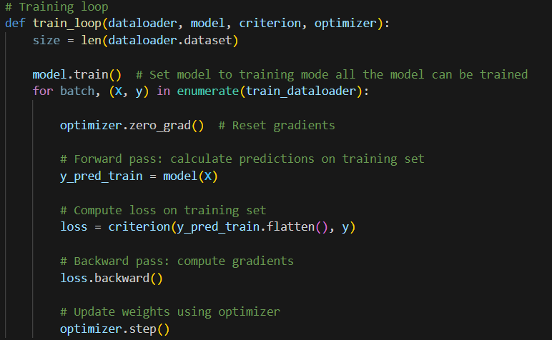
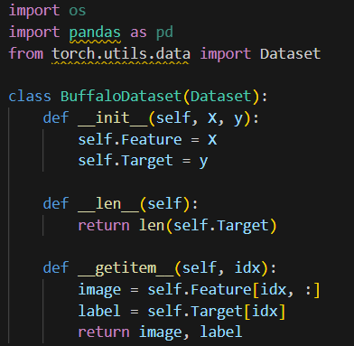
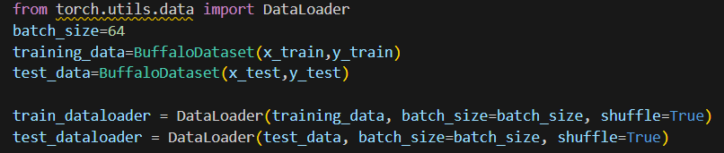
Batch creation

Slide 8
Fine Tuning the Neural Network
1 | Precipitation
2 | Turbidity
3 | Dissolved oxygen %
4 | Conductivity
5 | TDS
6 | Latitude
7 | Longitude
8 | Temperature
First, we want to determine which parameter we are predicting
Start with all other parameters are predicting the one, and cut down until accuracy stops improving
Table shows Test MSE loss
 | Features
Target | 1,2,3,4,6,7 | 1,2,3,4,6 | 1,2,3,4,7 | 1,2,3,7 | 1,2,4,7 | 1,3,4,7 | 1,4,7 | 1,4 | 4, | 1,6,7 | 1,6,7,8 | 1,6 | 1,7
TDS | 0.0744 | 0.0837 | 0.0661 | 0.9389 | 0.069 | 0.0603 | 0.0466 | 0.0398 | 0.0397 | 0.3763 | 0.5237 | 0.7195 | 0.8224
Conductivity |  |  |  |  |  |  |  |  |  | 0.4343
Dissolved oxygen % |  |  |  |  |  |  |  |  |  | 0.953
Turbidity |  |  |  |  |  |  |  |  |  | 0.8582
 | Features
Target | 1,2,3,4,6,7 | 1,2,3,4,6 | 1,2,3,4,7 | 1,2,3,7 | 1,2,4,7 | 1,3,4,7 | 1,4,7 | 1,4 | 4, | 1,6,7 | 1,6,7,8 | 1,6 | 1,7
TDS | 0.0744 | 0.0837 | 0.0661 | 0.9389 | 0.069 | 0.0603 | 0.0466 | 0.0398 | 0.0397 | 0.3763 | 0.5237 | 0.7195 | 0.8224
Conductivity |  |  |  |  |  |  |  |  |  | 0.4343
Dissolved oxygen % |  |  |  |  |  |  |  |  |  | 0.953
Turbidity |  |  |  |  |  |  |  |  |  | 0.8582

Slide 9
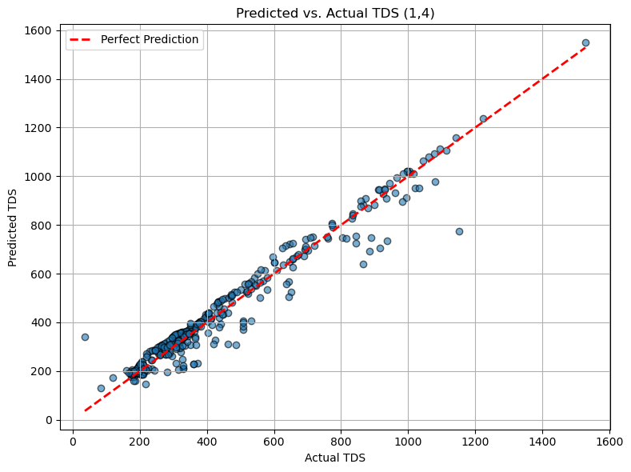
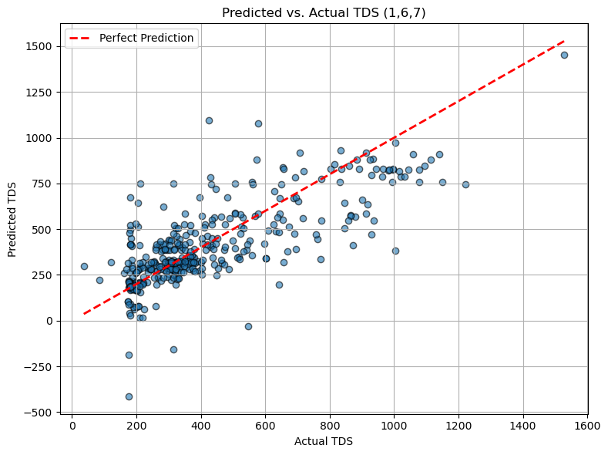
Results
RMSE: 52.26 MAE: 33.01
RMSE: 165.60 MAE: 114.73

Slide 10
Conclusion
To predict TDS
Using Conductivity and precipitation has an MSE of 0.039, with a nearly perfect prediction.
Using only known variables of precipitation and location gives an MSE of 0.38 with under and over predictions
Is this accurate enough to use to construct the GNN?

Slide 11
Future Work/Neural Network Uses
Developing a NN to predict river water quality from precipitation will help to develop a graphical neural network (GNN). Include other parameters such as land cover.
We need consistent data at each node to develop a well performing GNN.
Use GNN with precipitation input to determine if CSO occur, and what their impact on river water quality will be.
Use forecast precipitation to test model accuracy on forecast vs actual precipitaiton

Slide 12
Works Cited
[1] May, R. M., Arms, S. C., Marsh, P., Bruning, E., Leeman, J. R., Goebbert, K., Thielen, J. E.,Bruick, Z., and Camron, M. D., 2024: MetPy: A Python Package for Meteorological Data. Unidata, Unidata/MetPy, doi:10.5065/D6WW7G29.
https://shap.readthedocs.io/en/latest/example_notebooks/overviews/Be%20careful%20when%20interpreting%20predictive%20models%20in%20search%20of%20causal%20insights.html
Use SHAP to determine if relationship is causal

Slide 13
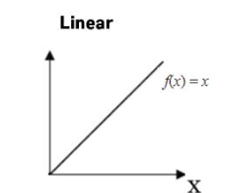
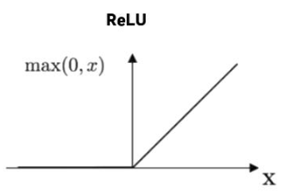
1st hidden layer
100 neurons
2nd hidden layer
60 neurons
Input layer
N features
Output layer
…
…
…

