Slide 1
ADA-FS: KIT & WP2
I/O estimation and scheduling, Integration with batch job scheduler, Optimization of data placement
Mehmet Soysal, Achim Streit

Slide 2

Mehmet Soysal
2009 Dipl.-Inform., Universität Karlsruhe
2009 Entwickler Netpioneer Karlsruhe
2009 KIT, bwGRID
2013-2016 bwHPC Head of Technical Advisory Board
Five Years experience with Scheduling and Ressourcemanagement
within HPC Systems.

Slide 3

Achim Streit
1999 Dipl.-Inform., U-Dortmund “Evaluation of Scheduling Strategies in Metacomputing” (U. Schwiegelshohn)
2003 Dr. rer. nat., U-Paderborn “Self Tuning Job Scheduling Strategies for the Resource Management of HPC Systems and Computational Grids” (B. Monien)
1999-2004 PC², U-Paderborn UNICORE Plus BMBF-Project, PhD
2005-2010 ZAM/JSC, FZJ Many Grid projects (national and EU), UNICORE
2010- SCC, KIT Enabling CSE/DIS, data management, scheduling/resource management/brokering

Slide 4
Experience/preliminary work
V. Hamscher, U. Schwiegelshohn, A. Streit, R. Yahyapour: Evaluation of Job-Scheduling Strategies for Grid Computing. HiPC 2000, DOI: 10.1007/3-540-44444-0_18
A. Streit: A Self-Tuning Job Scheduler Family with Dynamic Policy Switching. JSSPP 2002, DOI: 10.1007/3-540-45307-5_6
M. Hovestadt, O. Kao, A. Keller, A. Streit: Scheduling in HPC Resource Management Systems: Queuing vs. Planning. JSSPP 2003, DOI: 10.1007/10968987_1
L. Wang, J. Tao, R. Ranjan, H. Marten, A. Streit, J. Chen, D. Chen: G-Hadoop: MapReduce across distributed data centers for data-intensive computing, FGCS 29(3) 2013, DOI: 10.1016/j.future.2012.09.001
F. Jrad, J. Tao, I. Brandic, A. Streit: Multi-dimensional Resource Allocation for Data-intensive Large-scale Cloud Applications. CLOSER 2014, DOI: 10.5220/0004971906910702

Slide 5
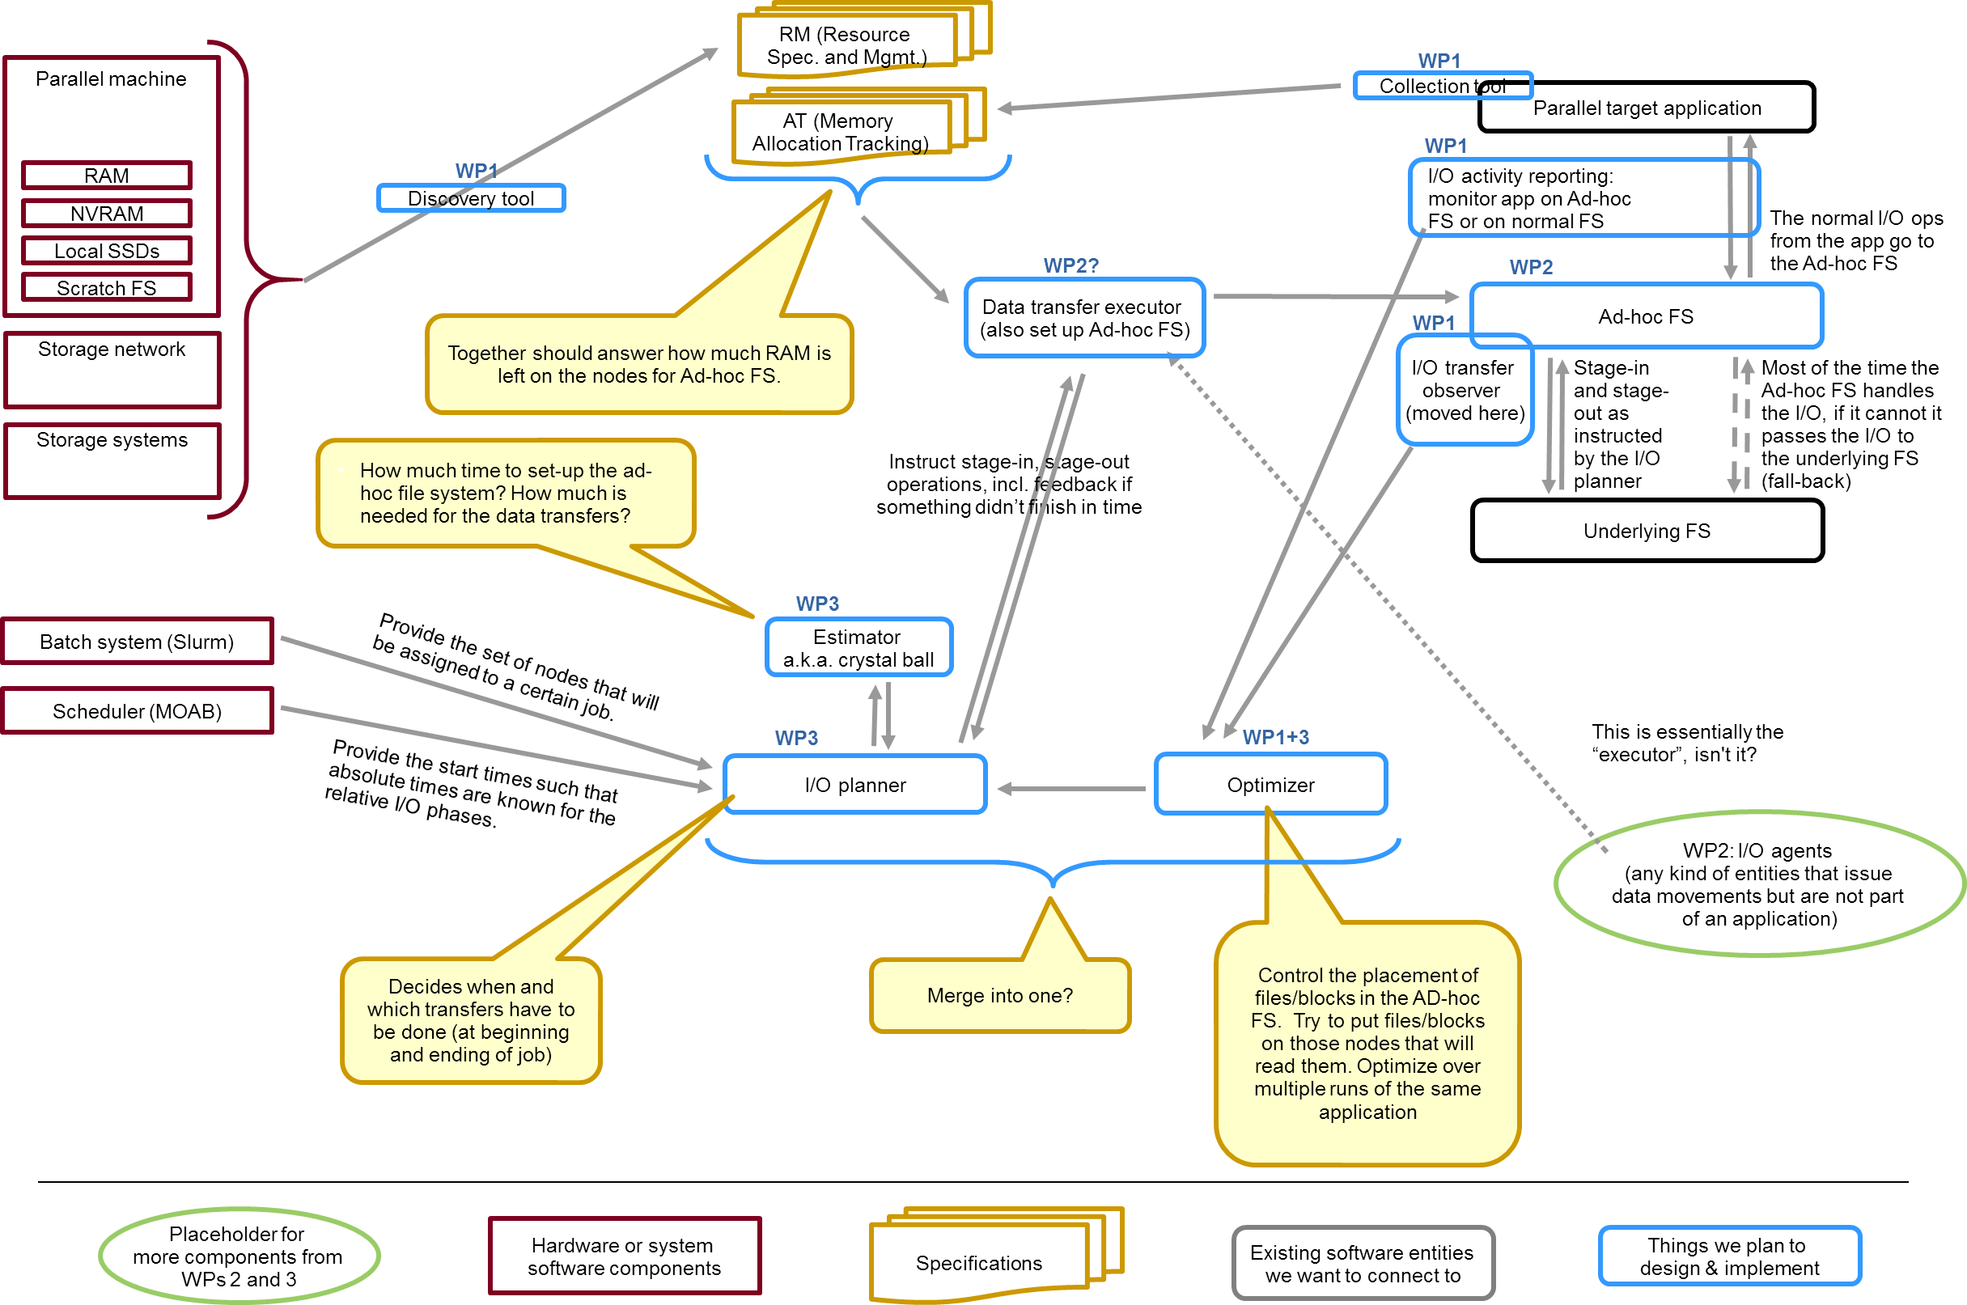
From 27.1.2015
WP2

Slide 6

Figure 1 in the proposal
HPC System
Planning
Batch System
Shared
File System
Applications
Discovery and Monitoring
Ad-hoc File System

Slide 7
Citations from the proposal
1 SofA “The proposed project ADA-FS aims to improve the I/O performance for extreme-scale parallel applications by a central I/O planning and a distributed ad-hoc overlay file system.”
2.2 Objectives: “The central I/O planner will coordinate all data transfers to and from all instances of the overlay file system. This will prevent a random mix of I/O requests where no application can anticipate how much of the total I/O bandwidth is available at any given point in time on the globally shared I/O infrastructure. Instead, the central I/O planning will allow appropriate predictions about transfer times to and from the overlay file systems. As long as an application reads and writes only within its private overlay file system, it will only use dedicated I/O resources in an exclusive manner.”

Slide 8
WP2 – Planning: Assumptions
Desireable:
The I/O Planner must work in concert with the existing resource management system (RMS)/scheduler of the HPC system.
The I/O Planner should avoid replacing any of existing components of the operating environment of a HPC system.
The I/O Planner must be general enough to enable the interplay with - in principle – any RMS/scheduler.
Mandatory:
The scheduler of the HPC system must be able to provide jobs start times, which are guaranteed within a certain time frame.
The RMS must be able to provide a list of nodes to be used by a soon starting job.

Slide 9
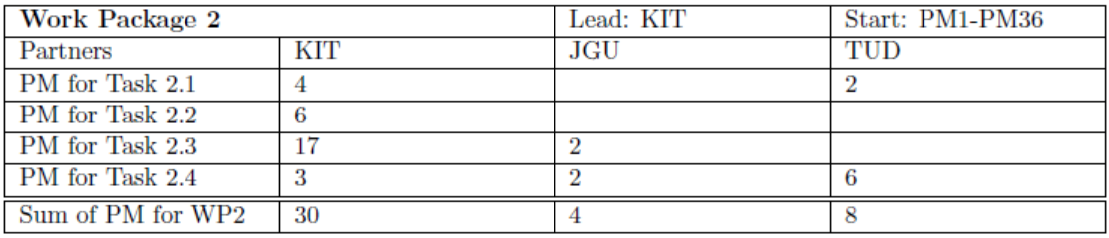
WP2 – Planning: Tasks
Task 2.1: Static and Dynamic Information Gathering
Task 2.2: Estimator
Task 2.3: I/O Scheduler
Task 2.4: Optimized Data Placement

Slide 10
Task 2.1 (Month 1-6): Static and Dynamic Information Gathering
Interfaces and connectors to components of WP1 and WP3 to obtain basic information for the I/O planner to execute its task
Demands for data transfers (in/outbound of the ad-hoc FS), e.g. volume, placement, if/when during job runtime, etc
Static information about the Exascale system, e.g.
Bandwidth/latency inside the HPC system (memory, SSDs, NVRAM, RAM, etc.)
Bandwidth/latency from the nodes to the storage system (depending on how the storage system is connected to the HPC system, this might not be uniform for all nodes)
Dynamic information about the usage of all memory/storage in the HPC system must be retrieved from discovery and usage tracking tools
Retrieve information from the RMS/scheduler
For a given job j the planned and guaranteed start time + the list of nodes that will be allocated to this job
Initially for SLURM as RMS and MOAB as scheduler on top

Slide 11
Task 2.2 (Month 7-16): Estimator
Works on behalf of the I/O Planner (see Task 2.3)
Retrieves (with the connectors from Task 2.1) as much static and dynamic information as possible
Calculates:
How much time is needed to set-up the ad-hoc file system on a given set of nodes?
How much time is needed for all data transfers between the storage system and the ad-hoc file system?
Amount of data
Amount of files
Available Bandwidth

Slide 12
Task 2.3 (Month 17-36): I/O Scheduler
Starts the Estimator (Task 2.2) to get the time information
Computes timetable with the planned set-up times and data transfers
Hands-over the timetable to the Data Transfer Executor (see Task 1.2) for execution
Provides hints for the placement of files or blocks in the ad-hoc file system (see Task 2.4)
Collaboration with Task 3.2 and 3.3
Monitoring of the execution of the timetable provides information for the I/O scheduler about errors or malfunctions → re-plan!
I/O scheduler works at/before the start + before and after termination of jobs → handles input and output

Slide 13
Task 2.4 (Month 31-36, “led” by TUD): Optimized Data Placement
Computes hints for the placement of files or blocks in the ad-hoc file system
Checks resource limitations/restrictions
To be used by the Data Transfer Executor (Task 1.2)
Takes additional information from Tasks 3.1 and 3.2
Optimize placement of files in the ad-hoc file system during stage-in
Goal: Input request from an application will be served by the same compute node
Result: substantially reduced data transfers between nodes within the ad-hoc file system → reduced latency and increase of effective I/O bandwidth

Slide 14

Data Staging, Multiple ad-hoc FS per Job
ADA-FS
BeeOND
Compute Node
Local Storage
Management with workspaces ?
Lustre/GPFS
BeeGFS
Cluster Gobal
Parallel Storage
NFS/NETAPP
EMC/JBOD
Site Global
Storage
Notes:
Nur eine ADA-FS Instanz pro Job oder mehrere/unterschiedliche denkbar, z.B.: - Unterschiedlicher Leistungsqualität (NVRAM und SSD)
- Unterschiedliche „Lebensdauer“ über Jobende hinaus
BeeOND: von BeeGFS ein ad-hoc filesystem, ganz neu
Workspaces = logische Einheiten von I/O-Daten des Jobs/Nutzers, kleines Tool/Script von HLRS/NEC

Slide 15
Data Staging, Questions
Data maybe place into logical units (workspace) ?
Data only needed by certain tasks or all ?
Ad-Hoc FS spread across non uniformed node local storage ?
RAM
NVRam
Size
Price and Speed
SSD
HDD
Notes:
Details im Ad-Hoc FS gerade NICHT verstecken, wie das im klassischen FS gemacht wird.
Also gibt unterschiedliche QoS-Eigenschaften innerhalb eines ad-hoc FS und ist das bekannt und soll das gesteuert/kontrolliert werden

Slide 16
Scheduler Progress / Data Staging (Moab)
Job submit
Data Stage-in Job
Als DAG
Submitfilter
Split
User Job
Data Stage-out Job
Neues Feature von MOAB (ab ca. 1 Jahr, v8.x)
Vererben von Knotenpartitionen an nachfolgende Jobs → ermöglicht ein vorheriges Data Staging für eigentlichen Compute Job
SLURM hat sog. BurstBuffer

Slide 17
Scheduler Progress / Data Staging
Prolog by Scheduler/RM
Userjob
Epilog Scheduler/RM
Reservation set by scheduler
before the actual „payload“ job starts
All nodes are available
Timelimit for copy back jobdata
Not all nodes are free
Could disturb running jobs
User has to do data Staging
Wallclock Limits
Notes:
In welchen zeitlichen Bereich agiert ADA-FS – auch im schwarzen Bereich?
Standardmäßig kann Prolog und Epilog benutzt werden, aber das würde zu einer deutlichen Verlängerung dieser führen – üblich heute im Sekundenbereich

Slide 18
Scheduler ressource allocation
Add later to the already established ADA-FS before X starts
Scheduler Iteration/Time
Node 1
Nodes
Node X
Allocated by Job
Free Nodes
useable by ADA-FS before X
Future Reservation
for Job X

Slide 19
Scheduler ressource allocation
Node 1
Nodes
Node X
Create overlapping reservation
Inherit for data staging
Notes:
Hinzufügen einer Reservierung am Anfang/Ende eines payload Jobs, um ADA-FS Data staging zu machen
Untersuchen, welche Option besser ist:
Zusätzliche Zeit einbauen wie im Bild → Antwortzeit verlängert sich
Passenden Mix an Jobs, so dass nachfolgender Job primär compute-lastig ist und ADA-FS nicht braucht
Klassischer Ansatz ohne ADA-FS, braucht dann mehr Zeit

Slide 20
Data Staging
Estimitation for I/O staging
Amount of data
Amount of files
Available Bandwidth (dynamic information)
Data maybe place into logical units (workspace) for easier handling?
Including quota for workspaces – not for enforcing, only for information
GPFS is able to do this, LUSTRE not
Task 1.3 – adhoc FS within Job with Beeond ?

Slide 21
Diverse questions
Only one ADA-FS per Job ?
All Nodes are needed to create ADA-FS ?
Nodes de-/attachable on the fly ?
Szenario bei zwei aneinander-stoßenden ADA-FS jobs
User Space ?
Can users start/stop/delete/modify ADA-FS ?
Support for Caching/Bursting Mode ?
Cache/Burst buffer additionally attached to whole HPC system
Heterogeneous Storages ?
Siehe vorherige Folien

