Slide 1



Advanced Data Placement via Ad-hoc File Systems at Extreme Scales (ADA-FS)
Andreas Knüpfer, Wolfgang E. Nagel, André Brinkmann, Achim Streit, Michael Kluge, Sebastian Oeste, Marc-André Vef, Mehmet Soysal
SPPEXA Annual Meeting 2016 Garching, 2016-01-27
Notes:
The given time slot for the presentation is 6 minutes plus 3 minutes for questions!

Slide 2

ADA-FS
ADA-FS: Advanced Data Placement via Ad-hoc File Systems at Extreme Scales
New project in the second funding period of SPPEXA
Addressing SPPEXA topics:
system software and runtime libraries
data management
Technische Universität Dresden: PI Wolfgang E. Nagel, Andreas Knüpfer, Michael Kluge, Sebastian Oeste
Johannes Gutenberg University Mainz: PI André Brinkmann, Marc-André Vef
Karlsruhe Institute of Technology: PI Achim Streit, Mehmet Soysal

Slide 3
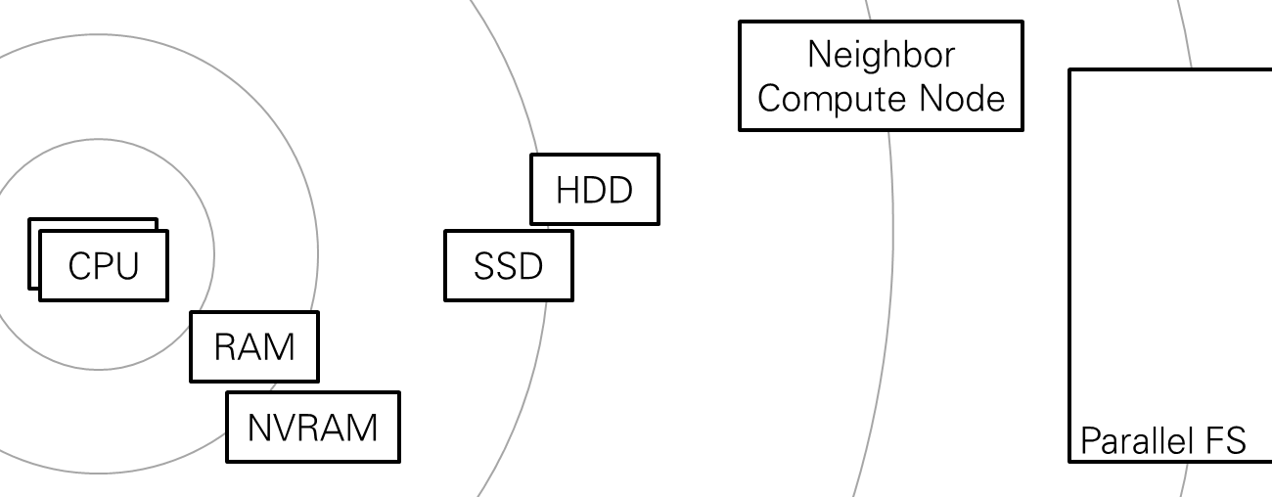
Project Rationale
I/O Challenges at Exascale
I/O subsystem is the slowest one in a HPC machine (bytes per flop, latency)
Shared medium: no reliable bandwidth, no good transfer time predictions
Upcoming architectures with “fat nodes” and intermediate local storages
Goal: optimize I/O
Using additional storages
Transparent solution for parallel applications
Pre-stage inputs early, cache outputs
Faster access
Pre-stage inputs
Notes:
I/O bandwidth per Flop/s decreases dramatically, esp. With new “fat compute nodes”
New local storages in HW architectures, must be used for competitive I/O performance
More complicated and machine-specific storage resources: different types, sizes, speeds, APIs, …
… should not be controlled/optimized by the application logic but by separate dedicated component

Slide 4
Background: Upcoming HPC Architectures
Expected Exascale architectures and announced 100 PF machines:
Orders of magnitude more processing units / compute power per node
Local intermediate storages, must be used for decent I/O performance
More complicated and machine-specific storage hierarchy
Bandwidth perspective:
 | # compute nodes N | Global I/O bandwidth S | Caching bandwidth C | Break-even point N*= S/C
SuperMUC / LRZ Phase 1 | 9400 | 200 GB/s | (0.5 GB/s) | 400
SuperMUC / LRZ Phase 2 | 9421+3072 | 250 GB/s | (0.5 GB/s) | 500
Titan / ORNL | 18688 | 240 GB/s | (0.5 GB/s) | 480
Summit / ORNL (anounced) | 3400 | 1 TB/s | 1.6 GB/s (assumed) | 625
Notes:
Latency is less critical with traditional-style I/O because
When using traditional storage HW like disks, then individual random accesses destroy performance, one cannot win much performance with that
New storage technologies like SSDs and NVRAM make such random accesses uncritical, therefore they may become prevalent again in the future
SuperMUC phase 2: Peak performance from phase 1 -> phase 2 doubled with only 1/3 more nodes, I/O bandwidth grew little from 200 to 250 GB/s, I/O BW per node slightly down, I/O BW per performance notable down

Slide 5
Proposed Solution
Ad-hoc overlay file system
Separate overlay file system per application run
Instantiated on the scheduled compute nodes
From before the parallel application starts until after it finishes
Central I/O planner
Global Planning of I/O including stage-in/-out of data, for all par. jobs
Optimization of data placement in the ad-hoc file system (resp. nodes)
Integration with systems batch scheduler
Application monitoring, resource discovery
I/O behavior, machine-specific storage types, sizes, speeds, …
Notes:
* The reasons one wants to have a central I/O planner – more on slide 9 below
Global parallel file systems are shared resources
No bandwidth guaranties, no reliably I/O time estimations
Cannot be optimized by one parallel job among many others

Slide 6
Overlay FS
Ad-hoc overlay file system:
Parallel Application Process
Parallel Application Process
Monitor I/O operations
I/O requests and responses
Ad-hoc overlay FS (node local)
Parallel FS (node-local kernel module)
Can modify or redirect I/O op.
Parallel FS (node-local kernel module)

Slide 7
Overlay FS
Ad-hoc overlay file system:
Separate overlay file system per application run
Instantiated on scheduled compute nodes
Allocate buffers in local storages
Ranks 0-7
RAM
SSD
Overlay FS
NVRAM
HDD
Ranks 8-15
RAM
SSD
Overlay FS
NVRAM
HDD
Other compute node, not part of same job
Ranks 16-23
RAM
SSD
Overlay FS
NVRAM
HDD
Other compute node, not part of same job

Slide 8
Overlay FS
Ad-hoc file system present from before the application starts until after it finishes
Allow buffering beforehand/afterwards
Buffer inputs
Partition inputs
Ranks 0-7
RAM
SSD
Inputs for rank 0
Parallel FS
All inputs
CPU
…
NVRAM
HDD
Inputs for rank 7
Ranks 8-15
RAM
SSD
Inputs for rank 8
CPU
…
NVRAM
HDD
Inputs for rank 15
Ranks 16-23
RAM
SSD
Inputs for rank 16
CPU
…
NVRAM
HDD
Inputs for rank 23
Notes:
Buffering inputs difficult, esp. correct partitioning of input data
Buffering outputs easy

Slide 9
I/O Planner
Individual parallel jobs cannot optimize I/O performance
Global parallel file systems are shared resources
No bandwidth guaranties, no reliably I/O time estimations
Central I/O planner schedules I/O operations
Assume all parallel jobs are under control of ADA-FS
Assume coarse-grained I/O behavior known: I/O phases and I/O gaps
Allow I/O phases of running jobs with priority
When stage-in inputs for future jobs? To which nodes?
When stage-out outputs from past jobs?
Integrate with job scheduling

Slide 10
Application Monitoring and Resource Discovery
Application monitoring
Monitor parallel applications, record I/O behavior
Generalize I/O behavior for types of applications
Predict I/O phases and I/O gaps → Input for I/O planner
Predict input partitioning → Input for Overlay FS buffering
Resource discovery and monitoring
Discover machine-specific storage types, sizes, reliable local speed, …
Monitor resource allocations by parallel applications, determine what is left for local buffers → Input for Overlay FS deployment
Approach: start with explicit specifications, research automated solutions

Slide 11
Challenges and Benefits
Restrictions
Each file/object is only accessed by a single application, yet from many nodes at a time
No ‘ls -a’ type operations in the overlay FS
No “communication via files” type operations
Practical benefits
Applications will be required to use additional burst buffers for I/O
Separation of concerns: decouple application logic from storage hierarchy
Enable bandwidth guarantees and reliable timing predictions for I/O operations, when combined with central I/O planning
Restricted POSIX FS semantics as additional research topic
Notes:
For 2) or similar types of global ls or global scan or file based messaging between ranks/processes
For last bullet: if the ad-hoc overlay FS is used for all jobs on a machine. Exactly then, a reliable prediction of transfer times is most useful for the planning.

Slide 12
Consortium and Previous Work
Wolfgang E. Nagel (Speaker), TU Dresden
Parallel performance monitoring and I/O monitoring
Flexible storage system design for local HPC infrastructure
André Brinkmann, Johannes Gutenberg-Universität Mainz
Development of metadata server-free parallel file system
Investigation of file system access traces to verify key assumptions 1 and 2 (both together with BSC)
Achim Streit, Karlsruher Institut für Technologie
Job scheduling and resource management for HPC and distributed systems: planning, self-tuning, brokerage
Large-scale data management

Slide 13
Work Plan
WP 1: Ad-hoc File System (led by JGU)
Design ad-hoc overlay file system
Coordination between nodes
WP 2: Planning (led by KIT)
I/O estimation and scheduling
Optimization of data placement
WP 3: Discovery and Monitoring (led by TUD)
Resource and Topology Discovery Dynamic Resource Usage Tracking
Monitoring of ad-hoc FS behavior and of application I/O
WP4: Integration and Demonstration (led by TUD)
Deployment and synchronization with underlying global parallel file system
Integration with batch job scheduler

Slide 14
Summary
Project goals
Improve I/O performance
Adopt upcoming architectural features
Transparent to application codes
Steps
Design overlay file system
Create central I/O planner
Discovery, monitoring, learning I/O behavior
Integration
Demonstration at scale

Slide 16
Neighbor Compute Node
Parallel FS
HDD
CPU
SSD
RAM
NVRAM

Slide 17
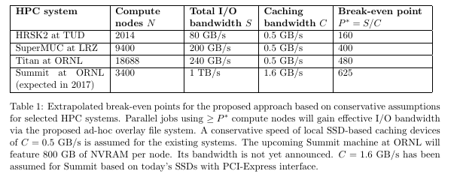
Background: Upcoming HPC Architectures
The table is from the proposal and answers the question „When is the combined bandwidth from local buffers (assume SSDs) higher than the bandwidth share from the global parallel FS. It uses conservative values for C and assumes that no other application on remaining compute nodes is stealing shares from the global paralle FS bandwidth – that means assumptions in favor of the global parallel FS
Alternative extrapolation for access latency as requested from Wolfgang Nagel:
Access latency to local RAM (RAM buffer): ~ 100 ns or few hundred clock cycles
Access to local NVRAM: few hundred ns
Access to local SSD block: few hundred us
Access to local HDD: 5-10 of ms or 200 IOOp/s
Access to global Lustre FS: tens of ms, even more if high MDS load
Still, I see latency as the wrong aspect here, because it applies to random accesses. One could argue that you are lost anyhow if your I/O performance depends on random reads. Instead, good I/O is using sequential reads where latency is not the main issue but bandwidth.

Slide 18
Ranks 0-7
RAM
SSD
Inputs for rank 0
Parallel FS
All inputs
CPU
…
NVRAM
HDD
Inputs for rank 7
Ranks 8-15
RAM
SSD
Inputs for rank 8
CPU
…
NVRAM
HDD
Inputs for rank 15
Other compute node, not part of same parallel job
Ranks 16-23
RAM
SSD
Inputs for rank 16
CPU
…
NVRAM
HDD
Inputs for rank 23
Other compute node, not part of same parallel job

