Slide 1
Biologically plausible model of human learning in simple arithmetic tasks
Boris Radovanovic
Supervised by Dr. Jelmer Borst

Slide 2
Alphabet arithmetic
A + 2 = C

Slide 3

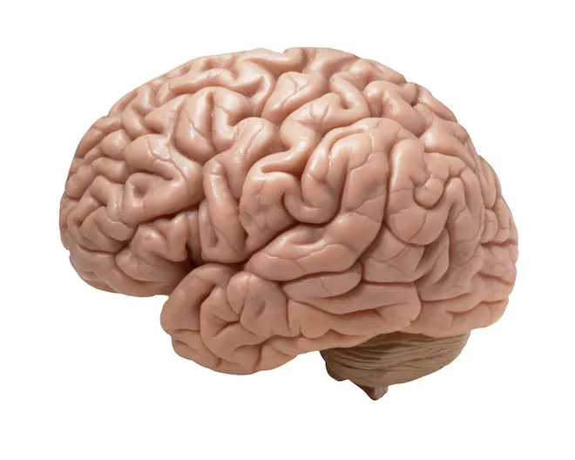
Alphabet arithmetic
A + 2 = C

Slide 4

Alphabet arithmetic
A + 2 = C

Slide 5
Learning
A + 2 : A → B → C
B + 4 : B → C → D → E → F
A + 2 : A → B → C
C + 3 : C → D → E → F
...
A + 2 : C

Slide 6
Learning
A + 2 : A → B → C
B + 4 : B → C → D → E → F
Counting
Procedural phase
A + 2 : A → B → C
???
C + 3 : C → D → E → F
...
A + 2 : C
Recall
Associative phase

Slide 7
Procedure for letter (L) + number (N)
result ← recall L + N = ?
if recall was not successful
result ← L
count ← 0
until count = N
increment result
increment count
end
end
learn L + N = result

Slide 8
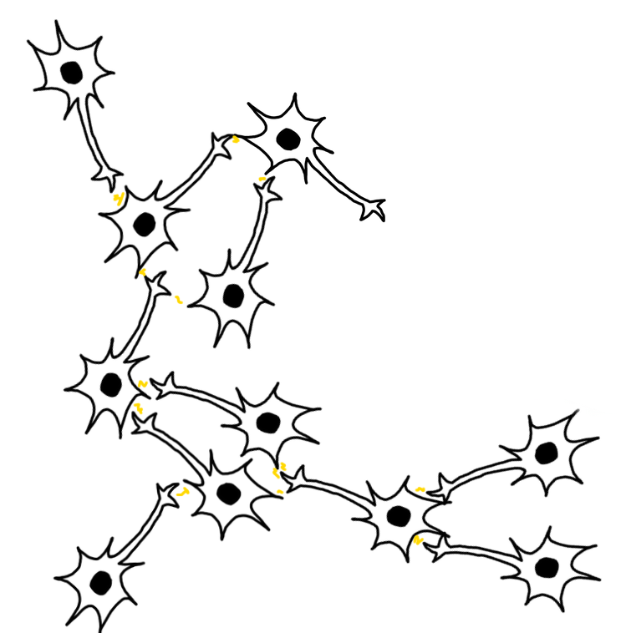
How do we actually do this with neurons?
result ← recall L + N = ?
if recall was not successful
result ← L
count ← 0
until count = N
increment result
increment count
end
end
learn L + N = result

Slide 9

Spiking leaky integrate-and-fire (LIF) neurons
x
voltage
time
time
approximation

Slide 10
Spiking leaky integrate-and-fire (LIF) neurons
f(x)
g(x)
...
group 1
group 2
group 3

Slide 11
Biologically plausible learning rules
Voja
makes neurons selective on inputs over time.
PES learns a function between neuron groups based on an error signal.

Slide 12
So....
result ← recall L + N = ?
if recall was not successful
result ← L
count ← 0
until count = N
increment result
increment count
end
end
learn L + N = result
looks simple, but is really hard
Models already exist, but are too brittle.

Slide 13
Counter intuitive behavior
var x ← 0
x ← 1
...
x
x
time
time

Slide 14
Everything always runs in parallel
synchronous
parallel
break invariants
do stuff
restore invariants
while maintaining invariants
do stuff
end

Slide 15
Noise accumulates over time

Slide 16
Hyperparameters are everywhere
5 hyperparameters in 1 rule
0.3 • dot(state, Run) + 1.2 • load_result - inc_result →
assoc_result = 2.5 • result_mem
total_assoc = 2.5 • total_mem
result_gate = Close
total_gate = Close
state_gate = Close
count_gate = Close
load_comp_a = 0.75 • One
load_comp_b = 0.75 • One
inc_comp_a = gen_inc_assoc
inc_comp_b = count_res
gen_inc_assoc = 2.5 • result_mem
Probably around 40 in the whole model
Changing one parameter breaks everything
Aubin et al. (2016)

Slide 17
Enough complaining..
Solution?

Slide 18
Solution 1: Cleanup memory
Cleanup
Retains information permanently!

Slide 19
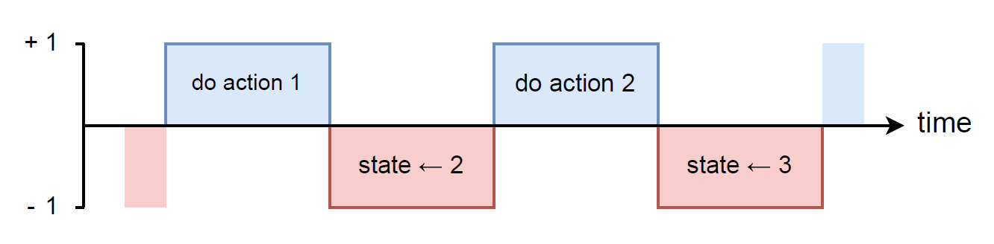
Solution 2: Clock
Perform actions on high pulse.
Change states on low pulse.

Slide 20
Eliminated most problems...
But model still didn’t work.
😞

Slide 21
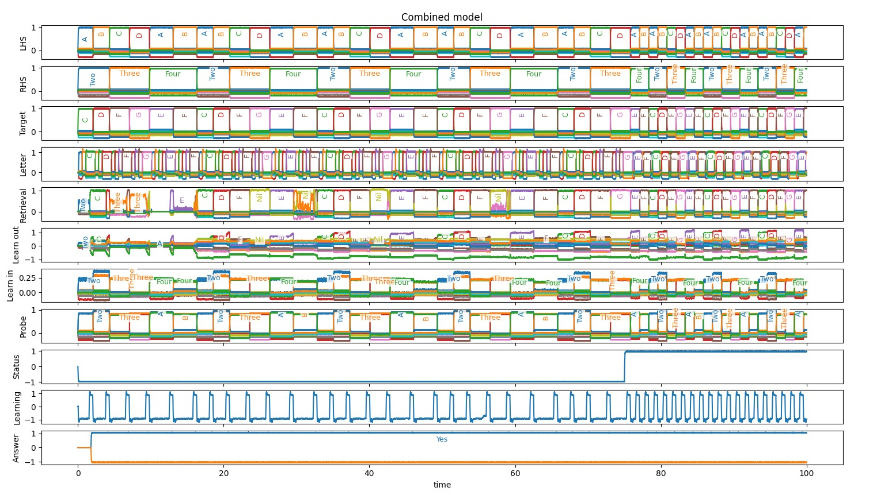
After a month of tinkering and rewriting,
2 days ago, the model suddenly worked!

Slide 22
¯\_(ツ)_/¯

Slide 23
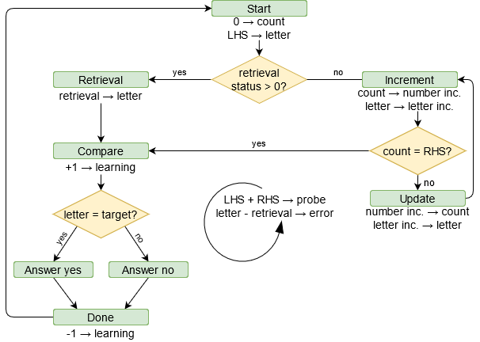
Model is much simpler and more robust
Code matches diagram almost 1-to-1

Slide 24
Thanks for listening!

