Slide 1

Team RITter
Allen Madsen, Daniel Giorgetti
Victor Calderon, Jeremy Leakakos
Edward Louw

Slide 2
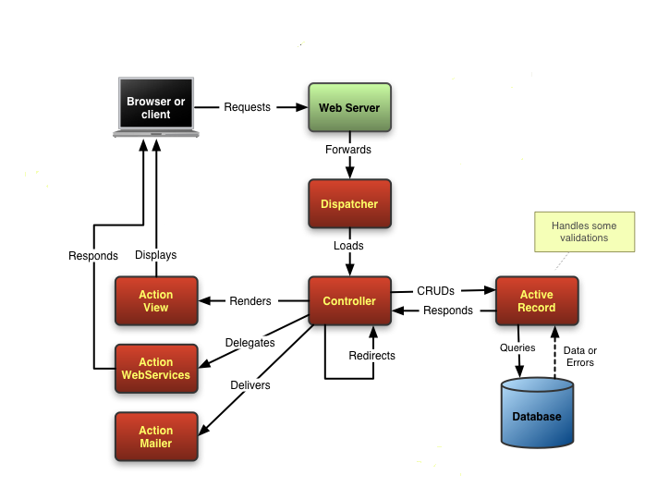
Architecture

Slide 3
Class/Object Diagram

Slide 4
Deployment Diagram

Slide 5
Conclusion
Issues encountered
Lessons learned
Possible future improvements

Slide 6

Questions

