Slide 1
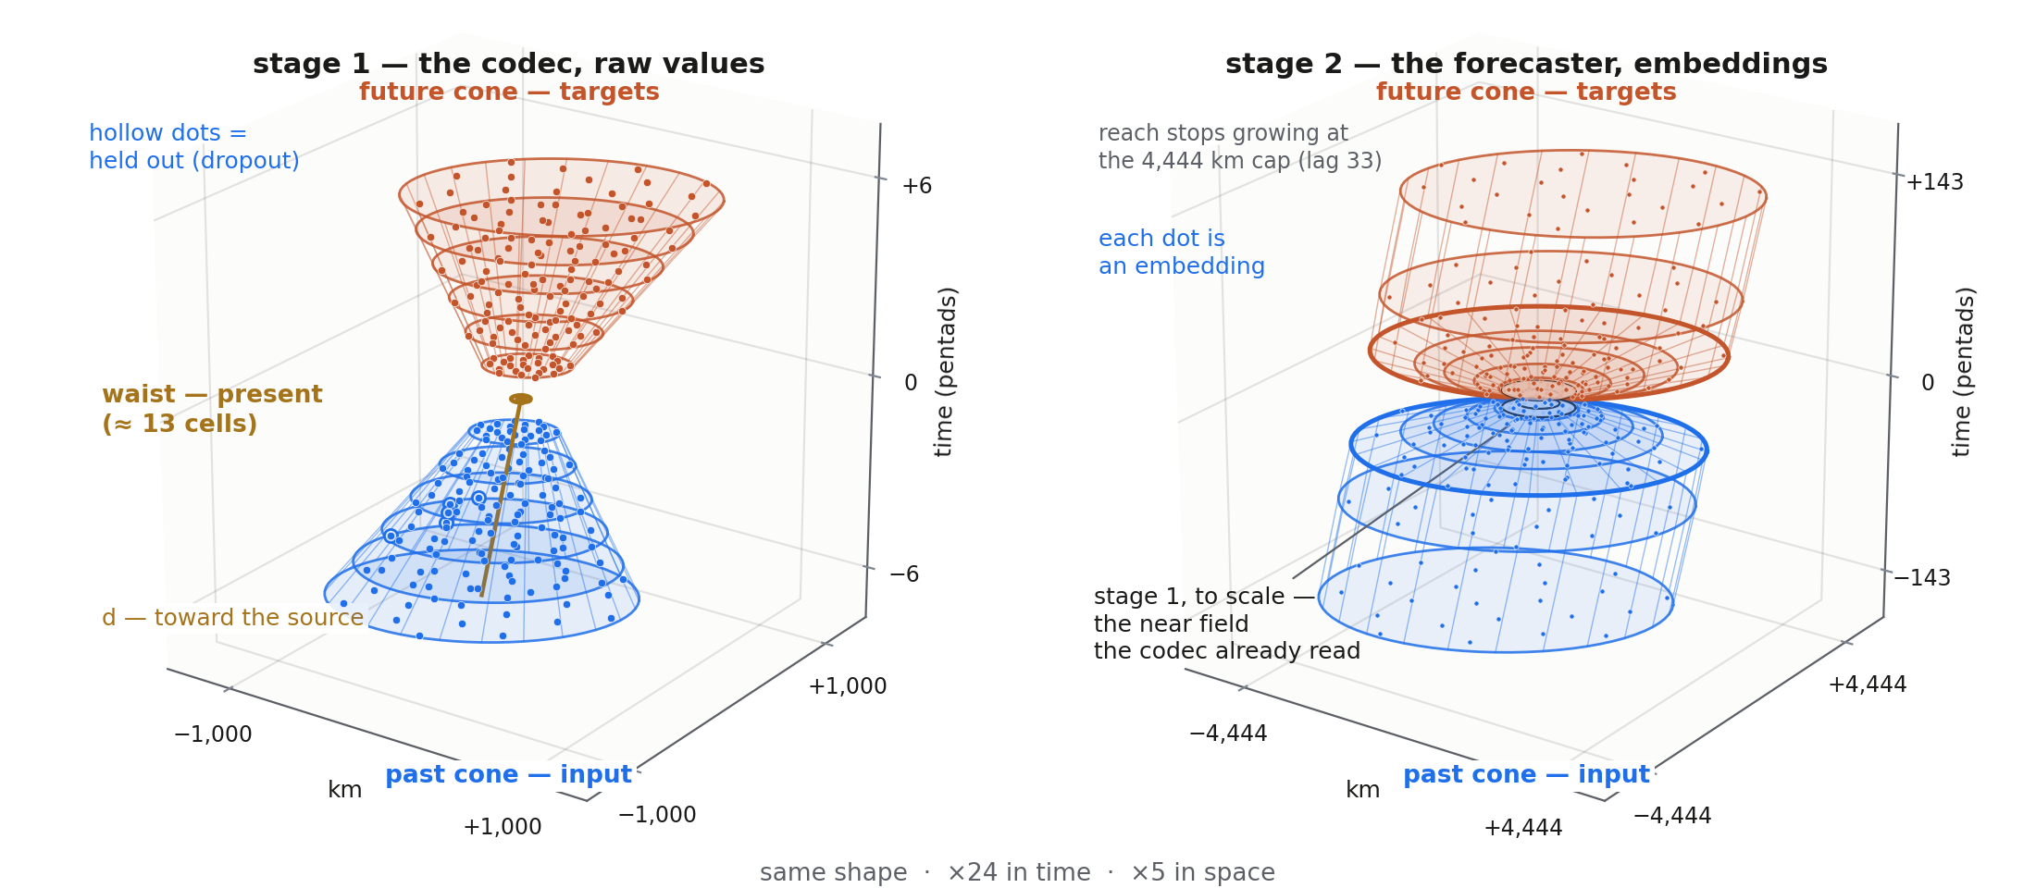
E-080 · THE CUT-OFF MIRRORED DOUBLE CONE · THE HOURGLASS AT TWO SCALES
Stage 1 reads raw values through a small hourglass; stage 2 reads stage 1's embeddings through the same shape, twenty times longer and five times wider
Stage 2's mirrored future side is the E-080 shape carried up a level — design intent; the stage-2 heads scored so far predict the next embedding and roll it forward.
past cone · input, never a forecast target, sometimes held out
waist · present — input in T1/T2/T4, predicted in T3
future cone · targets only, never input
cone.py::outer_spiral · E-071 §4.5
E-080 · the cut-off mirrored double cone
Notes:
One shape, two scales. On the left, stage one: the codec, the encoder that turns one place at one time into an embedding. It reads raw values through the small hourglass — the past cone of the last thirty days, six pentads deep and about nine hundred kilometres wide at its mouth for the ocean-surface channels; the waist of about thirteen cells at the present; and the mirrored future cone, six pentads ahead, which is only ever a target. Three rules, colour-coded and true at both scales. The past cone is input and never a forecast target; it is sometimes held out — a dropout pattern hides the most recent lags, a wedge of bearings, random dots, or one channel — and the one thing the model is ever asked to do with a hidden past dot is to fill it back in, which is task four, the reconstruction family kept from E-069b. The waist is the present: it is passed as input in the forecast tasks and in fill-in, and hidden and predicted in task three, the nowcast from history. The future cone is targets only and never input. On the right, stage two: the forecaster, which reads what stage one wrote. Each dot in its wide cone is an embedding, not a raw value, and the hourglass is the same shape drawn about twenty times longer and five times wider — lags seven to a hundred and forty-three pentads, two years, opening to the four-thousand-four-hundred-kilometre cap of the outer spiral, with the near field the codec already read cut out of the centre; that cut-out, drawn to scale, is the whole of stage one's hourglass. The present embedding is the waist. The future side, mirrored like stage one's, is the E-080 idea carried up a level: predict a cone of future embeddings rather than a single next step. That is stated here as the design intent; the stage-two heads the programme has scored so far predict the next embedding and roll it forward, one step at a time, over the long window that cone v2 assigns to stage two. Making stage two's targets a mirrored cone is a change to the forecaster's training, not to the codec, and it is not part of the E-080 experiment as pre-registered.

