Slide 1
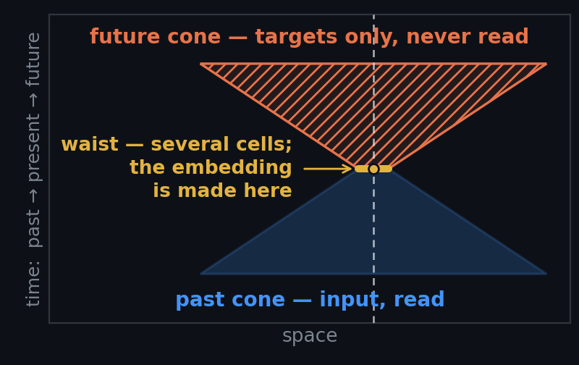
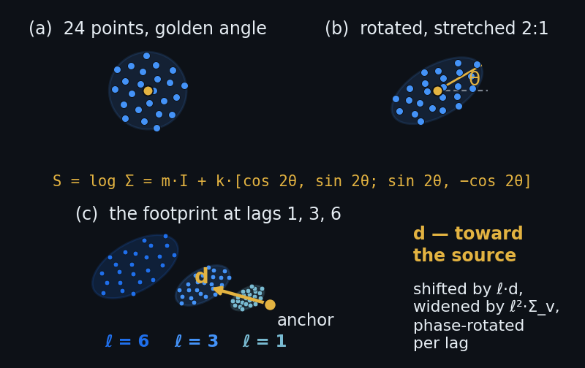
E-080 · THE CUT-OFF MIRRORED DOUBLE CONE · ONE-SLIDE SUMMARY
An hourglass that reads the past through a cone it shapes itself, tested three ways against its own fixed twin
THE HOURGLASS
THE CONE THE MODEL SHAPES
THE EXPERIMENT
RESULTS — figure to be inserted
R1 · future-cone loss per lead, A0 fixed / A1 learned / A2 primed, 3 seeds · R3 · learned drift vs upstream · R4 · the western-boundary depth check
Reserved for the measured result — empty until a run has produced it.
The design · slides 3–7
The present is a waist of ~13 cells, not a single tip; the past cone reads the last 30 days at every pentad; a prediction cone — the past cone mirrored through the anchor, +1…+6 pentads — is sampled the same way and used only as targets. Each example draws one of four tasks: forecast from waist + past (0.35), from the waist alone (0.15), nowcast the hidden present from the past under five dropout patterns (0.25), fill-in (0.25) — under E-069b's rules: knowable targets only, no copy targets, every loss family scored against its own predict-the-mean bar
The cone the model shapes · slides 8–12
A fixed 24-point sunflower, phase-rotated by the golden angle per lag, warped by eight dimensionless numbers per 1° cell and channel group: a drift d toward the source (capped at cone v2's design speed) and two ellipses stored as matrix logarithms — no kilometres, no angle to wrap — with Σ(ℓ) = Σ₀ + ℓ²Σ_{v}. One direction per flow, one scale and one memory per channel: s_{c} and τ_{c} inflate or shrink the shared ellipse and set how far back the channel reads, applied as a Gaussian aperture over the group's shared per-location tokens — zero extra tokens. Learned gate-first (a soft aperture over fixed dots, so the loader never depends on live weights), then hardened (dot tables re-baked at epoch boundaries)
The guards · slides 13, 15
Coarse-10°-plus-1°-residual prior; log-space soft floors; mirror tie; stop-gradient on target positions; evaluation geometry frozen for every arm; the far ring kept and never gated; the aperture never touches the loss weights — so the cone cannot learn to ask easy questions
The experiment · verdict · slide 17
A0 fixed hourglass — the control and everyone's eval geometry · A1 learned from A0's init · A2 learned, surface drift primed at −u_clim·Δt. Same 7 M codec, 20 k steps, frozen protocol, 3 seeds each, one tensor (family 7.2); read-outs R1–R5. Verdict: A1 beats A0 on R1 at every lead ≤ 3, paired at all seeds, R5 clean → adopt; A2 > A1 ≈ A0 → geometry from climatology; neither → keep A0
E-080 · the cut-off mirrored double cone
Notes:
This is the whole deck on one slide, for anyone who reads nothing else, and it is where the result goes when there is one. The left half is the argument in four steps. First, the design of the input and the targets: the present is a waist of about thirteen cells rather than a single point, because gradients need neighbours; the past is read at every pentad of the last thirty days; the future is a mirror image of the past cone, sampled identically and used only as targets; and each training example draws one of four tasks — forecast from everything, forecast from the present alone, nowcast the hidden present from the past, or fill in — under the three rules the E-069 experiment taught us (E-069 is the cone codec as built and measured at five seeds; the rules are that a target must be knowable from the input, must not be a copy of an input, and every loss family is scored against a predict-the-mean bar of its own). Second, the cone the model shapes: a fixed sunflower pattern, pushed through eight learned numbers per one-degree cell and channel group — a drift toward the source and two ellipses, stored as matrix logarithms so nothing is in kilometres and no angle wraps; the direction is shared by everything the water carries, while each channel has its own scale and its own memory, applied as a weight over shared tokens so it costs nothing; and the geometry is learned first through a soft weighting over fixed dots and only then baked into the dot table, so the data loader never has to know where the geometry currently is. Third, the guards, which exist because a learnable cone can learn to ask easy questions: the prior, the floors, the mirror tie, the stop-gradient on target positions, the frozen evaluation geometry, the ungated safety ring, and the rule that the aperture never reaches the loss weights. Fourth, the experiment as pre-registered: three arms — fixed, learned, and learned but primed with the climatological current reversed — on the global family 7.2 tensor (the first tensor covering the whole globe at quarter-degree resolution and five-day cadence, in its 7.2 build), the seven-million-parameter codec, twenty thousand steps, the frozen protocol with its held-out years, three seeds each; five read-outs; and the verdict rule written before any run. Two pictures carry the argument for a reader who has not seen the deck: the hourglass in space-time — the past cone narrowing to the waist and opening again into the mirrored future cone — and the warped sunflower, the fixed dot pattern first stretched into an ellipse and then drifting lag by lag toward the source. The third panel is deliberately empty. It is the space for the actual result — the forecast loss per lead for the three arms, the learned drift against the upstream direction, and the western-boundary depth check — and it stays empty until a run has produced those numbers, so that this slide can never show a picture of what we expected in place of what we measured. When the figure lands, the caption under the panel says which read-outs it shows, and the verdict line on the left is read against it.

