Slide 1
E-080 · DESIGN PROPOSAL · 15 SEPTEMBER 2026
The cut-off mirrored double cone
Stage 1 as an hourglass — and a cone the model shapes itself
future cone · targets only
E-080 · design proposal · 15 September 2026 · nothing here is measured yet
The deck turns Chris's four points into a specification: a waist instead of a tip, a mirrored cone of targets, a random mix of four tasks, and a cone whose shape the model learns per region — one direction per flow, one scale per channel.
waist
past cone · input
E-080 · the cut-off mirrored double cone
1
Notes:
This deck proposes the next shape of the stage-one model, the encoder that turns one place at one time into an embedding. Chris set four points this morning: the input cone loses its tip and becomes a bottleneck of several points; a second cone is sampled into the future and used only as targets; the model trains under a random mix of forecasting and reconstruction tasks; and the shape of the cone — where it points, how wide it is, which way it is stretched — becomes something the model learns separately for every region of the planet. The first three points are settled decisions and the deck turns them into a specification. The fourth is a request for a proposal, and the deck's recommendation is a warped sunflower: a fixed pattern of sample points that a small set of per-region numbers stretches and shifts, with one direction shared by everything a flow carries and one scale per channel, read through a soft aperture so that the loss can push on the numbers directly. Everything is written so it can be measured as one experiment, E-080, against the geometry we already have. Nothing in this deck has run.

Slide 2
WHERE WE COME FROM
One cone, five seeds, one clear reading
E-069 · the cone-native codec
E-071 · cone v2
30 days of dots around a North Atlantic cell, one 3×3 patch at the present, targets at +1 and +2 pentads
History did not put the cell's own velocity into the embedding — five seeds, two objectives, refuted
History did buy persistent fields (hidden sea-surface height at ~0.36 of the bar vs 0.75–0.90) and a 7–8 % better one- and two-pentad forecast
Global, harmonic climatology, profile tokens — the geometry's known faults, fixed
Reach from the fastest mechanism × 1.5 — a hemisphere by lag 3, so dots go log-radial
The open question v2 left: a cone wide enough to never exclude a driver samples the near field at one dot per thousands of kilometres.
E-080 · the cut-off mirrored double cone
2
Notes:
A quick reminder of the record, because the new design is a response to it. E-069 was the first cone-native codec: for every ocean cell it read a thirty-day cone of samples around it, called dots, plus the present three-by-three patch, and it was asked to predict the cell's own future one and two pentads out — a pentad is a five-day bin. Its headline hypothesis, that thirty days of history would put the cell's own current velocity into the embedding, was refuted at five seeds under two objectives. What the history did buy was real: fields that persist, like sea-surface height, were reconstructed far better from history, and the short forecast improved by seven to eight percent. Then cone v2 fixed the geometry's known faults — it went global, it smoothed the seasonal baseline, it placed the Argo float tokens where floats actually were, and it sized every cone from the fastest thing that could carry information, times a safety factor. That last choice has a cost the v2 plan named itself: with a reach of a hemisphere by lag three, a fixed budget of dots samples the near field very thinly. The design in this deck is what lets the cone be both — wide enough to never exclude a cause, and dense where the causes actually are — by letting each region decide where its dense part points.

Slide 3
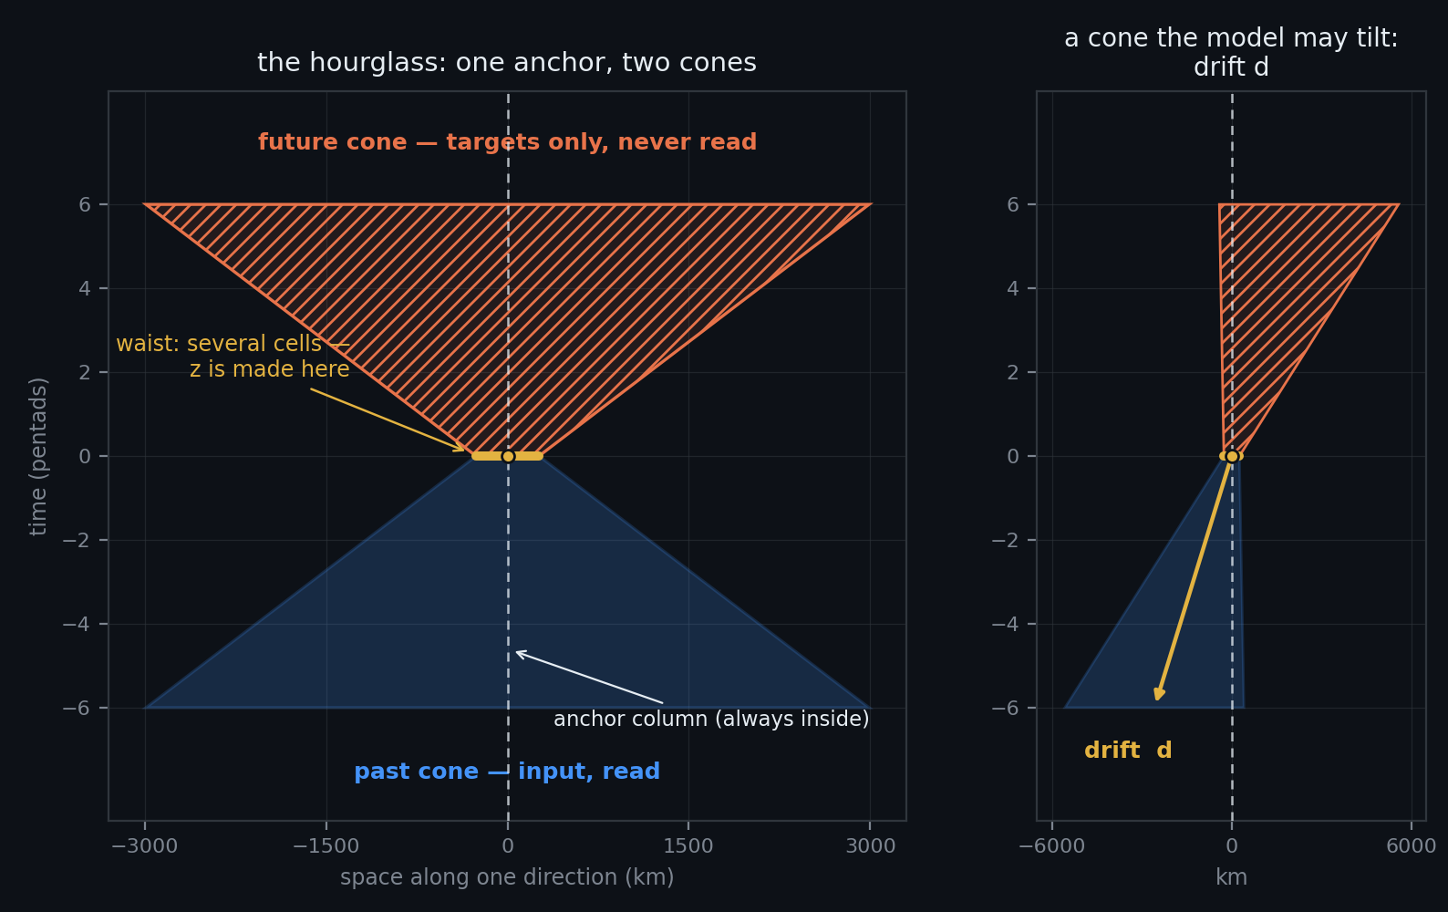
THE HOURGLASS IN ONE PICTURE
Past cone → waist → future cone
Past cone (lags −6…−1): read as input, dots at the per-lag ellipse plus the anchor column
Waist (lag 0): a disc of several cells — the cut-off tip — read as input and reconstructed; the embedding z summarises the waist
Future cone (leads +1…+6): never read; sampled the same way and used as targets only
Point-mirrored: the future cone at lead +ℓ is the past cone at lag −ℓ reflected through the anchor
E-080 · the cut-off mirrored double cone
3
Notes:
This is the whole shape on one page. Time runs upward, space sideways. Below the middle is the past cone: everything the model reads about the last thirty days, widening with lag because a driver further back in time can have come from further away. In the middle is the waist — the tip of the cone, cut off. In E-069 the present was a single three-by-three patch; here it is a small disc of several cells, and it is the only place the model both reads and is asked to reconstruct. The embedding is made here, at the waist. Above the middle is the future cone: the same shape reflected through the anchor point, widening into the future, and never read — it exists only to be predicted. Mirrored means point-mirrored: the future cone at lead plus three is the past cone at lag minus three turned through the anchor. That is not a decoration; it is what advection looks like in space-time. Water that reaches the anchor came from upstream and will go downstream, so a cone that leans upstream in the past should lean downstream in the future. The dashed line is the anchor column — the cell's own history and its own future — and it is always inside both cones whatever else the geometry does, so the fixed-frame forecast that stage two needs is always a target.

Slide 4
POINT 1 — THE WAIST: WHY THE TIP IS CUT OFF
A gradient does not exist within a single cell
The waist is a disc of radius r₀ around the anchor, sampled as a small sunflower: ~13 cells at the default (one centre + 12), never fewer than the 3×3 patch's nine
Read as input at lag 0 (values + observed flags) and reconstructed as the anchor family's target
What the waist buys: thermal wind is a density gradient; geostrophy is a sea-surface-height slope — both need neighbours at the same instant, not in the past
The waist has the same shape parameters as the cone at lag 0 (orientation, two semi-axes), so a boundary current can have an elongated waist along the flow
The embedding z summarises the waist; one z per anchor, as today
≈ 13
cells at the waist
one centre + 12, never fewer than the nine of the 3×3 patch
1 z
per anchor, as today
so stage 2 and every archived probe see the same kind of object
E-080 · the cut-off mirrored double cone
4
Notes:
Point one. Why cut the tip off at all? Because the quantities the AMOC read-out actually depends on are gradients. Thermal wind — the vertical shear of the current — is a horizontal density gradient. Geostrophic velocity is a slope in sea-surface height. A gradient does not exist inside one cell; it needs neighbours at the same moment. The E-069 record says the same thing from the other side: the snapshot twin's velocity read-out was exactly what a ridge regression on the raw three-by-three patch gives — geostrophy from the patch — and the cone added nothing to it. So the present deserves more than a single point. The waist is a small disc of cells around the anchor, thirteen by default, arranged as a tiny sunflower so that every bearing is represented. It is read as input, and it is what the model reconstructs in the anchor-reconstruction task. It carries the same shape parameters as the rest of the cone evaluated at lag zero, so where the flow is a narrow jet the waist can be stretched along it. One embedding per anchor summarises the waist, exactly as today, so stage two and every archived probe see the same kind of object.

Slide 5
POINT 2 — THE PREDICTION CONE
Sampled like the past cone, read by nobody
+1 … +6 pentads
30 days ahead, matching the 30 days of history
targets only
nothing in the future cone is ever read by the encoder
frozen at evaluation
the fixed v2 hourglass scores every arm and every seed
Leads +1…+6 pentads (30 days ahead), the mirror image of the past cone through the anchor: centre c(+ℓ) = −c(−ℓ), same axes and orientation at the same |ℓ|
Dots are targets only: each is a decoder query (channel, Δx, Δy, lead, depth) → (μ, log σ²), scored with the Gaussian negative log-likelihood already in cone_codec.py
The anchor column at every lead is always among the targets — the fixed-frame forecast stage 2 needs
Per-lead and per-family loss, each reported against its own predict-the-mean bar (the E-069b rule)
Evaluation geometry is frozen (the fixed v2 hourglass), whatever the training cone learns — so every number stays comparable across arms and seeds
E-080 · the cut-off mirrored double cone
5
Notes:
Point two. The prediction cone is the future half of the hourglass. It is sampled by the same machinery as the past cone, reflected through the anchor, out to six pentads ahead — thirty days, matching the thirty days of history. Nothing in it is ever read by the encoder. Each dot in it is a question put to the decoder: at this channel, this offset, this lead, this depth, what is the value? The decoder answers with a mean and a variance, and is scored with the Gaussian negative log-likelihood we already use. Two rules carry over from E-069b, the run that fixed the first masking plan: every loss family is reported against the score you would get by predicting the mean, so a target that cannot be known shows up as a bar of one rather than hiding in an average; and the anchor's own column is always among the targets, so the forecast at the anchor itself — the thing stage two rolls forward — is always trained. One more rule is new and matters for point four: the geometry used at evaluation time is frozen to the fixed hourglass. The training cone may move; the yardstick does not. Otherwise two runs with different learned cones would be scoring themselves on different questions.

Slide 6
POINT 3 — THE SAMPLING REGIME
One model, four questions, drawn at random per example
task | input | targets | share | what it teaches
T1 forecast | waist + past cone | future cone | 0.35 | the full problem
T2 snapshot forecast | waist only (past cone fully hidden) | future cone | 0.15 | the built-in twin: what history buys, inside one model
T3 nowcast from history | past cone under a dropout pattern; waist hidden | waist | 0.25 | the present from the past — persistence, advection, memory
T4 fill-in | waist + past cone, both under a dropout pattern | the hidden waist cells and dots | 0.25 | E-069b's reconstruction family, kept
Dropout patterns for T3 and T4, drawn independently (each fires with its own probability)
channel drop
at the waist — lag 0 only, chan_drop_scope lag0
recent-lag band
hide every dot at lag ≤ ℓ₀, ℓ₀ ∈ {1, 2, 3}
bearing wedge
hide a 90° sector
random dots
each dot hidden with p = 0.3
whole waist
T3 only
E-080 · the cut-off mirrored double cone
6
Notes:
Point three. Each training example draws one of four tasks. Task one is the full problem: read the waist and the past, predict the future cone. Task two is the same question with the past entirely hidden — the snapshot twin from E-069, but now living inside the same model, so every run reports what history buys without a second run. Task three is the nowcast: hide the present and reconstruct it from history, under one of several dropout patterns applied to the past. Task four keeps E-069b's reconstruction family: hide some cells and dots in both the waist and the past and fill them in. The dropout patterns are the ones already in the code plus one: dropping a channel at the present only, hiding the most recent lags so the model must extrapolate from stale history, hiding a wedge of bearings so it cannot lean on one direction, hiding dots at random to imitate sparse observations, and — for the nowcast only — hiding the whole present. The shares are a starting point, not a result; they are a knob the experiment records. The one rule that is not a knob comes from E-069b's failure: a target's channel must be visible somewhere in the input, at some lag, or the target is unknowable and only teaches the model to predict the mean.

Slide 7
POINT 3 — THE RULES THAT MAKE THE MIX SAFE
Three rules, all learned the hard way in E-069
1 · Knowable targets only
A target channel must be visible somewhere in the input (any lag, any dot). Under the first E-069 plan 80 % of hidden-dot targets broke this and 64 % of the loss was predict-the-mean.
2 · No copy targets
The anchor family scores hidden channels only (anchor_hidden_only); a target visible in the input is a copy, not a question.
3 · Every family against its own bar
Per (task, family, lead) loss, each divided by its predict-the-mean score; a task is “learned” only where the ratio is below one at held-out anchors.
The task is not told to the model by a token; the masks are visible (the mask_tok / miss_tok distinction stays), and the lead is in every query's coordinates — that is enough
Loss weights: equal across tasks per example; the shares in the table set the mix, not the weights
E-080 · the cut-off mirrored double cone
7
Notes:
Three rules, all paid for already. The first is that every target must be knowable from the input: the first E-069 plan hid a channel at the present and at every dot, so most of the hidden-dot targets belonged to channels the encoder could not see at all, and two thirds of the loss became a lesson in predicting the mean. The second is that no target may be a copy of something visible: the anchor family scores only channels that were dropped, because a target the model can read off the input is not a question. The third is that every loss family is reported against its own predict-the-mean bar, per task, per family, per lead, so a number is only called learned where the ratio sits below one at held-out anchors. On mechanics: the model is not told which task it is in by a special token. The masks are visible — there is already a token for "hidden by us" and a different one for "the data never observed this" — and every decoder query carries its lead in its coordinates. That is enough for the model to know what is being asked. The shares in the table decide how often each task is drawn; within an example the loss weights are equal.

Slide 8
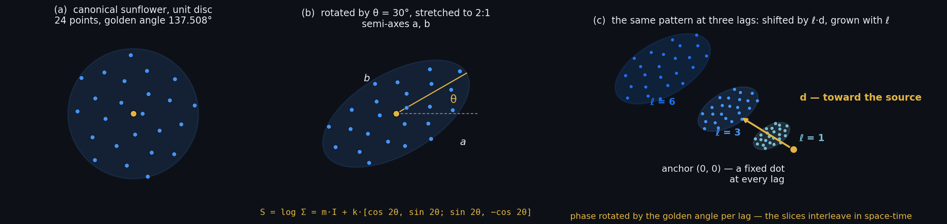
POINT 4 — THE CONE AS A WARPED SUNFLOWER
Eight numbers per region shape the whole hourglass — and none of them is in kilometres
For each region and channel group, the past cone at lag ℓ is a Gaussian footprint centred at anchor + ℓ·d with covariance Σ(ℓ), and the dots are the canonical sunflower mapped through it:
Σ(ℓ) = Σ₀ + ℓ²·Σ_{v} p(ℓ, i) = anchor + ℓ·d + Σ(ℓ)^{½} · u_{i}
u_{i} : the canonical sunflower on the unit disc (Vogel spiral, golden angle — the E-026 pattern in ml/temporal.py::spiral_offsets), fixed, 24 points
Phase-rotated by the golden angle per lag: bearing_{i,ℓ} = i·137.5° + ℓ·137.5°, so the six slices interleave in space-time instead of repeating the same bearings
Time itself stays dense: one slice per pentad — the finest cadence we have, and the 30-day window is the codec's whole job
d (2 numbers): the drift per pentad — where the footprint's centre moves for each pentad back in time; the arrow toward the source. Stored dimensionless: d = tanh(x) · v_design·Δt
Σ₀ (3): the waist ellipse, stored as its matrix logarithm S₀ = log Σ₀ — a symmetric 2×2 in log-km. Its trace is the size; its traceless part is (log aspect ratio) × (cos 2θ, sin 2θ); no 180° wrap, and a circle is S = m·I
Σ_{v} (3): the velocity-spread ellipse, also as log Σ_{v} — how fast the footprint widens with lag (standard deviation ∝ ℓ, as the reach ∝ (1 + ℓ) in ml/cone.py::reach_km)
Why log form: under Adam every parameter moves about one learning rate per step in its own units. A radius in km moves a fixed number of km (frozen at 850 km, twitchy at 30 km); a log-radius moves a fixed fraction — the same at any size
Future cone: reflected — centre −ℓ·d, the same Σ(ℓ); the anchor column (0, 0) is always added. Per-channel scale and memory: next slide
E-080 · the cut-off mirrored double cone
8
Notes:
Point four, the proposal, in its revision-3 form. The cone at a given lag is a Gaussian footprint: a centre, and a covariance that says how wide it is and in which direction it is stretched. The dots are the fixed sunflower — the same twenty-four-point pattern the project has used since E-026, the experiment that introduced the sunflower stencil for stage two — pushed through that covariance, so the pattern is squashed, stretched and shifted but never re-invented. One small change from earlier revisions, prompted by Chris asking whether time is sampled the same way: it is not a three-dimensional sunflower — time is sampled densely, one slice per pentad, because five days is the finest cadence the tensor has and the thirty-day window is the codec's whole job under cone v2's split — but a stack of identical slices repeats the same bearings at every lag, and consecutive lags sit closer together than the dots do, which is a redundant sampling of the cone's volume. So the sunflower's phase now advances by the golden angle from one lag to the next: the slices interleave, the cone is covered like a three-dimensional Fibonacci lattice, and it costs nothing. Eight numbers per region and channel group define it. Two are the drift: where the centre moves for each pentad you step back, the arrow toward the source, stored as a fraction of the design speed so it can never exceed it. Three are the waist ellipse, and here the storage matters: instead of an angle and two radii, we store the matrix logarithm of the covariance — a symmetric two-by-two matrix whose entries are in log-kilometres. Its trace is the overall size; its traceless part is the log of the aspect ratio times the double-angle phasor, cos two theta and sin two theta. That representation has no angle to wrap around at 180 degrees, treats a circle as the natural zero, and — the point the reviewer raised — is scale-free. Three more numbers are the velocity-spread ellipse, which says how fast the footprint widens per pentad; a footprint whose standard deviation grows linearly with lag is exactly the reach-grows-with-lag rule the geometry module already encodes. Why log form, in one sentence: the Adam optimiser moves every parameter by roughly one learning rate per step in that parameter's own units, so a radius stored in kilometres moves a fixed number of kilometres — which freezes a wide aperture and makes a narrow one jitter — while a log-radius moves by a fixed fraction of its current size, the same at every scale. The future cone is the mirror image with the same covariance, the anchor's own cell is always included, and the one thing this slide leaves out — that channels need different sizes — is the next slide.

Slide 9
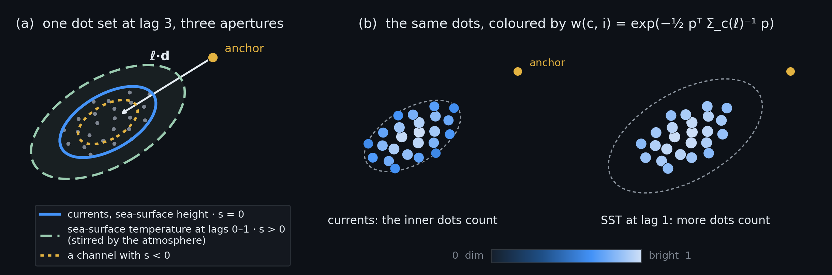
POINT 4 — ONE DIRECTION PER FLOW, ONE SCALE PER CHANNEL
The shape and the drift belong to the flow; only the size belongs to the channel
1 · Shared per region, lag and channel group: the shape Σ(ℓ) and the drift d of slide 8. Everything the water carries is carried the same way — the arrow toward the source and the elongation along the jet are properties of the flow, not of the tracer. One direction per flow.
2 · Per channel: two log-parameters — a scale s_{c} (two for the L-shaped channels: lags 0–1 and 2–6) and a memory τ_{c}. In space, S_{c}(ℓ) = S(ℓ) + s_{c}·I, i.e. Σ_{c}(ℓ) = exp(s_{c}) · Σ(ℓ) — the same ellipse inflated or shrunk, never turned. In time, lag ℓ is weighted by exp(−ℓΔt/τ_{c}) — how far back this channel is worth reading. One scale and one memory per channel; the aperture is a space-time object.
3 · Initialised from the reach-and-memory table in ml/cone.py::FAMILIES: wind stress 500 km with τ = 10 days (lags 0–1 count; lag 6 is at e⁻³); currents and sea-surface height 129.6 km·(1 + ℓ), long memory; sea-surface temperature and mixed-layer depth max(that, 500 km) at lags ≤ 1, then the ocean's growth; land 400 km flat, long memory. At step 0 every channel reads the reach and the lags the current geometry gives it
E-080 · the cut-off mirrored double cone
9
Notes:
This slide answers a question Chris asked: don't we need a scale for each channel? Yes — and the split is the whole design. What is shared is the direction: the drift toward the source and the elongation of the footprint along the jet. Those are properties of the flow. Temperature, salinity, sea-surface height and the currents themselves are all carried by the same water, so giving each of them its own arrow would multiply the parameters and let the model learn different "upstreams" for quantities that arrive from the same place. What is per channel is the scale. The current geometry module — the file `ml/cone.py`, whose `FAMILIES` table assigns every channel a propagation speed, a memory and a correlation length — already says the channels differ: wind stress reads five hundred kilometres at the two lags inside its ten-day memory and nothing beyond, the ocean channels grow at a hundred and thirty kilometres per pentad, sea-surface temperature and mixed-layer depth are L-shaped — wide at lags zero and one where the atmosphere stirs them, then the ocean's slow growth — and land is a flat four hundred kilometres because soil does not advect. So each channel gets a log-scale offset that inflates or shrinks the shared ellipse without turning it — two of them for the L-shaped channels, one for the first two lags and one beyond — and, since revision 3.1, a memory: a time constant that says how far back the channel is worth reading, applied as an exponential weight over lag. That second number is the same table's other column made learnable: wind stress today is hard-coded to read lags zero and one and nothing beyond, because its memory is ten days; with a learned memory that cut-off is a starting value, not a rule. Both start at the values the geometry module already uses, so at step zero every channel reads exactly the reach and the lags it reads today. In the picture: the left panel is one dot set with three apertures of different size but the same centre and orientation; the right panel shows the same dots weighted for two channels — for the currents only the inner dots count, for sea-surface temperature at lag one more of them do. How the weighting happens, and why it costs no tokens, is the next slide.

Slide 10
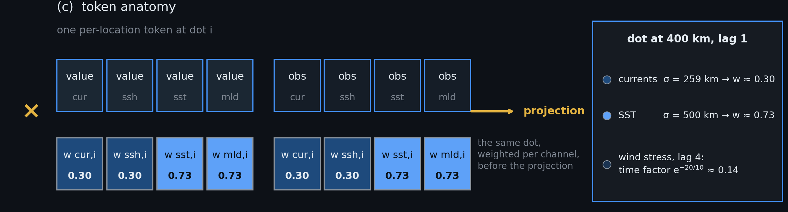
POINT 4 — READ AT ZERO EXTRA TOKENS: THE PER-CHANNEL APERTURE
One token per dot carries every channel; each channel's entries are weighted by its own aperture before the projection
A per-location token (E-071 §6.4) carries all channels of a group at one dot position p_{i}: a vector of values and a vector of observed flags, one token per dot — not one token per channel per dot
Each channel gets its own weight at that dot, w_{c,i,ℓ} = exp(−½ · p_{i}ᵀ Σ_{c}(ℓ)⁻¹ p_{i}) · exp(−ℓΔt/τ_{c}) — a space factor and a time factor — and it multiplies that channel's value and observed-flag entries before the projection. A dot outside channel c's aperture in space or beyond its memory in time contributes ≈ 0 for c and still carries the others at full weight
Worked example, a dot 400 km from the anchor at lag 1, apertures at their initial values: currents σ = 259 km → w ≈ 0.30; sea-surface temperature σ = 500 km → w ≈ 0.73 (both with a long memory, time factor ≈ 1). For wind stress at lag 4 the time factor alone is e^{−20/10} ≈ 0.14 — the “lags 0–1 only” rule, as a soft weight
The gradient reaches S, d, s_{c} and τ_{c} through w from every dot at once — not through four neighbouring cells — which is what lets the geometry learn (next slide)
The fixed safety ring (slide 13) is not gated: read at full weight, always. A safety net the model can switch off is not one
E-080 · the cut-off mirrored double cone
10
Notes:
The mechanism that makes a per-channel scale free is the per-location token, which cone v2 introduced in its section 6.4: instead of one token per channel per dot — the E-069 layout, seven hundred and six dot tokens for a handful of channels — one token per dot that carries every channel of the group as a vector of values and a vector of observed flags. Each channel's entries in that vector are multiplied by that channel's own aperture weight at that dot before the token is projected into the model. The weight has two factors. In space it is a Gaussian of the dot's offset under the channel's covariance: near the centre it is one, far outside the channel's aperture it is essentially zero. In time it is an exponential decay over lag with the channel's own memory, so a channel with a ten-day memory reads lag four at about fourteen percent — the hard "lags zero and one only" rule for wind stress, turned into a soft weight the model can move. So a dot four hundred kilometres from the anchor at lag one is read by the currents at about thirty percent — their initial aperture is two hundred and sixty kilometres — and by sea-surface temperature at about seventy percent, because its initial aperture at that lag is five hundred. Same token, same read, two different weights. No new tokens, no new reads, one elementwise multiply per token. And because the weight is a smooth function of the shared shape, the shared drift and the channel's own scale and memory, the loss reaches all four through every dot at once — a far better gradient than the four-neighbouring-cells one that reading at interpolated positions would give, and the reason the next slide can let the geometry learn without the data loader knowing where it currently is. One exception, stated once: the fixed far ring of cone v2 is never gated. It is the safety net, and a safety net the model can switch off is not one.

Slide 11
POINT 4 — HOW THE NUMBERS LEARN: GATE FIRST, HARDEN LATER
A soft aperture over fixed candidate dots in phase 1; the dot table re-baked from the learned ellipses in phase 2
Phase 1 — gate
The candidate dots per region and group are fixed: cone v2's log-radial set out to the design reach (E-071 §4.4, 36 per lag) plus the anchor column. The data loader's reads are regular, cacheable, and never depend on the model's weights. Each candidate token is weighted by the per-channel aperture of slide 10, and the ellipses, drift and offsets learn through those weights — from every candidate at once
Phase 2 — harden
Every N steps (2 k to start) the dense dot table per region is re-baked from the current ellipses — the warped sunflower of slide 8, 24 dots per lag — and the loader swaps tables at the epoch boundary. The fixed ring of 24 stays as the safety net; the apertures stay on (they are the per-channel scale). Reads remain regular within an epoch
Why not read at continuous positions (the deformable gather of revision 1): it couples the loader's read pattern to the live weights — irregular reads on the sampler's memory-mapped tensor and on the JAX/TPU port of the cone trainer — and its gradient sees only the four cells around each dot. The gate has neither problem, and the per-tensor pyramid of revision 1 is no longer needed
Learning rate: the geometry parameters get their own multiplier (×10 the codec's to start — the deformable-attention practice, Zhu et al. 2021), recorded in the run's metrics
Evaluation geometry stays frozen (slide 5) whatever phase training is in
E-080 · the cut-off mirrored double cone
11
Notes:
How does a loss reach a geometry, without the data loader having to know where the geometry currently is? In two phases. In the first, the candidate dots are fixed: the log-radial set cone v2 already specified, thirty-six per lag per group out to the design reach, plus the anchor's own column. Because the set is fixed, the sampler reads the same cells for a given region every time — regular, cacheable reads that never depend on what the model has learned so far, which is what the reviewer's comment B was rightly worried about. What the model learns is how much each candidate counts, per channel, through the aperture weights of the previous slide; and because every candidate contributes to those weights, the gradient on the ellipse, the drift and the per-channel offsets is informed by the whole candidate set at once, not by the four cells nearest each dot. In the second phase the geometry is hardened: every couple of thousand steps the dense dot table for each region is regenerated from the current ellipses — the warped sunflower of slide 8 — and the loader swaps to the new table at that boundary, so within an epoch the reads are as regular as before. The far ring stays fixed as the safety net, and the apertures stay on, because they are what carries the per-channel scale. This replaces revision 1's plan of reading at continuous positions by interpolation, which would have made the loader's read pattern depend on the live weights and whose gradient only ever saw four neighbouring cells; it also removes the pre-averaged pyramid that plan needed. One practical detail from the deformable-attention literature: the geometry parameters get their own learning-rate multiplier, ten times the codec's to start, recorded in the run so it can be tuned. And nothing here touches the evaluation geometry, which stays frozen to the fixed hourglass for every arm.

Slide 12
POINT 4 — WHERE THE NUMBERS LIVE
A 1° map per channel group, interpolated to the anchor
A 1° grid over the globe (180 × 360 = 64,800 cells); the anchor's parameters are the bilinear blend of the four surrounding map cells — smooth by construction, no seams
1° because the currents that carry the overturning are ~100 km wide (the Florida Current sits in an 80 km strait); a 10° cell would average the Gulf Stream with its recirculation and learn a drift near zero
Hierarchical prior: each map is a coarse 10° map plus a 1° residual, the residual under L2 shrinkage and a Laplacian smoothness penalty — a data-poor cell (ice edge, coast) inherits its neighbourhood's arrow instead of fitting noise. Each 1° cell still sees 16 anchors × 3,142 pentads ≈ 50 k anchor-pentads for eight numbers
No Argo ellipse. The Argo channels are the k nearest profile tokens (E-071 §3, E-076) — placed where floats were, each carrying its own offset, age and depth. There is no elliptic shape to learn; the search radius stays as specified there. Depth-dependent sourcing (at the RAPID line the upper limb flows north, the Deep Western Boundary Current south) is left to attention over those tokens, which see depth and offset together
Optional, phase 2: a first-harmonic seasonal term on the drift, d(τ) = d₀ + d₁ cos τ + d₂ sin τ — the Somali Current reverses with the monsoon
one map per channel group
ocean surface — currents, sea-surface height, sea-surface temperature, mixed layer
atmosphere — drift only at lags 0–1
land — no drift: v = 0, axes and angle only
≈ 1.6 M
geometry parameters, nominal
64,800 cells × 3 groups × 8 numbers, about half of it live (ocean maps over ocean, land maps over land), plus a scale s_c and a memory τ_c per channel (~100 numbers, global — slide 9) — cheap, and no compute
E-080 · the cut-off mirrored double cone
12
Notes:
Where do the eight numbers live? On a one-degree map. A one-degree grid over the globe has about sixty-five thousand cells; an anchor takes the blend of the four cells around it, so the geometry varies smoothly and never jumps at a cell edge. One degree is not a round number picked for comfort: the currents that carry the overturning are about a hundred kilometres wide — the Florida Current runs through an eighty-kilometre strait — and a ten-degree cell would average the Gulf Stream with the water flowing back the other way beside it and learn an arrow of nearly zero. The concern with a fine map is noise in cells that see little data, at the ice edge or along coasts. The answer is a hierarchical prior rather than a coarser map: every map is a coarse ten-degree map plus a one-degree residual, and the residual is shrunk toward zero and smoothed toward its neighbours, so a cell with little evidence inherits the arrow of its region. Even so, each one-degree cell sees about fifty thousand anchor-pentads for its eight numbers. There is one map per channel group, because what moves a signal decides where its source is: the ocean surface group, the atmosphere group with drift only inside its ten-day memory, and the land group, which does not advect and learns only axes and angle. Argo gets no map at all. Its channels arrive as the nearest profile tokens, placed where the floats actually were, each carrying its own offset, age and depth — there is no ellipse there to learn, and the earlier draft's three depth maps were a leftover from the column-only Argo of E-069. The physics that motivated them still matters — at the RAPID line the upper limb flows north and the deep boundary current south — but a token that carries its own depth and offset lets attention weight deep tokens from the north and surface tokens from the south by itself. That becomes a diagnostic rather than a geometry. All told the maps hold about one and a half million numbers, half of them live, plus a hundred or so per-channel scales and memories that are global rather than per region, and none of it costs compute.

Slide 13
POINT 4 — CONSTRAINTS, THE MIRROR, AND THE INITIAL CONE
Bounded by physics, tied to the fixed cone, started isotropic
Speed cap
|d| ≤ v_design · Δt = 5.4 m/s × 5 d = 2,333 km per pentad (E-071's fastest mechanism × 1.5), via a tanh parameterisation — the learned cone lives inside the v2 envelope
Log-space, with soft floors
Σ₀, Σ_{v}, s_{c} and τ_{c} are stored as logarithms (slide 8), so Adam's step is a fixed fraction at any size; the waist's eigenvalues are floored at one cell (28 km) and Σ_{v}'s at the design speed, by a softplus offset in log space rather than a clip
Prior
Coarse 10° + 1° residual, L2 shrinkage and Laplacian smoothness on the residual (slide 12) — one weight, recorded in the run's metrics
Mirror tie, by default
The future cone shares the eight numbers (reflected); an untied arm is the ablation, not the design
Stop-gradient on the target side
The loss reaches the geometry only through the input reads; the positions of targets are treated as constants
The v2 safety net stays, ungated
In addition to the learned ellipse, each lag keeps one fixed log-radial ring of 24 dots to the antipode, read at full weight — the cone can be directed without asserting that a driver could not have come from elsewhere
Init
d = 0; S₀ = the log of a 3-cell circle with the measured aspect 0.71 (ml/measure_flow_anisotropy.py); Σ_{v} from the 0.3 m/s of ml/cone.py::FAMILIES; s_{c} and τ_{c} from the same table per channel — the fixed hourglass exactly, so step 0 of the learned arm is the control
E-080 · the cut-off mirrored double cone
13
Notes:
The eight numbers are bounded by physics and tied to the fixed cone. The drift cannot exceed the design speed cone v2 set — the fastest measured current times one and a half, about two thousand three hundred kilometres per pentad — so the learned cone always lives inside the envelope v2 argued for. The shapes are stored as logarithms, so the optimiser moves them by fractions rather than by kilometres, and the floors — no waist narrower than one cell, no spread faster than the design speed — are soft offsets in that log space rather than hard clips that would kill the gradient. The one-degree residual is shrunk and smoothed under a single prior weight that the run records. The future cone shares the numbers, reflected; letting it have its own is an ablation. Two guards protect the learning itself. First, the loss reaches the geometry only through the input reads; where a target sits is treated as a constant. Without that, the model would learn to move its questions to wherever they are easiest, and a cone that points at flat water would look excellent. Second, the v2 safety net stays, and it is never gated: alongside the learned ellipse, every lag keeps one fixed ring of twenty-four dots at log-spaced radii to the far side of the planet, read at full weight. That is the point of v2 — a cone that is too narrow silently asserts that a driver could not have arrived — and the learned ellipse adds direction and density on top of it rather than replacing it. And the initial values reproduce the fixed hourglass exactly — the measured anisotropy for the waist, the geometry module's speed for the spread, its reach table for each channel's scale — so the learned arm starts as the control and every departure from it is something the data asked for.

Slide 14
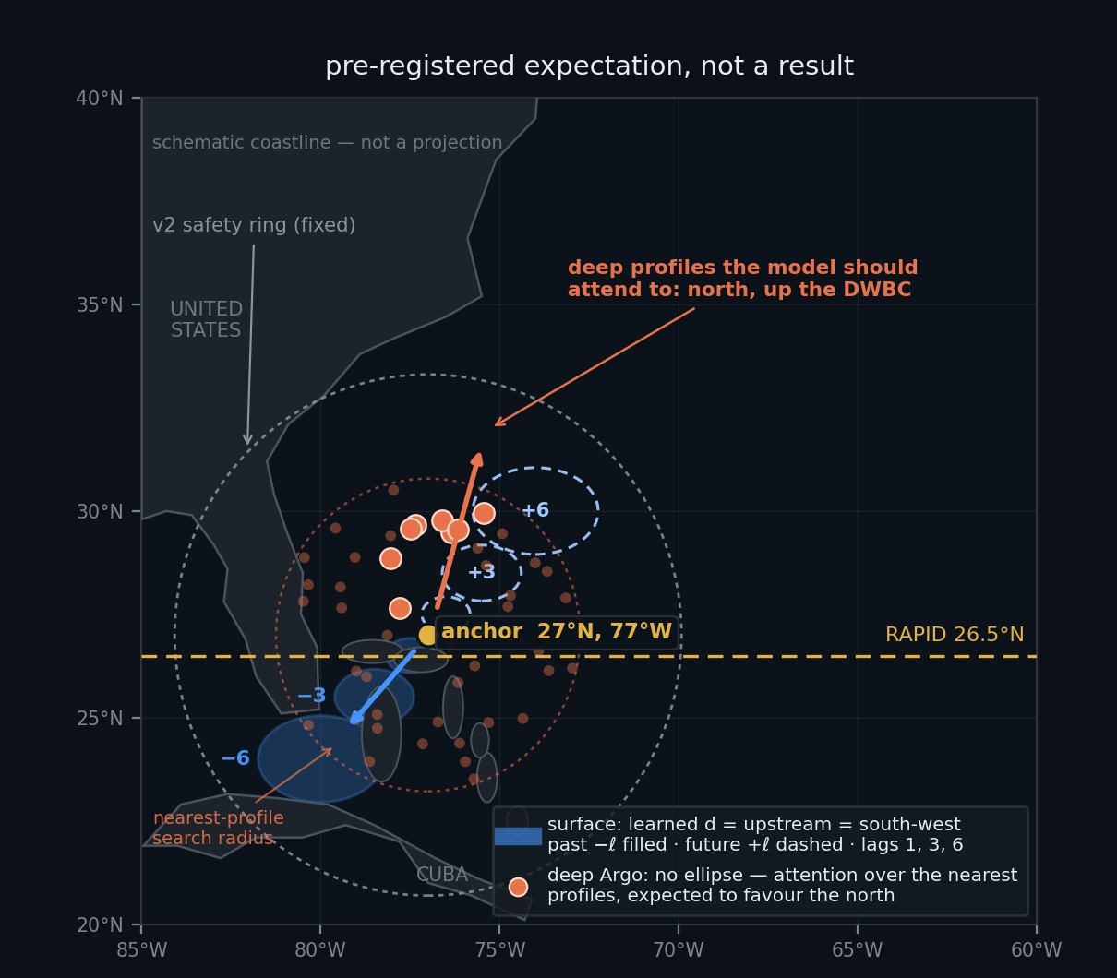
POINT 4 — THE AMOC EXAMPLE, DRAWN
One anchor on the western boundary: a learned surface cone, and deep profiles read from the other side
Surface group: the learned d should point south-west (up the Florida Current, toward the Loop Current); the future cone leans north-east along the Gulf Stream
Deep Argo: no ellipse to learn. The profile tokens within the search radius carry their own offset and depth; the model should put its attention on the deep (> 1000 dbar) profiles north of the anchor — up the Deep Western Boundary Current — and on the shallow ones to the south
Neither is programmed: these are the pre-registered expectations — a geometry check for the surface, an attention check for the deep
If the learned surface drift correlates with −u_clim (the climatological surface current, reversed) over the world ocean, the cone learned “upstream” from the data alone
E-080 · the cut-off mirrored double cone
14
Notes:
Here is the picture Chris asked for, drawn as we expect the model to draw it. An anchor on the western boundary just north of the RAPID line. For the surface group, water arrives up the Florida Current from the Caribbean, so the past cone should drift south-west, growing as it goes back, and the future cone should lean north-east along the Gulf Stream. The deep ocean is read differently, because Argo has no ellipse: the anchor sees the nearest profiles within the search radius, each token saying where it was, how old it is and how deep. The Deep Western Boundary Current runs the other way along the continental slope, so if the model has understood the deep ocean, its attention on deep profiles should sit north of the anchor, toward the Grand Banks, while its attention on shallow profiles sits south. Neither is programmed. They are what we expect to see if the mechanism works — a geometry check for the surface, an attention check for the deep — and they are written down now, before any run, so the check cannot be shaped by the result. The world-ocean version of the surface check is a single number: the correlation between the learned surface drift and the climatological surface current reversed, over cells where that current is at least a fifth of a metre per second. A clearly positive value means the cone learned "upstream" from the data alone. And the faint ring around the anchor is the fixed v2 safety net — always there, never learned, so nothing the model does can wall off a direction.

Slide 15
THE LOOPHOLE AND ITS FIX
A learnable cone can learn to ask easy questions
The loophole: if target positions could move, the gradient would move them to smooth water — a lower loss that means nothing.
Fix 1 · stop-gradient on target positions
Slide 13. The geometry is trained only by “which inputs help”, never by “which targets are easy”.
Fix 2 · the mirror tie
The future cone cannot be tuned separately from the past cone.
Fix 3 · frozen evaluation geometry
Held-out numbers are always scored on the fixed hourglass, for every arm.
Fix 4 · the aperture never touches the loss weights
In phase 1 the targets are the fixed mirrored candidate set with fixed weights; a model that shrinks its aperture cannot thereby shrink the set of questions it is scored on.
Residual second-order effect: as the input cone moves, the mirrored targets move with it. Monitored, not assumed away — report the target-variance under the learned cone vs the fixed cone at every eval; a drop > 10 % is a flag.
E-080 · the cut-off mirrored double cone
15
Notes:
One slide on the trap, because it is the kind that produces a beautiful curve and a wrong conclusion. If the model can move where its questions are asked, the gradient will move them to where the answers are easy — smooth open water, away from fronts — and the loss will fall for no reason we want. Three fixes. The target positions are constants as far as the gradient is concerned, so the geometry learns only from which inputs help. The future cone is tied to the past cone, so it cannot be tuned on its own. And every held-out number is scored on the frozen hourglass, the same for every arm. A fourth guard follows from the gate design: the learned aperture weights the inputs only, never the loss — the targets in phase one are the fixed mirrored candidate set with fixed weights, so a model that narrows its aperture gains nothing on the questions it is scored on. There is a residual, second-order version of the trap: as the input cone moves, the mirrored targets move with it. We do not assume that away. At every evaluation the run reports the variance of its targets under the learned cone against the fixed cone, and a drop of more than ten percent is a flag that the geometry is drifting toward easy water rather than toward the source.

Slide 16
WHAT IT COSTS
Tokens, gathers, parameters — the same regime as v2
 | E-069 (measured) | this design (budget)
waist | 42 patch tokens (14 ch × 3×3) | 13 per-location tokens carrying all surface channels
past cone | 706 dot tokens | phase 1: 6 lags × (1 + 36 candidates) × 4 groups ≈ 888 · phase 2: 6 × (1 + 24 ellipse + 24 ring) × 4 ≈ 1,176
Argo | 192 (32 × 6, column only) | 26 profile tokens (E-071 §3)
targets | 42 + 84 | 256 dot queries per example, drawn from the future cone and the hidden waist / dots (as n_dot_queries today)
geometry parameters | 0 | ≈ 1.6 M nominal, ~half live (slide 12); no compute
extra per-tensor artefact | — | none (revision 1's pyramid is gone); the per-region dot tables re-baked at epoch boundaries are small
Perceiver cost is linear in tokens: ~1.2× (phase 1) to ~1.6× (phase 2) E-069's encoder time, inside v2's own 2.1× estimate; the aperture weights are one elementwise multiply per token
Training cost per seed: E-069 seeds ran under one 4090-hour on the North Atlantic; budget 2–3 4090-hours per seed on the global tensor
E-080 · the cut-off mirrored double cone
16
Notes:
What it costs, in the same units as the earlier decks. The waist is thirteen per-location tokens each carrying all surface channels, which is fewer than the forty-two per-channel patch tokens E-069 used. The past cone is, in the gate phase, six lags of one anchor column and thirty-six fixed candidates for four channel groups — about nine hundred tokens — and after hardening six lags of the column, twenty-four ellipse dots and twenty-four ring dots — about twelve hundred. Argo comes as the twenty-six profile tokens cone v2 already specified. Targets are drawn as two hundred and fifty-six decoder queries per example, as now. The geometry adds about one and a half million parameters, half of them live and none of them costing compute, and no new per-tensor artefact — the pyramid of revision 1 is gone, and the re-baked dot tables are small. Because the encoder is a Perceiver, its cost is linear in the token count, so this is between one point two and one and a half times E-069 per step — inside the two-times cone v2 already budgeted for itself. Per seed, E-069 ran under one GPU-hour on the North Atlantic; on the global tensor, budget two to three. Nine runs for the experiment on the next slide is on the order of twenty-five GPU-hours.

Slide 17
THE EXPERIMENT — E-080, PRE-REGISTERED
Three arms, three seeds, four read-outs, one verdict rule
A0 · fixed
The hourglass with the v2 geometry (isotropic ellipses, ring, mirror), no learning — the control, and the eval geometry for everyone
A1 · learned
The eight numbers per region plus the per-channel scales, gate-then-harden (slide 11), initialised at A0
A2 · learned, primed
As A1, but d initialised at −u_clim · Δt (the climatological surface current, reversed) for the ocean surface group — tests whether the gradient can find upstream on its own (A1) or only keep it (A2)
Held fixed: same tensor (family 7.2, global), same 7 M codec, 20 k steps, frozen protocol (train ≤ 2020; 2008–09, 2016–17, 2021–24 held out), 3 seeds each.
R1 T1 future-cone loss per lead vs bar · R2 the T1 − T2 gap (what history buys) · R3 drift-vs-upstream correlation, world ocean, |u_clim| > 0.2 m/s
R4 the western-boundary depth check — surface drift south-west (geometry); attention mass on deep (> 1000 dbar) profile tokens north of the anchor, on shallow ones south (attention diagnostic)
R5 target-variance flag (slide 15)
Verdict: A1 adopted if it beats A0 on R1 at every lead ≤ 3, paired at all three seeds, with R5 clean. A2 > A1 with A1 ≈ A0 means the gradient cannot find upstream — then geometry is set from climatology, not learned. Neither → keep A0 and move to a dynamic (per-example) cone. First ablation after the arms: A1 without the far ring — does the ring pay for its tokens?
E-080 · the cut-off mirrored double cone
17
Notes:
The experiment, written before anything runs. Three arms. The fixed hourglass with cone v2's geometry is the control and also the evaluation yardstick for every arm. The learned arm starts from the control. The primed arm starts its surface drift at the climatological current reversed, which separates two questions: can the gradient find upstream on its own, or can it only keep upstream if handed it? Everything else is held fixed — the global family 7.2 tensor, the seven-million codec, twenty thousand steps, the frozen protocol with its held-out years, three seeds per arm because the read-outs are probe-scored. Five read-outs: the forecast loss per lead against its bar; the gap between the full task and the snapshot task, which is what history buys; the correlation of the learned drift with upstream over the world ocean; the depth check at the western boundary — the surface drift read from the map, the deep direction read from where the model puts its attention among the profile tokens; and the target-variance flag. The verdict rule is written now. The learned cone is adopted if it beats the control on the forecast at every lead up to three, paired at all three seeds, with the flag clean. If only the primed arm wins, the gradient cannot find upstream and geometry should be set from climatology rather than learned. If neither wins, the fixed hourglass stays and the next design is a dynamic cone — one whose drift is predicted per example from the waist — not a bigger static one. And the first ablation after the three arms is the one the reviewer and I disagree on: the same learned arm without the far ring, which measures whether the ring pays for its tokens rather than arguing it.

Slide 18
BUILD ORDER
Five steps, each with its test
in ml/cone.py · ml/cone_sampler.py · ml/cone_codec.py · ml/train_cone.py
1
Waist + future cone in the geometry (cone.py) waist_dots, future_dots = reflected inner_dots, the per-lag golden-angle phase in inner_dots; coverage_report extended with the mirror identity (future set = −past set) and re-asserted per lag under the phase — pure numpy, CPU test
2
The task mix (cone_codec.py::default_plan → plan_v3) T1–T4 with shares and the five dropout patterns; test: every target's channel is visible somewhere in the input, for 10 k drawn examples, zero violations
3
The aperture gate (cone_codec.py) per-channel space-time weights w_{c,i,ℓ} on the per-location candidate tokens, ring ungated; test: with every s_c → +∞ and τ_c → +∞ the forward pass equals the ungated model bit-for-bit, and the finite-difference gradient of the loss w.r.t. S₀, Σ_v, d, s_c, τ_c matches autograd
4
The parameter maps and the harden step (cone_codec.py::ConeGeometry, cone_sampler.py) 1° maps per group as coarse 10° + residual, matrix-log storage, the log-space floors, the prior, mirror, stop-gradient, init = A0; the sampler's dot table becomes a per-region lookup swapped at epoch boundaries; test: the table re-baked at init equals step 1's fixed dots to < 0.1 cell, and a swap mid-run changes no read of the current epoch
5
Read-outs in the trainer (train_cone.py) per-task bars, R3 drift maps exported as data/cone_drift_<group>.json for the app's Cones tab, R4 attention-by-depth-and-bearing at the western-boundary anchors, R5 flag; then the three arms as recipes f7l2-hourglass-{fixed,learned,primed}
Each step lands on main with its test before the next starts; step 4 is the only one that touches the data path, and only at epoch boundaries.
E-080 · the cut-off mirrored double cone
18
Notes:
The build order, for whoever implements it. Five steps, each small enough to land with its own test before the next begins. First the geometry: the waist and the future cone as functions in the cone module, with the coverage report extended to assert the mirror identity — pure numpy, testable on a laptop. Second the task mix, as a new masking plan next to the existing one, with a test that draws ten thousand examples and finds zero targets whose channel is invisible. Third the aperture gate in the codec: per-channel weights on the candidate tokens, with two tests — an infinite aperture must reproduce the ungated model exactly, and the gradient of the loss with respect to every geometry number must match finite differences. Fourth the parameter maps and the harden step — coarse plus residual, the matrix-log storage, the log-space floors, the prior, the mirror, the stop-gradient, the control initialisation, and the sampler's dot table as a per-region lookup that is only ever swapped at an epoch boundary — with a test that the table re-baked at initialisation equals the fixed dots and that a swap never changes a read inside the current epoch. Fifth the read-outs in the trainer, including exporting the learned drift maps to the app so the Cones tab can draw them, and the attention-by-depth diagnostic at the western-boundary anchors. Then the three arms are three recipes on the global tensor, and E-080 is dispatched under the usual rules.

Slide 19
OPEN DECISIONS FOR CHRIS
Two settled, seven still open — all reversible
Settled 15 Sep (Chris): 1° parameter maps with the coarse-plus-residual prior; no Argo ellipses — the nearest-profile tokens stay as E-071 §3 specifies them.
Future horizon
+6 pentads to mirror the past; or shorter (+1…+2 as E-069) with denser targets?
Task shares
0.35 / 0.15 / 0.25 / 0.25 — any of them a lever you want set differently?
Prior strength on the 1° residual
One weight, to be set by held-out loss on the training years — or fixed by hand for the first arm?
The v2 safety ring
Kept at every lag (24 tokens per lag per group); dropping it halves the past-cone tokens but restores v2's “too narrow” risk
Seasonal drift term
Deferred to phase 2; or in from the start (monsoon regions)?
Harden interval and geometry LR
N = 2 k steps and the geometry learning-rate multiplier ×10 — first guesses, both recorded per run
Time inside the 30-day window
Dense, one slice per pentad. A log-spaced inner time ramp (1, 2, 3, 5, 8, 13 pentads at the same six slices) is an ablation, not the design — it would move the codec's window into stage 2's
E-080 · the cut-off mirrored double cone
19
Notes:
Two choices are settled: the maps are at one degree with the coarse-plus-residual prior, and Argo keeps its nearest-profile tokens with no ellipse. Seven remain, each one line to change. The future cone goes to six pentads to mirror the past, where E-069 only asked for one and two. The task shares are a first guess. The strength of the prior on the fine map is one number, and the honest way to set it is by held-out loss on the training years rather than by hand — but the first arm may simply fix it. The v2 safety ring is kept at every lag, which is the safe and more expensive choice. The seasonal term on the drift waits for phase two. The harden interval and the geometry learning-rate multiplier are first guesses that every run records. And time stays dense inside the thirty-day window, one slice per pentad; a log-spaced time ramp that would stretch six slices over sixty-five days is listed as an ablation because it would move the codec's window into stage two's territory, which cone v2 deliberately separated in time. Say the word on any of these and the spec changes; none of them affects the build order.

Slide 20
E-080 · THE CUT-OFF MIRRORED DOUBLE CONE
Sources
the record this deck stands on
and on
E-069 · Two stencils, one cone — ml/plans/E069_cone_codec.md; results in ml/EXPERIMENTS.md#e-069 (five seeds, H1 refuted; what history buys)
E-069b masking-plan fix — ml/cone_codec.py::default_plan (chan_drop_scope, anchor_hidden_only), ml/train_cone.py
E-071 · Cone v2 — ml/plans/E071_cone_v2.md (§3 profile tokens, §4 design speeds and log-radial dots, §4.5 the split in time, §6.4 per-location tokens)
E-076 · Family 8 nearest observations — ml/plans/E076_family8_nearest_observations.md (the (value, Δx, Δy, Δt, n_R) token)
The geometry as built — ml/cone.py (FAMILIES, reach_km, slots, inner_dots, outer_spiral, coverage_report)
E-026 · the sunflower stencil — ml/temporal.py::spiral_offsets, the pattern the warped sunflower reuses
The geometry learning-rate multiplier and soft sampling weights: Zhu et al. 2021, Deformable DETR
The step-size argument for log-space parameters: Kingma & Ba 2015, Adam — the update is ≈ lr per step in the parameter's own units
The matrix logarithm of a symmetric 2×2 covariance: S = m·I + k·[cos 2θ, sin 2θ; sin 2θ, −cos 2θ] with m = ln σ₁ + ln σ₂, k = ln σ₁ − ln σ₂ — standard, no reference needed
Currents: E-071 §4.1's table (Somali 3.6 m/s, Gulf Stream ~2.5, DWBC 0.02–0.1 m/s); RAPID 26.5°N array for the limb directions
E-080 · the cut-off mirrored double cone
20
Notes:
Everything the deck leans on. The E-069 plan and its five-seed record; the E-069b masking fix in the codec; cone v2 for the design speeds, the profile tokens and the per-location tokens; family 8 for the token that carries its own offset; the geometry module for every constant. The learning mechanism borrows two things from the deformable-attention literature — soft sampling weights and a separate learning rate for the geometry — and the scale-free storage rests on how the Adam optimiser sizes its steps; the matrix-logarithm form of an ellipse is textbook linear algebra. The current speeds and the directions of the two AMOC limbs are the ones cone v2 already tabulated and the RAPID array's own description of the section.

Slide 21
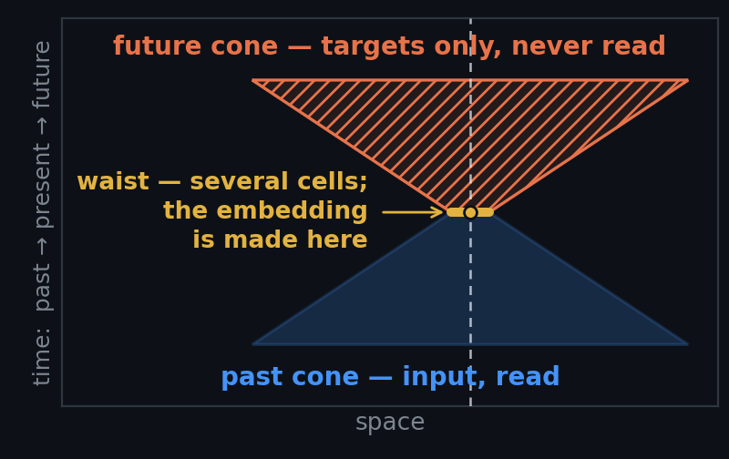
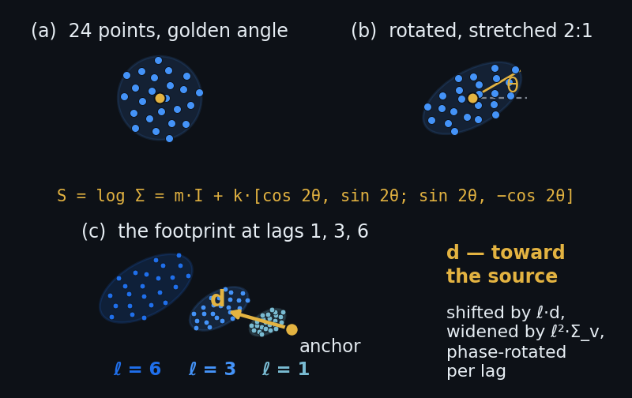
THE DECK ON ONE SLIDE — WITH ROOM FOR THE RESULT
An hourglass that reads the past through a cone it shapes itself, tested three ways against its own fixed twin
THE HOURGLASS
THE CONE THE MODEL SHAPES
THE EXPERIMENT
RESULTS — figure to be inserted
R1 · future-cone loss per lead, A0 fixed / A1 learned / A2 primed, 3 seeds · R3 · learned drift vs upstream · R4 · the western-boundary depth check
Reserved for the measured result — empty until a run has produced it.
The design · slides 3–7
The present is a waist of ~13 cells, not a single tip; the past cone reads the last 30 days at every pentad; a prediction cone — the past cone mirrored through the anchor, +1…+6 pentads — is sampled the same way and used only as targets. Each example draws one of four tasks: forecast from waist + past (0.35), from the waist alone (0.15), nowcast the hidden present from the past under five dropout patterns (0.25), fill-in (0.25) — under E-069b's rules: knowable targets only, no copy targets, every loss family scored against its own predict-the-mean bar
The cone the model shapes · slides 8–12
A fixed 24-point sunflower, phase-rotated by the golden angle per lag, warped by eight dimensionless numbers per 1° cell and channel group: a drift d toward the source (capped at cone v2's design speed) and two ellipses stored as matrix logarithms — no kilometres, no angle to wrap — with Σ(ℓ) = Σ₀ + ℓ²Σ_{v}. One direction per flow, one scale and one memory per channel: s_{c} and τ_{c} inflate or shrink the shared ellipse and set how far back the channel reads, applied as a Gaussian aperture over the group's shared per-location tokens — zero extra tokens. Learned gate-first (a soft aperture over fixed dots, so the loader never depends on live weights), then hardened (dot tables re-baked at epoch boundaries)
The guards · slides 13, 15
Coarse-10°-plus-1°-residual prior; log-space soft floors; mirror tie; stop-gradient on target positions; evaluation geometry frozen for every arm; the far ring kept and never gated; the aperture never touches the loss weights — so the cone cannot learn to ask easy questions
The experiment · verdict · slide 17
A0 fixed hourglass — the control and everyone's eval geometry · A1 learned from A0's init · A2 learned, surface drift primed at −u_clim·Δt. Same 7 M codec, 20 k steps, frozen protocol, 3 seeds each, one tensor (family 7.2); read-outs R1–R5. Verdict: A1 beats A0 on R1 at every lead ≤ 3, paired at all seeds, R5 clean → adopt; A2 > A1 ≈ A0 → geometry from climatology; neither → keep A0
E-080 · the cut-off mirrored double cone
21
Notes:
This is the whole deck on one slide, for anyone who reads nothing else, and it is where the result goes when there is one. The left half is the argument in four steps. First, the design of the input and the targets: the present is a waist of about thirteen cells rather than a single point, because gradients need neighbours; the past is read at every pentad of the last thirty days; the future is a mirror image of the past cone, sampled identically and used only as targets; and each training example draws one of four tasks — forecast from everything, forecast from the present alone, nowcast the hidden present from the past, or fill in — under the three rules the E-069 experiment taught us (E-069 is the cone codec as built and measured at five seeds; the rules are that a target must be knowable from the input, must not be a copy of an input, and every loss family is scored against a predict-the-mean bar of its own). Second, the cone the model shapes: a fixed sunflower pattern, pushed through eight learned numbers per one-degree cell and channel group — a drift toward the source and two ellipses, stored as matrix logarithms so nothing is in kilometres and no angle wraps; the direction is shared by everything the water carries, while each channel has its own scale and its own memory, applied as a weight over shared tokens so it costs nothing; and the geometry is learned first through a soft weighting over fixed dots and only then baked into the dot table, so the data loader never has to know where the geometry currently is. Third, the guards, which exist because a learnable cone can learn to ask easy questions: the prior, the floors, the mirror tie, the stop-gradient on target positions, the frozen evaluation geometry, the ungated safety ring, and the rule that the aperture never reaches the loss weights. Fourth, the experiment as pre-registered: three arms — fixed, learned, and learned but primed with the climatological current reversed — on the global family 7.2 tensor (the first tensor covering the whole globe at quarter-degree resolution and five-day cadence, in its 7.2 build), the seven-million-parameter codec, twenty thousand steps, the frozen protocol with its held-out years, three seeds each; five read-outs; and the verdict rule written before any run. Two pictures carry the argument for a reader who has not seen the deck: the hourglass in space-time — the past cone narrowing to the waist and opening again into the mirrored future cone — and the warped sunflower, the fixed dot pattern first stretched into an ellipse and then drifting lag by lag toward the source. The third panel is deliberately empty. It is the space for the actual result — the forecast loss per lead for the three arms, the learned drift against the upstream direction, and the western-boundary depth check — and it stays empty until a run has produced those numbers, so that this slide can never show a picture of what we expected in place of what we measured. When the figure lands, the caption under the panel says which read-outs it shows, and the verdict line on the left is read against it.

Slide 22
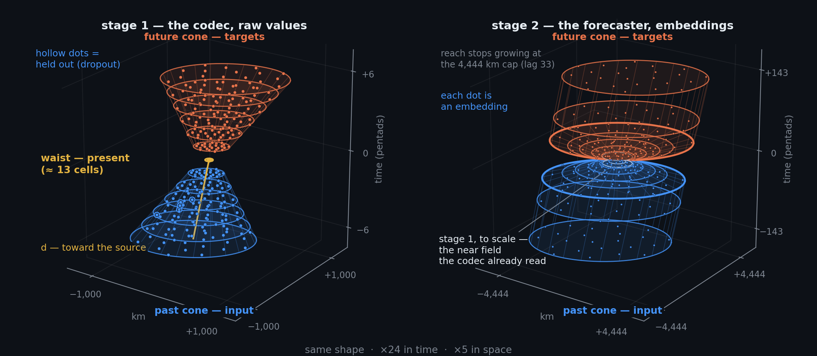
THE SAME HOURGLASS AT TWO SCALES
Stage 1 reads raw values through a small hourglass; stage 2 reads stage 1's embeddings through the same shape, twenty times longer and five times wider
Stage 2's mirrored future side is the E-080 shape carried up a level — design intent; the stage-2 heads scored so far predict the next embedding and roll it forward.
past cone · input, never a forecast target, sometimes held out
waist · present — input in T1/T2/T4, predicted in T3
future cone · targets only, never input
cone.py::outer_spiral · E-071 §4.5
E-080 · the cut-off mirrored double cone
22
Notes:
One shape, two scales. On the left, stage one: the codec, the encoder that turns one place at one time into an embedding. It reads raw values through the small hourglass — the past cone of the last thirty days, six pentads deep and about nine hundred kilometres wide at its mouth for the ocean-surface channels; the waist of about thirteen cells at the present; and the mirrored future cone, six pentads ahead, which is only ever a target. Three rules, colour-coded and true at both scales. The past cone is input and never a forecast target; it is sometimes held out — a dropout pattern hides the most recent lags, a wedge of bearings, random dots, or one channel — and the one thing the model is ever asked to do with a hidden past dot is to fill it back in, which is task four, the reconstruction family kept from E-069b. The waist is the present: it is passed as input in the forecast tasks and in fill-in, and hidden and predicted in task three, the nowcast from history. The future cone is targets only and never input. On the right, stage two: the forecaster, which reads what stage one wrote. Each dot in its wide cone is an embedding, not a raw value, and the hourglass is the same shape drawn about twenty times longer and five times wider — lags seven to a hundred and forty-three pentads, two years, opening to the four-thousand-four-hundred-kilometre cap of the outer spiral, with the near field the codec already read cut out of the centre; that cut-out, drawn to scale, is the whole of stage one's hourglass. The present embedding is the waist. The future side, mirrored like stage one's, is the E-080 idea carried up a level: predict a cone of future embeddings rather than a single next step. That is stated here as the design intent; the stage-two heads the programme has scored so far predict the next embedding and roll it forward, one step at a time, over the long window that cone v2 assigns to stage two. Making stage two's targets a mirrored cone is a change to the forecaster's training, not to the codec, and it is not part of the E-080 experiment as pre-registered.

