Slide 1
Cationic Antimicrobial Database
Brandon Laufer

Slide 2
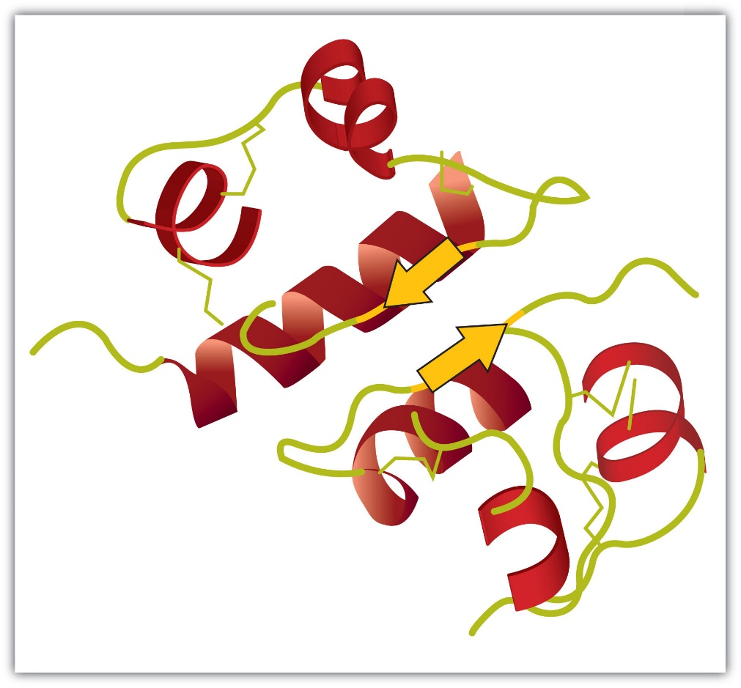
Data
Harvest
Type of Particle
Type of Serum
Particle and serum amount
Mass Spectrometry Data
Peptides synthesized
EC-50 of peptides synthesized

Slide 3
Preparing Mass Spec Data
Python code
Removes unnecessary lines (i.e. Modifications)
Adds other data about the peptides (pI, hydrophobicity, MW)
Also pulls from CAMP prediction databases
Results |  |  |  |  |  |  |  |  |  |  |  |  |  |  |  |  |  |  | SVM |  | RF |  | ANN | DA
ID | M/Z | Z | RT | SCAN | FILE | DENOVO | ALC | PEAKS SEARCH | PEAKS SCORE | PEAKS -10LOG(P_VALUE) | PEAKS DECOY |  | pI | MW | Length | Net Charge | Aliphatic | Hydrophobicity | Class | Amp Probability | Class | AMP Probability | Class | Class | AMP Probability
8179 | 501.932 | 3 | 8.5647 | 497 | D:\Paul\JHU ETD alligator serum NP\130513_PR_unchallenged_3mscn.raw | SAFGRRDNLRPNT | 73.14 | ASFWKGKFFWTV | 2.34 | 15.33 | 1 |  | 1503.76 | 10 | 12 | 2 | 32.5 | 0.24 | AMP | 0.638 | AMP | 0.754 | AMP | AMP | 0.703
8207 | 457.2379 | 3 | 9.8045 | 531 | D:\Paul\JHU ETD alligator serum NP\130513_PR_unchallenged_3mscn.raw | GGSTFETKSLKSQ | 60.64 | FKFYFKM(+15.99)QSK | 1.31 | 12.25 | 0 |  | 1353.64 | 10 | 10 | 3 | 0 | -0.7 | AMP | 0.856 | AMP | 0.5225 | AMP | AMP | 0.936
8248 | 527.7963 | 4 | 11.6124 | 580 | D:\Paul\JHU ETD alligator serum NP\130513_PR_unchallenged_3mscn.raw | LKANEYMQQVTKAKVTKQ | 37.11 | DRKRFPSHGFRAKSYKK | 0.98 | 9.13 | 1 |  | 2108.43 | 11.12 | 17 | 6 | 5.88 | -1.96 | AMP | 0.91 | AMP | 0.6365 | AMP | AMP | 0.791
8302 | 397.005 | 4 | 13.9186 | 645 | D:\Paul\JHU ETD alligator serum NP\130513_PR_unchallenged_3mscn.raw | LDRLPLVRFKSKL | 55.64 | LLSLRTVSRWILK | 0.85 | 7.98 | 0 |  | 1584.96 | 12.01 | 13 | 3 | 172.31 | 0.6 | AMP | 0.896 | AMP | 0.831 | AMP | AMP | 0.915
8310 | 533.1202 | 5 | 14.2751 | 655 | D:\Paul\JHU ETD alligator serum NP\130513_PR_unchallenged_3mscn.raw | LDRPLLVRFKSLKKQLHERGDL | 63.36 | RRVTLVSRFM(+15.99)KQFRLRLLNVL | 0.84 | 7.84 | 1 |  | 2646.28 | 12.6 | 21 | 6 | 134.29 | 0.2 | AMP | 0.909 | AMP | 0.829 | AMP | AMP | 0.987
8312 | 577.0958 | 4 | 14.3407 | 657 | D:\Paul\JHU ETD alligator serum NP\130513_PR_unchallenged_3mscn.raw | LLNKGKLVQAGRQEPWLKAR | 53.26 | LLWLQLM(+15.99)LLKLYYHSKKV | 55.42 | 19.76 | 1 |  | 2289.89 | 9.83 | 18 | 3 | 167.78 | 0.56 | AMP | 0.584 | AMP | 0.758 | AMP | AMP | 0.919
8327 | 422.5931 | 3 | 14.9941 | 675 | D:\Paul\JHU ETD alligator serum NP\130513_PR_unchallenged_3mscn.raw | LPACGLLLLAGKP | 41.03 | FFFLKPLQLL | 1.06 | 9.88 | 0 |  | 1265.6 | 8.75 | 10 | 1 | 156 | 1.46 | AMP | 0.782 | AMP | 0.6625 | AMP | AMP | 0.98
8331 | 364.2321 | 5 | 15.1803 | 680 | D:\Paul\JHU ETD alligator serum NP\130513_PR_unchallenged_3mscn.raw | HKTKKSPAKKNLRAPL | 39.19 | IHKERRIWIQIIVL | 3.64 | 5.29 | 0 |  | 1817.25 | 10.84 | 14 | 2 | 187.86 | 0.46 | AMP | 0.94 | AMP | 0.822 | AMP | AMP | 0.991

Slide 4
SQLite3 – Python Code
import os; import sys; import csv
print 'PRAGMA foreign_keys=OFF;'
print 'BEGIN TRANSACTION;'
print 'CREATE TABLE Peptide_Data (ID REAL, M_Z REAL, Z REAL, RT REAL, Scan REAL, DENOVO text, ALC REAL, PEAKS_Seq text, PEAKS_Score REAL, P_Value REAL, PEAKS_Decoy REAL, pI REAL, MW REAL, Length REAL, Net_Charge REAL, Aliphatic REAL, Hydrophobicity REAL, SVM_Class text, SVM_Amp_Prob REAL, RF_Class text, RF_Amp_Prob REAL, ANN_Class text, DA_Class text, DA_Amp_Prob REAL);'
with open('Final1.csv','r') as csvfile:
contents = csv.reader(csvfile, delimiter=',')
for row in contents:
line = row[0] + "','" + row[1] + "','" + row[2] + "','" + row[3] + "','" + row[4] + "','" + row[6] + "','" + row[7] + "','" + row[8] + "','" + row[9] + "','" + row[10] + "','" + row[11] + "','" + row[12] + "','" + row[14] + "','" + row[15] + "','" + row[16] + "','" + row[17] + "','" + row[18] + "','" + row[19] + "','" + row[20] + "','" + row[21] + "','" + row[22] + "','" + row[23] + "','" + row[24] + "','" + row[25]
print 'INSERT INTO Peptide_Data (ID, M_Z, Z, RT, Scan, DENOVO, ALC, PEAKS_Seq, PEAKS_Score, P_Value, PEAKS_Decoy, pI, MW, Length, Net_Charge, Aliphatic, Hydrophobicity, SVM_Class, SVM_Amp_Prob, RF_Class, RF_Amp_Prob, ANN_Class, DA_Class, DA_Amp_Prob) VALUES (\'' + line + '\');'
print 'CREATE INDEX idx1 ON Peptide_Data (DENOVO);'
print 'COMMIT;'

Slide 5
Microsoft Access
Change to Access
Why?
Can create forms so that all data is in the same format
Use harvest number for Primary Key
Add login to track who’s entering what
Things to work on
No duplicate sequences, yet ability to link one sequence to many harvests
Use links to find EC-50 data

